Slide 1
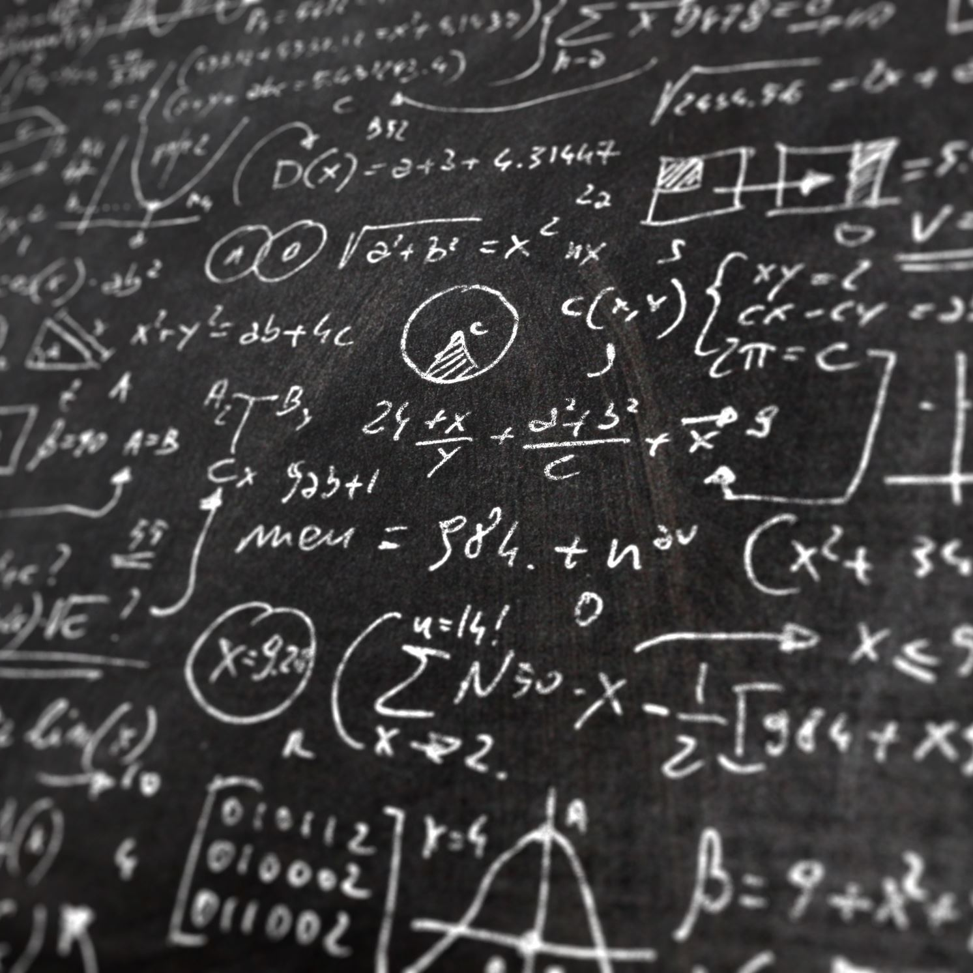
Harmonystate plan for happiness
Param Dave Pierre Litoux Hugo Deplagne

Slide 2
1) What technical/business constraints should the data storage component of the program architecture meet to fulfill the requirement described by the customer in paragraph «Statistics» ? So what kind of component(s) (listed in the lecture) will the architecture need ?
200Gb of data daily
Scalable & Long-term storage
Component needed : Data warehouse (Apache Hive on premise)
Centralized data storage: store large amount of data
Faster data analysis: Data warehouses are optimized for data analysis
Data integration: Data warehouses can integrate data from multiple sources
Redundant storage: Ensure that data is not lost in the event of a hardware failure.
It can be AP (CAP theorem)

Slide 3
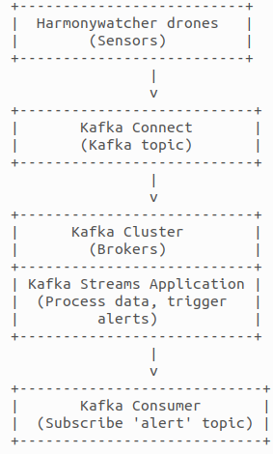
2) What business constraint should the architecture meet to fulfill the requirement describe in the paragraph «Alert» ? Which component to choose?
The alert should be triggered as quickly as possible to allow harmonymakers
to take action and prevent the spread of disharmony.
Low latency
Need real-time process of data from harmonywatchers
Apache Kafka stream processing
Kafka Consumers subscribed to the topic
Dispatch service
RabbitMQ

Slide 4
3) What mistake(s) from HarmonyState can explain the failed attempt ?
The data scientist of HarmonyState could have tested in intern a non-scalable model which passed the test on a small scale but failed on a large deployment.
It's the data engineering's job to write reliable and maintainable distributed software, possibly deploy them.
It’s the data analyst's job to extract domain information out of data.
It's the data devops' job Run and possibly deploy software, run and deploy the component required by it.
Data scientists can't do everything !

Slide 5
4) Harmonystate has likely forgotten some technical information in the report sent by the drone. In the future, this information could help Harmonystate make its harmonywatchers much more efficient. Which information ?
Harmonystate should consider collecting additional information from the harmonywatchers such as audio recordings or video feeds to provide more context and improve the accuracy of the data. This information could be used to develop more sophisticated algorithms for detecting agitated citizens and triggering alerts.
Adding a timestamp to the report could also help the harmonywatchers to do more precise statistics on certain range of time.

Slide 6
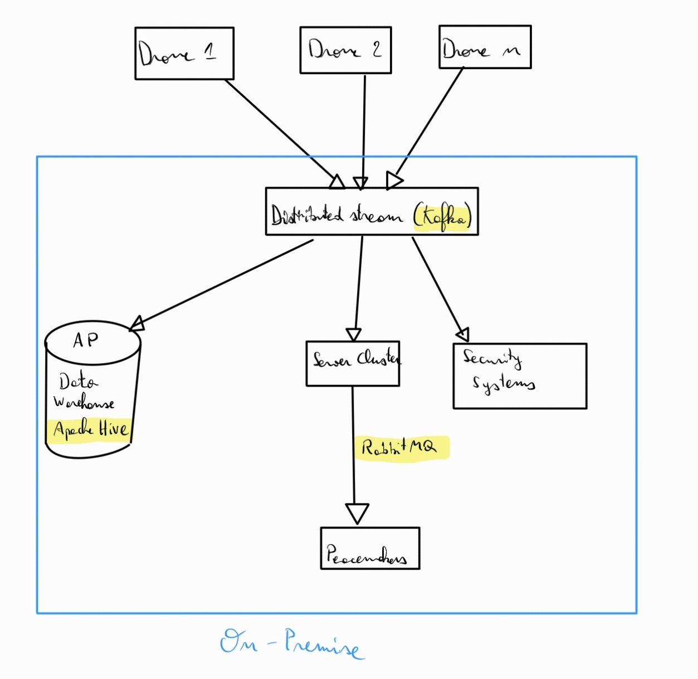
Scheme

Slide 7
Conclusion

