Slide 1
Neural prelude to a movement
Reza Shadmehr
Biomedical Engineering
Johns Hopkins University

Slide 2
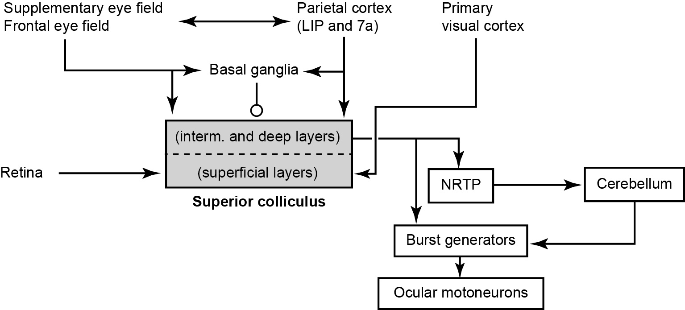
Why does it take so long to start a movement?
Neural basis of movement latency

Slide 3
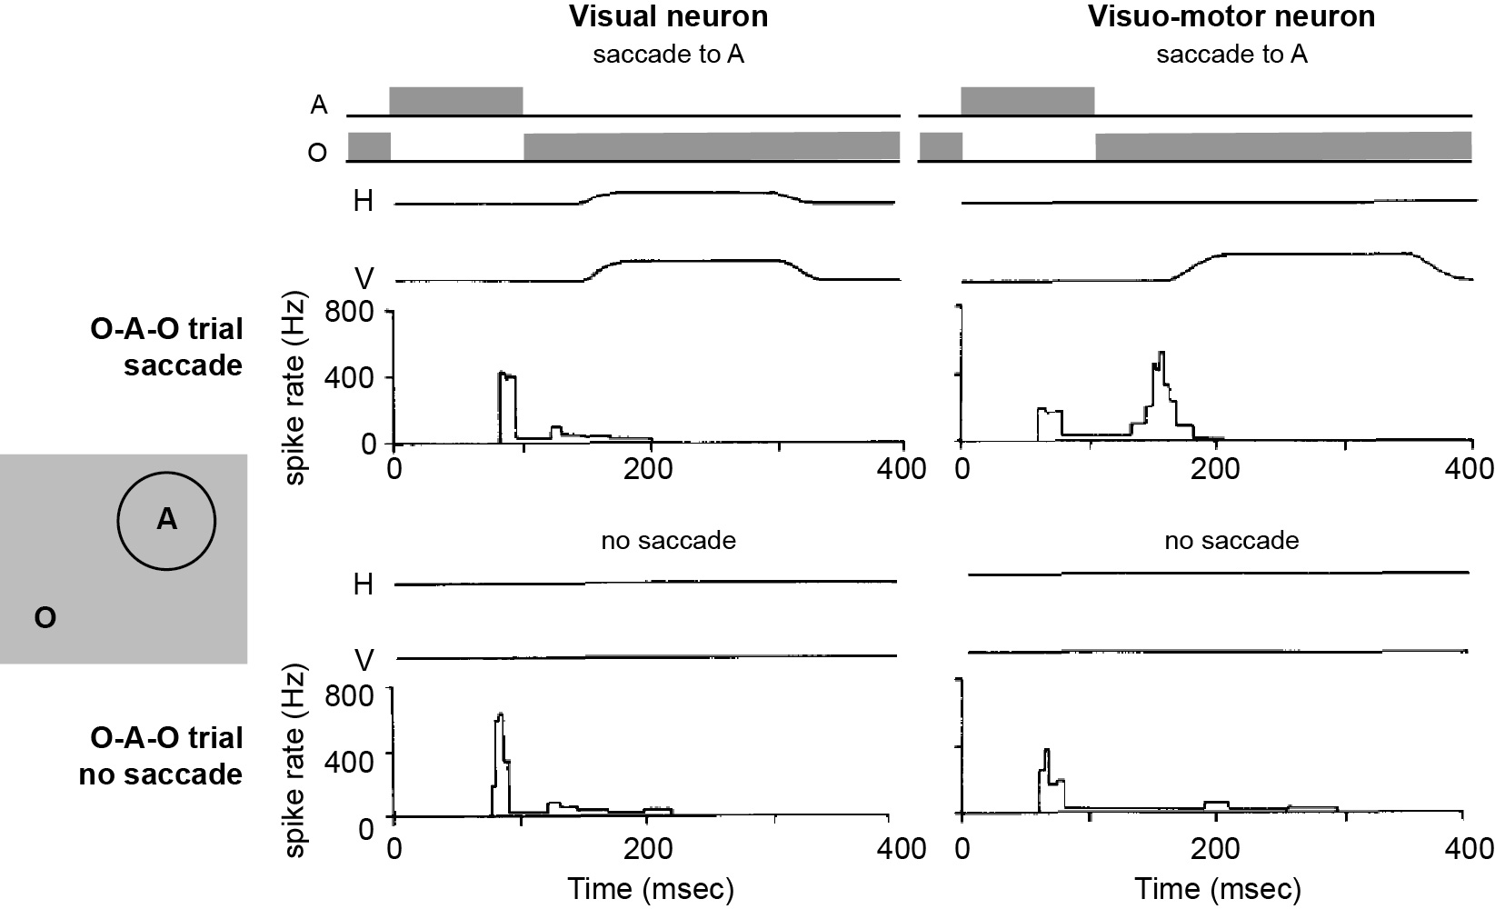
Visual and motor responses in the superior colliculus
Sparks, 1978

Slide 4
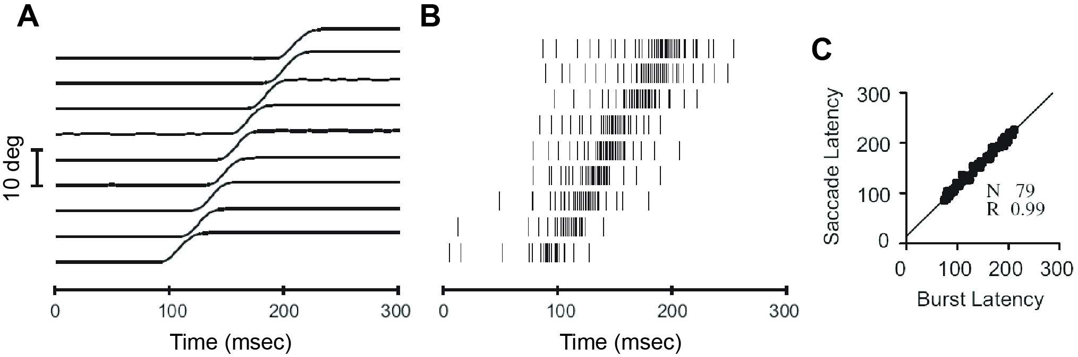
A burst in the visuomotor neuron always coincides with a saccade
Sparks and Hu, 1999

Slide 5
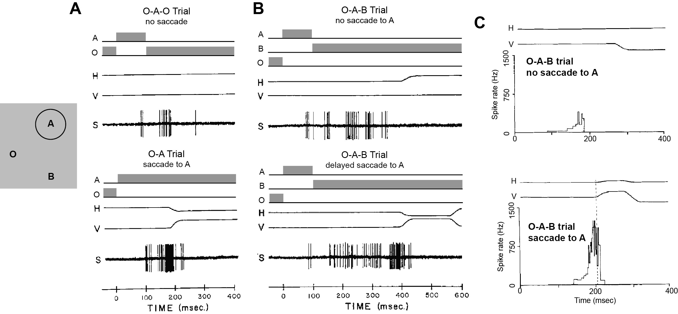
There is buildup of activity in the visuomotor neurons, but only sometimes it becomes large enough to produce a burst
Sparks, 1978

Slide 6
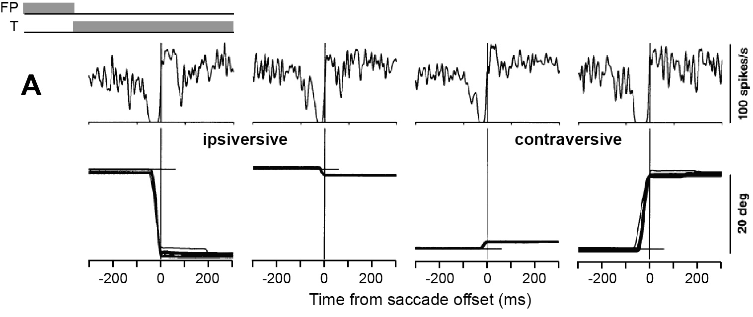
Fixation-related cells pause during saccades
Munoz and Wurtz, 1993

Slide 7
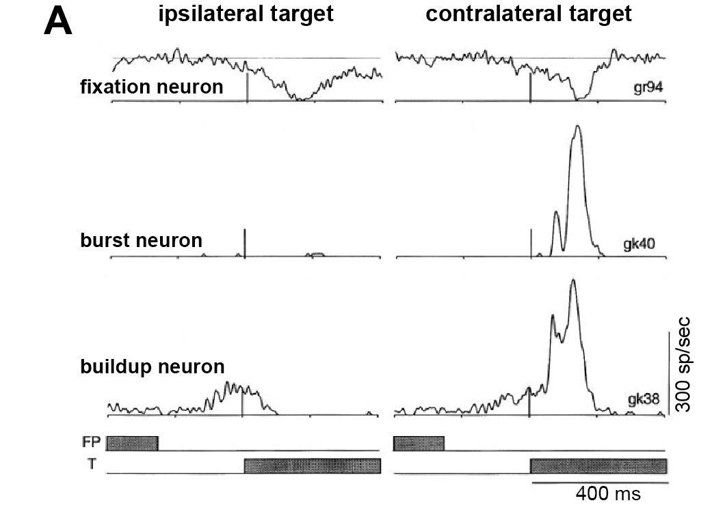
Two events occur during reaction time:
Activity falls in the fixation-related neurons
Activity rises in the buildup and burst neurons
Munoz and Wurtz, 1993

Slide 8
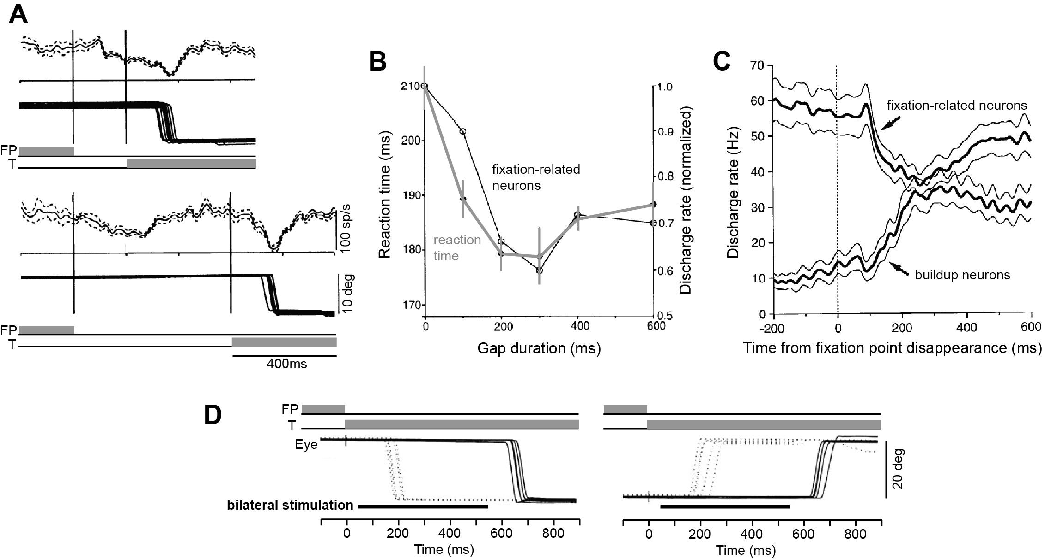
Reaction time tracks changes in the activity of fixation-related and build-up neurons
Dorris and Munoz, 1995

Slide 9
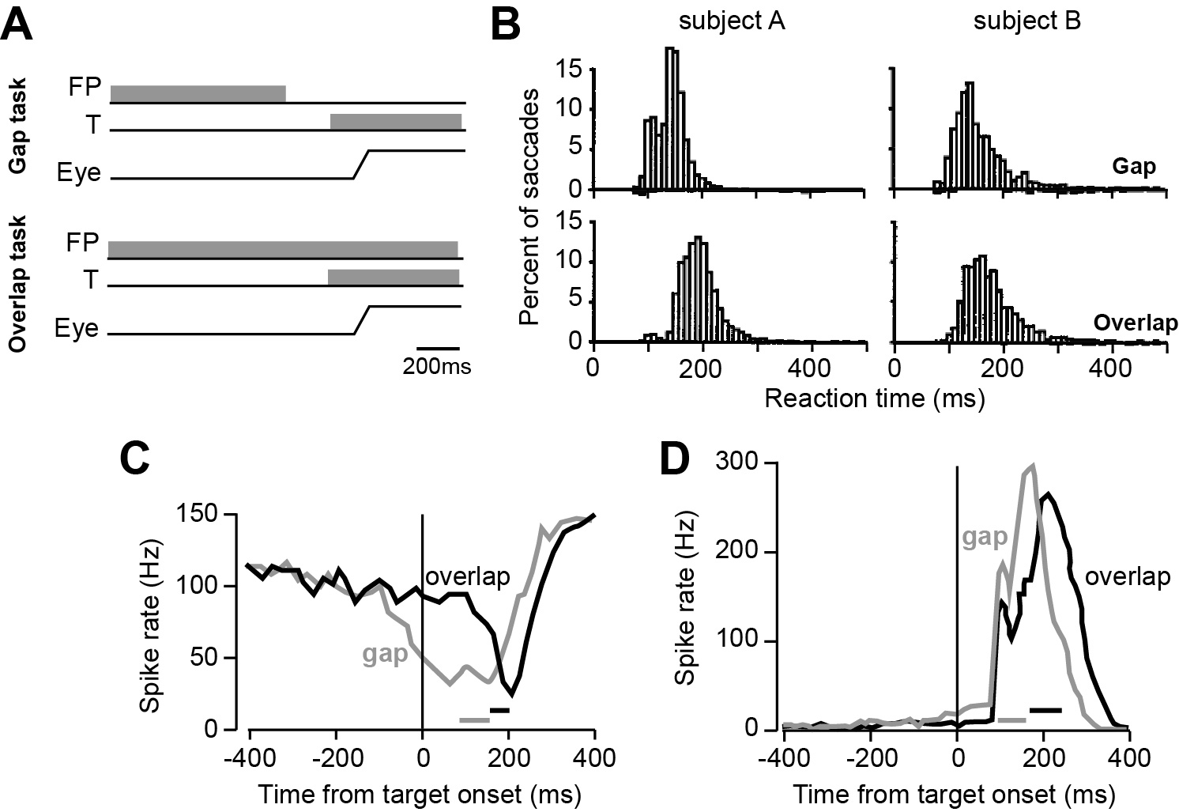
Latency is shorter when activity in fixation-related neurons declines earlier
Everling et al., 1999

Slide 10
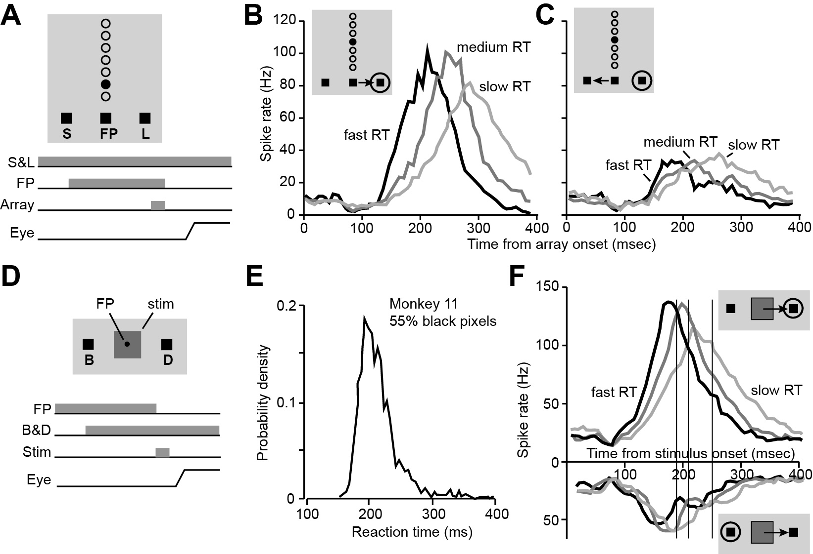
Latency is shorter when activity in buildup neurons rises faster
Time from stimulus onset (ms)
Ratcliff et al., 2007

Slide 11
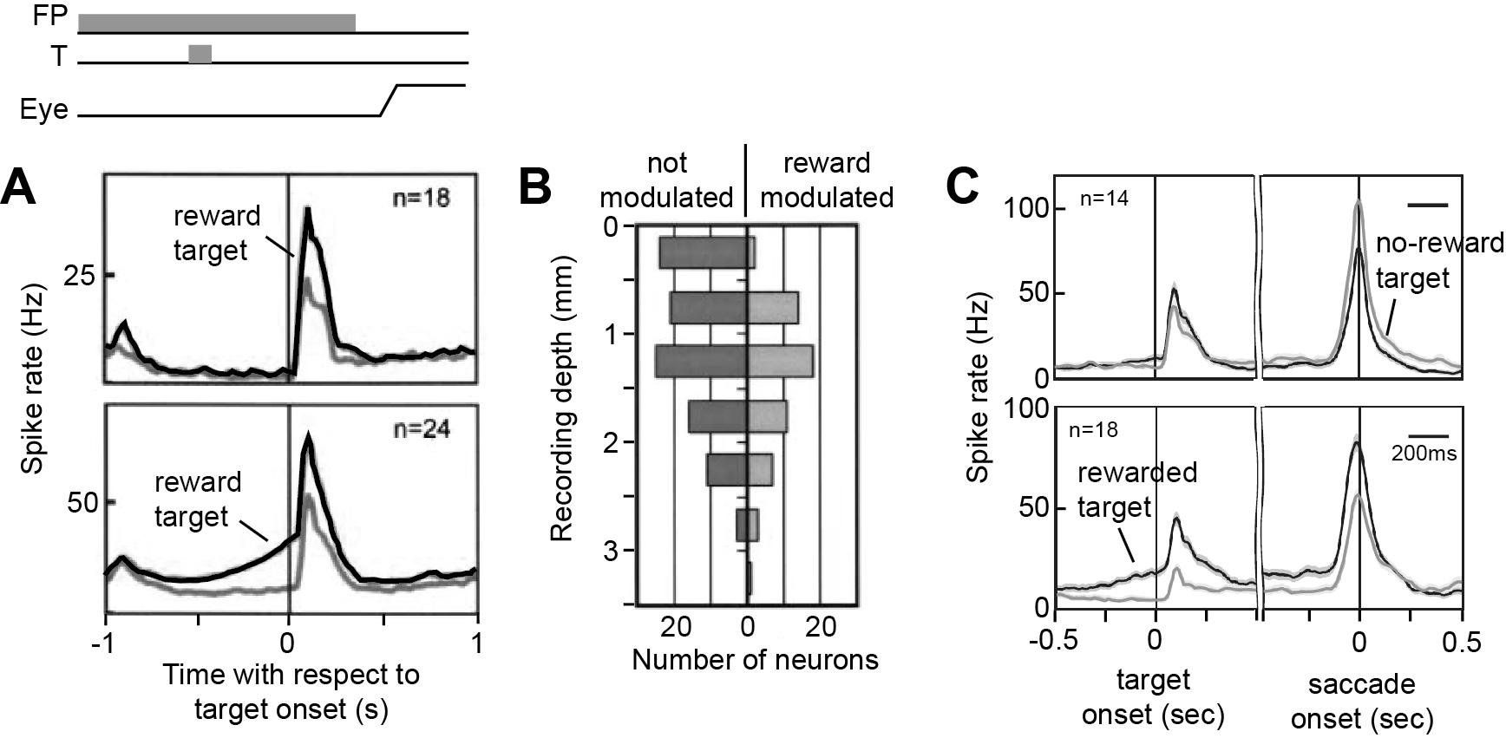
Reward increases the background activity in the visuomotor neurons, making them respond more strongly to the visual stimulus
Ikeda and Hikosaka, 2007

Slide 12
Summary
In SC, cells respond to visual stimulus onset at 80ms, but it takes another 80ms or more to start a movement.
During the reaction time, two events occur: activity of the fixation-related neurons decline, while activity in the movement-related neurons increase.
Utility of the action during holding appears to influence the rate of decline in the fixation-related neurons.
Utility of the action that evokes the saccade appears to influence the rate of increase in the movement-related neurons.

Slide 13
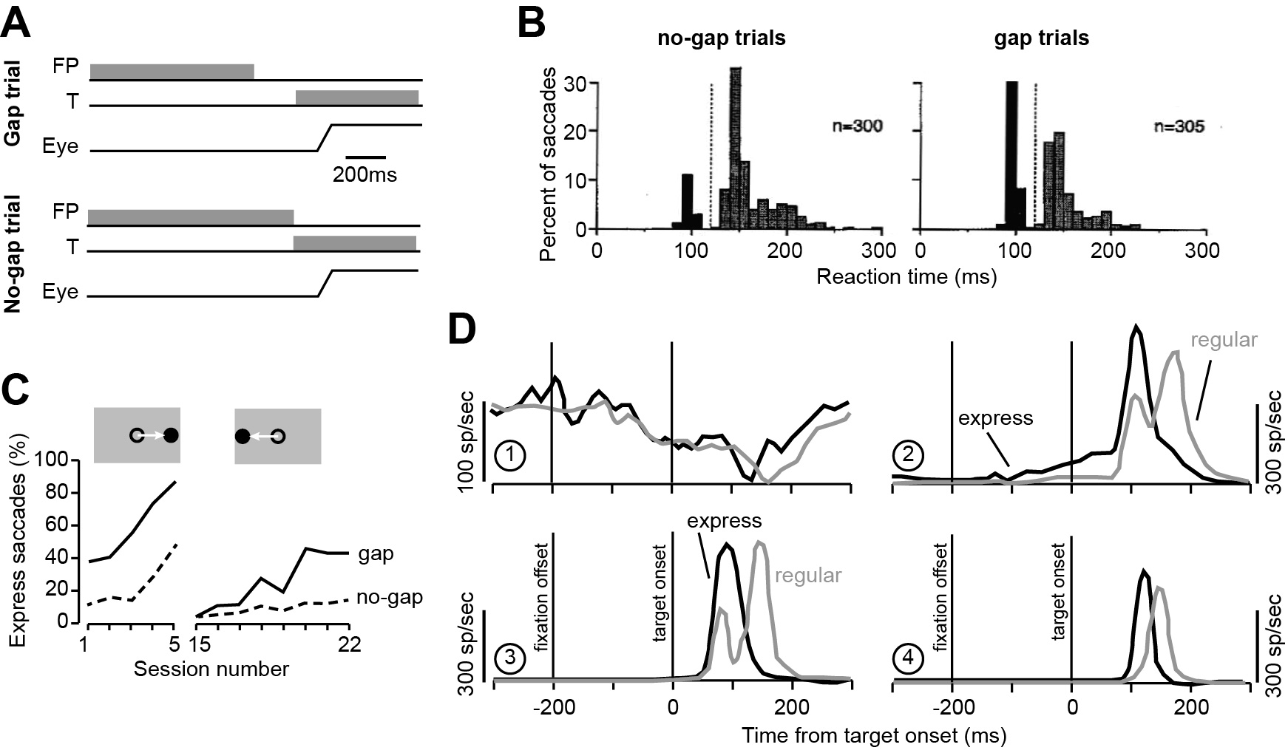
Reducing the reaction time by half: express saccades
Pare and Munoz, 1996

Slide 14
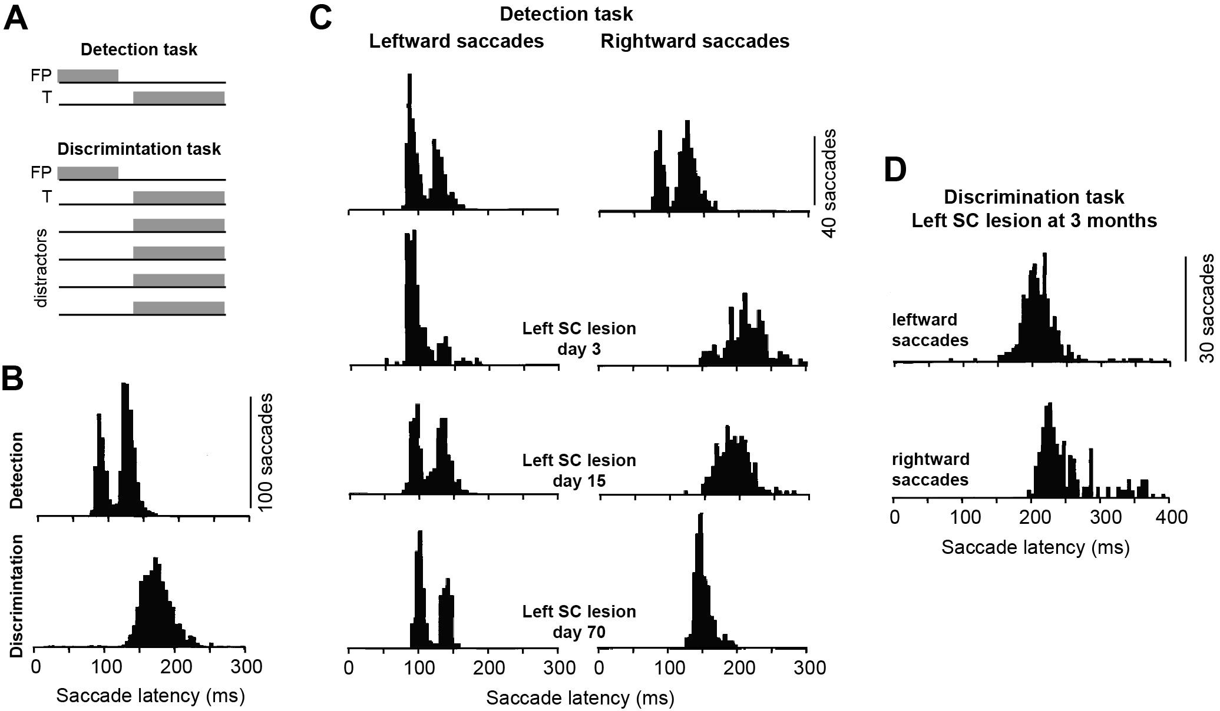
Superior colliculus is required for express saccades
Schiller et al., 1987

Slide 15
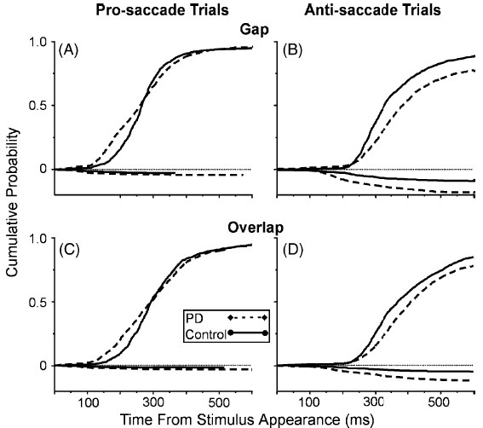
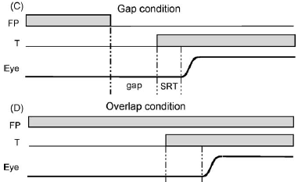
Pro- and Anti-saccade task
PD patients exhibit a reduced ability to inhibit reflexive saccades
Chan et al. (2005)

Slide 16
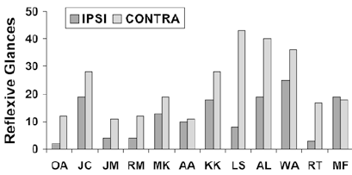
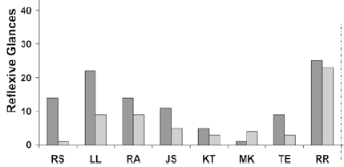
Anti-saccade task
FEF damage
LIP damage
FEF patients make more errors when the target is contralateral to the side of the lesion
Parietal patients make more errors when the target is ipsilateral to the side of the lesion
Machado and Rafal 2004

Slide 17
Summary
In SC, cells respond to visual stimulus onset at 80ms, but normally it takes another 80ms or more to start a movement.
During the reaction time, two events occur: activity of the fixation-related neurons decline, while activity in the movement-related neurons increase.
Utility of the stimulus holding the eyes, and the stimulus beckoning it, affect the reaction time.
It is possible to half the reaction time so that a saccade is made at 100ms or less following the stimulus.
In this case, the colliculus is primed for the movement by two factors: removal of the stimulus at fixation prior to target onset, and presentation of the target at one of finite and predictable locations.
Damage to the basal ganglia, FEF, and LIP suggest that the utility of the action may be computed elsewhere, and imposed on the SC.

Slide 18
Questions
Is in fact reaction time related to utility?
What neural structure sets the “threshold”?
How is a utility optimized to produce a feedback control system that results in a movement?
Does this view of reaction time in eye movements have parallels for skeletal movements?

