Slide 1
Reaction time of movements
Reza Shadmehr
Biomedical Engineering
Johns Hopkins University

Slide 2
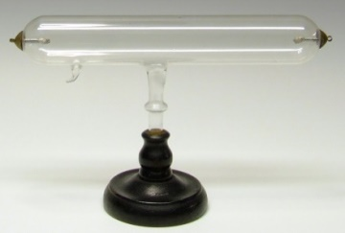
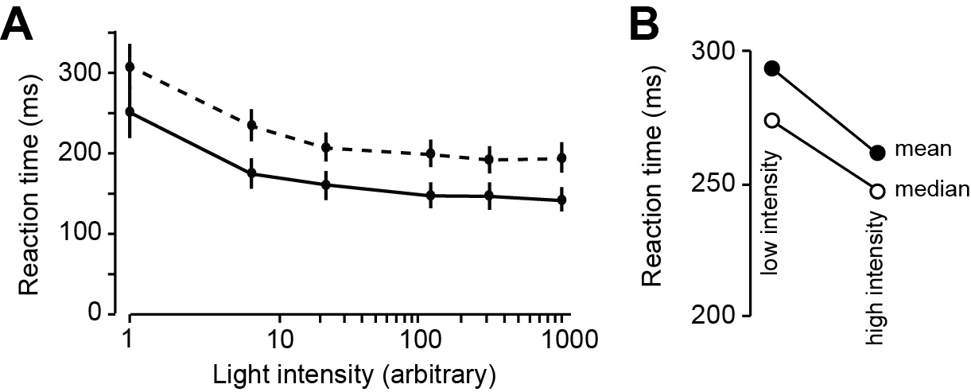
Movement latency is smaller for stimuli with greater intensity
Subject 1
Subject 2
James Cattell (1886)

Slide 3
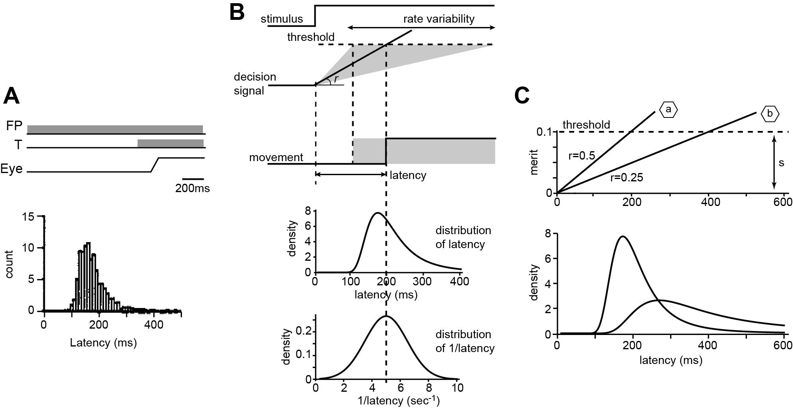
Development of a model: variable rise to a constant threshold
mean
median
McGill (1961), Vickers (1970), Ratcliff (1978), Carpenter (1999)

Slide 4
The merit of performing an action is represented by variable x, which rises and falls through accumulation of evidence.
The threshold for performing an action is set by
Once the merit of moving to a particular location reaches the threshold value, that movement is performed
The merit for performing an action has a rate specified by variable r.
The larger the rate r, the sooner the merit of that action will reach threshold, triggering the movement. Therefore, in this model the reaction time is the latency from presentation of stimulus to the time t that the merit signal x reaches threshold.
If we represent the rate of rise r as a random variable with a normal distribution, then the reaction time t will have a skewed distribution with a long tail.

Slide 5
During the reaction time, the merit of the possible action accumulates based on a rate parameter r, a normally distributed random variable.
To explain the relationship between rate of rise r and reaction time t, let us label the probability density of r as
The probability density of reaction time t is written as
If at start of the trial the baseline merit for performing some action is
The threshold needed to perform that action is
Then the reaction time is specified by the following ratio:
What is the probability density function for the random variable t (i.e., reaction time)?

Slide 6
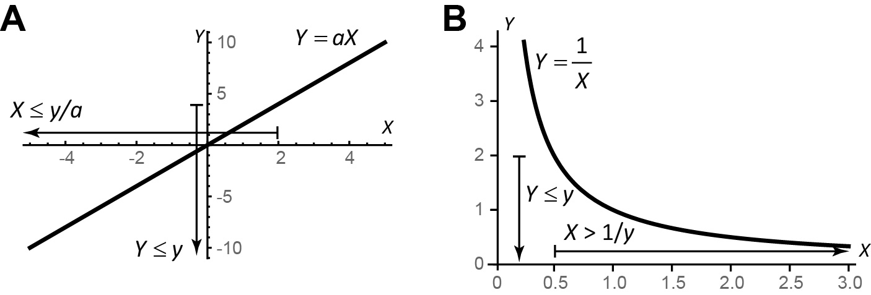
Algebra of random variables
Suppose that we have a random variable X.
We described it by its probability density function
The random variable Y is linearly related to X as follows:
We can compute the relationship between probabilities:
Make two new labels to call these probabilities:

Slide 7
The probability of random variable Y being less than some amount y is the same as the probability of random variable X being less than some amount y/a.
The probability density of Y is the derivative of its probability function:
Similarly, we write the probability density of X:

Slide 8
The reaction time is specified by the following ratio:
What is the probability density function for the random variable t (i.e., reaction time)?

Slide 9
Algebra of random variables

Slide 12
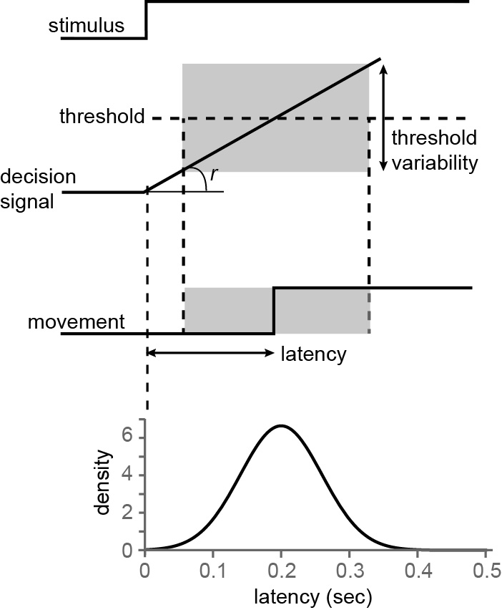
Alternate model: constant rise to a variable threshold
This model does not produce a skewed latency distribution

Slide 13
We label the threshold with random variable s and rate with parameter r, and then write the reaction time as:
In the variable threshold model, r is a constant, and s is a random variable with probability density

Slide 14
Summary
It takes time to start a movement: latencies have a skewed distribution.
It is thought that movement latency is related to a decision-making process in which merits of an action are accumulated, rising toward a threshold.
A normally distributed rate of rise coincides with a skewed distribution of latencies.
A normally distributed threshold coincides with a normally distributed latency.
Because movement latencies are skewed, this is consistent with a process where merit of an action is a random variable, integrated till it reaches a constant threshold.

Slide 15
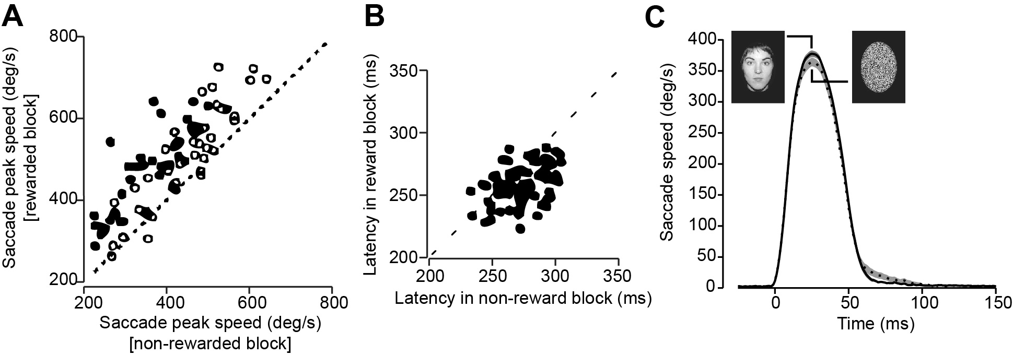
Increased reward reduces movement latency, and increases movement vigor
Takikawa et al. (2002) and Xu-Wilson et al. (2009)

Slide 16
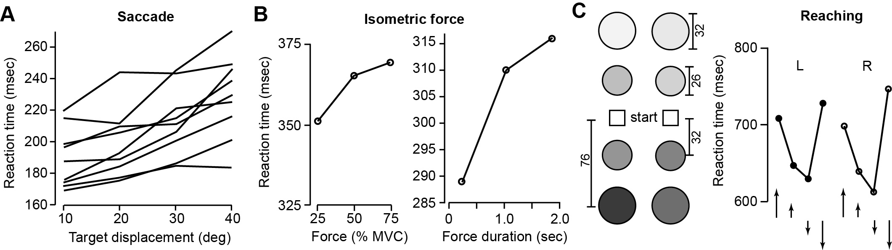
Increased effort increases movement latency
Fuller (1996), Stelmach and Worringham (1988), Ivry (1986), Rosenbaum (1980)

Slide 17
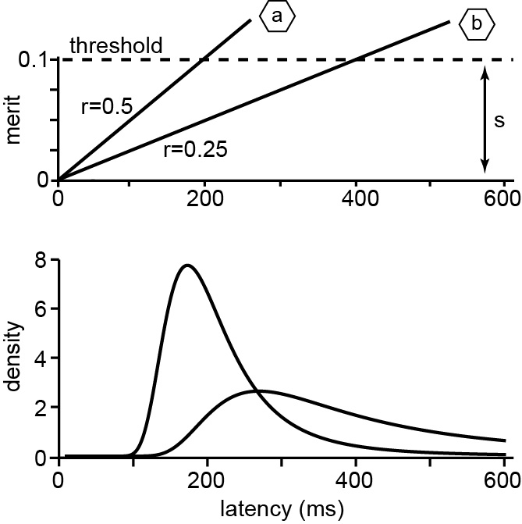
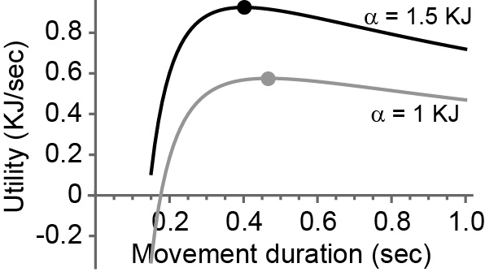
Idea: perhaps latency is related to movement utility
reward
effort
utility
duration
Let us assume that the rate of rise is proportional to the utility.

Slide 18
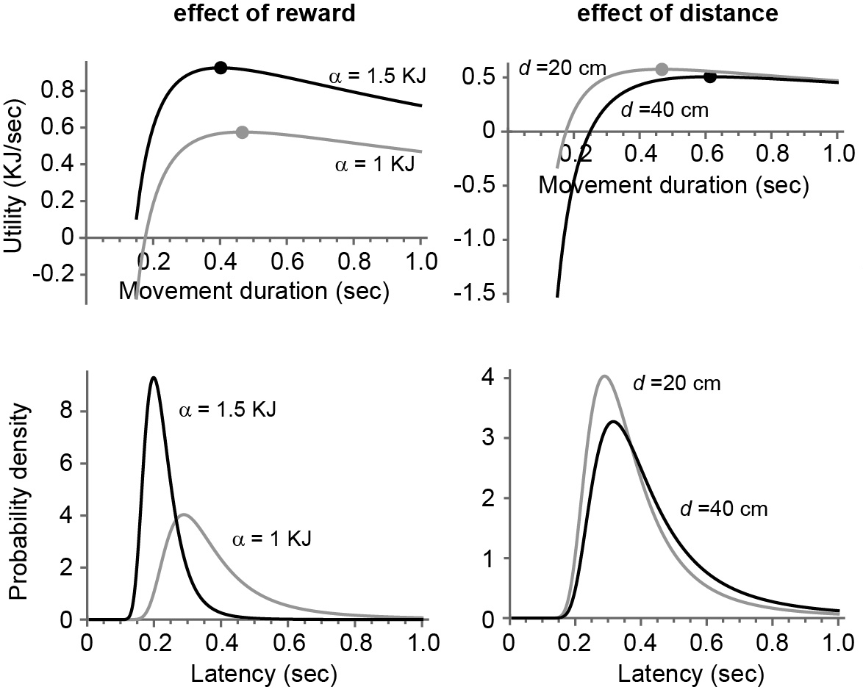
Model: rate of rise is proportional to utility

Slide 19
Summary
It takes time to start a movement: latencies have a skewed distribution.
It is thought that movement latency is related to a decision-making process in which merits of an action are accumulated, rising toward a threshold.
A normally distributed rate of rise coincides with a skewed distribution of latencies.
Here, we conjectured that the rate of rise may be proportional to utility of the movement.
Increased reward increases utility. This coincides with reduced movement latency, and increased vigor.
Increased effort decreases utility. This coincides with increased movement latency, and decreased vigor.

