Slide 1
UAV TOOLBOX ORGANIZATION
April 15, 2020

Slide 2


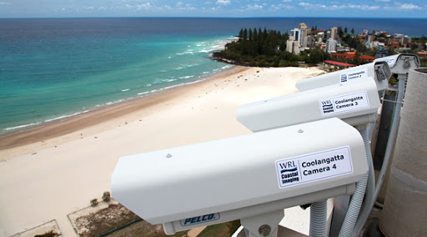
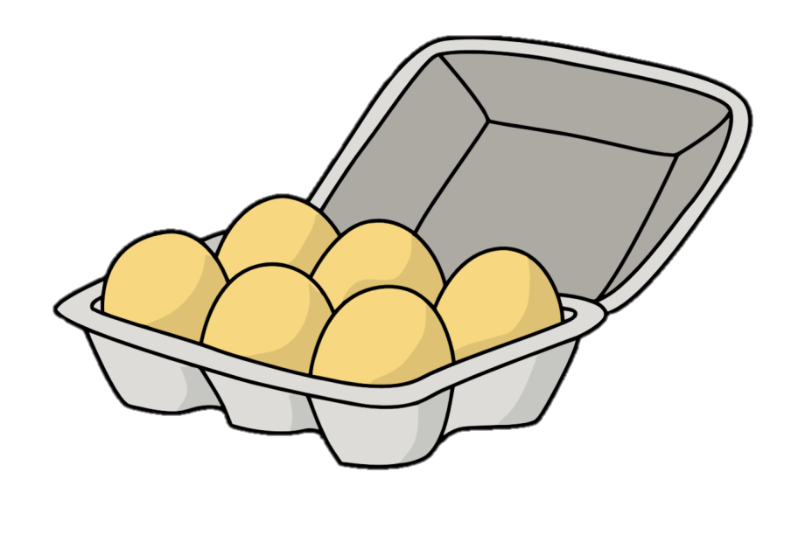



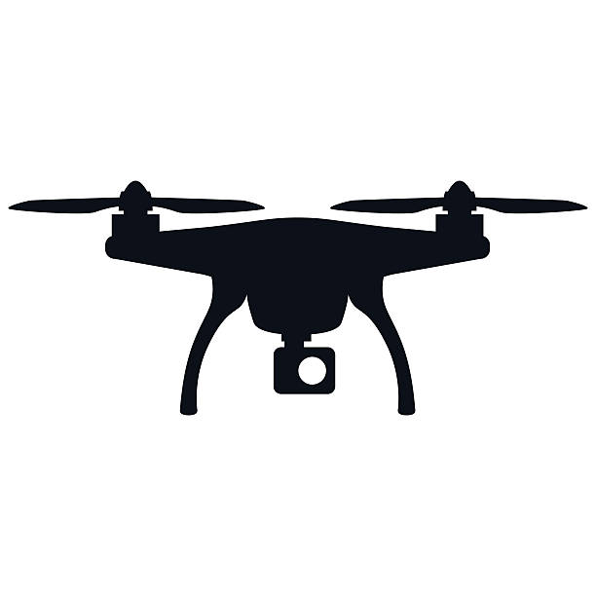
Photogrammetry basics are like baking ingredients…
A few staples, used together in slightly differently ways can make a lot of different things…
distortUV
UV2xyz
xyz2UV
undistortUV

Slide 3
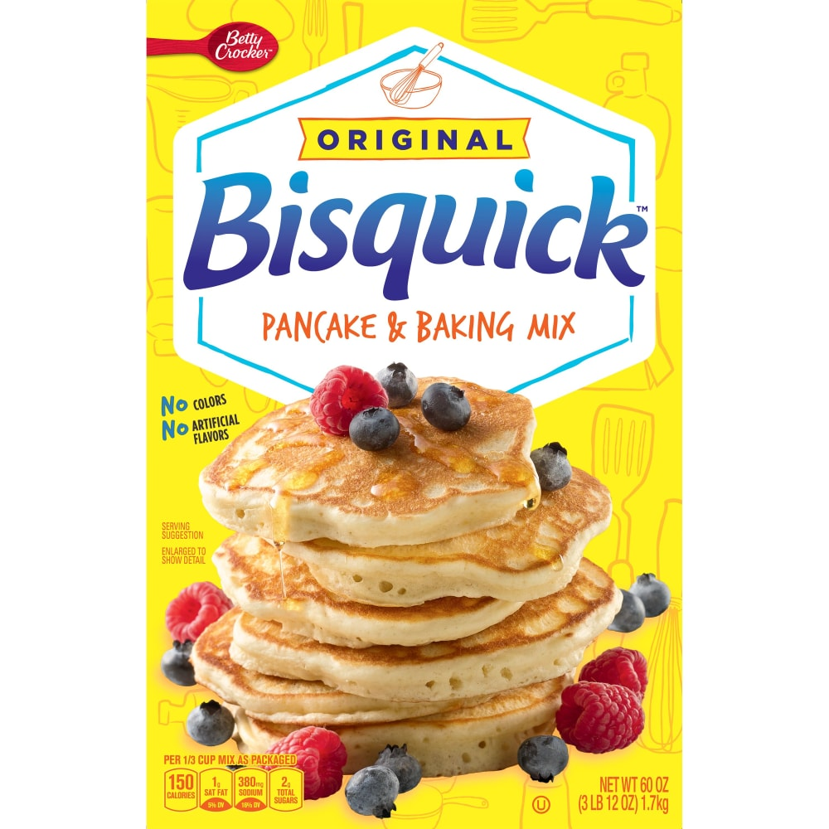
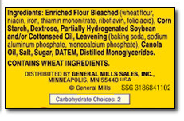
The UAS toolbox is like a premade mix…. It makes it easier to make…. but….
We are limited to a specific end product.
Its unclear how the staples were mixed together
(Hard to learn to make from scratch, or repurpose)
Some ingredients have unfamiliar names…

Slide 4

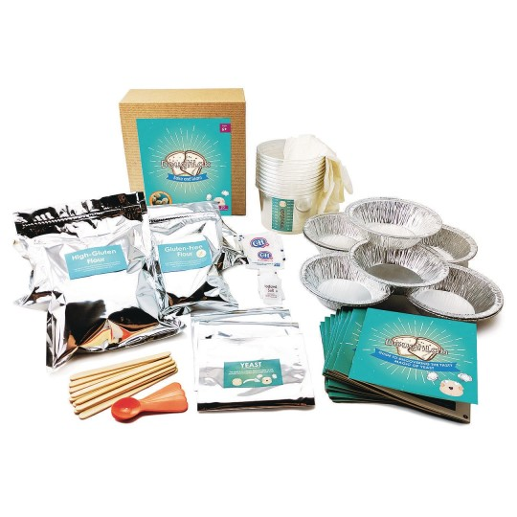
The UAS toolbox GUI has the same issue but amplified….
Additional features and ease typically complicate code and add more ingredients (preservatives…etc)
So we want to make a toolbox that highlights fundamental concepts but still can be used to make a product.
This way, bootcampers are not limited to a specific mix but have more freedom to explore with ingredients.

Slide 5
CIRN BOOTCAMP TOOLBOX PROGRESSION
Make X_CoreFunctions in active Matlab path
Run Code from A→G
A_formatIntriniscs
X_CoreFunctions
B_gcpSelection
CAMERA CALIBRATION
X_UASDemoData
C_SingleExtrinsicSolution
D_gridGenExampleRect
DOMAIN DEFINITION
MOVING CAMERA UAS
E_scpSelection
FIXED
CAMERA
F_variableExtrinsicSolutions
IMAGE
PRODUCTS
G1_ImageProducts
G2_PixelInstruments

Slide 6
FEATURES
Single toolbox
No need for participants to clone multiple repositories
Modular steps with saved output
No need to start entire toolbox over again if error
i.e. GeomSolver cannot find a solution and you have to click GCPs over and over
No need to start entire toolbox over if you want to change coordinate systems, or gcp selection
No assumed naming associations, filepaths…very flexible. User can modify that to their needs
References to CIRN Slides/Concepts
MetaData carried along, but not required to use core functions. Does not assume structure names etc.
‘Camera’-centric
Define camera parameters first (IO, EO)…separate from domain definition, rectification, etc.
Enter in realworld coordinates,
Define camera parameters first (IO, EO)…separate from domain definition, rectification, etc.
Clear progression….less functions

Slide 7
STILL TO BE DONE
Make Pixel instrument output consistent/workable with cbathy/vbar. Probably add a wrapper function at the end.
Add movies2image and Caltech toolbox scripts into progression. They do not need much change.
Perhaps make livescripts. Wanted to make sure older versions of matlab could handle the first version.
Write up manual
Introduce error messages.
Typos, Cirn slide references.

