Slide 1


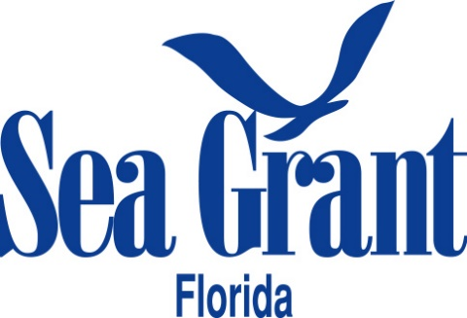

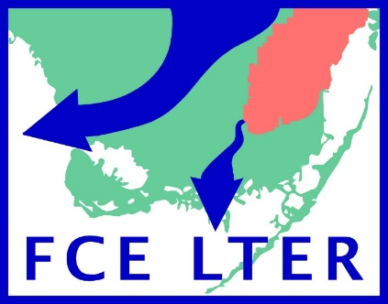
Preliminary examination of snook on offshore reefs in the Everglades National Park Ross Boucek & Jennifer Rehage Florida International University rbouc003@fiu.edu

Slide 2
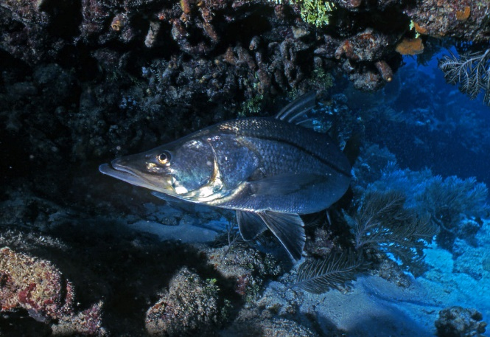
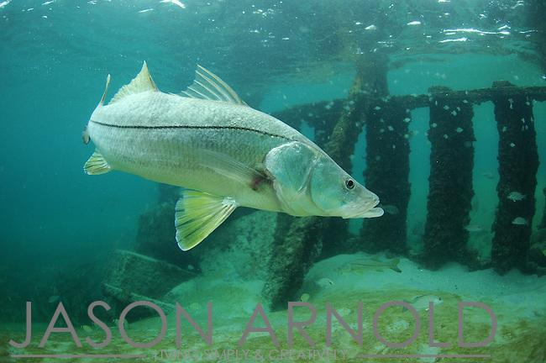
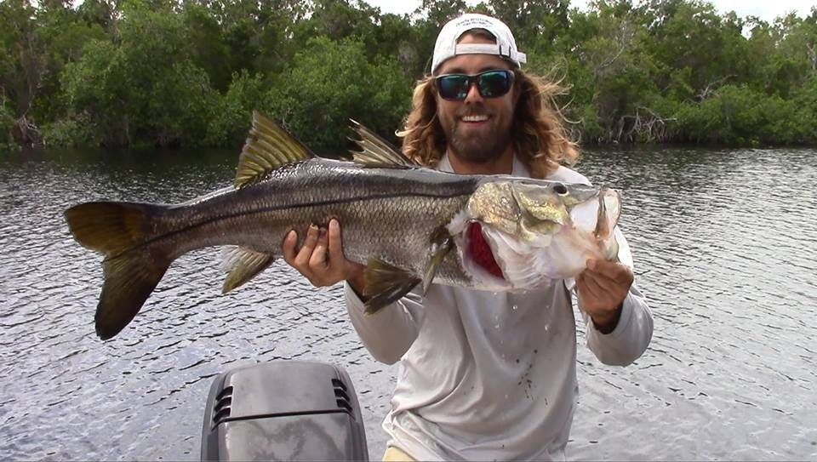
Common Snook
Tropical euryhaline
Found in all nearshore habitats
Offshore Reefs
Estuaries
Rivers

Slide 3
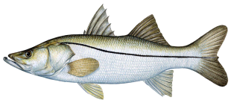

Freshwater
Estuary
Ocean

Slide 4

> 90% of fishing effort for snook in estuary
Freshwater
Estuary
Ocean

Slide 5
90% of fishing effort for snook in estuary
Estuary snook most studied
Freshwater
Estuary
Ocean

Slide 6
Less is known about snook in peripheral habitats
Freshwater
Estuary
Ocean

Slide 7
Peripheral habitats could influence resiliency to
fishing and disturbance
Freshwater
Estuary
Ocean

Slide 8
Charlotte Harbor snook
2010 cold event
Ocean

Slide 9
Low mortality
in river
High mortality in estuary
Ocean

Slide 10
-Rivers stayed warmer during the event
- Charlotte Harbor recovered faster than other Gulf Coasts estuaries
Ocean

Slide 11
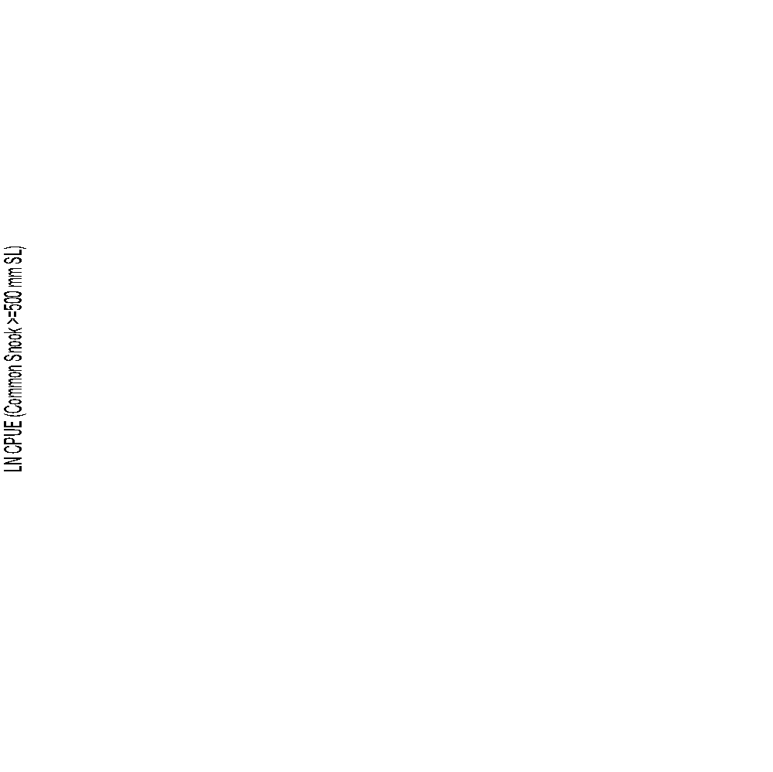
Charlotte Harbor more resilient than Tampa and the Everglades
Tampa
Three year recovery
Charlotte Harbor
CPUE
One year recovery
Everglades National Park
Four year recovery
1996
2014
Stevens et al. 2016 Ecosphere

Slide 12
Important to study these non-estuary populations
The abundance of snook in those habitats
Extent to which those habitats are used
Mechanisms behind usage

Slide 13
Important to study these non-estuary populations
The abundance of snook in those habitats
Extent to which those habitats are used
Mechanisms behind usage
Could improve predictions of population
resiliency to fishing and disturbance

Slide 14
Reef and ocean populations the least studied
Especially on the west coast of Florida
Freshwater
Estuary
Ocean

Slide 15
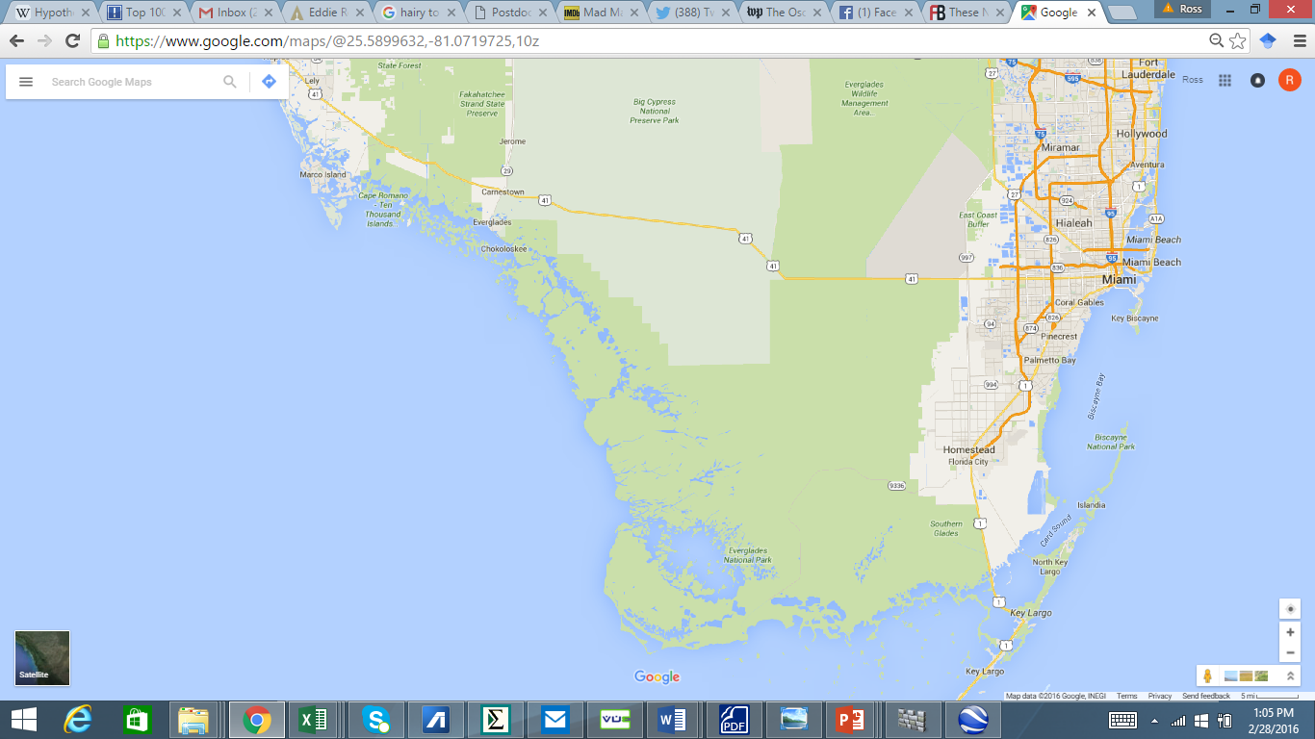


Ocean snook in Everglades National Park
?
?

Slide 16
Unknowns
Connectivity between ocean and inshore populations
Reasons why snook occur on those habitats
?
?

Slide 17
Research Questions
Are snook caught on reefs resident to those habitats, or are they migrating between reef and inshore areas?

Slide 18
Research Questions
Are snook caught on reefs resident to those habitats, or are they migrating between reef and inshore areas?
If snook are migrating to reefs from inshore areas, what mechanisms are driving that migration?

Slide 19
Methods: Conducted paired sampling in inshore and offshore areas
On Wreck:
Sampled via hook and line
Sampled at night (18:00-1:30)
Moon Phase (93-96% full)
Sampled in June, July, October
Same jigs used during each sample

Slide 20
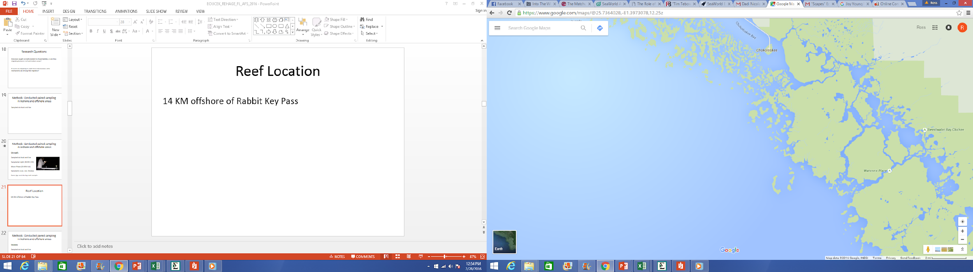
Wreck description
14 KM offshore of Rabbit Key Pass
Depth = 14-18 feet
Length = 25 meters
Sunken barge + rubble
Chokoloskee
Rabbit Key Pass
Pavilion Key

Slide 21
Methods: Conducted stable isotope study
Captured mud crab spp. from 4 habitats that vary in salinity conditions and distance mainland
-Represent isotopic habitat markers
-Analyzed snook fin clips
Ran both DC13 and DS34

Slide 22
Hypotheses
H1) Snook migrate between inshore and offshore habitats
Support for hypothesis
1) Snook catch rates, lengths, sex ratios on wreck show seasonality
2) Stable isotope signatures of snook are similar to inshore prey

Slide 23
Hypotheses
H2) Migrating snook are spawning on offshore reefs
Support for hypothesis
1) Higher catch rates compared to inshore populations
2) Average body size is larger on reefs
3) Proportionally more females on reefs compared to inshore populations
2)
δN
Inshore
Offshore
δC

Slide 24

Wreck description
Why snook might want to spawn on reefs

Slide 25
Wreck description
Why snook might want to spawn on reefs
Increased spread of larvae across nurseries

Slide 26
Wreck description
Why snook might want to spawn on reefs
Increased spread of larvae across nurseries
Adaptation to more stochastic sub-tropical environment
Increases chances that larvae reach
nurseries under varied environmental conditions

Slide 27
Wreck description
Why snook might want to spawn on reefs
Increased spread of larvae across nurseries

Slide 28
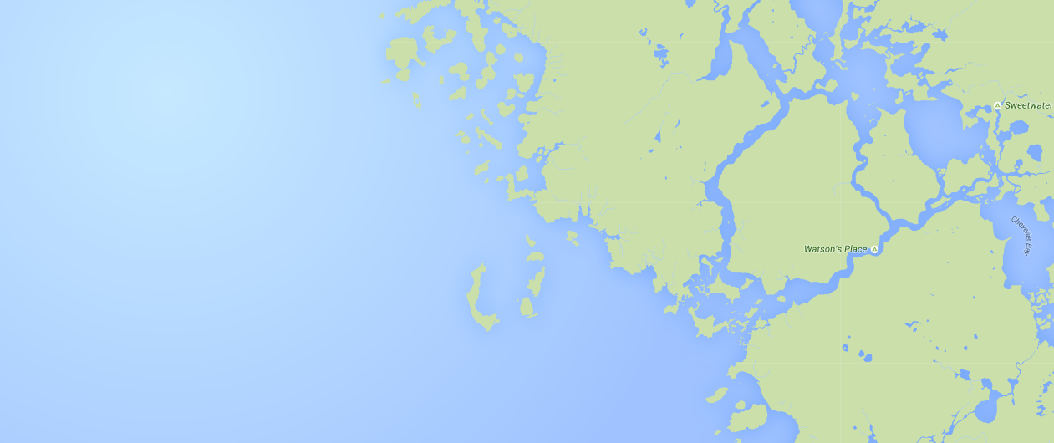
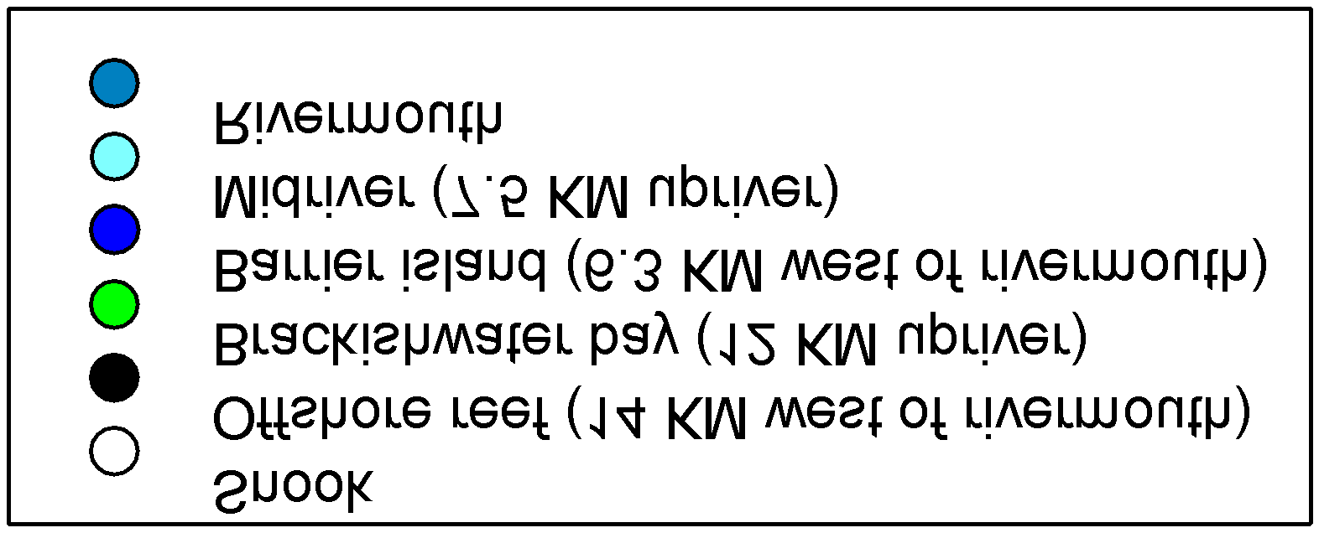
Locations of habitat markers
Capture locations of prey
Colors match dots on figure on next slide

Slide 29
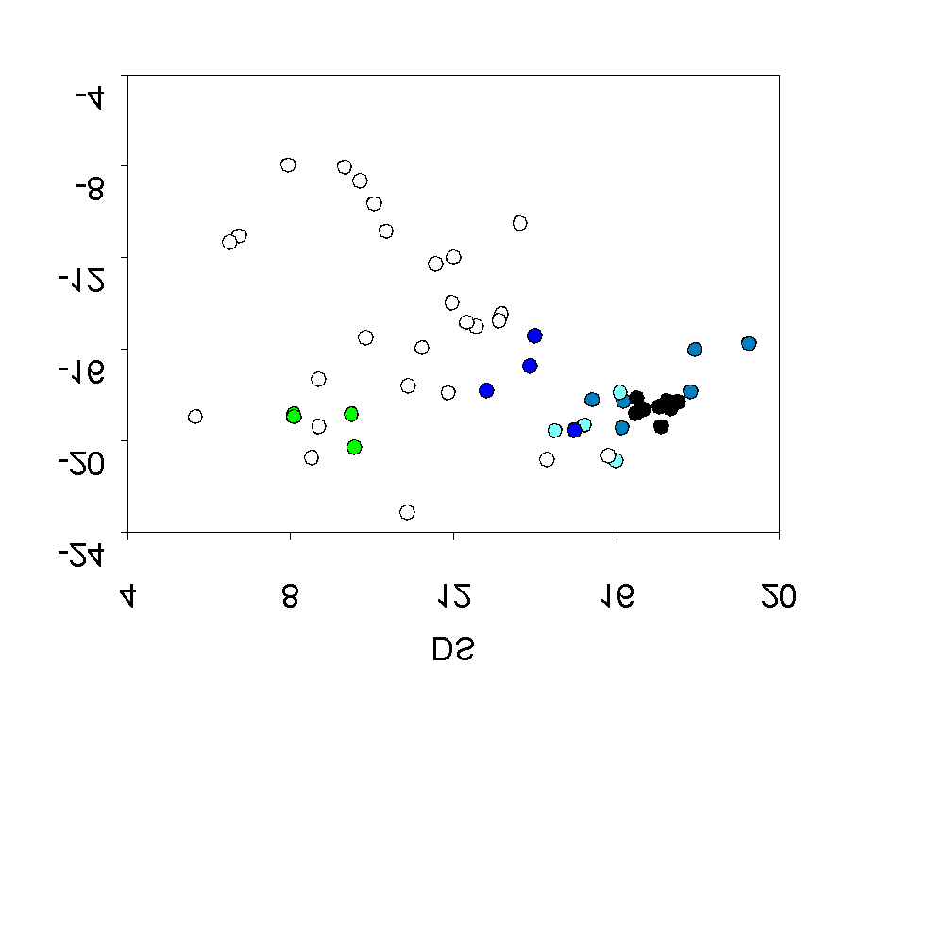
Snook and prey bi plots

Slide 30
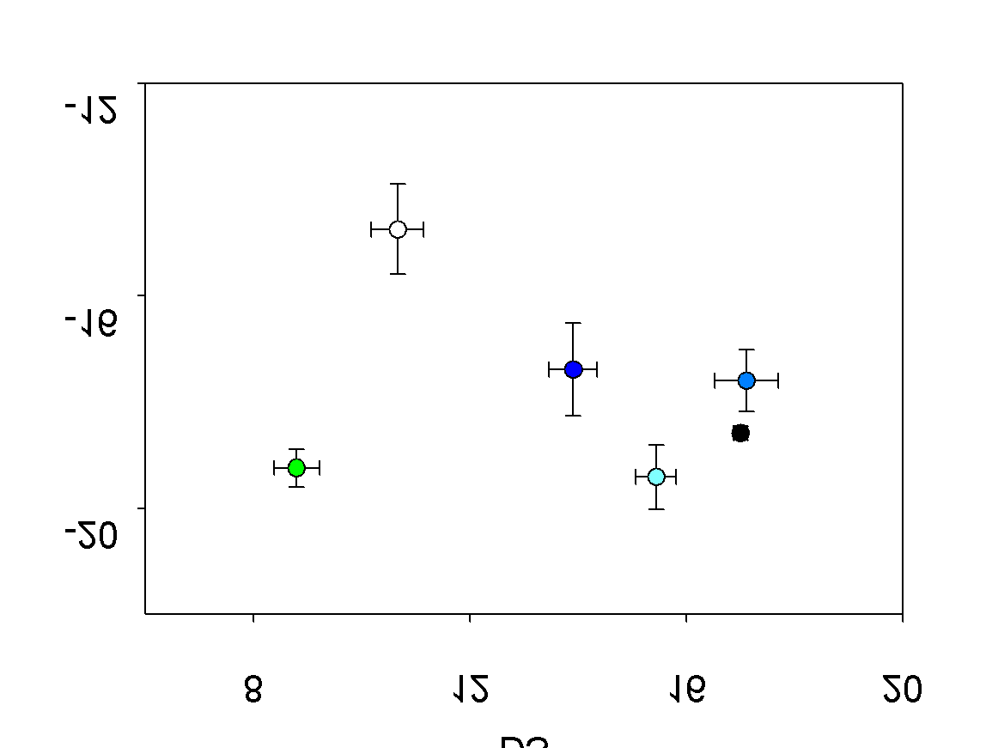
Snook and prey bi plots

