Slide 1
Part 1: How Does a Machine Learn?
Pixel's AI Field Guide · Live session 1 of 3
Topics 01–03 · about 60 minutes
Claude’s Plan · AI Overview module · Version 1.0
Pixel's AI Field Guide · Part 1: How Machines Learn · 1
Notes:
WELCOME (1 min). Introduce yourself and Pixel, the very literal lab robot from the study guide, and Dr. Ada Okafor, who runs the Curiosity Lab. Pixel learns alongside the audience and makes the mistakes beginners make.
Series: Part 1 = how AI works and learns (Topics 01-03). Part 2 = chatbots, types of AI, history (Topics 04-06). Part 3 = AI in the world: uses, harms, rules (Topics 07-10).
No programming or maths needed; the only arithmetic is adding small decimals.
Materials needed: projector; optional internet for the TensorFlow Playground demo (fallback slides included). Paper and pen for the audience help.

Slide 2
A rule nobody wrote
MISSION BRIEF
Your inbox just blocked a spam email it had never seen before.
Who wrote the rule that caught it?
Hands up: a programmer? The computer? Nobody?
Pixel's AI Field Guide · Part 1: How Machines Learn · 2
Notes:
OPENING (2 min). Ask for a show of hands for each option. Do NOT give the answer; say "we'll find out by the end of this session".
Expected: most people say "a programmer". The resolution (slide "Back to the inbox") is: nobody wrote that exact rule; the filter learned it from labeled examples.
Fact for the presenter: Gmail moved from hand-written rules to machine-learning-generated rules from 2014 (Topic 02).

Slide 3
Today's route
EXPLAIN
• 1. What counts as AI? A test you can use on any app
• 2. Two ways to build AI Following rules vs learning from examples
• 3. Inside learning Training, testing, and one artificial neuron
• By the end: explain how a spam filter learns its rule
Pixel's AI Field Guide · Part 1: How Machines Learn · 3
Notes:
ROADMAP (1 min). Keep it brief. Learning goals for this part (from the module outline LO1-LO3): define AI as inputs -> inferred outputs; distinguish rule-based AI from machine learning; trace training vs inference; compute one neuron's output.
Transition: "Let's start with the most basic question: what even counts as AI?"

Slide 4
What is AI?
EXPLAIN
Input → system infers → output
AI performs tasks we would say need human intelligence
Outputs: prediction, classification, recommendation, decision, content
To infer = to work something out from evidence
Pixel's AI Field Guide · Part 1: How Machines Learn · 4
Notes:
DEFINITION (3 min). Module definition: "AI is computer technology that performs tasks we would normally say need human intelligence, such as recognizing patterns, understanding language, making decisions or creating content."
OECD (updated Nov 2023): an AI system infers from the input it receives how to generate outputs (predictions, content, recommendations, decisions).
Emphasize: "perform tasks" means results LOOK intelligent; it does not mean the computer thinks or feels. Today's AI is built for particular tasks.
A calculator does not infer: it applies one fixed procedure to every input.
Source: Topic 01, Explanation sections 1-2 (../task-1/topics/01-what-is-ai.md).

Slide 5
AI or not?
PREDICT
• A. Calculator
• B. Spam filter
• C. Alarm clock
• D. Photo app that finds your dog
• E. Thermostat with one fixed rule
• F. Predictive text on your phone
Pixel's AI Field Guide · Part 1: How Machines Learn · 5
Notes:
ACTIVITY (2 min). "Decide for each: AI or not? Discuss with a neighbor for 60 seconds." Then count hands for each letter.
Do not reveal yet; the next slide gives the test and the answers.
Study guide link: Mission 01 Activity 1.1 is the full 12-card version of this sort (../task-2/study-guide/mission-01-is-it-ai.md).

Slide 6
The three-question test
DEBRIEF
Question | AI if…
1. Does it turn inputs into outputs? | yes (all software does)
2. Does it infer for new, varied inputs? | yes, not one fixed rule
3. Could a person write an exact recipe for every input? | no
AI: B spam filter, D photo app, F predictive text · Not AI: A, C, E
Pixel's AI Field Guide · Part 1: How Machines Learn · 6
Notes:
ANSWER (2 min). Walk through the test with one AI example (photo app: no one can write an exact recipe for recognizing YOUR dog in every lighting and pose) and one non-AI example (alarm clock: one fixed rule, "ring at 7:00").
Common misconception: "anything automatic or smart-sounding is AI". The test is about inferring outputs for new inputs.
Optional aside, the AI effect: once AI works, people stop calling it AI ("AI is whatever hasn't been done yet", Tesler's Theorem as reported by Hofstadter 1979).
Practice: test bank Q1-Q8 (Mission 01) in ../task-2/test-bank/test-bank.md.
Transition: "So how do people build systems that infer? There are two very different ways."

Slide 7
Two ways to build AI
Follow rules and search · or learn from examples
Pixel's AI Field Guide · Part 1: How Machines Learn · 7

Slide 8
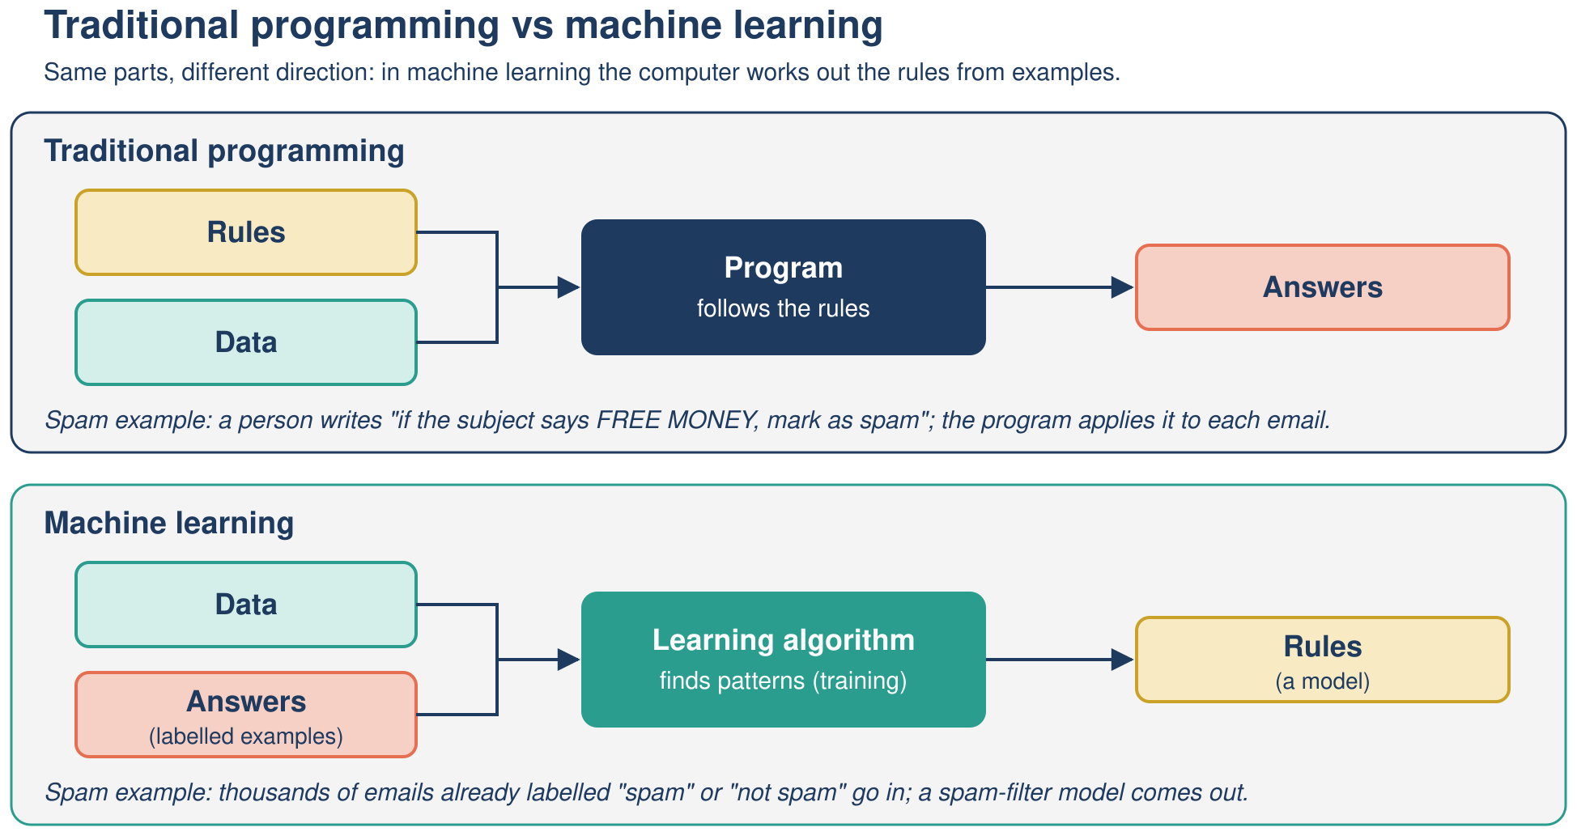
Rules in, or rules out?
EXPLAIN
People write the rules · or the rules are learned from examples
Pixel's AI Field Guide · Part 1: How Machines Learn · 8
Notes:
KEY CONTRAST (3 min). Point to the top row: a person writes the rules (rule-based or "symbolic" AI). Example: MYCIN (Stanford, early 1970s), about 600 IF-THEN rules giving antibiotic advice.
Bottom row: we give examples with the right answers (labels) and a learning algorithm produces the rules, called a model. This is machine learning (ML).
"Old vs new" is rough: both are still used, and hybrids exist (AlphaGo combined deep neural networks with search, 2016).
Diagram credit: original diagram created for this module (framing commonly attributed to F. Chollet, Deep Learning with Python, 2017).
Source: Topic 02, Explanation sections 2-4. Transition: "First, rules. Here is a puzzle that rule-based AI solves perfectly."

Slide 9
Pixel's river problem
TRY IT
Farmer, wolf, goat, cabbage. Boat holds the farmer + one item.
Never leave wolf + goat alone. Never leave goat + cabbage alone.
What must the first crossing be? (30 seconds)
Pixel's AI Field Guide · Part 1: How Machines Learn · 9
Notes:
PUZZLE (2 min). Read the rules aloud. Give 30 seconds of silent thinking, then take answers.
Expected answer (next slide): the farmer must take the goat. Taking the wolf leaves goat + cabbage; taking the cabbage leaves wolf + goat; going alone leaves everything.
Live option: open ../task-2/activities/river-crossing/river-crossing.html (works offline) and let a volunteer try a wrong move; the page explains why it fails. Fallback: this slide and the next.

Slide 10
Why only the goat works
DEBRIEF
• Take the wolf → goat eats cabbage
• Take the cabbage → wolf eats goat
• Go alone → both pairs are left together
• Take the goat → the only safe state
• Pixel's lesson: describe the problem precisely, then check every move
Pixel's AI Field Guide · Part 1: How Machines Learn · 10
Notes:
DEBRIEF (1 min). Each tempting move breaks a rule. This is exactly how a computer checks moves: it tests each possible action against the rules.
Transition: "To let a computer solve the whole puzzle, we describe it as a set of states and moves."

Slide 11
The puzzle as states
EXPLAIN
Crossings | New safe states reached (left bank | right bank)
0 | FWGC |
1 | WC | FG
2 | FWC | G
3 | C | FWG or W | FGC
4 | FGC | W or FWG | C
5 | G | FWC
6 | FG | WC
7 | | FWGC goal!
F farmer · W wolf · G goat · C cabbage · 10 safe states, 7 crossings
Pixel's AI Field Guide · Part 1: How Machines Learn · 11
Notes:
STATE SPACE (3 min). Vocabulary: a STATE is one arrangement (who is on which bank), e.g. "FWGC |" = everyone on the left. ACTIONS are crossings. RULES say which states are allowed. The GOAL is "| FWGC".
This table is exactly what breadth-first search discovers, level by level: all states 1 crossing away, then 2, and so on, never revisiting a state. At level 3 the search splits into two equally short routes (wolf first or cabbage first), which rejoin at level 5.
Facts verified by script (Topic 02): 16 possible arrangements, 10 safe, minimum 7 crossings, exactly 2 shortest solutions.
The full state-graph diagram (../task-2/assets/images/river-crossing-state-graph.svg) is too detailed to project; use it as a handout or point learners to Mission 02 Activity 2.2.

Slide 12
The two shortest plans
EXPLAIN
Crossing | Plan A (wolf first) | Plan B (cabbage first)
1 | take goat → | take goat →
2 | ← return alone | ← return alone
3 | take wolf → | take cabbage →
4 | ← bring goat back | ← bring goat back
5 | take cabbage → | take wolf →
6 | ← return alone | ← return alone
7 | take goat → | take goat →
Pixel's AI Field Guide · Part 1: How Machines Learn · 12
Notes:
SEARCH TRACE (3 min). Breadth-first search (BFS) explores all states 1 crossing away, then all states 2 crossings away, and so on, skipping states it has already visited. So the first time it reaches the goal, it has found a plan with the fewest crossings.
Reveal rows one by one if you like (or point down the table). Ask: "Why does the goat come BACK at crossing 4?" Answer: otherwise the goat is left with the item just delivered.
Full trace with frontier and visited set: ../task-2/activities/river-crossing/solver-output.txt; study guide Mission 02 Activity 2.3.

Slide 13
Search: strengths and limits
EXPLAIN
Strengths
Limits
• Guaranteed correct plan
• BFS finds the shortest plan
• Every step can be explained
• Needs exact rules written by people
• States can explode in number
• Learns nothing from experience
Pixel's AI Field Guide · Part 1: How Machines Learn · 13
Notes:
WRAP-UP OF RULES (2 min). Rule-based AI shines when the world can be described exactly (puzzles, route planning, games like chess).
"Combinatorial explosion": in big problems the number of states grows so fast that searching them all is impossible; this helped cause the first AI winter (Part 2).
Transition: "Now try writing exact rules for spam. 'Contains the word free'? Your friend writes 'free for lunch?'. We need another approach: learning."

Slide 14
Learning from examples
Training, testing, and Pixel's spam filter
Pixel's AI Field Guide · Part 1: How Machines Learn · 14

Slide 15
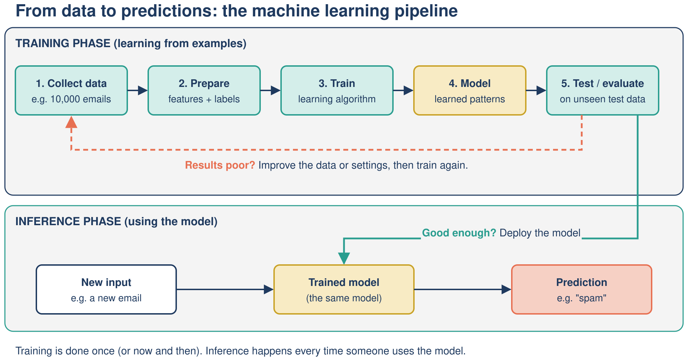
Two phases: training and inference
EXPLAIN
Pixel's AI Field Guide · Part 1: How Machines Learn · 15
Notes:
PIPELINE (3 min). TRAINING: the algorithm adjusts the model's parameters (weights) using labeled training data. FEATURES are the measurable inputs (e.g. "contains free", number of links); the LABEL is the right answer (spam / not spam).
TEST: we keep some labeled examples aside (the test set) and check the model on them, because doing well on examples you have already seen proves little.
INFERENCE (prediction): the finished model is used on new emails; it no longer changes while it predicts.
Source: Topic 02 Explanation section 3; Topic 03 section 3.

Slide 16
What Pixel's filter learned
EXPLAIN
Feature | Weight
contains "free" | +2
contains "urgent" | +2
contains "meeting" | −2
contains "invoice" | 0
3 or more links | +1
Rule: score of 2 or more → spam · illustrative (made-up) figures
Pixel's AI Field Guide · Part 1: How Machines Learn · 16
Notes:
WORKED EXAMPLE (2 min). These weights came from counting words in 10,000 labeled training emails (4,000 spam, 6,000 not spam): words much more common in spam get positive weights, words more common in normal email get negative weights. All figures are illustrative (made-up), as in Topic 02.
Nobody typed "+2 for free"; the counts produced it. This is the answer to our opening question taking shape.

Slide 17
Spam or not?
PREDICT
Score each email (threshold: 2)
Email 1: "URGENT: claim your free gift" + 4 links
Email 2: "Meeting moved, free coffee provided"
Pixel's AI Field Guide · Part 1: How Machines Learn · 17
Notes:
ACTIVITY (2 min). Give 45 seconds; neighbors compare. Weights are on the previous slide (go back if needed or leave it printed on a handout).
Answers (next slide): Email 1 = urgent +2, free +2, 3+ links +1 = 5 -> spam. Email 2 = meeting -2, free +2 = 0 -> not spam.
Point: one word ("free") does not decide; the combination does.

Slide 18
Answers
DEBRIEF
• Email 1: +2 urgent +2 free +1 links = 5 → spam
• Email 2: −2 meeting +2 free = 0 → not spam
• On 2,000 test emails: 93% correct
• 60 false positives (good mail blocked) · 80 false negatives (spam got through)
Pixel's AI Field Guide · Part 1: How Machines Learn · 18
Notes:
DEBRIEF (2 min). Test set (illustrative): 2,000 emails = 800 spam + 1,200 not spam. Caught 720 of 800 spam (80 false negatives); 60 genuine emails wrongly blocked (false positives); 1,860 / 2,000 = 93% accuracy.
FALSE POSITIVE = a wrong "yes" (genuine email sent to spam). FALSE NEGATIVE = a wrong "no" (spam reaches the inbox).
Quick question: "If we lower the threshold from 2 to 1, what happens?" Expected: more emails flagged -> more false positives, fewer false negatives. Every threshold is a trade-off.
Practice: Mission 04 Activity 4.1 "Be the spam filter"; runnable version ../task-2/activities/spam-filter/ (Python or Colab).

Slide 19
Which fruit model would you trust?
PREDICT
Model | Training set | Test set
A: skin rule (bumpy = orange) | 8 / 8 | ?
B: memorizer (exact weight match) | 8 / 8 | ?
C: weight rule (> 165 g = orange) | 7 / 8 | ?
Predict: which model does best on 4 new fruits? · illustrative (made-up) data
Pixel's AI Field Guide · Part 1: How Machines Learn · 19
Notes:
ACTIVITY (2 min). Ask for a hand vote: A, B or C? Many pick B because it is "perfect".
Answer (next slide): A 4/4, B 2/4, C 2/4. Source: Topic 03 Worked example Part A.

Slide 20
Perfect on practice, poor on new data
DEBRIEF
• Test scores: A 4/4 · B 2/4 · C 2/4
• B memorized the examples: overfitting
• C was too simple: underfitting
• Only the test set revealed the difference
Pixel's AI Field Guide · Part 1: How Machines Learn · 20
Notes:
DEBRIEF (2 min). OVERFITTING: a model matches its training data so closely that it fails on new data; the warning sign is a big gap between training and test results. UNDERFITTING: too simple to capture the real pattern, poor even on training data.
Pixel joke from the guide: Pixel memorized every answer in last year's quiz and was baffled when the questions changed.
Reduce overfitting (intuition): more varied data; simpler models when they work as well; always test on unseen data.
Practice: test bank Mission 04 questions Q28-Q39.

Slide 21
Three ways a machine can learn
EXPLAIN
Kind | Learns from | Example
Supervised | labeled examples | spam filter
Unsupervised | unlabeled data (finds groups) | grouping customers
Reinforcement | rewards and penalties | game-playing agent, robot maze
Pixel's AI Field Guide · Part 1: How Machines Learn · 21
Notes:
KINDS OF LEARNING (2 min). Supervised: the right answers (labels) are given; classification = a category, regression = a number. Unsupervised: no labels; the algorithm finds structure such as clusters. Reinforcement: an agent acts in an environment and learns from rewards and penalties.
Optional demo/side quest: ../task-2/activities/robot-maze/robot-maze.html compares a fixed rule, search (BFS) and Q-learning (reinforcement learning) in the same maze.
Transition: "Many of today's most impressive models are neural networks. Let's open one up."

Slide 22
Inside a neural network
One artificial neuron, then layers
Pixel's AI Field Guide · Part 1: How Machines Learn · 22

Slide 23
Be the neuron
TRY IT
Input | Value | Weight
x1: contains "free" | 1 | 0.6
x2: sender in contacts | 0 | −0.4
x3: 3 or more links | 1 | 0.3
bias |  | −0.5
Multiply, add, add the bias. Output 1 (spam) if the sum is greater than 0.
Pixel's AI Field Guide · Part 1: How Machines Learn · 23
Notes:
ACTIVITY (2 min). The neuron is a tiny spam detector (illustrative numbers, identical to Topic 03 Part B and the neuron diagram on the next slide).
Steps: multiply each input by its weight; add them and the bias; apply the step function (1 if the sum is greater than 0, otherwise 0).
Give 60 seconds. Answer on the next slide: 0.6 + 0 + 0.3 - 0.5 = 0.4 > 0 -> output 1 (spam).

Slide 24
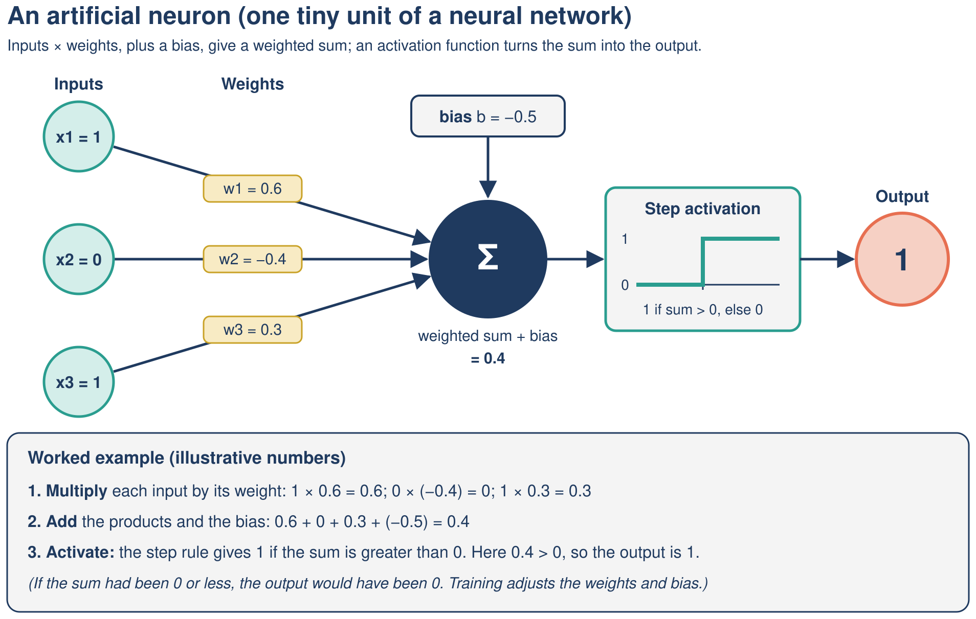
The neuron's answer
DEBRIEF
Sum = 0.4 > 0 → output 1 (spam) · if x2 = 1, sum = 0.0 → 0
Pixel's AI Field Guide · Part 1: How Machines Learn · 24
Notes:
DEBRIEF (2 min). With x2 = 1: 0.6 - 0.4 + 0.3 - 0.5 = 0.0, which is not greater than 0, so output 0 (not spam): the negative weight pulled the decision back exactly to the boundary.
Other activations: sigmoid(0.4) is about 0.60; ReLU gives 0.4.
Where do weights come from? Nobody sets them by hand: training starts with rough weights and nudges them, example after example. The perceptron (Rosenblatt, 1958) was the first famous version.
Misconception: neuron "bias" is a parameter; unfair bias is Part 3 (Topic 08).
Practice: Mission 05 Activity 5.1; test bank Q40-Q49.

Slide 25
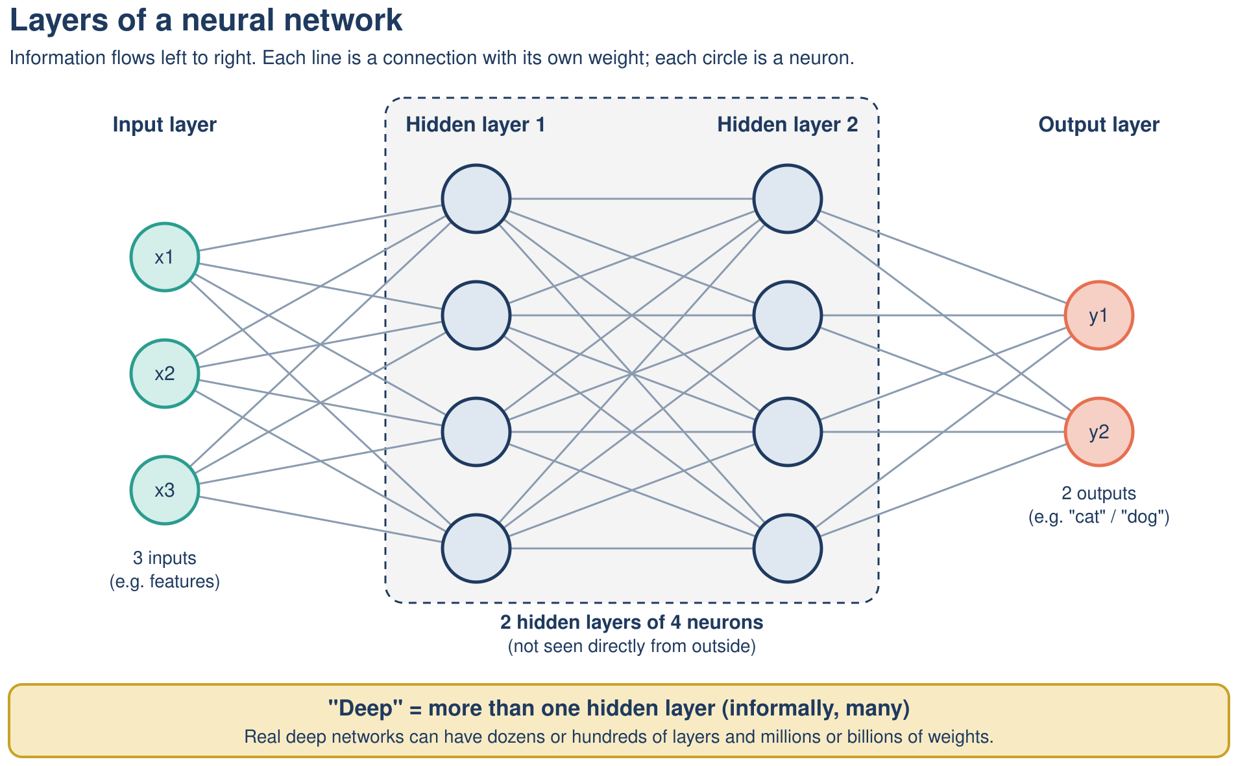
Layers make it deep
EXPLAIN
Deep = more than one hidden layer · learns its own features · hard to explain
Pixel's AI Field Guide · Part 1: How Machines Learn · 25
Notes:
LAYERS (3 min). Say aloud: deep networks need lots of data and computing power (GPUs) and are hard to explain, often called "black boxes" (accountability, Part 3). Each neuron takes all outputs of the previous layer as inputs. In image recognition, early layers respond to edges and color patches, later layers to shapes, the last to whole objects; nobody programs these features, they emerge in training.
Module rule of thumb: deep = more than one hidden layer (IBM: at least 4 layers counting input and output). "Deep" means many layers, NOT deep understanding.
Without activation functions, stacking layers adds nothing ("linear operations performed on linear operations are still linear", Google ML course).

Slide 26
Live demo: TensorFlow Playground
DEMO
• Question: can a network with no hidden layer separate a circle?
• Run 1: circle data, 0 hidden layers → predict, then press play
• Run 2: add 1 hidden layer of 4 neurons → compare
• Notice: the boundary bends only when hidden neurons exist
Pixel's AI Field Guide · Part 1: How Machines Learn · 26
Notes:
DEMO (4 min). Before class open both presets in tabs (internet needed; no account):
Preset P1 (0 hidden layers): https://playground.tensorflow.org/#activation=tanh&batchSize=10&dataset=circle&regDataset=reg-plane&learningRate=0.03&regularizationRate=0&noise=0&networkShape=&showTestData=false&discretize=false&percTrainData=50&x=true&y=true&xTimesY=false&xSquared=false&ySquared=false&cosX=false&sinX=false&cosY=false&sinY=false&collectStats=false&problem=classification&initZero=false&hideText=false
Preset P2 (1 hidden layer, 4 neurons): same URL with networkShape=4.
Steps: 1) ask the question; 2) press play on P1 for about 10 seconds: the boundary stays a straight line and test loss stays high; 3) switch to P2: the boundary curves around the circle and loss drops.
Results vary a little each run because starting weights are random. LAB NOTE: the Playground uses tiny 2-D toy datasets; real networks have millions of weights.
FALLBACK (no internet): describe the expected outcomes above and use Mission 05's simulated-results table (../task-2/study-guide/mission-05-inside-the-neuron.md).

Slide 27
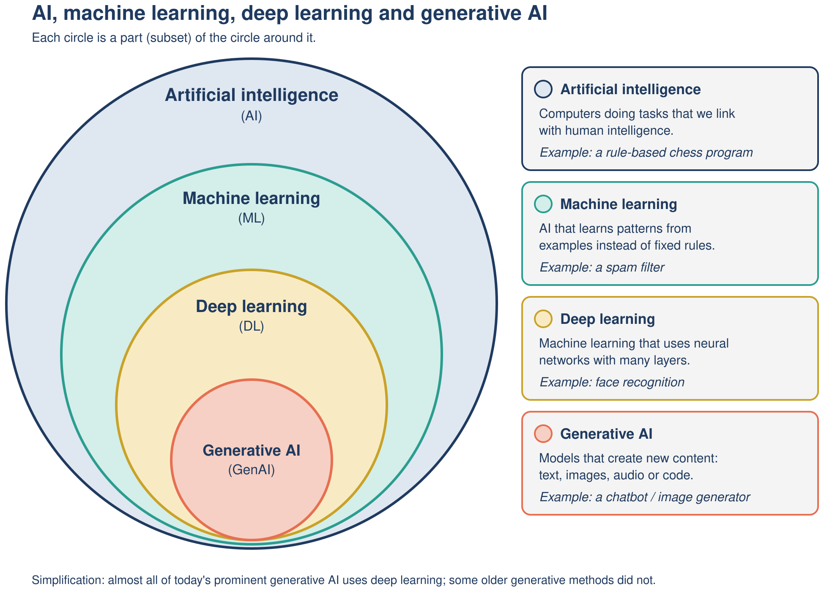
Back to the inbox
TAKEAWAY
Who wrote the spam rule? Nobody: it was learned from labeled examples
Pixel's AI Field Guide · Part 1: How Machines Learn · 27
Notes:
CONCLUSION (3 min). Resolve the opening: the filter's rule was produced by training on labeled examples and checked on a test set; no person typed it.
Connect the nest: AI includes rule-based systems like the river-crossing search; machine learning is the part that learns from data (the spam filter); deep learning uses many-layered neural networks; generative AI (next session) sits inside deep learning, with the caveat that some older generative methods were not deep learning.
Take-away sentence: "Rule-based AI follows rules people write; machine learning writes its own rules from examples, and we must test it on data it has never seen."

Slide 28
Next steps
NEXT STEPS
• Study guide: Missions 01–05 (start at 00-start-here.md)
• Practice: test bank Q1–Q49
• Try: river-crossing page · Prolog in SWISH · Teachable Machine
• Next session: how chatbots write, types of AI, history
Pixel's AI Field Guide · Part 1: How Machines Learn · 28
Notes:
NEXT STEPS (1 min). Files (relative to result/task-3/):
- Study guide start: ../task-2/study-guide/00-start-here.md; Missions 01 Is It AI?, 02 The River Problem, 03 Pixel's Rulebook (Prolog rule-based systems, not covered live), 04 Learning from Examples, 05 Inside the Neuron.
- Test bank: ../task-2/test-bank/test-bank.md, Mission 01-05 sections (Q1-Q49), answer key at the end.
- Videos: study guide resources page (../task-2/study-guide/resources.md), e.g. V2 Code.org "What is Machine Learning?" and V3 "How Neural Networks Work".
- Video scripts for replayable demos: ../task-1/formats/video-scripts/video-scripts.md (V02 spam filter, V03 neuron by hand).

