Slide 1
Part 2: How Does a Chatbot Write?
Pixel's AI Field Guide · Live session 2 of 3
Topics 04–06 · about 60 minutes
Pixel's AI Field Guide · Part 2: Chatbots, Types and History · 1
Notes:
WELCOME (1 min). Recap Part 1 in one sentence: machine learning writes its own rules from examples and is checked on a test set; deep learning uses many-layered neural networks.
Today: generative AI and large language models (LLMs), the two ways of classifying AI, and 75 years of AI booms and winters, ending with "why now?".

Slide 2
Finish the sentence
MISSION BRIEF
"The cat sat on the ___"
Shout out the next word
How did you choose it so fast?
Pixel's AI Field Guide · Part 2: Chatbots, Types and History · 2
Notes:
OPENING (2 min). Take a few answers: most people say "mat"; some say "floor" or "sofa".
Say: "You just did what a large language model does, one word-piece at a time, billions of times." Promise to explain how, and why it sometimes says things that are false.
Resolution at the end: a chatbot builds every reply by repeatedly predicting a likely next token; it was trained on huge amounts of text, it is narrow AI, and it is the product of a 70-year story.

Slide 3
Today's route
EXPLAIN
• 1. Generative AI How an LLM writes, one token at a time
• 2. Types of AI Two different ways to classify AI
• 3. History The start, the AI winters and the big comeback
• Finale: why did AI explode now?
Pixel's AI Field Guide · Part 2: Chatbots, Types and History · 3
Notes:
ROADMAP (1 min). Goals (LO2-LO5): distinguish generative from discriminative AI; trace next-token prediction; classify systems by capability and by functionality; explain the causes of the AI winters and the comeback.

Slide 4
Create, or decide?
EXPLAIN
Generative AI
Discriminative AI
• Creates new content
• Text, images, audio, code
• e.g. chatbot reply, image generator
• Labels, scores or predicts
• Chooses among answers
• e.g. spam filter, face unlock
Pixel's AI Field Guide · Part 2: Chatbots, Types and History · 4
Notes:
CONTRAST (2 min). Google's ML course: "Generative models can generate new data instances. Discriminative models discriminate between different kinds of data instances."
Link back: the Part 1 spam filter is discriminative (it outputs a label).
Quick check: "Is a house-price predictor generative?" No: it predicts a number.

Slide 5
Tokens: the pieces an LLM reads and writes
EXPLAIN
• A token = a word, part of a word, punctuation or a character
• "unbelievable" might be 2–3 tokens
• Rule of thumb: 100 tokens ≈ 75 English words
• An LLM is a huge neural network trained to predict the next token
Pixel's AI Field Guide · Part 2: Chatbots, Types and History · 5
Notes:
TOKENS (2 min). LLM = large language model: a very large deep neural network, usually a transformer (Vaswani et al., 2017), trained on huge amounts of text to predict the next token. GPT-3 (2020) had 175 billion parameters.
Rule of thumb from OpenAI/Google: about 3/4 of an English word per token.
Context window = the maximum number of tokens the model can consider at once.

Slide 6
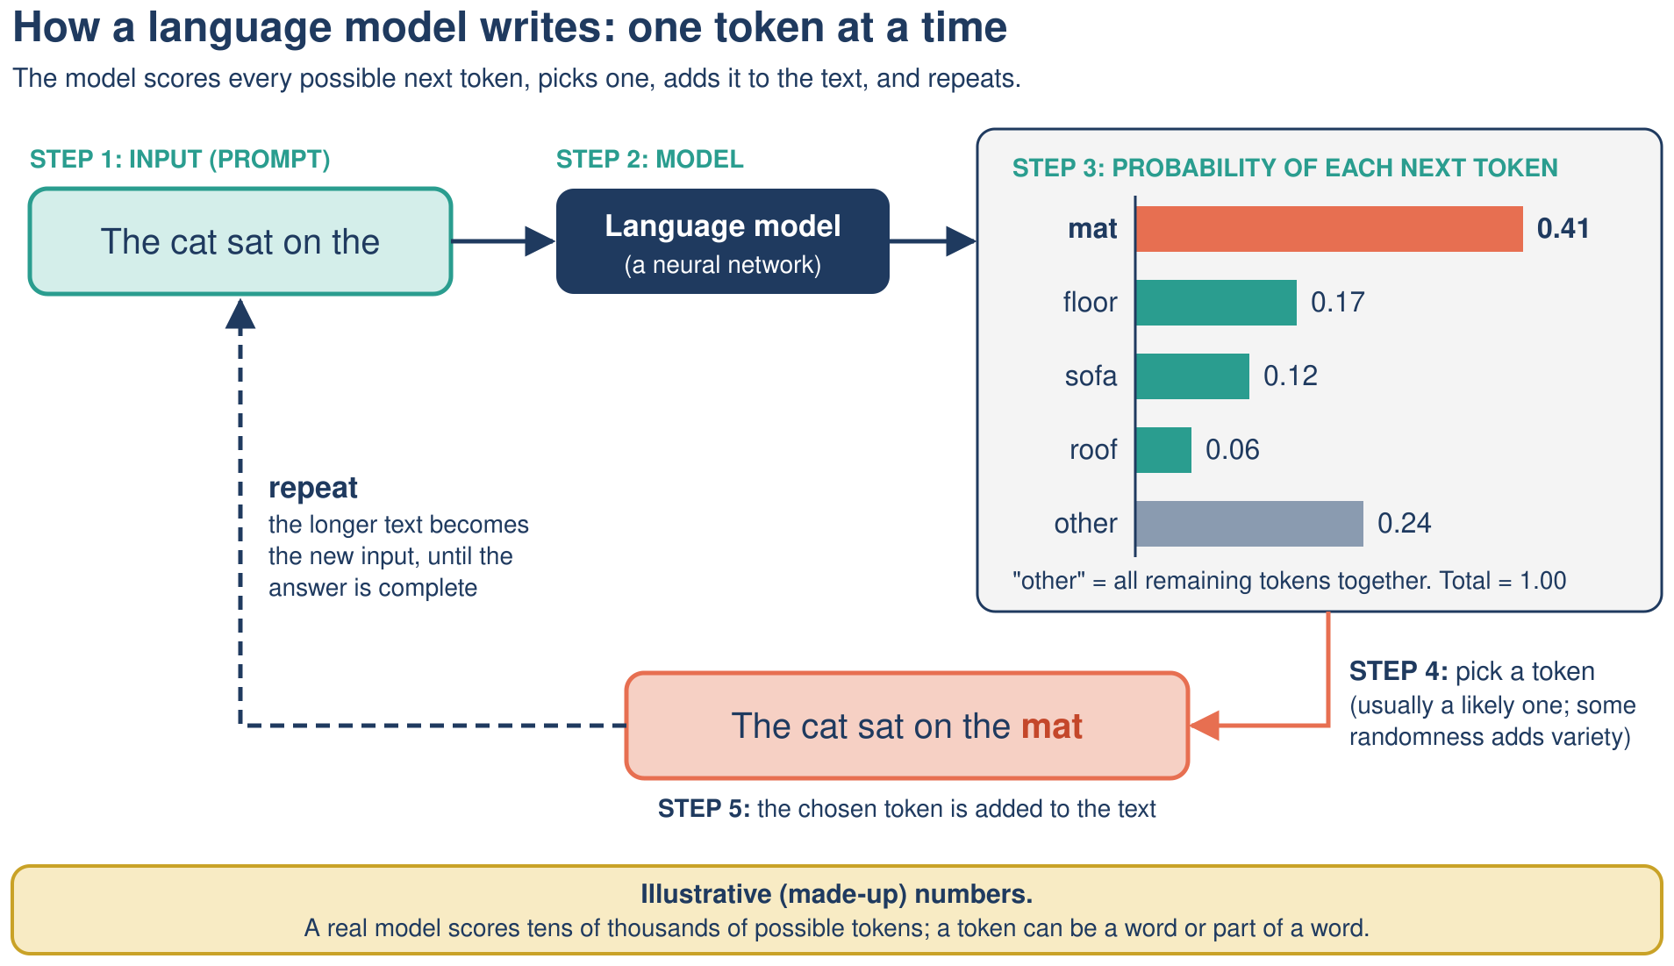
Next-token prediction
EXPLAIN
Probabilities are illustrative (made-up)
Pixel's AI Field Guide · Part 2: Chatbots, Types and History · 6
Notes:
THE LOOP (3 min). Step through slowly:
1) The model reads all the text so far. 2) It gives EVERY possible next token a probability. 3) It chooses one, usually by SAMPLING (a weighted random pick), not always the most likely. 4) It appends the token. 5) It repeats until it produces an end token.
Point at the bars: mat 0.41, floor 0.17, sofa 0.12, roof 0.06, other 0.24 (sum 1.00).
Misconception: the model does not look up a stored answer; it builds the reply piece by piece.

Slide 7
Same prompt, different answers?
PREDICT
• Temperature controls how adventurous the choice is
• Low temperature: "mat" chosen… more often or less often?
• High temperature: what happens to "roof"?
• Vote, then discuss with a neighbor (45 s)
Pixel's AI Field Guide · Part 2: Chatbots, Types and History · 7
Notes:
ACTIVITY (2 min). Let people vote by hand: low temperature -> "mat" more often? Answer on next slide.
Study guide link: Mission 06 Activity 6.2 (next-token spinner and temperature tally with 20 fixed random numbers).

Slide 8
Why outputs vary
DEBRIEF
• Low temperature: sharper odds → "mat" almost every time
• High temperature: flatter odds → "roof" appears more
• Sampling explains why the same prompt gives different replies
• Likely ≠ true: fluent text can be false (hallucination)
Pixel's AI Field Guide · Part 2: Chatbots, Types and History · 8
Notes:
DEBRIEF (2 min). Low temperature = predictable, repetitive; high = varied, surprising, more errors. Outputs can also change because models are updated and because of context.
HALLUCINATION = plausible but false output. It follows directly from the loop: the model produces likely-sounding text and has no built-in fact check. Full treatment in Part 3 (Topic 09).
Practice: test bank Q50-Q59 (Mission 06).

Slide 9
How a chatbot is trained
EXPLAIN
Stage | What happens
1. Pre-training | predict the next token in huge amounts of text
2. Fine-tuning | learn from example prompts and good replies
3. Human feedback (RLHF) | people rank replies; the model is rewarded
InstructGPT (2022): a 1.3B RLHF model beat the 175B GPT-3
Pixel's AI Field Guide · Part 2: Chatbots, Types and History · 9
Notes:
TRAINING (2 min). Pre-training is self-supervised: the real next token in the text is the label, so no one has to label data by hand. Fine-tuning is supervised. RLHF = reinforcement learning from human feedback, linking back to "reinforcement learning" in Part 1.
Point of the caption: how a model is trained matters, not only its size.
Caveat: "almost all of today's prominent generative AI systems use deep learning; earlier generative methods such as Markov-chain text generators (Shannon, 1948) did not." Mission 06 Activity 6.1 lets learners run a Markov-chain generator with cards.

Slide 10
Types of AI
Two different lenses, not one ladder
Pixel's AI Field Guide · Part 2: Chatbots, Types and History · 10

Slide 11
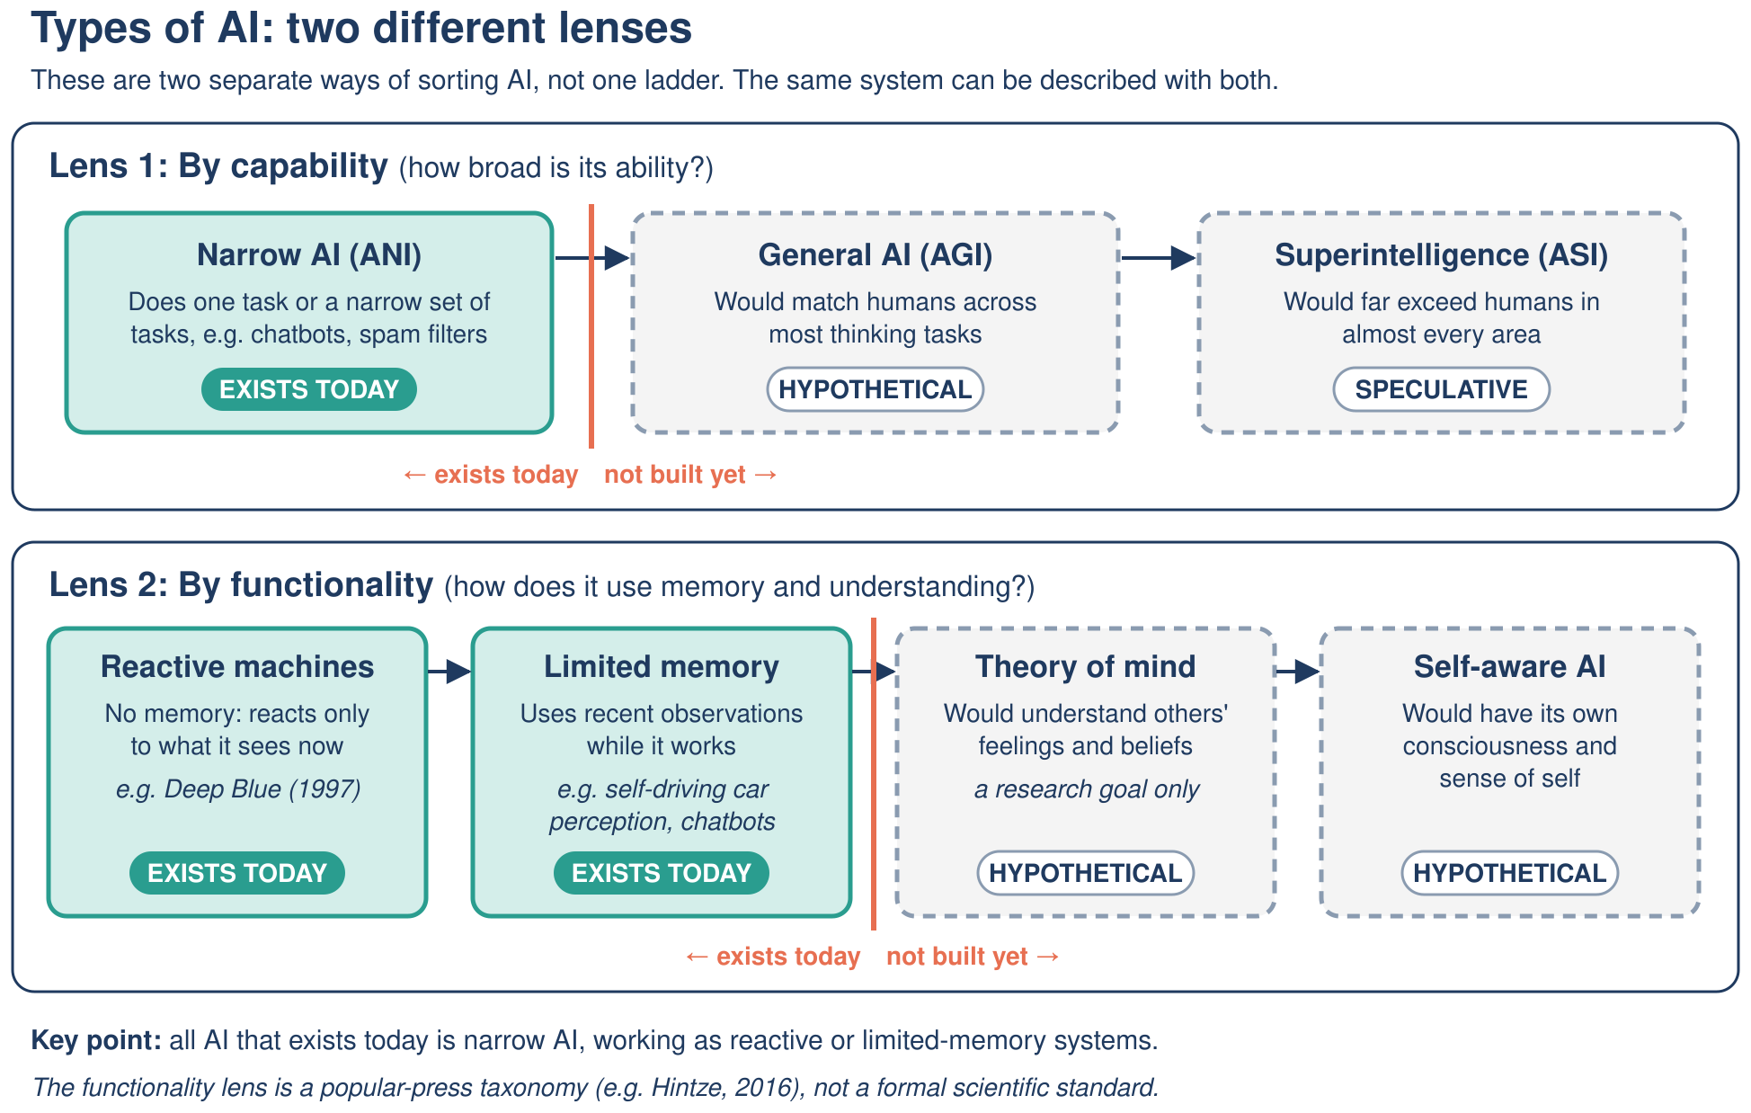
Two ways to classify AI
EXPLAIN
Pixel's AI Field Guide · Part 2: Chatbots, Types and History · 11
Notes:
TWO LENSES (3 min). Analogy: you can sort cars by size AND by fuel type; these are different questions, not one ladder.
Lens 1, capability: narrow AI (ANI, the only kind that exists), general AI (AGI, hypothetical: matching human abilities across any task), superintelligence (ASI, speculative; Bostrom 2014).
Lens 2, functionality (a popular-press taxonomy, Hintze 2016, not a formal scientific standard): reactive machines (e.g. Deep Blue), limited memory (uses recent observations while it works, e.g. a self-driving car tracking nearby cars, a chatbot using the conversation in its context window), theory of mind and self-aware (hypothetical).
Misconception: "memory" here is NOT training data.

Slide 12
Classify a chatbot
PREDICT
• Capability lens: narrow, general or super?
• Functionality lens: reactive or limited memory?
• Write down both answers and one reason each (60 s)
Pixel's AI Field Guide · Part 2: Chatbots, Types and History · 12
Notes:
ACTIVITY (2 min). Answer on the next slide. Expect some people to say "general" because chatbots discuss many topics: that is the misconception to address.

Slide 13
Both lenses at once
DEBRIEF
System | Capability | Functionality
Deep Blue (1997) | narrow | reactive
Self-driving car | narrow | limited memory
Chatbot (LLM) | narrow (debated) | limited memory
Netflix recommender | narrow | disputed
Pixel's AI Field Guide · Part 2: Chatbots, Types and History · 13
Notes:
DEBRIEF (2 min). Chatbot: mainstream view is that current LLMs are NOT AGI; this is debated and there is no agreed test or definition. It uses the conversation so far (context window) -> limited memory.
Netflix: IBM lists recommendations as reactive; others argue limited memory, so learners should justify their choice.
Everything that exists today is narrow AND either reactive or limited memory.
Practice: Mission 07 two-lens card sort; test bank Q60-Q68.

Slide 14
75 years of AI
The start · the failures · the big comeback
Pixel's AI Field Guide · Part 2: Chatbots, Types and History · 14

Slide 15
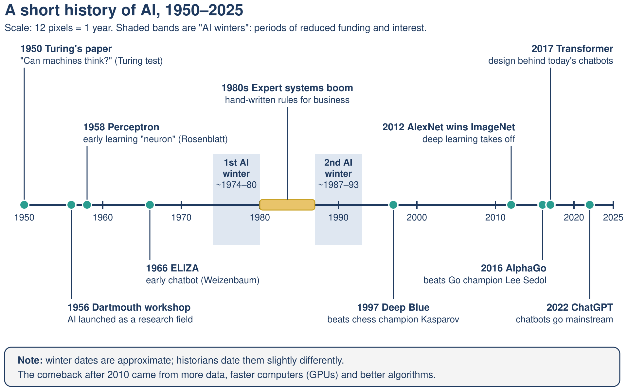
The AI timeline
EXPLAIN
Winter dates are approximate
Pixel's AI Field Guide · Part 2: Chatbots, Types and History · 15
Notes:
OVERVIEW (2 min). Three phases: the Start (1950s-60s), the Failures (two AI winters with the 1980s expert-systems boom between them), the Big Comeback (1997 on; deep learning from 2012). Don't read every date now; the next slides zoom in.

Slide 16
The start: big ideas, big promises
EXPLAIN
Year | Milestone
1950 | Turing asks "Can machines think?" (imitation game)
1955 | Dartmouth proposal coins "artificial intelligence"
1956 | Dartmouth workshop; Logic Theorist proves theorems
1958 | Rosenblatt's perceptron (a learning neuron)
1966 | Weizenbaum's ELIZA chatbot
Pixel's AI Field Guide · Part 2: Chatbots, Types and History · 16
Notes:
THE START (3 min). Correction to a common error: the term "artificial intelligence" first appears in the August 1955 proposal (McCarthy, Minsky, Rochester, Shannon); the workshop took place in summer 1956.
The perceptron is the neuron from Part 1. Newspapers hyped it as a machine that would one day be conscious.
ELIZA (1966) used simple pattern matching with its DOCTOR script, yet people felt understood: the "ELIZA effect".
Optional demo: ELIZA web version listed in ../task-2/study-guide/resources.md (Mission 08 Activity 8.2 has test inputs and a fallback). Type "I am worried about my exams" and show that it reflects your words back without understanding.

Slide 17
The failures: two AI winters
EXPLAIN
• ~1974–1980: promises outran results; funding cut (Lighthill report, 1973)
• Problems: too many states to search; single-layer perceptrons were limited (1969)
• 1980s boom: expert systems such as XCON saved companies millions
• ~1987–1993: expert systems proved brittle and costly; market collapsed
Pixel's AI Field Guide · Part 2: Chatbots, Types and History · 17
Notes:
WINTERS (3 min). An AI winter = a period of reduced funding and interest. Causes: over-promising, technical limits (combinatorial explosion from Part 1's search; Minsky & Papert's Perceptrons, 1969, showed single-layer limits such as XOR), and cost.
XCON (DEC, from 1980) configured computer orders; savings estimates range from about $25M to $40M a year. Expert systems could not learn and broke outside their rules; the Lisp-machine market collapsed in 1987.
1986: backpropagation popularized (Rumelhart, Hinton, Williams) - neural networks quietly improved.

Slide 18
Deep Blue beats Kasparov (1997)
PREDICT
Did Deep Blue learn chess, or search?
Use Part 1: rules + search, or learning from examples?
Pixel's AI Field Guide · Part 2: Chatbots, Types and History · 18
Notes:
ACTIVITY (1 min). Hand vote. Most people guess "learned".
Answer next slide: it searched, about 200 million positions per second, using rules and evaluation written with experts; it was not machine learning.

Slide 19
The big comeback
DEBRIEF
Year | Milestone | Approach
1997 | Deep Blue beats Kasparov 3.5–2.5 | search
2012 | AlexNet: 15.3% vs 26.2% error on ImageNet | deep learning
2016 | AlphaGo beats Lee Sedol 4–1 | deep learning + RL + search
2017 | Transformer architecture | deep learning
2022 | ChatGPT released (30 Nov) | LLM
Pixel's AI Field Guide · Part 2: Chatbots, Types and History · 19
Notes:
DEBRIEF + COMEBACK (3 min). Deep Blue = search, not ML. AlexNet (about 60 million weights, trained on GPUs) cut the top-5 error from 26.2% to 15.3% and launched the deep-learning era. AlphaGo combined deep neural networks, reinforcement learning and search (famous move 37). The transformer (2017, "Attention Is All You Need") underlies today's LLMs.
Practice: Mission 08 timeline card sort; test bank Q69-Q78.

Slide 20
Why did AI explode now?
TAKEAWAY
• Neural networks existed since 1958
• They waited for three ingredients at once:
• Data (the internet) · Compute (GPUs) · Better algorithms
• Hype pattern: breakthrough → big promises → hard limits → winter?
Pixel's AI Field Guide · Part 2: Chatbots, Types and History · 20
Notes:
FINALE (3 min). The "best for last" insight: the comeback was not a sudden invention. The 1958 neuron idea needed huge datasets, GPU computing power and better training methods, all strong at the same time around 2012.
Hype cycle lesson (Topic 06): breakthrough -> over-generalized promises -> hard limits -> winter, unless the technology delivers real value (then a steady phase).
Discussion (90 s, neighbors): "A start-up says its AI will replace all doctors by next year. Which warning signs from history do you see?" Expected: sweeping promise, short timeline, one success generalized to everything, no evidence on real patients.

Slide 21
Answering the opening
TAKEAWAY
• A chatbot writes by predicting the next token, again and again
• Trained on huge text, then fine-tuned with human feedback
• It is narrow AI with limited memory (mainstream view)
• Built on 70 years of ideas, data and compute
Pixel's AI Field Guide · Part 2: Chatbots, Types and History · 21
Notes:
CONCLUSION (2 min). Link back to "The cat sat on the ___": the audience predicted a likely word; an LLM does the same with probabilities over tokens and sampling. Because "likely" is not "true", chatbots can hallucinate, which leads into Part 3.

Slide 22
Next steps
NEXT STEPS
• Study guide: Missions 06–08
• Practice: test bank Q50–Q78
• Watch: 3Blue1Brown "Large Language Models explained briefly"
• Next session: AI in the world: uses, harms and rules
Pixel's AI Field Guide · Part 2: Chatbots, Types and History · 22
Notes:
NEXT STEPS (1 min). Files (relative to result/task-3/):
- ../task-2/study-guide/mission-06-the-word-guessing-machine.md, mission-07-sorting-the-robots.md, mission-08-time-machine.md
- ../task-2/test-bank/test-bank.md, Missions 06-08 (Q50-Q78)
- Video V6 (3Blue1Brown, "Large Language Models explained briefly") and V5 (Crash Course AI #3) are introduced with viewing questions in ../task-2/study-guide/resources.md
- Video scripts V04 (next-token loop), V05 (two lenses), V06 (timeline): ../task-1/formats/video-scripts/video-scripts.md

