Slide 1
Part 3: Who Is Responsible When AI Gets It Wrong?
Pixel's AI Field Guide · Live session 3 of 3
Topics 07–10 · about 60 minutes
Pixel's AI Field Guide · Part 3: AI in the World · 1
Notes:
WELCOME (1 min). Recap: Part 1 = how machines learn; Part 2 = how chatbots write (next-token prediction, hallucination) and AI's history. Today: real applications, ethical risks, limitations and myths, and the rules being written.

Slide 2
A real court case (2023)
MISSION BRIEF
A lawyer filed a brief citing six court cases found with ChatGPT. None of them existed.
Who is responsible: the lawyer, the chatbot, or its maker?
Pixel's AI Field Guide · Part 3: AI in the World · 2
Notes:
OPENING (2 min). Case: Mata v. Avianca (US federal court, June 2023). The lawyers were sanctioned $5,000. Ask for hands for each option; don't resolve yet.
Resolution at the end: the human user stays accountable for checking AI output; makers and regulators also carry responsibilities, which is what the new rules address.

Slide 3
Today's route
EXPLAIN
• 1. AI at work A six-part way to analyze any application
• 2. What can go wrong Bias, jobs, privacy and more
• 3. Limits and myths Why AI makes things up
• 4. The rules The EU AI Act and the AGI debate
Pixel's AI Field Guide · Part 3: AI in the World · 3
Notes:
ROADMAP (1 min). Goals LO6-LO9: analyze applications; discuss ethical risks with evidence; correct misconceptions and check for hallucinations; classify systems into EU AI Act risk tiers and explain the AGI debate fairly.

Slide 4
Analyze any AI application
EXPLAIN
Ask | Example: film recommender
Input | your ratings and viewing history
Output | a ranked list of films
AI type | machine learning
Benefit / risk | find films fast / filter bubbles, privacy
Human oversight | low stakes: little needed
Pixel's AI Field Guide · Part 3: AI in the World · 4
Notes:
FRAMEWORK (3 min). Six parts: input, output, AI type (rule-based / ML / deep learning / generative), benefit, risk, human oversight. Rule: the higher the stakes of an error, the more human oversight is needed.
Netflix (company figures, 2015 paper): the recommender influences about 80% of hours streamed.
How a recommender works: collaborative filtering = "people with similar taste liked this". Mission 09 Activity 9.1 traces one by hand.

Slide 5
Should Sam watch Film D?
TRY IT
User | Film A | Film B | Film C | Film D
Sam | 5 | 4 | 1 | ?
Priya | 5 | 5 | 1 | 5
Leo | 1 | 2 | 5 | 1
Whose taste is closest to Sam's? · illustrative (made-up) ratings
Pixel's AI Field Guide · Part 3: AI in the World · 5
Notes:
ACTIVITY (2 min). Ask: add up the rating differences on Films A-C. Sam vs Priya: 0 + 1 + 0 = 1. Sam vs Leo: 4 + 2 + 4 = 10. Priya is most similar and rated Film D 5 -> recommend Film D.
Risk to raise: a brand-new film nobody has rated cannot be recommended (cold-start problem), so popular items get more popular.
Source: Topic 07 Worked example.

Slide 6
Rank by stakes
PREDICT
• A. Song recommendations
• B. Navigation app route
• C. AI eye-disease screening
• D. Self-driving taxi
• Order from lowest to highest stakes. How much human checking does each need?
Pixel's AI Field Guide · Part 3: AI in the World · 6
Notes:
ACTIVITY (2 min). Neighbors agree on an order (60 s). Answer on the next slide.

Slide 7
Higher stakes, more oversight
DEBRIEF
• A → B → C / D: annoyance → delay → health and life
• Eye screening: IDx-DR (2018), ~87% sensitivity, ~90% specificity
• Self-driving: Uber test car killed a pedestrian (Tempe, 2018)
• Ask: who checks the AI, and who answers for errors?
Pixel's AI Field Guide · Part 3: AI in the World · 7
Notes:
DEBRIEF (2 min). C and D can be argued either way at the top; what matters is the reasoning about the consequence of an error.
IDx-DR (April 2018) was the first FDA-authorized autonomous AI screening system (diabetic retinopathy). Sensitivity = share of real cases caught; specificity = share of healthy people correctly cleared.
Uber, Tempe, March 2018: the NTSB found late detection, a distracted safety driver and poor safety culture -> accountability.
Waymo publishes safety figures; they are company-reported, so treat with care.
Practice: test bank Q79-Q86.

Slide 8
What can go wrong?
Bias · privacy · jobs · accountability · environment · misinformation
Pixel's AI Field Guide · Part 3: AI in the World · 8

Slide 9
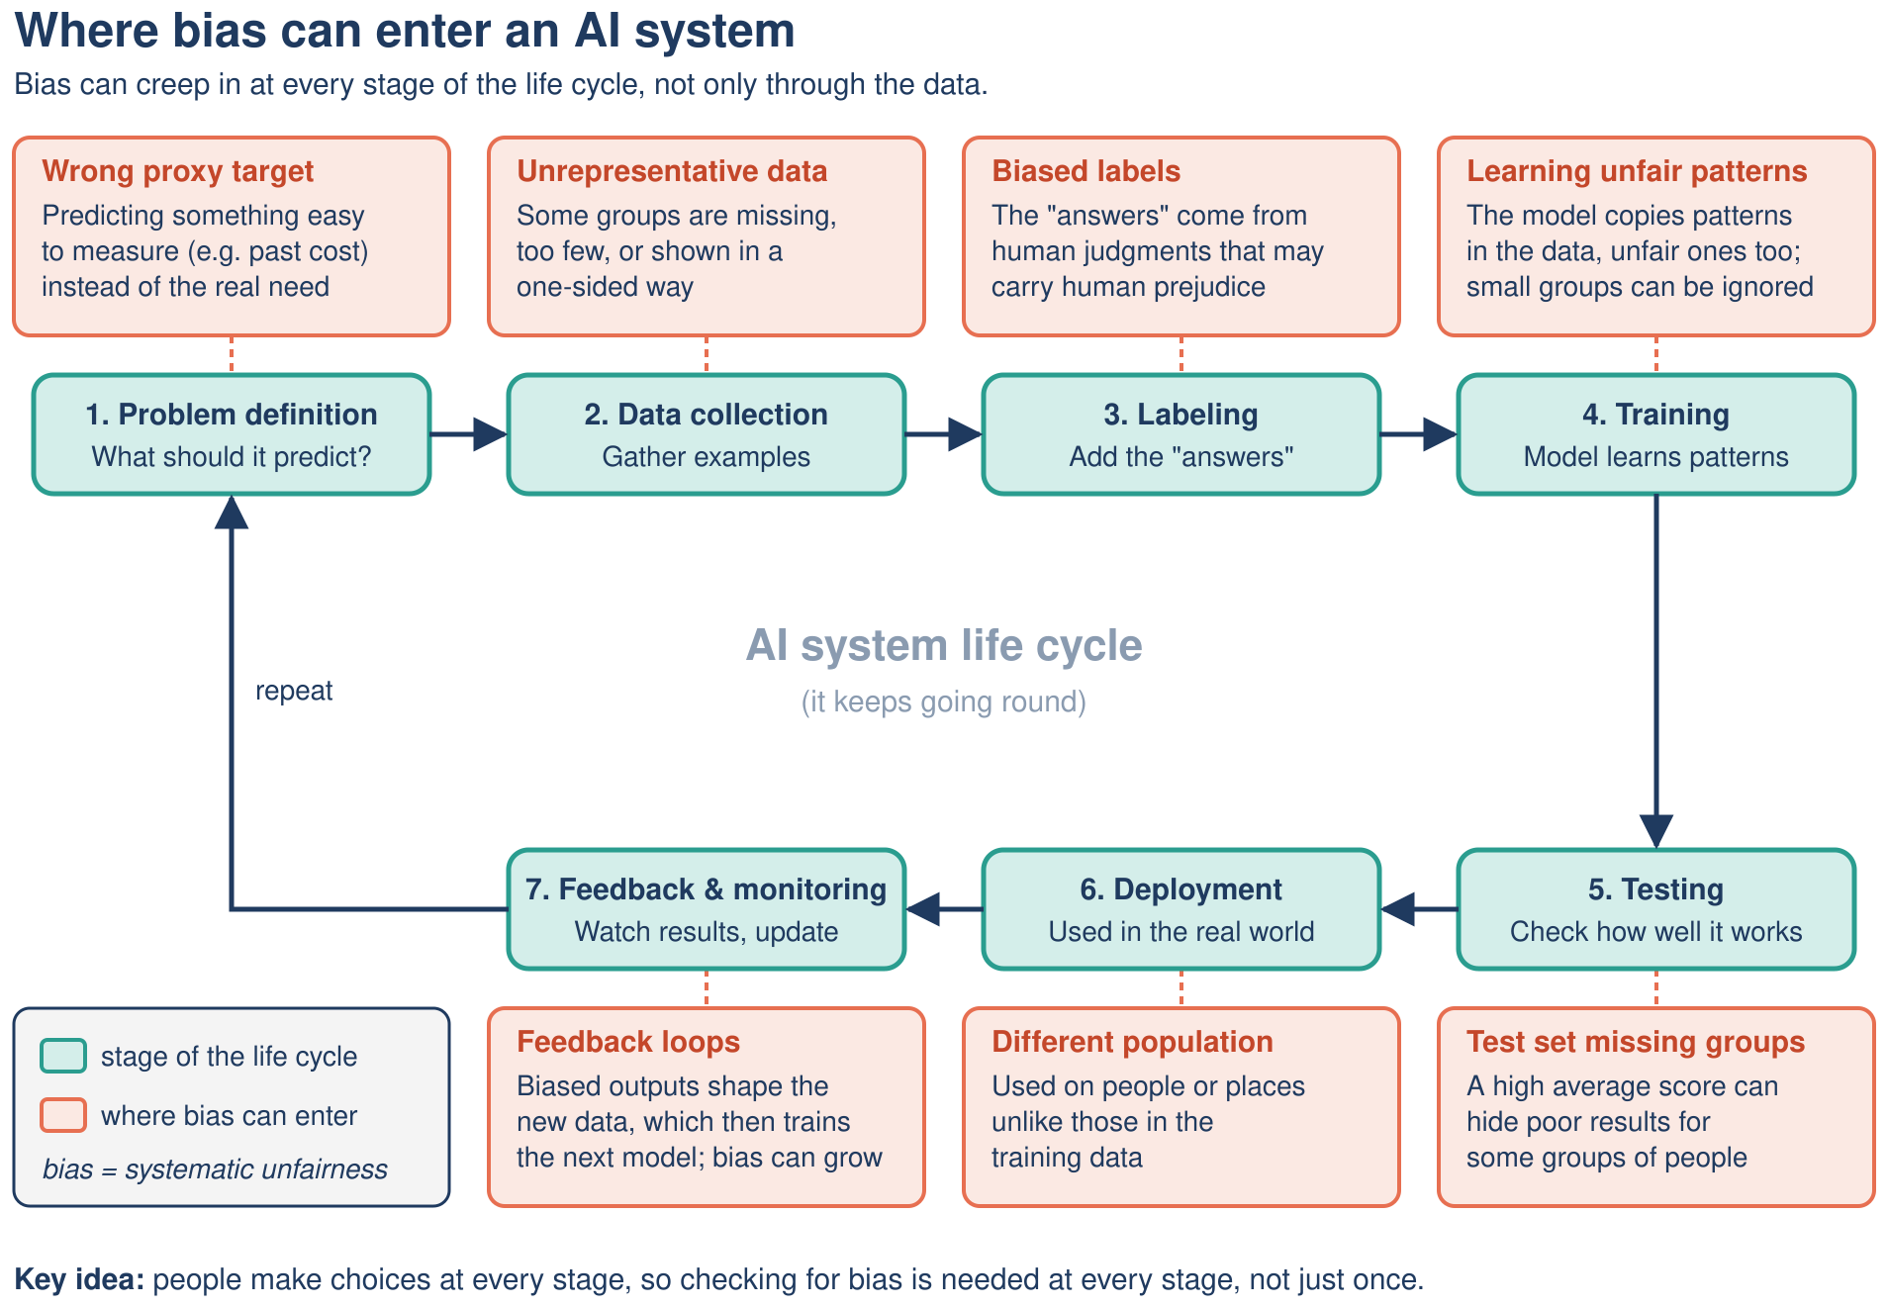
Where bias gets in
EXPLAIN
Pixel's AI Field Guide · Part 3: AI in the World · 9
Notes:
BIAS LIFE CYCLE (3 min). Bias can enter at every stage: wrong proxy target (problem definition), unrepresentative data, biased labels, the model learning unfair patterns or ignoring small groups, a test set missing groups, use on a different population, feedback loops.
Examples: Amazon's experimental hiring tool penalized CVs containing "women's" (Reuters 2018); a US healthcare algorithm used cost as a proxy for need and under-served Black patients (Obermeyer et al., 2019).
Link to Part 1: a model learns whatever patterns are in its training data.

Slide 10
Gender Shades (2018)
EXPLAIN
Group | Highest error rate
Lighter-skinned men | 0.8%
Darker-skinned women | 34.7%
1,270 parliamentarians · Buolamwini & Gebru, 2018
Pixel's AI Field Guide · Part 3: AI in the World · 10
Notes:
CASE (2 min). Joy Buolamwini and Timnit Gebru tested gender classifiers from IBM, Microsoft and Face++ on photos of 1,270 parliamentarians from three African and three European countries. Error rates reached 34.7% for darker-skinned women compared with at most 0.8% for lighter-skinned men.
Lesson: one overall accuracy number can hide big differences; test results separately for each group (disaggregated evaluation).
Video: V9 Joy Buolamwini TED talk, introduced in ../task-2/study-guide/resources.md.

Slide 11
Unbalanced training data
PREDICT
• Teachable Machine: train to recognize two people
• Person A: 50 photos · Person B: 5 photos
• Who gets misrecognized more often? Why?
Pixel's AI Field Guide · Part 3: AI in the World · 11
Notes:
ACTIVITY (2 min). Hand vote: A or B?
Answer: usually person B, because the model has seen far fewer examples of B and tends to favor the class it saw more often. This is a typical tendency, not a guarantee: results vary by photos, lighting and backgrounds.
Live option (webcam + internet, no account): Teachable Machine image project (https://teachablemachine.withgoogle.com/); Mission 10 Activity 10.2 has exact steps and a made-up fallback results table. Use volunteers only with consent.

Slide 12
Jobs: find the error
CHECK
• Claim: "The WEF says AI will destroy 92 million jobs by 2030."
• Report (2025): 170M jobs created, 92M displaced, net +78M
• What is wrong with the claim? What does "net" hide?
Pixel's AI Field Guide · Part 3: AI in the World · 12
Notes:
ACTIVITY (2 min). Expected answers: (1) 92M is displacement, not the net change; the same report projects 170M new jobs, net +78M (2025-2030). (2) The figures cover several drivers, not only AI. (3) "Net" hides real hardship: the displaced workers are not automatically the people who get the new jobs, so retraining matters.
Source: WEF Future of Jobs Report 2025 (more than 1,000 employers, 14 million workers, 55 economies). This corrects the "91 million" figure in an earlier draft of the module.

Slide 13
Three more risks, three real cases
EXPLAIN
Risk | Case
Privacy | Clearview AI fined €30.5M by the Dutch regulator (2024)
Deepfake fraud | Arup staff tricked by a deepfake video call: HK$200M (~US$25M), 2024
Environment | IEA: data-center electricity to ~945 TWh by 2030 (more than double)
Pixel's AI Field Guide · Part 3: AI in the World · 13
Notes:
RISKS (2 min). Clearview AI scraped billions of face images from the internet to build a face-recognition database. Arup (Hong Kong, January 2024): an employee joined a video call where every other participant was a deepfake. IEA (April 2025): data-center electricity use projected to more than double to about 945 TWh by 2030, more than Japan uses today.
Full case analysis method (7 steps: describe, stakeholders, benefits, harms, evidence, safeguards, judgment): Mission 10 Activity 10.3; Topic 08.

Slide 14
Limits and myths
Why AI makes things up, and what it is not
Pixel's AI Field Guide · Part 3: AI in the World · 14

Slide 15
Why chatbots hallucinate
EXPLAIN
• An LLM predicts likely text, not checked facts
• Rare facts → plausible inventions (names, dates, citations)
• Training often rewards a confident guess over "I don't know"
• It is not lying: there is no intent
Pixel's AI Field Guide · Part 3: AI in the World · 15
Notes:
HALLUCINATION (2 min). Link to Part 2's next-token loop. Kalai et al. (2025) argue that training and benchmarks reward guessing. Mitigations: grounding the model in retrieved documents (RAG), and checking sources yourself.
This explains the opening case: the fake citations looked exactly like real ones.

Slide 16
Spot the hallucinations
TRY IT
• A chatbot says:
• 1. "ELIZA was created by Alan Turing in 1956."
• 2. "ChatGPT was released in November 2022."
• 3. "Deep Blue learned chess from millions of games."
• Which claims are false? Use Part 2.
Pixel's AI Field Guide · Part 3: AI in the World · 16
Notes:
ACTIVITY (2 min). 60 seconds, neighbors. Answer next slide.

Slide 17
The four-step check
DEBRIEF
• False: ELIZA = Weizenbaum, 1966 · Deep Blue = search
• True: ChatGPT, 30 November 2022
• 1 Split into claims → 2 Prioritize risky ones
• 3 Verify independently → 4 Decide or rewrite
Pixel's AI Field Guide · Part 3: AI in the World · 17
Notes:
DEBRIEF (2 min). The four-step routine from Topic 09. Emphasize step 3: check against an independent, reliable source, not by asking the same chatbot.
Practice: Mission 11 Activity 11.2 (with a supplied fact box); test bank Q97-Q105.

Slide 18
Myth or fact?
EXPLAIN
Myth | Better statement
AI is alive or conscious | no evidence; it imitates human-like text
AI is always objective | it learns biases in its data
AI will take all jobs | it changes tasks; jobs are both lost and created
Confident means correct | fluent output can be false
Pixel's AI Field Guide · Part 3: AI in the World · 18
Notes:
MISCONCEPTIONS (2 min). Six misconceptions in Topic 09; four shown here. The other two: "AI understands like humans" (debated; judge systems by reliability, not by how human they sound) and "more data always fixes it" (the right data and the right target matter).
Pixel's line from Mission 11: "I said it confidently, so it must be true!" Dr. Ada: "Confidence is a tone of voice, not evidence."

Slide 19
The rules
The EU AI Act and the AGI debate
Pixel's AI Field Guide · Part 3: AI in the World · 19

Slide 20
EU AI Act: four risk tiers
EXPLAIN
Tier | Meaning | Example
Unacceptable | banned | social scoring
High | strict duties | hiring, credit, exam scoring
Transparency | must tell people | chatbots, deepfake labels
Minimal | no new duties | spam filters, games
Pixel's AI Field Guide · Part 3: AI in the World · 20
Notes:
EU AI ACT (3 min). Regulation (EU) 2024/1689, in force 1 August 2024; applies to anyone placing or using AI in the EU. It is risk-based: the stricter the risk, the stricter the rules. There are separate rules for general-purpose AI models. Fines up to EUR 35M or 7% of worldwide turnover for banned practices.
Banned practices include social scoring, emotion recognition in workplaces and schools, and untargeted scraping of faces to build databases.
Other frameworks: OECD AI Principles (2019, updated 2024) and UNESCO Recommendation on the Ethics of AI (2021) are non-binding; the Council of Europe Framework Convention (2024) is the first legally binding international AI treaty.

Slide 21
Which tier?
PREDICT
• A. Emotion recognition used in a school classroom
• B. CV-screening tool for hiring
• C. Customer-service chatbot
• D. Email spam filter
Pixel's AI Field Guide · Part 3: AI in the World · 21
Notes:
ACTIVITY (2 min). Neighbors classify each (60 s). Ask for a show of fingers 1-4 for each system (1 = unacceptable ... 4 = minimal). Answer on next slide.

Slide 22
Tiers and dates
DEBRIEF
System | Tier | Rules apply from
A. School emotion recognition | unacceptable | 2 Feb 2025
B. CV screening | high | 2 Dec 2027
C. Chatbot | transparency | 2 Aug 2026
D. Spam filter | minimal | no new duties
High-risk dates changed in 2026: re-check before teaching
Pixel's AI Field Guide · Part 3: AI in the World · 22
Notes:
DEBRIEF (2 min). Timeline (Topic 10): bans and AI-literacy duty from 2 Feb 2025; general-purpose AI model rules from 2 Aug 2025; general application including transparency from 2 Aug 2026; high-risk rules for stand-alone uses such as hiring, credit and education from 2 Dec 2027 (originally 2 Aug 2026) and for AI built into regulated products such as medical devices from 2 Aug 2028 (originally 2 Aug 2027).
UNCERTAINTY: the 2026 Digital Omnibus amendment is very recent (political agreement May 2026, in force 27 July 2026 per the Commission). Check the official EU pages before each teaching period.
Practice: Mission 12 Activities 12.1-12.2; test bank Q106-Q115.

Slide 23
AGI: what do experts actually say?
EXPLAIN
• No agreed definition, no agreed test
• Mainstream view: today's LLMs are not AGI (debated)
• 2023 survey of 2,778 researchers: 50% chance by 2047 machines beat humans at every task
• Huge disagreement: treat dates as opinions, not facts
Pixel's AI Field Guide · Part 3: AI in the World · 23
Notes:
AGI (3 min). Survey: Grace et al. (published 2024): 10% chance by 2027 and 50% by 2047 that unaided machines outperform humans at every task; 13 years earlier than the previous survey; wide spread of answers. Google DeepMind's "Levels of AGI" (Morris et al., 2023) rated 2023 chatbots as "Emerging AGI" on its own scale, showing that definitions change the answer.
Four viewpoints to present fairly: AGI is coming soon; current methods are not enough; prepare now for serious risks; focus on today's harms first.
Link to Part 2's hype pattern: predictions about AI have often been wrong in both directions.

Slide 24
Back to the courtroom
TAKEAWAY
• The human user stayed responsible for checking
• Makers and deployers carry duties too: that is what the rules add
• The chatbot did what LLMs do: produce likely, not true, text
• Your job: match trust to stakes, and verify
Pixel's AI Field Guide · Part 3: AI in the World · 24
Notes:
CONCLUSION (3 min). Resolve the opening: the court held the lawyers responsible; AI does not remove human accountability. The EU AI Act adds duties for providers and deployers, such as transparency for chatbots.
Pull the three sessions together: (1) machine learning learns patterns from data and must be tested on new data; (2) generative AI predicts likely tokens, so it can hallucinate; (3) the same learning from data can copy bias, so we analyze stakes, test by group and keep humans in charge.

Slide 25
Your AI-literacy checklist
TAKEAWAY
• Verify important claims with independent sources
• Match trust to stakes: more checking when errors hurt
• Protect privacy: think before you upload
• Disclose when you used AI; watch for deepfakes
Pixel's AI Field Guide · Part 3: AI in the World · 25
Notes:
FINAL TAKEAWAY (1 min). From Topic 10's AI-literacy checklist (also: ask governance questions; keep learning). Invite the audience to pick one habit to start this week.

Slide 26
Next steps
NEXT STEPS
• Study guide: Missions 09–12 + the final capstone
• Practice: test bank Q79–Q115
• Capstone: review the fictional product "MarkMate"
• Whole series: missions 01–12 · 115 practice questions
Pixel's AI Field Guide · Part 3: AI in the World · 26
Notes:
NEXT STEPS (1 min). Files (relative to result/task-3/):
- ../task-2/study-guide/mission-09-ai-in-the-wild.md, mission-10-the-fairness-files.md, mission-11-myth-busters.md, mission-12-tomorrows-rulebook.md (ends with the capstone, model answer and rubric)
- ../task-2/test-bank/test-bank.md (Q79-Q115; answer key at the end)
- Videos V9 (Joy Buolamwini, TED), V11 (Janelle Shane, TED, humorous), V12 (Code.org, privacy and the future of work): ../task-2/study-guide/resources.md
- Video scripts V07-V10: ../task-1/formats/video-scripts/video-scripts.md

