Slide 1
Spark
COMP 8150
Deepak Venugopal
Some Slides from Zaharia et al. AMPLAB Berkeley and Aditya Akella, UW-Madison

Slide 2
Resilient Distributed Datasets (NSDI 2012)
A Fault-Tolerant Abstraction for In-Memory Cluster Computing

Slide 3
Project Goals
Extend the MapReduce model to better support two common classes of analytics apps:
Iterative algorithms (machine learning, graphs)
Interactive data mining
Enhance programmability:
Integrate into Scala programming language
Allow interactive use from Scala interpreter
Notes:
Point out that Scala is a modern PL etc
Mention DryadLINQ (but we go beyond it with RDDs)
Point out that interactive use and iterative use go hand in hand because both require small tasks and dataset reuse

Slide 4
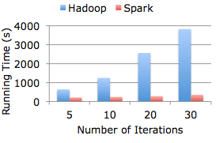
History
Developed by AMPLAB at UC-Berkeley
Read paper A Fault-Tolerant Abstraction for In-Memory Cluster Computing (NSDI 2012)

Slide 5
Motivation
MapReduce greatly simplified “big data” analysis on large, unreliable clusters
But as soon as it got popular, users wanted more:
More complex, multi-stage applications (e.g. iterative machine learning & graph processing)
More interactive ad-hoc queries
Response: specialized frameworks for some of these apps (e.g. Pregel for graph processing)
Notes:
We all know that MapReduce and related models had huge adoption for data mining
But as soon as people started putting data into them, they wanted to do more

Slide 6
Motivation
Complex apps and interactive queries both need one thing that MapReduce lacks:
Efficient primitives for data sharing
In MapReduce, the only way to share data across jobs is stable storage ➔ slow!

Slide 7
Examples
HDFS read
HDFS write
HDFS read
HDFS write
iter. 1
iter. 2
. . .
Input
HDFS read
query 1
result 1
query 2
result 2
query 3
result 3
Input
. . .
Slow due to replication and disk I/O, but necessary for fault tolerance
Notes:
Emphasize that the overhead of replication and disk IO from HDFS comes from FT

Slide 8
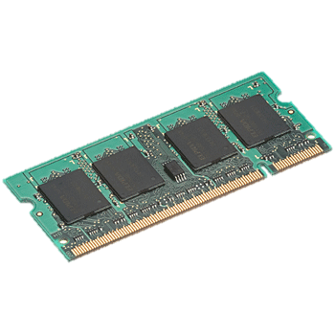
Goal: In-Memory Data Sharing
iter. 1
iter. 2
. . .
Input
query 1
one-time processing
query 2
query 3
Input
. . .
10-100× faster than network/disk, but how to get FT?

Slide 9
Challenge
How to design a distributed memory abstraction that is both fault-tolerant and efficient?

Slide 10
Approach 1: Fine-grained
E.g., Piccolo (Others: RAMCloud; DSM)
Distributed Shared Table
Implemented as an in-memory (dist) key-value store

Slide 11
Resilient Distributed Datasets (RDDs)
Restricted form of distributed shared memory
Immutable, partitioned collections of records
Can only be built through coarse-grained deterministic transformations (map, filter, join, …)
Efficient fault recovery using lineage
Log one operation to apply to many elements
Recompute lost partitions on failure
No cost if nothing fails
Notes:
Define RDDs more precisely here!

Slide 12
Working With RDDs
textFile = sc.textFile(”SomeFile.txt”)
RDD
RDD
Action
RDD
Transformations
RDD
Value
linesWithSpark.count()
74
linesWithSpark.first()
# Apache Spark
linesWithSpark = textFile.filter(lambda line: "Spark” in line)
Notes:
Let me illustrate this with some bad powerpoint diagrams and animations
This diagram is LOGICAL,

Slide 13

Example: Log Mining
Load error messages from a log into memory, then interactively search for various patterns
Base RDD
Transformed RDD
Cache 1
lines = spark.textFile(“hdfs://...”)
errors = lines.filter(lambda s: s.startswith(“ERROR”))
messages = errors.map(lambda s: s.split(“\t”)[2])
messages.cache()
results
Worker
tasks
Block 1
Driver
Action
messages.filter(lambda s: “mysql” in s).count()
Cache 2
messages.filter(lambda s: “php” in s).count()
Worker
Cache 3
. . .
Full-text search of Wikipedia
60GB on 20 EC2 machine
0.5 sec vs. 20s for on-disk
Worker
Block 2
Block 3
Notes:
Add “variables” to the “functions” in functional programming

Slide 14
Scaling Down
Notes:
Gracefully

Slide 15
Fault Recovery
RDDs track lineage information that can be used to efficiently recompute lost data
msgs = textFile.filter(lambda s: s.startsWith(“ERROR”))
.map(lambda s: s.split(“\t”)[2])
HDFS File
Filtered RDD
Mapped RDD
filter (func = startsWith(…))
map (func = split(...))

Slide 16
Language Support
Python
lines = sc.textFile(...) lines.filter(lambda s: “ERROR” in s).count()
Standalone Programs
Python, Scala, & Java
Interactive Shells
Python & Scala
Performance
Java & Scala are faster due to static typing
…but Python is often fine
Scala
val lines = sc.textFile(...) lines.filter(x => x.contains(“ERROR”)).count()
Java
JavaRDD<String> lines = sc.textFile(...); lines.filter(new Function<String, Boolean>() { Boolean call(String s) { return s.contains(“error”); } }).count();

Slide 17
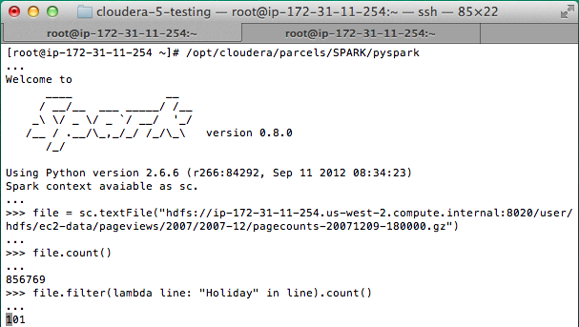
Interactive Shell
The Fastest Way to Learn Spark
Available in Python and Scala
Runs as an application on an existing Spark Cluster…
OR Can run locally
Notes:
The barrier to entry for working with the spark API is minimal

Slide 18
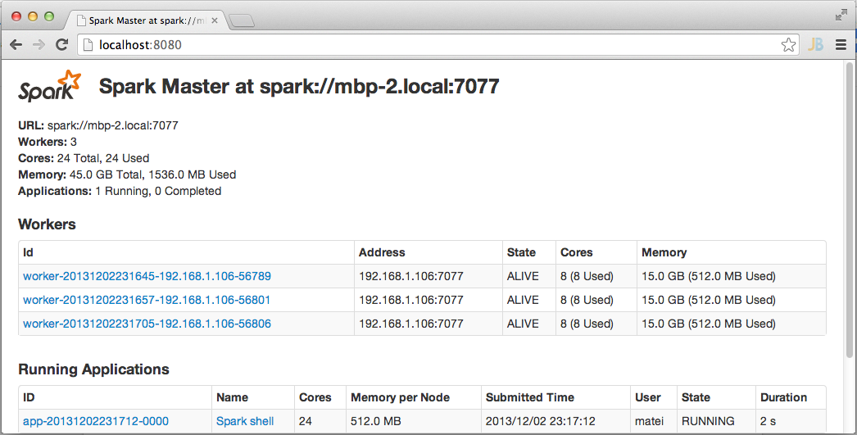
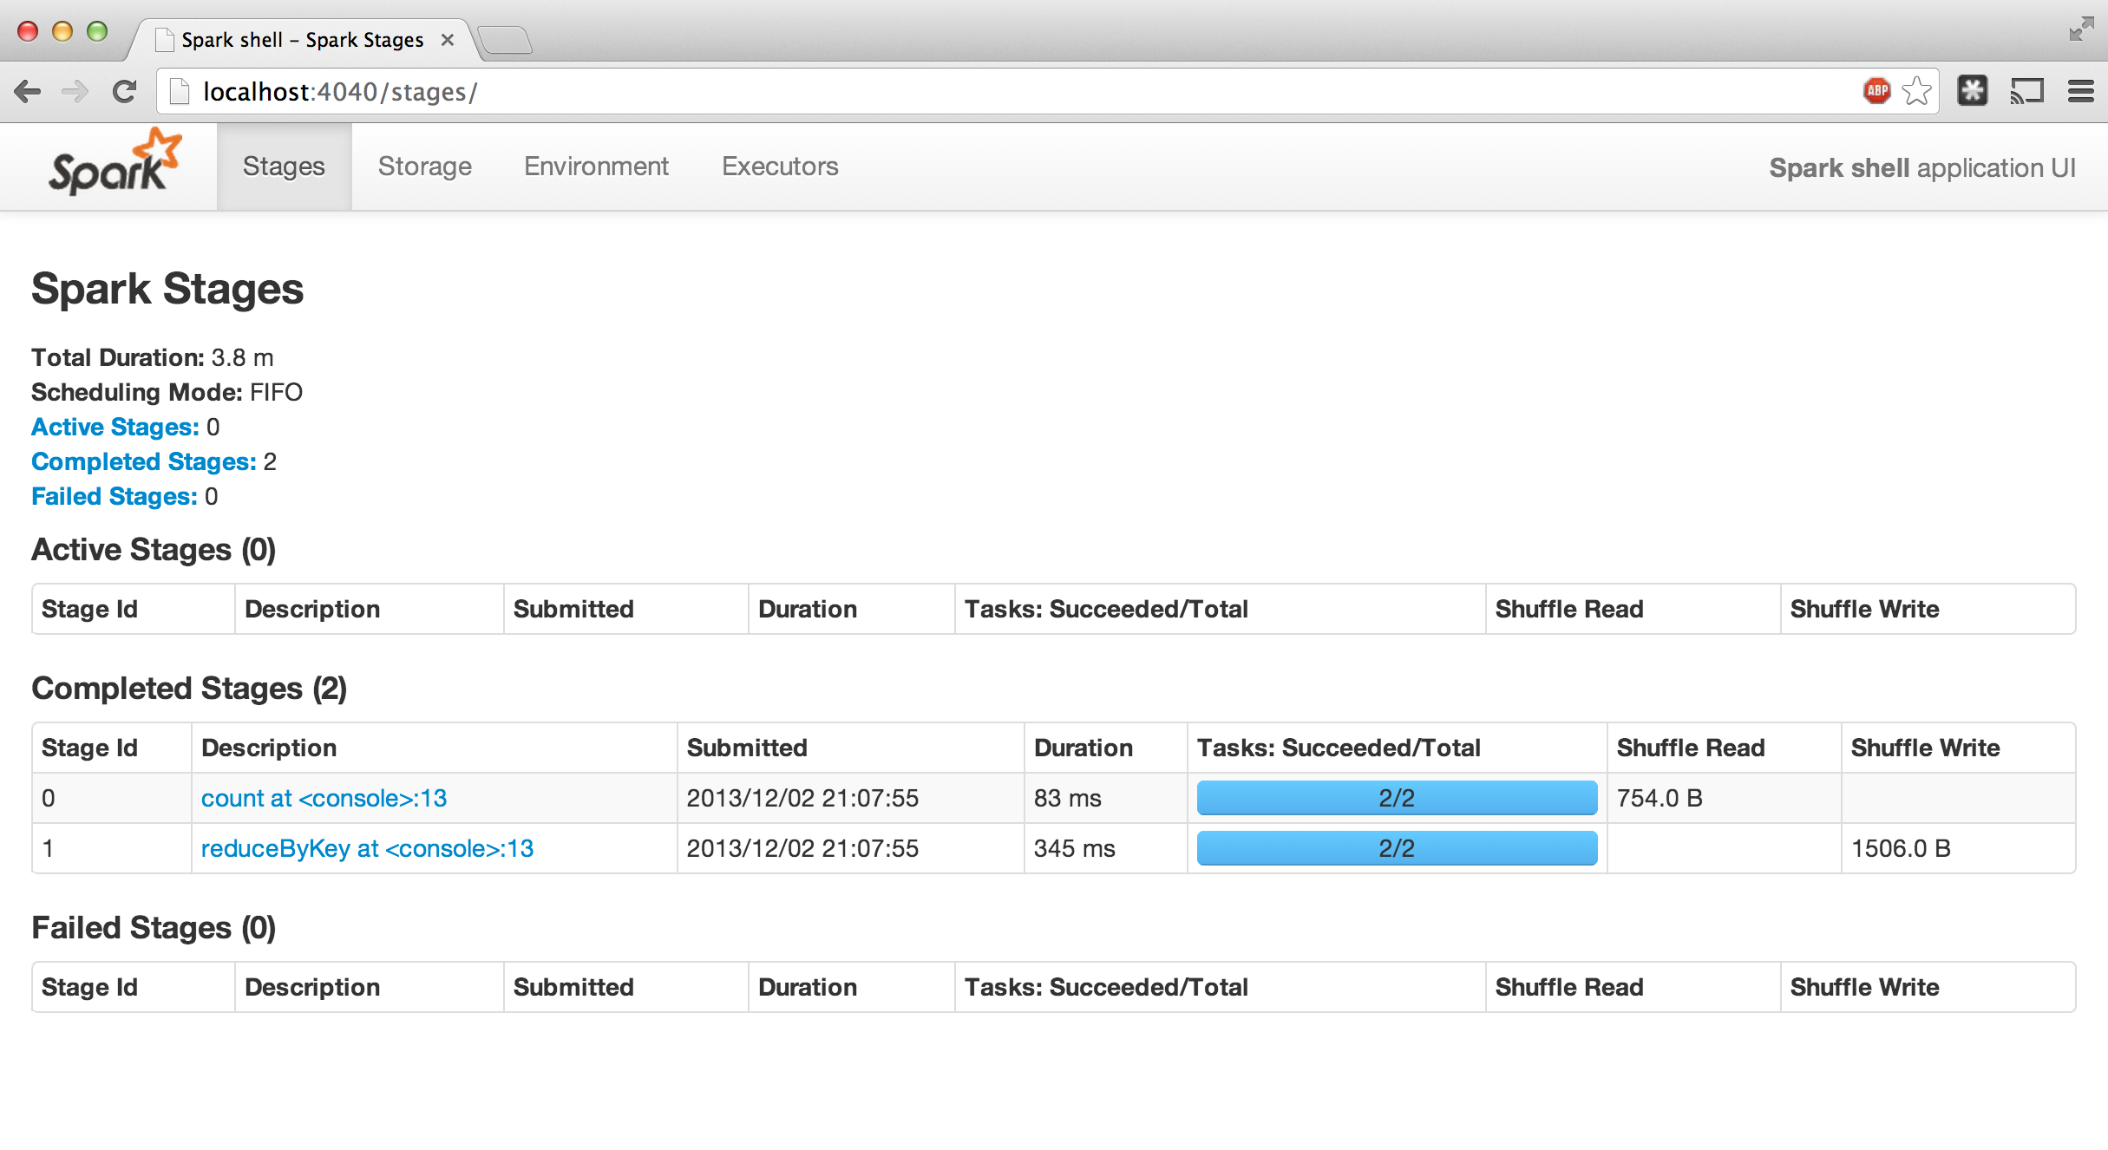
Administrative GUIs
http://<Standalone Master>:8080 (by default)

Slide 19
Generality of RDDs
RDDs can express surprisingly many parallel algorithms
These naturally apply the same operation to many items
Unify many current programming models
Data flow models: MapReduce, Dryad, SQL, …
Specialized models for iterative apps: BSP (Pregel), iterative MapReduce (Haloop), bulk incremental, …
Support new apps that these models don’t
Notes:
Similarity to GFS/HDFS: large blocks, append only.

Slide 20
Tradeoff Space
Network
bandwidth
Memory
bandwidth
Fine
K-V stores,
databases,
RAMCloud
Best for
transactional
workloads
Granularity
of Updates
Best for batch
workloads
HDFS
RDDs
Coarse
Low
High
Write Throughput

Slide 21
Advanced Features
Controllable partitioning
Speed up joins against a dataset
Controllable storage formats
Keep data serialized for efficiency, replicate to multiple nodes, cache on disk
Shared variables: broadcasts, accumulators
See online docs for details!

Slide 22
Spark Programming Interface
Scala, Java or Python
Provides:
Resilient distributed datasets (RDDs)
Operations on RDDs: transformations (build new RDDs), actions (compute and output results)
Control of each RDD’s partitioning (layout across nodes) and persistence (storage in RAM, on disk, etc)
Notes:
Mention that Scala is a JVM language

Slide 23
Spark Operations
Transformations (define a new RDD) | map filter sample groupByKey reduceByKey sortByKey | flatMap union join cogroup cross mapValues
Actions (return a result to driver program) | collect reduce count save lookupKey

Slide 24
Conviva GeoReport
Time (hours)
Aggregations on many keys w/ same WHERE clause
40× gain comes from:
Not re-reading unused columns or filtered records
Avoiding repeated decompression
In-memory storage of deserialized objects

Slide 25
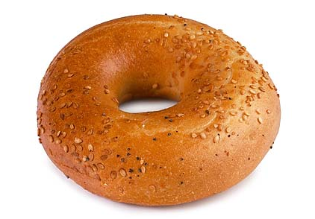

Frameworks Built on Spark
Pregel on Spark (Bagel)
Google message passing model for graph computation
200 lines of code
Hive on Spark (Shark)
3000 lines of code
Compatible with Apache Hive
ML operators in Scala
Notes:
Say it’s because these all do data-parallel operations

Slide 26
SparkContext
Main entry point to Spark functionality
Available in shell as variable sc
In standalone programs, you’d make your own (see later for details)

Slide 27
Creating RDDs
# Turn a Python collection into an RDD
sc.parallelize([1, 2, 3])
# Load text file from local FS, HDFS, or S3
sc.textFile(“file.txt”)
sc.textFile(“directory/*.txt”)
sc.textFile(“hdfs://namenode:9000/path/file”)
# Use existing Hadoop InputFormat (Java/Scala only)
sc.hadoopFile(keyClass, valClass, inputFmt, conf)

Slide 28
Basic Transformations
nums = sc.parallelize([1, 2, 3])
# Pass each element through a function
squares = nums.map(lambda x: x*x) // {1, 4, 9}
# Keep elements passing a predicate
even = squares.filter(lambda x: x % 2 == 0) // {4}
# Map each element to zero or more others
nums.flatMap(lambda x: => range(x))
# => {0, 0, 1, 0, 1, 2}
Range object (sequence of numbers 0, 1, …, x-1)
Notes:
All lazy

Slide 29
Basic Actions
nums = sc.parallelize([1, 2, 3])
# Retrieve RDD contents as a local collection
nums.collect() # => [1, 2, 3]
# Return first K elements
nums.take(2) # => [1, 2]
# Count number of elements
nums.count() # => 3
# Merge elements with an associative function
nums.reduce(lambda x, y: x + y) # => 6
# Write elements to a text file
nums.saveAsTextFile(“hdfs://file.txt”)
Notes:
Launch computations

Slide 30
Working with Key-Value Pairs
Spark’s “distributed reduce” transformations operate on RDDs of key-value pairs
Python: pair = (a, b) pair[0] # => a pair[1] # => b
Scala: val pair = (a, b) pair._1 // => a pair._2 // => b
Java: Tuple2 pair = new Tuple2(a, b); pair._1 // => a pair._2 // => b

Slide 31
Some Key-Value Operations
pets = sc.parallelize( [(“cat”, 1), (“dog”, 1), (“cat”, 2)])
pets.reduceByKey(lambda x, y: x + y) # => {(cat, 3), (dog, 1)}
pets.groupByKey() # => {(cat, [1, 2]), (dog, [1])}
pets.sortByKey() # => {(cat, 1), (cat, 2), (dog, 1)}

Slide 32
Example: Word Count
lines = sc.textFile(“hamlet.txt”)
counts = lines.flatMap(lambda line: line.split(“ ”)) .map(lambda word: (word, 1)) .reduceByKey(lambda x, y: x + y)
“to” “be” “or”
(to, 1) (be, 1) (or, 1)
(be, 2) (not, 1)
“to be or”
“not” “to” “be”
(not, 1) (to, 1) (be, 1)
(or, 1)
(to, 2)
“not to be”

Slide 33
Other Key-Value Operations
visits = sc.parallelize([ (“index.html”, “1.2.3.4”), (“about.html”, “3.4.5.6”), (“index.html”, “1.3.3.1”) ])
pageNames = sc.parallelize([ (“index.html”, “Home”), (“about.html”, “About”) ])
visits.join(pageNames) # (“index.html”, (“1.2.3.4”, “Home”)) # (“index.html”, (“1.3.3.1”, “Home”)) # (“about.html”, (“3.4.5.6”, “About”))
visits.cogroup(pageNames) # (“index.html”, ([“1.2.3.4”, “1.3.3.1”], [“Home”])) # (“about.html”, ([“3.4.5.6”], [“About”]))

Slide 34
Using Local Variables
Any external variables you use in a closure will automatically be shipped to the cluster:
query = sys.stdin.readline()
pages.filter(lambda x: query in x).count()
Some caveats:
Each task gets a new copy (updates aren’t sent back)
Variable must be Serializable / Pickle-able
Don’t use fields of an outer object (ships all of it!)

Slide 35
Closure Mishap Example
This is a problem:
class MyCoolRddApp { val param = 3.14 val log = new Log(...) ... def work(rdd: RDD[Int]) { rdd.map(x => x + param) .reduce(...) } }
How to get around it:
class MyCoolRddApp { ... ...
def work(rdd: RDD[Int]) { val param_ = param rdd.map(x => x + param_) .reduce(...) } }
NotSerializableException: MyCoolRddApp (or Log)
References only local variable instead of this.param

Slide 36
PageRank Performance
Notes:
54 GB Wikipedia dataset

Slide 37
Other Iterative Algorithms
Time per Iteration (s)
Notes:
100 GB datasets

Slide 38
Conclusion
Spark offers a rich API to make data analytics fast: both fast to write and fast to run
Achieves 100x speedups in real applications
State-of-the-art in cluster computing

Slide 39
Get Started
Up and Running in a Few Steps
Download
Unzip
Shell
Project Resources
Examples on the Project Site
Examples in the Distribution
Documentation
http://spark.apache.org

