Slide 1
Unsupervised Learning: Clustering
Slides adapted from Vibhav Gogate, Carlos Guestrin, Dan Klein & Luke Zettlemoyer

Slide 2
Overview of Learning
Type of Supervision
(eg, Experience, Feedback)
 | Labeled Examples | Reward | Nothing
Discrete Function | Classification |  | Clustering
Continuous Function | Regression
Policy | Apprenticeship Learning | Reinforcement Learning
What is Being Learned?

Slide 3
Clustering
Clustering systems:
Unsupervised learning
Requires data, but no labels
Detect patterns e.g. in
Group emails or search results
Customer shopping patterns
Program executions (intrusion detection)
Useful when don’t know what you’re looking for
But: often get gibberish!

Slide 4
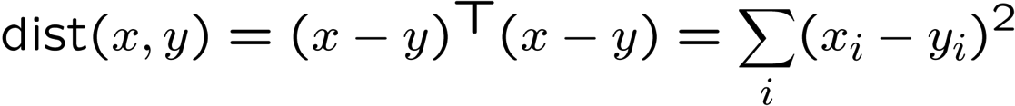
Clustering
Basic idea: group together similar instances
Example: 2D point patterns
What could “similar” mean?
One option: small (squared) Euclidean distance

Slide 5
K-Means: Algorithm
An iterative clustering algorithm
Pick K random points as cluster centers (means)
Alternate:
Assign data instances to closest cluster center
Change the cluster center to the average of its assigned points
Stop when no points’ assignments change

Slide 6
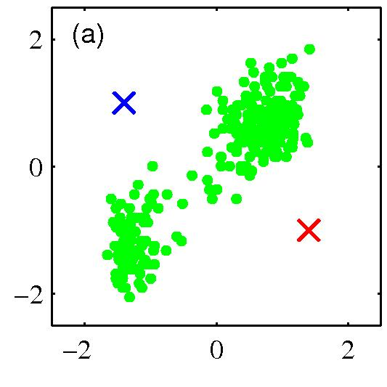
K-means clustering: Example
Pick K random points as cluster centers (means)

Slide 7
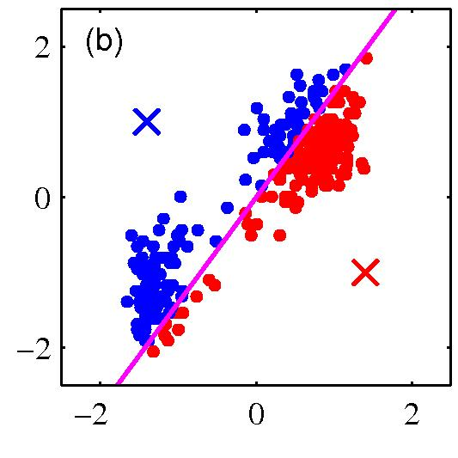
K-means clustering: Example
Iterative Step 1
Assign data instances to closest cluster center

Slide 8
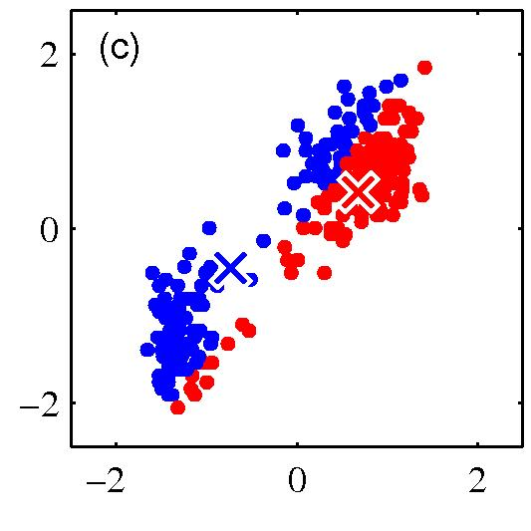
K-means clustering: Example
Iterative Step 2
Change the cluster center to the average of the assigned points

Slide 9
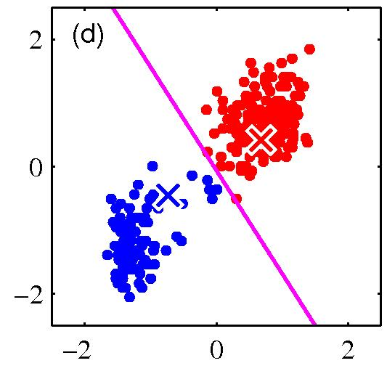
K-means clustering: Example
Repeat until convergence

Slide 10
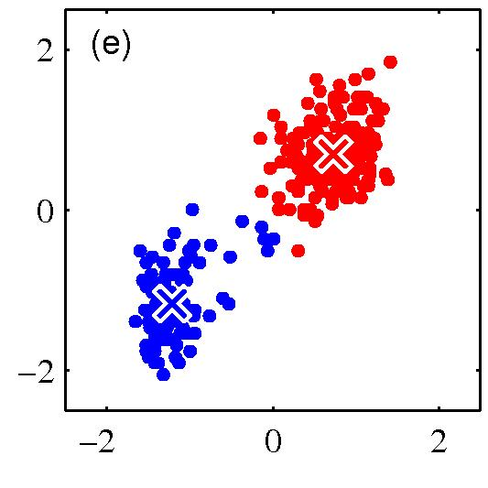
K-means clustering: Example

Slide 11
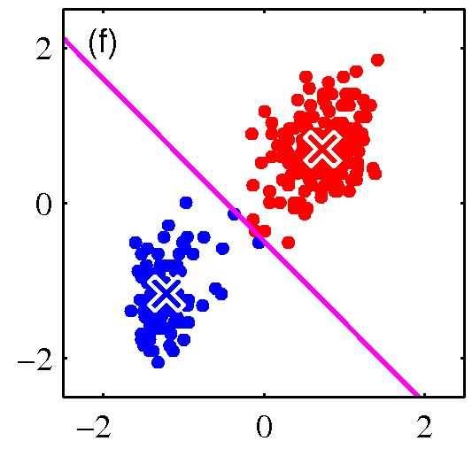
K-means clustering: Example

Slide 12
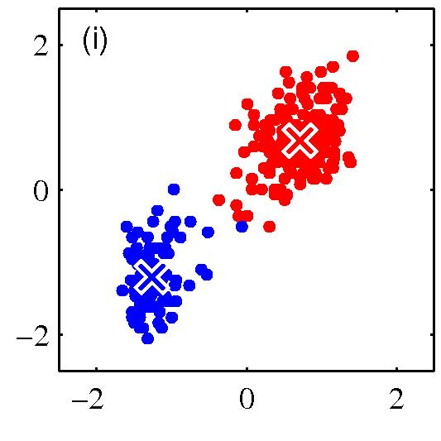
K-means clustering: Example

Slide 13
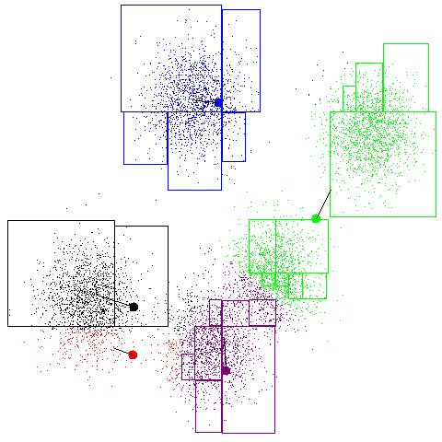
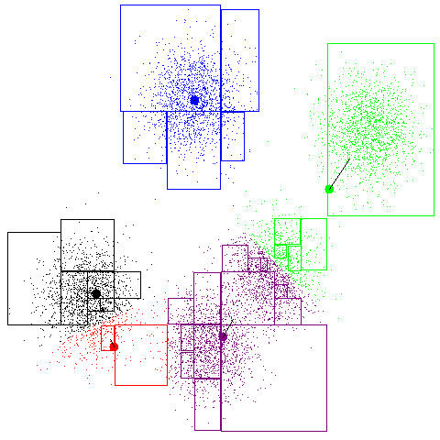
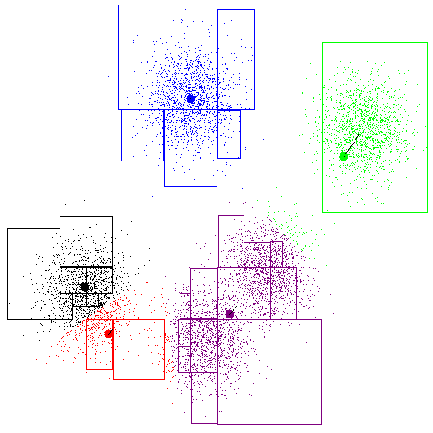
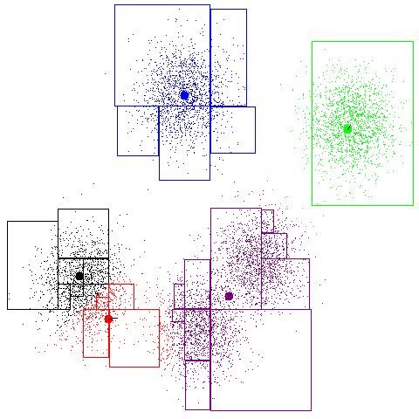
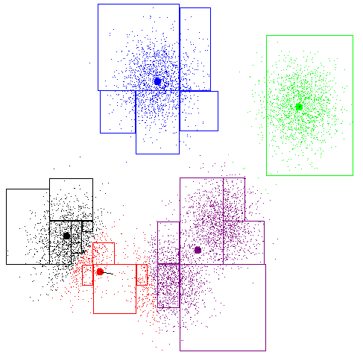
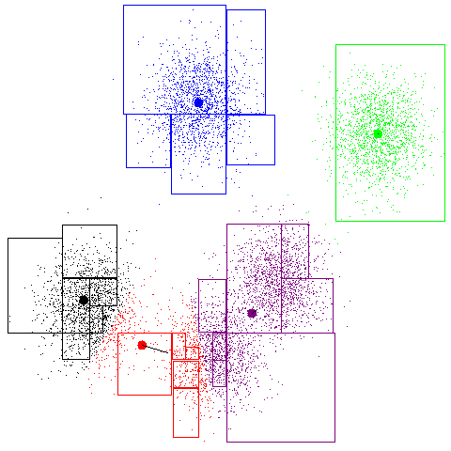
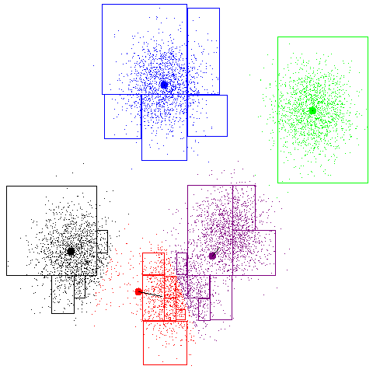
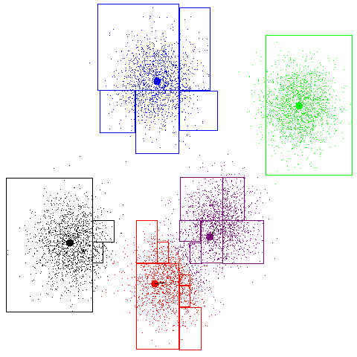
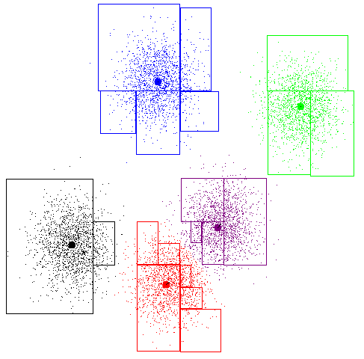
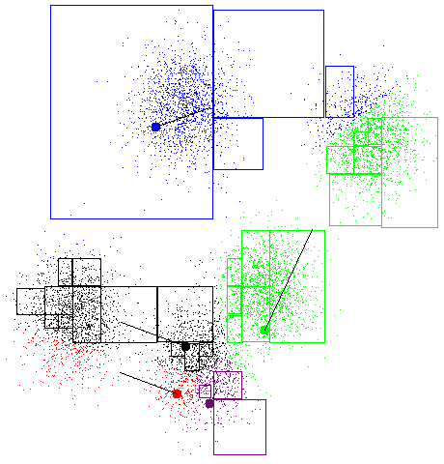
K-Means Example

Slide 14
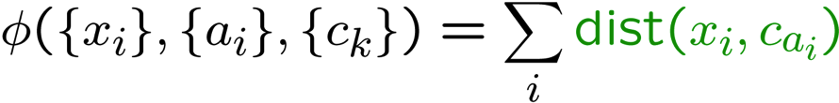
K-Means as Optimization
Minimize the total distance of points to their means:
Two stages each iteration:
Update assignments: fix means c,
change assignments a
Update means: fix assignments a,
change means c
Co-ordinate Gradient Descent
Will it converge?
Yes!, if you can argue that each update can’t increase Φ
points
means
assignments

Slide 15
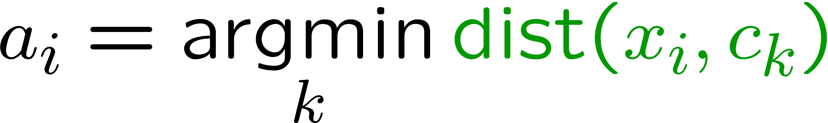

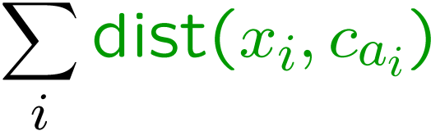
Phase I: Update Assignments
For each point, re-assign to closest mean:
Can only decrease total distance phi!

Slide 16
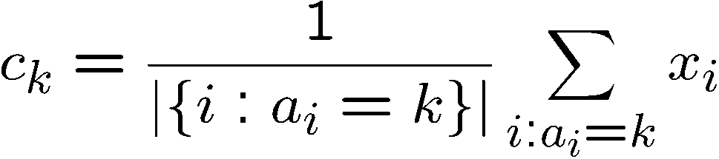
Phase II: Update Means
Move each mean to the average of its assigned points:
Also can only decrease total distance… (Why?)
Fun fact: the point y with minimum squared Euclidean distance to a set of points {x} is their mean

Slide 17
Initialization
K-means is non-deterministic
Requires initial means
It does matter what you pick!
What can go wrong?
Various schemes for preventing this kind of thing: variance-based split / merge, initialization heuristics

Slide 18
K-Means Getting Stuck
A local optimum:

Slide 19
Another Example
Y
X

Slide 20
K-Means Questions
Will K-means converge?
To a global optimum?
Will it always find the true patterns in the data?
If the patterns are very very clear?
Do people ever use it?
Very popular algorithm
How many clusters to pick?
Hard question, decide experimentally

Slide 21
EM: Soft Clustering
Clustering typically assumes that each instance is given a “hard” assignment to exactly one cluster.
Does not allow uncertainty in class membership or for an instance to belong to more than one cluster.
Problematic because data points that lie roughly midway between cluster centers are assigned to one cluster
Soft clustering gives probabilities that an instance belongs to each of a set of clusters.

Slide 22
Probabilistic Clustering
Try a probabilistic model!
allows overlaps, clusters of different size, etc.
Can tell a generative story for data
P(X|Z) P(Z)
Challenge: we need to estimate model parameters without labeled Zs
Z | X₁ | X₂
?? | 0.1 | 2.1
?? | 0.5 | -1.1
?? | 0.0 | 3.0
?? | -0.1 | -2.0
?? | 0.2 | 1.5
… | … | …

Slide 23

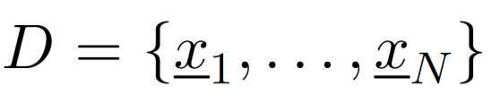
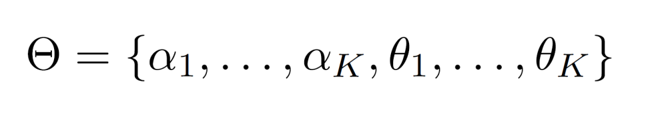
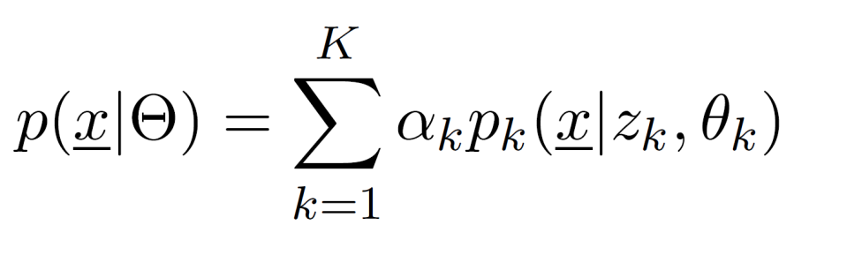
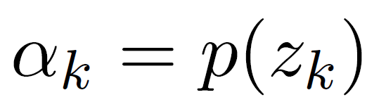
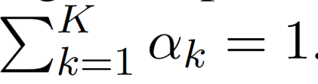
Finite Mixture Models
Given a dataset:
Mixture model:
Note: only one of them equals 1 at any given point. Each point is assumed to be generated from exactly one mixture component!
Mixture Weights.

Slide 24
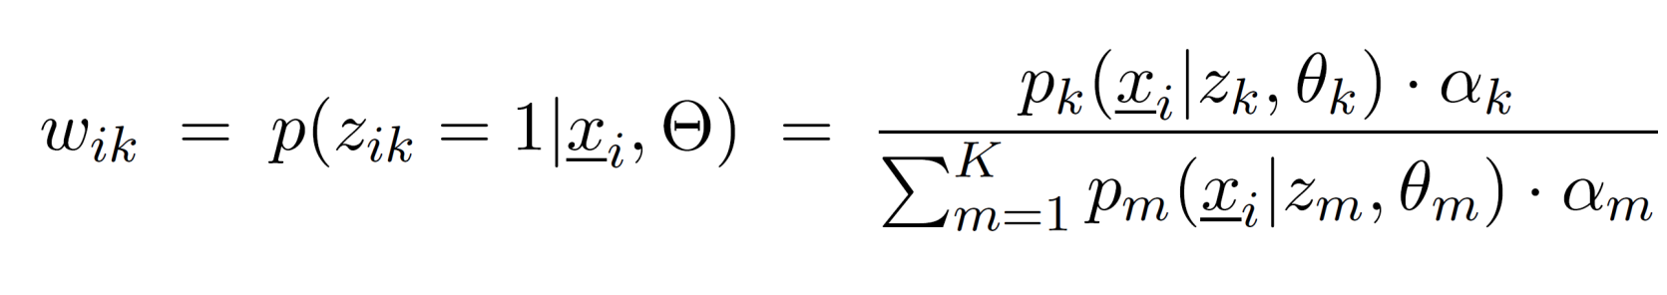
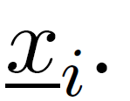
Finite Mixture Model: Probabilistic View
The membership weight express our uncertainty about which of the “K” components generated the vector

Slide 25
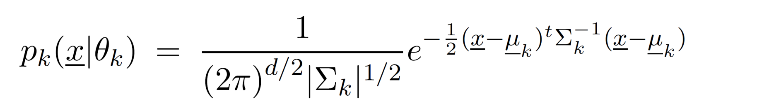
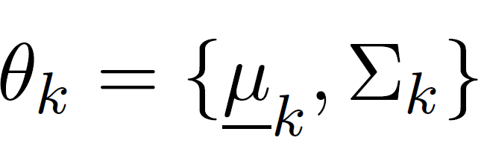
Gaussian Mixture Models (GMMs)
We can define a GMM by making each “k-th” component a Gaussian density with parameters:
Question: How to learn these parameters from data?

Slide 26
Expectation Maximization

Slide 27
EM algorithm: Key Idea
Start with random parameters
Find a class for each example (E-step)
Since we are using probabilistic classification, each example will be given a vector of probabilities
Now we have a supervised learning problem. Estimate the parameters of the model using the maximum likelihood method (M-step)
Iterate between the E-step and M-step until convergence

Slide 28
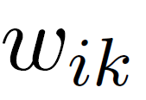
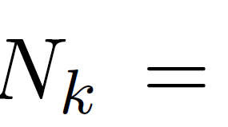
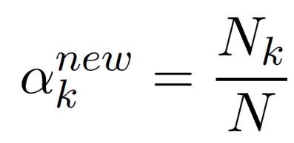
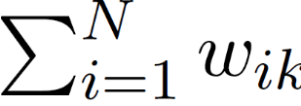
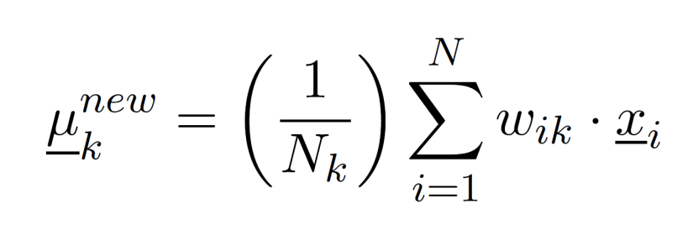
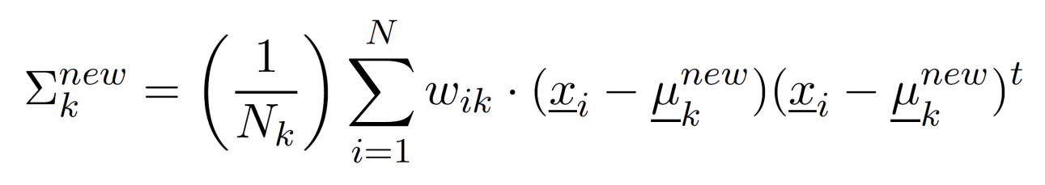
EM: Two Easy Steps
E-step: (Yields a N x K matrix)
Compute for all data points indexed by “i” and all mixture components indexed by “k.”
M-step:
Use the membership weights and data to compute the new parameters

Slide 29
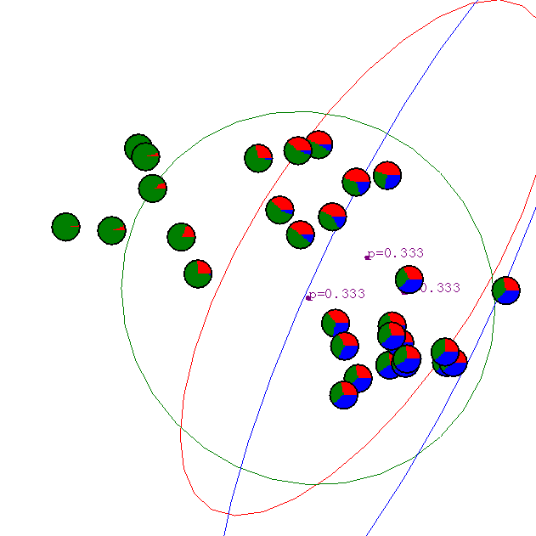
Gaussian Mixture Example: Start

Slide 30
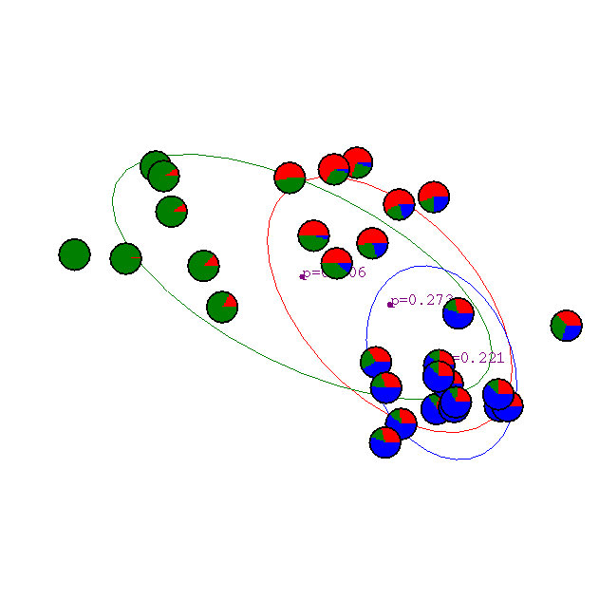
After first iteration

Slide 31

After 2nd iteration

Slide 32

After 3rd iteration

Slide 33

After 4th iteration

Slide 34

After 5th iteration

Slide 35

After 6th iteration

Slide 36

After 20th iteration

Slide 37
Properties of EM
EM converges to a local minima
This is because each iteration improves the log-likelihood
Proof same as K-means
E-step can never decrease likelihood
M-step can never decrease likelihood
If we make hard assignments instead of soft ones. Algorithm is equivalent to K-means!

Slide 38
What you should know
K-means for clustering:
algorithm
converges because it’s coordinate ascent
EM for mixture of Gaussians:
Remember, E.M. can get stuck in local minima,
And empirically it DOES!

Slide 39
Agglomerative Clustering
Agglomerative clustering:
First merge very similar instances
Incrementally build larger clusters out of smaller clusters
Algorithm:
Maintain a set of clusters
Initially, each instance in its own cluster
Repeat:
Pick the two closest clusters
Merge them into a new cluster
Stop when there’s only one cluster left
Produces not one clustering, but a family of clusterings represented by a dendrogram

Slide 40
Agglomerative Clustering
How should we define “closest” for clusters with multiple elements?

Slide 41
Agglomerative Clustering
How should we define “closest” for clusters with multiple elements?
Many options:
Closest pair (single-link clustering)
Farthest pair (complete-link clustering)
Average of all pairs
Ward’s method (min variance, like k-means)
Find pair of clusters that leads to minimum increase in total within cluster distance after merging
Different choices create different clustering behaviors

Slide 42
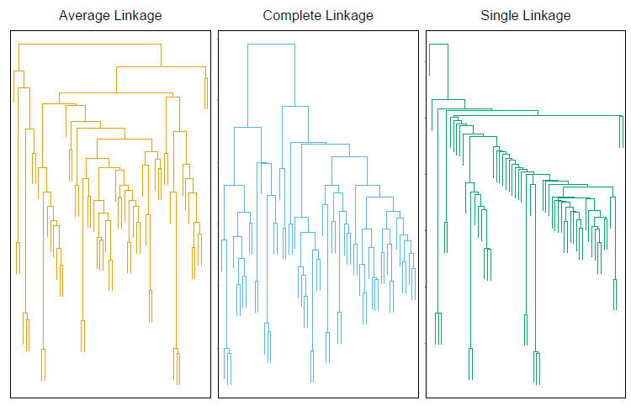
Clustering Behavior
Average
Farthest
Nearest
Mouse tumor data from [Hastie]

