Slide 1
Recommendation Systems
Deepak Venugopal
4745
Some Slides Courtesy Vibhav Gogate, Padhraic Smyth

Slide 2
Recommendation Systems
Some references
Chapter by Melville and Sindhwani , encyclopedia of ML, 2010
Chapter on recommendation systems, Mining massive datasets, Rajaraman, Leskovec and Ullman

Slide 3
Recommendation Systems
Present a user with items he/she may like
Useful in several practical cases
Movies
Products
Services
Etc.
https://en.wikipedia.org/wiki/Collaborative_filtering#/media/File:Collaborative_filtering.gif

Slide 4
Ratings data
Data with users N and M items
Represent as a NXM matrix
Entries of the matrix
Ratings
Binary value (did user like/dislike, watch/did-not-watch, listen/did-not-listen,…)

Slide 5
Examples
Amazon
Ebay
Netflix
Youtube
Pandora
Goodreads
…

Slide 6
Netflix Challenge
Netflix held a 1Million$ challenge to improve their recommendation system
Privacy issues??
Currently the Netflix dataset has been taken down

Slide 7
Item-1 | Item-2 | Item-3 | Item-4 | Item-5
2 | 2 | 1 | 3
1 |  | 1 | 1
2 |  | 1 | 3 | 3
2 |  | 1 | 2 | 1
….
Users
Training data
Item-1 | Item-2 | Item-3 | Item-4 | Item-5
1 | ? | 2 | 1 | ?
Testing data

Slide 8
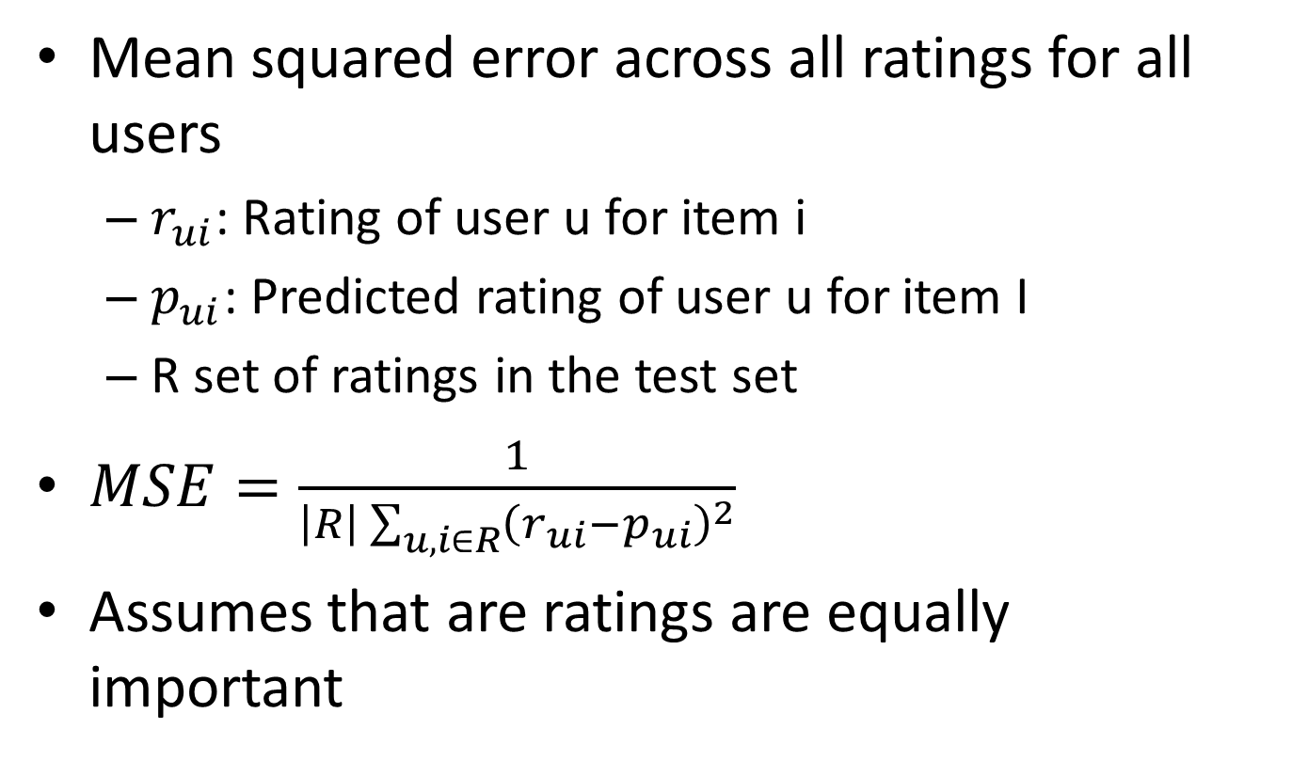
Evaluation Metrics
Mean squared error across all ratings for all users
$r_{ui}$: Rating of user u for item i
$p_{ui}$: Predicted rating of user u for item I
R set of ratings in the test set
$MSE=\frac{1}{\left|R\right|\sum_{u,i∈R}{{\left(r_{ui}−p_{ui}\right)}^{2}}}$
Assumes that are ratings are equally important

Slide 9
Evaluation Metrics
Precision based metrics
Rank the predictions
Measure precision in the top K places of the rankings
More emphasis on getting important predictions right
Real ideal evaluation: Would the user be persuaded to buy an item X that they would otherwise not buy?
Harder to do

Slide 10
Content based recommendations
Recommend an item to a user if the user previously liked similar item
Ignore the preferences of other users
How to measure similarity?
Movies with certain actors, genre, director, etc.
Music genre, year, etc.

Slide 11
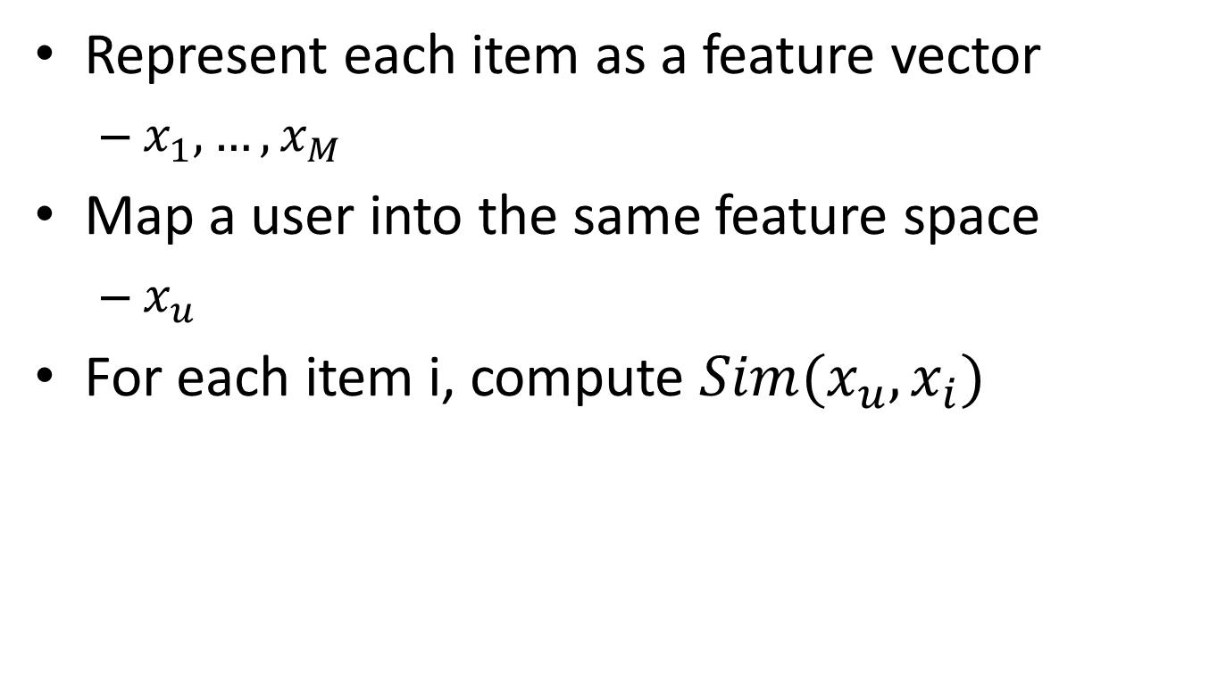
Content based recommendation
Represent each item as a feature vector
$x_{1},…,x_{M}$
Map a user into the same feature space
$x_{u}$
For each item i, compute $Sim(x_{u},x_{i})$

Slide 12
Example:Text Content
Items=documents
Features=words or phrases
Represent a document as “bag of words”
Count the frequency of words in the document
Use TF-IDF for vectorizing a document from the frequency counts

Slide 13
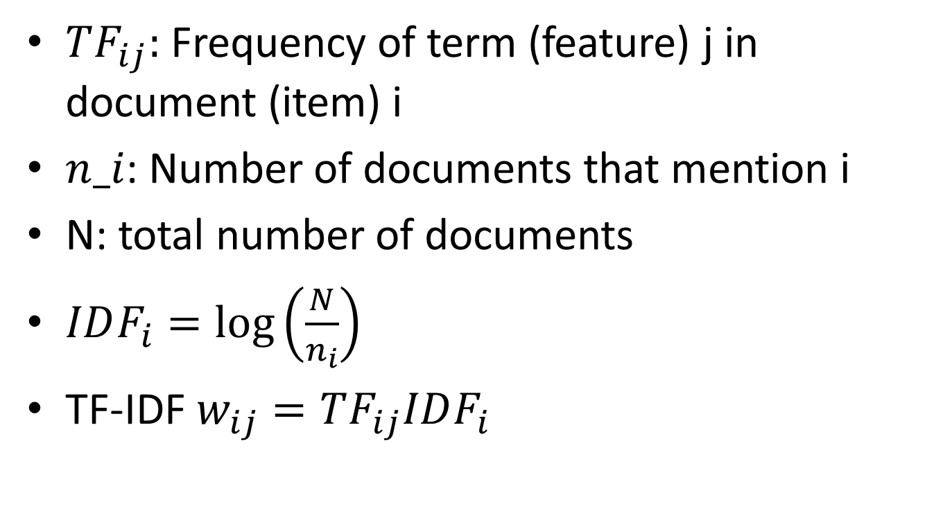
Example:Text
$TF_{ij}:$ Frequency of term (feature) j in document (item) i
$n_i$: Number of documents that mention i
N: total number of documents
$IDF_{i}=\log\left(\frac{N}{n_{i}}\right)$
TF-IDF$w_{ij}=TF_{ij}IDF_{i}$

Slide 14
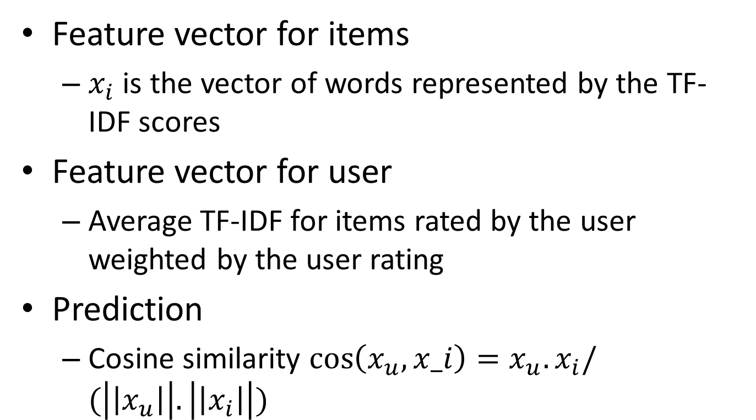
Example:Text
Feature vector for items
$x_{i}$ is the vector of words represented by the TF-IDF scores
Feature vector for user
Average TF-IDF for items rated by the user weighted by the user rating
Prediction
Cosine similarity $\cos\left(x_{u},x_i\right)=x_{u}.x_{i}/(\left|\left|x_{u}\right|\right|.\left|\left|x_{i}\right|\right|)$

Slide 15
Tf-idf
TERM | TERM-COUNT
This | 1
Is | 1
a | 2
Sample | 1
Document 1
TERM | TERM-COUNT
This | 1
Is | 1
a | 2
example | 3
Document 2

Slide 16
Tf-idf
TERM | TF
This | 1/5
Is | 1/5
a | 2/5
Sample | 1/5
Document 1
TERM | TERM-COUNT
This | 1/7
Is | 1/7
a | 2/7
example | 3/7
Document 2

Slide 17
Tf-idf
TERM | idf
This | Log(2/2)=0
Is | 0
a | 0
Sample | Log(2/1)
Document 1
TERM | idf
This | 0
Is | 0
a | 0
example | Log(2/1)
Document 2

Slide 18
Content based recommendation
Pros
Easy to implement
Only need data for a user
New items with no ratings can be included as long as we can compute its feature vector
Cons
Items must have similar features which is not always the case
Finding features might be hard
How do we perform predictions for new users?

Slide 19
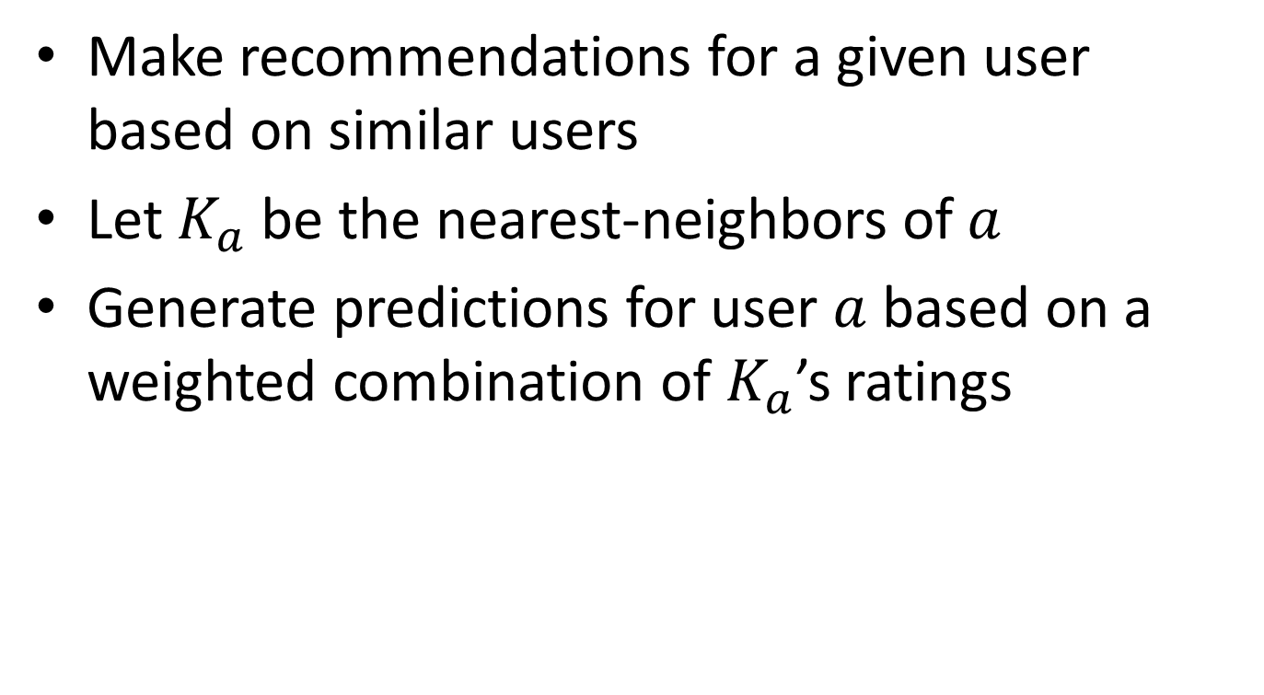
User-User Collaborative Filtering
Make recommendations for a given user based on similar users
Let $K_{a}$ be the nearest-neighbors of $a$
Generate predictions for user $a$ based on a weighted combination of $K_{a}$’s ratings

Slide 20
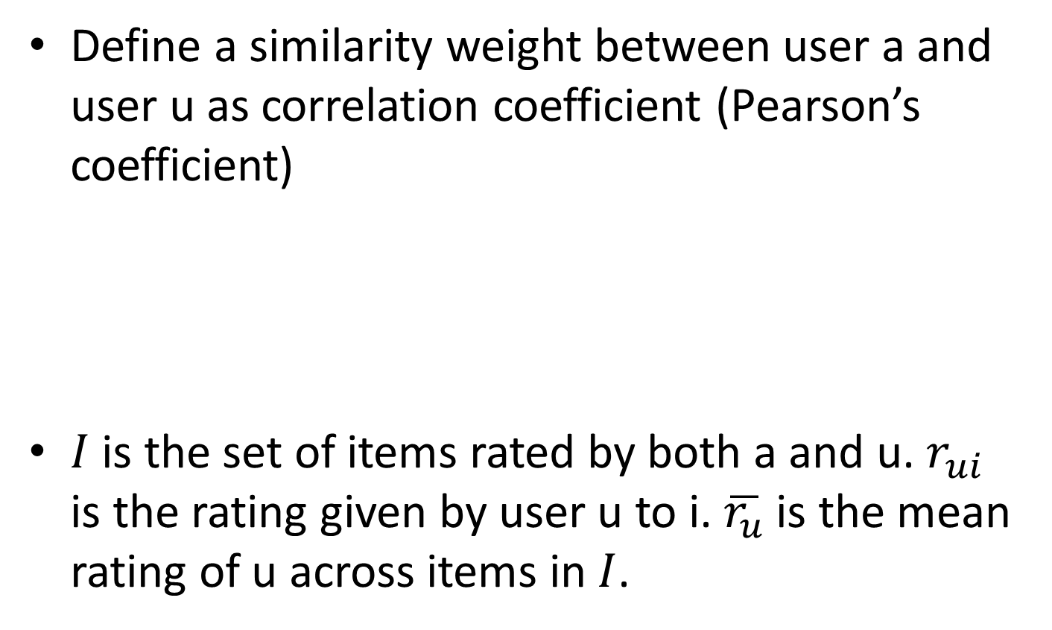
User-User Collaborative Filtering
Define a similarity weight between user a and user u as correlation coefficient (Pearson’s coefficient)
$I$ is the set of items rated by both a and u. $r_{ui}$ is the rating given by user u to i. $\overline{r_{u}}$is the mean rating of u across items in $I$.

Slide 21
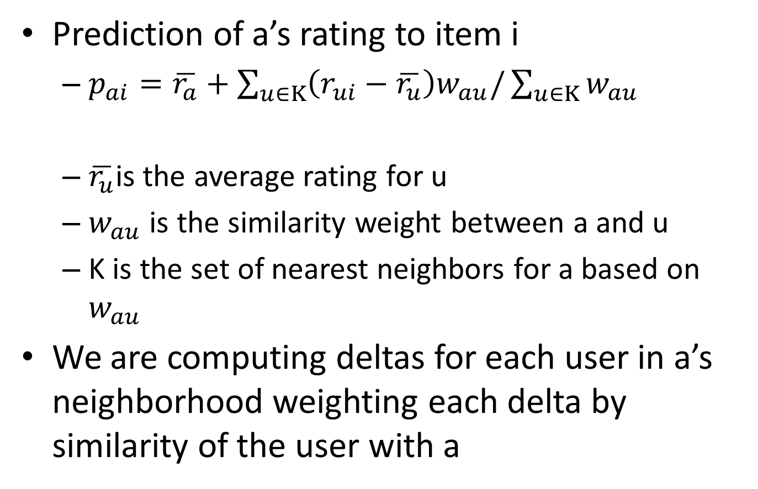
User-User Collaborative Filtering
Prediction of a’s rating to item i
$p_{ai}=\overline{r_{a}}+\sum_{u∈K}{\left(r_{ui}−\overline{r_{u}}\right)w_{au}/\sum_{u∈K}{w_{au}}}$
$\overline{r_{u}}$is the average rating for u
$w_{au}$ is the similarity weight between a and u
K is the set of nearest neighbors for a based on $w_{au}$
We are computing deltas for each user in a’s neighborhood weighting each delta by similarity of the user with a

Slide 22

User-User Collaborative Filtering
P1 | P2 | P3 | P4 | P5 | P6
1 |  | 3 | ? | 1
1 |  | 3 | 2 | 4
1 | 2 | 3 | 3 | 5 | 4
0.18
0
$$p_{13}=1.6+\left(2−2.5\right)∗\frac{0.18}{0.18}=1.1$$

Slide 23
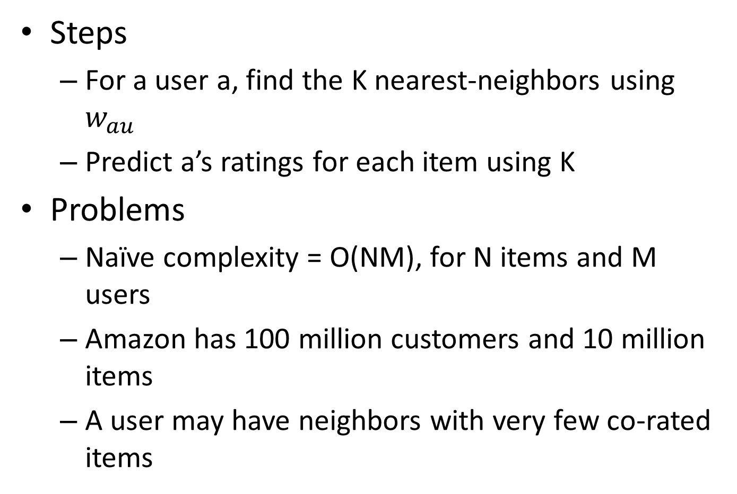
User-User Algorithm
Steps
For a user a, find the K nearest-neighbors using $w_{au}$
Predict a’s ratings for each item using K
Problems
Naïve complexity = O(NM), for N items and M users
Amazon has 100 million customers and 10 million items
A user may have neighbors with very few co-rated items

Slide 24
Heuristics
Remove customers with too few purchases
Randomly sample customers
Remove rarely purchased events
Cluster customers/items etc.

Slide 25
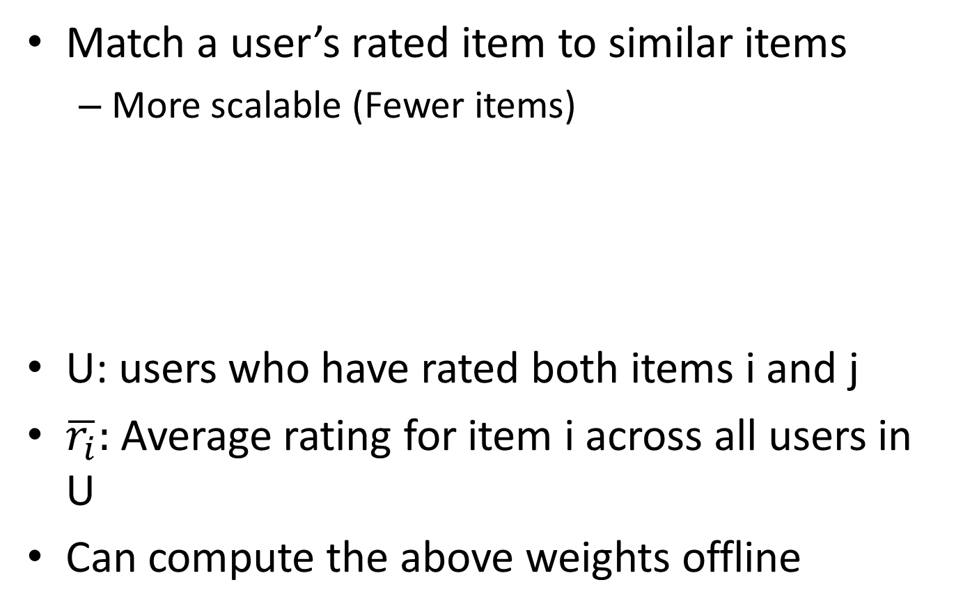
Item based Collaborative Filtering
Match a user’s rated item to similar items
More scalable (Fewer items)
U: users who have rated both items i and j
$\overline{r_{i}}:$ Average rating for item i across all users in U
Can compute the above weights offline

Slide 26

Item based Collaborative Filtering
Predict the rating for item i by user a
$p_{ai}=\sum_{j∈K}{r_{aj}w_{ij}/\sum_{j∈K}{|w_{ij}|}}$
K is the neighborhood set most similar to item i among all items rated by user a

Slide 32
User-User Vs Item
Item-Item appears to be more stable
Item dimensionality is smaller. More data per item than per user
Algorithmically Item-Item can be implemented faster than User-User (Linden,Smith and York, Amazon Recommender System)

Slide 33
Pros/cons of collaborative filtering
Pros
Works for any kind of item
No feature engineering since we don’t need features (in content based we needed features)
Cons
Cannot recommend items that have not been rated
Need to have users in the system (“cold start”: what to do when there are no users as yet)
Popularity bias

Slide 34
Hybrid methods
Implement both content based recommendation and collaborative filtering
Combine the recommender results

