Slide 1
Natural Language Processing
Vasile Rus
http://www.cs.memphis.edu/~vrus/nlp

Slide 2
Outline
Announcements
Problems with CFG
Feature Structures
  Subsumption and Unification

Slide 3
Announcements
Project status report

Slide 4
Problems with simple context-free grammars
Subcategorization
Agreement
Naïve Solutions lead to overgeneration
  Number of non-terminal symbols explodes
  Massive redundancy
  Loss of generality
Solution: Features
Idea behind: Grammatical categories are no longer atomic but complex with an internal structure

Slide 5
Agreement
Sample rule that takes into account features:
  S → NP VP
  (but only if the number of the NP is equal to the number of the VP)

Slide 6
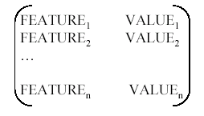
Feature structures
Feature structures are sets of feature-value pairs (also called attribute-value pairs)
The common notation for a feature structure is an attribute-value matrix(AVM) e.g.

Slide 7
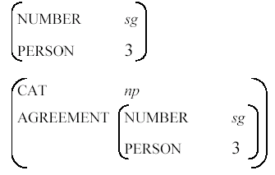
Feature structures (cont’d)
Features are atomic symbols
Values are atomic symbols or complex feature structures e.g.

Slide 8
Feature structures (cont’d)
CAT NP
NUMBER SINGULAR
PERSON 3
CAT NP
AGREEMENT NUMBER SG
PERSON 3
Feature paths: list of features through a feature structure
e.g. {agreement number}

Slide 9
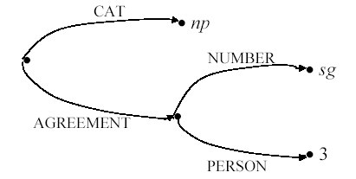
Feature structures (cont’d)
Feature structures can also be described as feature paths, i.e.directed acyclic graphs whose arcs are labeled with features names and values appear as nodes

Slide 10
Feature structures (cont’d)
Feature structures must be consistent and feature paths must be unique,
  i.e. a feature may not have two different values on the same level
  but it is possible to assign the same value to more than one feature (reentrancy or structure sharing)
Reentrant feature structures share precisely the same value (or node in the graph), they not only have equal values
A shared value is notated by coindexing boxes

Slide 11
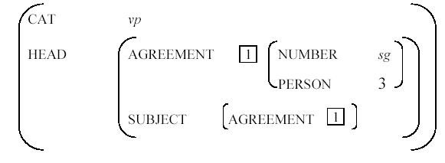
Feature structures (cont’d)
Example of reentrancy

Slide 12
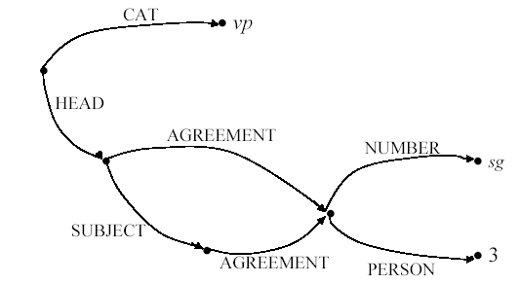
Feature structures (cont’d)
Example of reentrancy in graph notation

Slide 13

Subsumption
There is an ordering relation between feature structures: a less specific feature structure subsumes an equally or more specific one. E.g.
  [Cat NP] subsumes
Subsumption corresponds to the subset relation in set theory
The subsumption relation is represented by the binary operator ⊑

Slide 14
Subsumption (cont’d)
Formally, a feature structure F subsumes a feature structure G, i.e. F ⊑ G, if and only if:
  For every feature x in F, F(x) ⊑ G(x)
  For all paths p and q in F such that F(p) = F(q), it is also the case that G(p) = G(q)
F(x) means the value of feature x of feature structure F.

Slide 15
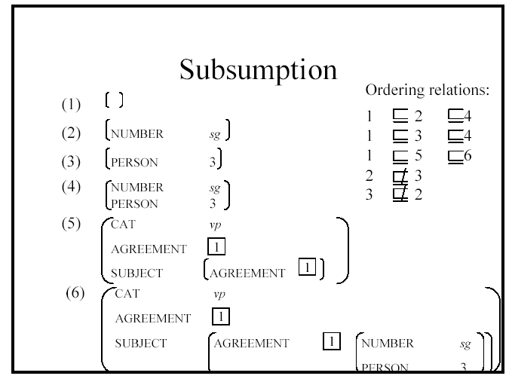
Subsumption (cont’d)

Slide 16
Subsumption (cont’d)
Subsumption is a partial ordering relation between feature structures (i.e. there are pairs of feature structures that neither subsume nor are subsumed by each other)
There are two cases in which the ordering relation does not hold:
  if feature structures contain different but compatible information
  if they contain conflicting information

Slide 17
Unification of feature structures
Unification is an operation for
  combining information (merging the information content of two feature structures)
  comparing information (rejecting the merger of incompatible features)
  Unification is represented as the binary operator

Slide 18
Unification of feature structures (cont’d)
The unified feature structure contains all the information from the unified feature structures but no additional information
Unification is monotonic
  i.e. the unified feature structure still satisfies the original feature structure(no values are overwritten)
Unification corresponds to the union operation in set theory, but may fail in case of incompatible information
  i.e. feature structures have to be consistent even when they are the result of a unification

Slide 19
Unification of feature structures (cont’d)
Formally, the unification of two feature structures F and G is defined as the most general feature structure H, such that F ⊑ H and G ⊑ H.
This is notated as H = F ⊔ G

Slide 20
Unification of feature structures (cont’d)
Examples
  Equality test:
  [Number sg] ⊔ [Number sg] = [Number sg]
  Incompatible values
  [Number sg] ⊔ [Number pl] = fails
  [ ] value compatible with any value (unspecified)
  [Number sg] ⊔ [Number [ ]] = [Number sg]
  Adding information
  [Number sg] ⊔ [Person 3] = Number sg
  Person 3

Slide 21
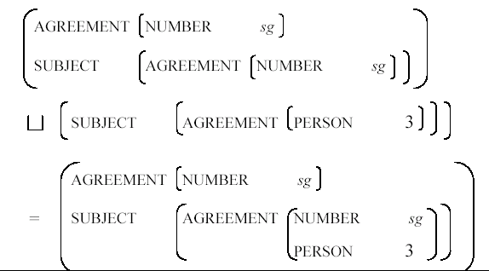
Examples for unification of feature structures
Unification of features with similar values

Slide 22
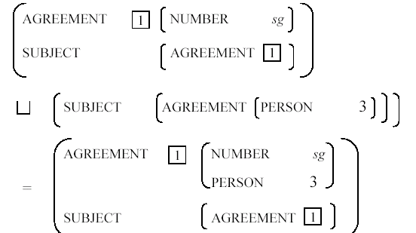
Examples for unification of feature structures(cont’d)
Unification of features with identical values

Slide 23
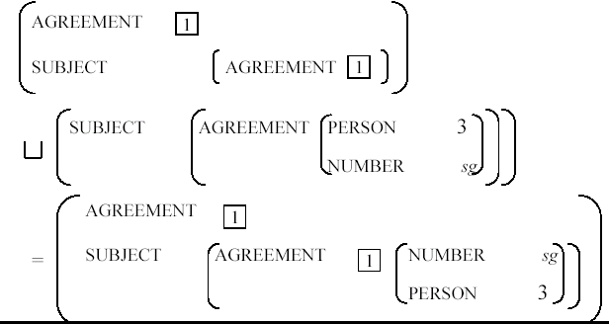
Examples for unification of feature structures(cont’d)
Further copying (instantiation)

Slide 24
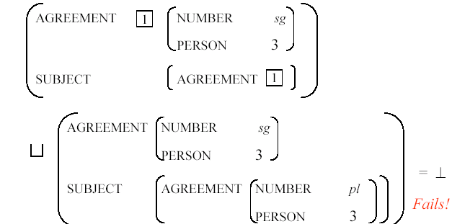
Examples for unification of feature structures(cont’d)
Example of failure to unify

Slide 25
Feature structures in the grammar
CF grammar rules can be augmented with feature structures and with unification operations to express constraints on the constituents of a rule
An example notation (the PATR-II formalism – Shieber 1986):
β ₀ → β ₁... β _{n} {set of constraints}
  Where the constraints have one of the following two forms:
    < βi feature path> =(unify) atomic value
    < βi feature path> =(unify) < βj feature path>
  E.g.:
    S <- NP VP {<NP NUMBER> = <VP NUMBER>}

Slide 26
Feature structures in the grammar (cont’d)
S → NP VP
{NP AGREEMENT} = {VP AGREEMENT}
  This flight serves breakfast
  These flights serve breakfast
S → Aux NP VP
{Aux AGREEMENT} = {NP AGREEMENT}
  Does this flight serve breakfast?
  Do these flights serve breakfast?

Slide 27
Feature structures in the grammar (cont’d)
NP → Det Nominal
<Det AGREEMENT> = <Nominal AGREEMENT>
<NP AGREEMENT> = <Nominal AGREEMENT>
  this flight vs. these flights

Slide 28
Feature structures in the grammar (cont’d)
Lexical constituents receive their agreement features directly from the lexicon
  Aux → does
  <Aux AGREEMENT NUMBER> = sg
  <Aux AGREEMENT PERSON> = 3
  Det → this
  <Aux AGREEMENT NUMBER> = sg
  Det → these
  <Aux AGREEMENT NUMBER> = pl

Slide 29
Feature structures in the grammar (cont’d)
Verb → serve
<Verb AGREEMENT NUMBER> = pl
Verb → serves
<Verb AGREEMENT NUMBER> = sg
<Verb AGREEMENT PERSON> = 3
Non-lexical constituents (e.g. VPs) receive agreement values from their constituents
VP → Verb NP
<VP AGREEMENT> = <Verb AGREEMENT>

Slide 30
Feature structures in the grammar (cont’d)
Agreement (NP and Nominal)
  Noun → flight
  <Noun AGREEMENT NUMBER> = sg
  Noun → flights
  <Noun AGREEMENT NUMBER> = pl
  Nominal → Noun
  <Nominal AGREEMENT> = <Noun AGREEMENT>

Slide 31
Feature structures in the grammar (cont’d)
For most grammatical categories, the features are copied from one child to the parent
The child that provides the features is called the head of the phrase (the features are the head features)
  VP → Verb NP
  <VP AGREEMENT> = <Verb AGREEMENT>
  NP → Det Nominal
  <Det AGREEMENT> = <Nominal AGREEMENT>
  <NP AGREEMENT> = <Nominal AGREEMENT>
  Nominal →Noun
  <Nominal AGREEMENT> = <Noun AGREEMENT>

Slide 32
Subcategorization
VP → Verb
<VP HEAD> = <Verb HEAD>
<VP HEAD SUBCAT> = INTRANS
VP → Verb NP
<VP HEAD> = <Verb HEAD>
  <VP HEAD SUBCAT> = TRANS
VP → Verb NP NP
<VP HEAD> = <Verb HEAD>
<VP HEAD SUBCAT> = DITRANS

Slide 33
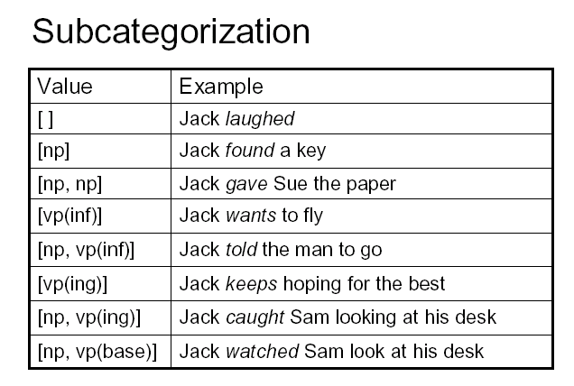
Subcategorization (cont’d)
_none, _np, _np_np, _vp:inf, _np_vp:inf…

Slide 34
Summary
Problems with CFG
Feature Structures
  Subsumption and Unification

