Slide 1
Natural Language Processing
Vasile Rus
http://www.cs.memphis.edu/~vrus/nlp

Slide 2
Outline
Meaning
Word Sense Disambiguation

Slide 3
Announcements
Project Presentations

Slide 4
Eye halve a spelling chequer
It came with my pea sea
It plainly marques four my revue
Miss steaks eye kin knot sea.
Eye strike a key and type a word
And weight four it two say
Weather eye am wrong oar write
It shows me strait a weigh.
As soon as a mist ache is maid
It nose bee fore two long
And eye can put the error rite
Its rare lea ever wrong.
Eye have run this poem threw it
I am shore your pleased two no
Its letter perfect awl the weigh
My chequer tolled me sew.

Slide 5
Meaning
So far, we have focused on the structure of language, not on what things mean
We have seen that words have different meaning, depending on the context in which they are used
Every day language tasks that require some semantic processing:
  Answering an essay question on an exam
  Deciding what to order at a restaurant by reading a menu
  Realizing you’ve been insulted

Slide 6
Meaning (continued)
Now, look at meaning representations—representations that link linguistic forms to knowledge of the world
We are going to cover:
  What is the meaning of a word
  How can we represent the meaning
  What formalisms can be used
    Meaning representation languages

Slide 7
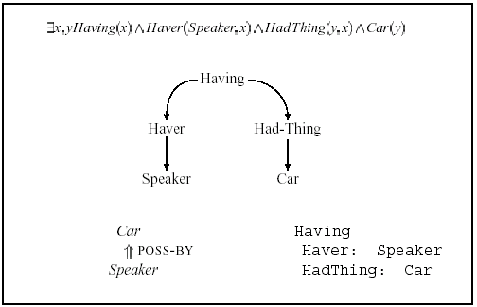
Common Meaning Representations
Correspondences Between Representations
Meaning Representation consists of structures composed of sets of symbols
Symbol structures are objects and relations among objects

Slide 8
What Can Serve as a Meaning Representation?
Anything that serves the core practical purposes of a program that is doing semantic processing
What is a Meaning Representation Language?
What is Semantic Analysis?

Slide 9
Requirements for Meaning Representation
Verifiability
Unambiguous Representation
Canonical Form
Inference
Expressiveness

Slide 10
Verifiability
System can match input representation against representations in knowledge base. If it finds a match, it can return Yes; Otherwise No.
Does Maharani serve vegetarian food?
Serves(Maharani,vegetarian food)

Slide 11
Unambiguous Representation
Single linguistic input can have different meaning representations
Each representation unambiguously characterizes one meaning.
Example: I wanna eat someplace that's close to UofM.
  E₁: want(I,E₂)
  E₂: eat(I,O₁,Loc₁)

Slide 12
Ambiguity and Vagueness
System should allow us to represent vagueness
I want to eat Italian food

Slide 13
Representing Similar Concepts
Distinct inputs could have the same meaning
  Does Maharani have vegetarian dishes?
  Do they have vegetarian food at Maharani?
  Are vegetarian dishes served at Maharani?
  Does Maharani serve vegetarian fare?
Alternatives
  Four different semantic representations
  Store all possible meaning representations in KB

Slide 14
Canonical Form
Solution: Inputs that mean same thing have same meaning representation
Is this easy? No!
  Vegetarian dishes, vegetarian food, vegetarian fare
  Have, serve
What to do?

Slide 15
How to Produce a
Canonical Form
Systematic Meaning Representations can be derived from thesaurus
  food ___
  dish ___|____one overlapping meaning sense
  fare ___|
We can systematically relate syntactic constructions
  [S [NP Maharani] serves [NP vegetarian dishes]]
  [S [NP vegetarian dishes] are served at [NP Maharani]]

Slide 16
Inference
Consider a more complex request
  Can vegetarians eat at Maharani?
  vs.
  Does Maharani serve vegetarian food?
Why do these result in the same answer?
Inference: Draw conclusions about truth of propositions not explicitly stored in KB
serve(Maharani,VegetarianFood) => CanEat(Vegetarians,AtMaharani)

Slide 17
Non-Yes/No Questions
Example: I'd like to find a restaurant where I can get vegetarian food.
serve(x,VegetarianFood)
Matching succeeds only if variable x can be replaced by known object in KB.

Slide 18
Meaning Structure of Language
Human Languages
  Display a basic predicate-argument structure
  Make use of variables
  Make use of quantifiers
  Display a partially compositional semantics

Slide 19
Predicate-Argument Structure
Represent concepts and relationships among them
Some words act like arguments and some words act like predicates:
  Nouns as concepts or arguments: red(ball)
  Adj, Adv, Verbs as predicates: red(ball)
Subcategorization (argument) frames specify number, position, and syntactic category of arguments
Examples:
  NP give NP2 NP1
  NP give NP1 to NP2
  give(x,y,z)

Slide 20
Semantic (thematic) Roles
Semantic Roles: Participants in an event
  Agent: George hit Bill. Bill was hit by George
  Theme: George hit Bill. Bill was hit by George
Semantic (Selectional) Restrictions: Constrain the types of arguments verbs take
  George assassinated the senator
  *The spider assassinated the fly
Verb subcategorization: Allows linking arguments in surface structure with their semantic roles
Prepositions are like verbs
  Under(ItalianRestaurant,$15)

Slide 21
First Order Predicate Calculus (FOPC)
FOPC provides sound computational basis for verifiability, inference, expressiveness
  Supports determination of truth
  Supports compositionality of meaning
  Supports question-answering (via variables)
  Supports inference

Slide 22
Meaning of Words
Lexical Semantics: What is it?
Old view: Words have to be interpreted “in context”
Recent view: Systematic structure for words

Slide 23
Definitions
What is the lexicon?
  A list of lexemes
What is a lexeme?
  Word Orthography + Word Phonology + Word Sense
What is the word sense?
What is a dictionary?
What is a computational lexicon?

Slide 24
Lexical Relations I: Homonymy
What is homonymy?
  Words having same form with unrelated meanings, i.e. between different lexemes
  A bank holds investments in a custodial account
  Agriculture is burgeoning on the east bank
Related concepts
  homophones: “read” vs. “red”
    Same pronunciation but different spelling
  homographs: “bass” vs. “bass”
    Same spelling but different pronunciation

Slide 25
Lexical Relations II: Polysemy
What is polysemy?
  Different (related) meanings of same lexeme
  The bank is constructed from red brick
  I withdrew the money from the bank
Distinguishing polysemy from homonymy is not straightforward

Slide 26
Word Sense Disambiguation
For any given lexeme, can its senses be reliably distinguished?
Assumes a fixed set of senses for each lexical item

Slide 27
Lexical Relations III: Metaphor and Metonymy
What is metaphor?
  Describing concept using words that are appropriate in other completely different contexts
  That doesn’t scare Digital
What is metonymy?
  Replacing a concept by another, closely related
  GM killed the Fiero
    Product-for-the-Process metonymy
Generative Lexicon: Extension of existing senses to a new meaning.

Slide 28
Lexical Relations IV: Synonymy
What is synonymy?
  Different lexemes with same meaning
  How big is that plane?
  How large is that plane?
Very hard to find true synonyms
  A bigger apple (older)
  A larger fat apple (?)
Influences on substitutability
  subtle shades of meaning differences
  polysemy
  register
  collocational constraints

Slide 29
Lexical Relations V: Hyponymy
What is hyponymy?
  One lexeme denotes a subclass of the other
Not symmetric
  car is a hyponym of vehicle and vehicle is a hypernym of car
  Test: That is a car implies That is a vehicle
What is an ontology?
  Ex: CAR#1 is an object of type car
What is a taxonomy?
  Ex: car is a kind of vehicle. CAR#1 is an object of type car
What is an object hierarchy?

Slide 30
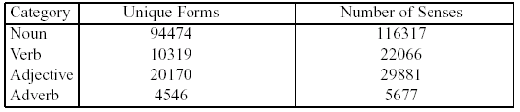
WordNet
Most widely used hierarchically organized lexical database for English (Fellbaum, 1998)
Demo: http://www.cogsci.princeton.edu/~wn/

Slide 31
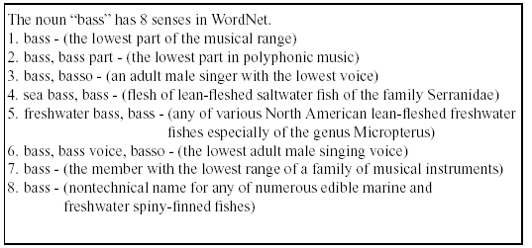
Format of WordNet Entries

Slide 32
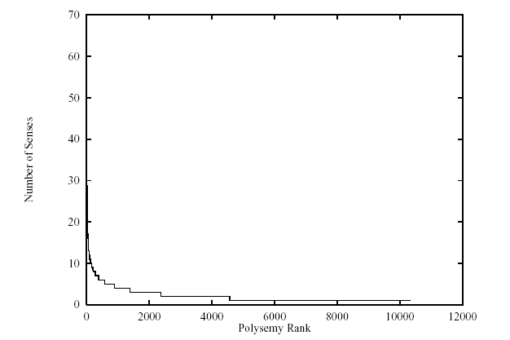
Distribution of Senses among WordNet Verbs

Slide 33
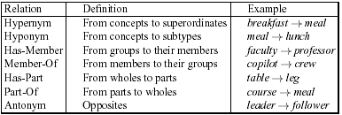


Lexical Relations in WordNet

Slide 34
Synsets in WordNet
Example: {chump, fish, fool, gull, mark, patsy, fall guy, sucker, schlemiel, shlemiel, soft touch, mug}
Definition: “a person who is gullible and easy to take advantage of”.
Important: This exact synset makes up one sense for each of the entries listed in the synset.
Theoretically, each synset can be viewed as a concept in a taxonomy
  Compare to: (∃w,x,y,z) Giving(x) ^ Giver(w,x) ^ Givee(z,x) ^ Given(y,x).
  WN represents “give” as 45 senses, one of which is the synset {supply, provide, render, furnish}.

Slide 35
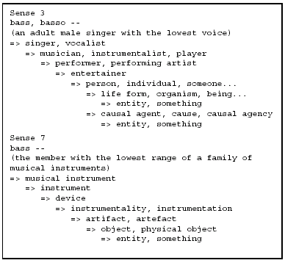
Hypernymy in WordNet

Slide 36
The problem of Word Sense Disambiguation
  Two examples:
  1. There is a table and 4 chairs in the dining room.
  2. The chair of the Computer Science and Engineering Department is Dr. T.
  For humans is not a real problem
  Ex. 1: chair = piece of furniture
  Ex. 2: chair = person
  For machines - a hard problem in NLP

Slide 37
WSD applicability
Why should one want to know the sense of a word ?
  Machine Translation
    See for instance AltaVista Babelfish
  Information Retrieval.
    Query: chair AND department AND math
    Retrieve documents:
      Referring to the Chair of the Department of Math
      Referring to some chairs in the Department of Math
  Knowledge acquisition
  Coreference

Slide 38
Word Sense...
Disambiguation:
  Distinguish word senses in texts with respect to a dictionary
  WordNet, LDOCE, Roget
Discrimination
  Cluster word senses in a text
  Pros:
    no need for a-priori dictionary definitions
    agglomerative clustering is a well studied field
  Cons:
    sense inventory varies from one text to another
    hard to evaluate
    hard to standardize

Slide 39
Word Sense Disambiguation
With respect to a dictionary (WordNet)
  1. (37) sense -- (a general conscious awareness; "a sense of security"; "a sense of happiness"; "a sense of danger"; "a sense of self")
  2. (23) sense, signified -- (the meaning of a word or expression; the way in which a word or expression or situation can be interpreted; "the dictionary gave several senses for the word"; "in the best sense charity is really a duty"; "the signifier is linked to the signified")
  3. (19) sense, sensation, sentience, sentiency, sensory faculty -- (the faculty through which the external world is apprehended)
  4. (8) common sense, good sense, gumption, horse sense, sense, mother wit -- (sound practical judgment; "I can't see the sense in doing it now"; "he hasn't got the sense God gave little green apples"; "fortunately she had the sense to run away")
  5. (1) sense -- (a natural appreciation or ability; "a keen musical sense"; "a good sense of timing")

Slide 40
Main directions
Knowledge-based approaches
  Lesk 86
Corpus based approaches
  Supervised algorithms:
    Instance-Based Learning (Ng & Lee 96)
    Naïve Bayes
  Semi-supervised algorithms: Yarowsky 95
  Hybrid algorithms (supervised + dictionary)

Slide 41
WSD evaluation: Senseval
Senseval 1: 1999 – about 10 teams
Senseval 2: 2001 – about 30 teams
Senseval 3: 2004 – check www.senseval.org for details
How to compare WSD systems?
  methodology
  sense inventory (what dictionary)
Senseval 1: Hector dictionary
  State-of-the-art for fine grained WSD is 75-80%
Senseval 2: WordNet dictionary
  Fine grained statistical systems: 64%
  Fine grained all words systems: 69%
Senseval 3: WordNet
  Many other tasks in addition to English WSD
  Broader Semantic Analysis
  Logic Form Identification task (27 participants)

Slide 42
Task Definition
Knowledge-based WSD = class of WSD methods relying (mainly) on knowledge drawn from dictionaries and/or raw text
Resources
  Machine Readable Dictionaries
  Raw corpora
No Manually annotated corpora
Scope
  All open class words

Slide 43
Machine Readable Dictionaries
In recent years, most dictionaries made available in Machine Readable format (MRD)
  Oxford English Dictionary
  Collins
  Longman Dictionary of Ordinary Contemporary English (LDOCE)
Thesauri – add synonymy information
  Roget Thesaurus
Semantic networks – add more semantic relations
  WordNet
  EuroWordNet

Slide 44
MRD – A Resource for Knowledge-based WSD
For each word in the language vocabulary, an MRD provides:
  A list of meanings
  Definitions (for all word meanings)
  Typical usage examples (for most word meanings)
WordNet definitions/examples for the noun plant
  buildings for carrying on industrial labor; "they built a large plant to manufacture automobiles“
  a living organism lacking the power of locomotion
  something planted secretly for discovery by another; "the police used a plant to trick the thieves"; "he claimed that the evidence against him was a plant"
  an actor situated in the audience whose acting is rehearsed but seems spontaneous to the audience

Slide 45
MRD – A Resource for Knowledge-based WSD
A thesaurus adds:
  An explicit synonymy relation between word meanings
A semantic network adds: hypernymy/hyponymy (IS-A), meronymy/holonymy (PART-OF), antonymy, entailment, etc.
WordNet synsets for the noun “plant”
1. plant, works, industrial plant
2. plant, flora, plant life
WordNet related concepts for the meaning “plant life”
{plant, flora, plant life}
hypernym: {organism, being}
hypomym: {house plant}, {fungus}, …
meronym: {plant tissue}, {plant part}
holonym: {Plantae, kingdom Plantae, plant kingdom}

Slide 46
Corpus Based Approaches: The Supervised Methodology
Create a sample of training data where a given target word is manually annotated with a sense from a predetermined set of possibilities
  One tagged word per instance/lexical sample disambiguation
Select a set of features with which to represent context
  co-occurrences, collocations, POS tags, verb-obj relations, etc...
Convert sense-tagged training instances to feature vectors.
Apply a machine learning algorithm to induce a classifier
  Form – structure or relation among features
  Parameters – strength of feature interactions
Convert a held out sample of test data into feature vectors
  “correct” sense tags are known but not used
Apply classifier to test instances to assign a sense tag

Slide 47
Naïve Bayesian Classifier
Naïve Bayesian Classifier well known in Machine Learning community for good performance across a range of tasks (e.g., Domingos and Pazzani, 1997)
…Word Sense Disambiguation is no exception
Assumes conditional independence among features, given the sense of a word
  The form of the model is assumed, but parameters are estimated from training instances
When applied to WSD, features are often “a bag of words” that come from the training data
  Usually thousands of binary features that indicate if a feature is present in the context of the target word (or not)

Slide 48
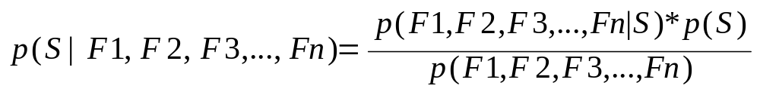
Bayesian Inference
Given observed features, what is most likely sense?
Estimate probability of observed features given sense
Estimate unconditional probability of sense
Unconditional probability of features is a normalizing term, doesn’t affect sense classification

Slide 49
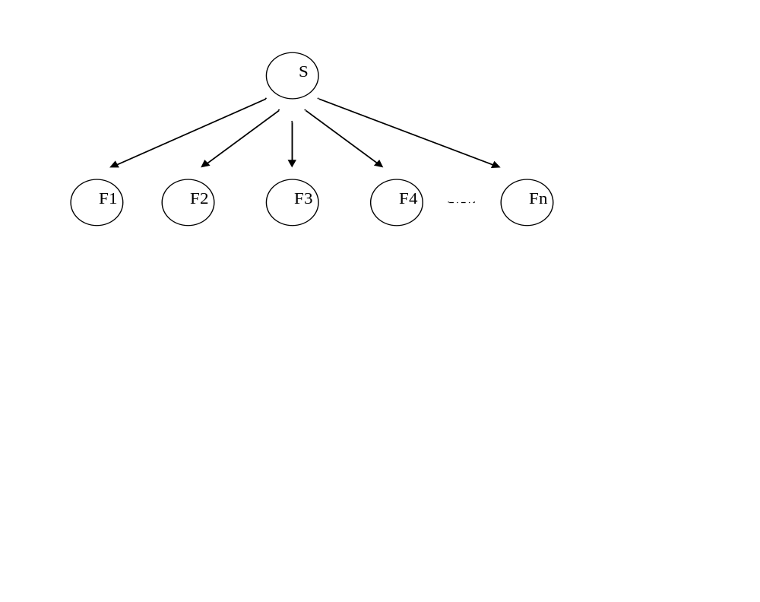
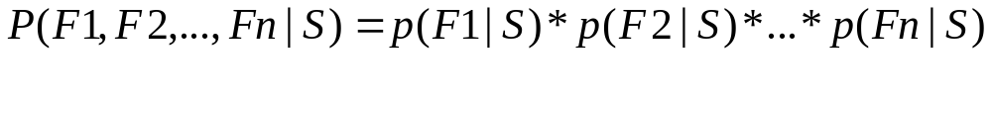
Naïve Bayesian Model

Slide 50
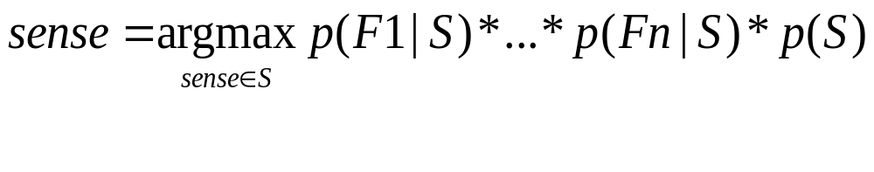
The Naïve Bayesian Classifier
  Given 2,000 instances of “bank”, 1,500 for bank/1 (financial sense) and 500 for bank/2 (river sense)
    P(S=1) = 1,500/2000 = .75
    P(S=2) = 500/2,000 = .25
  Given “credit” occurs 200 times with bank/1 and 4 times with bank/2.
    P(F1=“credit”) = 204/2000 = .102
    P(F1=“credit”|S=1) = 200/1,500 = .133
    P(F1=“credit”|S=2) = 4/500 = .008
  Given a test instance that has one feature “credit”
    P(S=1|F1=“credit”) = .133*.75/.102 = .978
    P(S=2|F1=“credit”) = .008*.25/.102 = .020

Slide 51
Comparative Results
(Leacock, et. al. 1993) compared Naïve Bayes with a Neural Network and a Context Vector approach when disambiguating six senses of line…
(Mooney, 1996) compared Naïve Bayes with a Neural Network, Decision Tree/List Learners, Disjunctive and Conjunctive Normal Form learners, and a perceptron when disambiguating six senses of line…
(Pedersen, 1998) compared Naïve Bayes with Decision Tree, Rule Based Learner, Probabilistic Model, etc. when disambiguating line and 12 other words…
…All found that Naïve Bayesian Classifier performed as well as any of the other methods!

Slide 52
Next …
Latent Semantic Analysis
Syntax-driven semantics: Logic Form

