Slide 1
Natural Language Processing
Vasile Rus
http://www.cs.memphis.edu/~vrus/teaching/nlp

Slide 2
Outline
Information Bottleneck
Solutions:
  Information Extraction
  Question Answering (QA)
Natural Language applied to Command and Control

Slide 3

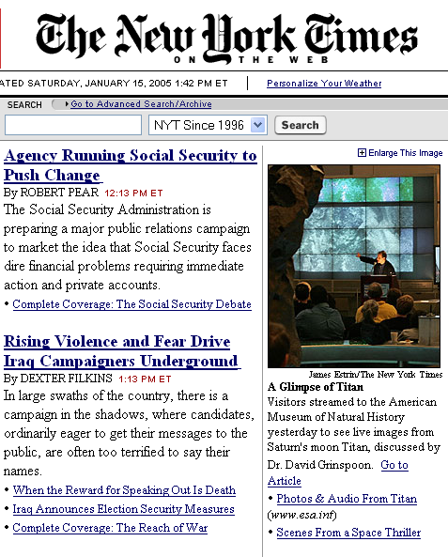

Information Bottleneck

Slide 4
Information and Information Needs
I want to know:
  What are the states already hooked to National Lambda Rail ?
  How much did they invest ?
  What is the major hub in each state ?
  What is the closest hub to Memphis/Murfreesboro/Nashville/etc. ?
How to gather this info:
  Do it myself with Google
  Ask my RA to collect it with Google
  Or …
Days or weeks

Slide 5
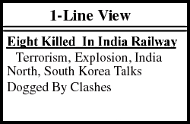

Information Processing
J
F
M
A
M
J
J
A
Meta
-Data
EMPLOYEE / EMPLOYER Relationships:
Jan Clesius
works for
Clesius
Enterprises
India Bombing
Bill Young
works for
InterMedia
Inc.
COMPANY / LOCATION
Relationshis
:
NY Times
Clesius Enterprises is in New York, NY
Andhra Bhoomi
InterMedia
Inc. is in Boston, MA
Dinamani
Dainik Jagran

Slide 6
Solutions
Metadata: have relational metadata associated with each document / web page
  Metadata manually inserted by content creators
  XML, Semantic Web
Information Extraction: automatically extract metadata
  From unstructured and semi-structured collections
  IE provides a way of automatically transforming semi-structured or unstructured data into an XML compatible format
Question Answering (QA)
  Closer to human QA process

Slide 7
What is Information Extraction ?
As a task:
Filling slots in a database from sub-segments of text.
October 14, 2002, 4:00 a.m. PT
For years, Microsoft Corporation CEO Bill Gates railed against the economic philosophy of open-source software with Orwellian fervor, denouncing its communal licensing as a "cancer" that stifled technological innovation.
Today, Microsoft claims to "love" the open-source concept, by which software code is made public to encourage improvement and development by outside programmers. Gates himself says Microsoft will gladly disclose its crown jewels--the coveted code behind the Windows operating system--to select customers.
"We can be open source. We love the concept of shared source," said Bill Veghte, a Microsoft VP. "That's a super-important shift for us in terms of code access.“
Richard Stallman, founder of the Free Software Foundation, countered saying…
IE
NAME TITLE ORGANIZATION
Bill Gates CEO Microsoft
Bill Veghte VP Microsoft
Richard Stallman founder Free Soft..

Slide 8
Terrorist Attack Example
At least seven police officers were killed and as many as 52 other people, including several children, were injured Monday in a car bombing that also wrecked a police station. Kirkuk´s police said they had "good information" that Ansar al-Islam was behind the blast.
<BOMBING> :=
BOMB: “a car bombing”
PERPETRATOR: “Ansar al-Islam”
DEAD: “At least seven police officers”
INJURED: “as many as 52 other people, including several children”
DAMAGE: “a police station”
LOCATION: ”Kirkuk”
DATE: “Monday”

Slide 9

Biomedical Data Example
Cell 2003 Jan 24;112(2):169-80
Twist Regulates Cytokine Gene Expression through a Negative Feedback Loop that Represses NF-kappaB Activity.
Sosic D, Richardson JA, Yu K, Ornitz DM, Olson EN.
During Drosophila embryogenesis, the dorsal transcription factor activates the expression of twist, a transcription factor required for mesoderm formation. We show here that the mammalian twist proteins, twist-1 and -2, are induced by a cytokine signaling pathway that requires the dorsal-related protein RelA, a member of the NF-kappaB family of transcription factors. Twist-1 and -2 repress cytokine gene expression through interaction with RelA. ...
PMID: 12553906 [PubMed - in process]
tf | i | tf
twist-1 | interact | RelA
twist-2 | interact | RelA
Info
Extract
80% Precision
30% Recall

Slide 10
What is so Hard About It ?
Language is complex
Argumentation is complex
Background knowledge is often required
Human intelligence and language understanding are closely linked
Document Format
The ultimate solution is to code up a thinking machine but the word on the street is that human intelligence is really hard to replicate.

Slide 11
Why is It so HARD to Process NL?
Mainly because of AMBIGUITIES!
Example:
  At last, a computer that understands you like your mother.
- 1985 McDonnell-Douglas ad
From Lilian Lee’s: "I'm sorry Dave, I'm afraid I can't do that": Linguistics, Statistics, and Natural Language Processing, circa 2001.

Slide 12
Ambiguities
Interpretations of the ad:
  1. The computer understands you as well as your mother understands you.
  2. The computer understands that you like your mother.
  3. The computer understands you as well as it understands your mother.

Slide 13
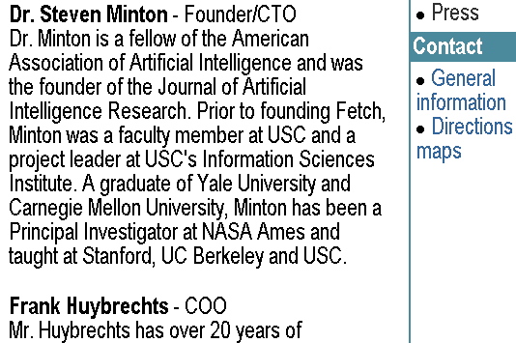
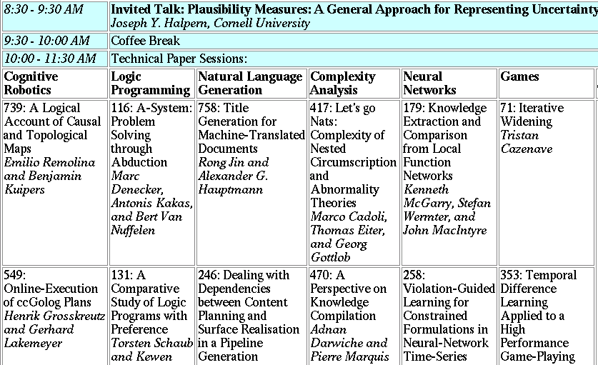
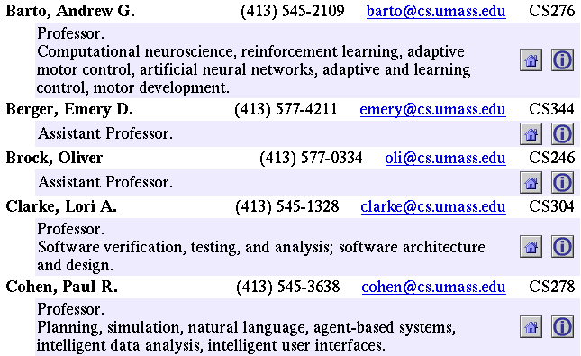
Landscape of IE Tasks:
Degree of Formatting
Text paragraphs
without formatting
Grammatical sentences
and some formatting & links
Astro Teller is the CEO and co-founder of BodyMedia. Astro holds a Ph.D. in Artificial Intelligence from Carnegie Mellon University, where he was inducted as a national Hertz fellow. His M.S. in symbolic and heuristic computation and B.S. in computer science are from Stanford University. His work in science, literature and business has appeared in international media from the New York Times to CNN to NPR.
Non-grammatical snippets,
rich formatting & links
Tables
Notes:
Different families of features may be more or less useful in different data sets.

Slide 14
State of the Art Performance
Named entity recognition from newswire text
  Person, Location, Organization, …
  Performance in high 80’s or low- to mid-90’s
Binary relation extraction
  Contained-in (Location1, Location2)
  Member-of (Person1, Organization1)
  Performance in 60’s or 70’s or 80’s

Slide 15
Other applications of IE Systems
Summarizing medical patient records by extracting diagnoses, symptoms, physical findings, test results.
Gathering earnings, profits, board members, etc. [corporate information] from web, company reports
Verification of construction industry specifications documents (are the quantities correct/reasonable?)
Extraction of political/economic/business changes from newspaper articles

Slide 16
Question Answering
Inputs:
  a question in English
  a large collection of text (Gb)
Output:
  a set of possible answers drawn from the collection
“What is the capital
of Italy?”
QA
SYSTEM
Text
Corpora
“Rome”

Slide 17
QA Performance
Mean Reciprocal Rank (MRR)
  Assign a perfect score of 1.0 for a correct answer on first position
  Assign ½ for a correct answer on second position
  Assign ¼ for a correct answer of on third position
State-of-the-art:
  MRR~55%
    You get the right answer on the second position most of the time

Slide 18
Architecture of Best QA System
Question
Question Type
IR engine
Named Entity Rec.
Answer Type
Paragraph Retrieval
Answer Extraction
Question Keywords
Quality
Answer Justification
Answers
Question Processing
Paragraph Retrieval
Answer Processing

Slide 19
Processing Overview
Candidate Docs
Candidate Pars
Candidate Answers
Top Five Answers
Doc 1
Paragraph 1
Answer 1
Answer 1
Paragraph 2
Answer 2
Answer 2
Doc 2
Paragraph 3
Answer 3
Answer 4
Answer k
Answer 5
Paragraph m
Doc n

Slide 20
Question Processing (1/2)
Tokenize the question, tag the question with parts of speech tags, syntactically parse the question
  Who/WHNP is/VBZ the/DT voice/NN of/IN Miss/NNP Piggy/NNP ?/?
Detect question type
  WHO
    Who was the first American in space ?
  WHERE
    Where is the Taj Mahal ?
  WHAT-WHO
    What two US biochemists won the Nobel Prize in medicine in 1992 ?
  WHAT-WHEN
    In what year did Joe DiMaggio compile his 56-game hitting streak ?

Slide 21
Question Processing (2/2)
Detect the answer type
  WHO => PERSON
  WHERE => LOCATION (city/country/state/…)
  WHAT-WHO => PERSON
Detect keywords for Information Retrieval (IR)
  Named Entities are extremely important
  Common nouns are important
  Verbs are not important
  Prepositions, conjunctions are not important at all

Slide 22
Paragraph Retrieval
Send selected keywords to an Information Retrieval (IR) system:
  {first, American, space}
Process the returned documents to find relevant paragraphs that might contain an answer
Order those paragraphs based on few relevant features:
  Same order keywords
  Proximity of keywords

Slide 23
Answer Processing
Detect candidate answers using the Answer type and a Named Entity Recognizer (NER)
  SMU/UNIVERSITY is in the heart of Dallas/CITY, a thriving metropolitan area. That our 163/QUANTITY tree-lined acres boast historic Collegiate Georgian buildings, beautiful lawns, and smiling faces. And that there's always something happening on campus. Or you could see for yourself. And while you’re here, you can learn all about admission, scholarships, financial aid, and campus life.
Order candidate answers based on a composed score:
  Same word sequence
  Same sentence score
  Matched keywords score
Return top five answers

Slide 24
Hard Questions
Q471: What year did Hitler die?
    best answer in a collection of documents
    A: “Hitler committed suicide in 1945”
    2. how to justify the answer:
    using world knowledge
    suicide – {kill yourself}
    kill – {cause to die}
How to build Knowledge Bases?
  manually
  automatically from online dictionaries such as WordNet

Slide 25
WordNet
Lexical database of English words
words with same meaning form a synset
  each synset has a gloss: definition + usage examples
Synsets are organized using a set of lexico-semantic relations:
  Hypernymy
  Hyponymy
  Meronymy
  Holonymy
  others
ISA relation
R-ISA relation
Nouns, verbs form a hierarchy

Slide 26
WordNet Glosses
WordNet glosses can be viewed as a rich source of knowledge
Question Answering example:
  Q471: What year did Hitler die?
  A: “Hitler committed suicide in 1945”
WordNet entries: {suicide}: (killing yourself} {kill}: ( cause to die)
To automatically exploit the world knowledge embedded in definitions they need to be mapped into a computational representation

Slide 27
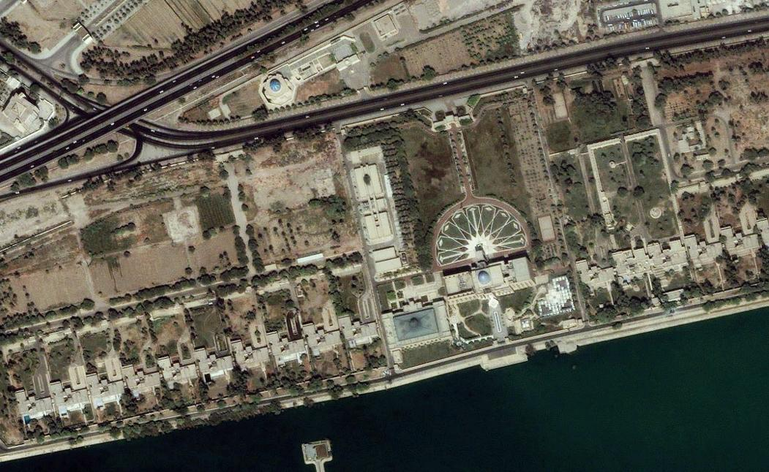
Multimedia QA
NL Command and Control (Waldinger et al. 2003)
Example:
“Show me the Sijood Palace in
Baghdad.”

Slide 28
Next Time
Summarization

Slide 29
Thank You!

