Slide 1
Natural Language Processing
Vasile Rus
http://www.cs.memphis.edu/~vrus/teaching/nlp

Slide 2
Outline
Summarization

Slide 3
AutoSummarize
Let’s try it! With Microsoft Word

Slide 4
What is text summarization?
to reduce (long) textual information to its most essential points
to distill the most important information from a source or sources to produce an abridged version of it (Endres-Niggemeyer, 1998; Mani and Maybury, 1999; Spärck-Jones, 1999).

Slide 5




an exciting challenge...
...put a book on the scanner, turn the dial to ‘2 pages’, and read the result...
...download 1000 documents from the web, send them to the summarizer, and select the best ones by reading the summaries of the clusters...
...forward the Japanese email to the summarizer, select ‘1 par’, and skim the translated summary.

Slide 6
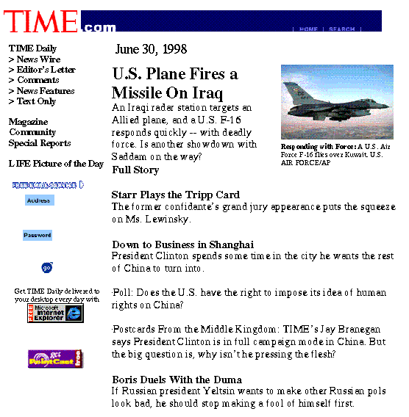
Headline news — informing

Slide 7
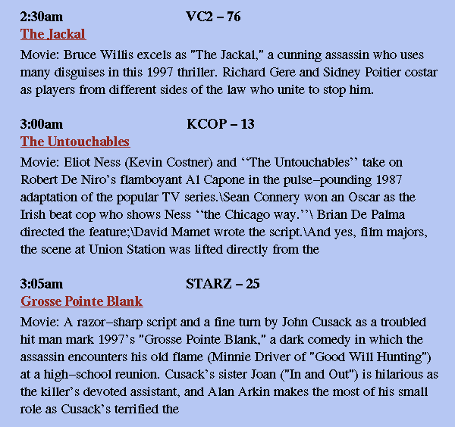
TV-GUIDES — decision making

Slide 8
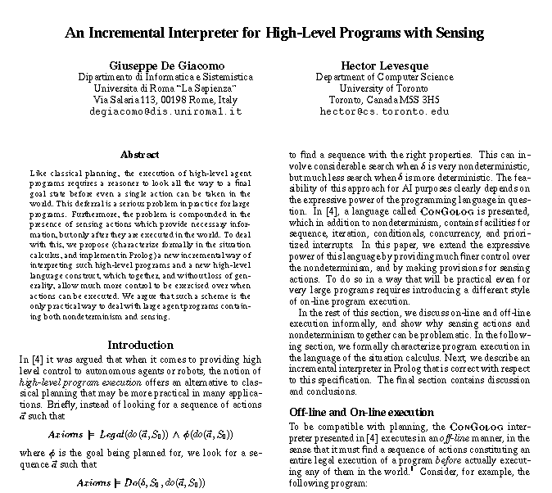
Abstracts of papers — time saving

Slide 9
Questions
What kinds of summaries do people want?
  What are summarizing, abstracting, gisting,...?
How sophisticated must summarization systems be?
  Are statistical techniques sufficient?
  Or do we need symbolic techniques and deep understanding as well?

Slide 10
Some concepts
Abstracts: “a concise summary of the central subject matter of a document” [Paice90].
Indicative, informative, and critical summaries
Extracts (representative sentences)

Slide 11
Types of summaries
dimensions
genres
context

Slide 12
Dimensions
Single-document vs. multi-document

Slide 13
Genres
headlines
outlines
minutes
biographies
abridgments
sound bites
movie summaries
chronologies, etc.
[Mani and Maybury 1999]

Slide 14
‘Genres’ of Summary?
Indicative vs. informative
  ...used for quick categorization vs. content processing.
Extract vs. abstract
  ...lists fragments of text vs. re-phrases content coherently.
Generic vs. query-oriented
  ...provides author’s view vs. reflects user’s interest.
Background vs. just-the-news
  ...assumes reader’s prior knowledge is poor vs. up-to-date.
Single-document vs. multi-document source
  ...based on one text vs. fuses together many texts.

Slide 15
Examples of Genres
Exercise: summarize the following texts for the following readers:
text1: Coup Attempt
text2: childrens’ story
reader1: your friend, who knows nothing about South Africa.
reader2: someone who lives in South Africa and knows the political position.
reader3: your 4-year-old niece.
reader4: the Library of Congress.

Slide 16
Context
Query-specific
Query-independent

Slide 17
What does summarization involve?
Three stages (typically)
  content identification
  conceptual organization
  realization

Slide 18
Spärck Jones’s three sets of factors
Input factors (source form, subject type, unit)
Purpose factors (situation, audience, use)
Output factors (material, format, style)
[Spärck Jones 99]

Slide 19
Aspects that Describe Summaries
Input (Sparck Jones 97)
  subject type: domain
  genre: newspaper articles, editorials, letters, reports...
  form: regular text structure; free-form
  source size: single doc; multiple docs (few; many)
Purpose
  situation: embedded in larger system (MT, IR) or not?
  audience: focused or general
  usage: IR, sorting, skimming...
Output
  completeness: include all aspects, or focus on some?
  format: paragraph, table, etc.
  style: informative, indicative, aggregative, critical...

Slide 20
Text summarization
Key issues:
  how to identify the most important content out of the rest of the text?
  how to synthesize the substance and formulate a summary text based on the identified content?
Major approaches:
  Selection based: produce ”extracts”
  Text understanding based: produce ”abstracts”

Slide 21
Overview of Extraction Methods
Position in the text
  lead method; optimal position policy
  title/heading method
Cue phrases in sentences
Word frequencies throughout the text
Cohesion: links among words
  word co-occurrence
  coreference
  lexical chains
Discourse structure of the text
Information Extraction: parsing and analysis

Slide 22
Selection based summarization: how does it work?
The most content-bearing sentences or passages are identified and selected to compose a summary.
Compute a significance value for each sentence: (Luhn, 1958; Edmundson, 1969)
  Count word frequency
  the keywords, title words, cue words it contains;
  the position of the sentence
RST (Rhetorical structure theory) based discourse analysis (Marcu, 1997)
Passage and sentence similarity analysis (Goldstein et al, 2000; CMU)

Slide 23
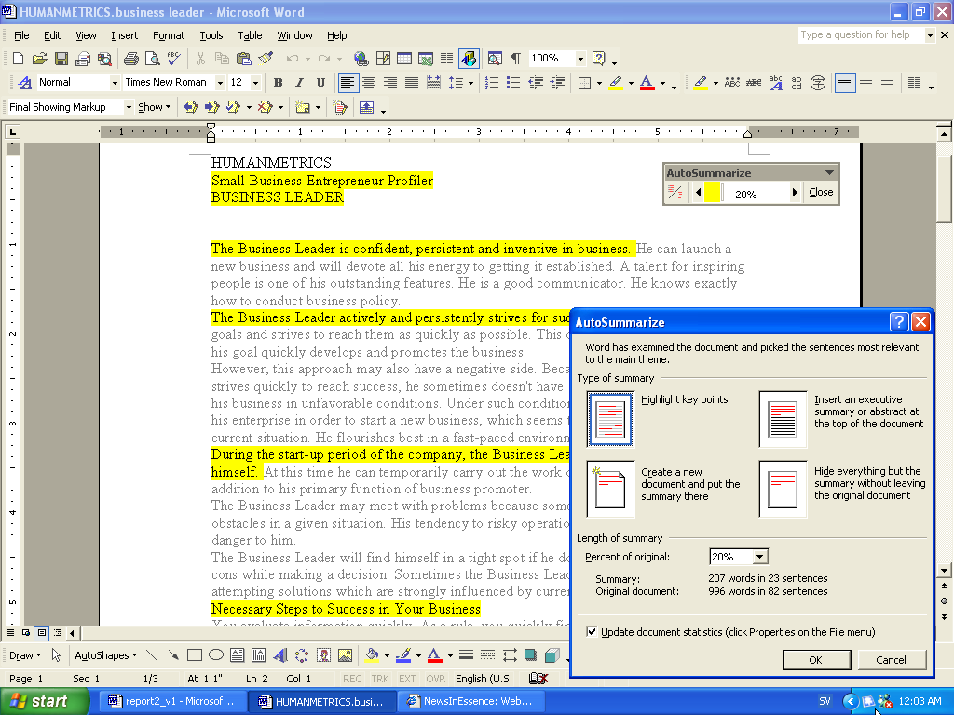
MSWord AutoSummarize

Slide 24
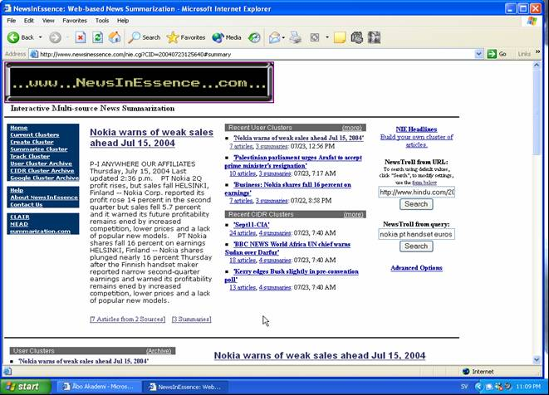
MEAD/NewsINEssence (Radev et al, 2003)

Slide 25
Text understanding system
A text understanding task often aims to recover all of the information that there is in a text, including what is implicit in what is actually written.
  “All the richness of natural language becomes fair game, including metaphor, metonymy, discourse structure, and the recognition of the author's underlying intentions, and the full interplay between language and world knowledge becomes central to the task.”

Slide 26
Text understanding based summarization
Depend on complete sentence analysis and discourse analysis with full knowledge support
  Syntactic parser, semantic interpreter
  Linguistic knowledge, world knowledge, domain knowledge
  Reasoning mechanisms that work effectively over huge knowledge collections

Slide 27
Selection based vs. Understanding based
Selection based: generally applicable, but incoherent content, poor readability due to unclear relationships between the selected text excerpts, dangling references, and so on.
Understanding based: high precision, but very slow, large amount of wasted computation, highly domain specific.
Endres-Niggenger (2000) found that, people prefer (sometimes) extractive summaries instead of gloss-over abstractive summaries!

Slide 28
The reality:
The dominant approach in practice is still selection-based;
Understanding based systems only exist in theory, and will continue to be so for quite a while;
However, certain text understanding tasks in small scale or restricted domains can be done.

Slide 29
Next time …
Review, Project Presentations, Final Exam

