Slide 1
Natural Language Processing
Vasile Rus
http://www.cs.memphis.edu/~vrus/teaching/nlp/

Slide 2
Outline
Part of Speech tagging revisited
Hidden Markov Models
Viterbi Algorithm

Slide 3
Part of Speech Tagging
Task: given a sentence assign to each word a part of speech tag from a tagset
Statistically:
  Maximize P(T|W)
Naïve: generate all possible tag sequences to determine which one is most likely. But there are an exponential number of possible tag sequences!
Better:
  Use Markov assumption: the next event is dependent on a finite history of previous events

Slide 4
Modeling POS tagging
t_{1m}
t_{2m}
t_{3m}
t_{nm}
t₁₂
t₂₂
t₃₂
t_{n2}
t₁₁
t₂₁
t₃₁
t_{n1}
W₁
W₂
W₃
W_{n}
w – word, t – tag, → dependency (to be labeled with a probability)

Slide 5
Hidden Markov Models
s_{1m}
s_{2m}
s_{3m}
s_{nm}
s₁₂
s₂₂
s₃₂
s_{n2}
s₁₁
s₂₁
s₃₁
s_{n1}
O₁
O₂
O₃
O_{n}
O – observation
S – state (hidden)
→ dependency

Slide 6
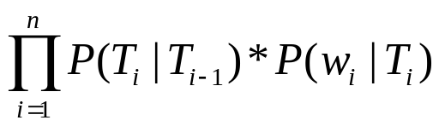
Computing the Probability of a Sentence and Tags
We want to find the sequence of tags that maximizes the formula P (T₁..T_{n}| w₁..w_{n}), which can be estimated as:
P (T_{i}| T_{i−1}) is computed by multiplying the arc values in the HMM
P (w_{i}| T_{i}) is computed by multiplying the lexical generation probabilities associated with each word

Slide 7
Hidden Markov Model (HMM)
HMMs allow you to estimate probabilities of unobserved events
Given plain text, which underlying parameters generated the surface
E.g., in speech recognition, the observed data is the acoustic signal and the words are the hidden parameters

Slide 8
HMMs and their Usage
HMMs are very common in Computational Linguistics:
  Speech recognition (observed: acoustic signal, hidden: words)
  Handwriting recognition (observed: image, hidden: words)
  Part-of-speech tagging (observed: words, hidden: part-of-speech tags)
  Machine translation (observed: words, hidden: words in target language)

Slide 9
Noisy Channel Model
In speech recognition you observe an acoustic signal (A=a₁,…,a_{n}) and you want to determine the most likely sequence of words (W=w₁,…,w_{n}): P(W | A)
Problem: A and W are too specific for reliable counts on observed data, and are very unlikely to occur in unseen data

Slide 10
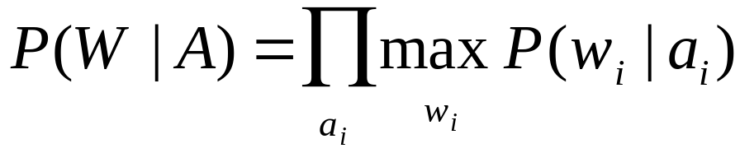
Noisy Channel Model
Assume that the acoustic signal (A) is already segmented with regard to word boundaries
P(W | A) could be computed as
Problem: Finding the most likely word corresponding to an acoustic representation depends on the context
E.g., /'pre-z&ns / could mean “presents” or “presence” depending on the context

Slide 11
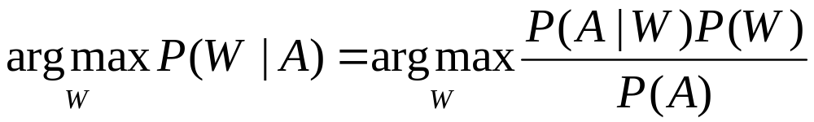
Noisy Channel Model
Applying Bayes’ rule:
The denominator P(A) can be dropped, because it is constant for all W
P(W) is the language model
P(A|W) is the acoustic model

Slide 12
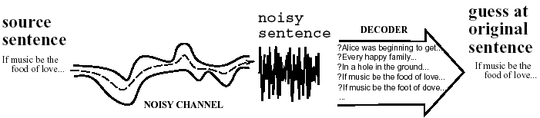
Noisy Channel in a Picture

Slide 13
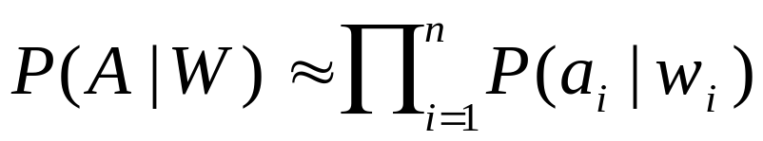
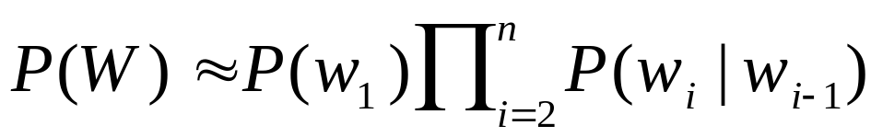
Decoding
The decoder combines evidence from
  The likelihood: P(A | W)
  This can be approximated as:
  The prior: P(W)
  This can be approximated as:

Slide 14


Search Space
Given a word-segmented acoustic sequence listing all candidates
Compute the most likely path
'bot | ik-'spen-siv | 'pre-z&ns
boat | excessive | presidents
bald | expensive | presence
bold | expressive | presents
bought | inactive | press

Slide 15
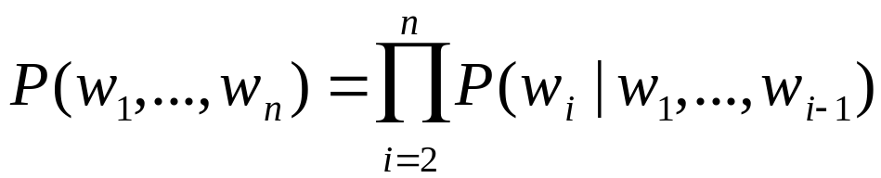
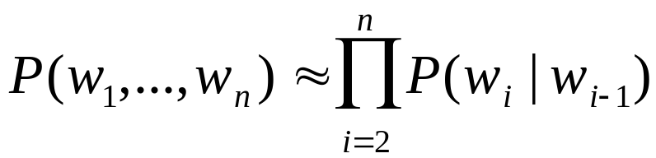
Markov Assumption
The Markov assumption states that probability of the occurrence of word w_{i} at time t depends only on occurrence of word w_{i-1} at time t-1
  Chain rule:
  Markov assumption:

Slide 16
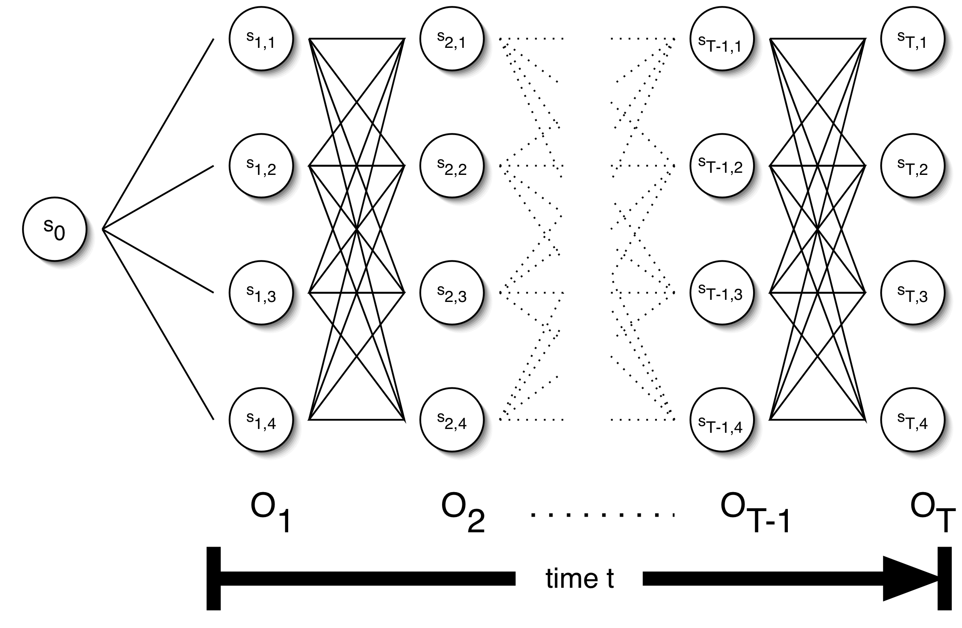
The Trellis

Slide 17

Parameters of an HMM
States: A set of states S=s₁,…,s_{n}
Transition probabilities: A= a_{1,1},a_{1,2},…,a_{n,n} . Each a_{i,j} represents the probability of transitioning from state s_{i} to s_{j}.
Emission probabilities: A set B of functions of the form b_{i}(o_{t}) which is the probability of observation o_{t} being emitted by s_{i}
Initial state distribution: is the probability that s_{i} is a start state

Slide 18

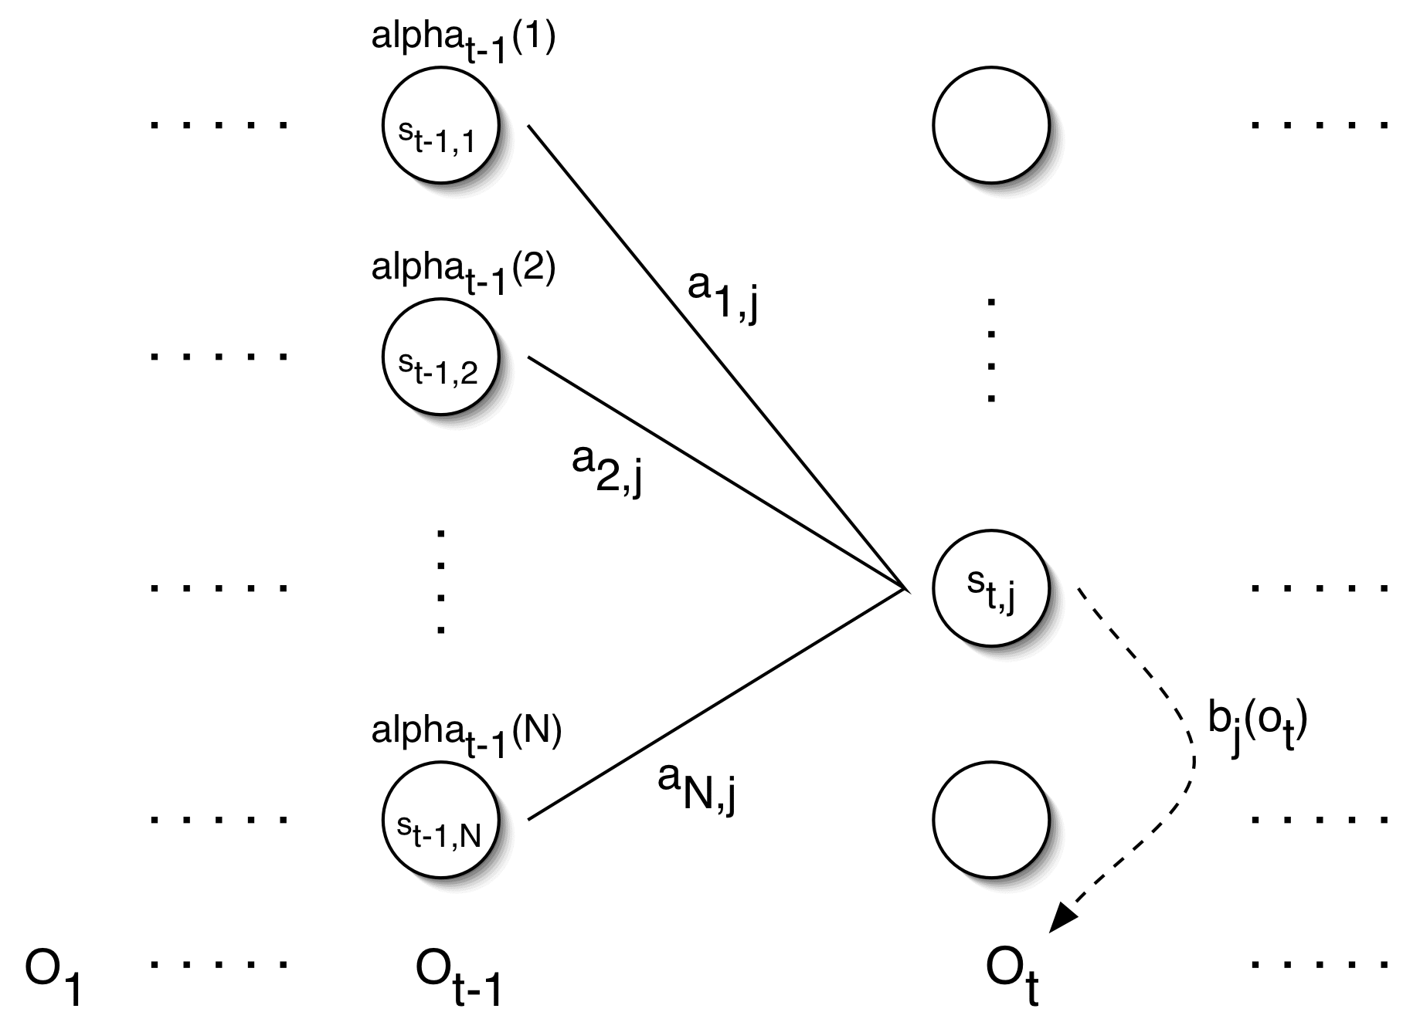
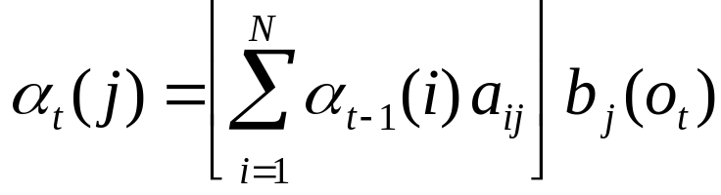
Forward Probabilities

Slide 19
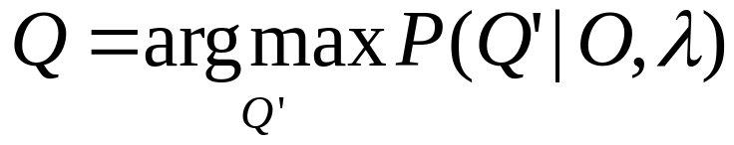
HMM Decoding
We want to find the path with the highest probability.
We want to find the state sequence Q=q₁…q_{T}, such that

Slide 20
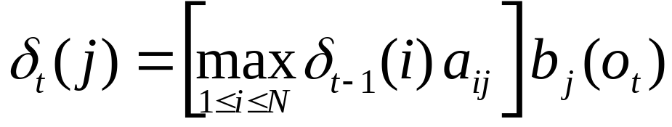
Viterbi Algorithm
Similar to computing the forward probabilities, but instead of summing over transitions from incoming states, compute the maximum
Forward:
Viterbi Recursion:

Slide 21
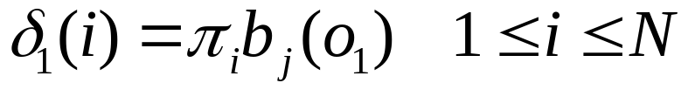
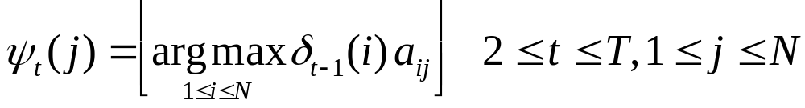
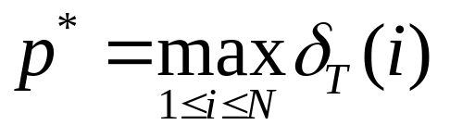
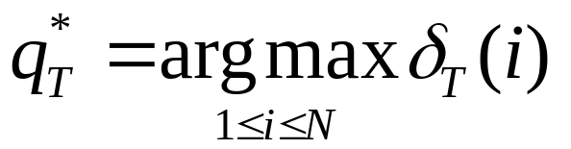
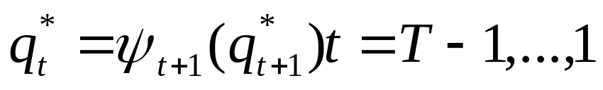
Viterbi Algorithm
Initialization:
Induction:
Termination:
Read out path:

Slide 22
HMM Taggers: Supervised vs. Unsupervised
Training Method
  Supervised
    Relative Frequency
    Relative Frequency with further Maximum Likelihood training
  Unsupervised
    Maximum Likelihood training with random start
Read corpus, compute counts
Use Forward-Backward to estimate lexical probabilities
Compute most likely hidden state sequence
Determine POS role that each state most likely plays

Slide 23
Hidden Markov Model Taggers
When?
  To tag a text from a specialized domain with word generation probabilities that are different from those in available training texts
  To tag text in a foreign language for which training corpora do not exist at all
Initialization of Model Parameter
  Randomly initialize all lexical probabilities involved in the HMM
  Use dictionary information
    Jelinek’s method
  Equivalence class
    group all the words according to the set of their possible tags
    E.g. bottom, top  JJ-NN class

Slide 24
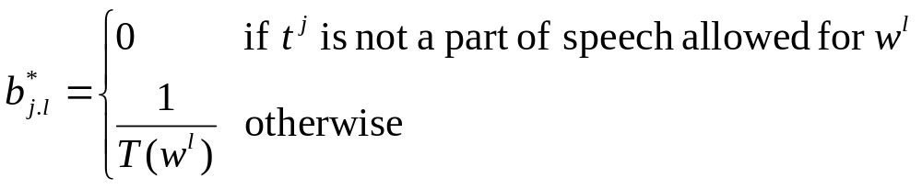
Hidden Markov Model Taggers
Jelinek’s method
  Assuming that words occur equally likely with each of their possible tags

Slide 25
Summary
Part of Speech tagging revisited
Hidden Markov Models
Forward Algorithm
Viterbi Algorithm
Backward Algorithm
Forward-Backward Algorithm

Slide 26
Next Time!
Syntax!

