Slide 1
Natural Language Processing
Vasile Rus
http://www.cs.memphis.edu/~vrus/teaching/nlp

Slide 2
Cortana: The Most Human AI Ever Built
Maybe
https://www.yahoo.com/tech/inside-windows-cortana-the-most-human-ai-ever-124740656729.html

Slide 3
Major Trend Now: Building Personal Assistants
The new killer app
Windows Cortana
Google Now
Apple’s Siri
Amazon’s Alexa
  Integrated in Amazon’s Echo, available for about $190 from Amazon.com

Slide 4
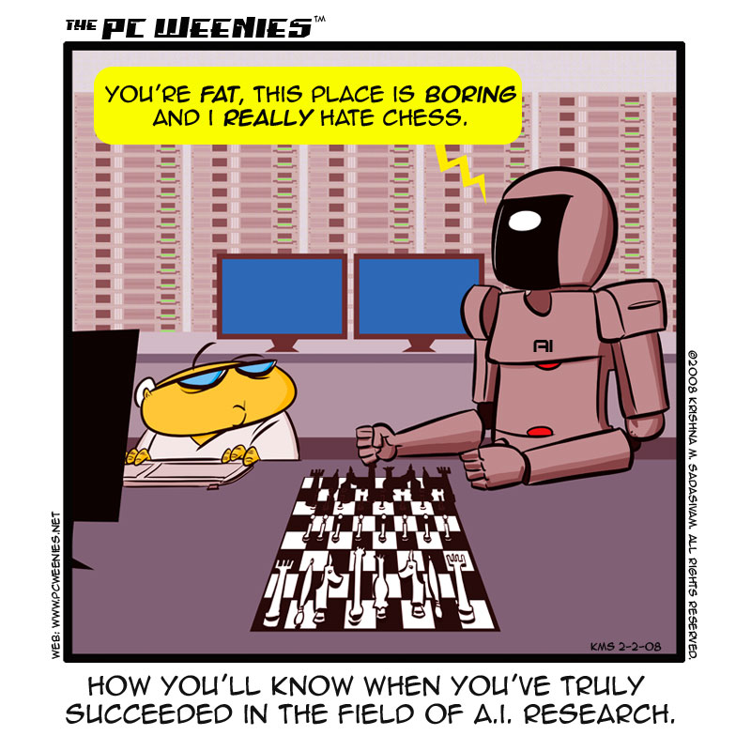
Let’s start with some humor …

Slide 5
Overview
Announcements
What is NLP?
Levels of Language Processing
A little bit of History

Slide 6
Announcements
Web Page:
  http://ww.cs.memphis.edu/~vrus/teaching/nlp/
Check the page at least daily
  It is the main way of getting latest info about class

Slide 7
Why a NLP course/curse ?
Natural Language (NL) is a natural way to communicate/exchange information
Computers can naturally handle strings
  They store / input / process/ output information in ways not closely related to human language
NL Processing is bridging the two worlds
  Bringing the computer closer to humans rather than the other way around

Slide 8
Why a NLP course ?
To see where we are in passing the ultimate test of intelligent systems:
  The Turing Test: Human-Computer conversation indistinguishable from Human-2-Human conversation
To understand, process, and render language for applications such as
  Conversational Systems, Auto-Tutoring, Reading Comprehension, Translation, Summarization, Question Answering, Information Extraction, etc.

Slide 9
Why a NLP course ?
“Ultimate objective is to transform the human-computer
communication experience so that users can address a
computer at any time and any place at least as effectively
as if they were addressing another person”
National Science Foundation
Human Language and Communication Program

Slide 10
NLP/CL/HLT/… ?
Why a NLP course?
  Natural Language Processing
  Computational Linguistics
  Language Understanding
  (Intelligent) Text Processing
  Human Language Technology
  Natural Language Engineering
  Etc.
NLP is NOT Speech Processing
  NLP is about written language
  Voice Processing would be a better choice for Speech Processing

Slide 11
Goals of this Course
Learn about problems and possibilities of Natural Language Processing:
  What are the major issues?
  What are the major solutions?
    How well do they work ?
    How do they work ?

Slide 12
Goals of this Course
At the end you should:
  Agree that language is subtle and interesting!
  Feel some ownership over the algorithms
  Be able to assess NLP problems
    Know which solutions to apply, when, and how
  Be able to read papers in the field
  Provide your own solutions to NLP problems

Slide 13
Questions the Course Will Answer
What kinds of things do people say?
What do these things say about the world?
What words, rules, statistical facts do we find?
Can we build programs that learn from text?

Slide 14
Today
Motivation
Course Goals
Why NLP is difficult
Levels/Stages of language processing
The two approaches
History
  Corpus-based statistical approaches
  Symbolic methods

Slide 15
Why is It so HARD to Process NL?
Mainly because of AMBIGUITIES!
Example:
  At last, a computer that understands you like your mother.
- 1985 McDonnell-Douglas ad
From Lilian Lee’s: "I'm sorry Dave, I'm afraid I can't do that": Linguistics, Statistics, and Natural Language Processing, circa 2001

Slide 16
Ambiguities
Interpretations of the ad:
  1. The computer understands you as well as your mother understands you.
  2. The computer understands that you like your mother.
  3. The computer understands you as well as it understands your mother.

Slide 17
What is Language ?
□▫ ☼◊▼◘ ◙■◦▫▼►□ ▫◙
☼▼◘ ◙■◦▫□ ▫◙ ☼ ▫▼►□
▼◘ ▼◘ ▼◦▫□►□◙ ▼◘
To a 6-month old child a written sentence in English is nothing more than the following sentence, in a ‘geometric’ language, is to you:

Slide 18
What is Language ?
Why not teach computers English, Chinese, German, Italian, Romanian, … ?
How ?
  Take the NLP class
  Work hard
  Hopefully at the end of the class you will have a better idea how to teach computers a Natural Language!

Slide 19
Humans vs Computers
Computers “see” text in English the same you have seen the previous text!
People have no trouble understanding language
  Communicate to each other (socialize)
  Common sense knowledge
  Reasoning capacity
  Experience
Computers have
  No common sense knowledge
  No reasoning capacity
Computers do not socialize
Unless we teach them!

Slide 20
Humans vs Computers
Computers are not brains
  There is evidence that much of language understanding is built-in to the human brain
Key problems:
  Representation of meaning
  Language only reflects the surface of meaning
  Language presupposes communication between people

Slide 21
Levels of Language Processing
Speech Processing/Character Recognition
  Speech: Phonetics and Phonology
Natural Language Processing
  Morphology
  Syntax
  Semantics
  Pragmatics
  Discourse
Interaction of the two above

Slide 22
Speech/Character Recognition
Decomposition into words, segmentation of words into appropriate phones or letters
Requires knowledge of phonological patterns:
  I’m enormously proud.
  I mean to make you proud.

Slide 23
Phonetics and Phonology
Phonetics and phonology: how words and corresponding sounds relate
    It's very hard to recognize speech.
    It's very hard to wreck a nice beach.

Slide 24
Morphology
Morphology: how words are formed from smaller units called morphemes
  Leads to smaller/lighter dictionaries
  Morphological parsing:
    Foxes: fox + es
    helps a lot for morphologically complex languages (Turkish, Welsh)
      Welsh example
        Llanfairpwllgwyngyllgogerychwyrndrobwyll-llantisiliogogogoch
        the Church of Mary in a white hollow by a hazel tree near a rapid whirlpool by the church of St. Tisilio by a red cave
        "Llanfairpwllgwyngyll" or simply "Llanfair P.G."
  Spelling changes
    drop, dropping
    hide, hiding
  Stemming is similar (but not identical)
    Foxes stems to fox
    used in Information Retrieval

Slide 25
Syntax
Concerns how words group together in larger chunks, namely phrases and sentences
Different syntactic structure implies different interpretation
  The pod bay door is open.
  Is the pod bay door open ?
  I saw the ostrich with a telescope.
  Colorless green ideas sleep furiously.

Slide 26
Syntactic Analysis
Associate constituent structure with string
Prepare for semantic interpretation
S
NP VP
I V NP
OR: watch
Subject Object
I terrapin
Det
the
watched det N
the terrapin

Slide 27
Semantics
Example: good syntax but meaningless
  Colorless green ideas sleep furiously.
Lexical Semantics: deals with meaning of individual words
  The word plant has two very distinct senses
    Physical plant
    Flower
Compositional Semantics: deals with the semantics of larger constructs
  I wanna eat someplace that’s close to the campus.

Slide 28
Semantics
A way of representing meaning
Abstracts away from syntactic structure
Example:
  First-Order Logic: watch(I,terrapin)
  Can be: “I watched the terrapin” or “The terrapin was watched by me”

Slide 29
Pragmatics
Pragmatics: concerns how sentences are used in different situations and how use affects the interpretation of the sentence
  If you scratch my back I will scratch yours

Slide 30
Pragmatics
Real world knowledge, speaker intention, goal of utterance.
Related to sociology.
Example 1:
  Could you turn in your assignments now (command)
  Could you finish the homework? (question, command)
Example 2:
  I couldn’t decide how to catch the crook. Then I decided to spy on the crook with binoculars.
  To my surprise, I found out he had them too. Then I knew to just follow the crook with binoculars.
  [ the crook [with binoculars]]
  [ the crook] [ with binoculars]

Slide 31
Discourse
Concerns how sentences group together in larger units of communication
  I saw the ostrich with a telescope. He stole it from the nearby store.

Slide 32
Discourse Analysis
Discourse: multi-sentence processing.
  Pronoun reference:
  The professor told the student to finish the assignment. He was pretty aggravated at how long it was taking to pass it in.
  Multiple reference to same entity:
  George W. Bush, president of the U.S.
  Relation between sentences:
  John hit the man. He had stolen his bicycle.

Slide 33
NLP Pipeline
speech
text
Phonetic Analysis
Character Recognition
Morphological analysis
Syntactic analysis
Semantic Interpretation
Discourse Processing

Slide 34
Two Approaches
Symbolic
  Encode all the necessary knowledge
  Good when annotated data is not available
  Allows steady development
  The development can be monitored
  Fits well with logic and reasoning in AI
Statistical
  Learn language from its usage
  Supervised learning require large collections manually annotated with meta-tags
  Development is almost blind
    Few ways to check the correctness
    Debugging is very frustrating

Slide 35
History: 1940’s and 1950’s
Work on two foundational paradigms
  Automaton
  Probabilistic or information-theoretic models

Slide 36
History: 1940’s and 1950’s
Automaton
  Turing’s (1936) model of algorithmic computation
  McCulloch-Pitts neuron as a simplified computing element
  Kleene’s (1951, 1956) finite automata and regular expressions
  Shannon (1948) applied probabilistic models of discrete Markov processes to automata for language
  Chomsky (1956) inspired from Shannon’s work
    First considered finite-state machines as a way to characterize a grammar
    Led to the field of formal language theory: a language is a sequence of symbols

Slide 37
The Two Camps: 1957-1970
Symbolic camp
Stochastic camp

Slide 38
At the Dawn of Computing Era …
Late ‘50s and early ‘60s
  Margaret Masterman & colleagues designed semantic nets for machine translation
1964:
  Danny Bobrow’s work at MIT shows that computers can understand natural language well enough to solve algebra world problems correctly
  Bert Raphael’s work at MIT demonstrates the power of a logical representation of knowledge for question answering
1965:
  Joseph Weizenbaum built ELIZA, an interactive program that carries on a dialogue in English on any topic
1966:
  Negative report on machine translation kills Natural Language Processing Research
1969:
  Roger Schank (Stanford) defined conceptual dependency model for natural language understanding

Slide 39
ALPAC Report - 1966
Automatic Language Processing Advisory Committee (ALPAC 1966)
  a committee set up by US sponsors of research in MT due to slow progress
Concluded that MT had failed according to its own aims, since there were no fully automatic systems capable of good quality translation and there seemed little prospect of such systems in the near future
The committee was also convinced that, as far as US government and military needs for Russian-English translation were concerned, there were more than adequate human translation resources available

Slide 40
The Two Camps: 1957-1970
Symbolic camp
  Chomsky: formal language theory, generative syntax, parsing
  Linguists and computer scientists
  Earliest complete parsing systems
    Zelig Harris, UPenn: A possible critique reading!!!

Slide 41
The Two Camps: 1957-1970
Symbolic camp – Artificial intelligence
  Created in the summer of 1956
  Two-month workshop at Dartmouth
  Focus of the field initially was the work on reasoning and logic (Newell and Simon)
Early natural language systems that were built
  Worked in a single domain
  Used pattern matching and keyword search

Slide 42
The Two Camps: 1957-1970
Stochastic camp
  Took hold in statistics and EE
  Late 50’s: applied Bayesian methods to OCR (optical character recognition)
  Mosteller and Wallace (1964): applied Bayesian methods to the problem of authorship attribution for The Federalist papers.

Slide 43
Additional Developments
1960’s
  First on-line corpora: The Brown corpus of American English
    1 million word collection of samples from 500 written texts
    Different genres (news, novels, non-fiction, academic,….)
    Assembled at Brown University (1963-64, Kucera and Francis)
    William Wang’s (1967) DOC (Dictionary on Computer)
      On-line Chinese dialect dictionary

Slide 44
Explosion in research: 1970-1983
Stochastic paradigm
  Developed speech recognition algorithms
  HMM (Hidden Markov Models)
  Developed independently by Jelinek et al. at IBM and Baker at CMU
Logic-based paradigm
  Prolog, definite-clause grammars (Pereira and Warren, 1980)
  Functional grammar (Kay, 1979) and LFG (Lexical Functional Grammars)

Slide 45
Explosion of research: 1970-1983
1970:
  Jaime Carbonell developed SCHOLAR, an interactive program for computer-aided instruction based on semantic nets as the representation of knowledge
Natural language understanding
  SHRDLU (Winograd, 1972)
  The Yale School (Schank and colleagues)
    Focused on human conceptual knowledge and memory organization
  Logic-based LUNAR question-answering system (Woods, 1973)
  Discourse modeling paradigm (Grosz and colleagues)

Slide 46
Revival of Empiricism and FSM’s: 1983-1993
Finite-state models for
  Phonology and morphology (Kaplan and Kay, 1981)
  Syntax (Church, 1980)
Return of empiricism
  Rise of probabilistic models in speech and language processing
  Largely influenced by work in speech recognition at IBM
Considerable work on natural language generation

Slide 47
Coming Together: 1994-1999
Probabilistic and data-driven models had become quite standard
Increases in speed and memory of computers allowed commercial exploitation of speech and language processing
  Spelling and grammar checking
Rise of the Web emphasized the need for language-based information retrieval and information extraction
  Mushrooming of search engines

Slide 48
Summary
Syllabus
Introduction to NLP/CL

Slide 49
Next
Perl
Words
Project Discussion

