Slide 1
Natural Language Processing
Vasile Rus
http://www.cs.memphis.edu/~vrus/teaching/nlp

Slide 2
Outline
Announcements
Word Categories (Parts of Speech)
Part of Speech Tagging

Slide 3
Announcements
Paper presentations
Projects

Slide 4
Language
Language = words grouped according to some rules called a grammar
Language = words + rules
  Rules are too flexible for system developers
  Rules are not flexible enough for poets

Slide 5
Words and their Internal Affairs: Morphology
Words are grouped into classes/ grammatical categories/ syntactic categories/parts-of-speech (POS) based
  on their syntactic and morphological behavior
    Noun: words that occur with determiners, take possessives, occur (most but not all) in plural form
  and less on their typical semantic type
    Luckily the classes are semantically coherent at some extent
A word belongs to a class if it passes the substitution test
  The sad/intelligent/green/fat bug sucks cow’s blood.
They all belong to the same class: ADJ

Slide 6
Words and their Internal Affairs: Morphology
Word categories are of two types:
  Open categories: accept new members
    Nouns
    Verbs
    Adjectives
    Adverbs
  Closed or functional categories
    Almost fixed membership
    Few members
    Determiners, prepositions, pronouns, conjunctions, auxiliary verbs?, particles, numerals, etc.
    Play an important role in grammar
Any known human language has nouns and verbs (Nootka is a possible exception)

Slide 7
Nouns
Noun is the name given to the category containing: people, places, or things
A word is a noun if:
  Occurs with determiners (a student)
  Takes possessives (a student’s grade)
  Occurs in plural form (focus - foci)
English Nouns
  Count nouns: allow enumeration (rabbits)
  Mass nouns: homogeneous things (snow, salt)

Slide 8
Verbs
Words that describe actions, processes or states
Subclasses of Verbs:
  Main verbs
  Auxiliaries (copula be, do, have)
  Modal verbs: mark the mood of the main verb
    Can: possibility
    May: permission
    Must: necessity
  Phrasal verbs: verb + particle
    Particle: word that combines with verb
      It is often confused with prepositions or adverbs
      Can appear in places in which prepositions and adverbs cannot
        For example before a preposition: I went on for a walk

Slide 9
Adjectives & Adverbs
Adjectives: words that describe qualities or properties
Adverbs: a very diverse class
  Subclasses
    Directional or locative adverbs (northwards)
    Degree adverbs (very)
    Manner adverbs (fast)
    Temporal adverbs (yesterday, Monday)
      Monday: Isn’t it a noun ?

Slide 10
Prepositions
Occur before noun phrases
They are relational words indicating temporal or spatial relations or other relations
  by the river
  by tommorow
  by Shakespeare

Slide 11
Conjunctions
Used to join two phrases, clauses, or sentences
Subclasses
  Coordinating conjunctions (and, or, but)
  Subordinating conjunctions or complementizers (that)
    link a verb to its argument

Slide 12
Pronouns
A shorthand for noun phrases or entities or events
Subclasses:
  Personal pronouns: refer to persons or entities
  Possessive pronouns
  Wh-pronouns: in questions and as complementizers

Slide 13
Other categories
Interjections: oh, hey
Negatives: no, not
Politeness markers: please
Greetings: hello
Existentials: there

Slide 14
Tagsets
Tagset – set of categories/POS
The number of categories differ among tagsets
Trade-off between granularity (finer categories) and simplicity
Available Tagsets:
  Dionysius Thrax of Alexandria: 8 tags [circa 100 B.C.]
  Brown corpus: 87 tags
  Penn Treebank: 45 tags
  Lancaster UCREL project’ C5 (used to tag the BNC): 61 tags (see Appendix C)
  C7: 145 tags (see Appendix C)

Slide 15
The Brown Corpus
The first digital corpus (1961)
  Francis and Kucera, Brown University
Contents: 500 texts, each 2000 words long
  From American books, newspapers, magazines
  various genres:
    Science fiction, romance fiction, press reportage, scientific writing, popular lore

Slide 16
Penn Treebank
First syntactically annotated corpus
1 million words from Wall Street Journal
Part of speech tags and syntax trees

Slide 17
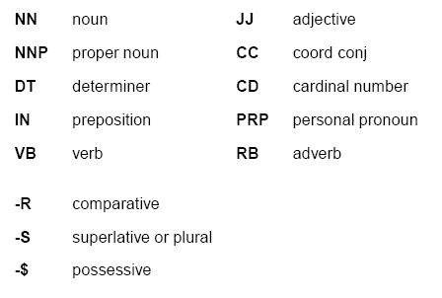
Important Penn Treebank Tags

Slide 18
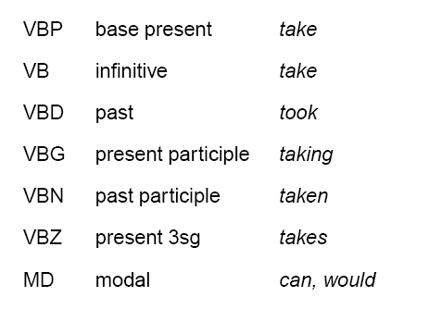
Verb Inflection Tags

Slide 19
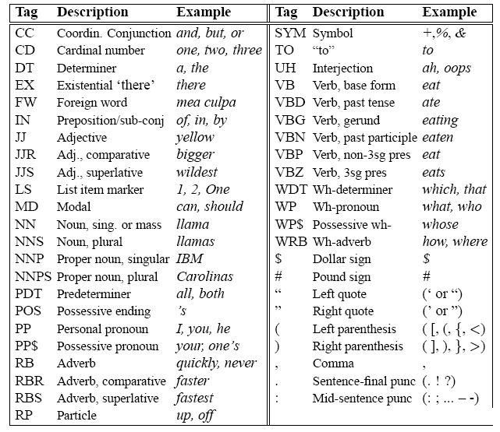
Penn Treebank Tagset

Slide 20
Terminology
Tagging
  The process of labeling words in a text with part of speech or other lexical class marker
Tags
  The labels
Tag Set
  The collection of tags used for a particular task

Slide 21
Example
Input: raw text
Output: text as word/tag
Mexico/NNP City/NNP has/VBZ a/DT very/RB bad/JJ pollution/NN problem/NN because/IN the/DT mountains/NNS around/IN the/DT city/NN act/NN as/IN
walls/NNS and/CC block/NN in/IN dust/NN and/CC smog/NN ./.
Poor/JJ air/NN circulation/NN out/IN of/IN the/DT mountain-walled/NNP Mexico/NNP City/NNP aggravates/VBZ pollution/NN ./.
Satomi/NNP Mitarai/NNP died/VBD of/IN blood/NN loss/NN ./.
Satomi/NNP Mitarai/NNP bled/VBD to/TO death/NN ./.

Slide 22
Significance of Parts of Speech
A word’s POS tells us a lot about the word and its neighbors:
  Can help with pronunciation: object (NOUN) vs object (VERB)
  Limits the range of following words for Speech Recognition
    a personal pronoun is most likely followed by a verb
  Can help with stemming
    A certain category takes certain affixes
  Can help select nouns from a document for IR
  Parsers can build trees directly on the POS tags instead of maintaining a lexicon
  Can help with partial parsing in Information Extraction

Slide 23
Choosing a tagset
The choice of tagset greatly affects the difficulty of the problem
Need to strike a balance between
  Getting better information about context (introduce more distinctions)
  Make it possible for classifiers to do their job (need to minimize distinctions)

Slide 24
Issues in Tagging
Ambiguous Tags
  hit can be a verb or a noun
  Use some context to better choose the correct tag
Unseen words
  Assign a FOREIGN label to unknowns
  Use some morphological information
    guess NNP for a word with an initial capital
closed-class words in English HELP tagging
    Prepositions, auxiliaries, etc.
    New ones do not tend to appear

Slide 25
How hard is POS tagging?
In the Brown corpus,
- 11.5% of word types ambiguous
- 40% of word TOKENS
Number of tags | 1 | 2 | 3 | 4 | 5 | 6 | 7
Number of word types | 35340 | 3760 | 264 | 61 | 12 | 2 | 1

Slide 26
Tagging methods
Rule-based POS tagging
Statistical taggers
  more on this in few weeks
Brill’s (transformation-based) tagger

Slide 27
Rule-based Tagging
Two stage architecture
  Dictionary: an entry = word + list of possible tags
  Hand-coded disambiguation rules
ENGTWOL tagger
  56,000 entries in lexicon
  1,100 constraints to rule out incorrect POS-es

Slide 28
Evaluating a Tagger
Tagged tokens – the original data
Untag the data
Tag the data with your own tagger
Compare the original and new tags
  Iterate over the two lists checking for identity and counting
  Accuracy = fraction correct

Slide 29
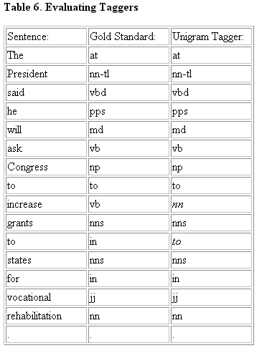
Evaluating the Tagger
This gets 2 wrong
out of 16, or 12.5% error
Can also say an accuracy
of 87.5%.

Slide 30
Training vs. Testing
A fundamental idea in computational linguistics
Start with a collection labeled with the right answers
  Supervised learning
  Usually the labels are assigned by hand
“Train” or “teach” the algorithm on a subset of the labeled text
Test the algorithm on a different set of data
  Why?
    Need to generalize so the algorithm works on examples that you haven’t seen yet
    Thus testing only makes sense on examples you didn’t train on

Slide 31
Statistical Baseline Tagger
Find the most frequent tag in a corpus
Assign to each word the most frequent tag

Slide 32
Lexicalized Baseline Tagger
For each word detect its possible tags and their frequency
Assign the most common tag to each word
  90-92% accuracy
  Compare to state of the art taggers: 96-97% accuracy
  Humans agree on 96-97% of the Penn Treebank’s Brown corpus

Slide 33
Tagging with Most Likely Tag
Secretariat/NNP is/VBZ expected/VBN to/TO race/VB tomorrow/NN
People/NNS continue/VBP to/TO inquire/VB the/DT reason/NN for/IN the/DT race/NN for/IN outer/JJ space/NN
Problem: assign most likely tag to race
Solution: we choose the tag that has the greater probability
  P(VB|race)
  P(NN|race)
Estimates from the Brown corpus:
  P(NN|race) = .98
  P(VB|race) = .02

Slide 34
Stastistical Tagger
The Linguistic Complaint
  Where is the linguistic knowledge of a tagger?
  Just a massive table of numbers
  Aren’t there any linguistic insights that could emerge from the data?
  Could thus use handcrafted sets of rules to tag input sentences, for example, if a word follows a determiner tag it as a noun

Slide 35
The Brill tagger
An example of TRANSFORMATION-BASED LEARNING
Very popular (freely available, works fairly well)
A SUPERVISED method: requires a tagged corpus
Basic idea: do a quick job first (using the lexicalized baseline tagger), then revise it using contextual rules

Slide 36
Brill Tagging: In more detail
Training: supervised method
  Detect most frequent tag for each word
  Detect set of transformations that could improve the lexicalized baseline tagger
Testing/Tagging new words in sentences
  For each new word apply the lexicalized baseline step
  Apply set of learned transformation in order
  Use morphological info for unknown words

Slide 37
An example
Examples:
  It is expected to race tomorrow.
  The race for outer space.
Tagging algorithm:
  Tag all uses of “race” as NN (most likely tag in the Brown corpus)
    It is expected to race/NN tomorrow
    the race/NN for outer space
  Use a transformation rule to replace the tag NN with VB for all uses of “race” preceded by the tag TO:
    It is expected to race/VB tomorrow
    the race/NN for outer space

Slide 38
Transformation-based learning in the Brill tagger
Tag the corpus with the most likely tag for each word
Choose a TRANSFORMATION that deterministically replaces an existing tag with a new one such that the resulting tagged corpus has the lowest error rate
Apply that transformation to the training corpus
Repeat
Return a tagger that
  first tags using most frequent tag for each word
  then applies the learned transformations in order

Slide 39
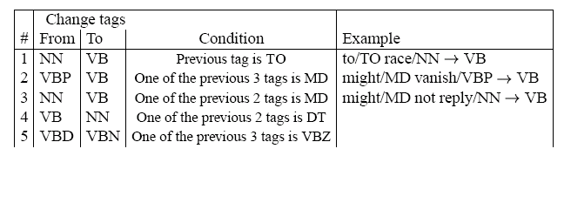
Examples of learned transformations

Slide 40
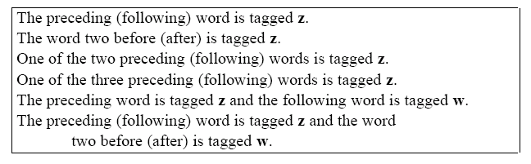
Templates

Slide 41
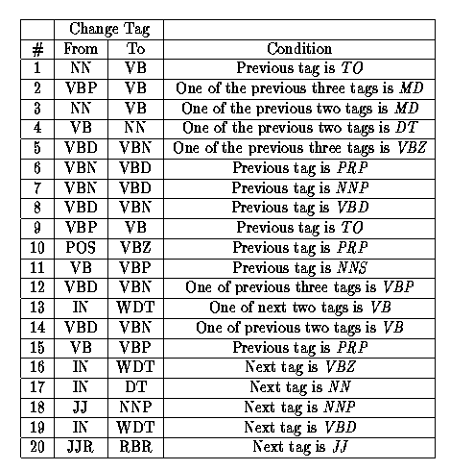
First 20 Transformation Rules
From: Transformation-Based Error-Driven Learning and Natural Language Processing: A Case Study in Part of Speech Tagging Eric Brill. Computational Linguistics. December, 1995.

Slide 42
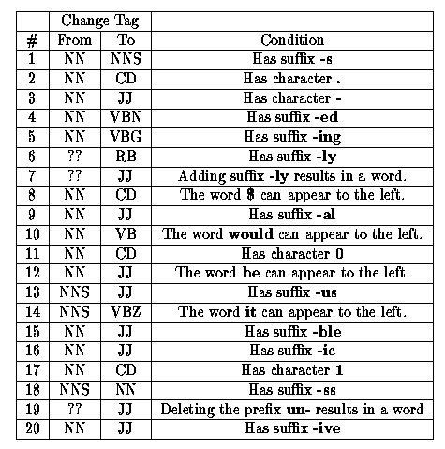
Transformation Rules for Tagging Unknown Words
From: Transformation-Based Error-Driven Learning and Natural Language Processing: A Case Study in Part of Speech Tagging Eric Brill. Computational Linguistics. December, 1995.

Slide 43
Summary
Parts of Speech
Part of Speech Tagging

Slide 44
Next Time
Language Modeling

