Slide 1
Natural Language Processing
Vasile Rus
http://www.cs.memphis.edu/~vrus/teaching/nlp/

Slide 2
Outline
Tokenization
Sentence Boundaries
N-grams
  Language models
  Smoothing methods

Slide 3
Language
Language = words grouped according to some rules called a grammar
Language = words + rules
  Rules are too flexible for system developers
  Rules are not flexible enough for poets

Slide 4
Language
Dictionary
  set of words defined in the language
  open (dynamic)
Grammar
  set of rules which describe what is allowable in a language
  Classic Grammars
    meant for humans who know the language
    definitions and rules are mainly supported by examples
    no (or almost no) formal description tools; cannot be programmed
  Explicit Grammar (CFG, Dependency Grammars,...)
    formal description
    can be programmed & tested on data (texts)

Slide 5
Written Language Processing
Preprocessing
Morphology: handles words
Syntax
Semantics
Pragmatics
Discourse
handle rules for grouping
words in legal
language constructs

Slide 6
More on Words
Type vs. token
  Type is a vocabulary entry
  Token is an occurrence in a text of a word
Word senses
How many words are there in the following sentence:
“If she is right and I am wrong then we are way over to the right of where we ought to be.”

Slide 7
Preprocessing
The simplest way to represent a text is as a stream of characters
Difficult to process text in this format
It would be nice to work with words
The task of converting a text from a stream/string to a list of tokens is known as tokenization

Slide 8
Where are the Words ?
□▫ ☼◊▼◘ ◙■◦▫▼►□ ▫◙
☼▼◘ ◙■◦▫□ ▫◙ ☼ ▫▼►□
▼◘ ▼◘ ▼◦▫□►□◙ ▼◘
What if I told you ▫ is ‘space’ would you be able to detect the words ?
Try to detect anything between spaces in the following sentence:
  Westchester County has hired an expert on "cyberbullying" to talk to students, teachers, parents and police about young people who harass their peers with mean-spirited Web sites, hounding text messages, invasive cell-phone photos and other high-tech tools.
Are they all proper words ?

Slide 9
Preprocessing: Tokenization
Simplest tokenizer: everything between white spaces are words

Slide 10
Preprocessing: Tokenization
Punctuation is only part of written language
  Nobody speaks hyphens, semicolumns, etc.
  They help better recording the spoken language
Tokenization is the process of detecting words and separating punctuation from written words
  Treebank Guidelines

Slide 11
Tokenization:Treebank Guidelines
most punctuation is split from adjoining words
double quotes (") are changed to doubled single forward- and backward- quotes (`` and '')
verb contractions and the Anglo-Saxon genitive of nouns are split into their component morphemes, and each morpheme is tagged separately. Examples
  children's --> children 's
  parents' --> parents '
  won't --> wo n't
  gonna --> gon na
  I'm --> I 'm
This tokenization allows us to analyze each component separately, so (for example) "I" can be in the subject Noun Phrase while "'m" is the head of the main verb phrase
There are some subtleties for hyphens vs. dashes, elipsis dots (...) and so on, but these often depend on the particular corpus or application of the tagged data
In parsed corpora, bracket-like characters are converted to special 3-letter sequences, to avoid confusion with parse brackets. Some POS taggers, such as Adwait Ratnaparkhi's MXPOST, require this form for their input
In other words, these tokens in POS files: ( ) [ ] { } become, in parsed files: -LRB- -RRB- -RSB- -RSB- -LCB- -RCB- (The acronyms stand for (Left|Right) (Round|Square|Curly) Bracket.)

Slide 12
Where are the Sentences ?
~ 90% of periods are sentence breaks
State of the art: 99% accuracy
English capitalization can help
The Problem: period . ; it can denote
  a decimal point (5.6)
  an abbreviation (Mr.)
  the end of a sentence
  thousand segment separator: 3.200 (three-thousand-two-hundred)
  initials: A. B. Smith
  ellipsis …

Slide 13
Preprocessing: Sentence Breaks
"`Whose frisbee is this?' John asked, rather self-consciously. `Oh, it's one of the boys' said the Sen.“
The group included Dr. J. M. Freeman and T. Boone Pickens Jr.
a. It was due Friday by 5 p.m. Saturday would be too late.
a.b. She has an appointment at 5 p.m. Saturday to get her car fixed.

Slide 14
Algorithm
Hypothesize SB after all occurrences of . ? !
Move boundary after following quotation marks
Disqualify periods if:
  Preceded by a known abbreviation that is not usually sentence final, but followed by a proper name: Prof. or vs.
  Preceded by a known abbreviation and not followed by an uppercase word
Disqualify a boundary with a ? or ! if:
  It is followed by a lowercase letter
Regard other hypothesized SBs as sentence boundaries

Slide 15
Words and Their Co-occurence
Tokenization helps mapping text representation from strings of chars to sequences of words
Once you have words you can model language using statistics about word co-occurences, i.e. N-grams

Slide 16
Language Models
A number of applications can benefit from language statistics
Build language models
  To determine the probability of a sequence of words
  To make word predictions
    “I’d like to make a collect ….”
N-gram = use previous N-1 words to predict the next one
  Also called language model (LM), or grammar
Important for
  Speech recognition
  Spelling correction
  Hand-writing recognition
  …

Slide 17
Why N-grams?
Compute likelihood P([n_{i}]|w)
Word
P(term|w)
P(w)
P(term|w)P(w)
new
.36
.001
.00036
P([n_{i}]|new)P(new)
P([n_{i}]|neat)P(neat)
P([n_{i}]|need)P(need)
P([n_{i}]|knee)P(knee)
neat
.52
.00013
.000068
need
.11
.00056
.000062
knee
1.00
.000024
.000024
Unigram approach: ignores context
Need to factor in context (n-gram)
  Use P(need|I) instead of just P(need)
  Note: P(new|I) < P(need|I)

Slide 18
Next Word Prediction
From a NY Times story...
  Stocks plunged this ….
  Stocks plunged this morning, despite a cut in interest rates
  Stocks plunged this morning, despite a cut in interest rates by the Federal Reserve, as Wall ...
  Stocks plunged this morning, despite a cut in interest rates by the Federal Reserve, as Wall Street began
  Stocks plunged this morning, despite a cut in interest rates by the Federal Reserve, as Wall Street began trading for the first time since last Tuesday's terrorist attacks.

Slide 19
Human Word Prediction
Domain knowledge
Syntactic knowledge
Lexical knowledge

Slide 20
Claim
A useful part of the knowledge needed to allow Word Prediction can be captured using simple statistical techniques
Compute:
  probability of a sequence
  likelihood of words co-occurring
Why would we want to do this?
  Rank the likelihood of sequences containing various alternative hypotheses
  Assess the likelihood of a hypothesis

Slide 21
Why is this useful?
Speech recognition
Handwriting recognition
Spelling correction
Machine translation systems
Optical character recognizers

Slide 22
Handwriting Recognition
Assume a note is given to a bank teller, which the teller reads as I have a gub. (cf. Woody Allen)
NLP to the rescue ….
  gub is not a word
  gun, gum, Gus, and gull are words, but gun has a higher probability in the context of a bank

Slide 23
Real Word Spelling Errors
They are leaving in about fifteen minuets to go to her house.
The study was conducted mainly be John Black.
Hopefully, all with continue smoothly in my absence.
Can they lave him my messages?
I need to notified the bank of….
He is trying to fine out.

Slide 24
For Spell Checkers
Collect list of commonly substituted words
  piece/peace, whether/weather, their/there ...
Example:
“On Tuesday, the whether …’’
“On Tuesday, the weather …”

Slide 25
Language Model
Definition: Language model is a model that enables one to compute the probability P, or likelihood, of a sentence S, denoted as P(S).
Let’s look at different ways of computing P(S) in the context of Word Prediction

Slide 26
Word Prediction:
Simple vs. Smart
Simple: Every word follows every other word with equal probability (0-gram)
  Assume |V| is the size of the vocabulary
  Likelihood of sentence S of length n is = 1/|V| × 1/|V| … × 1/|V|
  If English has 100,000 words, probability of each next word is 1/100000 = .00001
n times
Smarter: probability of each next word is related to word frequency (unigram)
  – Likelihood of sentence S = P(w₁) × P(w₂) × … × P(w_{n})
  – Assumes probability of each word is independent of probabilities of other words.
Even smarter: Look at probability given previous words (N-gram)
  – Likelihood of sentence S = P(w₁) × P(w₂|w₁) × … × P(w_{n}|w_{n-1})
  – Assumes probability of each word is dependent on probabilities of other words.

Slide 27
Chain Rule
Conditional Probability
  P(A₁,A₂) = P(A₁) · P(A₂|A₁)
The Chain Rule generalizes to multiple events
  P(A₁, …,A_{n}) = P(A₁) P(A₂|A₁) P(A₃|A₁,A₂)…P(A_{n}|A₁…A_{n-1})
Examples:
  P(the dog) = P(the) P(dog | the)
  P(the dog bites) = P(the) P(dog | the) P(bites| the dog)

Slide 28
Relative Frequencies and Conditional Probabilities
Relative word frequencies are better than equal probabilities for all words
  In a corpus with 10K word types, each word would have P(w) = 1/10K
  Does not match our intuitions that different words are more likely to occur (e.g. the)
Conditional probability more useful than individual relative word frequencies
  Dog may be relatively rare in a corpus
  But if we see barking, P(dog|barking) may be very large

Slide 29
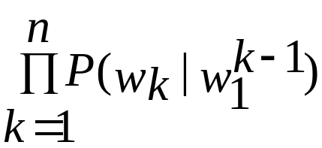
For a Sequence of Words
In general, the probability of a complete sequence of words w₁…w_{n} is
P(w₁^{n} ) = P(w₁)P(w₂|w₁)P(w₃|w₁..w₂)… P(w_{n}|w₁…w_{n-1}) =
But this approach to determining the probability of a word sequence is not very helpful in general – gets to be computationally very expensive

Slide 30
Markov Assumption
How do we compute P(w_{n}|w₁^{n-1})?
Trick: Instead of P(rabbit|I saw a), we use P(rabbit|a).
  This lets us collect statistics in practice
  A bigram model:
P(the barking dog) = P(the|<start>) P(barking|the) P(dog|barking)

Slide 31
Markov Assumption
Markov models are the class of probabilistic models that assume that we can predict the probability of some future event without looking too far into the past
  Specifically, for N=2 (bigram):
    P(w₁^{n}) ≈ Π_{k=1} ^{n} P(w_{k}|w_{k-1})
Order of a Markov model: length of prior context
  bigram is first order, trigram is second order, …

Slide 32
Counting Words in Corpora
What is a word?
  e.g., are cat and cats the same word?
  September and Sept?
  zero and oh?
  Is seventy-two one word or two? AT&T?
  Punctuation?
How many words are there in English?
Where do we find the things to count?

Slide 33
Corpora
Corpora are (generally online) collections of text and speech
Examples:
  Brown Corpus (1M words)
  Wall Street Journal and AP News corpora
  ATIS, Broadcast News (speech)
  TDT (text and speech)
  Switchboard, Call Home (speech)
  TRAINS, FM Radio (speech)
Compiled corpora (for specific tasks)
TREC (500 mil. words) – for Information Retrieval evaluations
WSJ, AP, ATIS, …
British National Corpus (100 mil. words) – balanced corpus

Slide 34
Training and Testing
Probabilities come from a training corpus, which is used to design the model
  overly narrow corpus: probabilities don't generalize
  overly general corpus: probabilities don't reflect task or domain
A separate test corpus is used to evaluate the model, typically using standard metrics
  held out test set
  cross validation
  evaluation differences should be statistically significant

Slide 35
Terminology
Sentence: unit of written language
Utterance: unit of spoken language
Word Form: the inflected form that appears in the corpus
Lemma: lexical forms having the same stem, part of speech, and word sense
Types (V): number of distinct words that might appear in a corpus (vocabulary size)
Tokens (N): total number of words in a corpus
Types seen so far (T): number of distinct words seen so far in corpus (smaller than V and N)

Slide 36
Simple N-Grams
An N-gram model uses the previous N-1 words to predict the next one:
  P(w_{n} | w_{n-N+1} w_{n-N+2…} w_{n-1} )
unigrams: P(dog)
bigrams: P(dog | big)
trigrams: P(dog | the big)
quadrigrams: P(dog | chasing the big)

Slide 37
Using N-Grams
Recall that
  N-gram: P(w_{n}|w₁^{n-1} ) ≈ P(w_{n}|w_{n-N+1}^{n-1})
  Bigram: P(w₁^{n}) ≈ Π P(w_{k}|w_{k-1})
For a bigram grammar
  P(sentence) can be approximated by multiplying all the bigram probabilities in the sequence
Example:
P(I want to eat Chinese food) =
P(I | <start>) P(want | I) P(to | want) P(eat | to) P(Chinese | eat) P(food | Chinese)

Slide 38
A Bigram Grammar Fragment
Eat on | .16 | Eat Thai | .03
Eat some | .06 | Eat breakfast | .03
Eat lunch | .06 | Eat in | .02
Eat dinner | .05 | Eat Chinese | .02
Eat at | .04 | Eat Mexican | .02
Eat a | .04 | Eat tomorrow | .01
Eat Indian | .04 | Eat dessert | .007
Eat today | .03 | Eat British | .001

Slide 39
Additional Grammar
<start> I | .25 | Want some | .04
<start> I’d | .06 | Want Thai | .01
<start> Tell | .04 | To eat | .26
<start> I’m | .02 | To have | .14
I want | .32 | To spend | .09
I would | .29 | To be | .02
I don’t | .08 | British food | .60
I have | .04 | British restaurant | .15
Want to | .65 | British cuisine | .01
Want a | .05 | British lunch | .01

Slide 40
Computing Sentence Probability
P(I want to eat British food) = P(I|<start>) P(want|I) P(to|want) P(eat|to) P(British|eat) P(food|British) = .25×.32×.65×.26×.001×.60 = .000080
vs.
P(I want to eat Chinese food) = .00015
Probabilities seem to capture “syntactic'' facts, “world knowledge''
  eat is often followed by a NP
  British food is not too popular
N-gram models can be trained by counting and normalization

Slide 41
N-grams issues
Sparse data
  Not all n-grams found in training data
  need smoothing
Change of domain
  Train on WSJ, attempt to identify Shakespeare – won’t work

Slide 42
N-grams issues
N-grams more reliable than (N-1)-grams
Language Generation experiment
  Choose N-Grams according to their probabilities and string them together
  For bigrams – start by generating a word that has a high probability of starting a sentence, then choose a bigram that is high given the first word selected, and so on

Slide 43
Approximating Shakespeare
As we increase the value of N, the accuracy of the N-gram model increases, since choice of next word becomes increasingly constrained
Generating sentences with random unigrams...
  Every enter now severally so, let
  Hill he late speaks; or! a more to leg less first you enter
With bigrams...
  What means, sir. I confess she? then all sorts, he is trim, captain.
  Why dost stand forth thy canopy, forsooth; he is this palpable hit the King Henry.

Slide 44
Approximating Shakespeare (cont’d)
Trigrams
  Sweet prince, Falstaff shall die.
  This shall forbid it should be branded, if renown made it empty.
Quadrigrams
  What! I will go seek the traitor Gloucester.
  Will you not tell me who I am?

Slide 45
Approximating Shakespeare (cont’d)
There are 884,647 tokens, with 29,066 word form types, in about a one million word Shakespeare corpus
Shakespeare produced 300,000 bigram types out of 844 million possible bigrams: so, 99.96% of the possible bigrams were never seen (have zero entries in the table)
Quadrigrams worse: What's coming out looks like Shakespeare because it is Shakespeare

Slide 46
N-Gram Training Sensitivity
If we repeated the Shakespeare experiment but trained our N-grams on a Wall Street Journal corpus, what would we get?
This has major implications for corpus selection or design

Slide 47
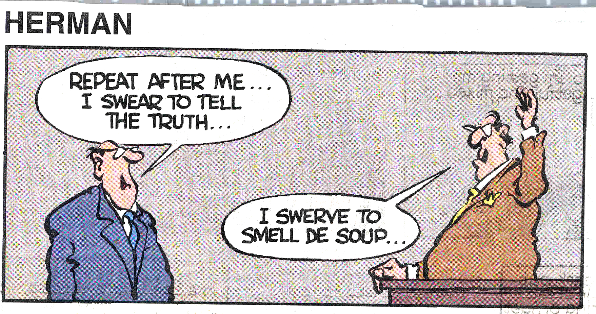
Example of bad language model

Slide 48
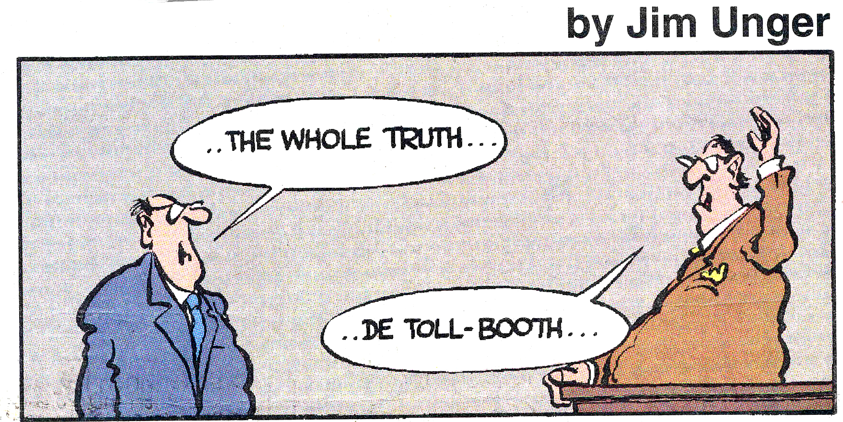
A bad language model

Slide 49
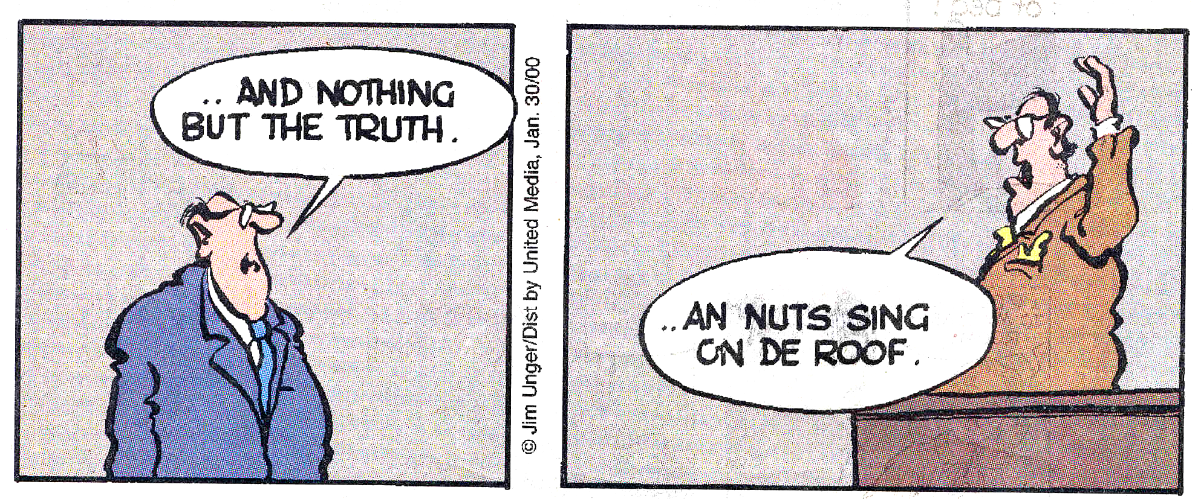
A bad language model

Slide 50
A Good Language Model
Determine reliable sentence probability estimates
  should have smoothing capabilities (avoid the zero-counts)
  apply back-off strategies: if N-grams are not possible, back-off to (N-1) grams
P(“And nothing but the truth”) ≈ 0.001
P(“And nuts sing on the roof”) ≈ 0

Slide 51
Bigram Counts
 | I | Want | To | Eat | Chinese | Food | Lunch
I | 8 | 1087 | 0 | 13 | 0 | 0 | 0
Want | 3 | 0 | 786 | 0 | 6 | 8 | 6
To | 3 | 0 | 10 | 860 | 3 | 0 | 12
Eat | 0 | 0 | 2 | 0 | 19 | 2 | 52
Chinese | 2 | 0 | 0 | 0 | 0 | 120 | 1
Food | 19 | 0 | 17 | 0 | 0 | 0 | 0
Lunch | 4 | 0 | 0 | 0 | 0 | 1 | 0

Slide 52
Bigram Probabilities:
Use Unigram Count
Normalization: divide bigram count by unigram count of first word.
Computing the probability of I I
  P(I|I) = C(I I)/C(I) = 8 / 3437 = .0023
A bigram grammar is an VxV matrix of probabilities, where V is the vocabulary size
I | Want | To | Eat | Chinese | Food | Lunch
3437 | 1215 | 3256 | 938 | 213 | 1506 | 459

Slide 53
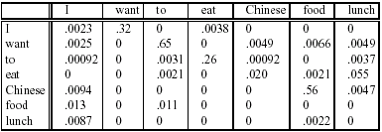
Learning a Bigram Grammar
The formula P(w_{n}|w_{n-1}) = C(w_{n-1}w_{n})/C(w_{n-1}) is used for bigram “parameter estimation”

Slide 54
Smoothing Techniques
Every n-gram training matrix is sparse, even for very large corpora (Zipf’s law )
Solution: estimate the likelihood of unseen n-grams

Slide 55
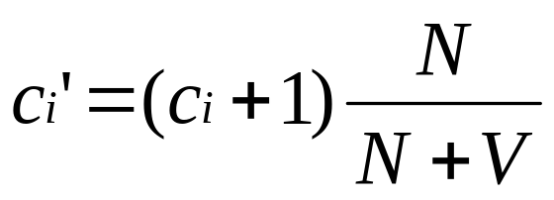
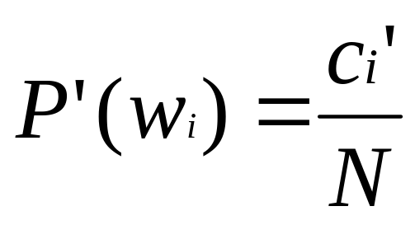
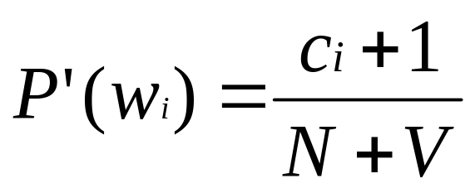
Add-one smoothing
  Add 1 to every n-gram count
  Smoothed count for unigram is:
  Normalize by N/(N+V)
  Smoothed probability:

Slide 56
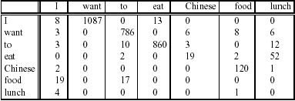
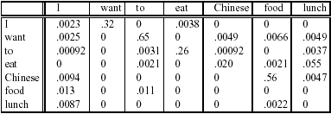
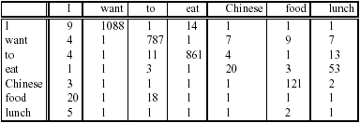
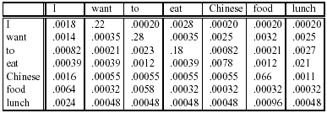
Add-one smoothed bigrams
P(w_{n}|w_{n-1}) = C(w_{n-1}w_{n})/C(w_{n-1})
P′(w_{n}|w_{n-1}) = [C(w_{n-1}w_{n})+1]/[C(w_{n-1})+V]

Slide 57
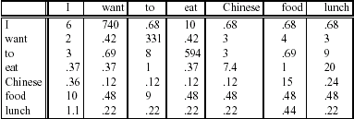
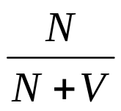
Add-one smoothing flaw
N values
I 3437
want 1215
to 3256
eat 938
Chinese 213
food 1506
lunch 459
V = 1616
c_{i}
c_{i}′=(c_{i}+1)
Too Much Probability Mass Is Shifted to Unseen N-grams!

Slide 58
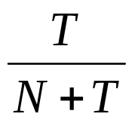
Discounted smoothing: Witten-Bell
Witten-Bell Discounting
  A zero N-gram is just an N-gram you haven’t seen yet…
  Model unseen N-grams by the N-grams you’ve only seen once (T = total number of N-gram types in the data)
  Total probability of unseen N-grams estimated as the probability of things we’ve already seen

Slide 59
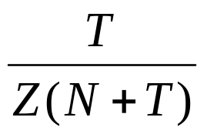
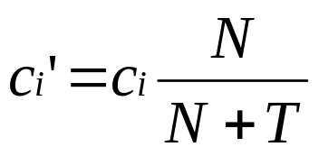
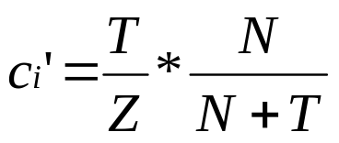
Discounted smoothing: Witten-Bell
  We can divide the probability mass equally among unseen bigrams; Let Z = number of unseen n-grams
  if c_{i}=0; else
  T is the number of types we’ve already seen (conditioned on previous word)
  N is the total number of bigram tokens
  Z is the number of types with count zero

Slide 60
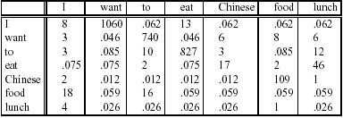
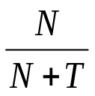
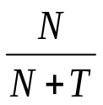
Witten-Bell Bigram Counts
T & N values
I 95 3437
want 76 1215
to 130 3256
eat 124 938
Chinese 20 213
food 82 1506
lunch 45 459
V = 1616
c_{i}
c_{i}′=(c_{i}+1)
c_{i}′ = T/Z · if c_{i}=0
c_{i} · otherwise

Slide 61
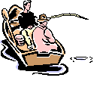
Other smoothing methods:
Good-Turing
Imagine you are fishing
You have caught 10 Carp, 3 Cod, 2 tuna, 1 trout, 1 salmon, 1 eel.
How likely is it that next species is new? 3/18
How likely is it that next is tuna? Less than 2/18

Slide 62
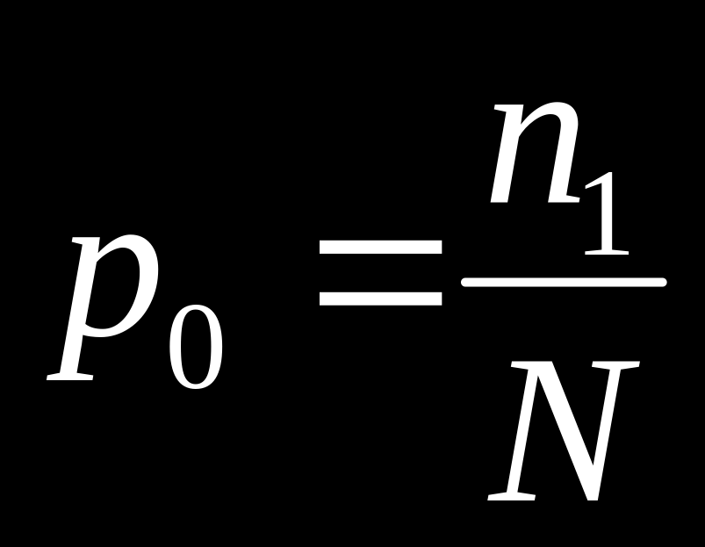

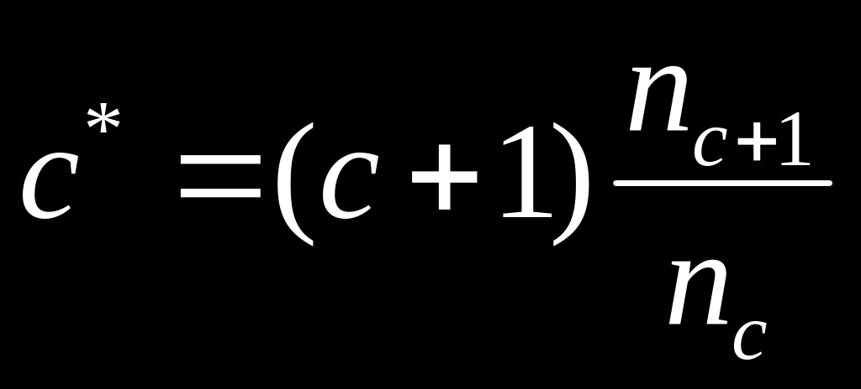
Smoothing: Good Turing
How many species (words) were seen once? Estimate for how many are unseen.
All other estimates are adjusted (down) to give probabilities for unseen

Slide 63
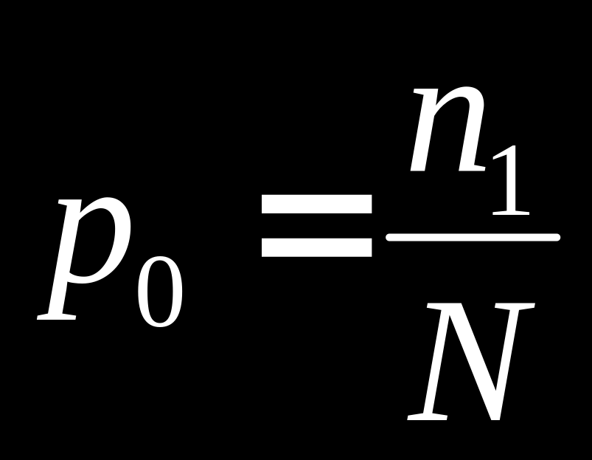
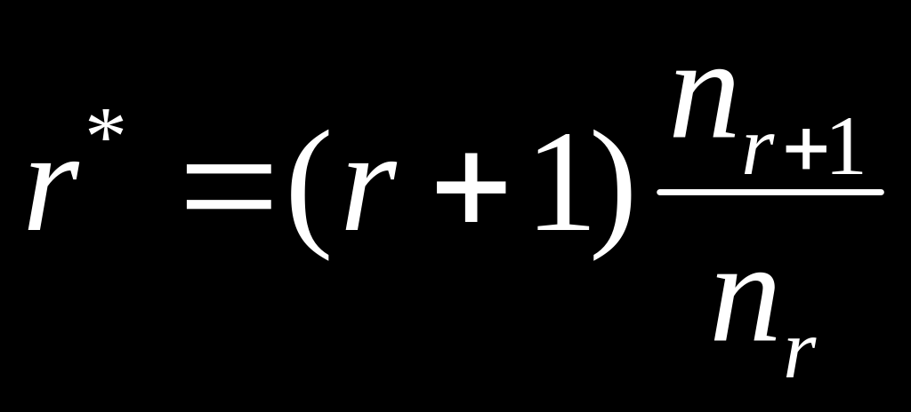
Smoothing:
Good Turing Example
10 Carp, 3 Cod, 2 tuna, 1 trout, 1 salmon, 1 eel.
How likely is new data (p₀ ).
  Let n₁ be number occurring
  once (3), N be total (18). p₀=3/18
How likely is eel? 1*
    n₁ =3, n₂ =1
    1* =2 ×1/3 = 2/3
    P(eel) = 1* /N = (2/3)/18 = 1/27

Slide 64
Back-off methods
Notice that:
  N-grams are more precise than (N-1)grams (remember the Shakespeare example)
  But also, N-grams are more sparse than (N-1) grams
How to combine things?
  Attempt N-grams and back-off to (N-1) if counts are not available
  E.g. attempt prediction using 4-grams, and back-off to trigrams (or bigrams, or unigrams!) if counts are not available

Slide 65
Some Useful Empirical Observations
A small number of events occur with high frequency
A large number of events occur with low frequency
You can quickly collect statistics on the high frequency events

Slide 66
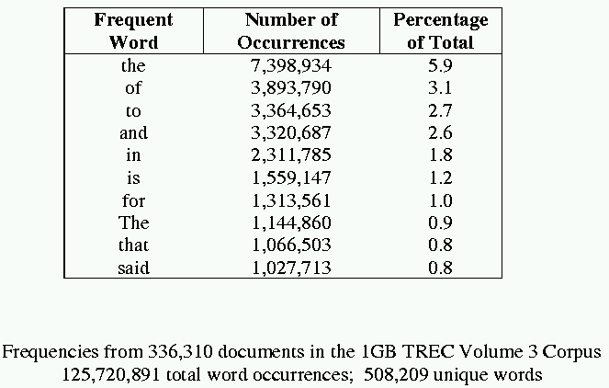
Text properties (formalized)
Sample word frequency data

Slide 67
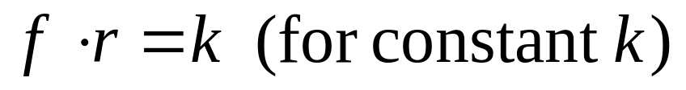
Zipf’s Law
f_{n} ~ 1/nª, where f_{n} is the frequency of occurrence of the n-th ranked item and ‘a’ is close to 1.
http://www.nist.gov/dads/HTML/zipfslaw.html
the frequency of any word is roughly inversely proportional to its rank in the frequency table

Slide 68
Zipf’s Law for Brown Corpus
For example, in the Brown Corpus "the" is the most frequently-occurring word, and all by itself accounts for nearly 7% of all word occurrences (69971 out of slightly over 1 million)
the second-place word "of" accounts for slightly over 3.5% of words (36411 occurrences)
The third-place word is "and" (28852)
Only 135 vocabulary items are needed to account for half the Brown Corpus

Slide 69
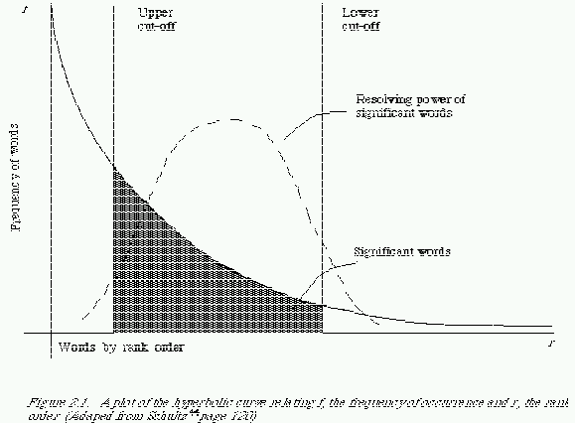
Zipf curve

Slide 70
More on Zipf’s Law
Li (1992) shows that just random typing of letters including a space will generate “words” with a Zipfian distribution
  http://linkage.rockefeller.edu/wli/zipf/

Slide 71
Zipf’s Law Impact on Language Analysis
Good News: Stopwords will account for a large fraction of text so eliminating them greatly reduces size of vocabulary in a text
Bad News: For most words, gathering sufficient data for meaningful statistical analysis (e.g. for correlation analysis for query expansion) is difficult since they are extremely rare

Slide 72
Vocabulary Growth
How does the size of the overall vocabulary (number of unique words) grow with the size of the corpus?
This determines how the size of the inverted index (in Information Retrieval) will scale with the size of the corpus.
Vocabulary not really upper-bounded due to proper names, typos, etc.

Slide 73
Heaps’ Law
If V is the size of the vocabulary and the n is the length of the corpus in words:
Typical constants:
  K ≈ 10−100
  β ≈ 0.4−0.6 (approx. square-root)

Slide 74
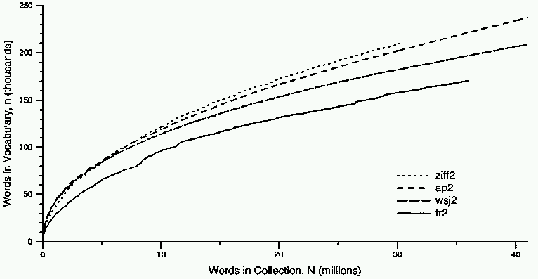
Heaps’ Law Data

Slide 75
Summary
Tokenization
Sentences Boundaries
N-grams
  Language models
  Smoothing methods

Slide 76
Next Time
HMM tagging

