Slide 1
MetaCache: context-aware classification of metagenomic reads using minhashing
André Müller (Bioinformatics 2017)

Slide 2
Introduction
Efficient processing of large-scale metagenomic short read data is of high importance to the research community and industrial applications
More recent alignment-free tools are able to avoid aligning reads to references but still achieve fast execution times and high accuracy based on exact k-mer matching.
MetaCache, which index data structure requires significantly less memory than Kraken and CLARK and is able to achieve both high sensitivity and high precision at comparable classification speed.

Slide 3
Approach
Fast k-mer indexing and look-up can effectively accelerate taxonomic read assignment
Shortcomings of Kraken and CLARK
Memory consumption: 72 GB of RAM for 2256 RefSeq (Kraken)
Sensitivity vs. precision: the choice of value k is a trade off. (k=20 improves sensitivity decreases precision, k=31 improves precision decreases sensitity)

Slide 4
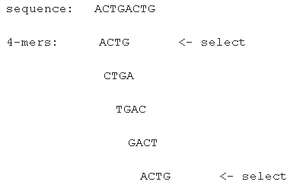
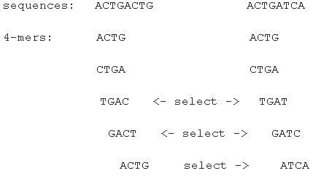
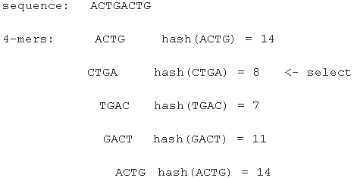
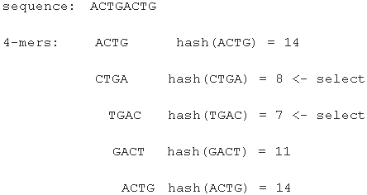
Sample k-mers in sequence

Slide 5
Jaccard index of 2 texts
CTAGCTTAATAT
A = {CTA, TAG, AGC, GCT, CTT, TTA, TAA, AAT, ATA, TAT}
CTAGCATAATAT
B = {CTA, TAG, AGC, GCA, CAT, ATA, TAA, AAT, ATA, TAT}
J(A,B) = |A ∩ B| / |A ∪ B|
= 7/13 = 0.54

Slide 6
MinHashing
Apply hash function to all k-mers
A’ = {83, 229, 55, 198, 128, 184, 79,57, 188, 165}
B’ = {83, 229, 55, 81, 90, 188, 79,57, 188, 165}
sketch S_{s}(X) = s smallest hash values h(x) of all x ∈ X
M_{s}(A,B) ~ J(A,B)
S₄(A’) = {55, 57, 79, 83}, S₄(B’)={55, 57, 79, 81}
M_{s}(A,B) = 3/5 = 0.6

Slide 7
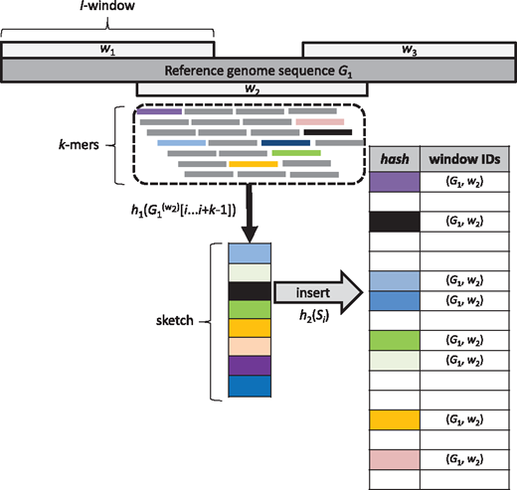
Database construction
Each genome is covered by windows of length l
A hash funtion h₁ is applied to each k-mer within a window
The s smallest unique of the resulting hash values (called features) are selected and together form a so-called sketch of the local window
All features from a sketch are inserted into a hash table using a second hash function h₂

Slide 8
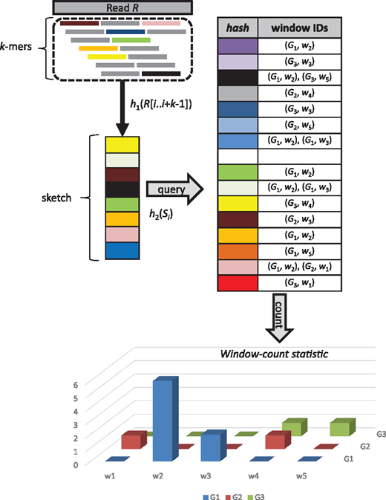
Classification
R is classified by first computing its sketch(es) of size s. In case a read is longer than the window size l, a sketch will be computed for each read window of size l.
Each sketch member is then used to query the precomputed feature index. The returned window IDs are used to construct a window count statistic.
R is then classified by means of the genome providing the highest evidence in terms of k-mer counts.

Slide 9
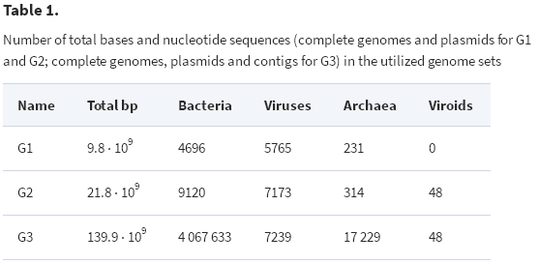
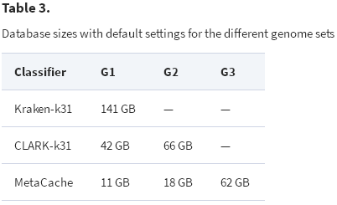
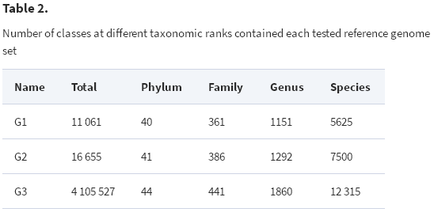
Materials

Slide 10
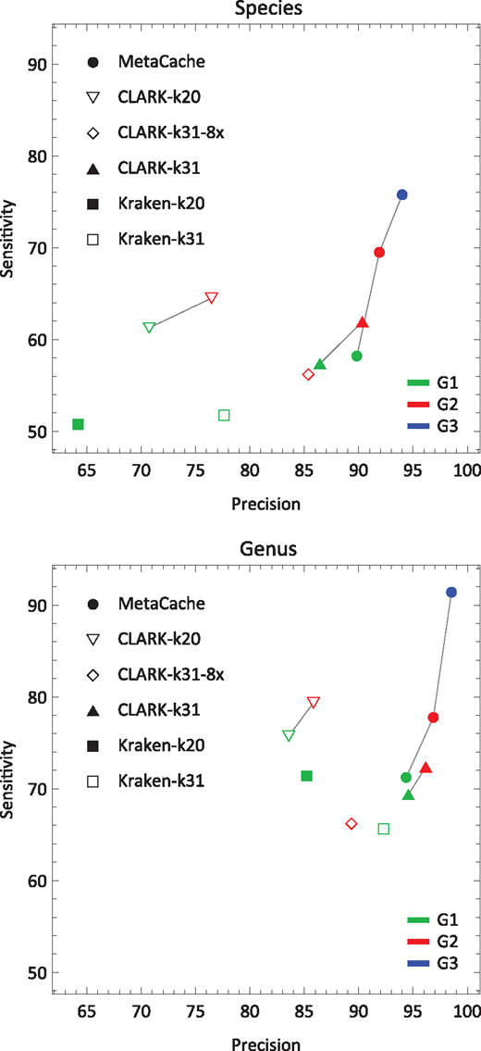
Results

Slide 11
Running time and memory
On G1, MetaCache requires only 30 min and 16 GB of RAM while Kraken needs 1 h 20 min and 165 GB of RAM and CLARK 3 h 40 min and 152 GB of RAM.
On G2, MetaCache takes 45 min and 27 GB of RAM clearly outperforming CLARK which requires 5 h 30 min and 218 GB of RAM.
Finally on the much bigger dataset G3, MetaCache requires 4 h 50 min and 121 GB of RAM while CLARK exceeds the memory capacity of our 512 GB workstation.

