Slide 1


Analysis of Optimal Alignments Unfolds Aligners’ Bias in Existing Variant Profiles
Quang Tran

Slide 2

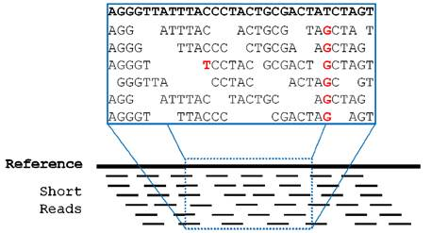
Background
DNA sequence: the string of four letters/bases A (adenine), G (guanine), C (cytosine), T (thymine)
A reference genome (a reference): DNA sequence assembled by scientists as a representative example of a species
Short reads: fragments of DNA sequence, result from sequencing, much shorter in length compared to reference
https://sop.washington.edu/dna-chain-sequence/
ee.washington.edu

Slide 3
Reference Human Genome
…TTAATAAATATCAGTTATTCAATACTTTATTTAGACATTTTGTTAGATTATTTTGACCAACTGAAGTCTATCTATCTATCT
ATCTAAATGTTCTGAGCATGTTCAAAGTAAGCTAGGCCAACCTATAATTTTCGGTGTGCTAAATGCATTTTCTATCTATA
TTAACTTATGATATTTTCAGTTTACGGGGGTTTGTTGAGACATAACTTCATCATACATCAAGGAGCATCTTCTATCTATC
GTATATGGGATATAGTTAAAGCAGTGATCAGAGGAAAATCTATAGCCTTAACACATTTATTAATAAAAGTTCTATCTATC
GTAGGAATTAAATTATCAGCTGAAAAATGTAAAAAGTATCTAAAAGAGTAAGCAGAAAGTACAAGAAAGATCTATCTA
ACCCAAAGTAGAAAAAAGTGAAAATTAATAAAATAAGAAGCCAAAAAACAGATCAAATCAGTAAACCAAATCTATCT
AATCTTGTTCTTTAAACAAATCAACAAAGTTGACAAAAAAATTAGATCTTTTAATCATGAATAAAAAAAATCTATCTATC
GAGAAAGCACAAAAATGAATAAGGAATGGTGAGAGAAATAACTATTGATAATCAGCAAATAAAAAATCATTCTATCTA
TAAAAACAATGTTGTTCACATCTATGAAAAACATTGAAAGCTAGAGGGAATGGGTAATTTTCTAGAAAAATCTATCTA
TACAATTCACCACAACTGACTTCAAAAAAAAAAAAAAAAAAAAAGAAGTACCGCACTTATGTGAGCAATTTCTATCTA
TCCATAGAGAAATACAGTTGTCATGGAATTATAACACACACACAAACACTAGGTTTAGATGTTTTCACAGTCTATCTAA
AGAATTCCACCAAACCTTTAGAAATCAGATCGTCCAAAGGCAAATTAACAACTCTCAGCCATTTGAGGCATCTATCTA
AAATATTACAATTGAGGCAAGATATACTGTACTGAAAACTTGAGGAAAAAGCAGGAGAGAAAGTTCCTTTTCTATCTA
GGGAAATTCGAATACTCAAAAGTGCTTACATACAATGAAAAATTTGGAAATCCATAAGCATGGCCAAGGTTCTATCTA
GGGACACATGCTCAGAAAAGGCCTGAGAAGACACTAATAACTCACCTTTAGTAATTCCTAGGCTCACAGCTCTATCTA
AAGAAAAAATGAAGGCTAAGGCAGAATTATATATGGCTCCGCTAAGTGTTGAGGGAGCCCCAATACAGAGTCTATCT
TCAGTAAGCAAAGTCTGGGAGAAGTTTTTCATATTTTTTTCTTTCTTGGCTCCTTGCAGTCAAGGAAATCTCTATCTA…

Slide 4
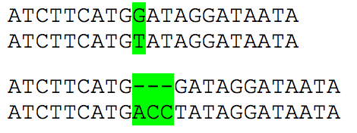
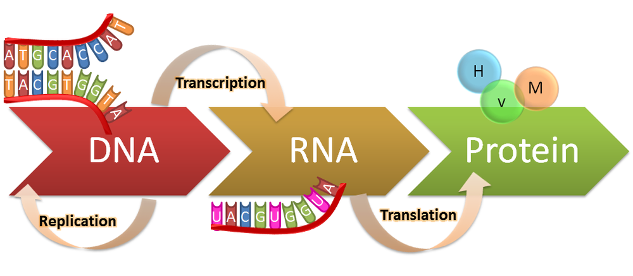
Genetic Variants
…TTAATAAATATCAGTTATTCAATACTTTATTTAGACATTTTGTTAGATTATTTTGACCAACTGAAGTCTATCTATCTATCT
ATCTAAATGTTCTGAGCATGTTCAAAGTAAGCTAGGCCAACCTATAATTTTCGGTGTGCTAAATGCATTTTCTATCTATA
TTAACTTATGATATTTTCAGTTTACGGGGGTTTGTTGAGACATAACTTCATCATACATCAAGGAGCATCTTCTATCTATC
GTATATGGGATATAGTTAAAGCAGTGATCAGAGGAAAATCTATAGCCTTAACACATTTATTAATAAAAGTTCTATCTATC
GTAGGAATTAAATTATCAGCTGAAAAATGTAAAAAGTATCTAAAAGAGTAAGCAGAAAGTACAAGAAAGATCTATCTA
ACCCAAAGTAGAAAAAAGTGAAAATTAATAAAATAAGAAGCCAAAAAACAGATCAAATCAGTAAACCAAATCTATCT
AATCTTGTTCTTTAAACAAATCAACAAAGTTGACAAAAAAATTAGATCTTTTAATCATGAATAAAAAAAATCTATCTATC
GAGAAAGCACAAAAATGAATAAGGAATGGTGAGAGAAATAACTATTGATAATCAGCAAATAAAAAATCATTCTATCTA
TAAAAACAATGTTGTTCACATCTATGAAAAACATTGAAAGCTAGAGGGAATGGGTAATTTTCTAGAAAAATCTATCTA
TACAATTCACCACAACTGACTTCAAAAAAAAAAAAAAAAAAAAAGAAGTACCGCACTTATGTGAGCAATTTCTATCTA
TCCATAGAGAAATACAGTTGTCATGGAATTATAACACACACACAAACACTAGGTTTAGATGTTTTCACAGTCTATCTAA
AGAATTCCACCAAACCTTTAGAAATCAGATCGTCCAAAGGCAAATTAACAACTCTCAGCCATTTGAGGCATCTATCTA
AAATATTACAATTGAGGCAAGATATACTGTACTGAAAACTTGAGGAAAAAGCAGGAGAGAAAGTTCCTTTTCTATCTA
GGGAAATTCGAATACTCAAAAGTGCTTACATACAATGAAAAATTTGGAAATCCATAAGCATGGCCAAGGTTCTATCTA
GGGACACATGCTCAGAAAAGGCCTGAGAAGACACTAATAACTCACCTTTAGTAATTCCTAGGCTCACAGCTCTATCTA
AAGAAAAAATGAAGGCTAAGGCAGAATTATATATGGCTCCGCTAAGTGTTGAGGGAGCCCCAATACAGAGTCTATCT
TCAGTAAGCAAAGTCTGGGAGAAGTTTTTCATATTTTTTTCTTTCTTGGCTCCTTGCAGTCAAGGAAATCTCTATCTA…
DNA sequences from two different people
Alice
Substitution
Bob
Insertion-deletion
https://genius.com/Biology-genius-the-central-dogma-annotated

Slide 5
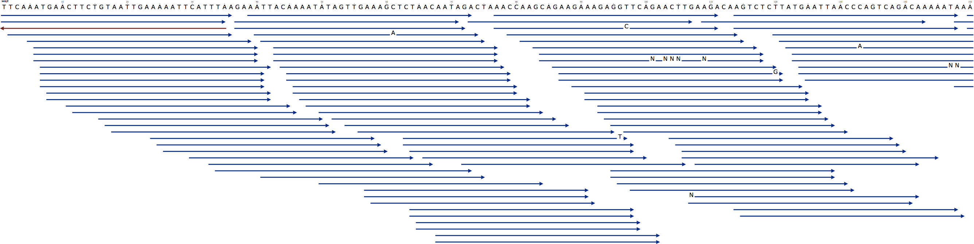
Variant Detection
Relies on tools which align short reads to a reference genome to detect genetic variants
Coverage: the number of reads that include a given nucleotide in the reconstructed genome
= the # of reads * read length / genome length
Notes:
Good.

Slide 6
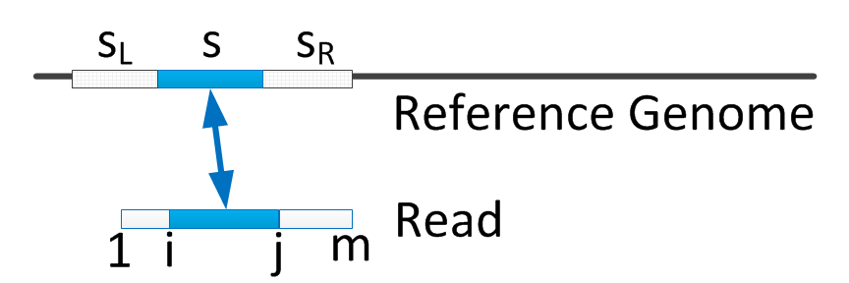
Variant Detection (cont)
Reference with aligned reads | CIGAR | Explanation
ATGGCCC - -TTTTTAATCGGTACTTGGGAAA TAATCGG CCAGTTTT GG- - -TTGG | 7M 2M2I4M 2M3D4M | Alignment(match or mismatch) Insertion Deletion
CIGAR stands for Concise Idiosyncratic Gapped Alignment Report.
Notes:
Good.

Slide 7
Goals and Contributions
The International HapMap Project and 1000 Genome Project produced over 10 million single nucleotide variation (SNV) and approximately a million insertion/deletion (INDEL)
We showed that this reference of thousand INDELs were constructed in a biased manner.
Existence of many theoretically optimal alignments between INDEL reads and reference
We examined aligners, and showed alignments result in INDEL calls that agree/disagree with the profiles.
Reason: the arbitrary selection of one of the optimal alignments

Slide 8
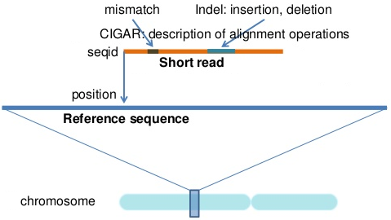
Align Short Reads to Genomes
Mapping reads to correct locations
Aligning reads correctly to those locations

Slide 9
Multiple Optimal Alignments
General model of alignment:
Affine gap model: a gap opening is penalized more than a gap extension (2nd & 3rd).
Alignments: TCAG (read) TCACACAG (reference) | INDEL calls
TCACACAG T - - CA - - G | TCA | T ACA | A
TCACACAG TCA - - - - G | ACACA | A
TCACACAG T - - - - CAG | TCACA | T
Optimal Alignments: maximize the sum of pair-scores less any penalty for introduced gaps

Slide 10
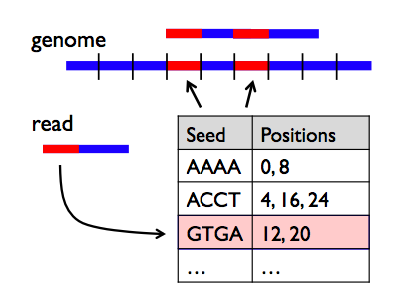
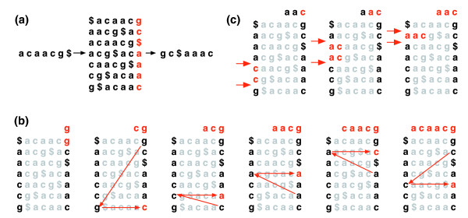
Pair-wise Alignment
Mapping can be enhanced by different methods (FM index or hash table)
Alignment itself is essentially the same formulation of optimal pair-wise alignment, based on dynamic programming
amplab.cs.berkeley.edu
intro-prog-bioinfo-2011.wikispaces.com

Slide 11

Pair-wise Alignment (cont)
Given 2 sequence x, y:
x = x₁x₂…x_{n}
y = y₁y₂…y_{m}
Optimal alignment is found by constructing matrix M:
M[i,j]: the score of optimal alignment between
x₁…x_{i} and y₁…y_{j}, where M[i,0] = i, and M[0, j]=j

Slide 12

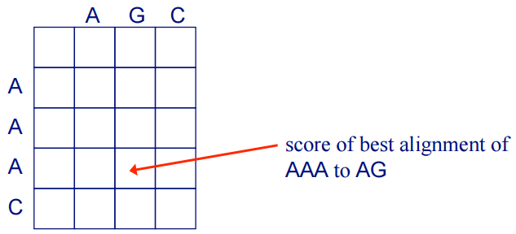
Pair-wise Alignment (cont)
Dynamic Programming :
AAAC vs. AGC
Consider best alignment + score of aligning pair

Slide 13
Construct all Optimal Alignments
When matrix M is filled,
Start from the entry with the highest cost
Retraces all steps where optimal decision made
Briefly,
Find (i, j) such that M[i, j] is maximum
Return Trace(M, i, j)

Slide 14
Data and Aligners
NCBI Human genome GRCh37, and Integrated Variant Set from 1000 Genomes Project
1,442,639 INDELs
6,685 of INDELs have multiple optimal alignments
Popular short read aligners:
Bowtie2
BWA
SHRiMP2
RazerS
CUSHAW2
GASSST
Smalt

Slide 15
Experimental Design
Create set of reads containing alternative alleles from INDEL locations with more than one optimal alignments
Align each read above to reference genome by 7 aligners
Correct alignment of a read to INDEL location gives rise to a variant call
Compare the aligners’ degree of agreement with known variant profiles

Slide 16
Experimental Design (cont)
Variant Profile:
Reference : …ATTTCCACTTGCCGCCG…
xAy
Indels: ACCGA|A
Create r = uACCGAv (read)
where u: suffix of x, and v: prefix of y (same length in range from 25 to 50)
Align r to reference genome:
uA - - - v u - - - Av
uACGAv uACGAv

Slide 17


Evaluation Terms
INDEL location i has n_{i} optimal alignments:
Probability an aligner call INDEL in agreement with known variant is 1/n_{i}
Summing over events, the expected number of instances that agree with known profiles
Where N: the number of INDEL locations with multiple optimal alignments
Likelihood of the difference between actual and expected agreements (p-value)

Slide 18


Analysis of INDELs with Multiple Optimal Alignments
Aligners | Correct mapping % | Actual agreement% | Expected agreement% | P-value
Bowtie2 | 96 | 99 | 30 | 0.0000546
BWA | 93 | 99 | 30 | 0.0000550
SHRiMP2 | 97 | 99 | 31 | 0.0001491
RazerS | 88 | 75 | 31 | 0.0001631
CUSHAW2 | 97 | 70 | 31 | 0.0000562
GASSST | 91 | 8 | 17 | 0.0015892
Smalt | 96 | 5 | 31 | 0.0003852

Slide 19
INDEL Complexity
In many INDEL locations, there’s more than on theoretically optimal alignments
Each has same chance of being biologically correct
No correct optimal alignment among all possible ones
An aligner arbitrarily picks one, a variant caller utilizes that the aligner’s result
Existing variant profiles only report one
We define: complexity of each INDEL location as the number of optimal alignments at the location

Slide 20
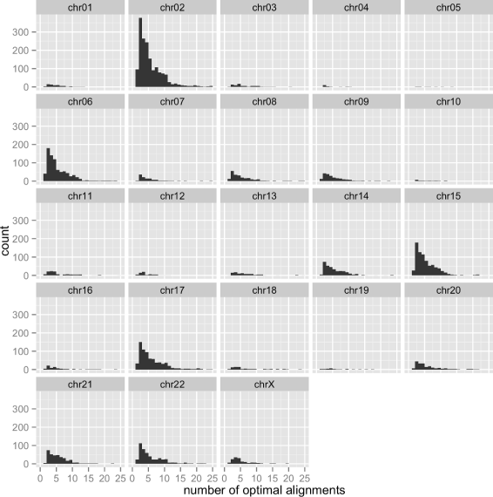
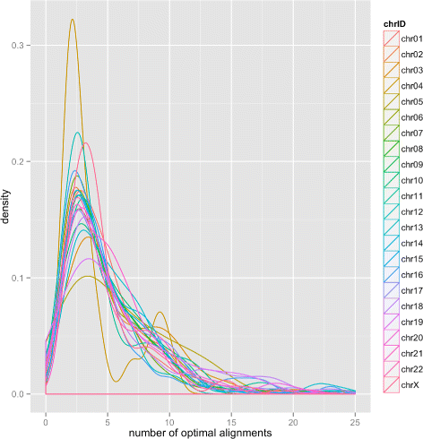
Distribution of INDEL complexity across Human chromosomes

Slide 21
Conclusion
Current INDEL profile constructed and curated by 1000 genome project exhibits a bias at certain INDEL locations.
Increasing coverage and realigning reads can improve accuracy of calling variants, but cannot resolve the problem caused by multiple optimal alignments

Slide 22
Acknowledgements
Shanshan Gao
Nam S. Vo
Diem-Trang Pham
Dr. Vinhthuy Phan

