Slide 1
Seminar on paper:
“Eliciting Design Requirements for Maintenance-Oriented IDEs: A Detailed Study of Corrective and Perfective Maintenance Tasks” by
Ko et al. (2005)
Presented by Scott Fleming
Wed 27 Aug 2014
(This slide does not count toward the 10-slide max)

Slide 2
Problem
Developers spend considerable time reading and navigating code during maintenance
  maintenance = 60-90% of development cost
But recent tools have focused on creation of code
  Example: Eclipse (quibble quibble)
Goal: Better understand how developers navigate and provide implications for design

Slide 3
Method: Empirical Study
Participants: 10 Expert(-ish) Java programmers
Tasks: Five maintenance tasks
  70 min to complete
Environment: Eclipse
  Interruptions included for realism
Data collected: Video (mainly)
Analysis method: Qualitative coding

Slide 4
Claims (inductively produced hypotheses)
Software maintenance interleaves 3 activities:
  Collecting task-relevant code fragments—a working set
  Navigating dependencies between fragments
  Repairing/creating code
Programmers spend considerable time navigating between dependencies
Programmers spend considerable time inspecting irrelevant code

Slide 5
Evidence of working sets
Some programmers started tasks, switched to easier ones, and then switched back
When switching away, they lost their tabs (working sets)
They spent avg of 60 seconds recovering tabs when they switched back

Slide 6
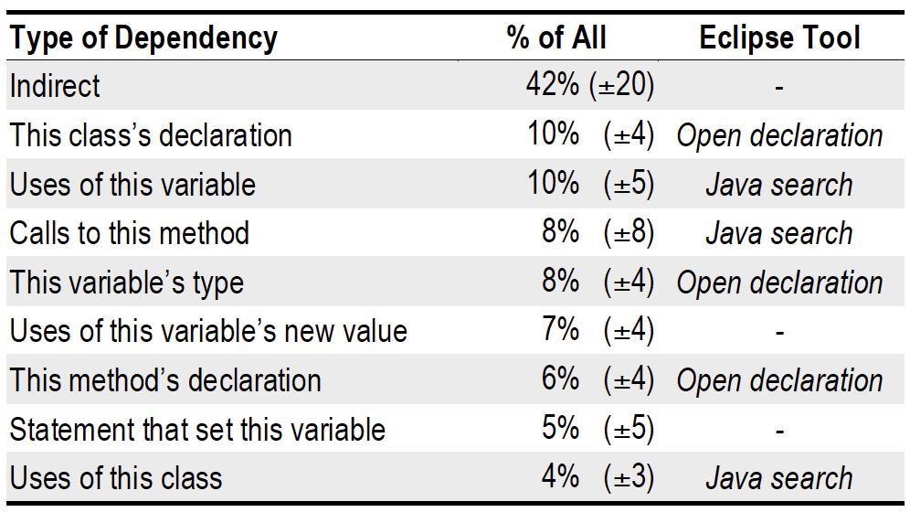
Evidence of dependency navigations
Avg 65 deps navigated in 70 min—almost 1 per min
Types of deps navigated:
Direct (58%)
Table 4 from the paper

Slide 7
Evidence of considerable time navigating
“Glancing” over direct dependencies costly
  Avg 27% of direct dep navs returned to code just navigated from
  Searched avg 9 seconds before finding prev location
Indirect navs costly
  Example: Each programmers spent avg 10 min total visually searching files (14% of their time)
  Example: Scrolling in package explore and searching tabs cost each programmer avg 5 min total (7% of their time)
TOTAL COST: 19 min (35% of 70 min) on nav alone!

Slide 8
Evidence of considerable time spent inspecting irrelevant code
88% of programmers’ hypotheses about cause of bug were false
Programmers spent avg of 25 min (out of 70) inspecting task-irrelevant code

Slide 9
Evidence of more time wasted
Misleading feedback in Eclipse
  Bad syntax error highlighting
  Long line hid the defective code
Copy/paste errors
  In 10% of copies, programmers forgot to change refs (vis. indistinct or off screen)

Slide 10
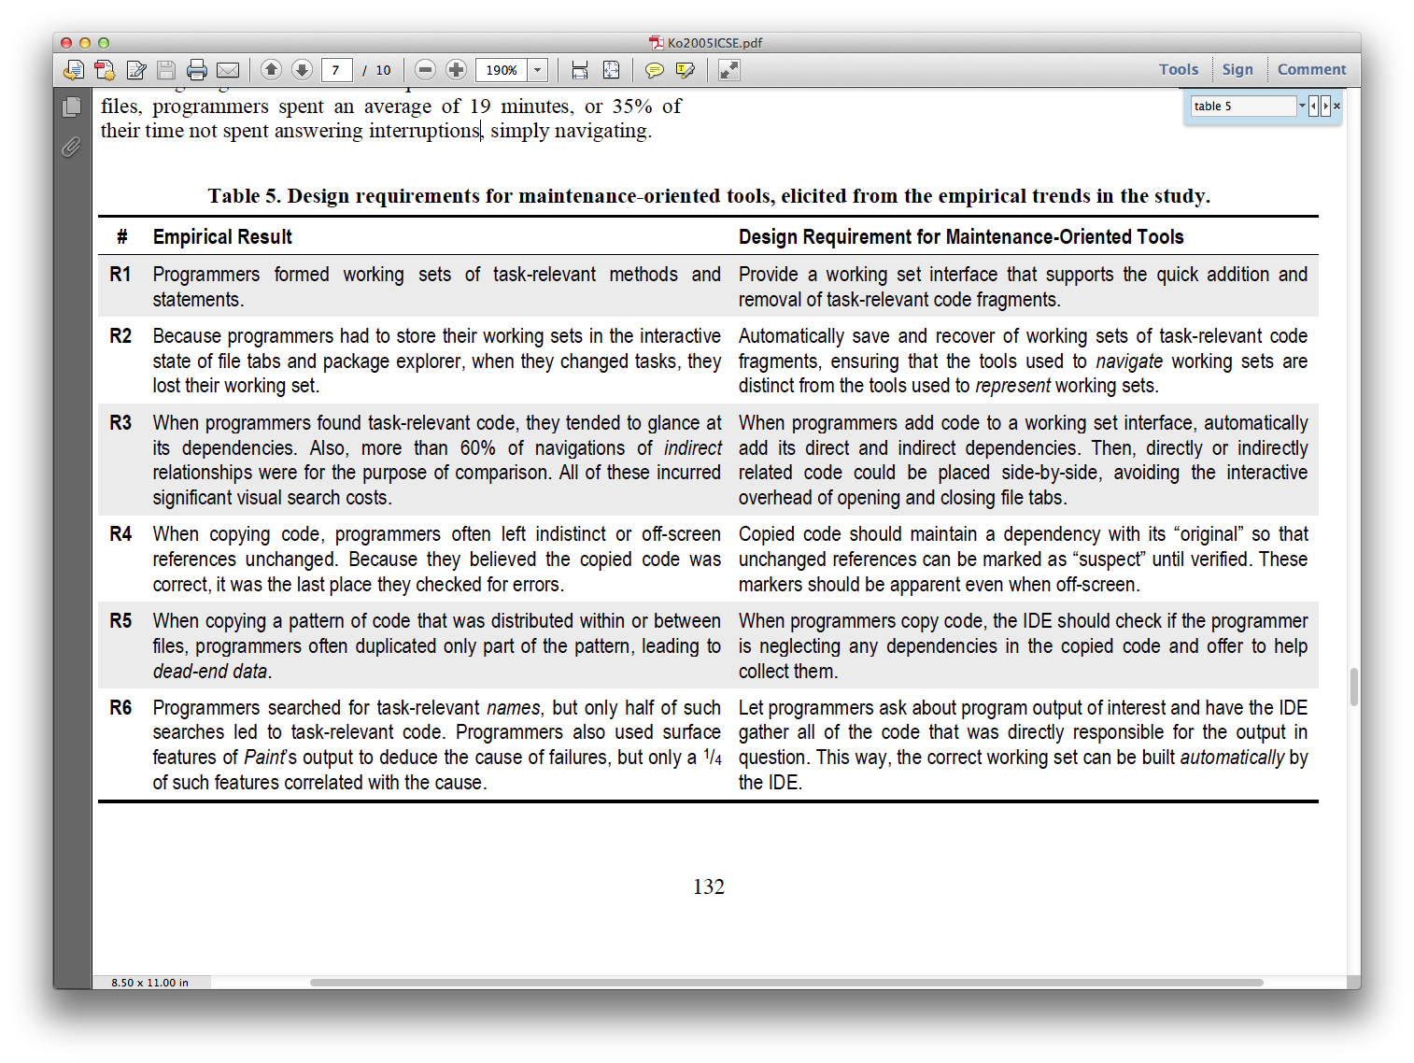
Contribution: Empirically Based Requirements
Table 5 from the paper
Notes:
First two noteworthy—Mylyn and CodeBubbles

Slide 11
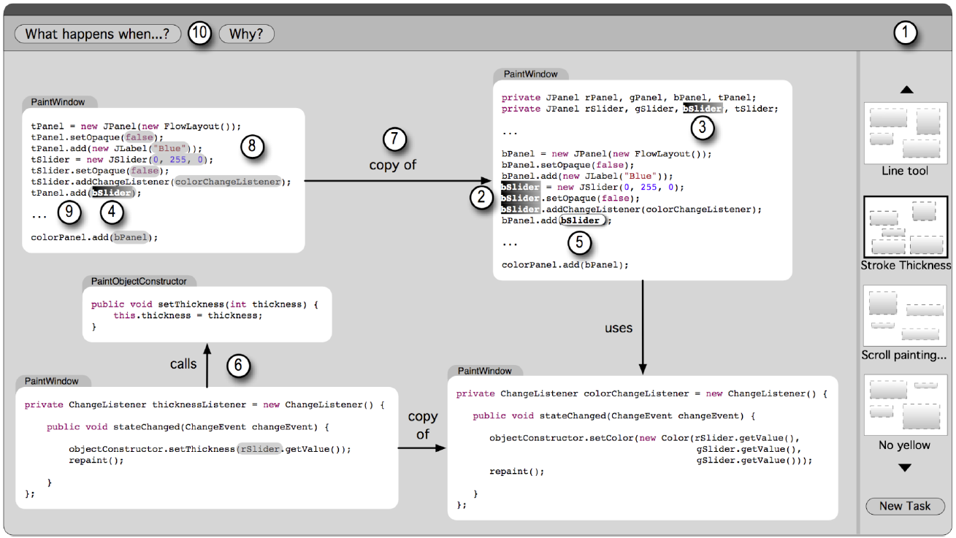
Contribution: Design That Satisfies Reqs
The End – Thank You!
Figure 10 from the paper
Notes:
Fragments instead of files
Sets of working sets (1)
Supporting reading (2-5)
Visualizing dependencies (6-9)
Context in-place (press meta key to see code surrounding fragments)
Working sets from questions (10)

