Slide 1
Seminar on paper:
“An Exploratory Study of How Developers Seek, Relate, and Collect Relevant Information during Software Maintenance Tasks” by
Ko et al. (2006)
Presented by Quang Tran
Mon 23 Nov 2015

Slide 2
Problem
Most useful software : brief development, longer maintenance & adaption to new contexts of use
  Much time of exploring unfamiliar parts of system’s source code to understand parts of system to relevant tasks
Task context: parts/relationships of artifact relevant during work on a maintenance task
Q’s: How relevant? What type of relevant? How to keep track of relevant? How task contexts differ?
Goal: investigate strategies for understanding and utilizing relevant info and discover development environments related to strategies

Slide 3
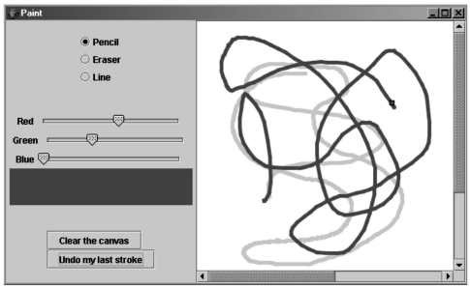
Method: Exploratory Study
Participants: 31 initially, 10 narrowed (Java exp)
  7 “experts”, 3 “above avg” (undgrad & grad)
Tasks: five maintenance tasks
  70 min to complete (including interruptions)
  Nature of tasks: 3 debugging, 2 enhancement
Environment: Eclipse 2.1.2
Paint Java Swing application
  Small, unfamiliar system
  9 source files, 503 lines
  Allowed users to draw, erase,
  clear, and undo
Fig 1 from the paper

Slide 4
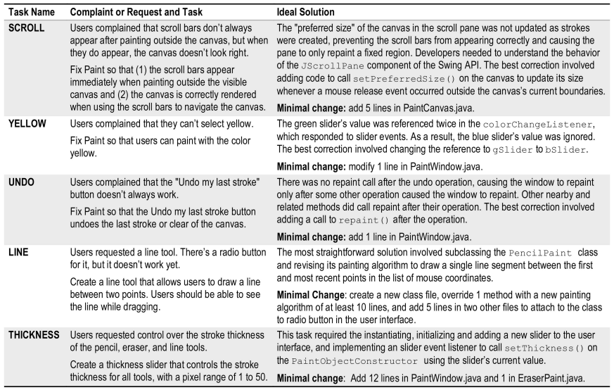

Five maintenance tasks
Tab 1 from the paper

Slide 5
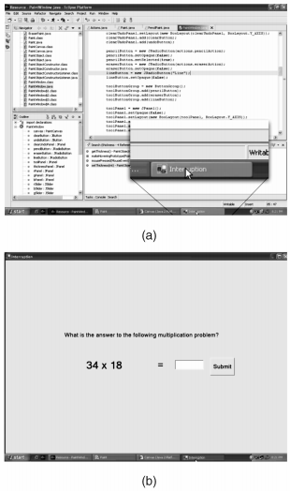
Method (cont)
Interruptions:
  Came from a server (audible alert)
  Required developers full attention
  Designed to mimic real interruptions
  Came every 2.5 – 3.5 mins
Procedure:
  Complete a survey (expertise)
  5 tasks in 70 mins
  $10 per correct request completed
  $2 each ignored interruption
  Once done, check and pay accordingly
Fig 2 from the paper

Slide 6
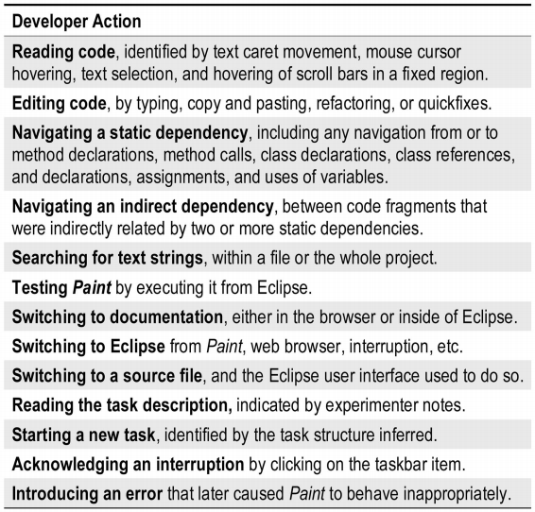
Results
12 hours of screen-captured video across 10 developers’ work
Tab 2 from the paper

Slide 7
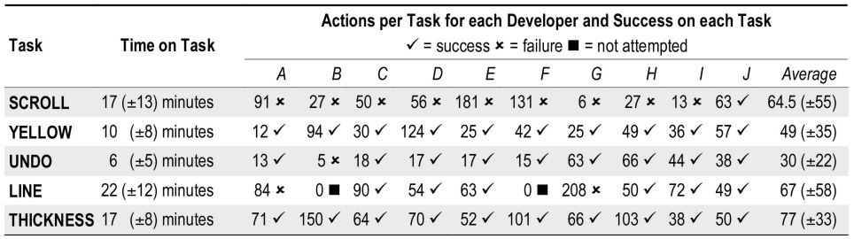
Results: division of labor
Spent more time on difficult taks
Fifth of their time on reading code
Fifth of their time on editing code
Quarter of their time on textual searches
Tenth of their time on testing
Tab 3 from the paper

Slide 8
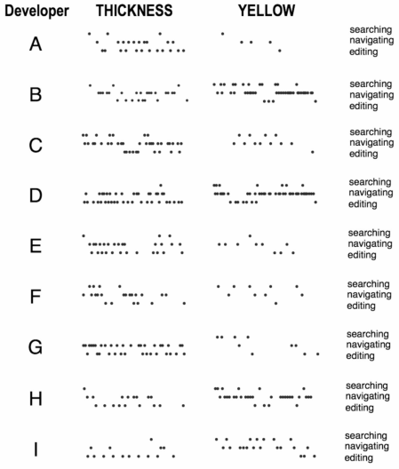
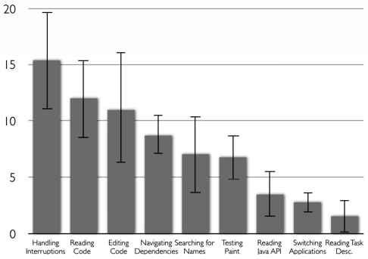
Results: task structure
Not independent
Find code
Determine what to edit
Edit
Fig 3 from the paper
Fig 4 from the paper

Slide 9
Results: forming perceptions of relevance
Involved several levels of engagement
Based on different types of cues
Common observation
Look at file name
If relevant, open file
Look for code identifiers, comments, etc
If found relevant method, examine more closely

Slide 10
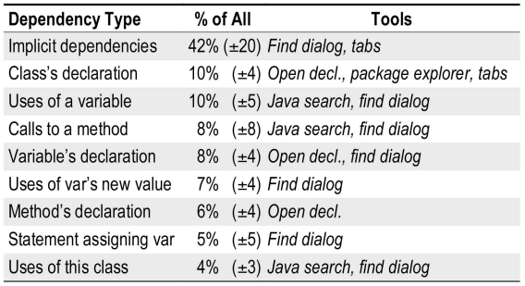
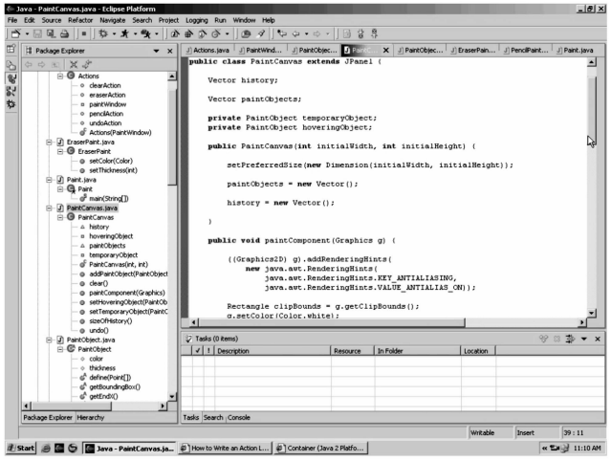
Results: Navigating Dependencies of Relevant Information
65(+/-18) over 70 mins
Direct (58% ) and indirect
Fig 5 from the paper
Tab 4 from the paper

Slide 11
Results: Representing task contexts
Package explorer/file tabs
2 developers used bookmarks
Windows task bar for running applications
Web browser for documentation
2 developers used paper notes

Slide 12
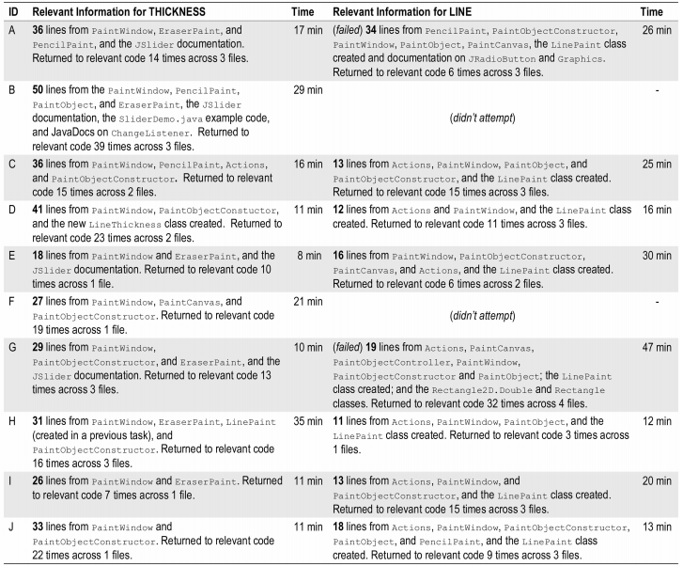
Task Contexts for THICKNESS and LINE
Tab 5 from the paper

Slide 13
Results: Impact of interruptions
Only had an impact if two conditions were met
  an important task was not externalized at the time of acknowledging the interruption
  developers could not recall the state after returning from interruption
Developers always completed edits before acknowledging interruptions
Eg: interrupted just after repairing a syntax error but just before saving the changes (avg 38 seconds)

Slide 14
Limitations
Subjective and base on authors interpretations
Program size not representative
Small sample size
Inexperienced subjects

Slide 15
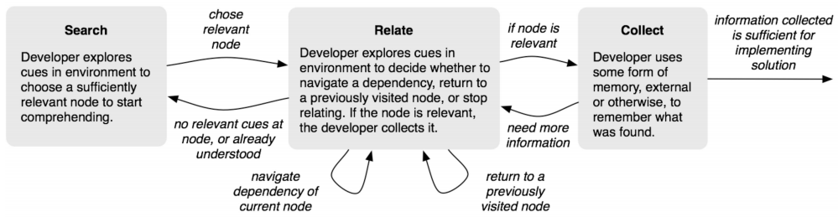
Implications
Theory:
  There is a need for a new model of program understanding
  Authors model
  Searching, relating, and collecting relevant information
  Forming perceptions of relevance
Tools:
  Navigating between dependencies was a major concern
  Took on average 19 minutes
  Many repeated navigations
  Could be reduced if more helpful tools were available
Fig 6 from the paper

Slide 16
Conclusion
Developers must locate and understand relevant portions of code before making a change
This study inspired a new model
Based on searching, relating, and collecting
Reliance of environment cues
Study identifies a need for more streamlined environments
The End – Thank You!

Slide 17
Paper Critique
Pros
  Poses interesting questions
  Introduces a model for identifying relevant tasks
Cons
  The participants were students
  Self-reporting survey to gauge expertise
  Relatively simple program
  Strange methods
  Interruptions every 2-3 minutes
  Judging relevance by developer behavior

