Slide 1
Seminar on paper:
“How Developers Use Multi-Recommendation System in Local Code Search” by
Ge et al. (2014)
Presented by Quang Tran
Wed 16 Sep 2015

Slide 2
Problems
Developers start programming tasks by searching for relevant code
  88% of manually-composed queries retrieve no relevant
Existing search tools depend solely on string matching, cannot find semantically-related code.
  Example: regular expression (grep), InstaSearch, Sando
Goal: An implementation of multiple query recommendation techniques (tool: Coronado ext to Sando)

Slide 3
Tool: Sando
A Visual Studio plug-in allows to search code snippets in local codebase
Queries: similar with those accepted by Google
Supports C and C# code
Treats different levels of software entities (class, methods, and fields)
Orders results based on Inverse Document Frequency scores (IDF)

Slide 4
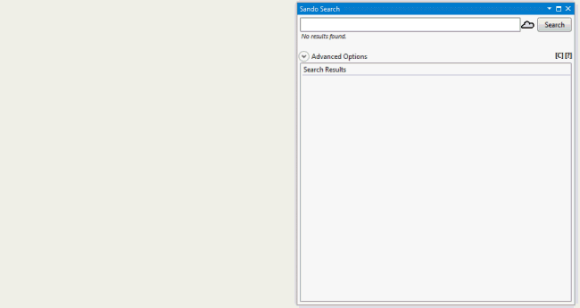

Tool screenshot
Fig 1 from the paper

Slide 5
Components
Codebase terms:
  Collects terms when indexer traverses project
  Breaks source code into set of terms, identifiers, terms by splitting identifiers
Term occurrence matrix:
  Records the number of occurrences of every 2 terms appear together, eg. {create, path}, {path, manager}
Verb-Direct-Object repository
Software engineering thesaurus:
  SE terms, abbre’s: imap, synonyms: “load”-“initialize”
English thesaurus: WordNet database

Slide 6
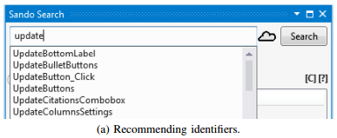
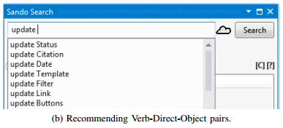
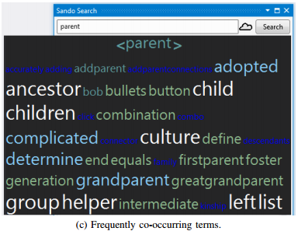
Pre-search recommendation
Fig 2 from the paper

Slide 7
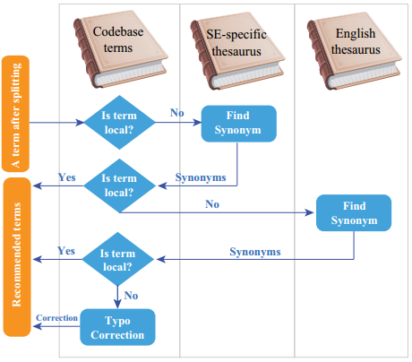
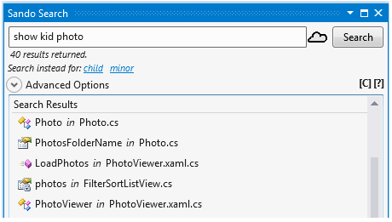
Post-search recommendation
Pre-process:
split search term
getelementname
Synonym:
Typo:
use local terms,
adopt 2-gram index
to find terms
Fig 3, 4 from the paper

Slide 8
Longitudinal study
Answer research questions:
RQ1: How often do developers use Coronado’s recommendations during their normal work to improve their queries?
RQ2: Do developers seem satisfied with queries constructed from Coronado’s recommendations?

Slide 9
Results
RQ1. Use of recommendations
  Adoption rate, used in about 32% of all queries, and the raw number utilized, 820, indicate having a real impact
  pre-search and post-search suggests that both types of recommendations in Coronado are equally useful
  (70%) of recommendations usage in the field is during exploratory searches
RQ2. Quality of search results for recommended queries
  Recommendation-based queries received a click more often than manual queries.
  Identifier and Verb-Direct-Object were most successful

Slide 10
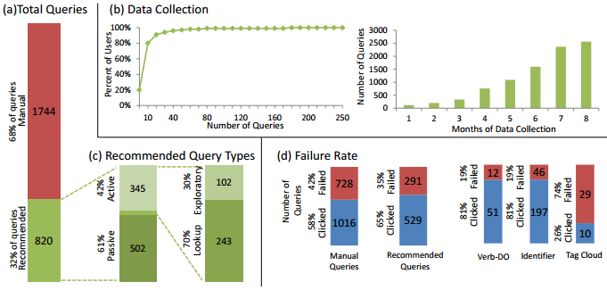
Results (cont)
Fig 5 from the paper

Slide 11
Conclusion
Help developers easily find the code to reuse/edit
Help developers compose queries relevant codebase
Investigate the usability and usefulness of techniques
32% of all queries issued by taking recommendation
Preventive and corrective equally useful
Developers tend to adopt more readable recommendations
The End – Thank You!

