Slide 1

RNA-SEQ Analysis Workflow
Quang Tran

Slide 2
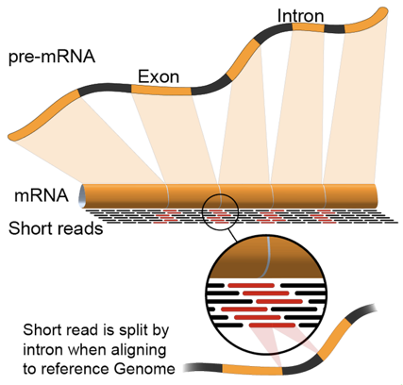
RNA-Seq Analysis
RNA abundance quantification
Gene expression ⇨ Differential expression
Transcript variation
ATCGATGC
ATCGATGC
ATCAATGC
ATCAATGC
Alternative splicing
http://en.wikipedia.org/wiki/RNA-Seq
Exon 1
Exon 2
Exon 3
Exon 4
Exon 1
Exon 4
Exon 2
Exon 3
Exon 4

Slide 3
RNA-Seq Analysis: main approaches
Assemble reads into transcripts
Coverage and accuracy
Map reads to reference genome, and identify isoforms
Constraints
Quantify isoforms
Compute significance of expression
RNA-Seq metrics:
RPKM: Reads per killobase per million reads
FPKM: Fragments per killobase per million
Exon 1
Exon 2
Exon 3

Slide 4
Problems
Huge amount of data: DNA/RNA seq
Transcripts: # of sequences
Tools for aligning and counting cDNA: complex, compute-intensive
⇨ FM index based light-weight alignment method: fast, accurate as current method

Slide 5
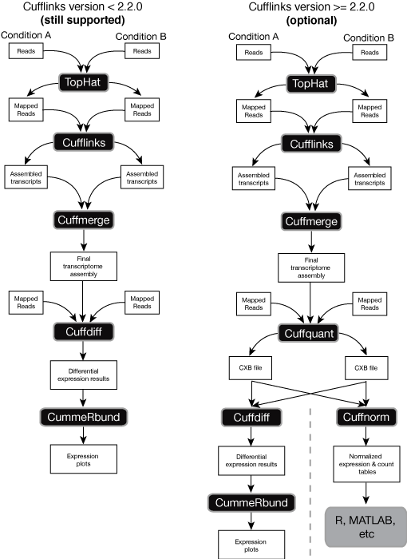
Method
BaseSpace workflow
http://cole-trapnell-lab.github.io/cufflinks/manual/

Slide 6
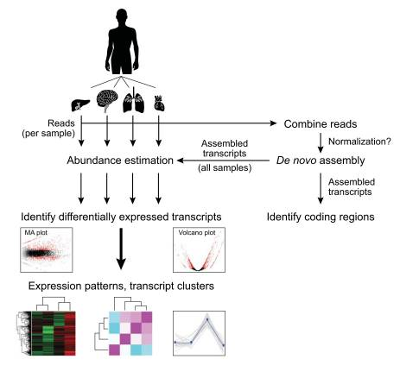
Method(cont)
Trinity
http://www.ncbi.nlm.nih.gov/pmc/articles/PMC3875132/

Slide 7
Experiments
Schizosaccharomyces pombe, also called "fission yeast“
Genome size: 12,462,637
Genes: 4,929
4 sets of paired-end reads
Sp_ds.left & right (diauxic shift)
Sp_hs.left & right (heat shock)
Sp_log.left & right (logarithmic growth)
Sp_plat.left & right (plateau phase)

Slide 8
Results
De novo assembly: combine the raw reads from different conditions into a single FASTQ file (for each end) and use Trinity to generate a reference assembly
Trinity --seqType fq --SS_lib_type RF --left sp.left.fq.gz --right sp.right.fq.gz --CPU 6 --max_memory 64G --output trinity_reference > trinity_reference.log

Slide 9
Results
################################
## Counts of transcripts, etc.
################################
Total trinity 'genes': 377
Total trinity transcripts: 384
Percent GC: 38.66
########################################
Stats based on ALL transcript contigs:
########################################
Contig N10: 3373
Contig N20: 2605
Contig N30: 2219
Contig N40: 1936
Contig N50: 1703
Median contig length: 772
Average contig: 1047.80
Total assembled bases: 402355
#####################################################
## Stats based on ONLY LONGEST ISOFORM per 'GENE':
#####################################################
Contig N10: 3373
Contig N20: 2605
Contig N30: 2216
Contig N40: 1936
Contig N50: 1695
Median contig length: 772
Average contig: 1041.98
Total assembled bases: 392826

Slide 10
Results
Compare de novo reconstructed transcripts to reference annotations
Build GMAP index
Align Trinity transcripts to genome using GMAP
Build STAR index
Align RNA-Seq reads to genome using STAR

Slide 11
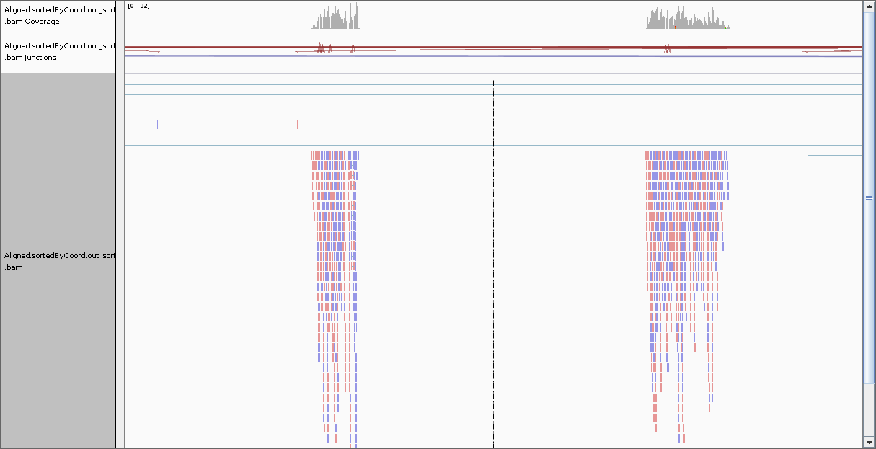
Results

Slide 12
Results
Quantification using RSEM
Align the RNA-Seq reads to the Trinity transcripts using Bowtie
Run RSEM to estimate the number of reads mapped to each transcript
Sp_hs.isoforms.results
Sp_hs.genes.results

Slide 13
Results
DE analysis using R
Create count matrix: abundance_estimates_to_matrix.pl
Trinity_trans.counts.matrix
Perform pairwise sample comparisons using edgeR
*.pdf

Slide 14
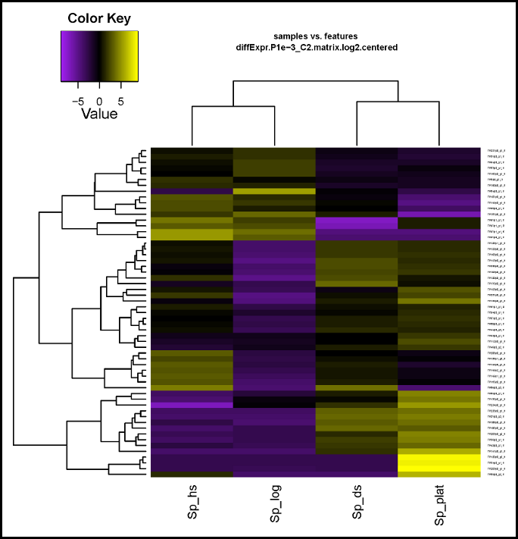
Results
Extracting DE transcripts and generating heatmaps
analyze_diff_expr.pl

Slide 15
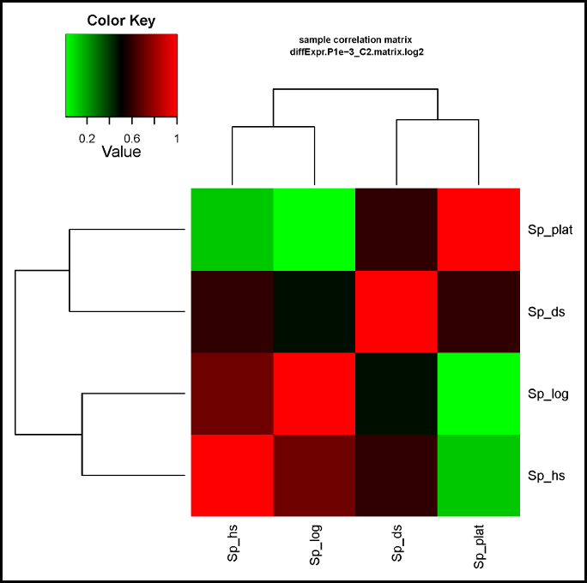
Results
Sample correlation matrix
The End – Thank You!

