Slide 1

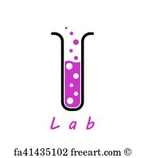

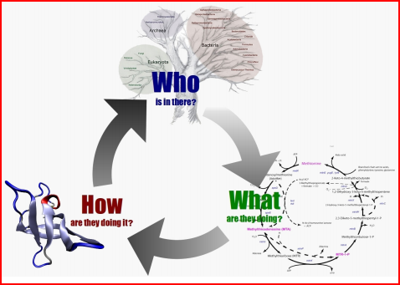
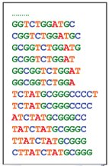

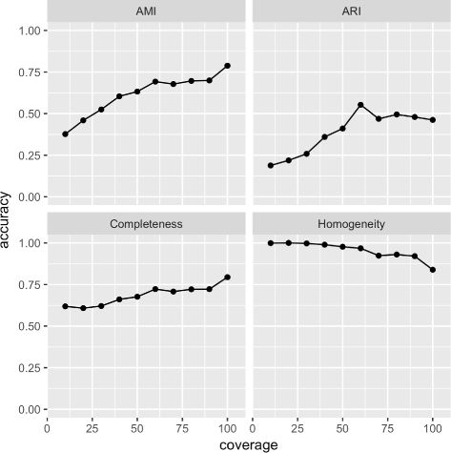
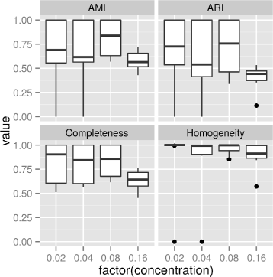

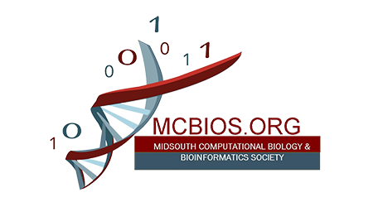


Unknown Bacteria Detection in Oral Microbial Communities Using 16S rRNA Genes
Quang Tran, Diem-Trang Pham and Vinhthuy Phan
Department of Computer Science, The University of Memphis
,
Introduction
Motivation
Experiments and Results
Metagenomics is an application of modern genomic techniques to the study of microbial communities directly in their environments, bypassing the need for isolation and lab cultivation of individual species (Chen & Patcher 2005)
Quantification and identification of microbial genomes based on next-generation sequencing data is a challenging problem in metagenomics.
Current methods have mostly focused on analyzing bacteria whose genomes have been sequenced, such analyses are, however, complicated by the presence of unknown bacteria or bacteria whose genomes have not been sequence.
Human Oral Microbiome Database 16SrRNA genes: 899 sequences, varied lengths: 1,323 to 1656 bases. Read coverage was 10x to 100x and percentage of unknown bacteria: 1% to 16%, Illumina sequencing platform
The affect of coverage on prediction accuracy (Fig. 4L): prediction accuracy was higher at higher coverage. As coverage approached 100x, clusters became less homogenous.
The affect of unknown bacteria concentration (Fig. 4R): Prediction accuracy tended to decrease with more unknown bacteria (dropping dramatically @ 16%)
Methods
Reference 16S rRNA genes Database
Short reads from oral environments
Our method for identifying unknown bacteria from short reads that come from 16S rRNA genes of all bacteria (including known and unknown bacteria) in an environmental sample works as Fig.
Clustering unmapped reads (step 3): each cluster is a collection of reads that cover a contiguous genomic region (Fig.2)
Bowtie2 alignment
Aligning reads to the collection of already-sequenced 16S rRNA genes of known bacteria
SAMtools filtering
Assuming reads that are not mapped belong to unknown bacteria
Figure 1. (L) Sequencing machine takes a sample, and then produce short reads (Source: https://www.intechopen.com). (R) From these reads, we classify reads to sequences and profile environmental samples.
(Source: http://www.cbs.dtu.dk/)
Clustering unmapped reads
Clustering unmapped reads to distinct clusters
Unknown organisms
Each cluster represents a hypothetical unknown bacterium
Conclusion
We found this method made accurate and robust predictions at different read coverages and percentages of unknown bacteria.
Pros: A reduction in experimental and computational costs and a potentially high accuracy across samples due to the strong conservation of the 16S rRNA gene.
Figure 2. Reads mapped to a contiguous region of a 16S rRNA gene
Figure 3. Workflow for detecting unknown bacteria
Problem definition:
A sample: reads from environment: {R1, R2, R3,… Rn}
Database: reference sequences: {G1, G2, G3,… Gn}
Assign R_{i} to a correct G_{j}, where R_{i} actually came from.
References
Challenges:
Bacteria mutate very quickly, whole genomes mutate a lot.
Due to evolution, the reference genome databases are still far from complete.
Current methods suffer when a large fraction of microbial are unknown.
Tran Q, Pham D-T, Phan V. "Using 16S rRNA gene as marker to detect unknown bacteria in microbial communities.", BMC Bioinformatics, 2017, Volume 18, N. 14, P 155.
Figure 4. (L) Accuracy of predicting unknown bacteria (measured by 4 different metrics) at read coverage ranging from 10x to 100x, (R) Accuracy of predicting unknown bacteria (measured by 4 different metrics) at different amount of unknown bacteria

