Slide 1
PROTECT YOUR WORLD

Slide 2

HELLO!
My Name Is Ethan Caldwell
I’m presenting my project 2: “PROTECT YOUR WORLD” an 80’s style game (based off of space invaders)

Slide 3
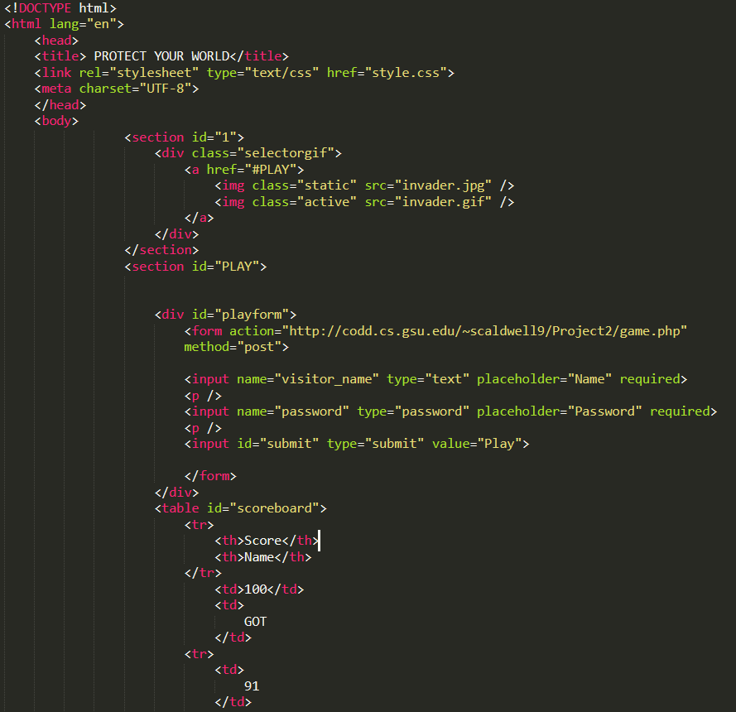
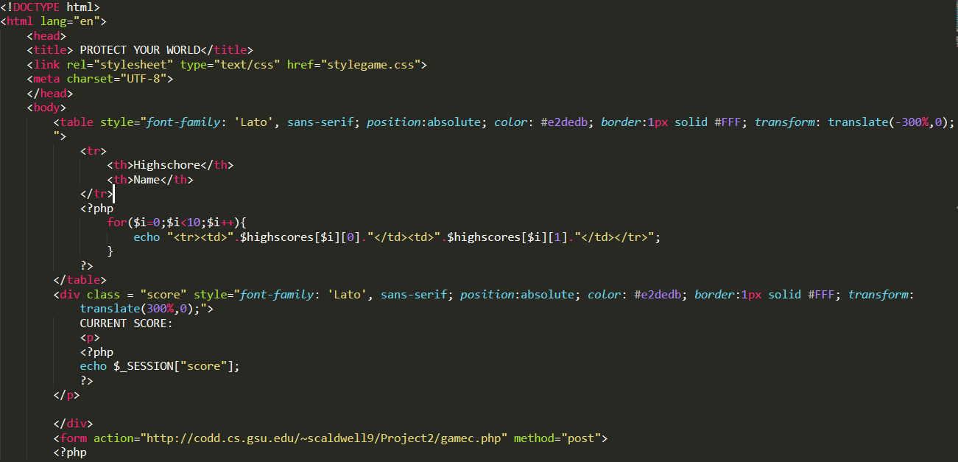
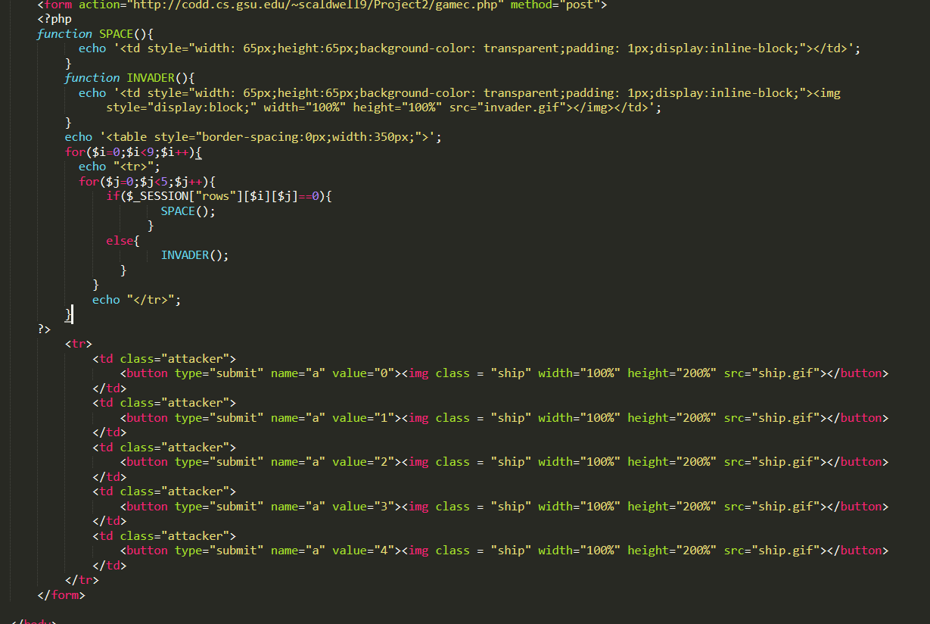
1
HTML SNIPPETS

Slide 4
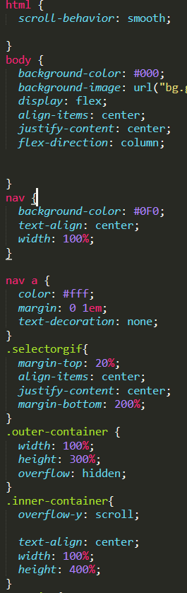
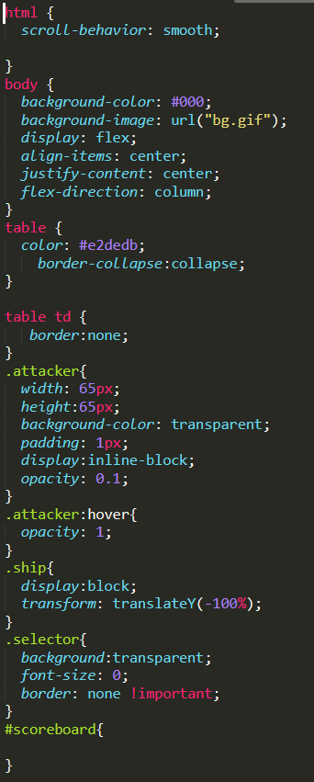
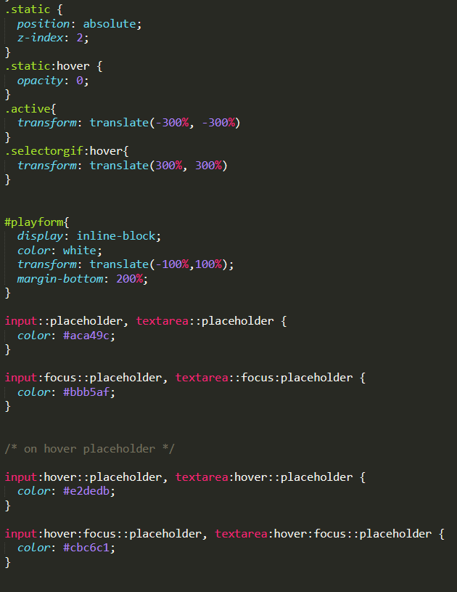
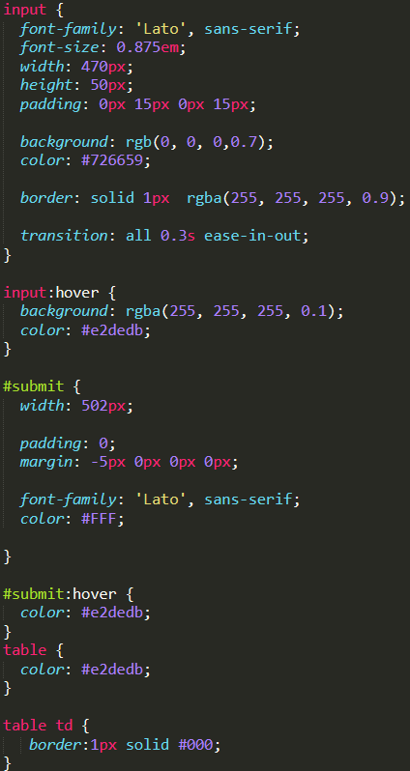
2
CSS SNIPPETS

Slide 5
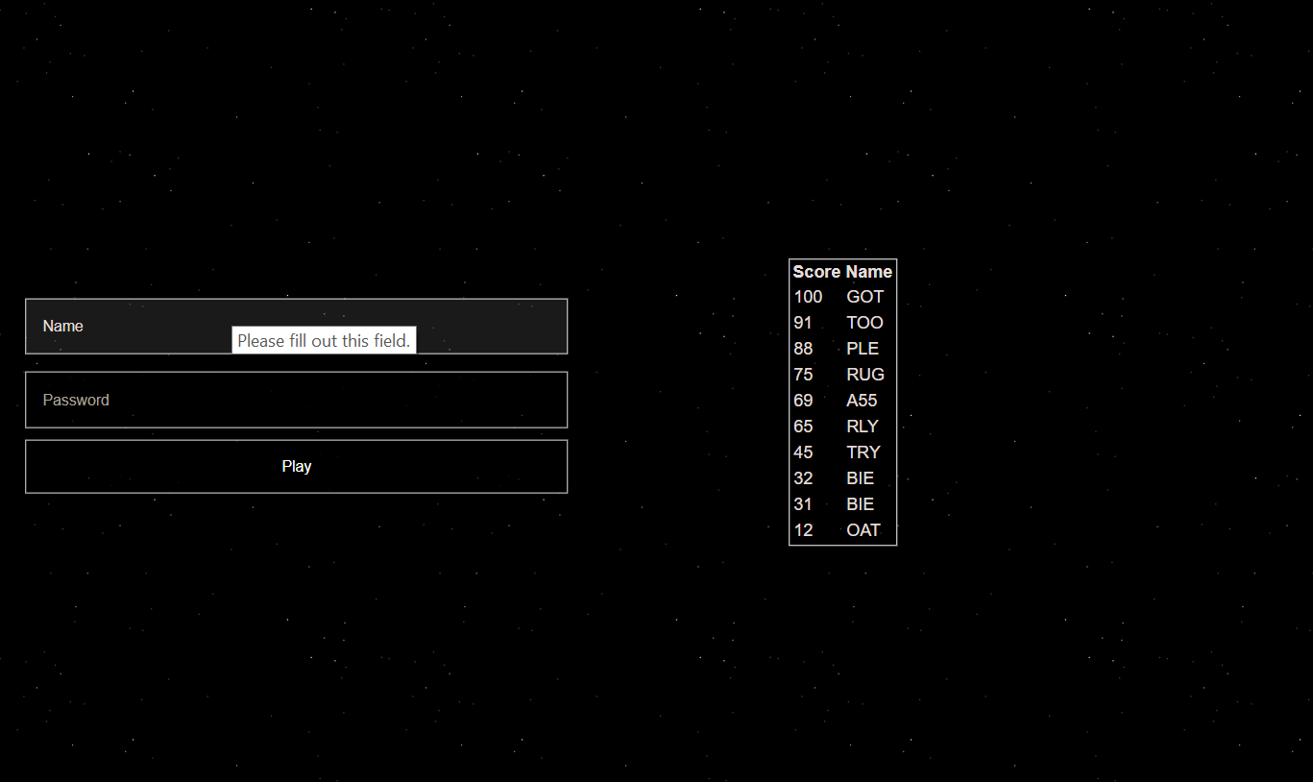
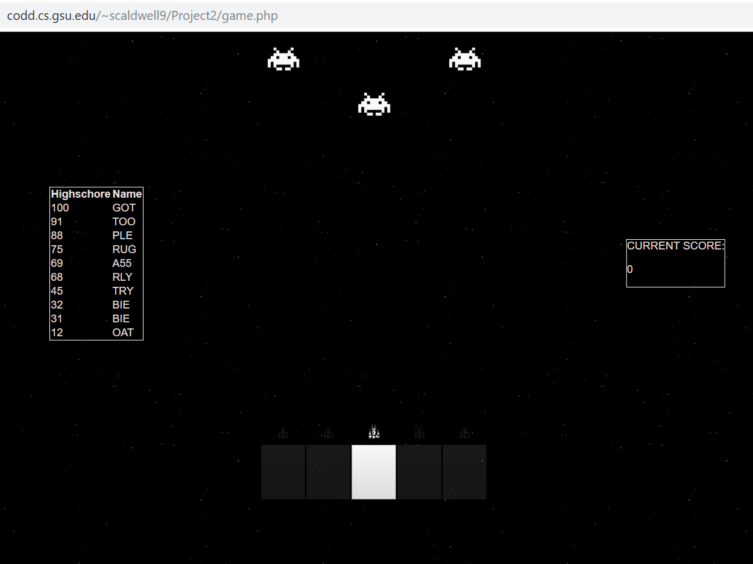
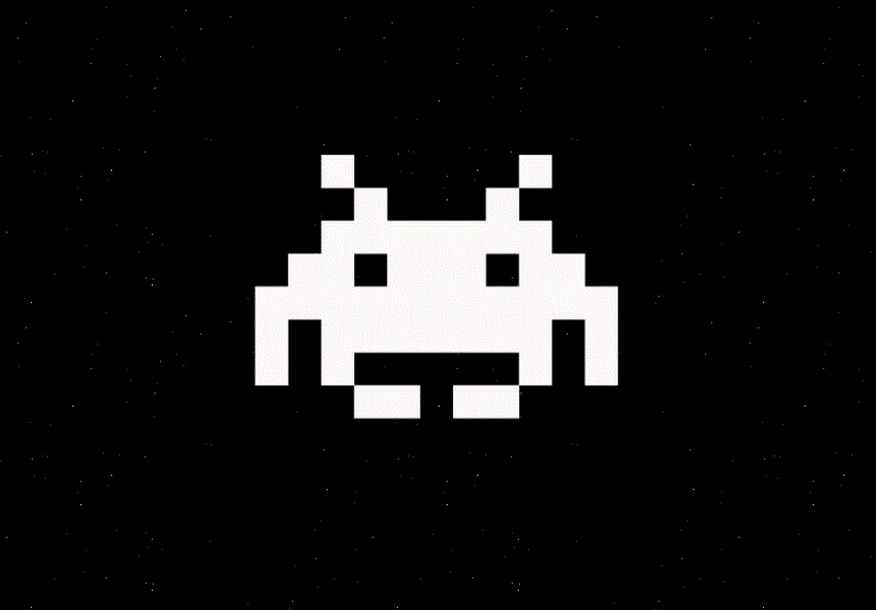

Slide 6
HOW IT WORKS

Slide 7
PHP Forms and Logic
STEP 1: CREATE A MATRIX OF INVADERS
PHP 2-D ARRAY
SESSIONS
STEP 2: HAVE THE LAYERS APPROACH THE PLAYER
PHP FORM SUBMISSION
POSTS

Slide 8
Each Page follows a linear procedure
LOAD INITIAL PAGE
PLAYER SELECTS ATTACK POSITION
LOAD NEW PAGE FROM SELECTION
CREATE NEW RANDOM ENEMIES, TRACK SCORE
SUBMIT POSTS FROM SELECTION
DELETE SELECTED INVADER, TEST FOR GAME OVER, MOVE ENEMIES

Slide 9
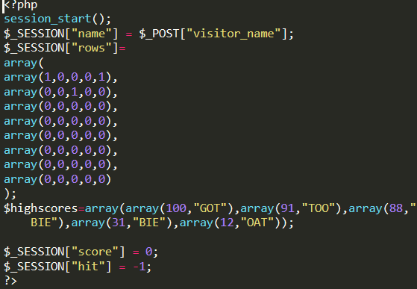
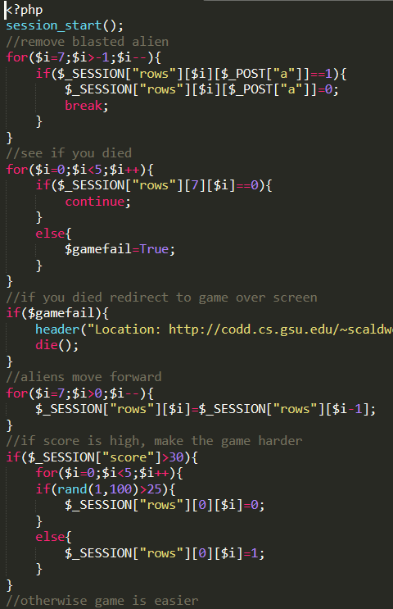
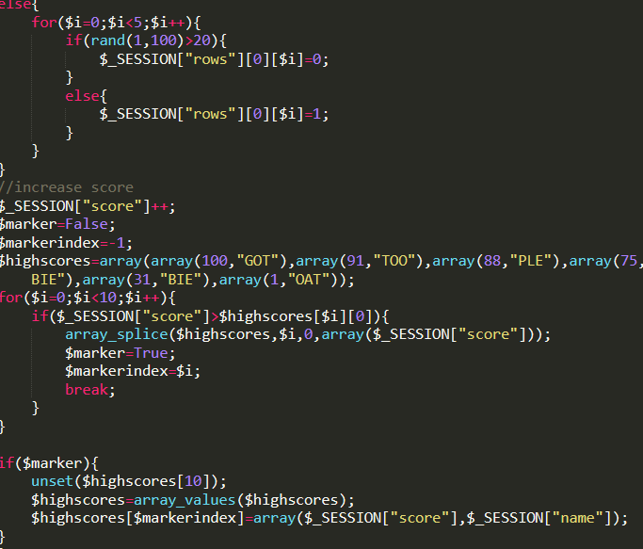
Initial Array

Slide 10
DEMO
GO

Slide 11

FULL GAME EXPLANATION
NEW SESSION “SUPERBOOST”
MAKES YOUR BLASTS STRONGER!

Slide 12
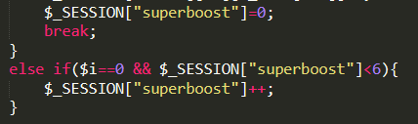
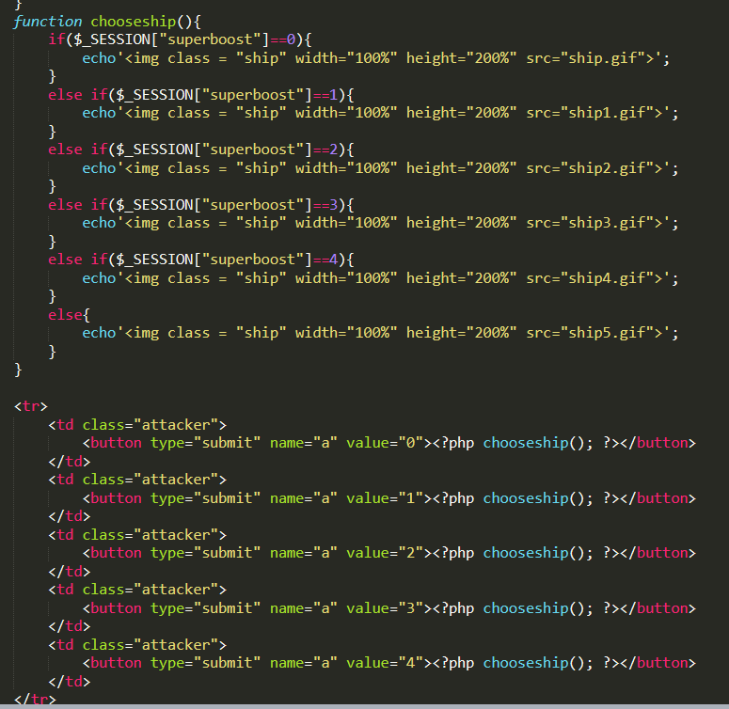
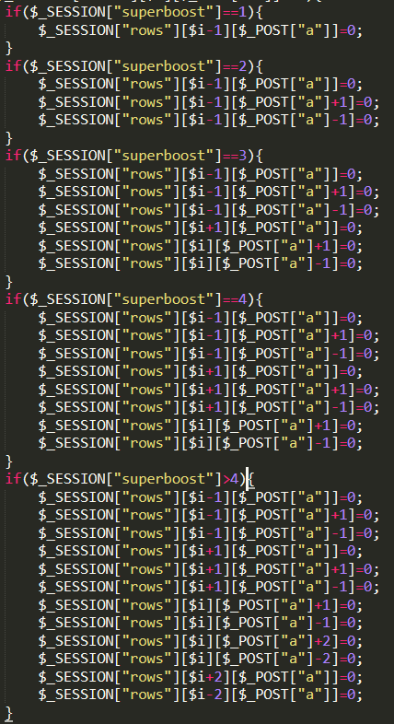
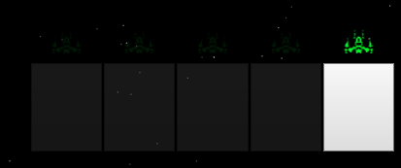
“MISS” shots to CHARGE UP

Slide 13
REAL GAME
GO

Slide 14
😉
THANK YOU!!!

