Slide 1
Lost Forever:
Fast ways for dog days

Slide 2
Hello!
I AM ETHAN CALDWELL
I created Lost Forever
You can find me at:
github.com/CobaltM

Slide 3
1.
What is Lost Forever?
A brief background on travel

Slide 4
“I learned a long time ago that trying to micromanage the perfect vacation is always a disaster. That leads to terrible times”
-Anthony Bourdain

Slide 5
Life is hard. Work is hard. Why is vacationing hard?
Problems with vacations
too many options
too much planning hassle
too little time
Let’s fix vacations!

Slide 6
Easier Vacations
How ready made vacations are the future of your travels

Slide 7
You can also split your content
Lost Forever’s Model
TAKE AWAY
Lengthy research
Laundry list of services
Complicated planning
Many phone calls
KEEP
Great Hotels
Personal experiences
Individual preferences
An awesome vacation

Slide 8
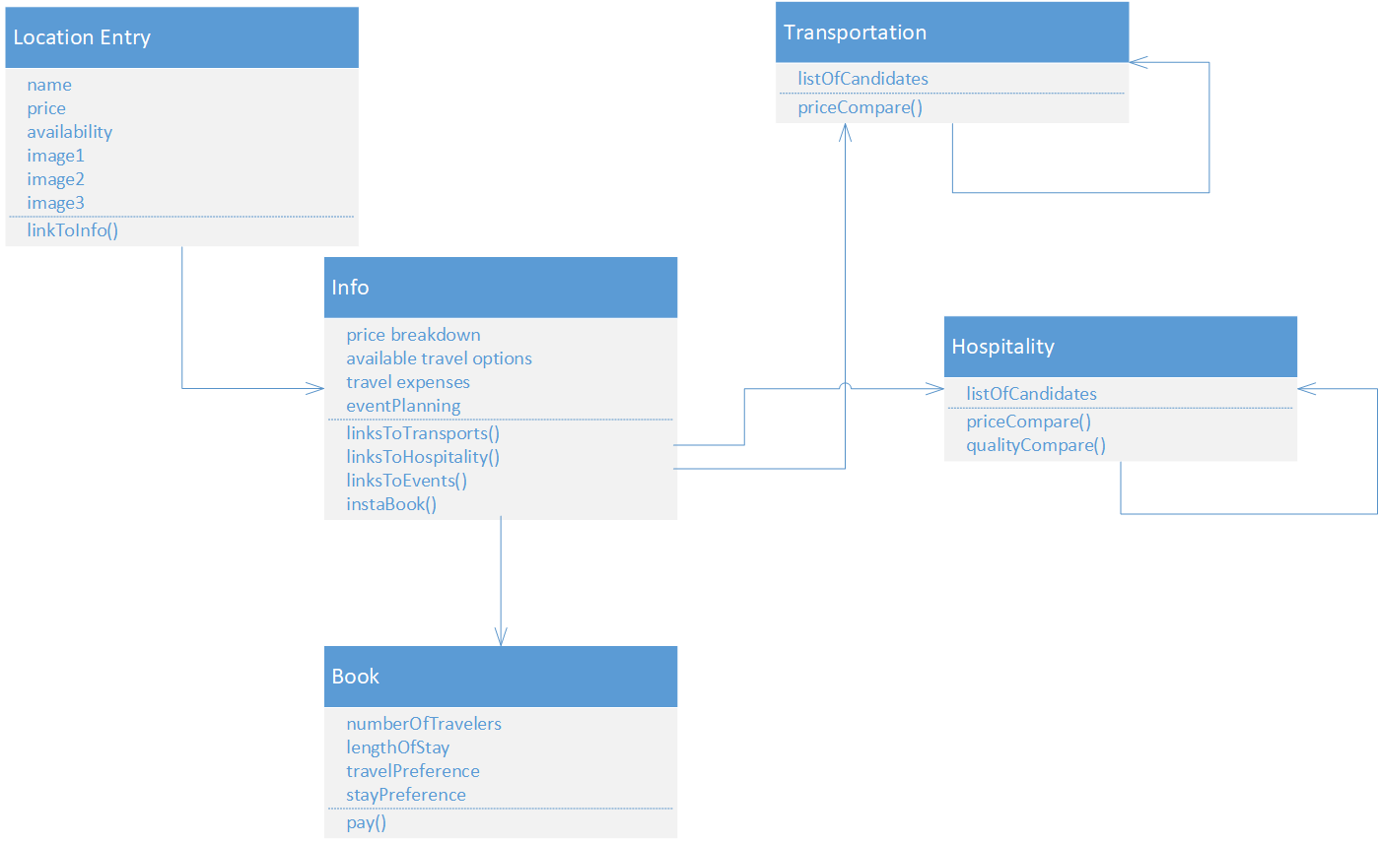
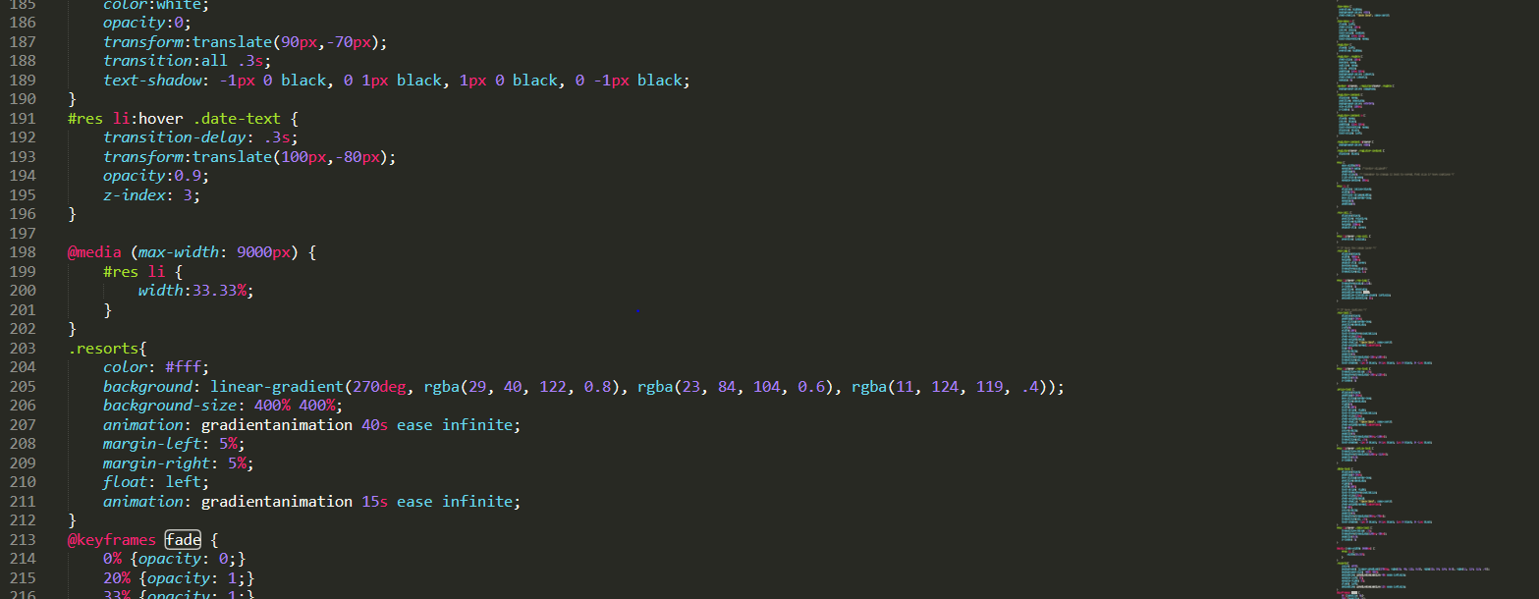
How it works
Select a destination
answer a 5 questions
buy your trip

Slide 9

Go Anywhere.

Slide 10
Use charts to explain your ideas
Key Functionalities
Ease
Desire
Support

Slide 11
Thanks!
ANY QUESTIONS?
http://codd.cs.gsu.edu/~scaldwell9/project1/

