Slide 1
04/16 進度報告

Slide 2
嘗試修正Shape可解釋性不足 — 二值化
結論: 從推論準確度來看，二值化對於Shape的推論準確度並無增長

Slide 3
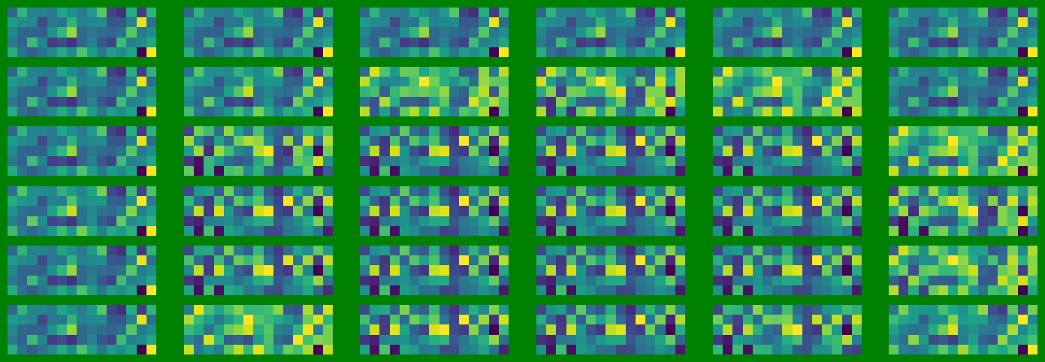


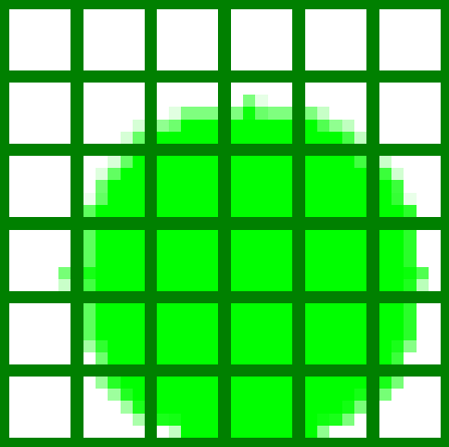
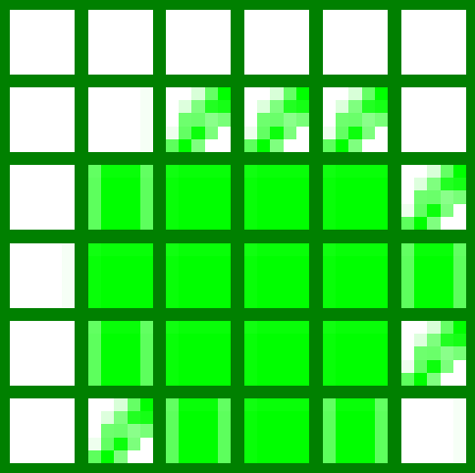
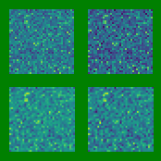
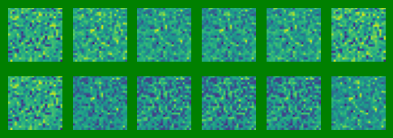
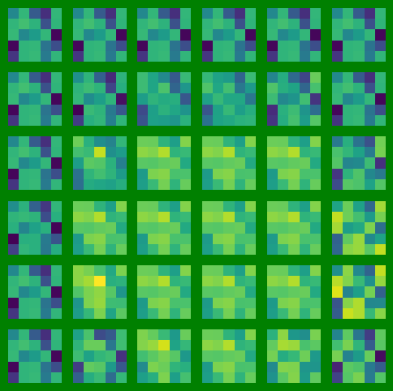
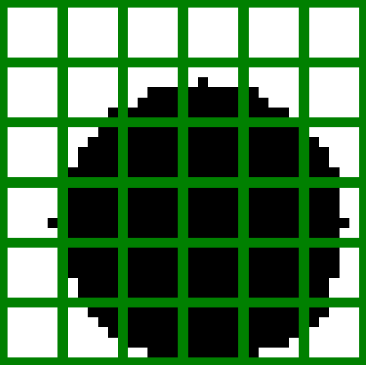
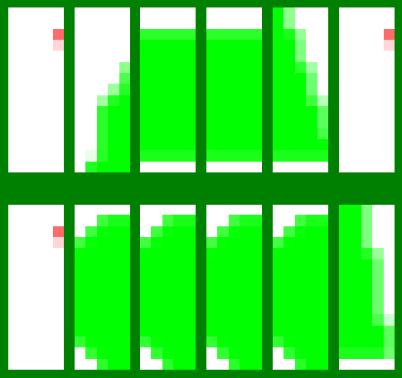
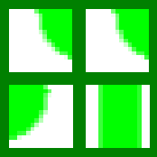
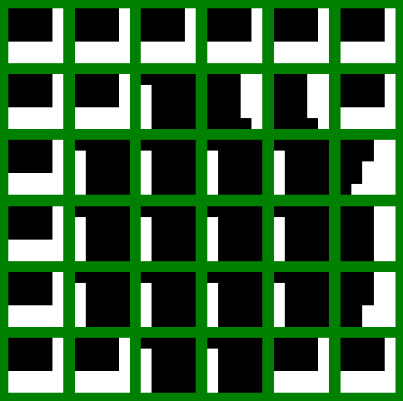
嘗試修正Shape可解釋性不足 — 二值化
RM0_RGB
Original_split1
Original_split2
Origin Image split
RM-CI0_RGB
RM1
RM2
RM0_Gray
Origin Image split
RM-CI2
RM-CI1
RM-CI0_Gray

Slide 4
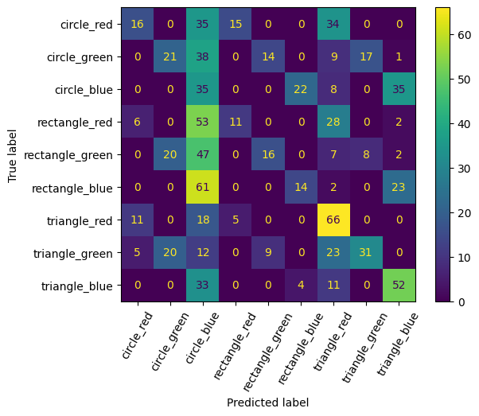
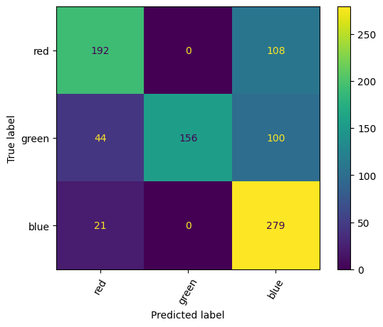
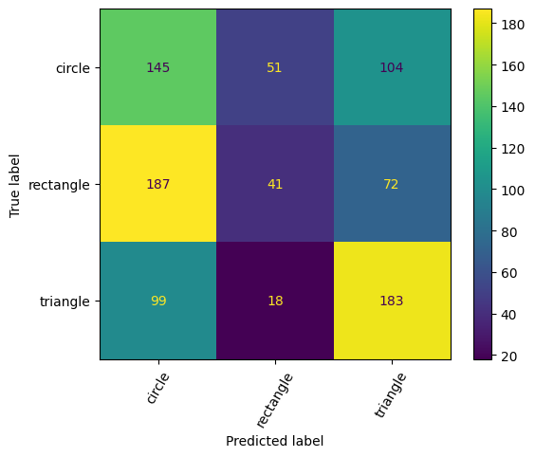
嘗試修正Shape可解釋性不足 — 二值化
採用每個layer依推論類別進行投票。如果票數相同，則以Conv2的推測類別為預測推論類別
=> accuracy: 29.11%, color accuracy: 69.67%, shape accuracy:41%

Slide 5
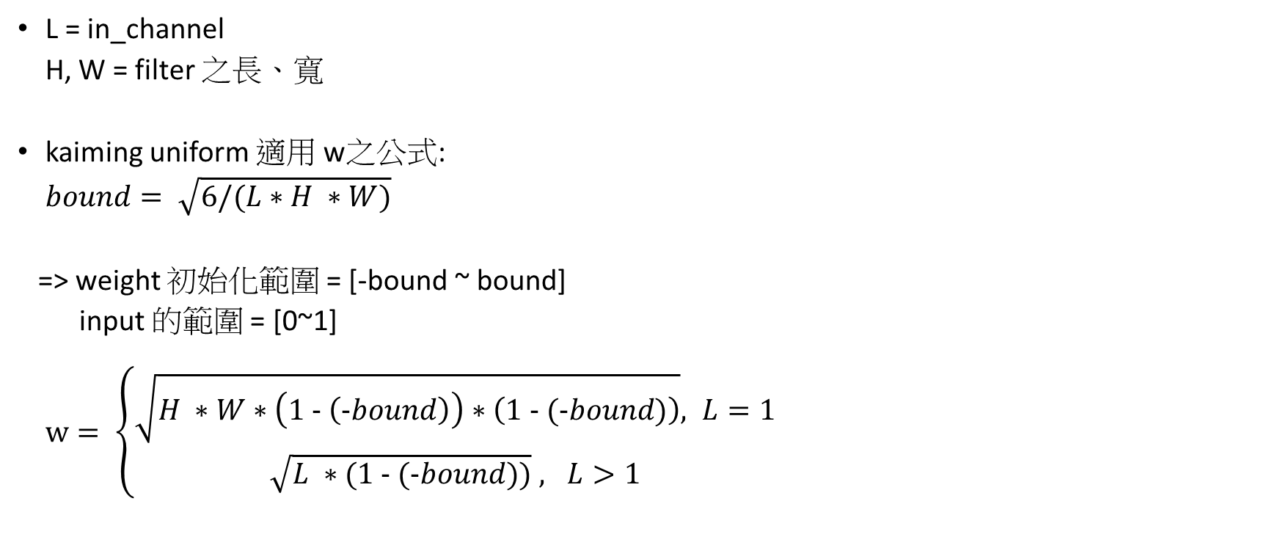
修正w範圍
L = in_channel
H, W = filter 之長、寬
kaiming uniform 適用 w之公式:
$bound= \sqrt{6/(L∗H ∗W)}$
=> weight 初始化範圍 = [-bound ~ bound]
input 的範圍 = [0~1]
$w= \left\{\begin{aligned}\sqrt{H ∗W∗\left(1 - \left(-bound\right)\right)∗\left(1 - (-bound)\right)}, L=1 \\ &\sqrt{L ∗(1 - (-bound))} , L>1\end{aligned}\right.$

