Slide 1
0608報告

Slide 2
LAB色差 + 平行架構 in Colored_MNIST
全連接層
色彩特徵傳遞區塊
30 色 Filter (30,3)
RM_color: (30, 6, 6)
Input
28 * 28
灰階特徵傳遞區塊
70 Filter
(70, 5, 5)
RM_gray: (70, 6, 6)

Slide 3
Colored_MNIST

Slide 4
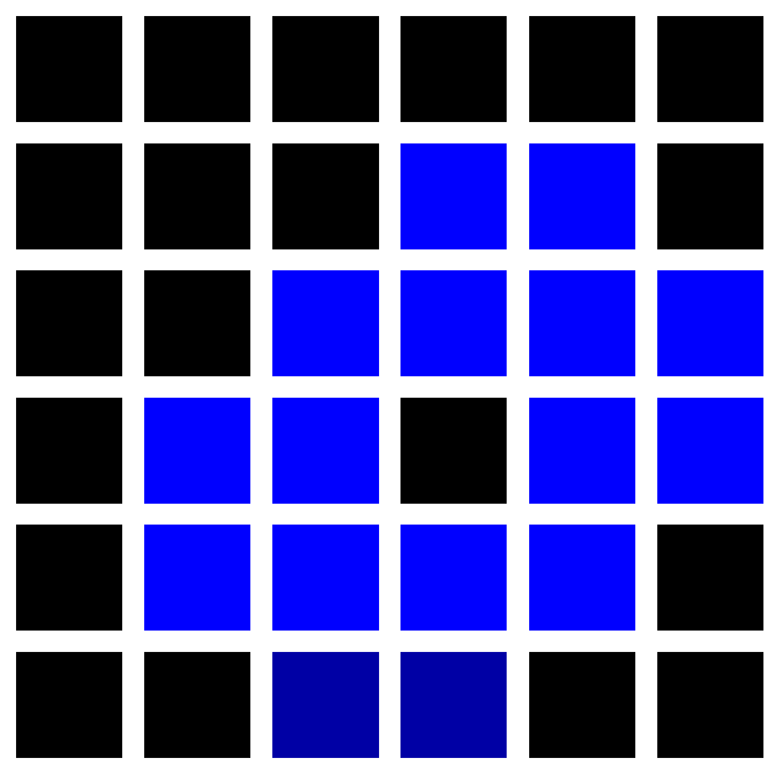
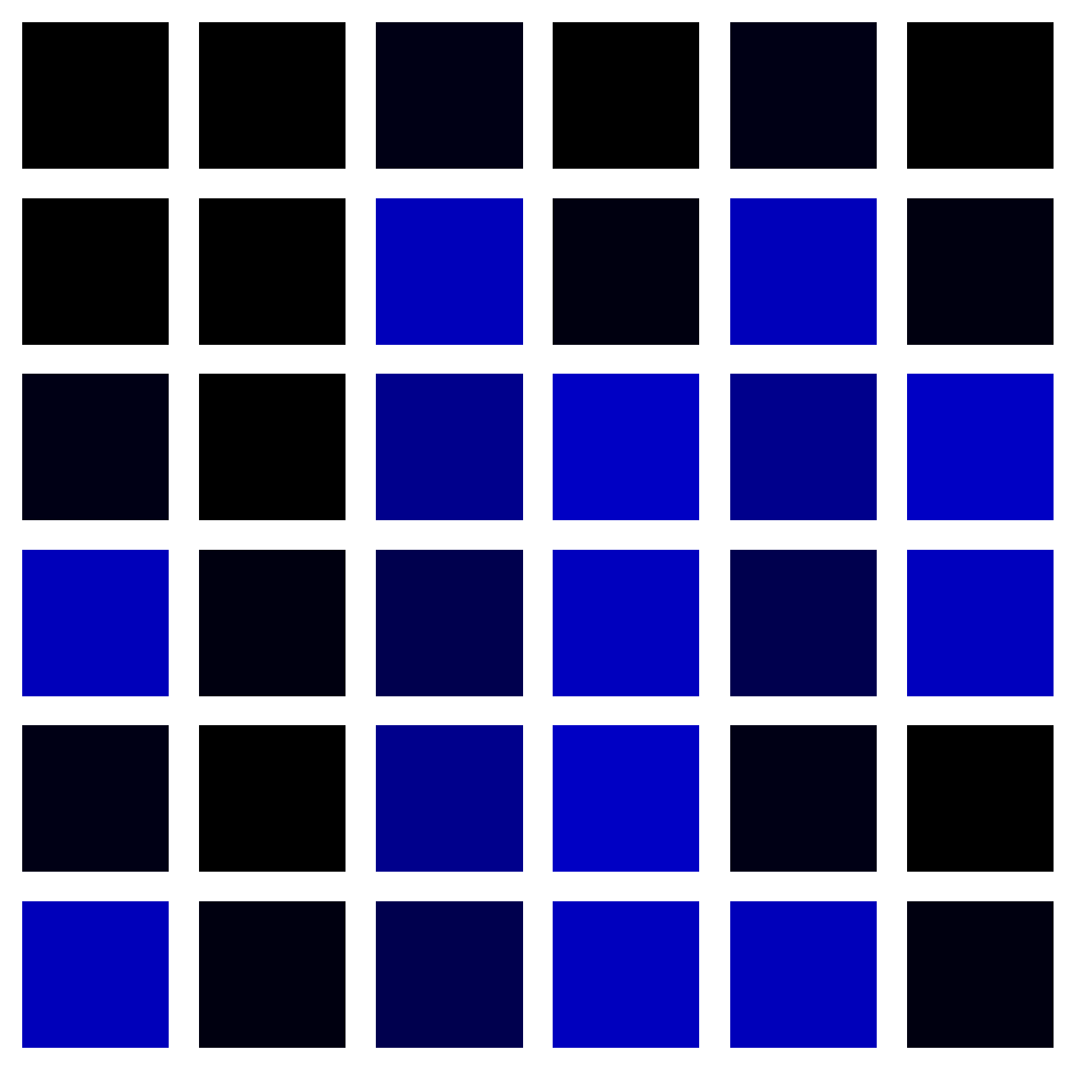
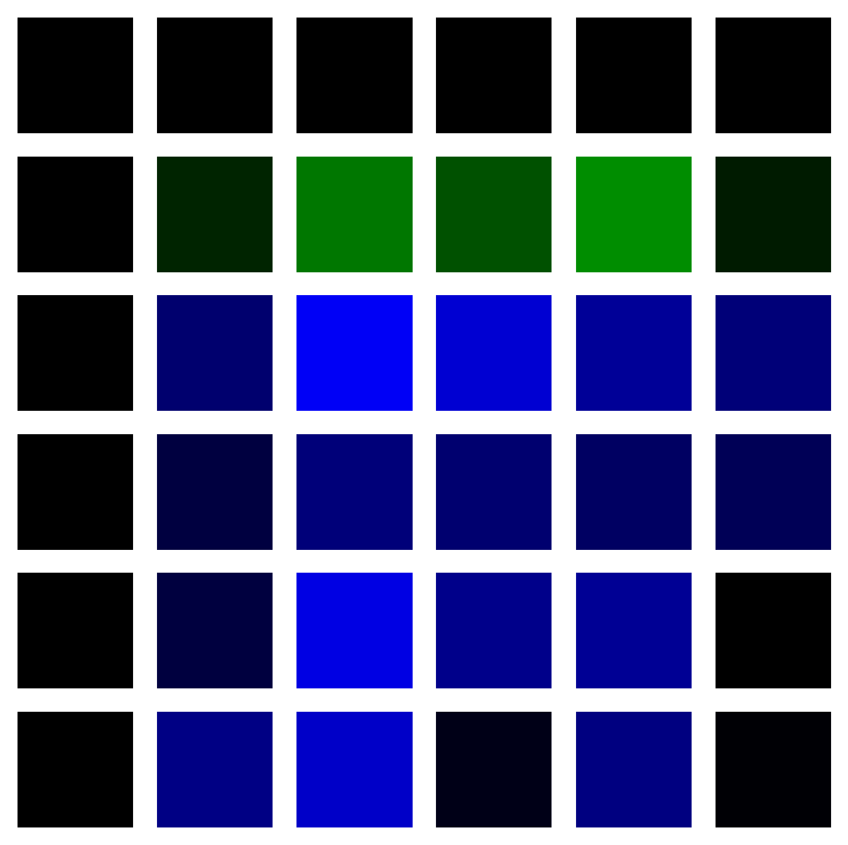
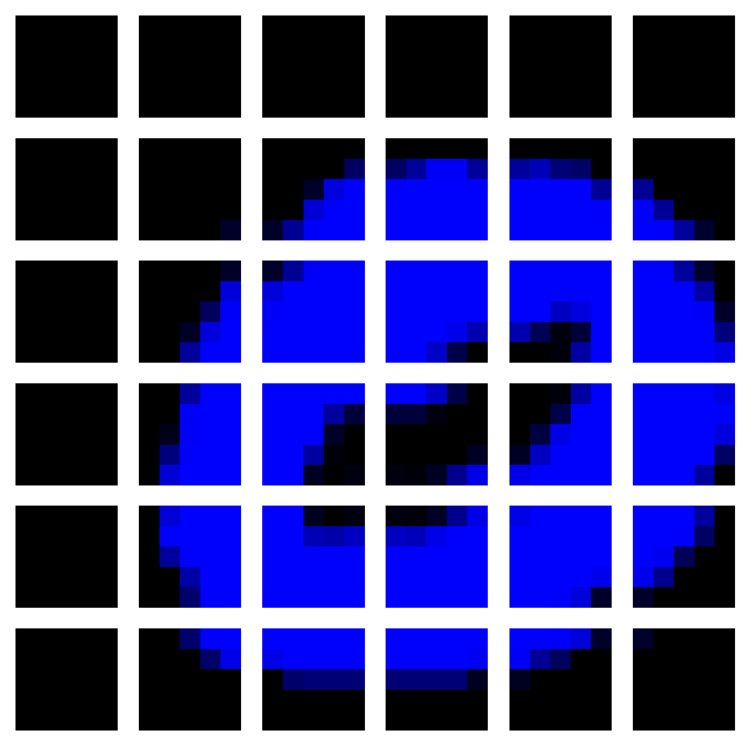
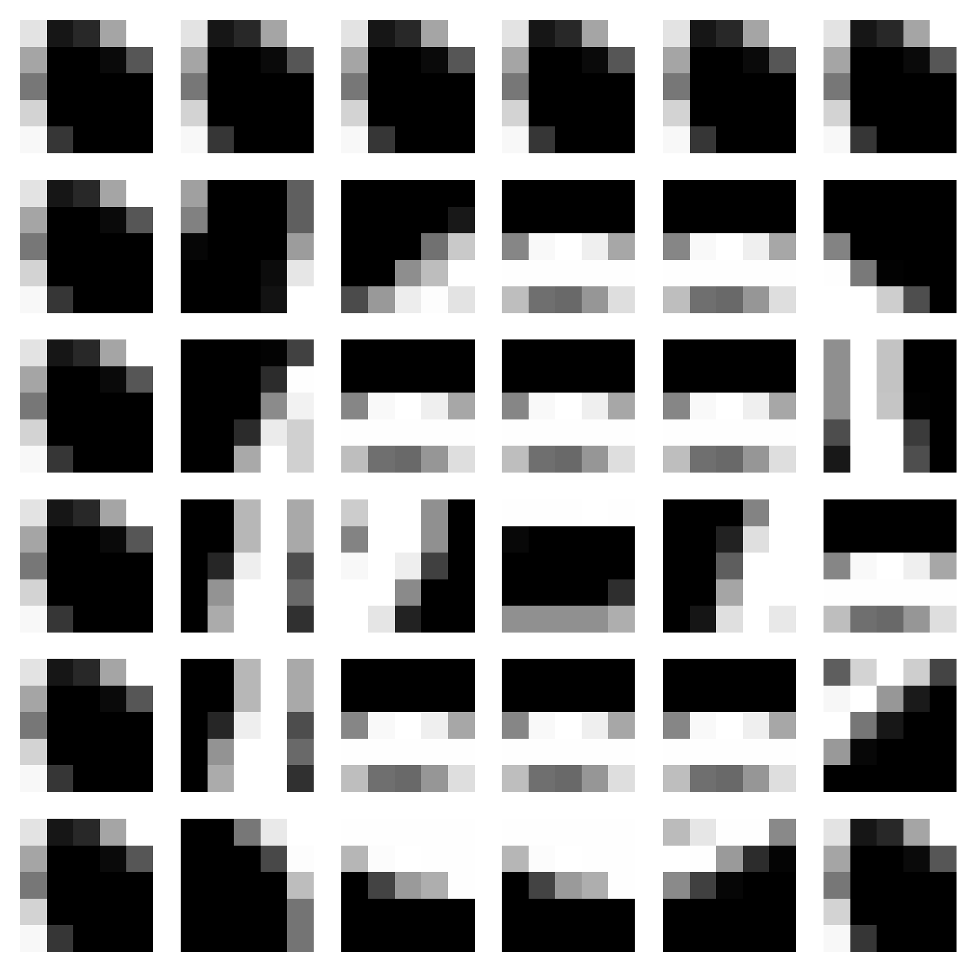


LAB + 平行架構 in Colored_MNIST
Origin

Slide 5

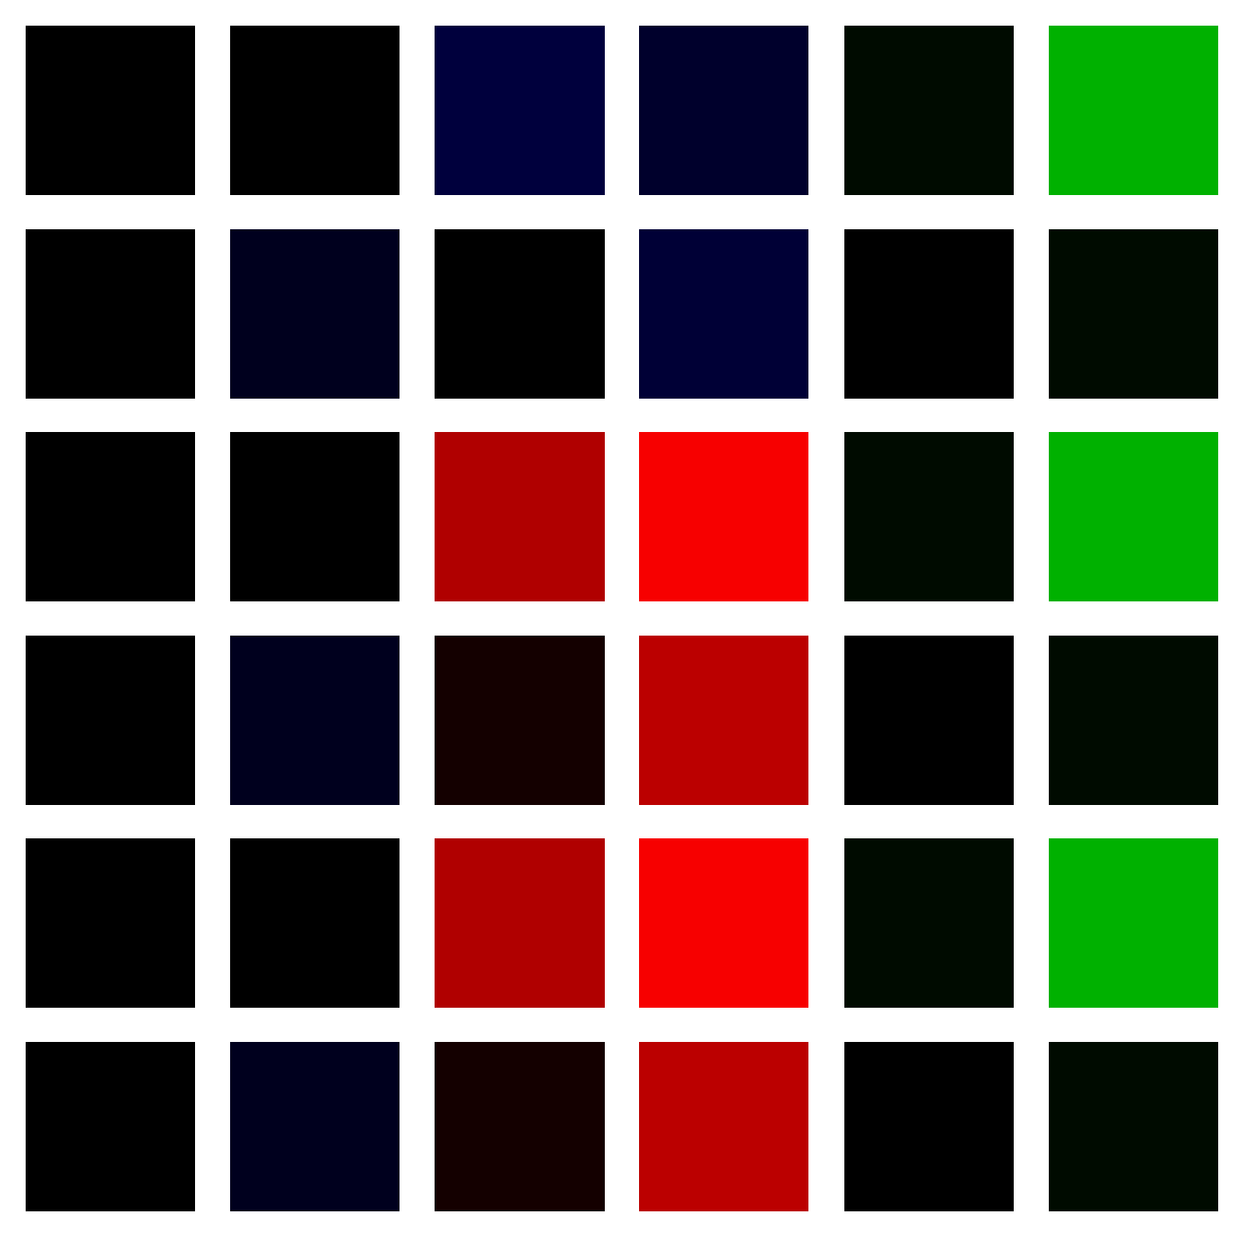
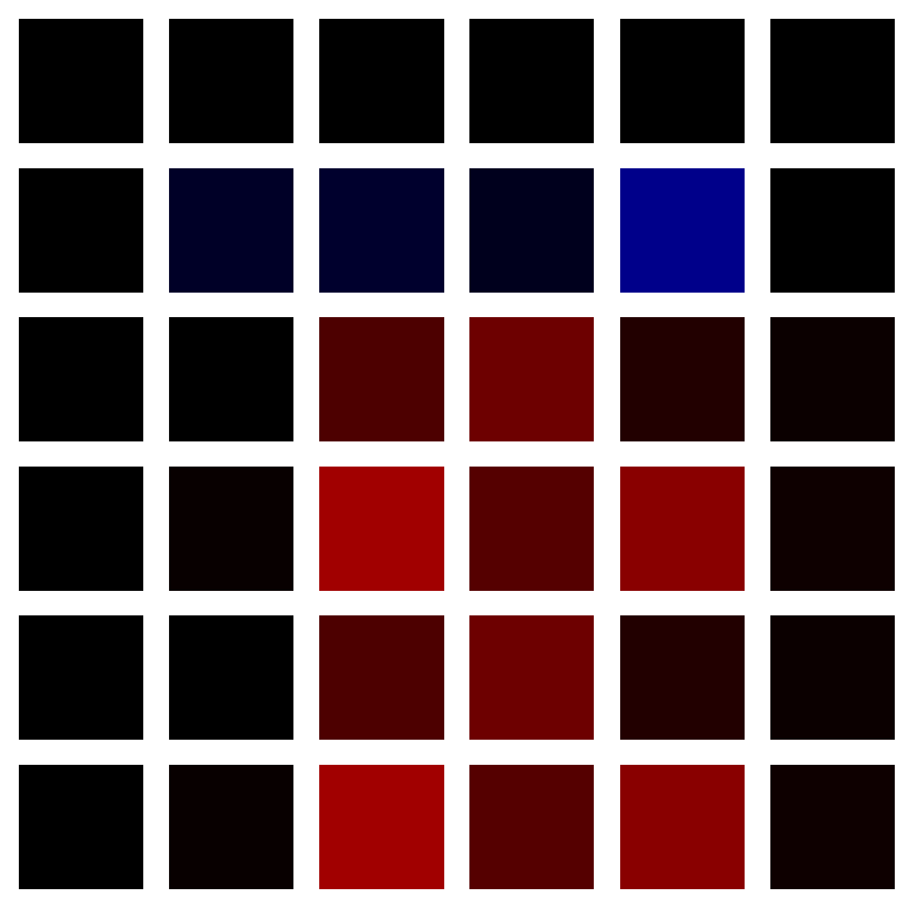
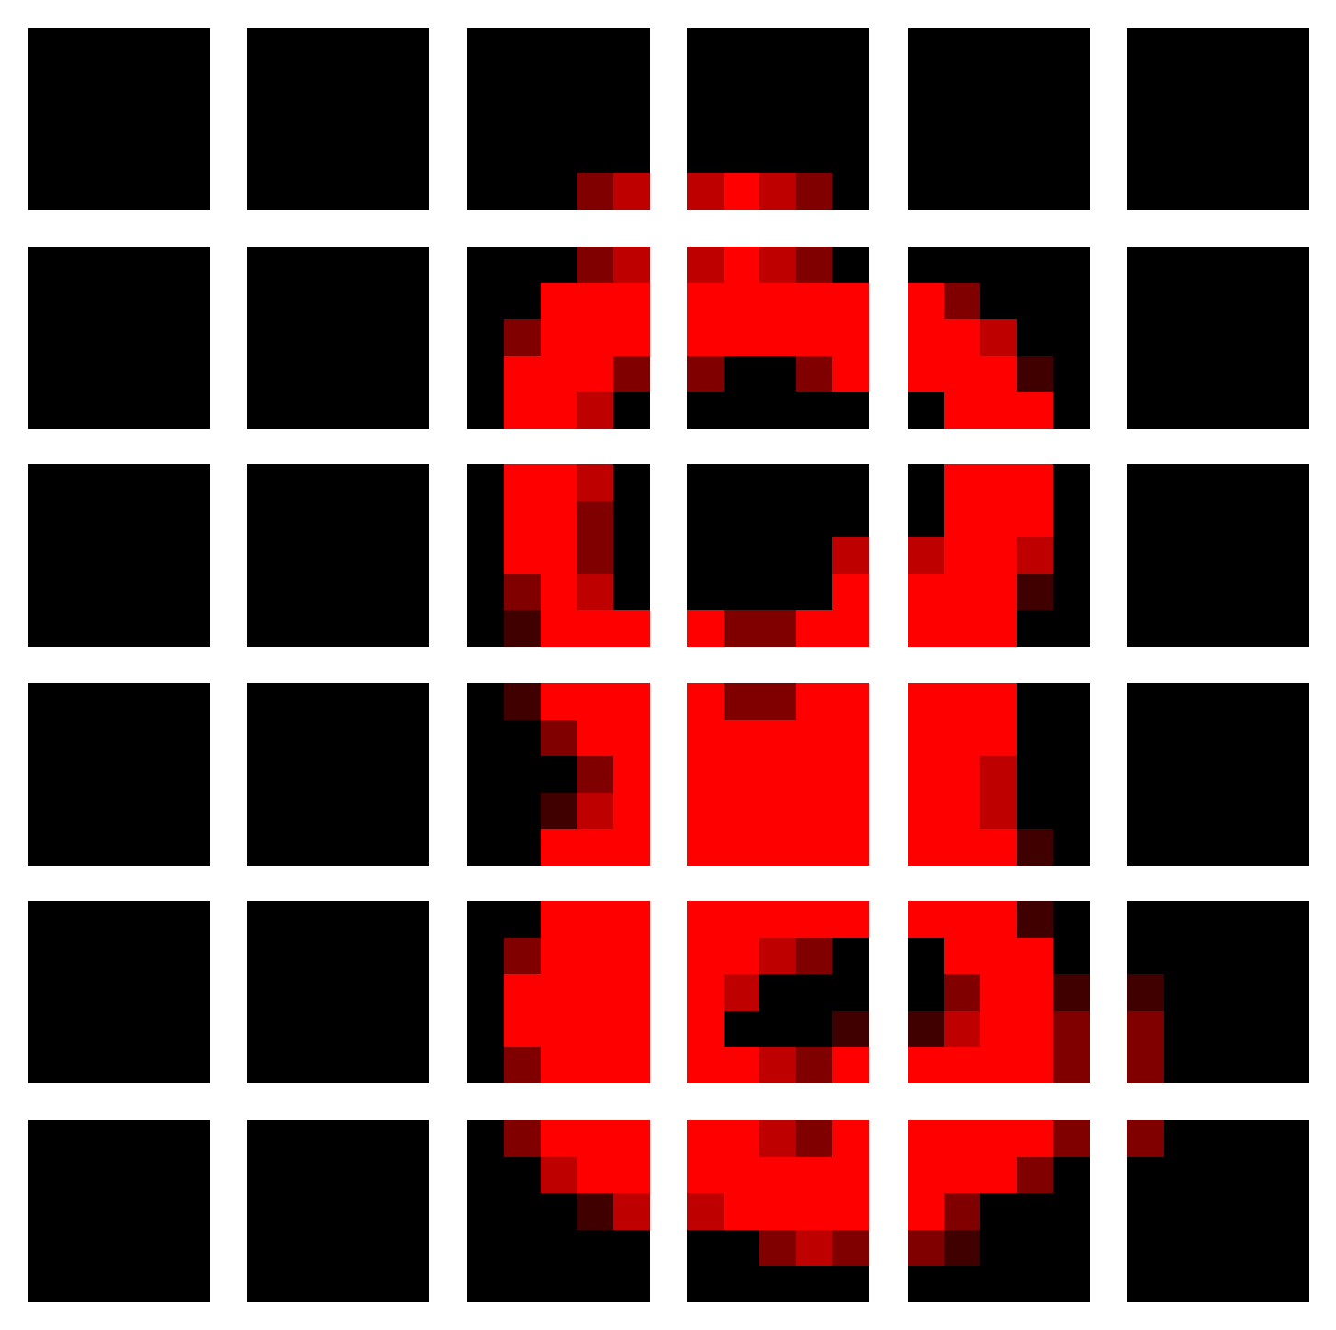
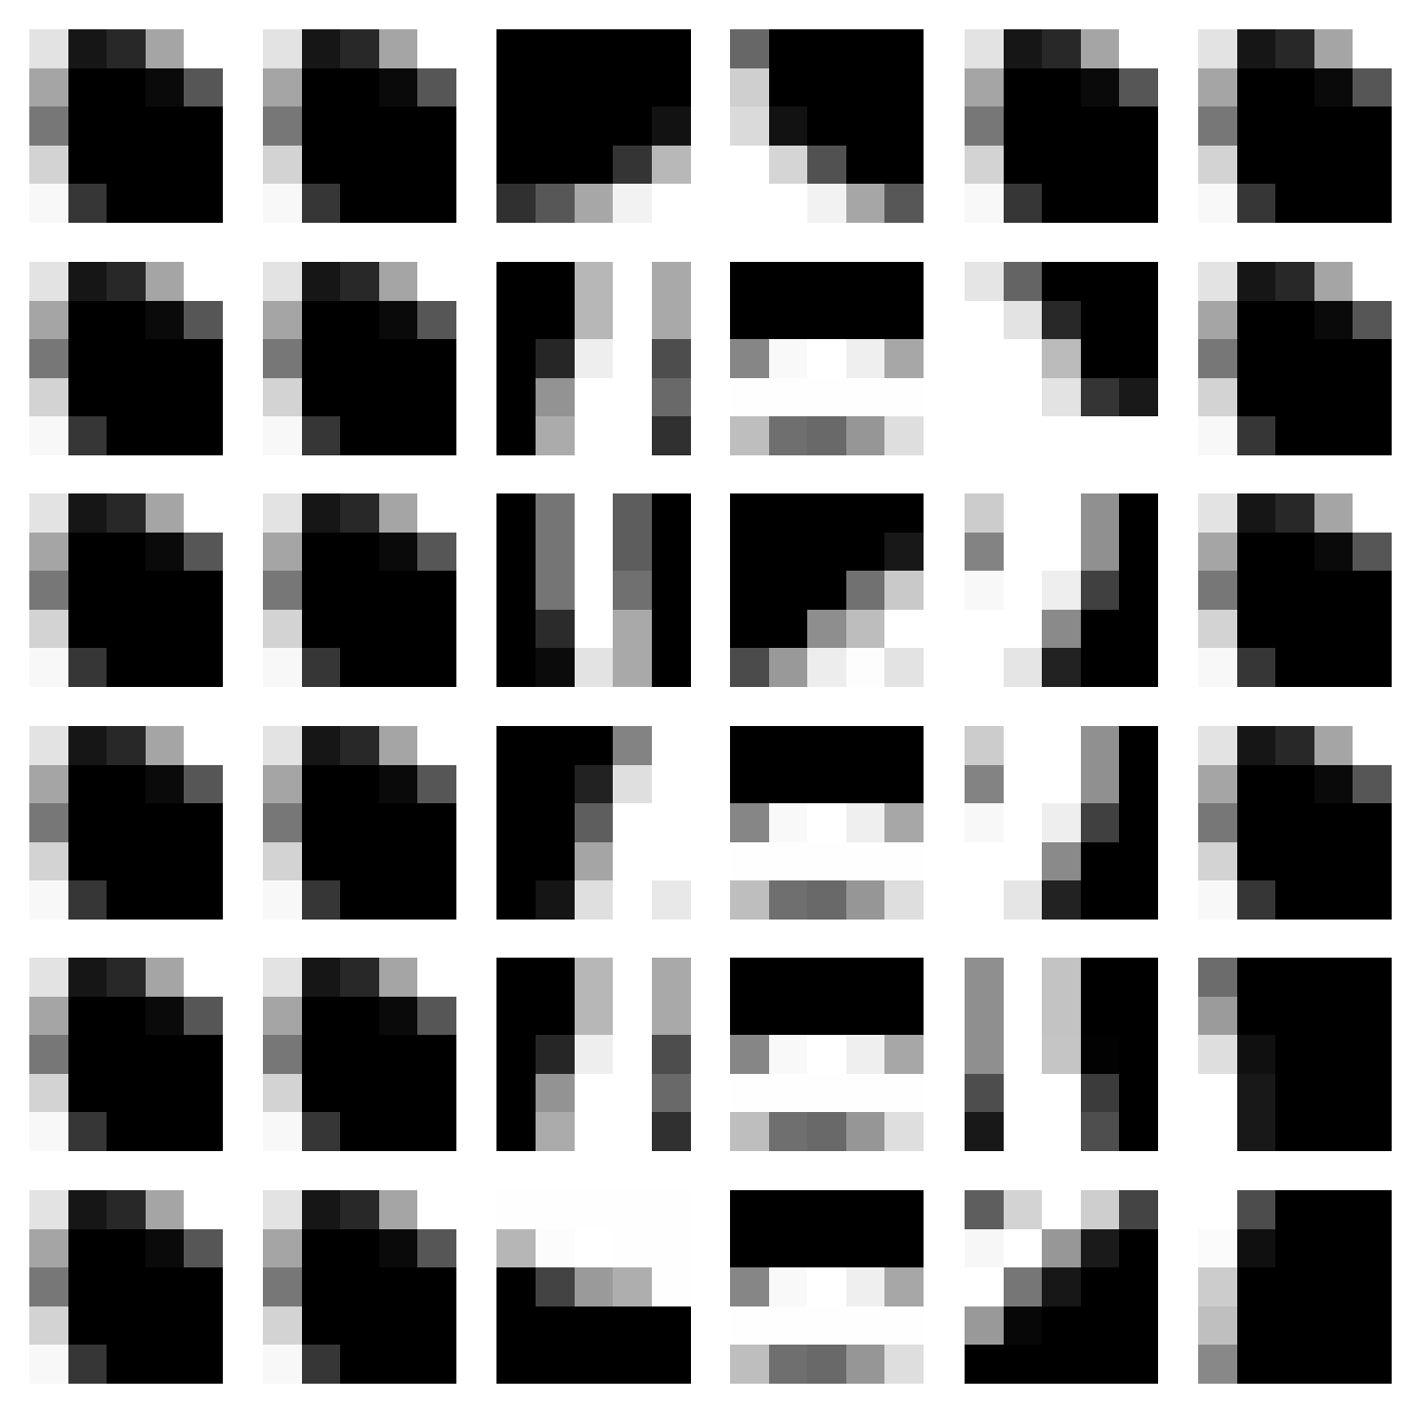


LAB 色差+ 平行架構 in Colored_MNIST
Origin

Slide 6

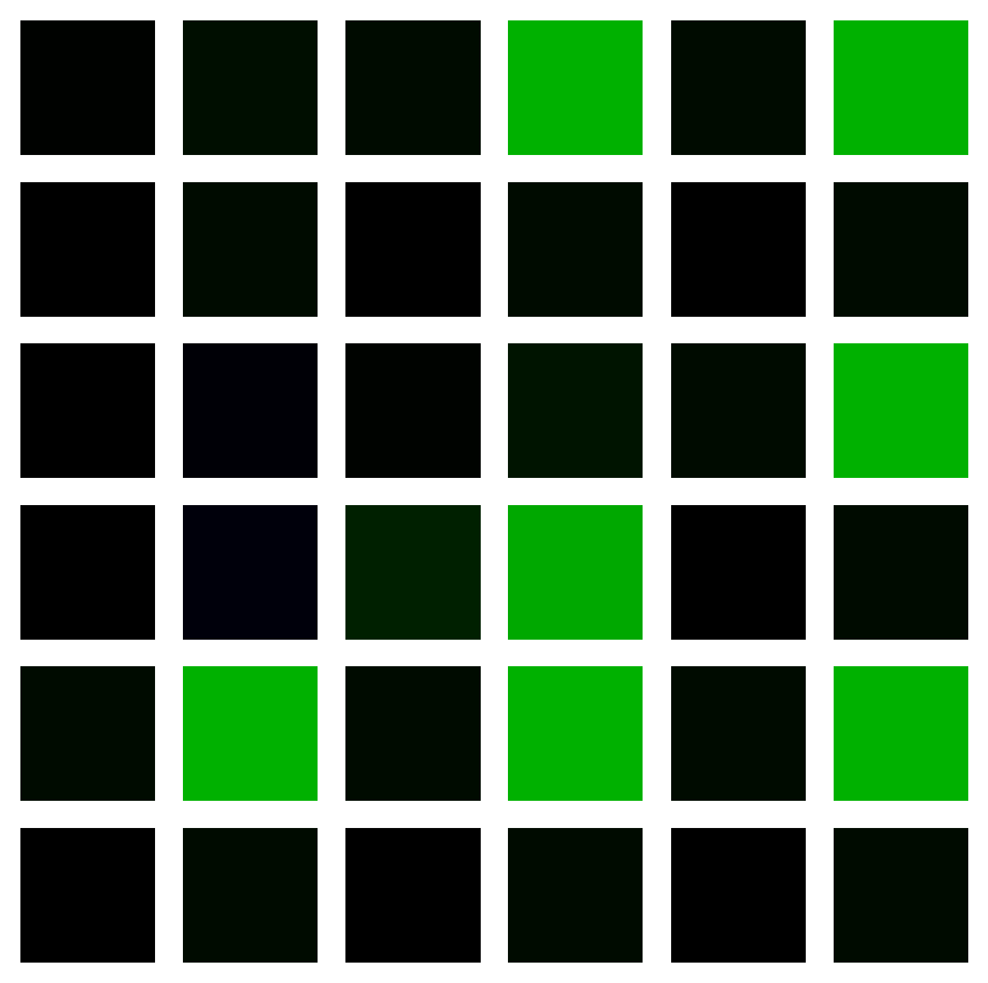
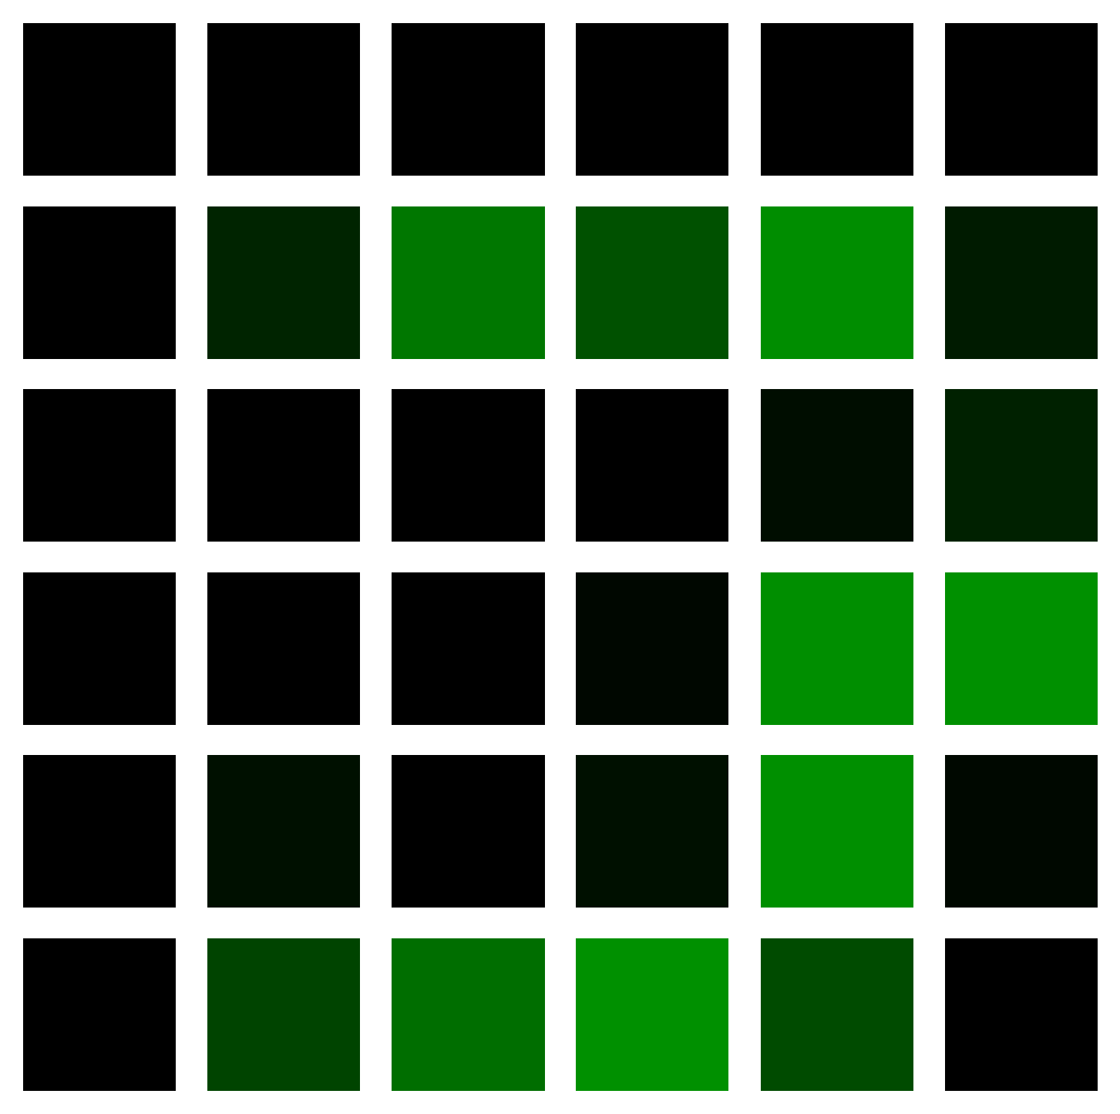
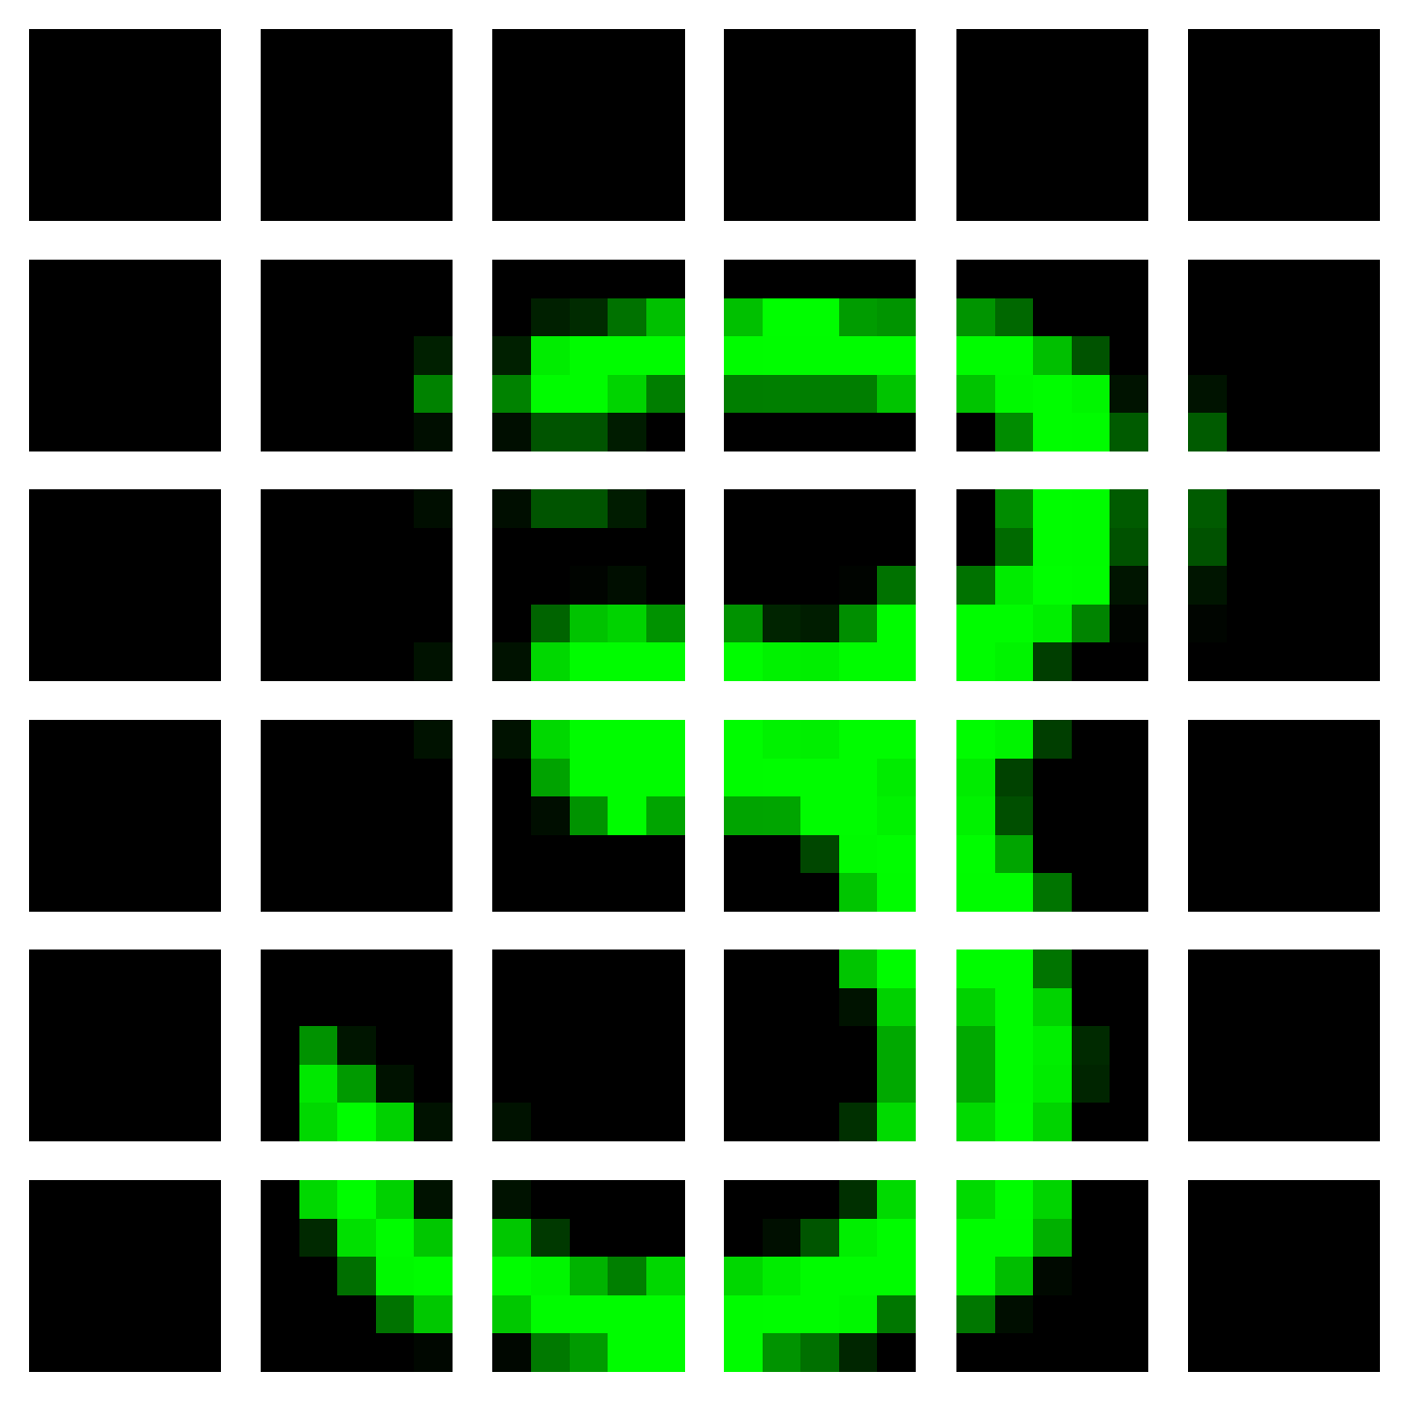
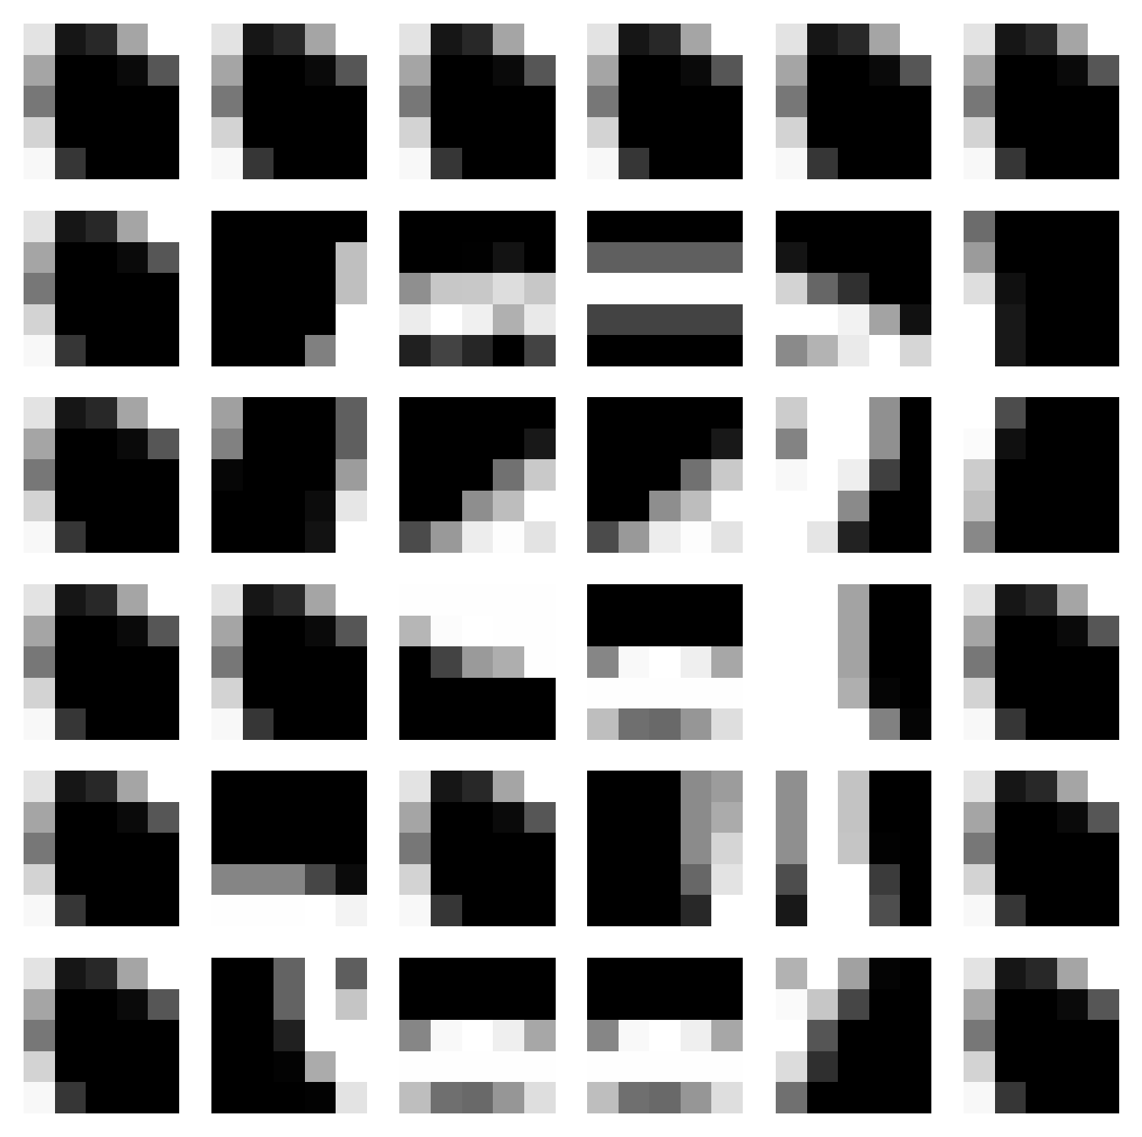
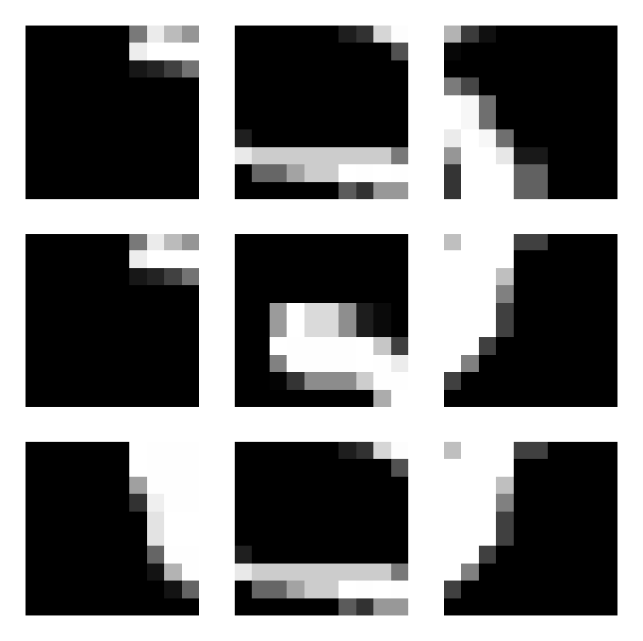
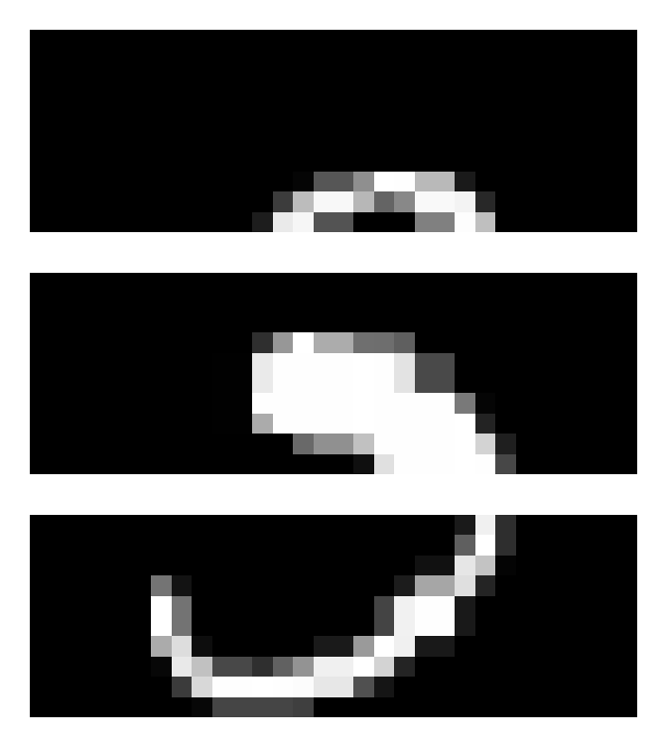
LAB 色差 + 平行架構 in Colored_MNIST
Origin
Notes:
Id = 153

Slide 7
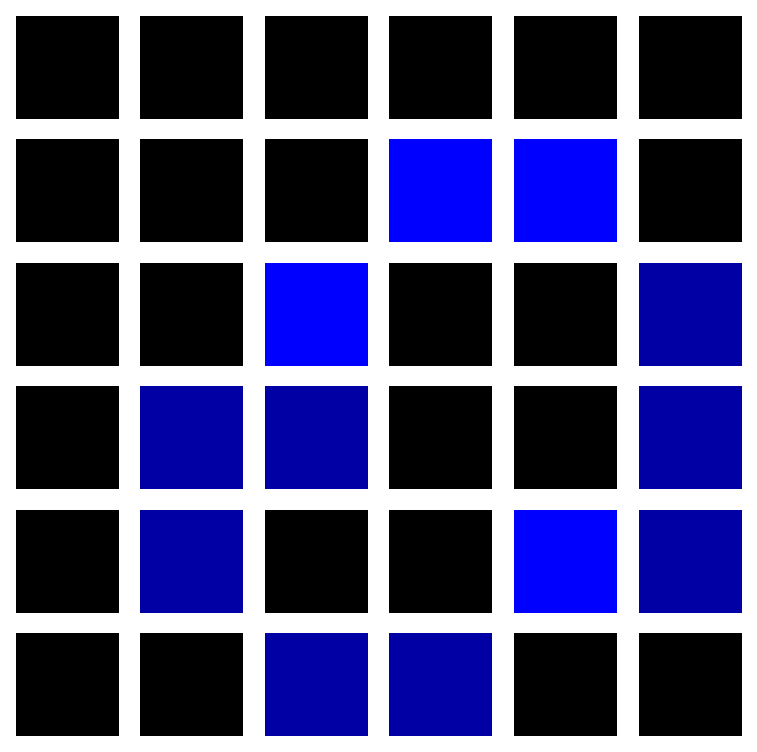
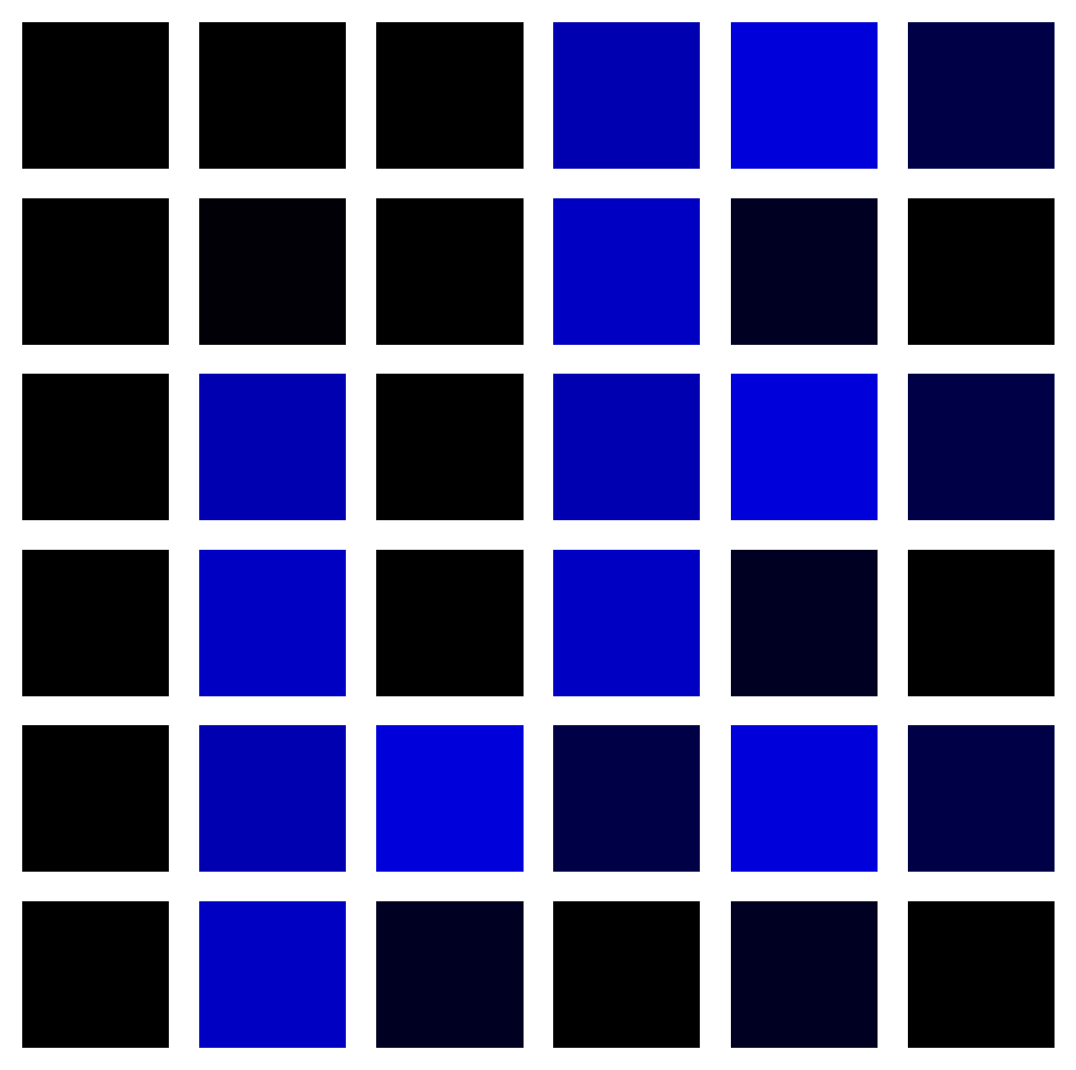
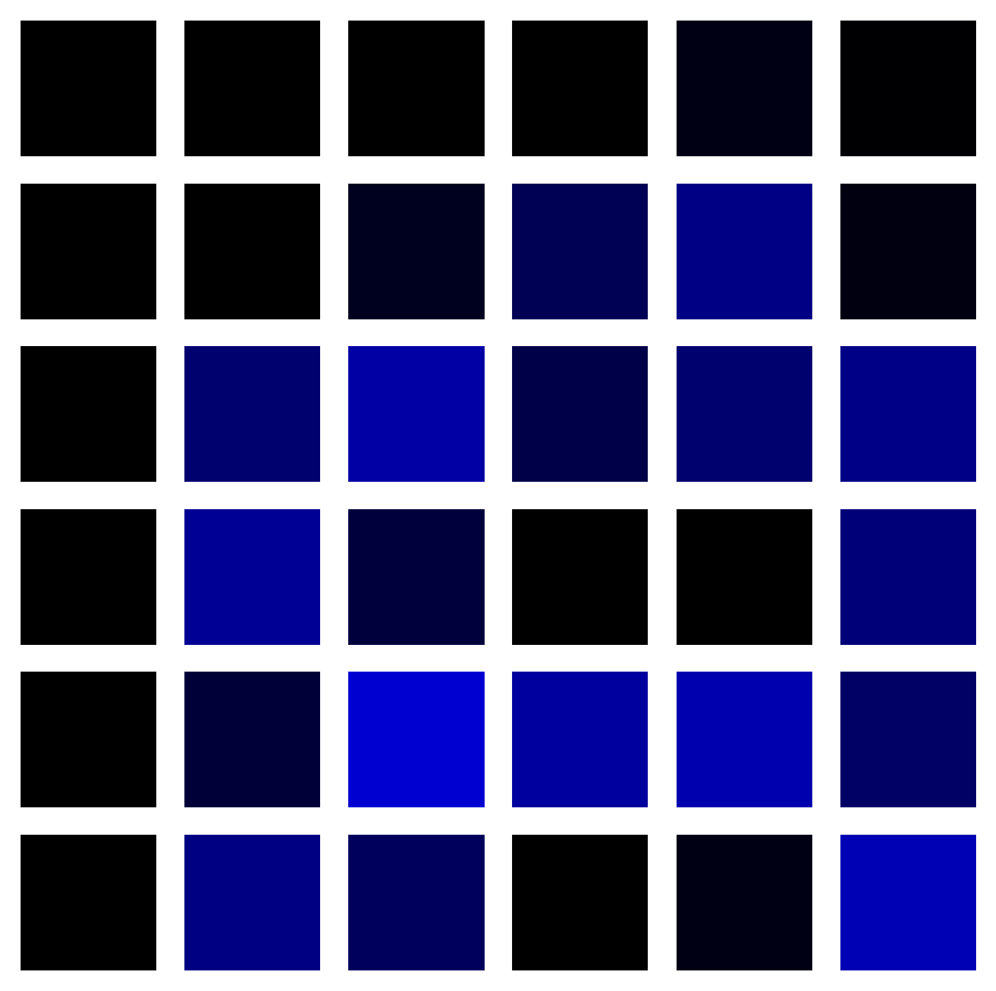
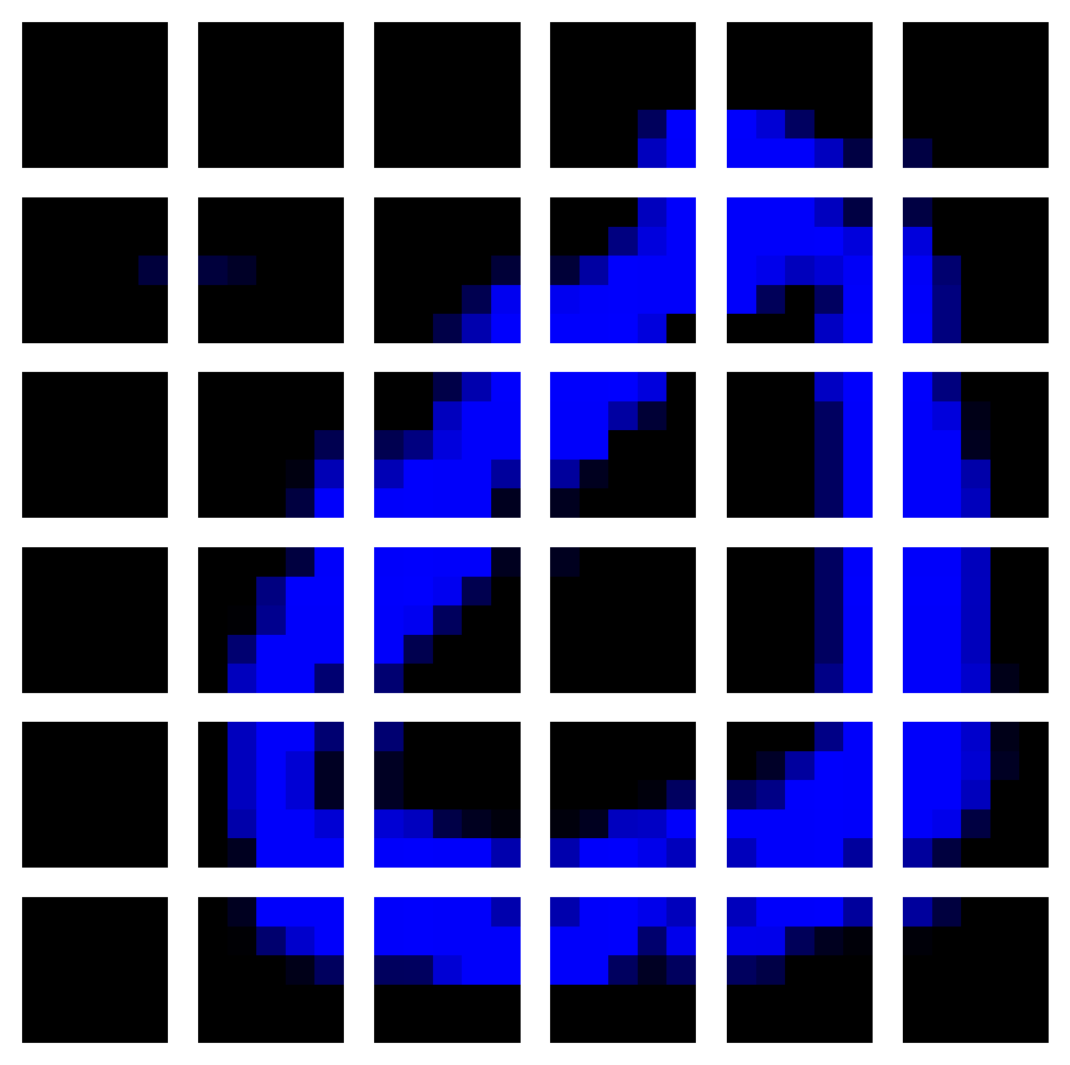
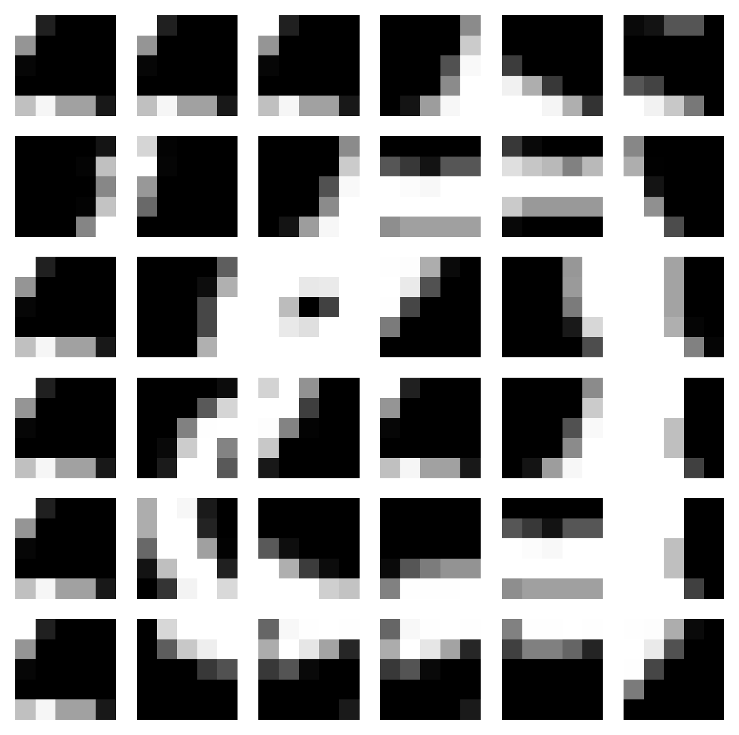
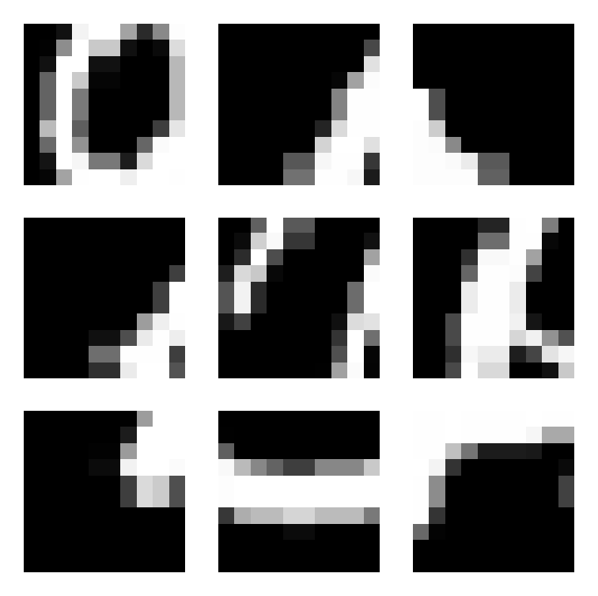

歐式距離(無加權)+ 平行架構 in Colored_MNIST
Origin
Notes:
Id = 130

Slide 8

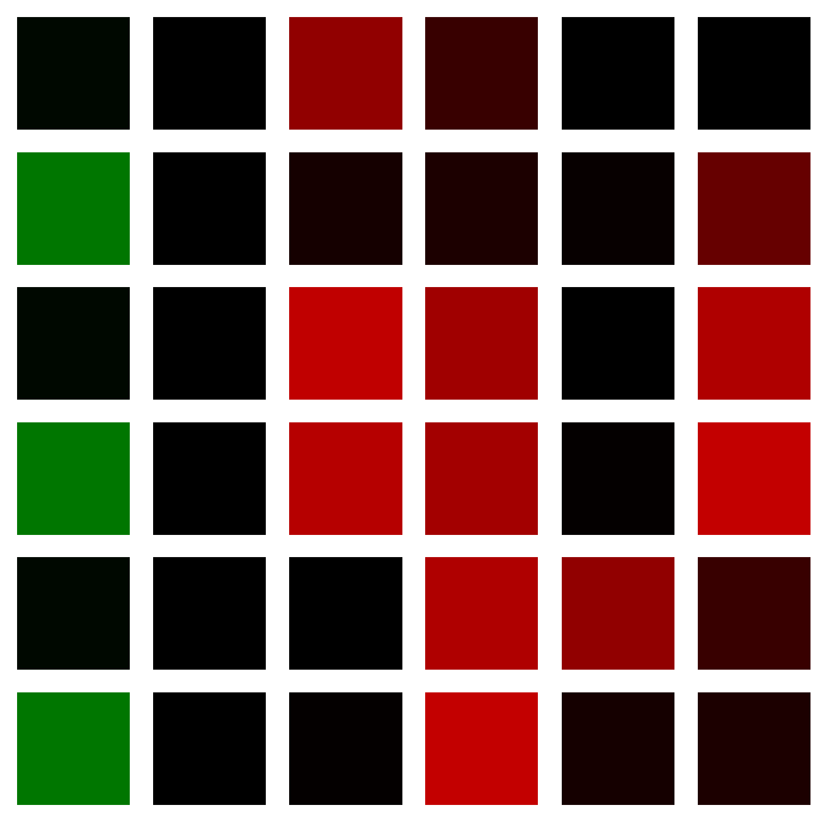

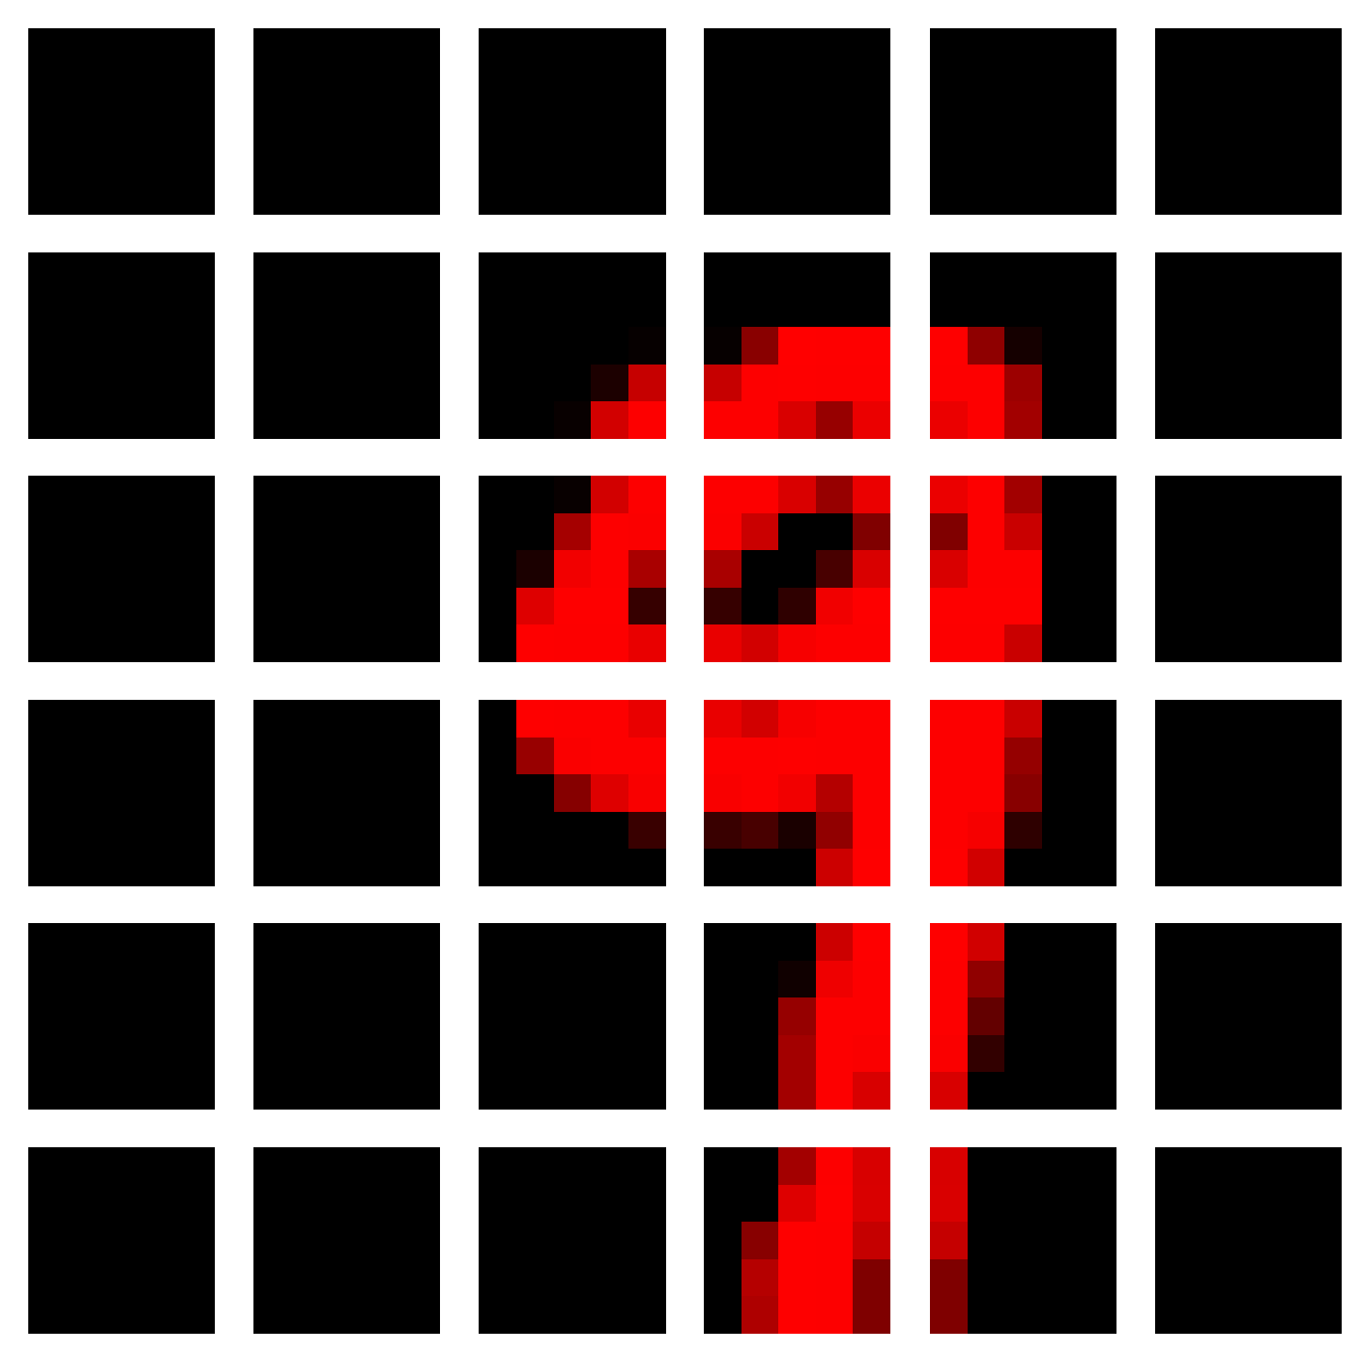
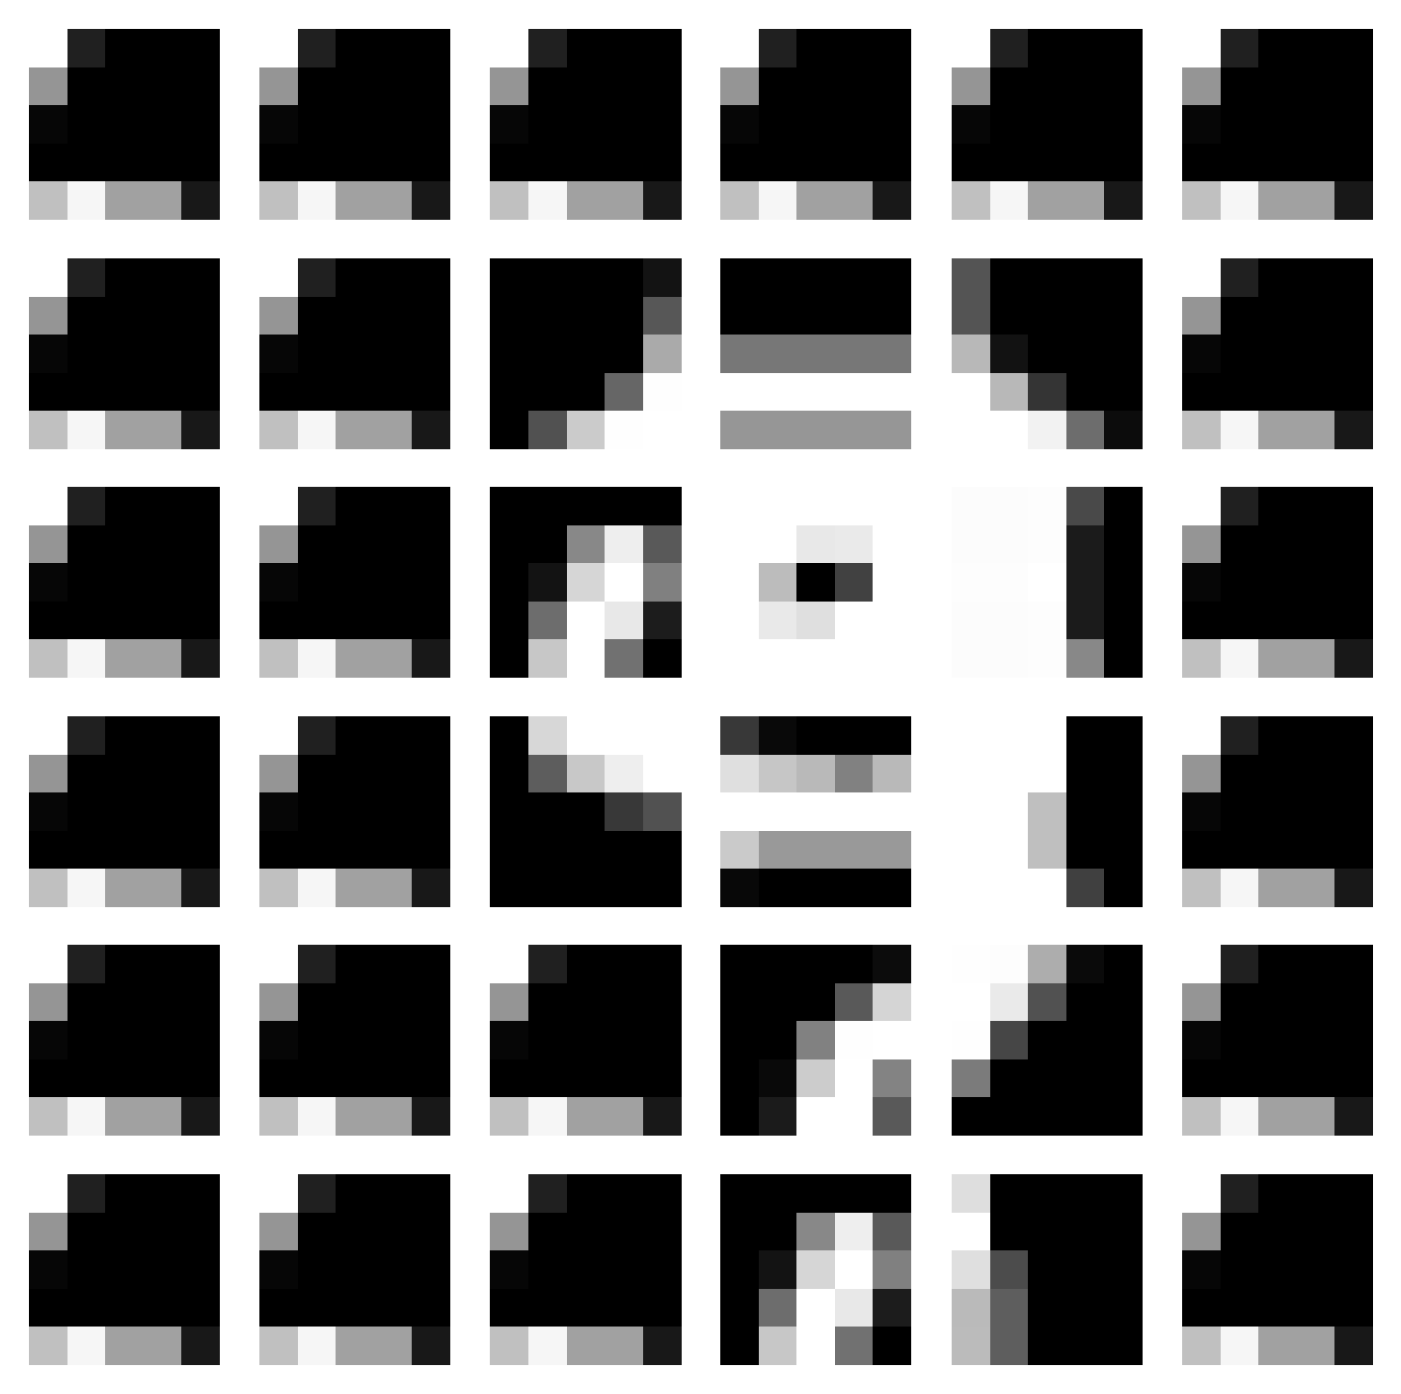
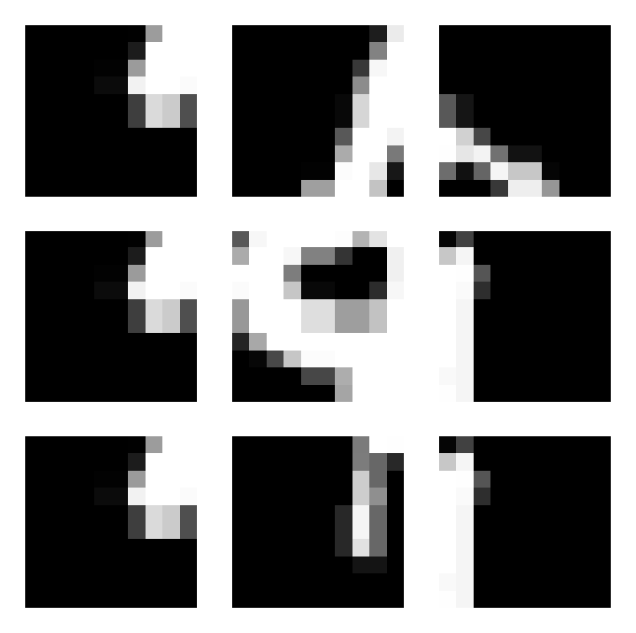
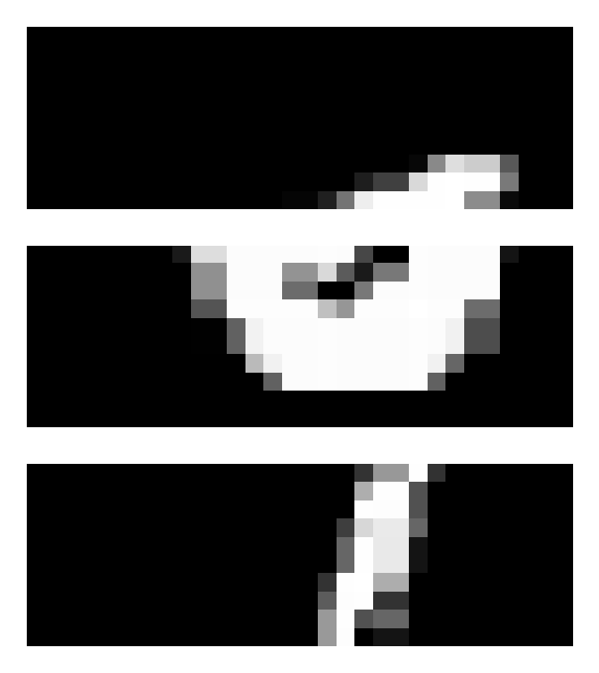
歐式距離(無加權)+ 平行架構 in Colored_MNIST
Origin
Notes:
Id = 50

Slide 9
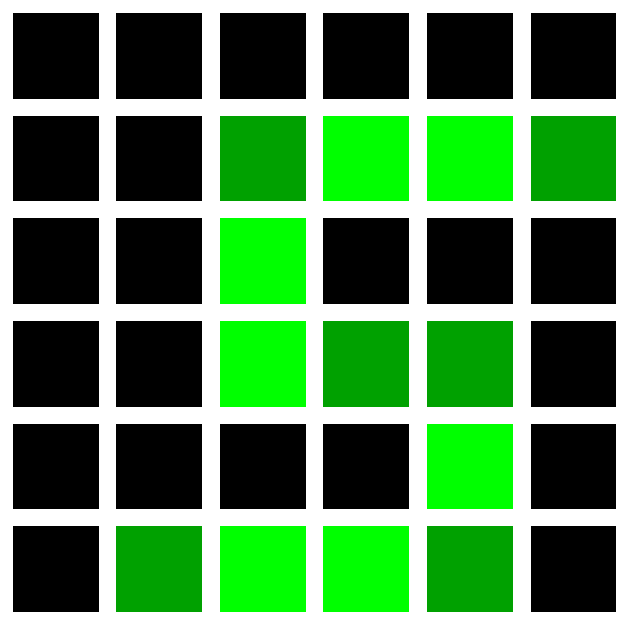
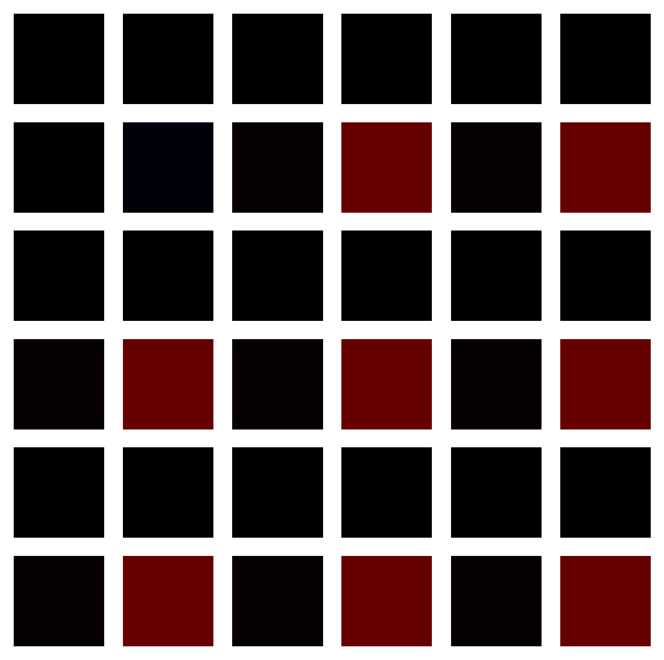
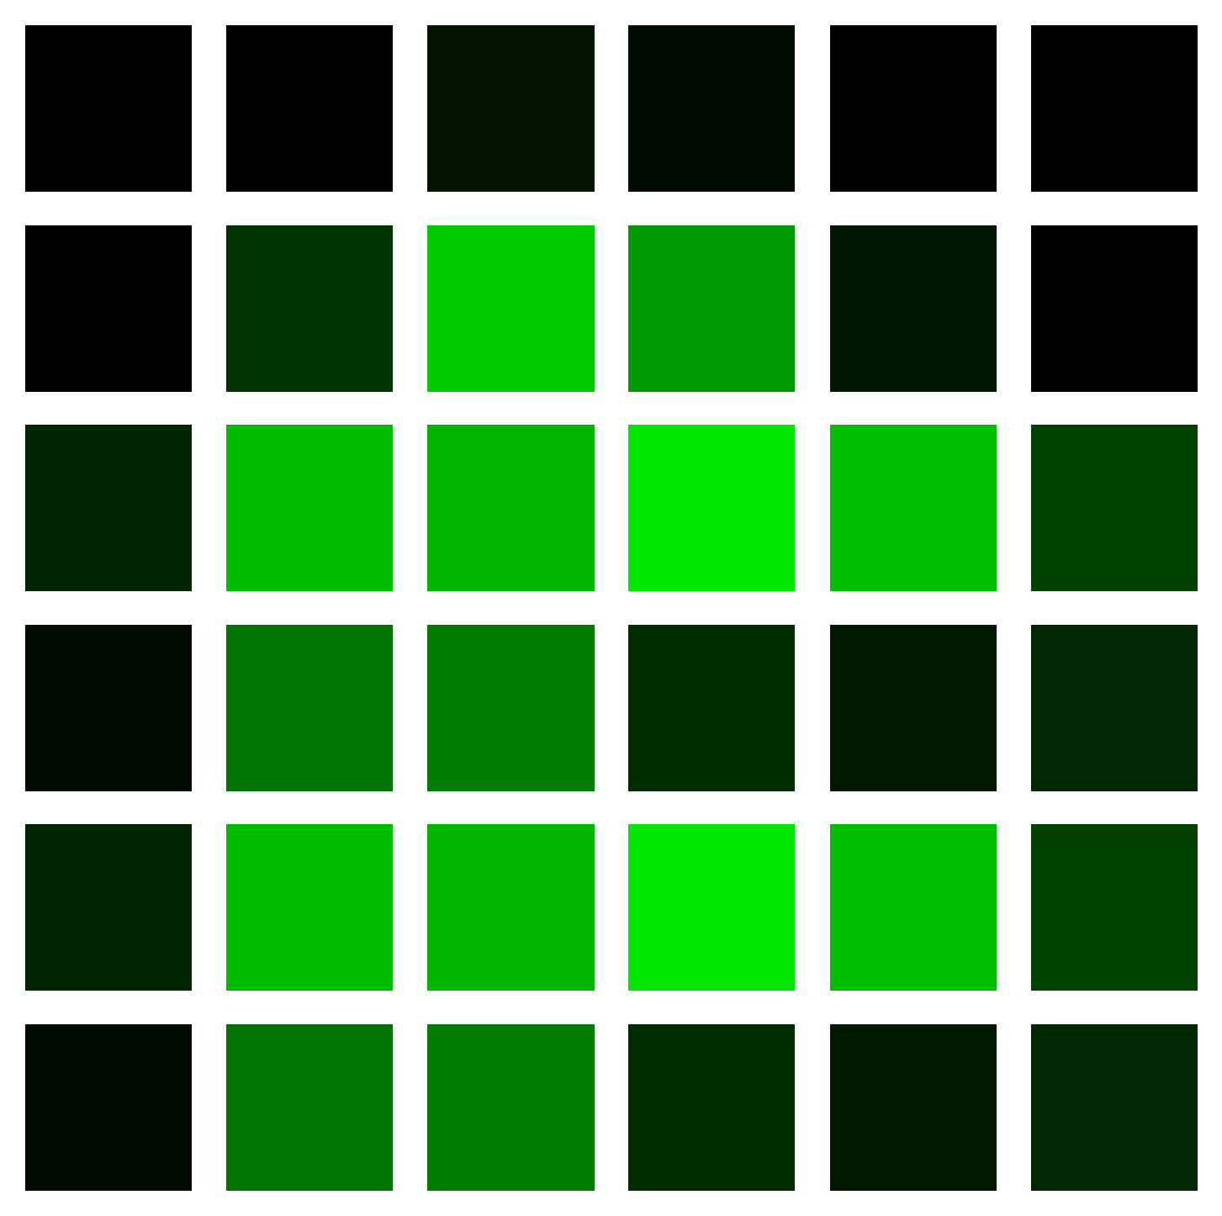
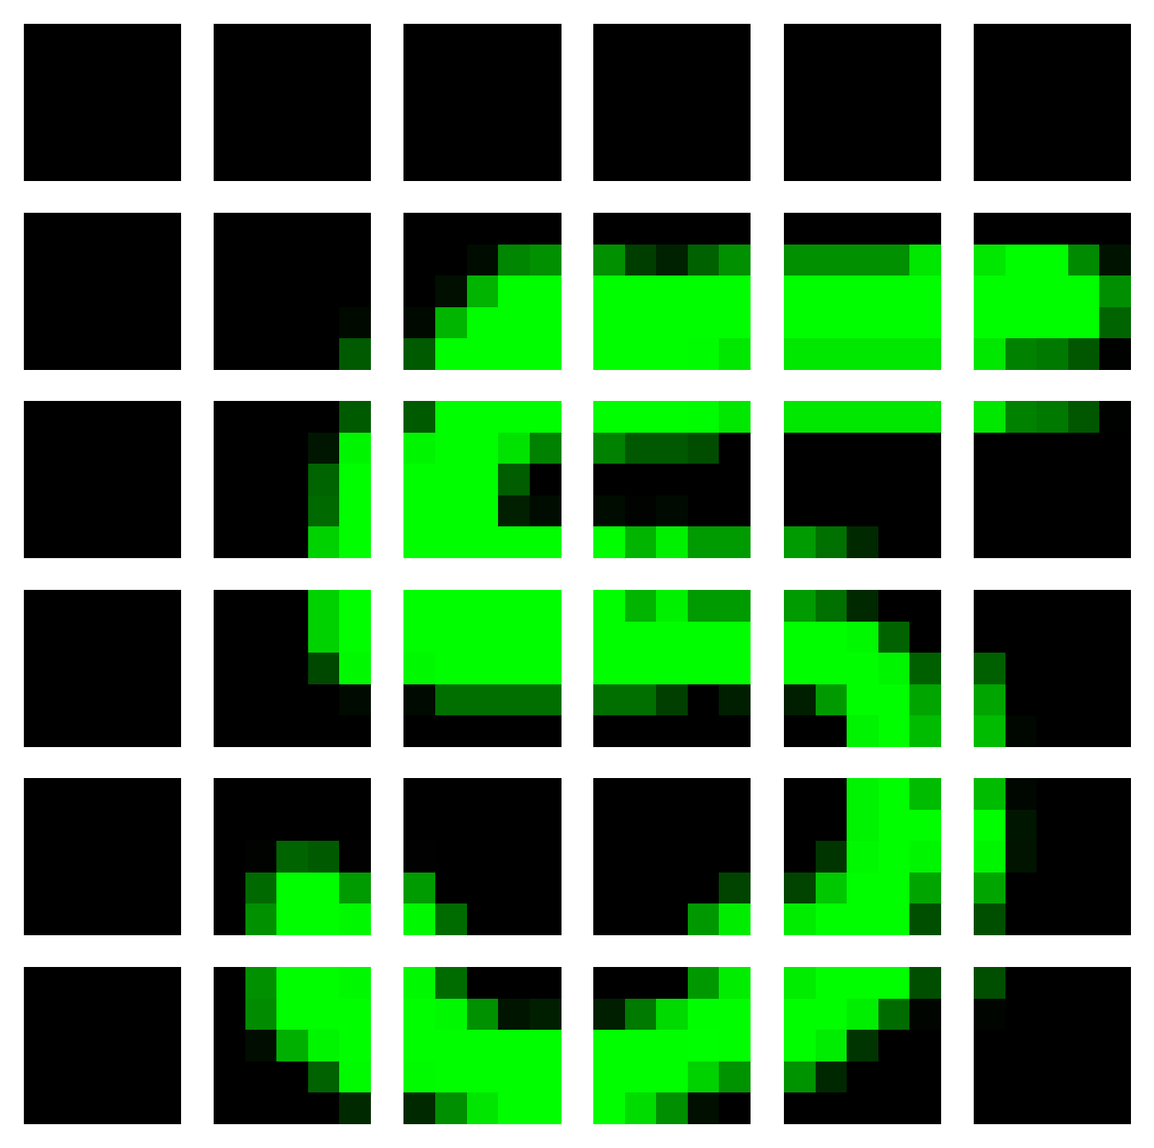
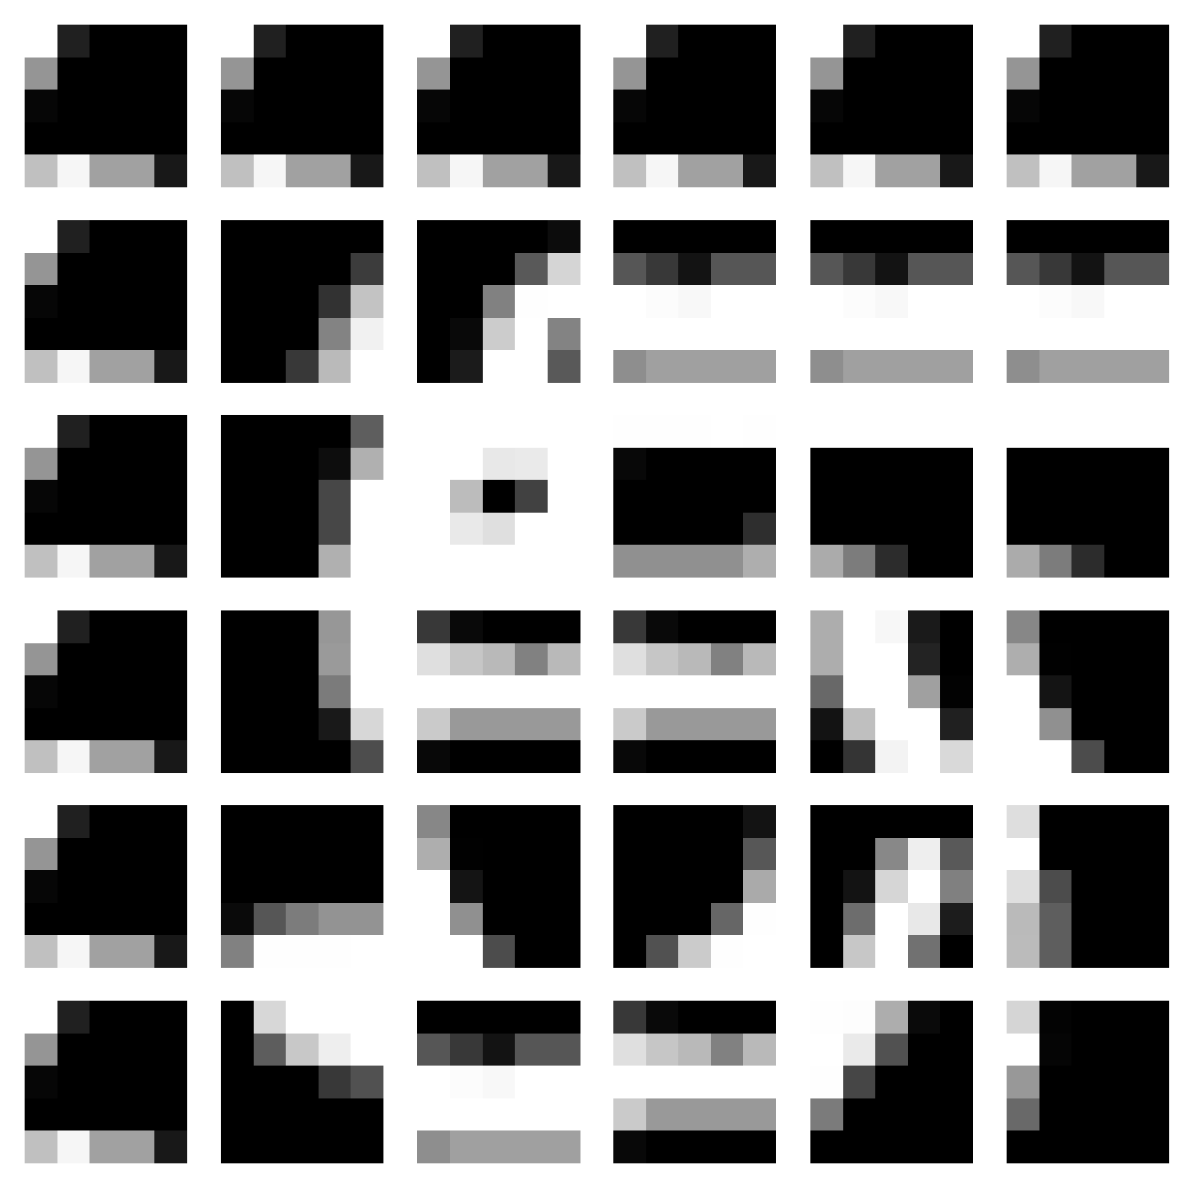
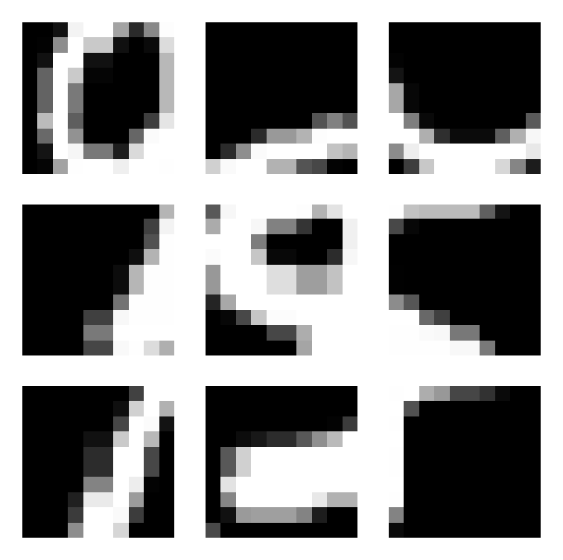
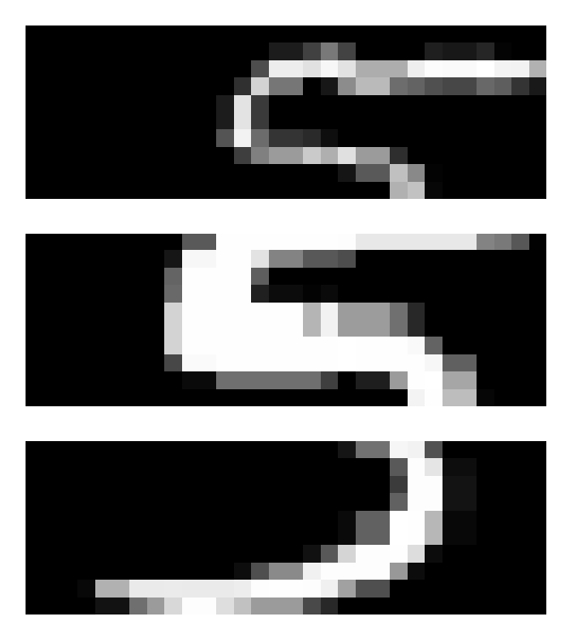
歐式距離(無加權)+ 平行架構 in Colored_MNIST
Origin

Slide 10
Colored_FashionMNIST

Slide 11
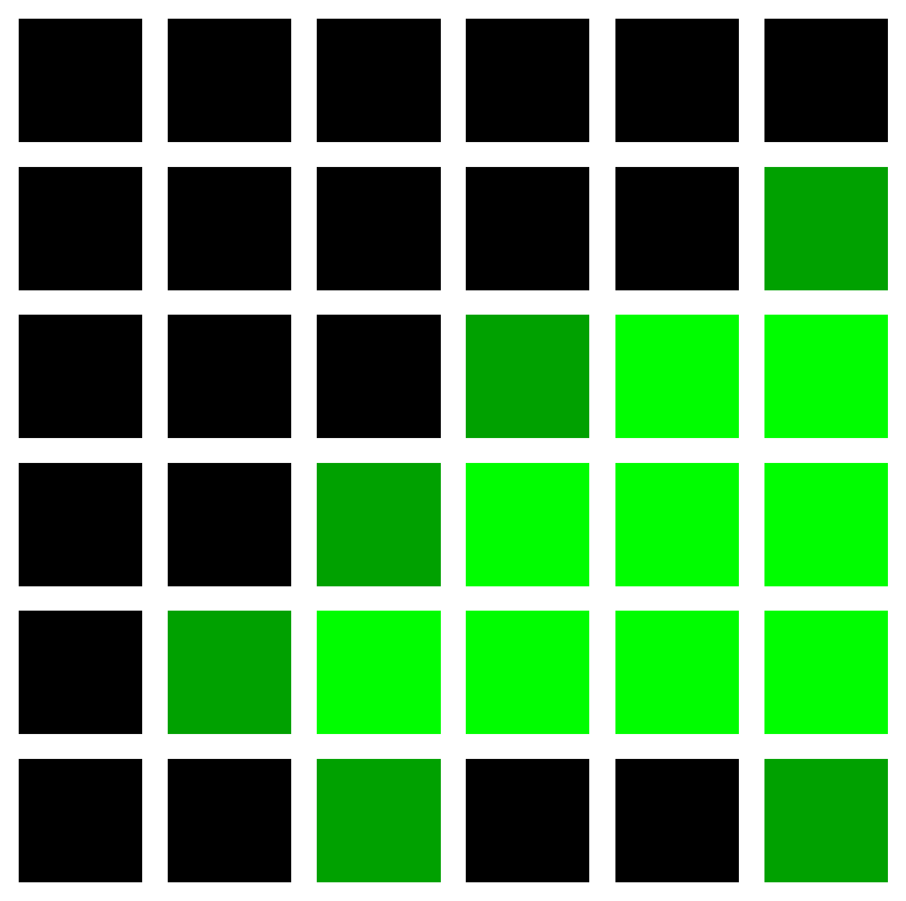

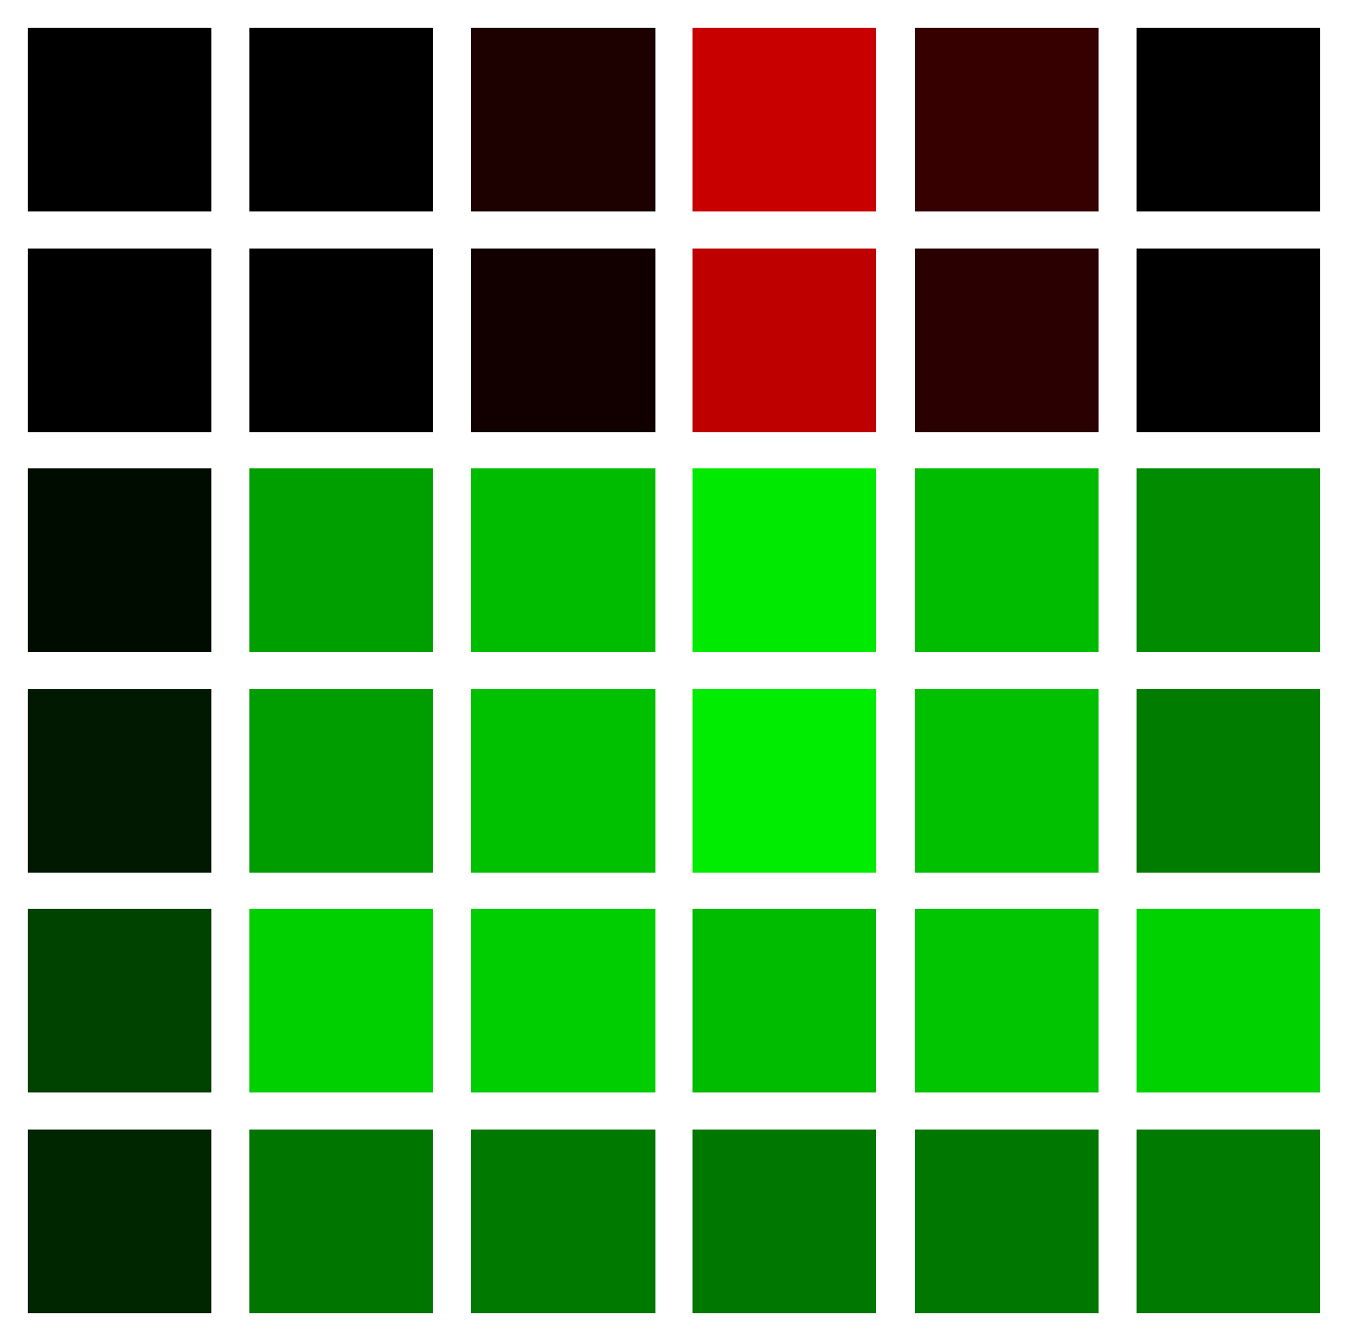
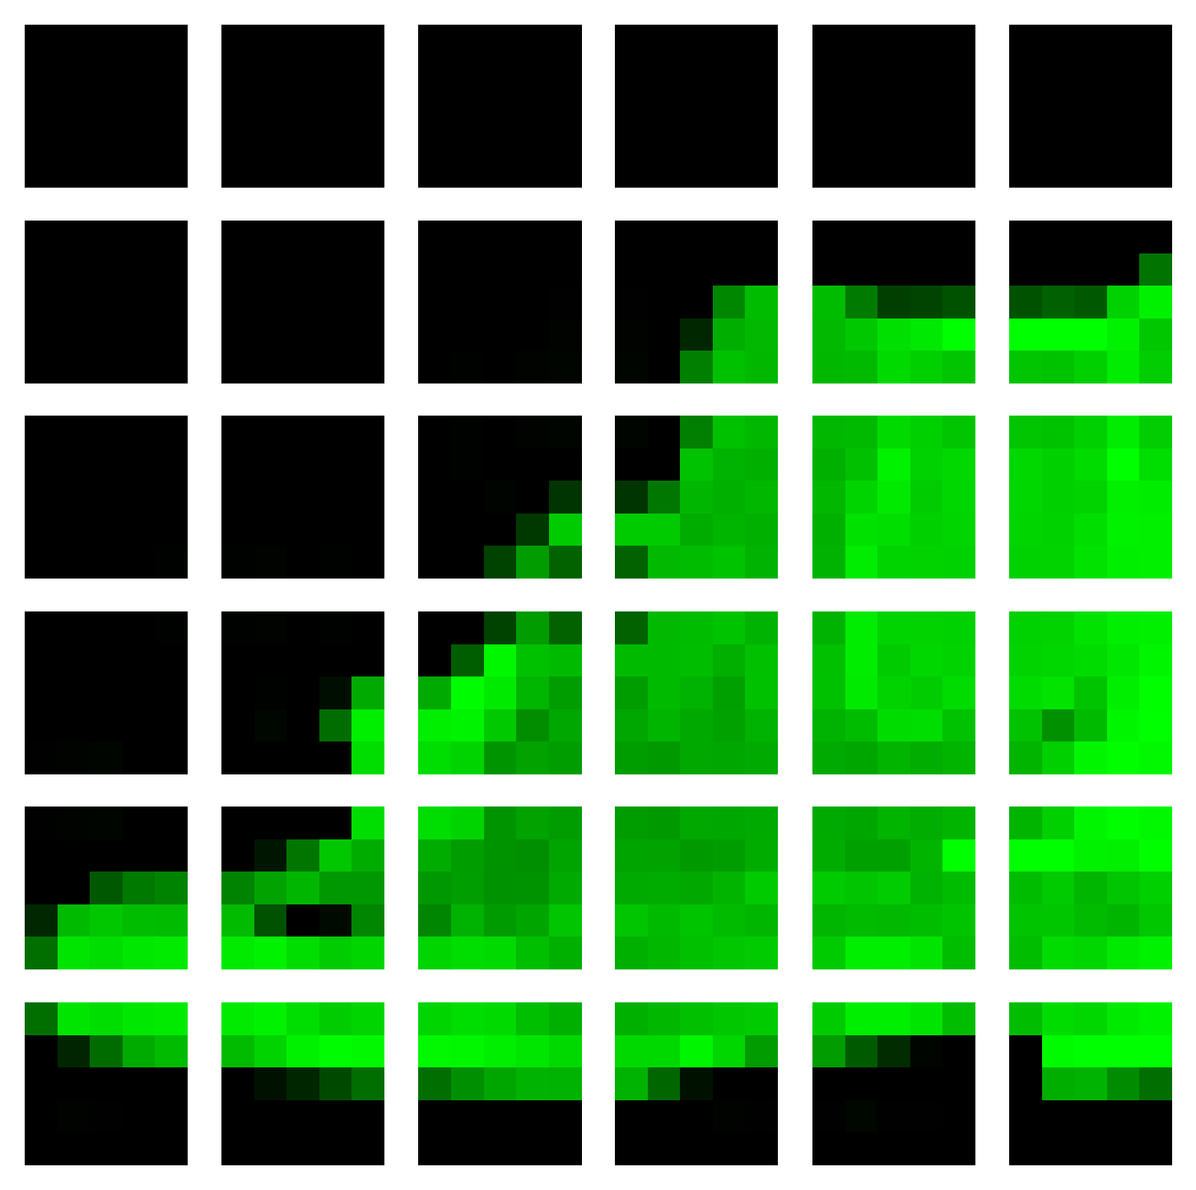
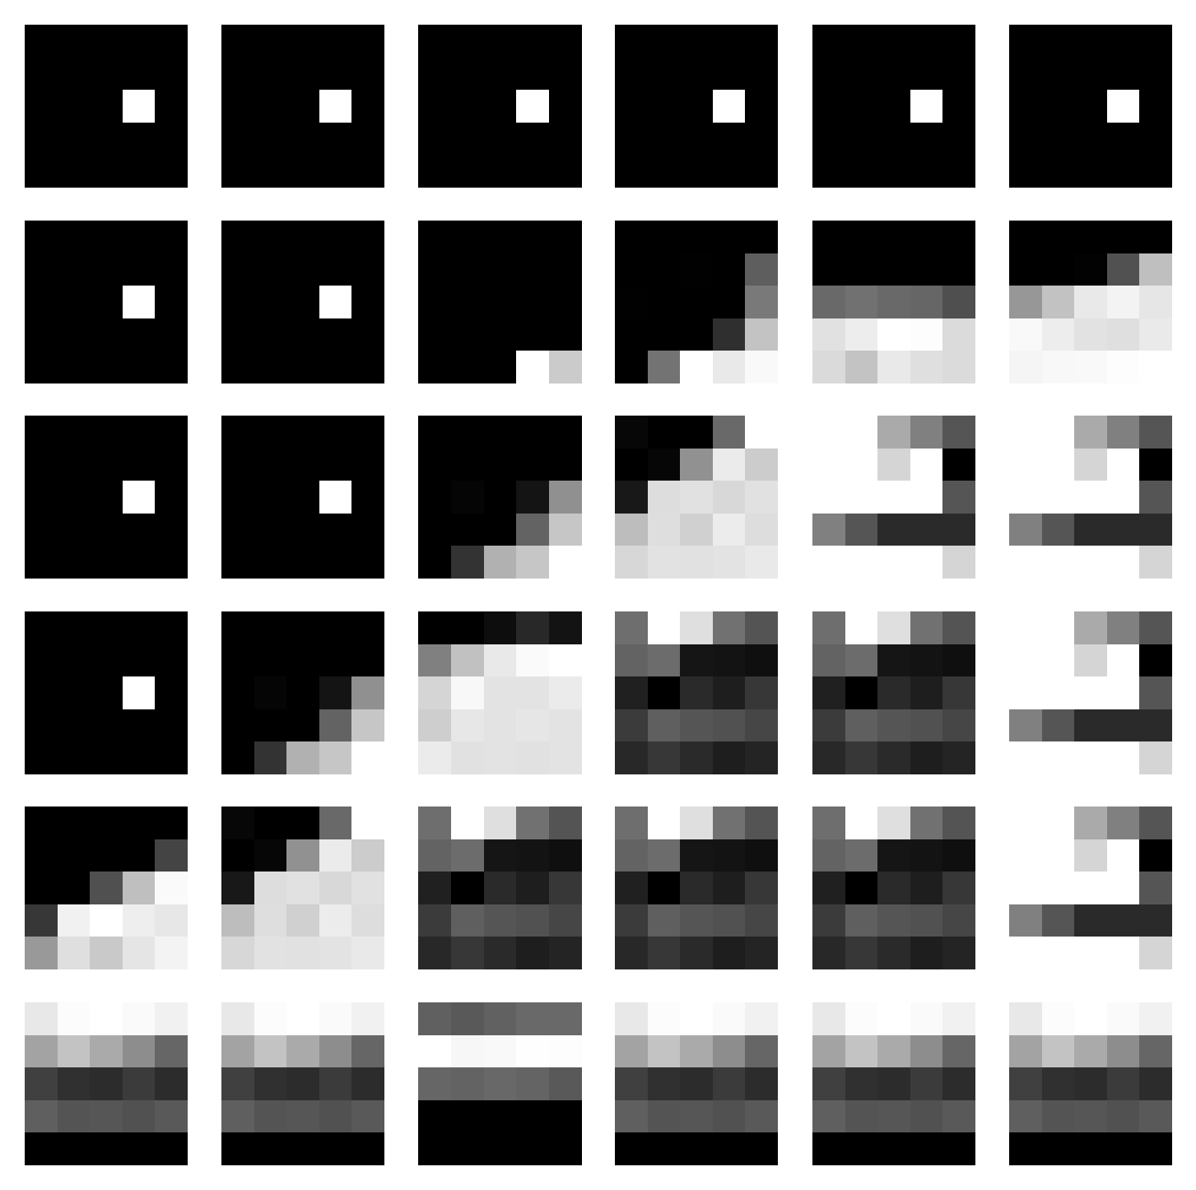
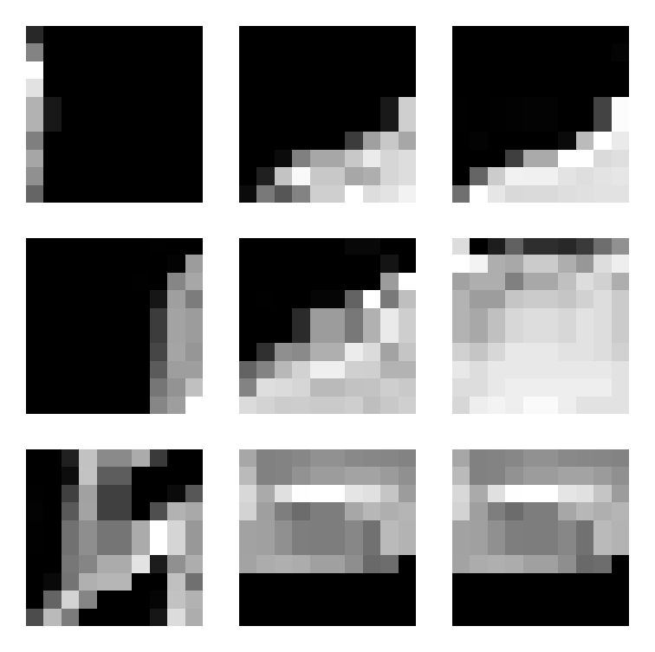
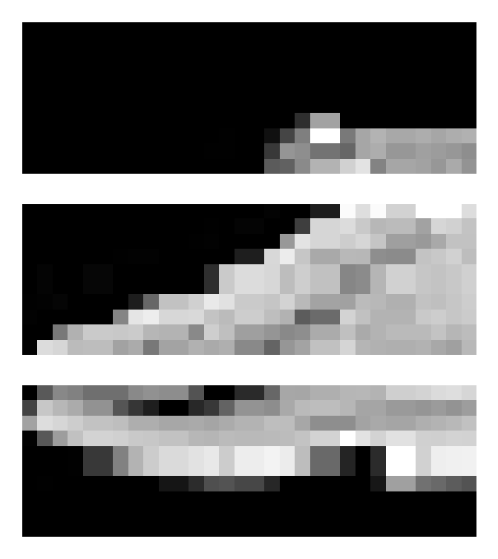
Lab色差 + 平行架構 in Colored_FashionMNIST
Train_acc = 0.8727
Test_acc = 0.8285
Origin
Notes:
Green_9, id = 70

Slide 12

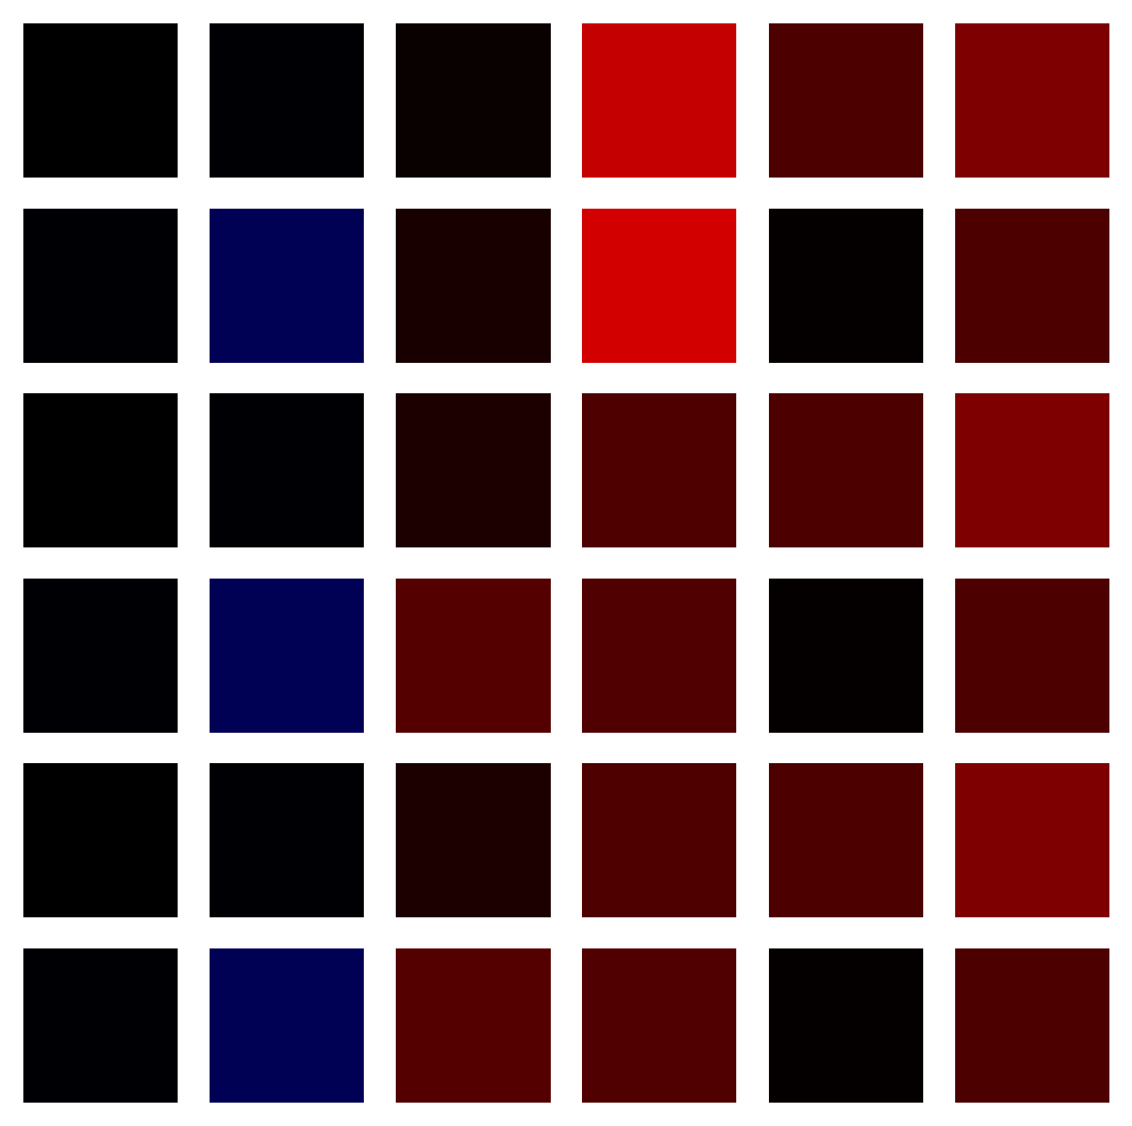
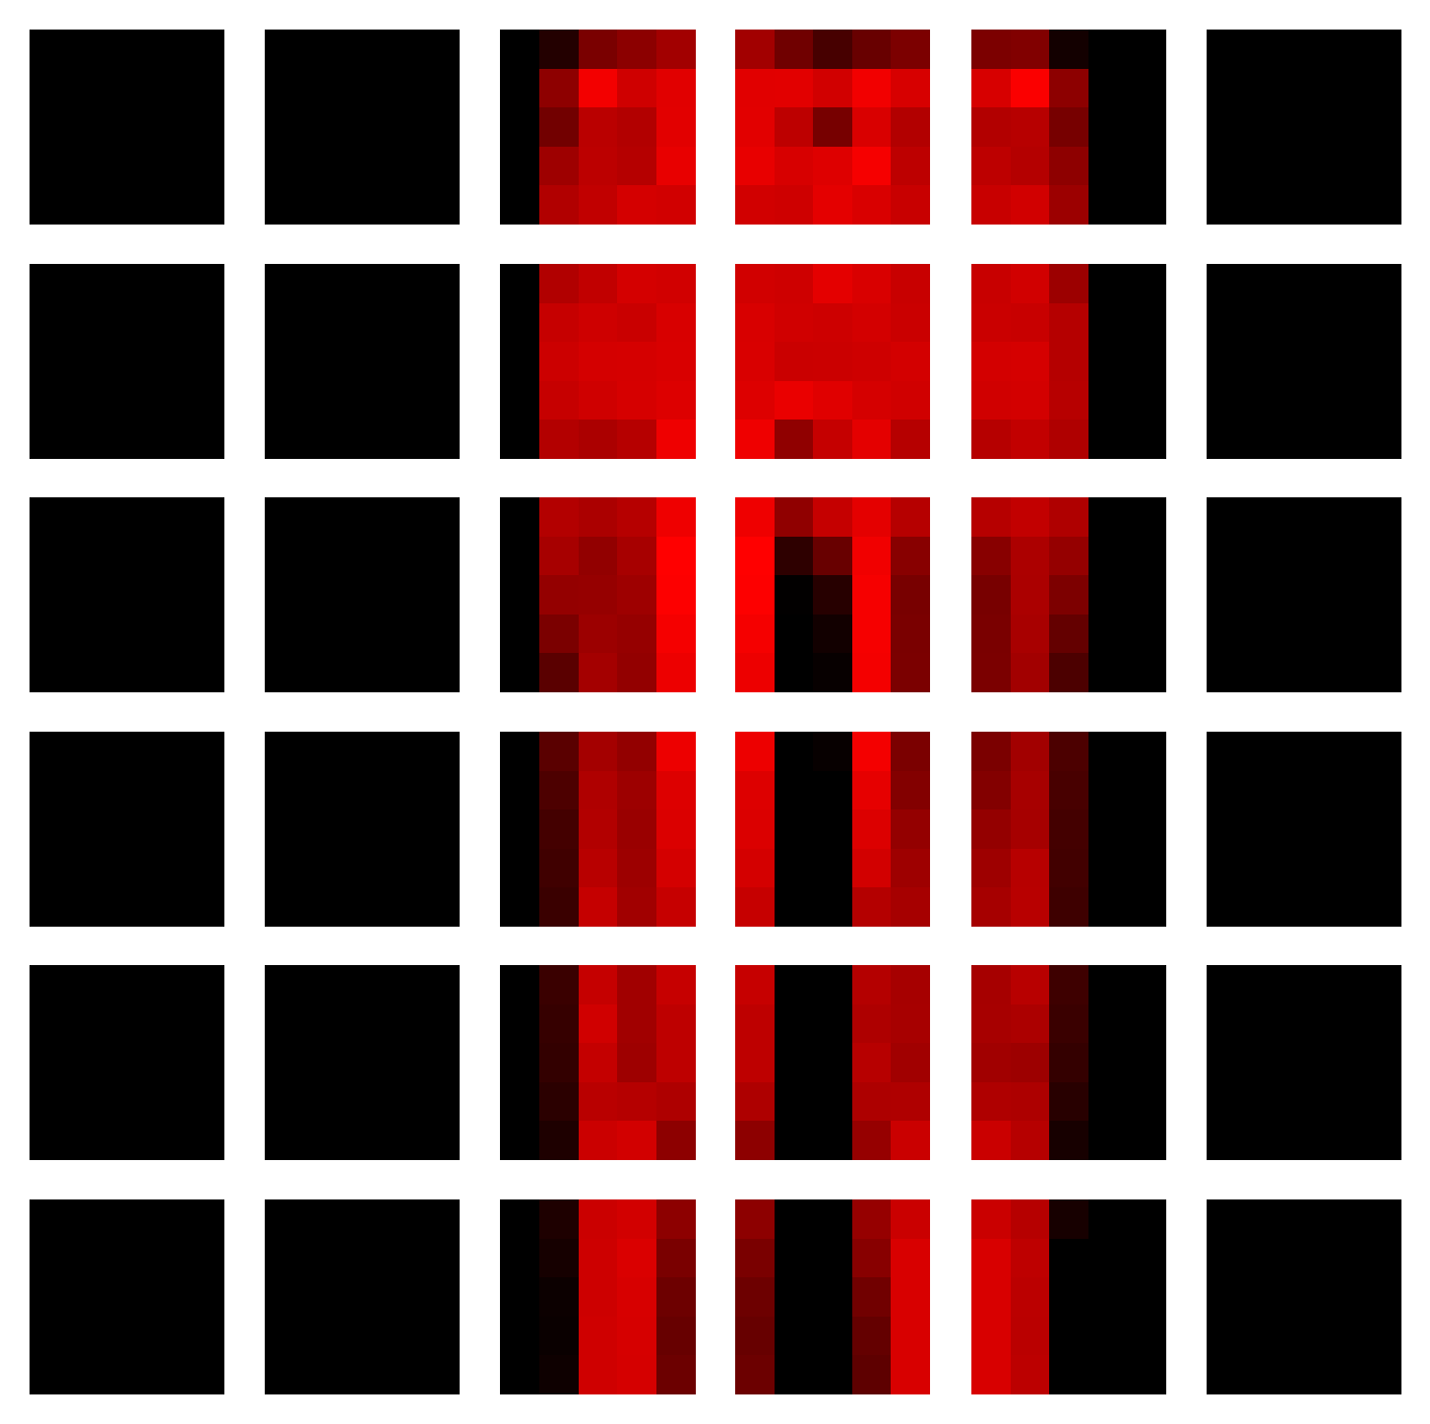
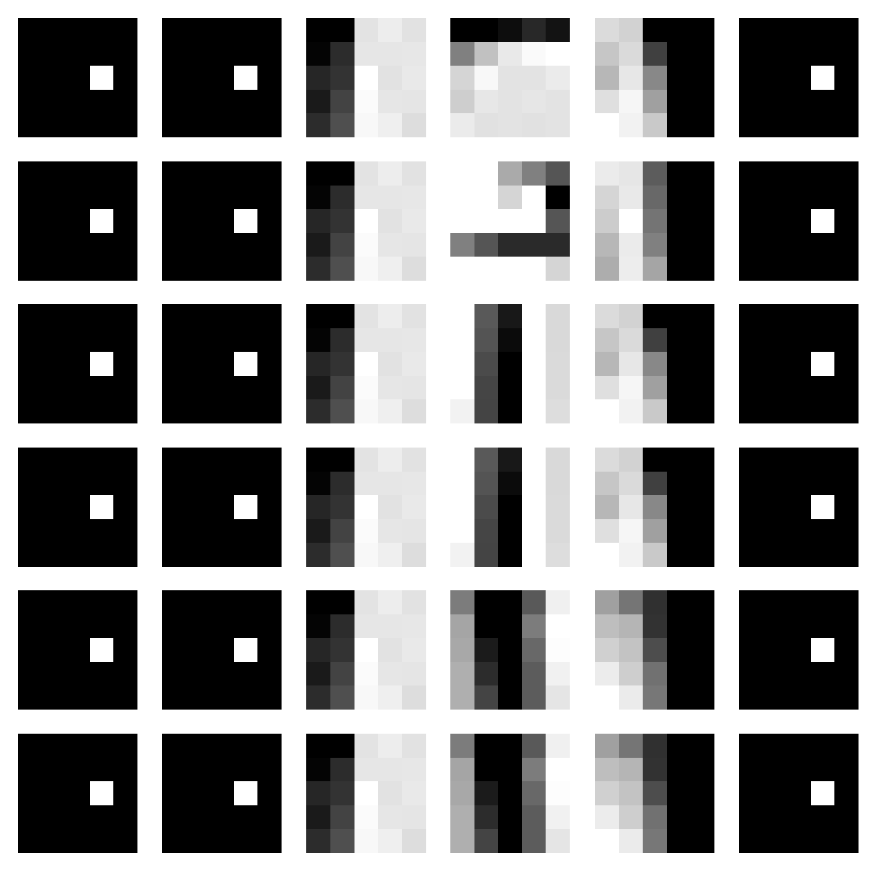
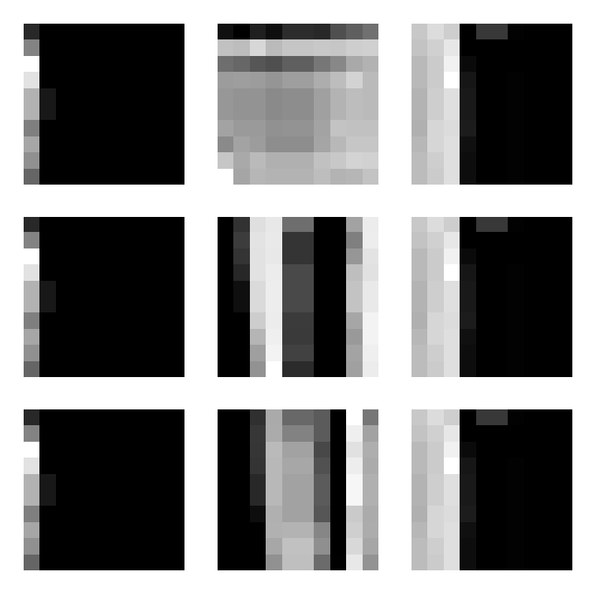
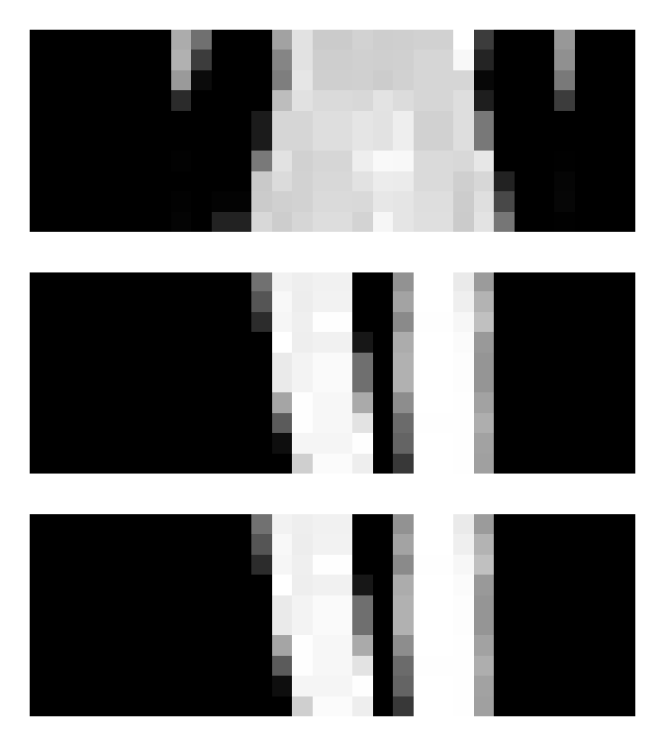
Lab色差 + 平行架構 in Colored_FashionMNIST
Train_acc = 0.8727
Test_acc = 0.8285
Origin
Notes:
Green_4, id = 172

Slide 13
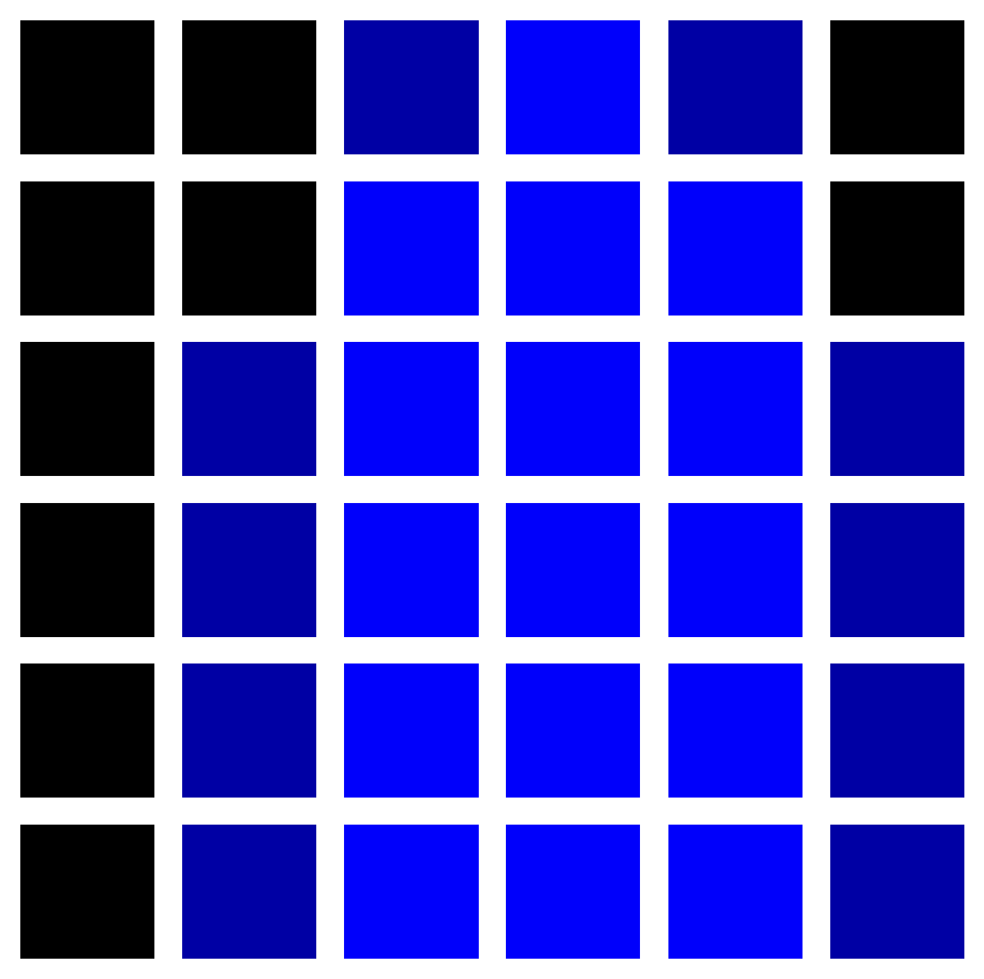
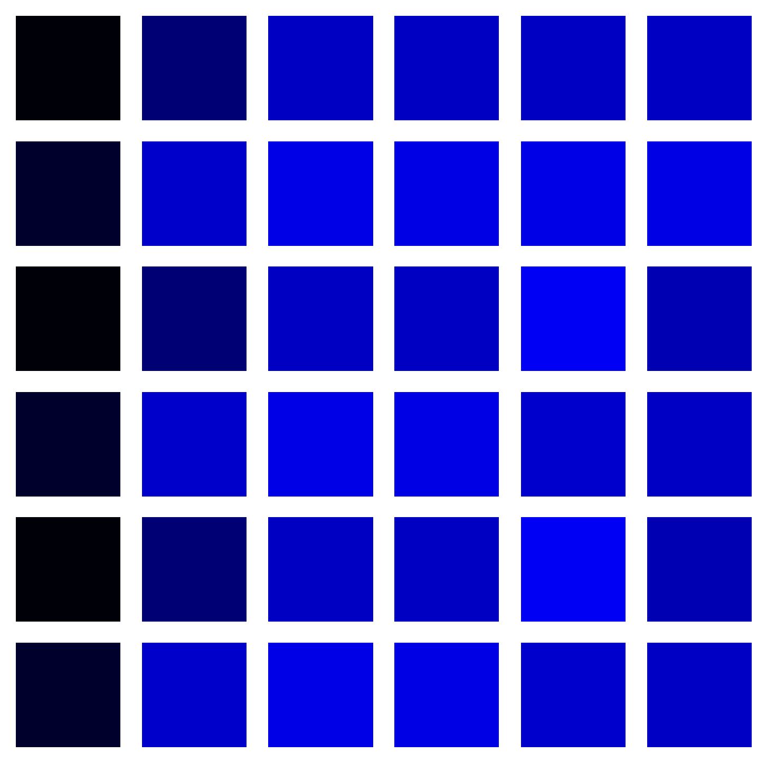

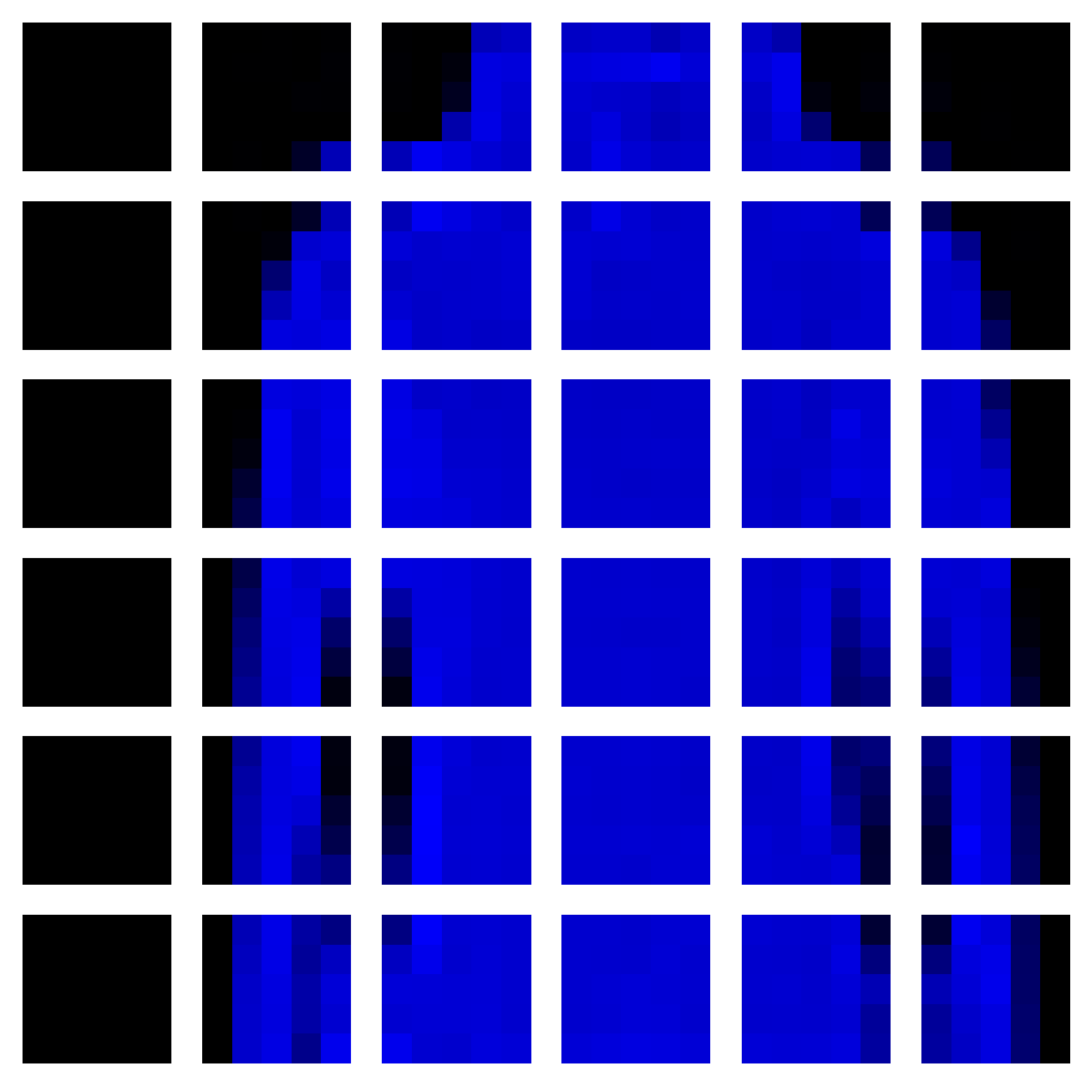
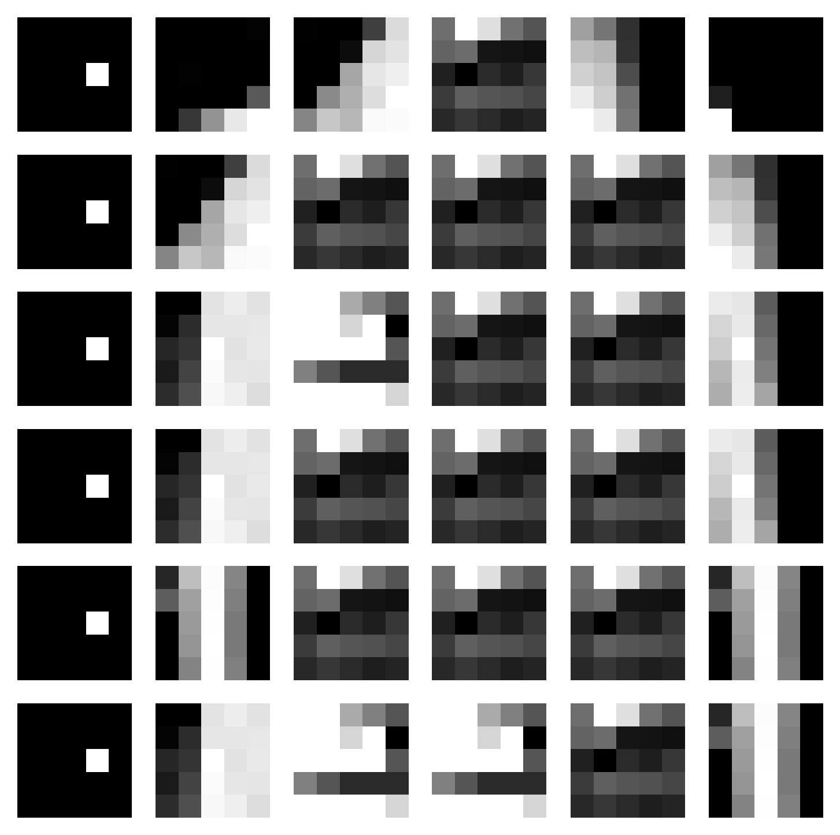
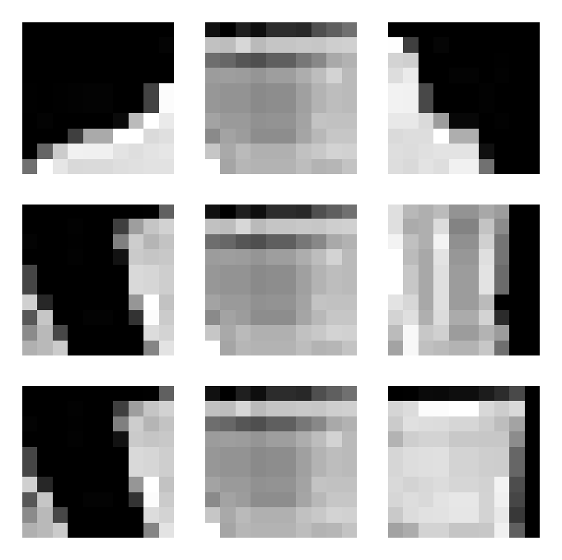
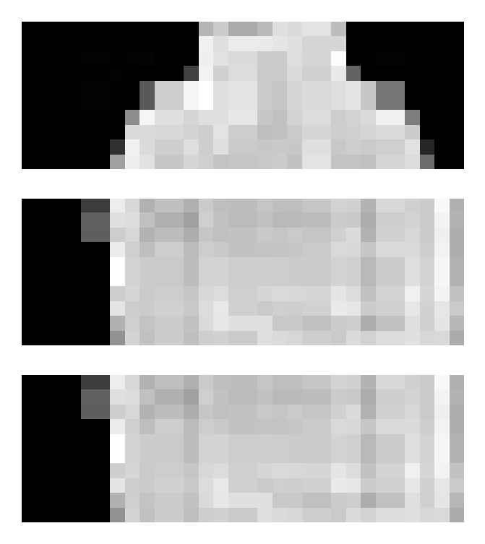
Lab色差 + 平行架構 in Colored_FashionMNIST
Train_acc = 0.8727
Test_acc = 0.8285
Origin
Notes:
Blue_2 id=74

Slide 14







歐式距離(無加權)+ 平行架構 in Colored_FashionMNIST
Train_acc = 0.8715
Test_acc = 0.822
Origin
Notes:
Green_2 id=23

Slide 15







歐式距離(無加權)+ 平行架構 in Colored_FashionMNIST
Train_acc = 0.8715
Test_acc = 0.822
Origin
Notes:
Green_2 id=23

Slide 16







歐式距離(無加權)+ 平行架構 in Colored_FashionMNIST
Train_acc = 0.8715
Test_acc = 0.822
Origin

Slide 17







歐式距離(無加權)+ 平行架構 in Colored_FashionMNIST
Train_acc = 0.8715
Test_acc = 0.822
Origin

Slide 18
Malaria

Slide 19









LAB色差+ 平行架構 in Malaria
Train_acc = 0.7302
Test_acc = 0.7396
Origin
label：Parasitized

Slide 20








LAB色差+ 平行架構 in Malaria
Train_acc = 0.7302
Test_acc = 0.7396
Origin
label：Uninfected
Notes:
Id=6

Slide 21









歐式距離(無加權)+ 平行架構 in Malaria
Train_acc = 0.7297
Test_acc = 0.732
Origin
label：Parasitized

Slide 22









歐式距離(無加權)+ 平行架構 in Malaria
Train_acc = 0.7297
Test_acc = 0.732
Origin
label：Uninfected

