Slide 1

COCHISE LINUX USER GROUP

Slide 2
UPCOMING CLUG EVENTS
(May be conducted on Big Blue Button depending upon the Covid-19 Situation.)
11 June, Ubuntu Hour, 1800-1900, Schlotzsky’s Cafe, 3900 E. Fry Blvd., SV
27 June, CLUG Mtg, 1300-1545, SV Public Library conference room, 2600 E. Tacoma St., SV

Slide 3
How To Use GParted

Slide 4
How to Use GParted
GParted is a graphical tool for managing disks on Linux. It is very powerful. You can do almost any type of partitioning and disk management with GParted. GParted has a simple user interface and it is very easy to use.

Slide 5
Installing GParted on Ubuntu
GParted is not installed on Ubuntu by default. But it is available in the official package repository of Ubuntu. So, it is easy to install. First, update the APT package repository cache with the following command:
sudo apt update
Now, install GParted with the following command:
sudo apt install gparted

Slide 6
Starting GParted
Now that GParted is installed, you can start GParted from the Application Menu of Ubuntu
GParted requires root privileges. To allow root privileges to GParted, type in your login password and click on Authenticate.

Slide 7
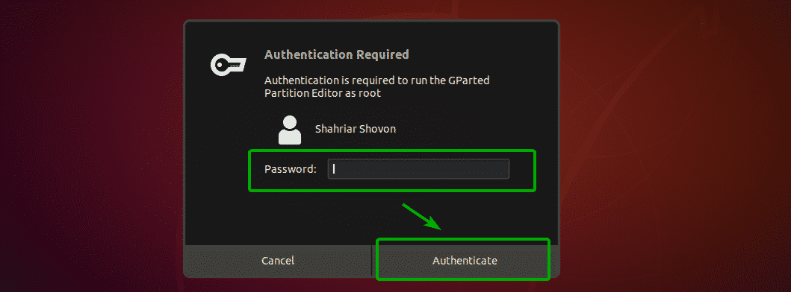

Slide 8
Starting Gparted 3
GParted should start.

Slide 9
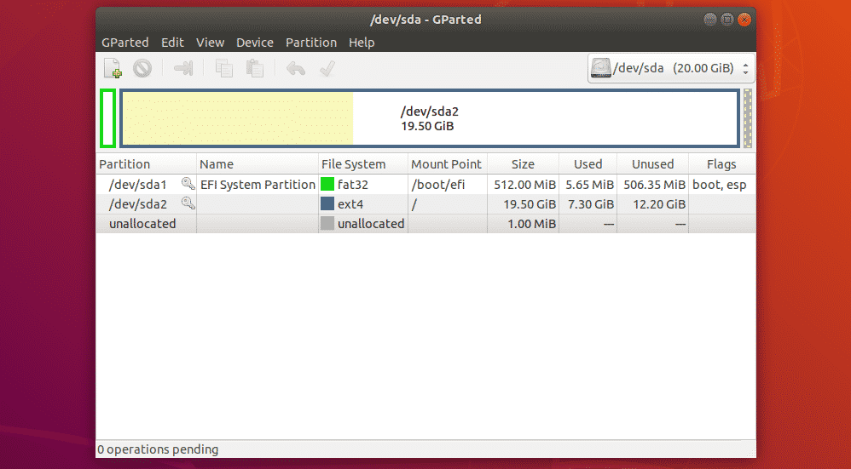
Starting Gparted 4

Slide 10
Selecting Storage Device
The first thing to do in GParted is to select the storage device that you want to work with. To do that, click on the drop down menu on the top right corner of GParted.

Slide 11
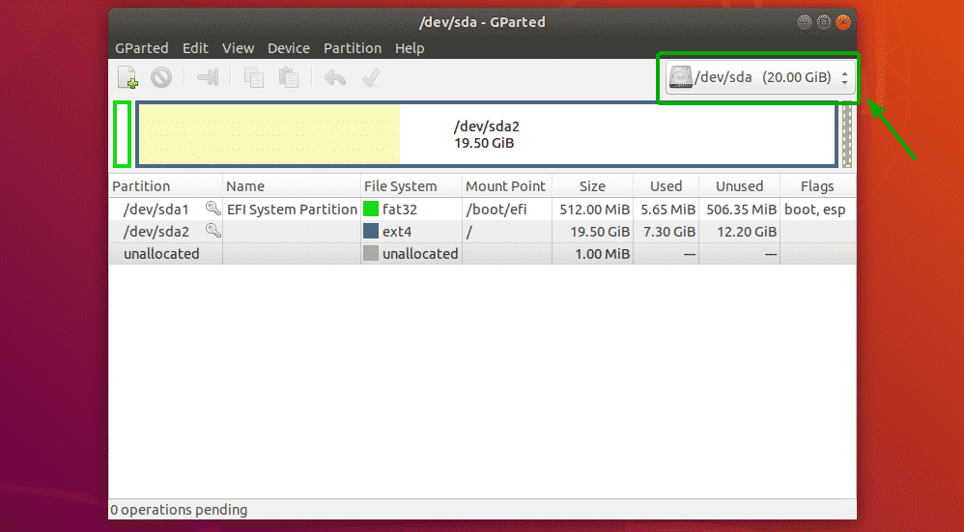
Selecting Storage Device 2

Slide 12
Selecting Storage Device 3
Then, select the storage device that you want to work with.

Slide 13
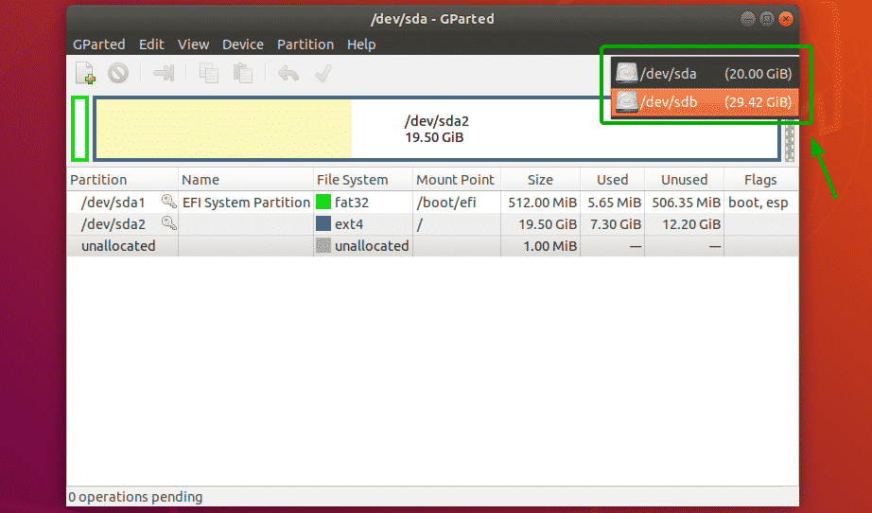
Selecting Storage Device 4

Slide 14
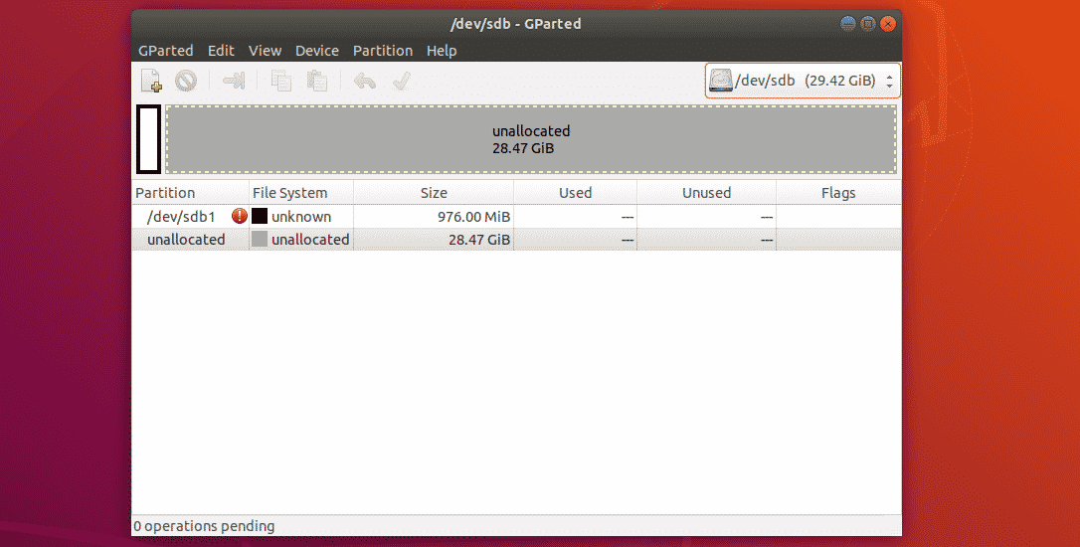
Selecting Storage Device 5

Slide 15
Creating a New Partition Table
To create a new partition table using GParted, click on Device > Create Partition Table…

Slide 16
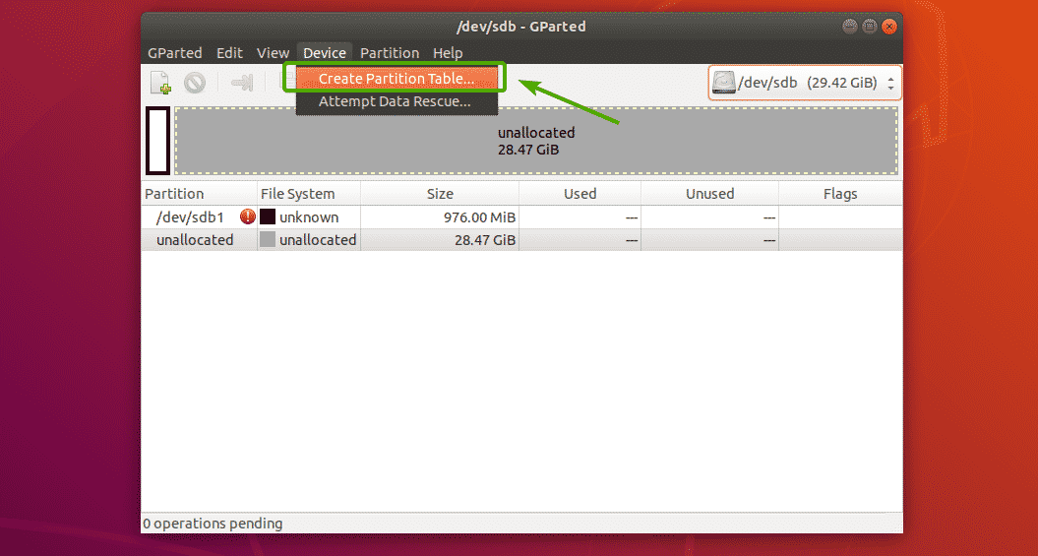
Creating A New Partition Table 2

Slide 17
Creating a New Partition Table 3
You will see a dialog box. From here, you can select your desired partition table type. The most widely known partition table types are msdos and gpt. By default, msdos is selected. But you can click on the dropdown menu to change it.

Slide 18
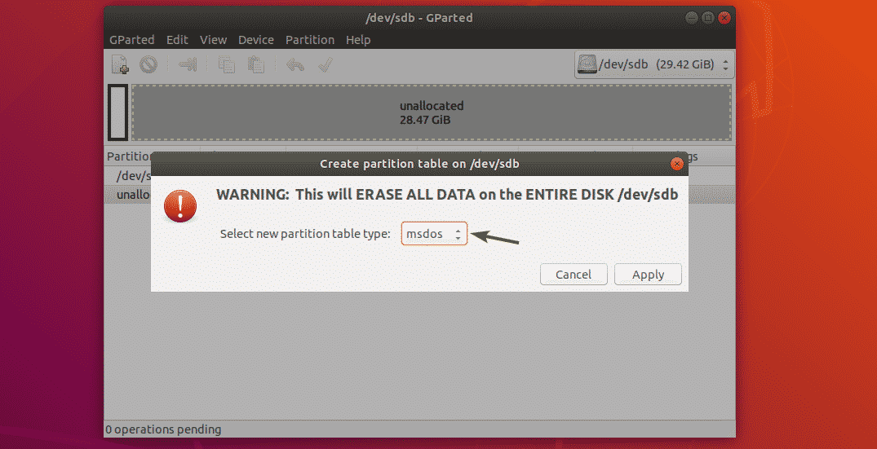
Creating A New Partition Table 4

Slide 19
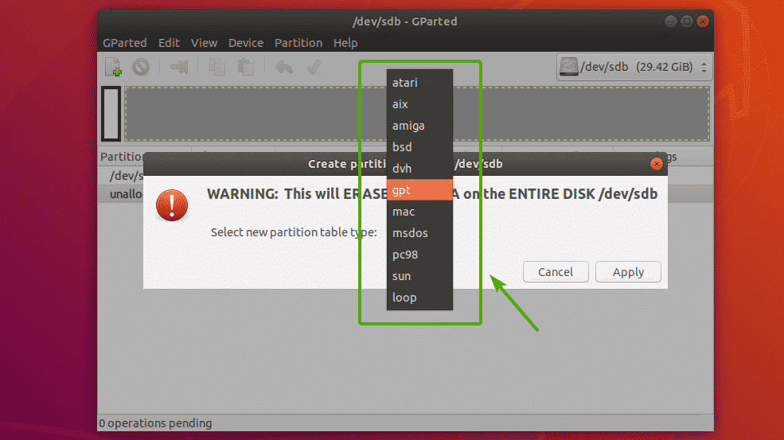
Creating A New Partition Table 5

Slide 20
Creating a New Partition Table 6
Once you’ve selected a partition table type, click on Apply.
An empty partition table should be created

Slide 21
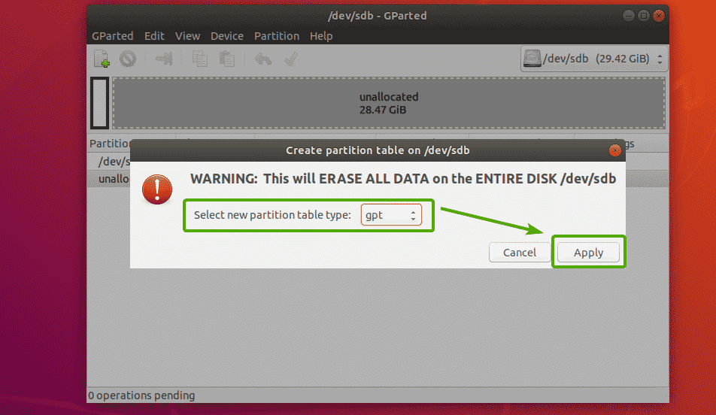
Creating A New Partition Table 7

Slide 22
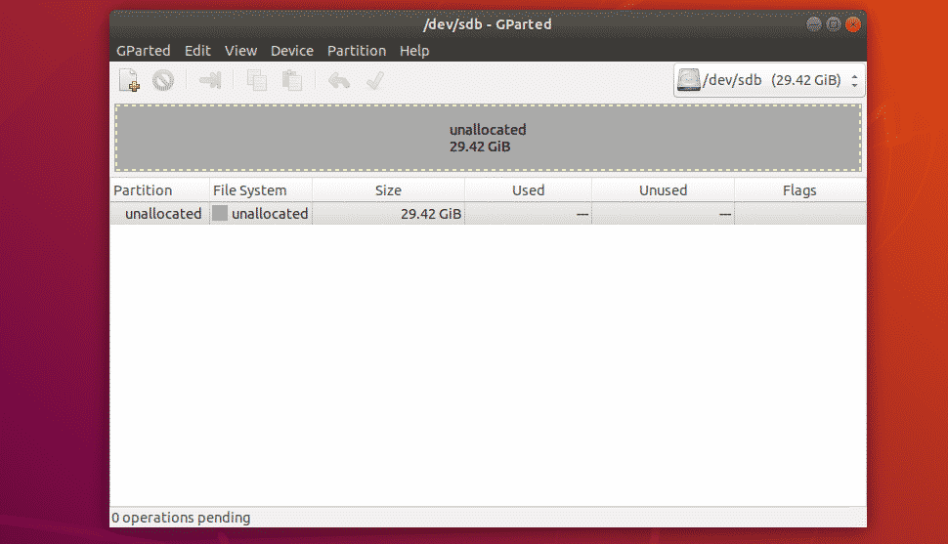
Creating A New Partition Table 8

Slide 23
Creating New Partitions
Before you create a new partition, make sure you have enough unallocated free spaces. Now, to create a new partition with GParted, select the unallocated space and click on Partition > New.

Slide 24
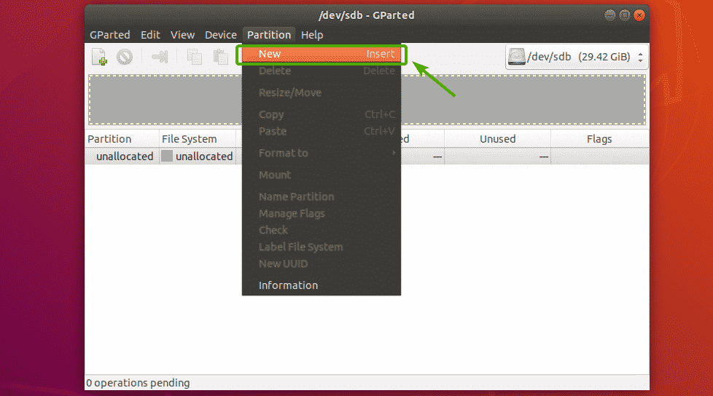
Creating New Partitions 2

Slide 25
Creating New Partitions 3
A new window should appear.

Slide 26
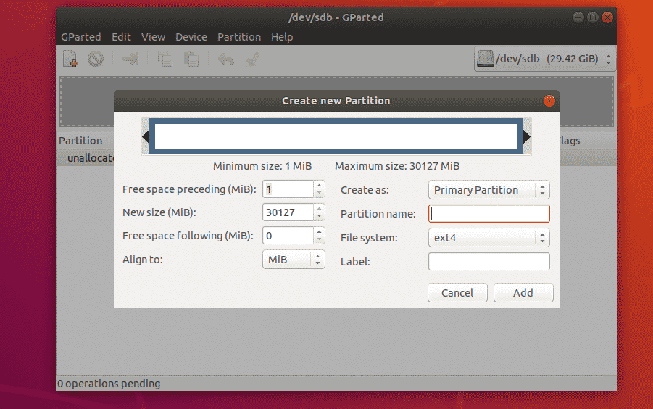
Creating New Partitions 4

Slide 27
Creating New Partitions 5
You can move the slider back and forth to change the size of the partition. You can also type in the size of the new partition directly in the New size (MiB) textbox

Slide 28
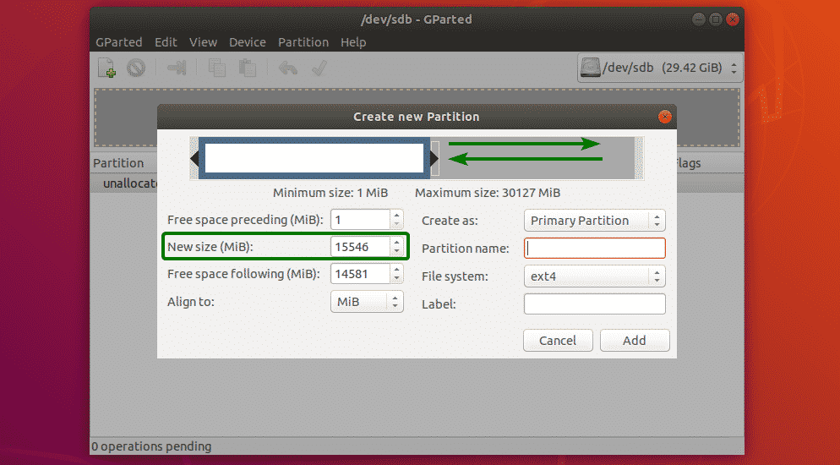
Creating New Partitions 6

Slide 29
Creating New Partitions 7
You can also select a file system for your new partition using the File system dropdown menu. By default, ext4 is selected. This is one of the thing I like about GParted. It formats the partition to your desired file system when you create a new partition.
GParted supports a lot of file systems. The file systems that are installed on your computer should be enabled here. The ones that are not installed are disabled at the moment. To enable the disabled ones here, you will have to install the file systems on your computer.
You can also type in a Partition name and a Label for your new partition. These are used to make it easy for yourself to identify the partition, nothing else. You can also leave them empty if you want. These are completely optional

Slide 30
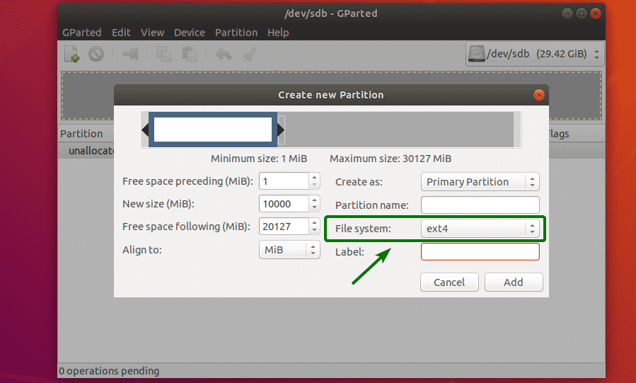
Creating New Partitions 8

Slide 31
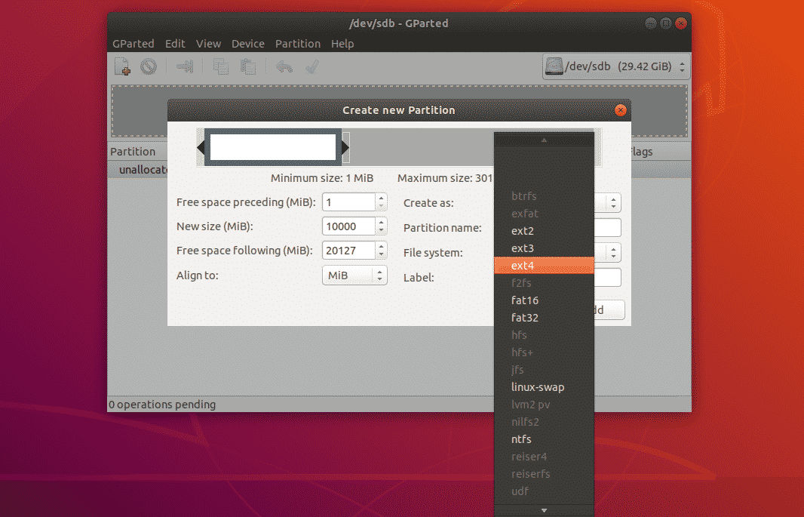
Creating New Partitions 9

Slide 32
Creating New Partitions 10
To create the partition select add. However, the changes are not yet saved permanently.

Slide 33
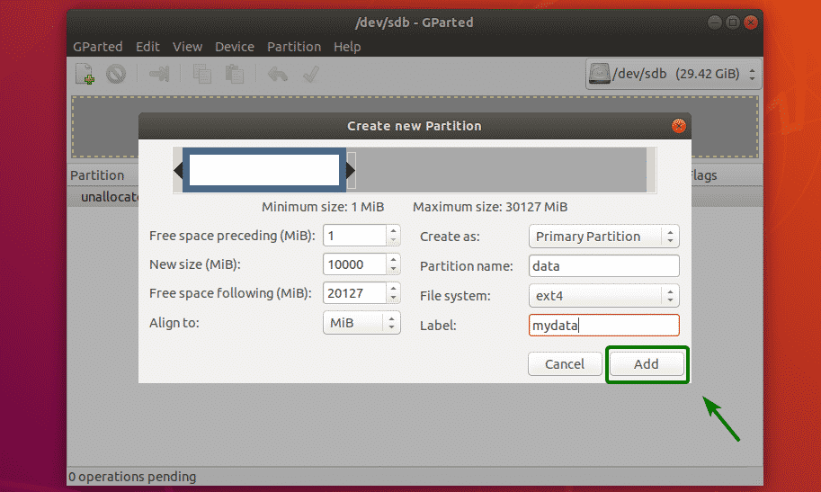
Creating New Partitions 11

Slide 34
Creating New Partitons 12
If everything is alright, then click on the check mark icon to save the changes permanently

Slide 35
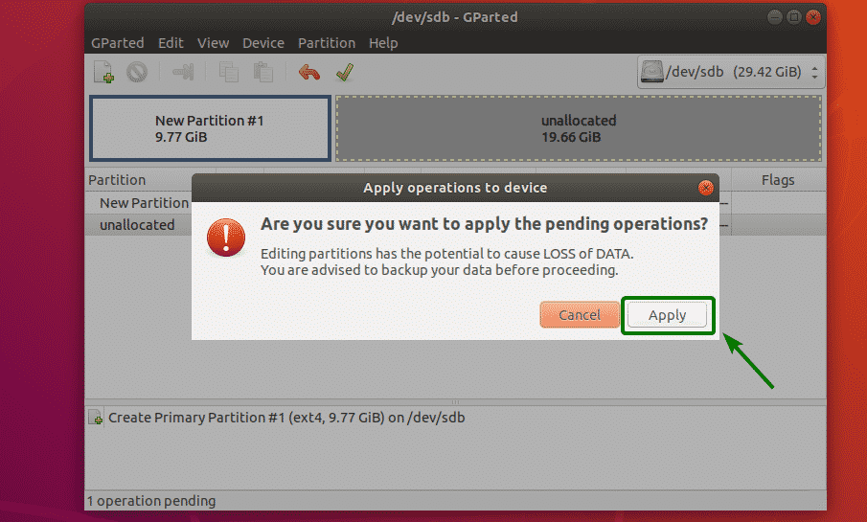
Creating New Partitions 13

Slide 36
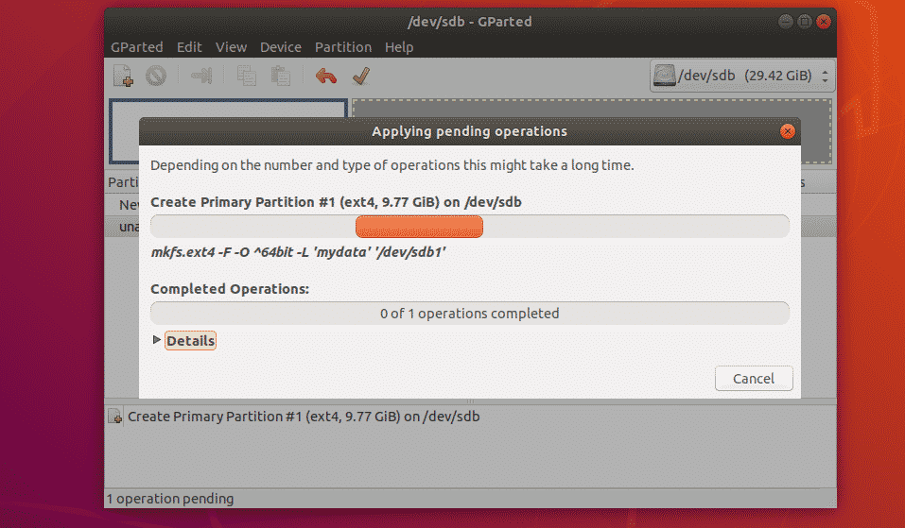
Creating New Partitions 14

Slide 37
Creating New Partitions 15
The new partition is then formatted.

Slide 38
Creating New Partitions 16
Once it’s done, click on Close

Slide 39
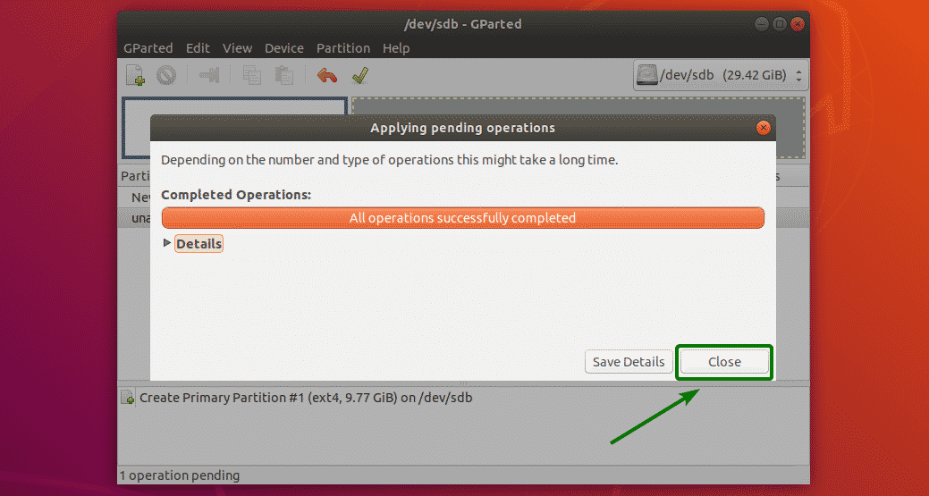
Creating New Partitions 17

Slide 40
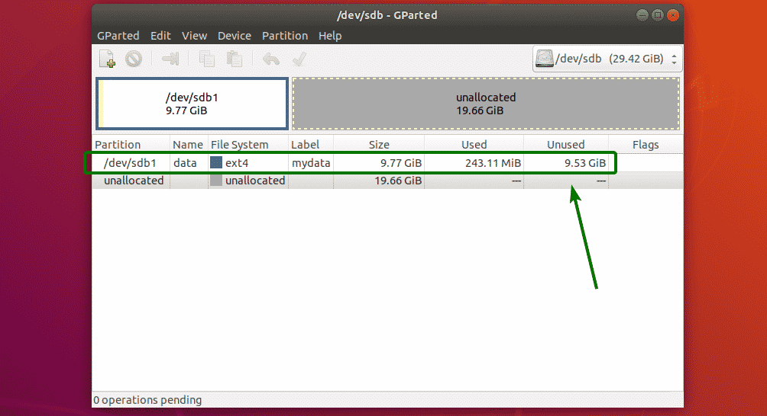
Creating New Partitions 18

Slide 41
Resizing Partitions
There are 2 resize operations that you can perform on a partition, Extend and Shrink. In order to extend a partition, you must have unallocated free spaces after that partition. To resize a partition, right click on the partition and click on Resize/Move.

Slide 42
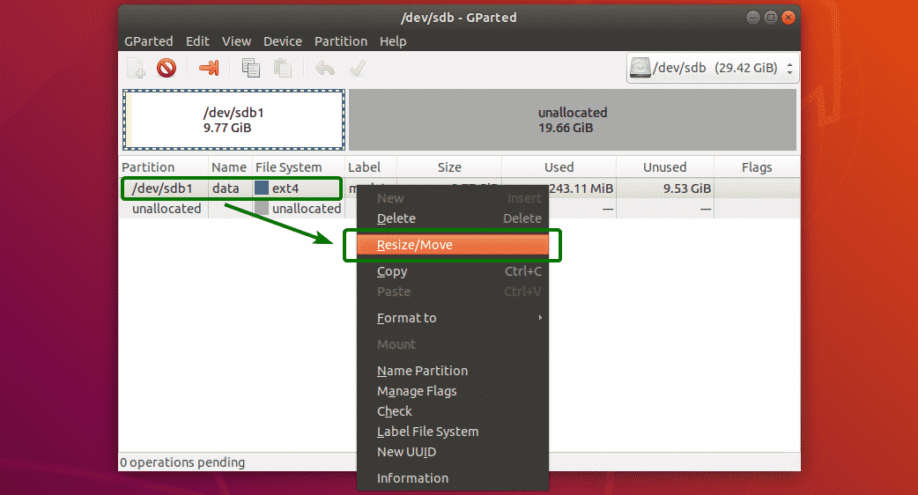
Resizing Partitions 2

Slide 43
Resizing Partitions 3
Now, you can use the handle to extend or shrink the partition. You can also type in the new size of the partition directly on the New size (MiB) textbox

Slide 44
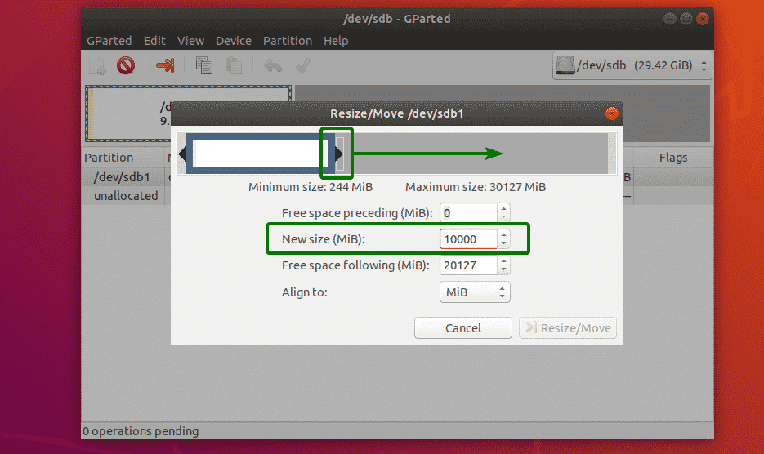
Resizing Partitions 4

Slide 45
Resizing Partitions 5
Once you’re done, click on Resize/Move.

Slide 46
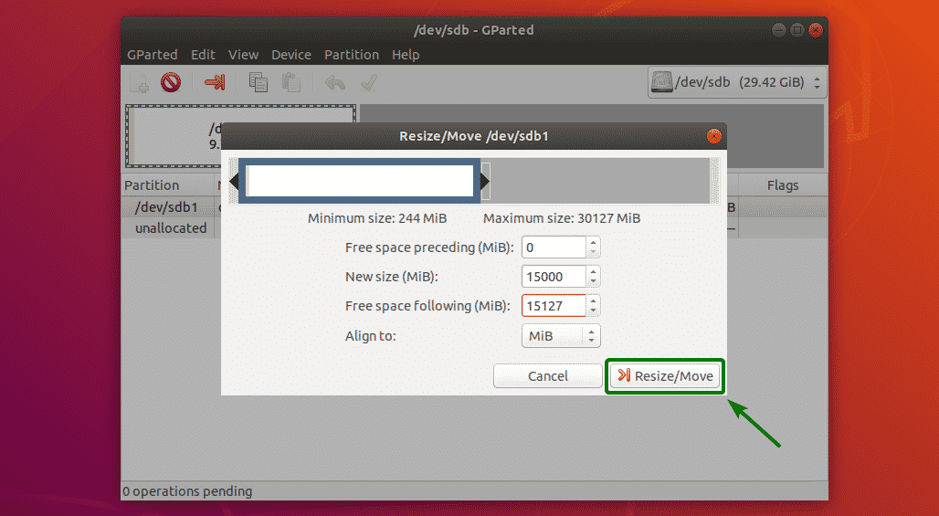
Resizing Partitions 6

Slide 47
Resizing Partitions 7
If everything is alright, then click on the check mark icon to save the changes permanently.

Slide 48
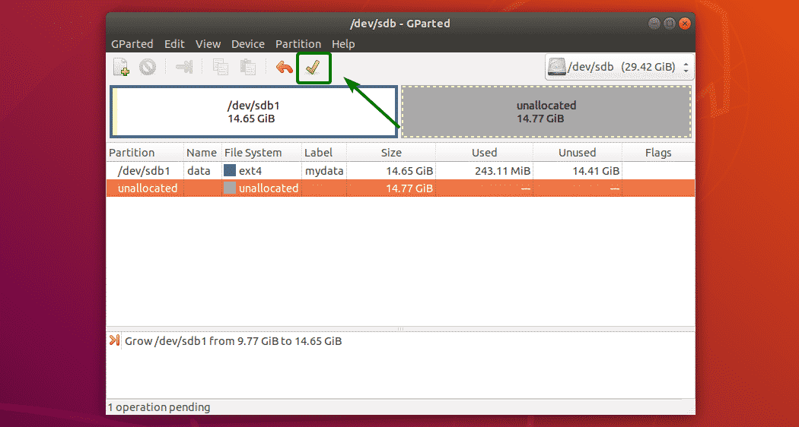
Resizing Partitions 8

Slide 49
Resizing Partitions 9
Now, click on Apply to confirm the operation.

Slide 50
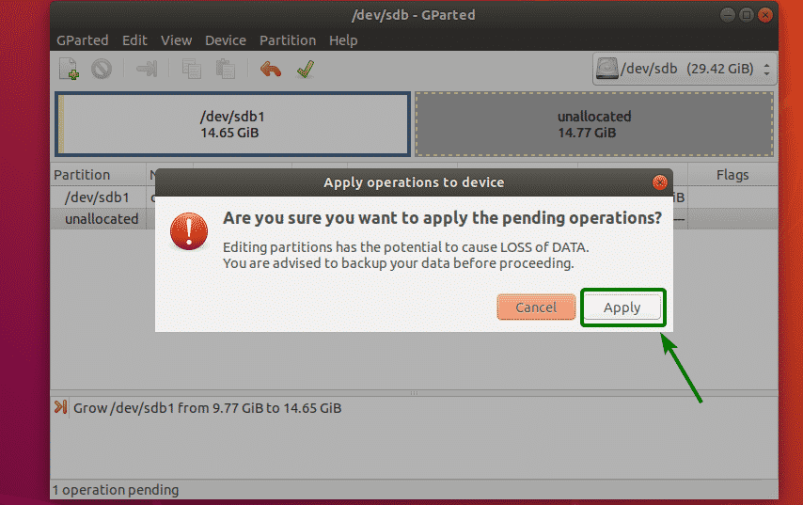
Resizing Partitions 10

Slide 51
Resizing Partitions 11
The changes should be applied. Now, click on Close

Slide 52
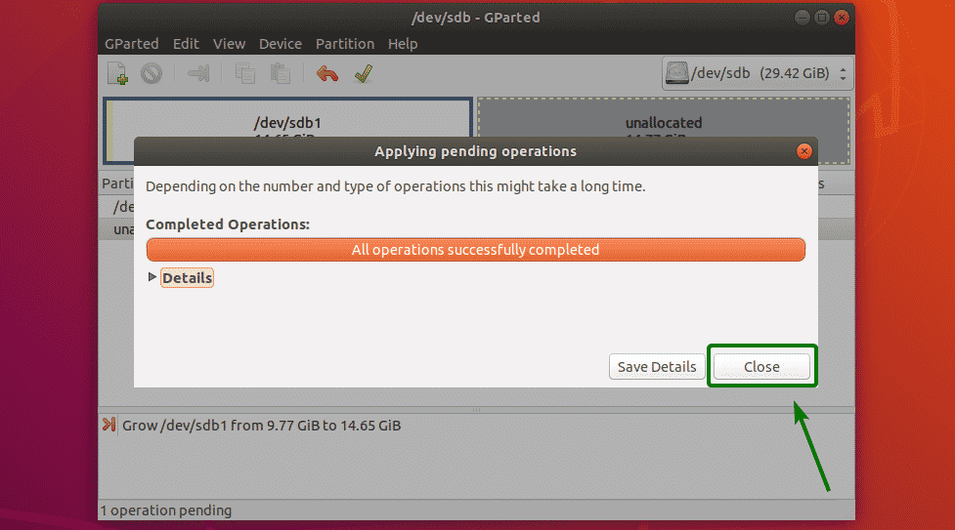
Resizing Partitions 12

Slide 53
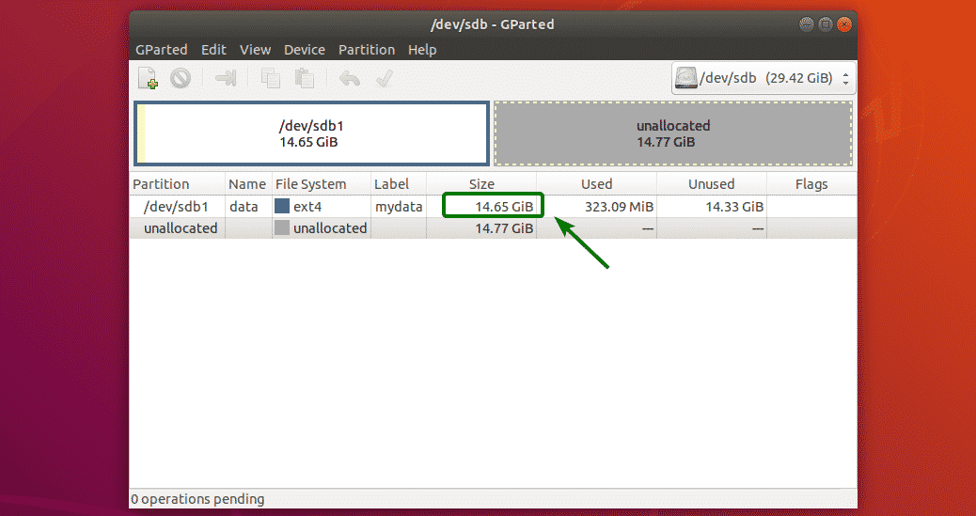
Resizing Partitions 13

Slide 54
Deleting Partitions
To delete a partition, right click on the partition and click on Delete.

Slide 55
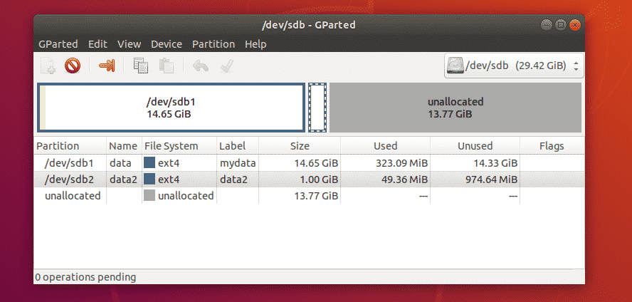
Deleting Partitions 2

Slide 56
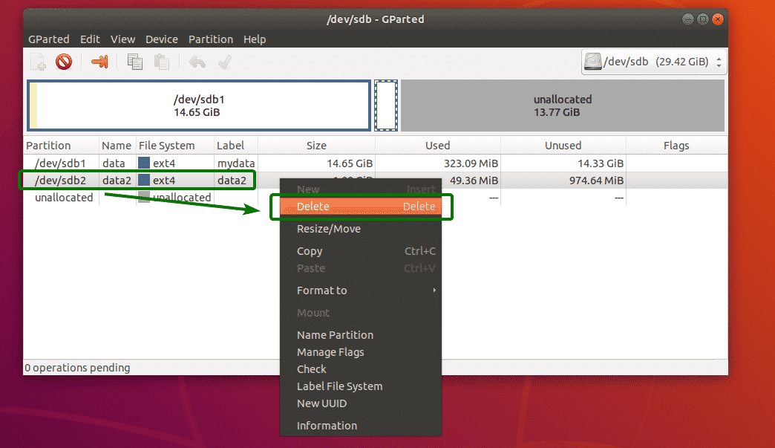
Deleting Partitions 3

Slide 57
Deleting Partitions 4
Now, to save the changes permanently, click on the check mark icon

Slide 58
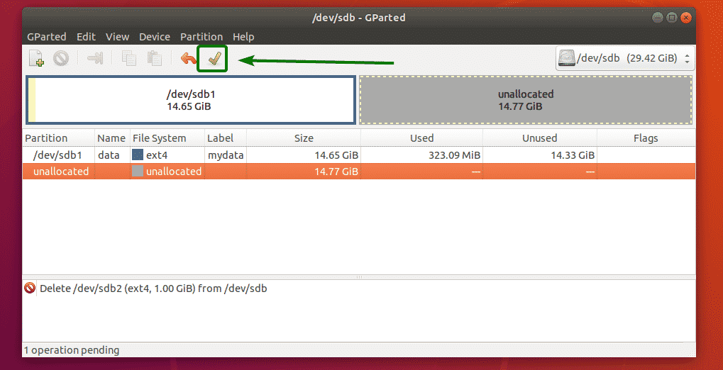
Deleting Partitions 5

Slide 59
Deleting Partitions 6
Now, to confirm the operation, click on Apply.

Slide 60
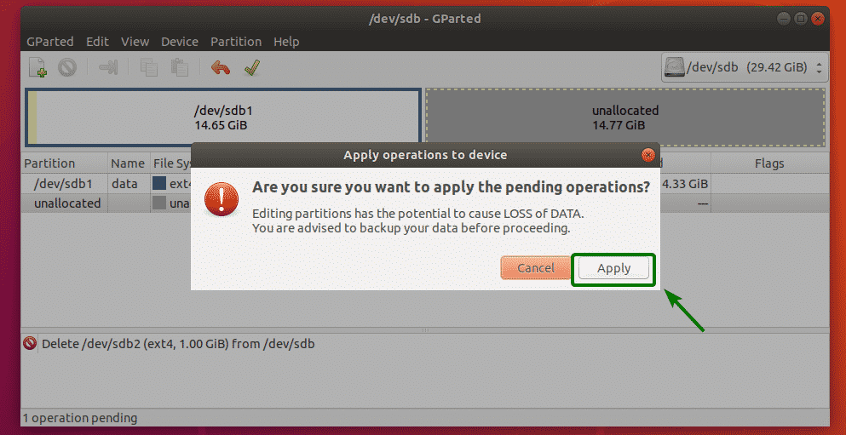
Deleting Partitions 7

Slide 61
Deleting Partitions 8
Once the operation is complete, click on Close.

Slide 62
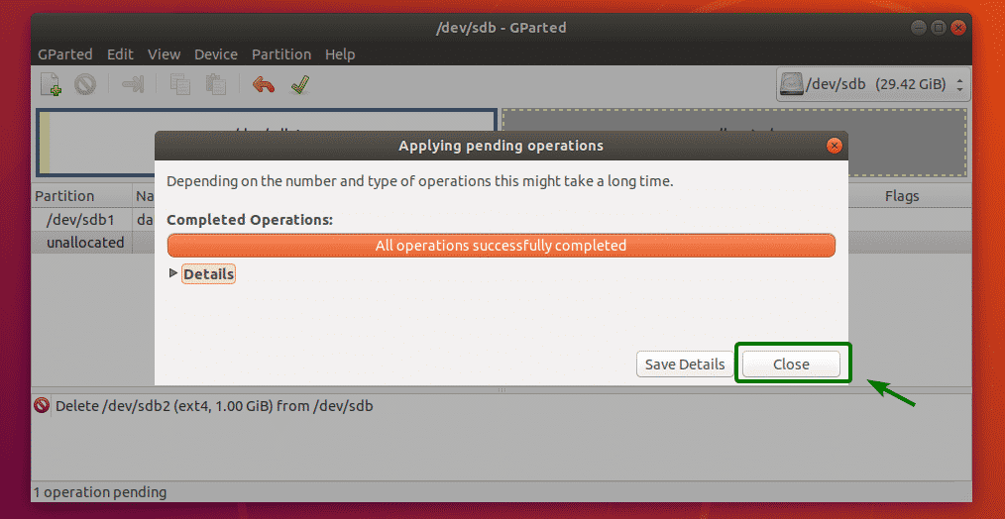
Deleting Partitions 9

Slide 63
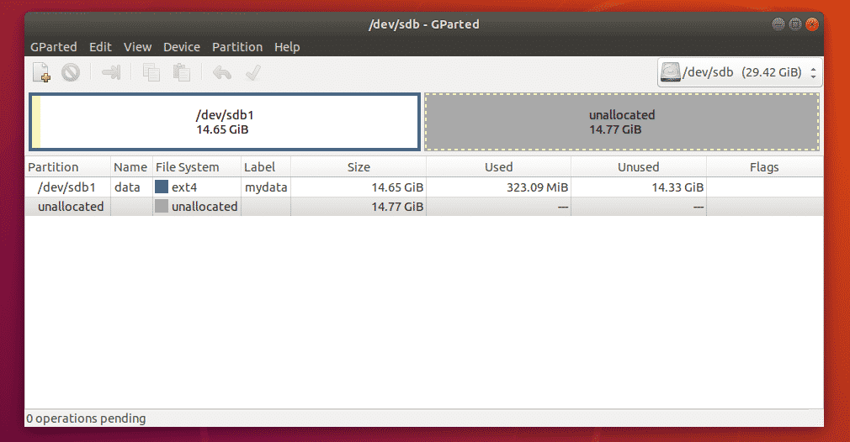
Deleting Partitions 10

Slide 64
Formatting A Partition
To format a partition with GParted, right click on the partition and click on Format to and select the filesystem type which you want the partition to be formatted to.

Slide 65
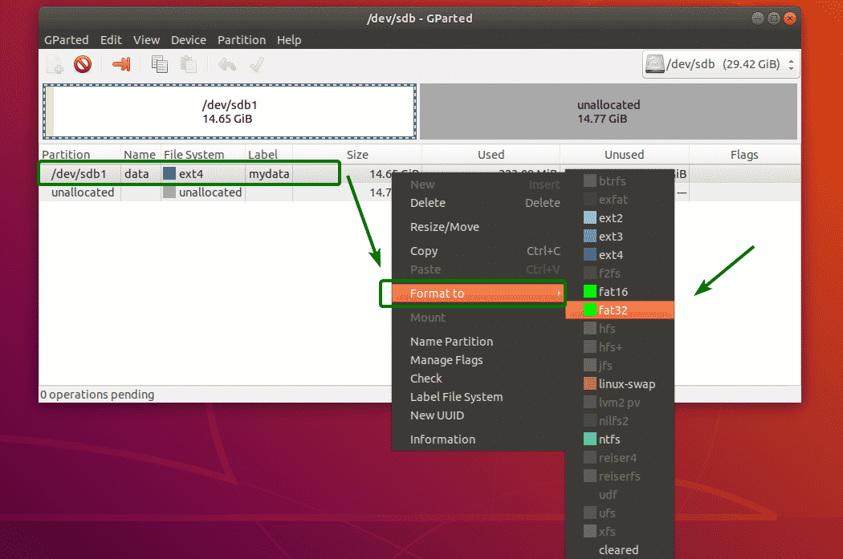
Formatting A Partition 2

Slide 66
Formatting A Partition 3
Now, to save the changes permanently, click on the check mark icon

Slide 67
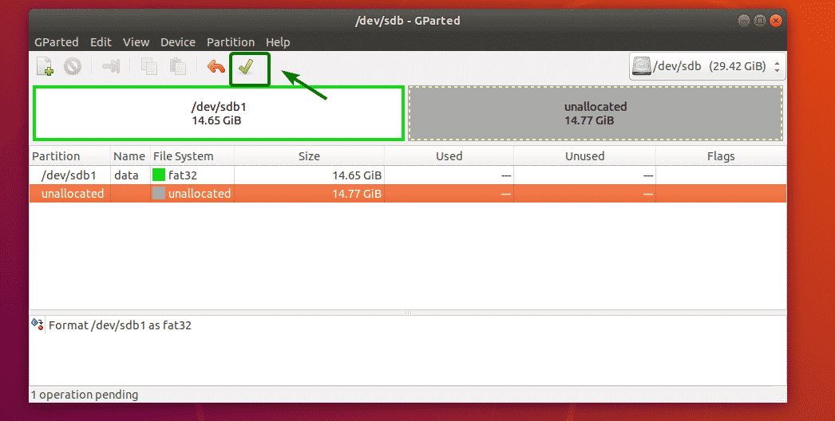
Formatting A Partition 4

Slide 68
Formatting A Partition 5
Now, click on Apply

Slide 69
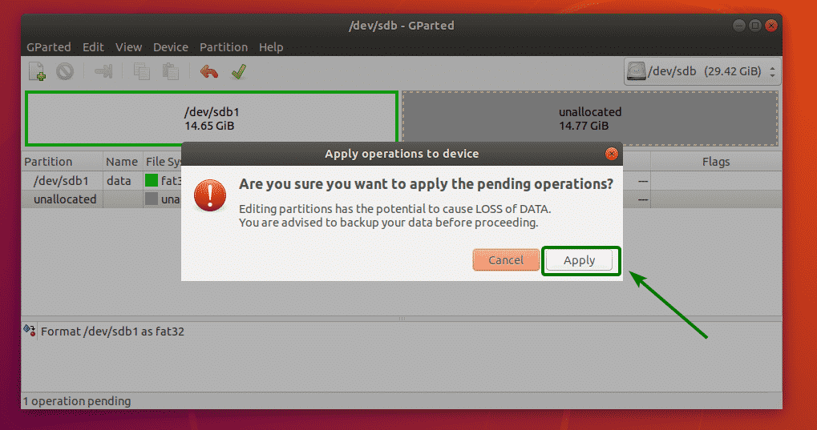
Formatting A Partition 6

Slide 70
Formatting A Partition 7
Once the operation is complete, click on Close.

Slide 71
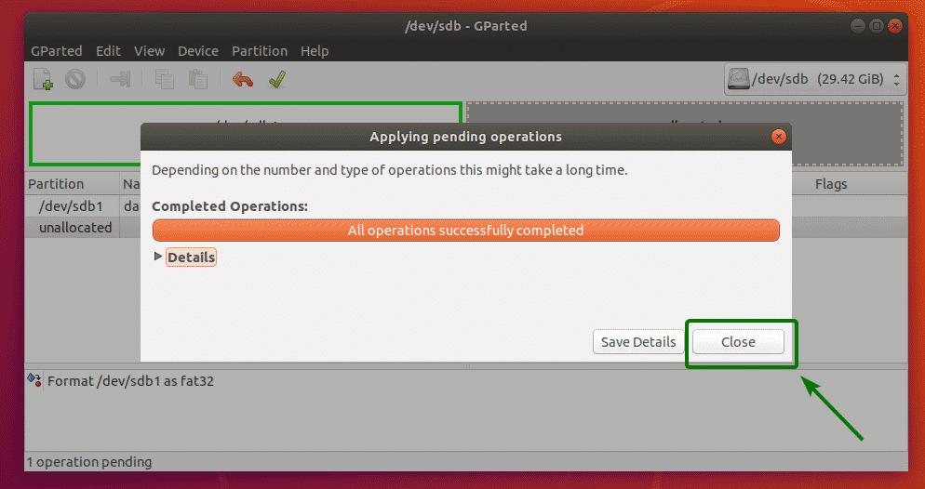
Formatting A Partition 8

Slide 72
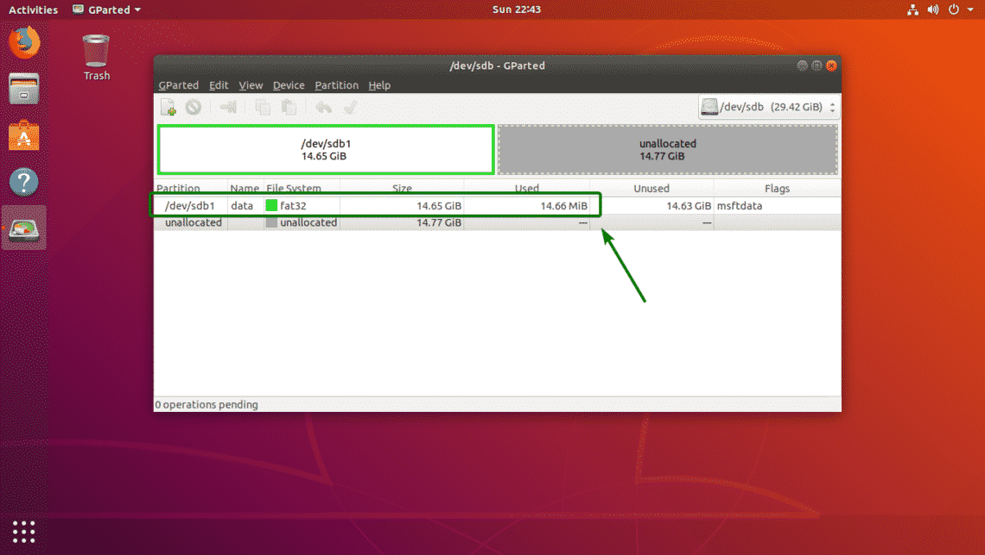
Formatting A Partition 9

Slide 73
Cochise Linux User Group

