Slide 1

How to Make a Bootable Flash Drive Using Balena Etcher

Slide 2
Etcher
Why do you need a bootable flash drive?
To install or test an operating system on your computer.
When you boot with the flash drive and you choose to try the OS, it is a live system and nothing on your computer is changed

Slide 3
Etcher
You can either install Etcher on your computer as an AppImage or add the Debian Repository to your computer. (Your choice)
If you intend to use it often you may opt to add the repository

Slide 4
Etcher
To install as an AppImage
Navigate to Balena Etcher’s website:
https://www.balena.io/etcher/
Download the 64 bit version

Slide 5
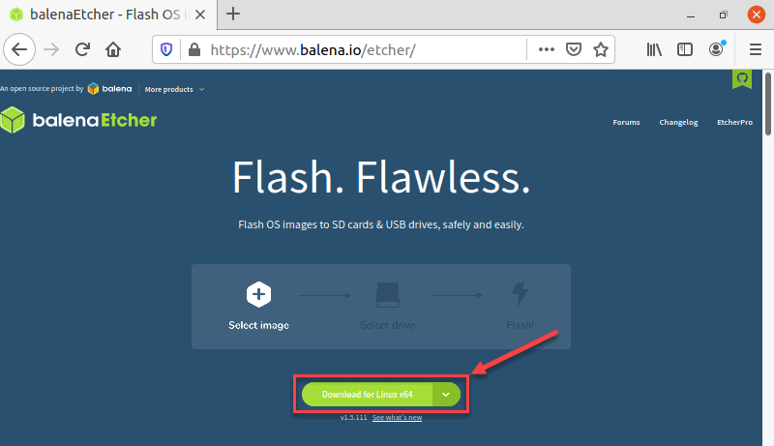

Slide 6
Etcher
Navigate to where you downloaded the zip file (generally Downloads)
Right click and select “Extract Here”

Slide 7
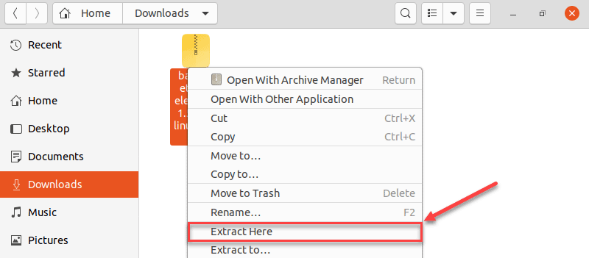
Etcher

Slide 8
Etcher
Right click the file that has been extracted and select “Properties”

Slide 9
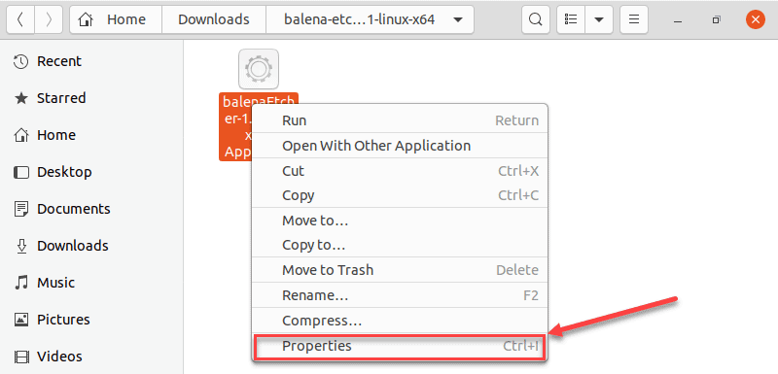
Etcher

Slide 10
Etcher
In the “Properties file select “Permissions” tab
Check “allow executing file as program”

Slide 11
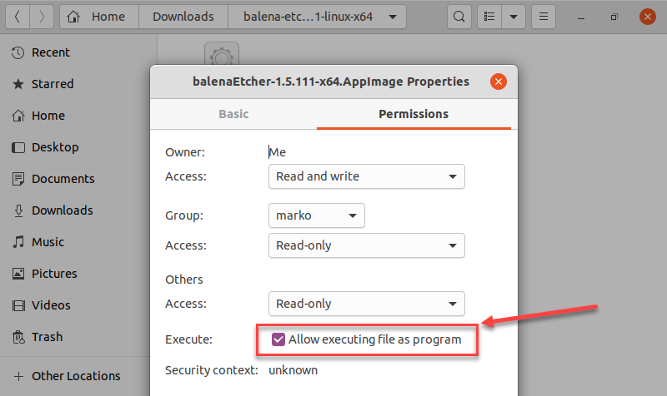
Etcher

Slide 12
Etcher
Close the properties window
To run the program all you have to do is double click the app icon

Slide 13
Balena Etcher
If you intend to use Etcher often you can add the Debian repository for Etcher.
In the terminal type: echo "deb https://deb.etcher.io stable etcher" | sudo tee /etc/apt/sources.list.d/balena-etcher.list
Ubuntu will confirm the addition of the repository

Slide 14
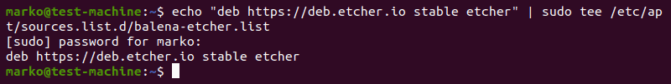
Etcher

Slide 15
Balena Etcher
Next you must add the repository key to authenticate the package source.
sudo apt-key adv --keyserver hkps://keyserver.ubuntu.com:443 --recv-keys 379CE192D401AB61

Slide 16
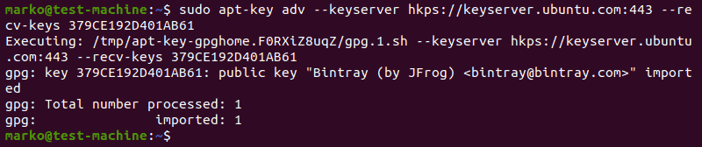
Etcher

Slide 17
Balena Etcher
To install Etcher, type in the terminal:
sudo apt update
sudo apt install balena-etcher-electron
When prompted do you want to continue, hit enter
After installation it will be in your menu along with the other programs.

Slide 18
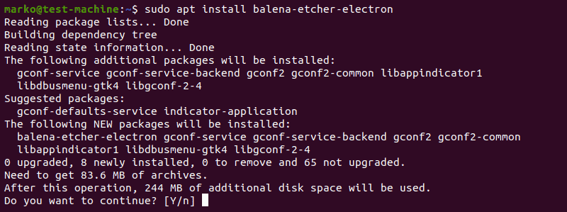

Slide 19
Using Etcher
To run the program either select it from the menu or double click on the app icon (if you installed it as an AppImage)
Select the image that you want to flash (you have to have previously downloaded the ISO)

Slide 20
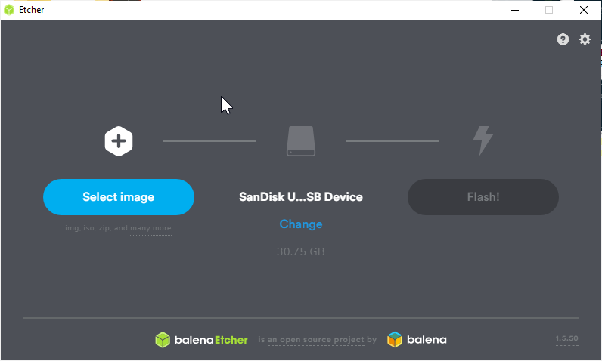

Slide 21
Using Etcher
Your next step is to choose the target for the flash.

Slide 22
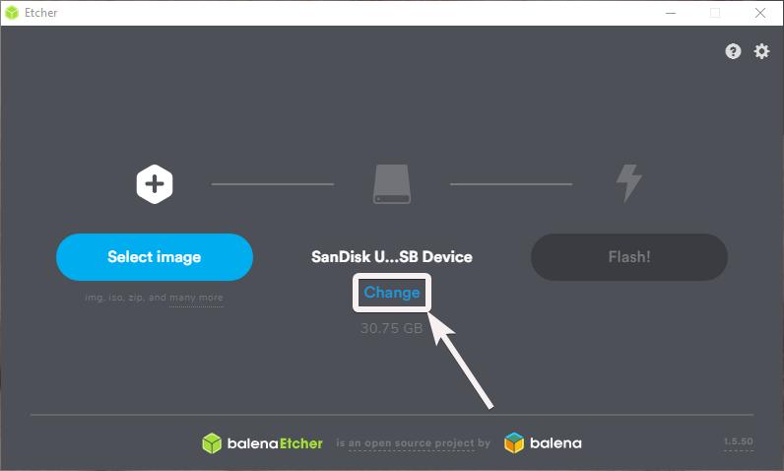

Slide 23
Using Etcher
Your final step is to select flash and Etcher will begin to flash the selected image to the selected target.
After it has completed it will verify that it did a good job, so if the download was good you will have a working bootable flash drive.

Slide 24
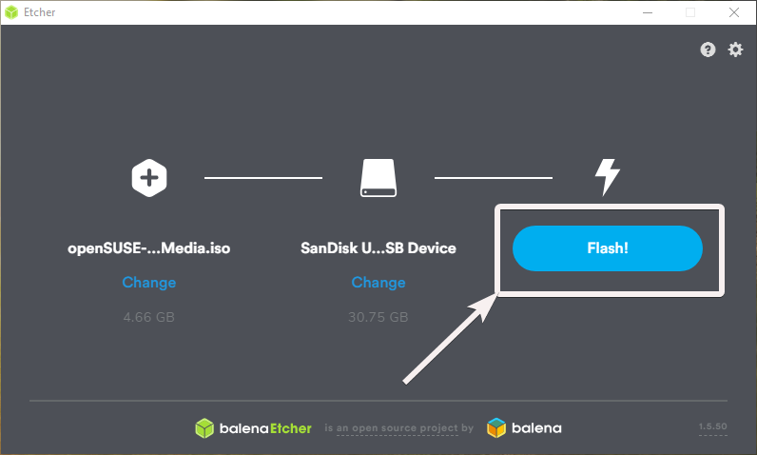

Slide 25
How to Make a Bootable Flash Drive Using Balena Etcher

