Slide 1

Xubuntu

Slide 2
Xubuntu
Established distribution
Ubuntu with xfce desktop environment
First released 1 June 2006
Release schedule same as Ubuntu
32 and 64 bit releases
LTS versions supported for 3 years

Slide 3
Xubuntu Minimum Install Requirements
700 MHz processor
(dual core processor recommended)
512 Mbs RAM (1-2+ Gbs recommended)

Slide 4
Xubuntu Ease of Installation
Average installation time 25-30 minutes
No hangups or problems noted

Slide 5
Xubuntu Resources
Ubuntu Forums
Ask Ubuntu
Xfce Forums

Slide 6
Xubuntu Ease of Navigation
Microsoft Windows Like Desktop
Desktop easily configurable

Slide 7
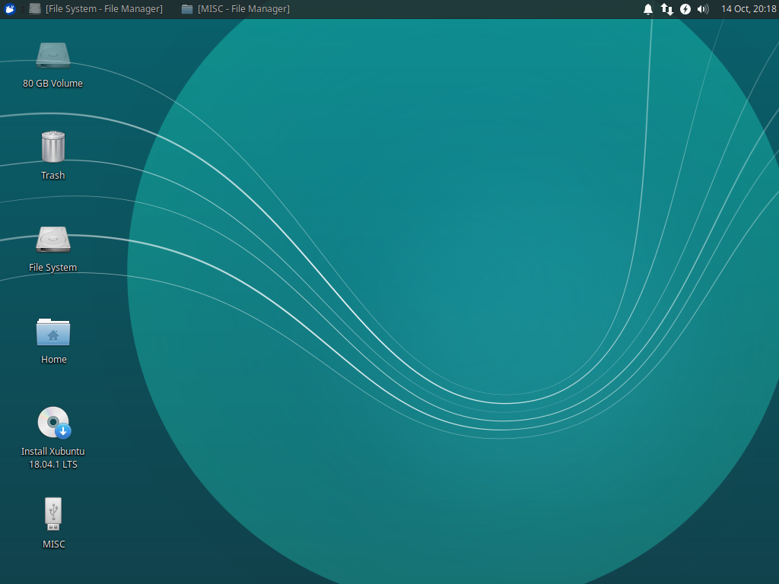
Xubuntu Desktop

