Slide 1

Cochise Linux User Group

Slide 2

Rescuezilla

Slide 3
Rescuezilla
Rescuezilla is a specialist Ubuntu-based distribution designed for system rescue tasks, including backups and system restoration.
It was forked from the "Redo Backup & Rescue" project which was abandoned in 2012.
Works directly from the live CD/USB image
Works with Linux, macOS and Windows

Slide 4
Rescuezilla
Version 1.0.5 released 11 November 2019
Version 1.0.5.1 released 24 March 2020
Version 1.0.6 released 18 June 2020
Version 1.0.6.1 released 26 June 2020
Version 2.0 released 14 October 2020
Version 2.1 released 12 December 2020
Version 2.1.1 released 14 December 2020

Slide 5
Rescuezilla
An easy-to-use disk imaging application that's fully compatible with Clonezilla.
Disk imaging makes a backup of your computer's hard drive which is managed as files stored on an external hard drive.
If your hard drive fails, you can restore your disk image and within a few minutes all your documents and settings will be restored to the exact same state they were in when the last snapshot was taken.

Slide 6
Rescuezilla
No Installation Needed
It's Easy-To-Use
Fully interoperable with Clonezilla (will not do device to device backup)
Boots in Seconds
Access Your Files
Recover Lost Data
Easy Internet Access
Drive Configuration Tools

Slide 7
Rescuezilla
Download the ISO from https://rescuezilla.com/
Create a bootable USB flash drive
Boot from that USB flash drive

Slide 8
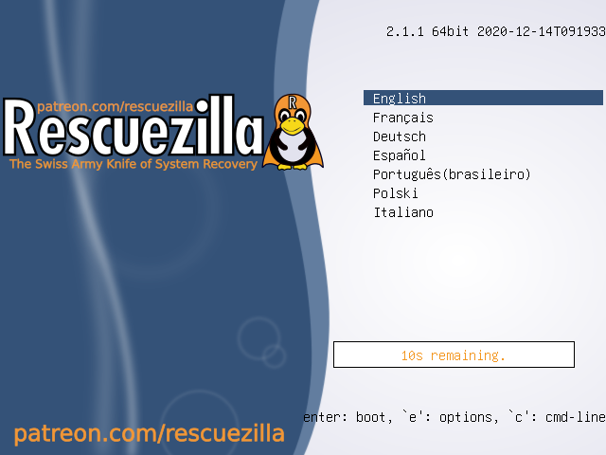
Rescuezilla

Slide 9
Rescuezilla
The ISO has a very limited number of applications; ArandR, Gparted, Firefox, PCManFM, Mousepad, a terminal, and of course Rescuezilla
Select Rescuezilla

Slide 10
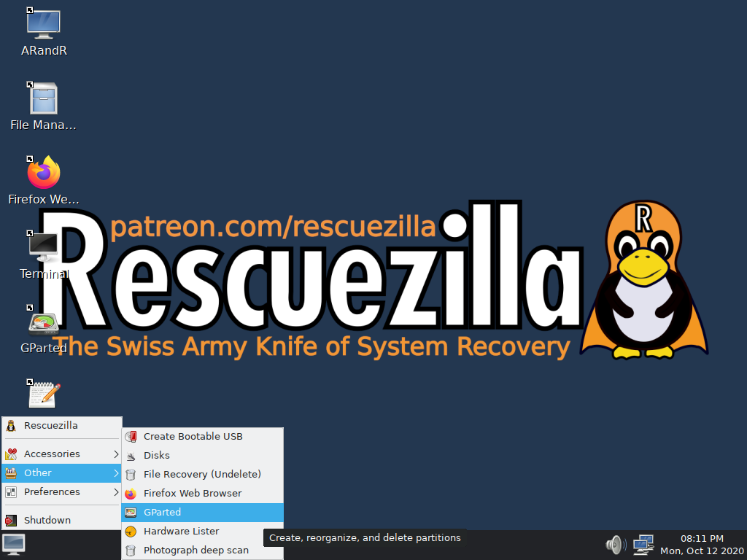
Rescuezilla Start Page

Slide 11
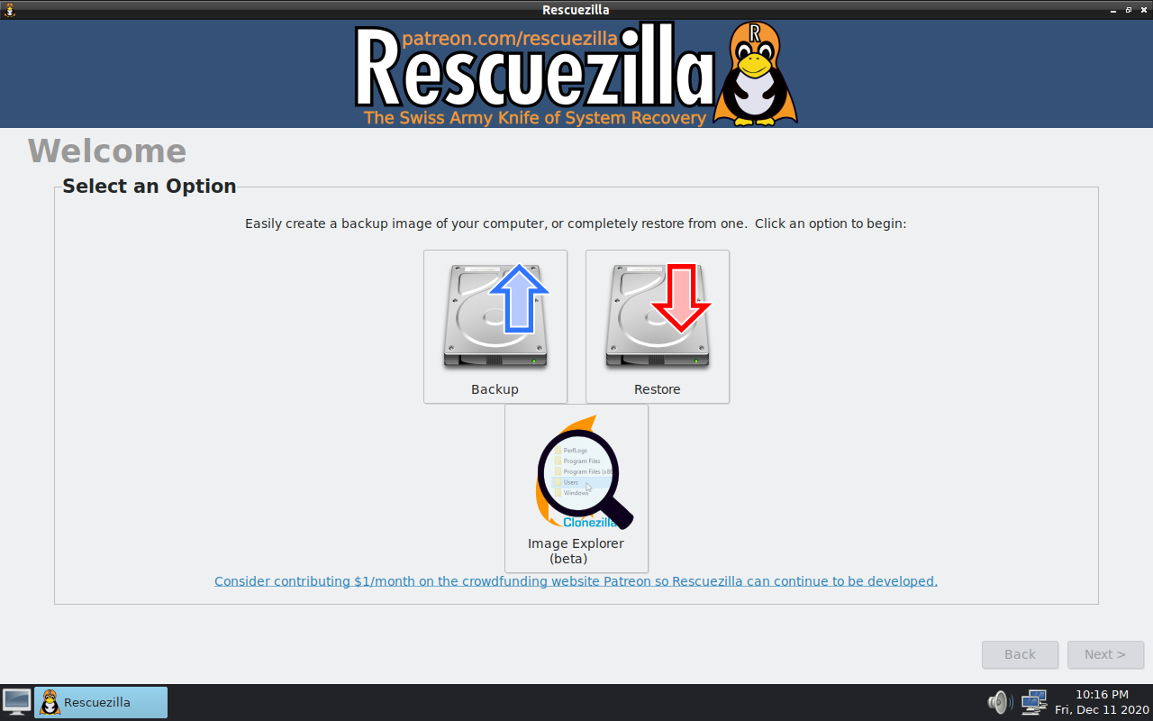
Rescuezilla Backup

Slide 12
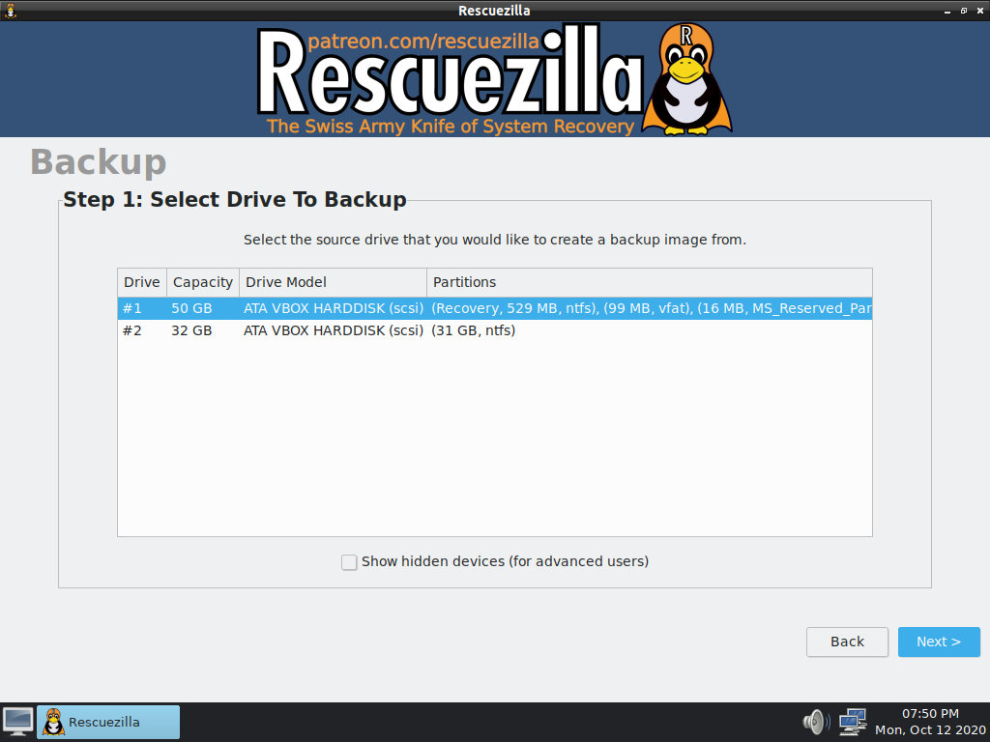
Rescuezilla Backup-1

Slide 13
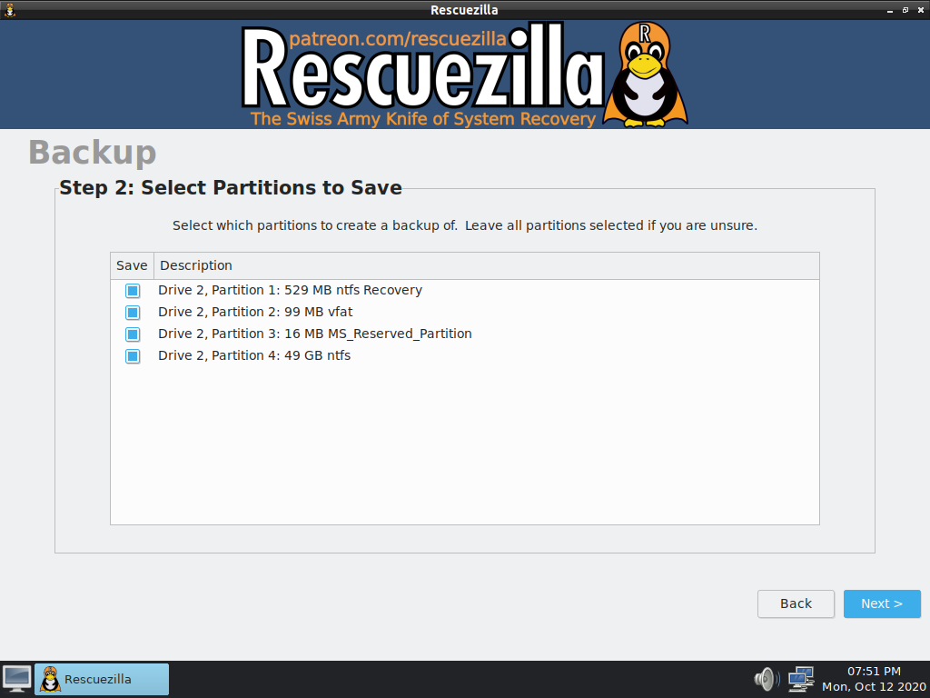
Rescuezilla Backup-2

Slide 14
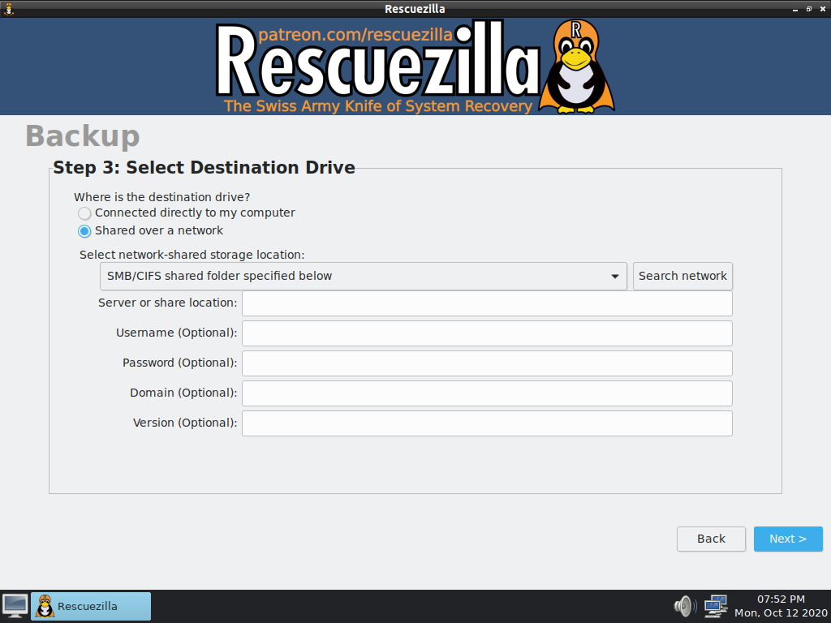
Rescuezilla Backup-3

Slide 15
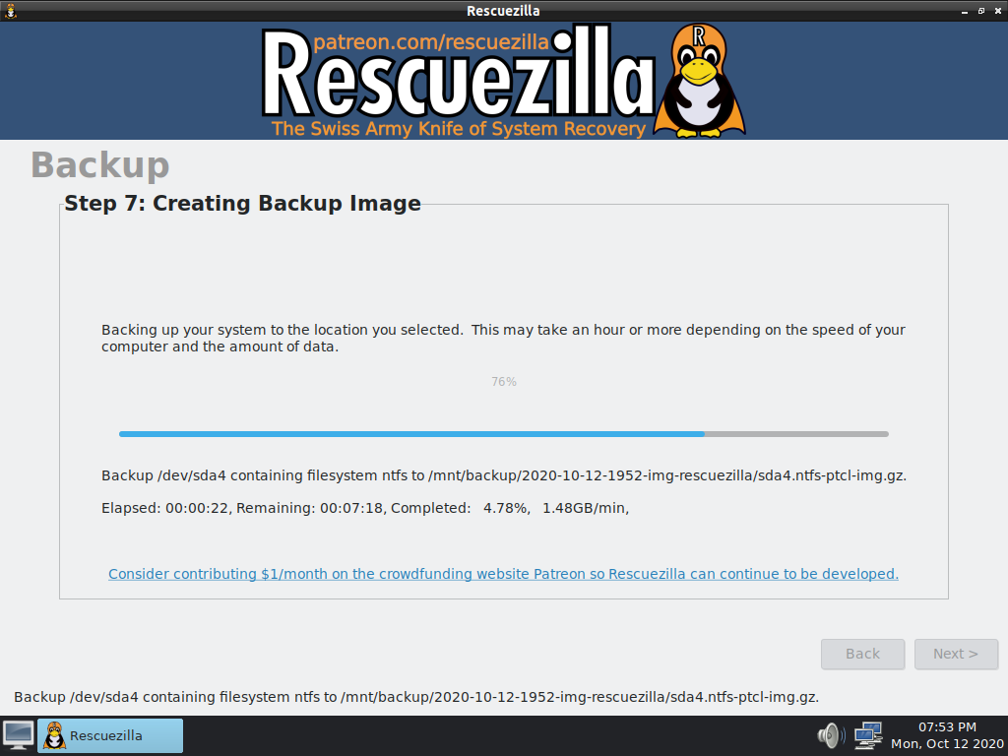
Rescuezilla Backup-4

Slide 16
Rescuezilla Restore

Slide 17
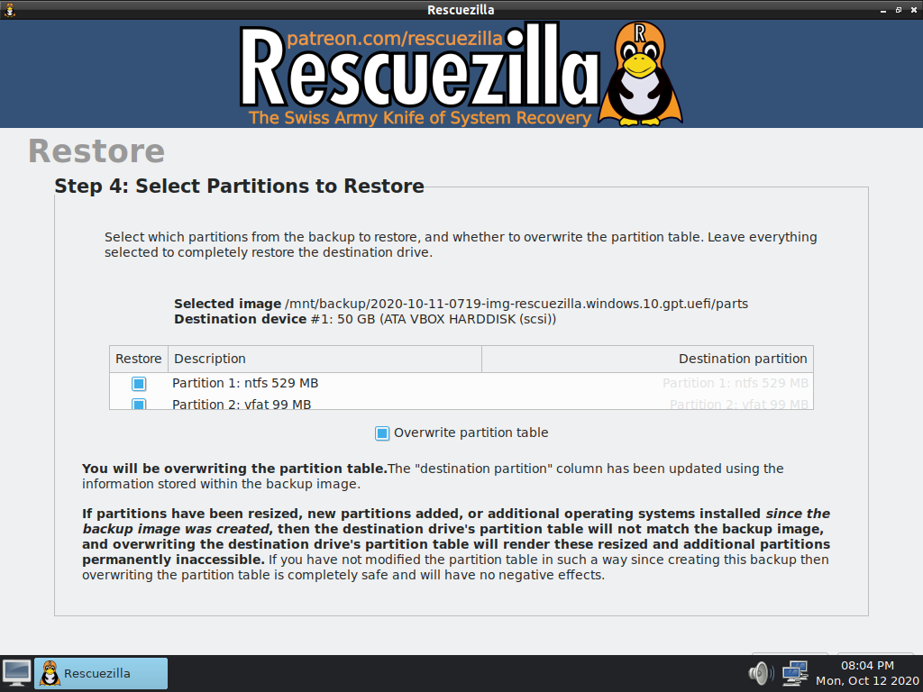
Rescuezilla Restore

Slide 18
Rescuezilla
I used Rescuezilla 2.0 to back up and restore the hard drive of an ASUS EeePC with 2 GB of RAM to a 32 GB flash drive
Backup took 31 minutes 4 seconds
Restore took 5 minutes 41 seconds
Success!!!!

Slide 19
Rescuezilla
I created a document and saved it.
I deleted it and then emptied the trash to test the recovery capability.
That process was unsuccessful
However, a new Image Explorer is scheduled to be included in the 2.1 release and it should have that capability

Slide 20
Rescuezilla 2.1.1
On 12 December 2020 version 2.1 was released
Two days later version 2.1.1 was released
The Image Explorer is still in beta format and I still could not get it to work

Slide 21
Rescuezilla
Backed up a computer 4 TB hard drive (Ubuntu 20.04.1 installed) with 16 GB of RAM to a 32 GB flash drive using version 2.1.1. It took 13 minutes 12 seconds.
Restored the image to the hard drive. It took 10 minutes 12 seconds.
Success.

