Slide 1

How To Change Lost Or Forgotten Password

Slide 2
Admin Password
Even if you set up your computer to boot automatically without entering a password there will be times when you must enter that password.
The admin or sudo password is the password that you entered when the operating system was first installed on your computer.

Slide 3
HOW TO CHANGE YOUR ADMIN PASSWORD
If you forget your password or never knew it you are able to create a new one if you have physical possession of the computer.
How can you do that? First boot into recovery mode.

Slide 4
HOW TO CHANGE YOUR ADMIN PASSWORD
If you do not see GRUB menu during a normal boot, hold down the shift key during boot up.
This works only if you installed the OS in legacy mode.
If you installed in EFI mode you must tap the escape key during boot.
If you have more than one OS installed you will automatically see the boot options

Slide 5
HOW TO CHANGE YOUR ADMIN PASSWORD
Select recovery mode for the operating system (usually the 2nd entry)
Press enter

Slide 6
HOW TO CHANGE YOUR ADMIN PASSWORD
Use the down arrow on your keyboard to highlight “root drop to root shell prompt”
Press enter
You will see the root prompt at the bottom of the window.

Slide 7
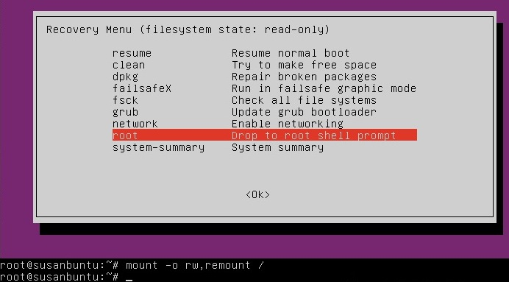
HOW TO CHANGE YOUR ADMIN PASSWORD

Slide 8
HOW TO CHANGE YOUR ADMIN PASSWORD
Remember you are in the root account so be careful because as root you can change anything in the system including bricking it.

Slide 9
HOW TO CHANGE YOUR ADMIN PASSWORD
If you have forgotten your user name as well
ls /home will give you a list of users

Slide 10
HOW TO CHANGE YOUR ADMIN PASSWORD
Type passwd username replacing user name with your name.
You'll then be prompted for a new password.
Just type the password. You will have no indication that your password is being accepted. Just hit enter when you are done.
You'll be prompted to retype the password. Do so and hit Enter again.

Slide 11
HOW TO CHANGE YOUR ADMIN PASSWORD
Type exit
You will return to the menu. Select “resume resume normal boot”

Slide 12
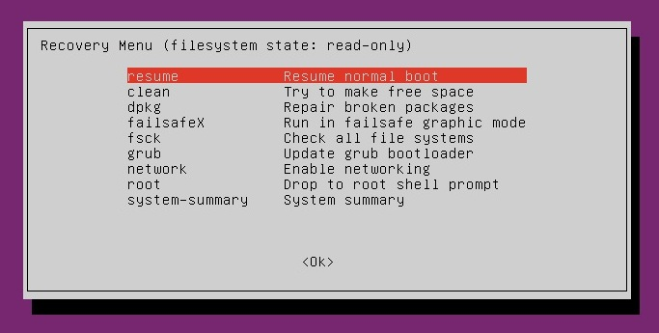
HOW TO CHANGE YOUR ADMIN PASSWORD

Slide 13
HOW TO CHANGE YOUR ADMIN PASSWORD
NOW YOU KNOW YOUR PASSWORD!!!

Slide 14
HOW TO CHANGE YOUR ADMIN PASSWORD
For an easy step by step you can also see:
www.psychocats.net/ubuntu/resetpassword

Slide 15
How To Change Lost Or Forgotten Password

