Slide 1

Cochise Linux User Group

Slide 2
Upcoming Events
10 September, Ubuntu Hour, Schlotzsky’s, 3900 E. Fry Blvd., 1800-1900.
26 September, CLUG Meeting, Location TBA, 1300-1545.

Slide 3
What To Do If Ubuntu Won’t Boot

Slide 4
What To Do If Ubuntu Won’t Boot
It happens
Don’t panic!!!
Here’s how to fix some Ubuntu booting problems.

Slide 5
What To Do If Ubuntu Won’t Boot
If Ubuntu is not starting, work through these five steps:
Check for bootable devices
Is the GRUB bootloader working?
Repair the bootloader menu
Reinstall Ubuntu
Replace faulty hardware

Slide 6
#1 Check for bootable devices
If your computer isn’t booting, could it be because there is a bootable disk attached or loaded?
You’re not alone. One of the most common problems with Ubuntu not booting occurs right after installation. This is because the Ubuntu boot disk (USB device or a DVD) is set as the boot device.
In short, Ubuntu won’t boot after install because the disk is still present. So, eject the disk, and ensure the correct boot device is selected.
Checking the boot device can be done in your system UEFI/BIOS, or if available, the boot order menu. Both can be accessed from the POST screen, which appears when your PC powers up. Take a moment to change the boot order, then try rebooting.

Slide 7
#2 GRUB Bootloader Issues Might Stop Ubuntu Booting
GRUB is the bootloader that ensures the selected operating system boots. On a dual booting machine, it will list and boot all installed operating systems, including Windows.
However, installing Windows alongside Ubuntu can lead to the bootloader being overwritten, leading to problems booting Ubuntu.
Other issues can corrupt the bootloader, such as a failed upgrade, or power failure. It isn’t unusual for a bug to ruin the Linux experience

Slide 8
GRUB Bootloader Issues Might Stop Ubuntu Booting
To check the GRUB bootloader, restart your PC, while holding Shift. You should now see a list of the installed operating systems; navigate the menu using the arrow keys. If you see the GRUB Bootloader, skip this step
If not, then the problem is that the GRUB bootloader is broken or overwritten. Repairing the bootloader is the only solution.

Slide 9
#3 Repair the GRUB Bootloader to Boot Ubuntu
If GRUB is not loading, then Ubuntu won’t boot. Fortunately, you can repair GRUB using the Ubuntu installation media. Restart the computer with the disc inserted and wait for it to load up.
Again, you may need to change the boot order, Make a note of the boot order before you change it!

Slide 10
Repair the GRUB Bootloader to Boot Ubuntu -2
With the installation disc booted into the Live environment, confirm you have a network connection and then open a Terminal. Enter:
sudo apt-add-repository ppa:yannubuntu/boot-repair
sudo apt update
sudo apt install -y boot-repair
boot-repair

Slide 11
Repair the GRUB Bootloader to Boot Ubuntu -3
This will install the boot-repair tool and run it after the final instruction. Wait for the system to be scanned, then select Recommended Repair. (There is also an Advanced options view, where you can select a default OS, default disk or partition, and more.)

Slide 12
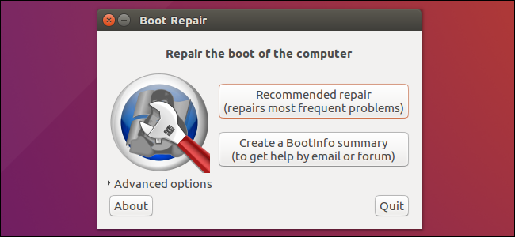
Repair the GRUB Bootloader to Boot Ubuntu -4

Slide 13
Repair the GRUB Bootloader to Boot Ubuntu -5
Click Apply when done. You should now be able to restart your PC and boot into Ubuntu. Alternatively, it will be listed an option in the GRUB bootloader menu.
When repair is finished, note the URL (paste.ubuntu.com/XXXXX) that appeared on a paper, then reboot and check if you recovered access to your Oss.
If the repair did not succeed, indicate the URL to people who help you by email or forum.

Slide 14
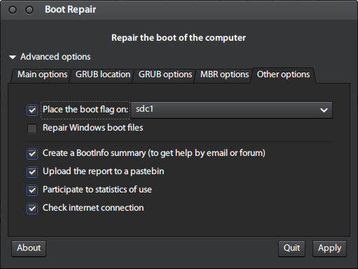
Repair the GRUB Bootloader to Boot Ubuntu -6

Slide 15
Ubuntu Still Won’t Boot? Fix the GRUB Bootloader Menu
If you can see the bootloader, then you don’t have to do any of the previous steps. There is a built-in recovery tool which you can use to help fix Ubuntu booting problems.
In the bootloader menu, select Advanced options for Ubuntu. Next, use the arrow keys to select the entry appended with (recovery mode). Tap Enter to continue and wait as Ubuntu is booted into a slimmed down version.

Slide 16
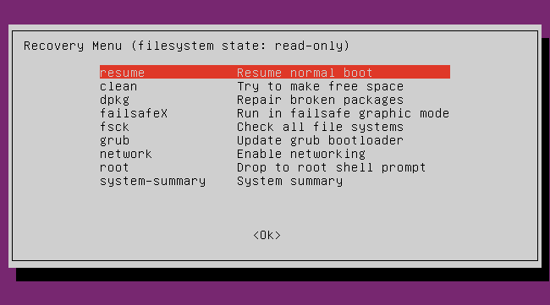
Ubuntu Still Won’t Boot? Fix the GRUB Bootloader Menu

Slide 17
Ubuntu Still Won’t Boot? Fix the GRUB Bootloader Menu -2
Several repair options can solve situations when Ubuntu won’t boot. The three you should try, in order, are:
fsck: This is the file system check tool, which scans the hard disk drive and repairs any errors it finds
clean: Use this to make free space, useful if the reason for Ubuntu not booting is a lack of HDD space.
dpkg: With this, you can repair broken software packages. Failed software installations or updates can cause problems with Ubuntu not starting. Repairing them should solve this.
If Ubuntu has never booted previously, you should also try the failsafeX tool. Graphics drivers or a problem with the Xorg graphical server might be the fault if Ubuntu won’t boot after installing. Use failsafeX to overcome this.

Slide 18
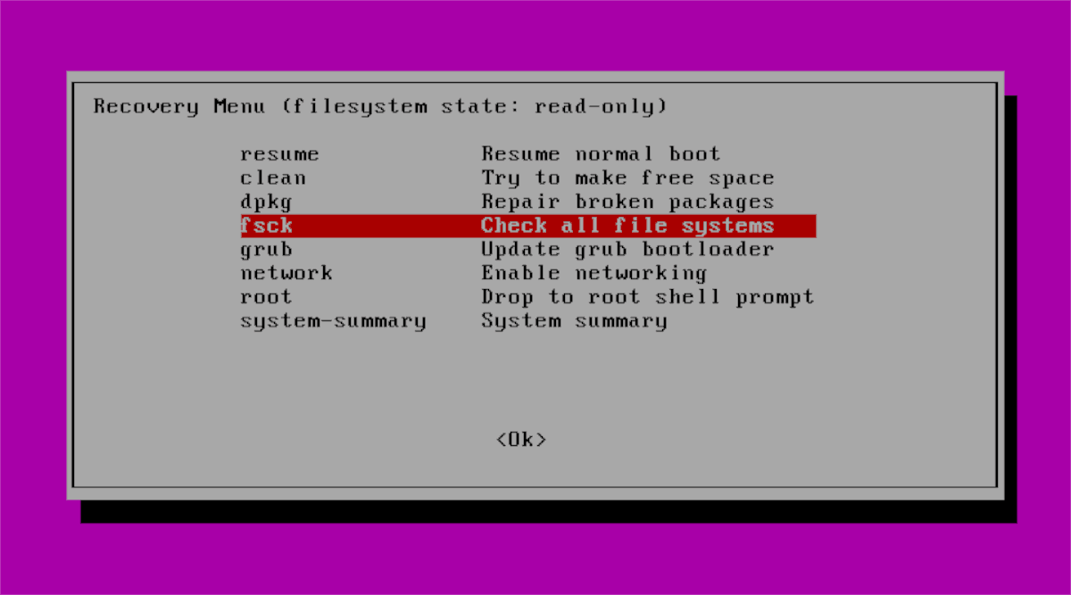
Ubuntu Still Won’t Boot? Fix the GRUB Bootloader Menu -3

Slide 19
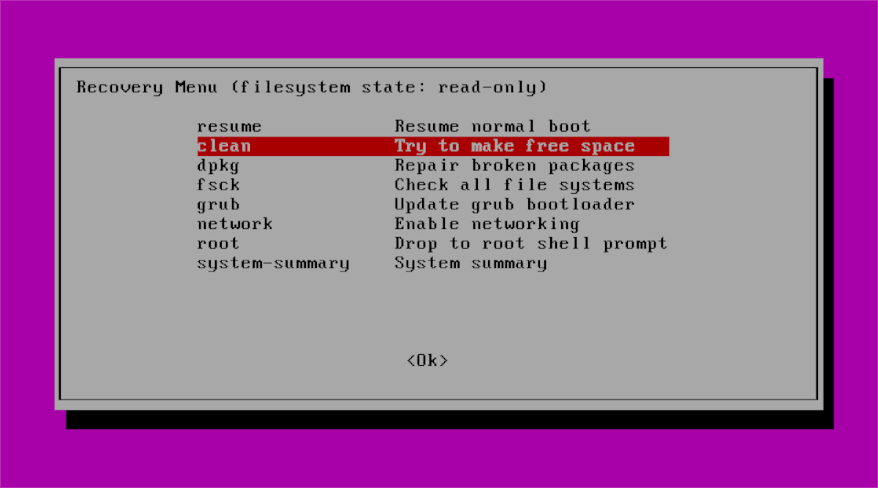
Ubuntu Still Won’t Boot? Fix the GRUB Bootloader Menu -4

Slide 20
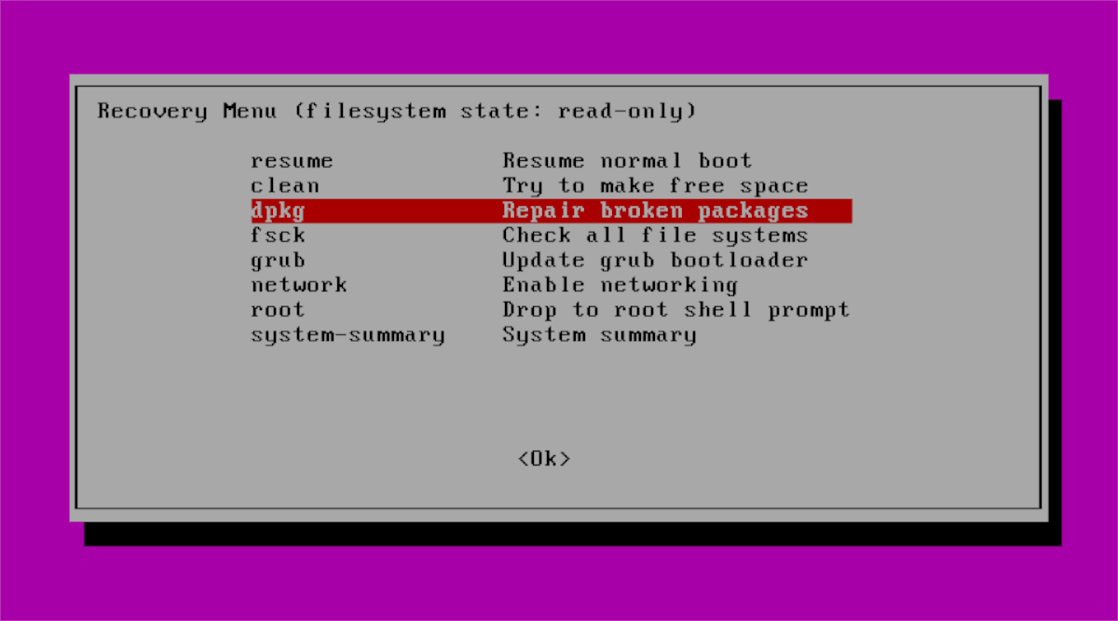
Ubuntu Still Won’t Boot? Fix the GRUB Bootloader Menu -5

Slide 21
#4 Ubuntu Not Starting? Time to Reinstall
In the event of a dreadful failure that could prove time-consuming to resolve, you might prefer to simply reinstall Ubuntu. This can be done without overwriting your existing files and folders. In fact, it’s one of the easiest fixes if Ubuntu won’t boot.
Again, boot into the Live environment on your Ubuntu CD/DVD or USB drive, and begin the installation. The installer will detect the existing instance of Ubuntu and give you the option to Reinstall Ubuntu.
Look for the option with the note “Documents, music, and other personal files will be kept…” In most cases, installed software will be retained too.
Of course, as a precaution, you should already have a backup of all your Ubuntu data.
Once the reinstallation is complete, Ubuntu should be back up and running.
The Erase Ubuntu and Install option is not advised unless other options fail and your data is backed up.

Slide 22
#5 Replace Your Faulty Hardware
Another cause of Ubuntu being unable to boot comes in the shape of faulty hardware. Boot problems can be caused by:
Hard disk drive and cabling
Motherboard
Processor (CPU)
Power Supply
Faulty Video Card

Slide 23
What To Do If Ubuntu Won’t Boot
A copy of these slide can be downloaded from our website:
https://github.com/CochiseLinuxUsersGroup/Presentations

Slide 24
Cochise Linux User Group

