Slide 1


CLUG
Cochise Linux User Group
Git Primer – Git Your Project On...
By: Paul Bernard
CochiseLinux.com

Slide 2
What This Will Cover
Explain what GIT is/does.
Show you how to get started with GitHub
Learn how to set up your local (linux) system to work with git/github.
Really it is a preparation presentation for our upcoming 'Create Free Websites with Jekyll and GitHub-Pages' presentation.

Slide 3
What Should You Know?
Truth is, not much!
A basic understanding of the Command Line will get you through any issues.
If you saw our 'Intro to the Command Line' presentation, you are set.

Slide 4
Lets dive in!

Slide 5
What is Git?
Git is a distributed revision control system.
It allows many software developers to work on the same project without having to be in the same physical location.
This takes a peer-to-peer approach on version control.

Slide 6
What is Github?
GitHub is a website that implements the git system.
It is a 'Web-based Git repository hosting service'

Slide 7
Github Info
Using git/github on Linux requires being comfortable with the command line.
On OSX and Windows, there are graphical github clients that can be used.
The command line interface is more powerful and should be used when possible (or comfortable).
More info at github.com

Slide 8

GitHub Setup
You can sign up for a free account at www.github.com

Slide 9
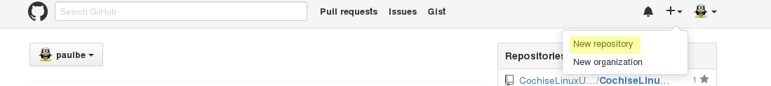
GitHub Setup (cont)
Once you have signed up / signed in, you can start by creating a repo.

Slide 10
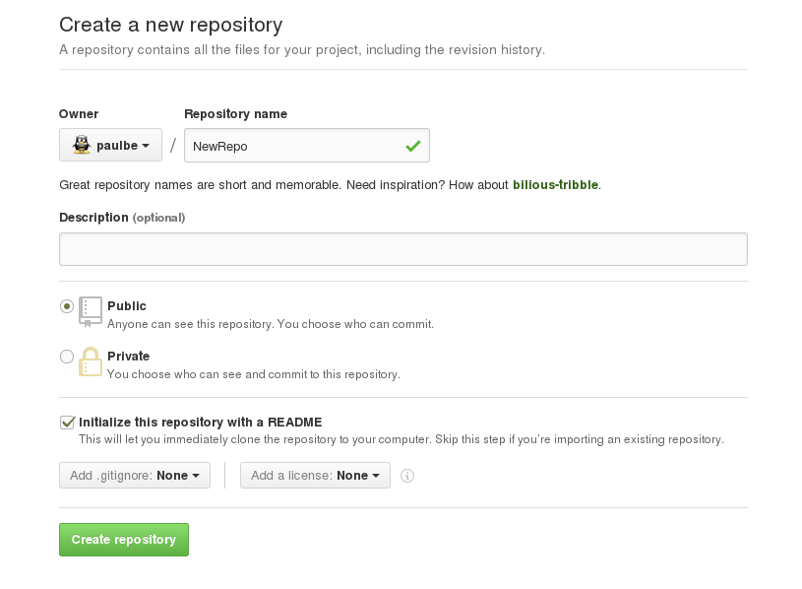
GitHub Setup (cont)

Slide 11
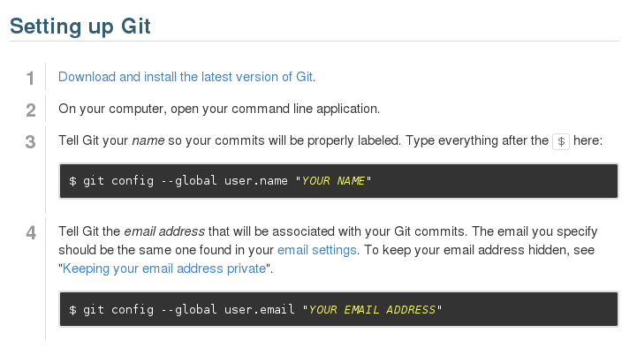
Local Config

Slide 12
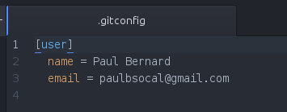
Local Config
This config file will be in your home directory.
~/.gitconfig

Slide 13
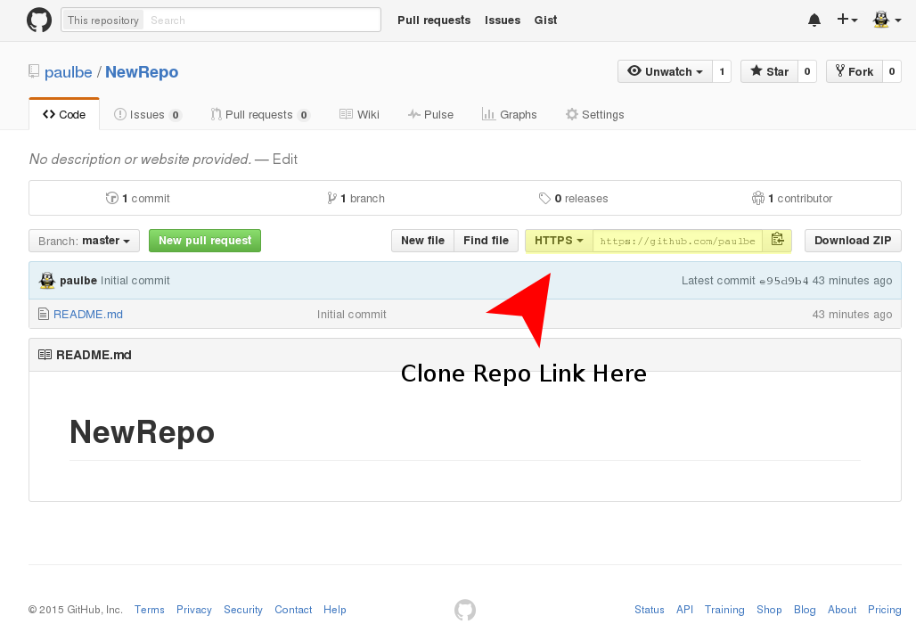
Clone A Repo

Slide 14
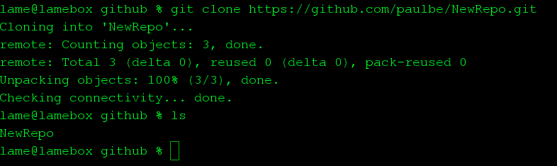
Clone A Repo
With the link from the previous page, we can now clone a repo on our local machine.
$ git clone <repo_clone_link>

Slide 15
Local Changes
After the clone, we have a copy of the repo that is on GitHub.
We can now make the changes we wish to the repo on our local machine.

Slide 16
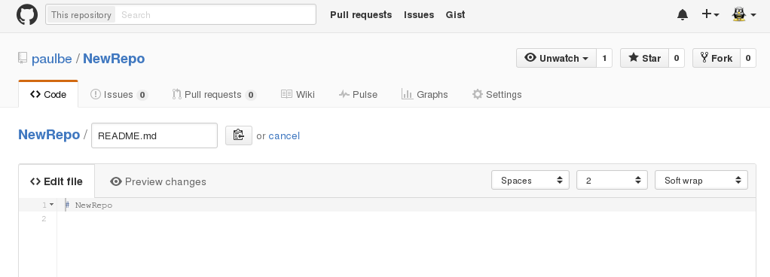
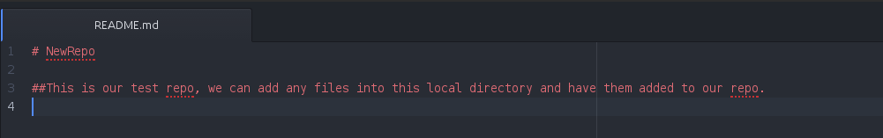
Local Changes

Slide 17
Update Remote Files
Now we have made our changes, it is time to update your files to GitHub.
This is the process I normally take.
  $ git status (this will show any local changes that have not been committed)
  $ git add . (this adds modified files in the current working tree, preparing them for the next commit)
  $ git commit -m “commit message” (this commits any changes and sets a specified commit message)
  $ git push origin master (this pushes your changes to the remote repo)

Slide 18
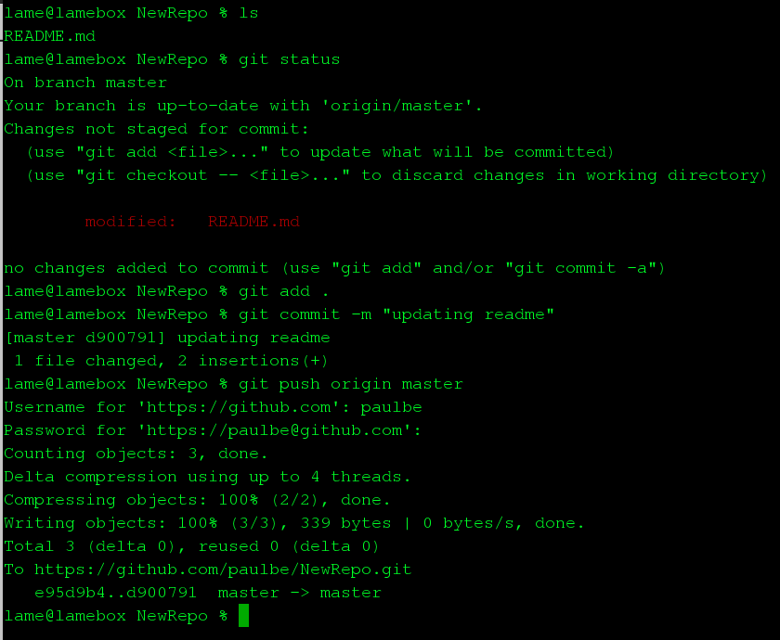
Update Remote Files (cont)

Slide 19
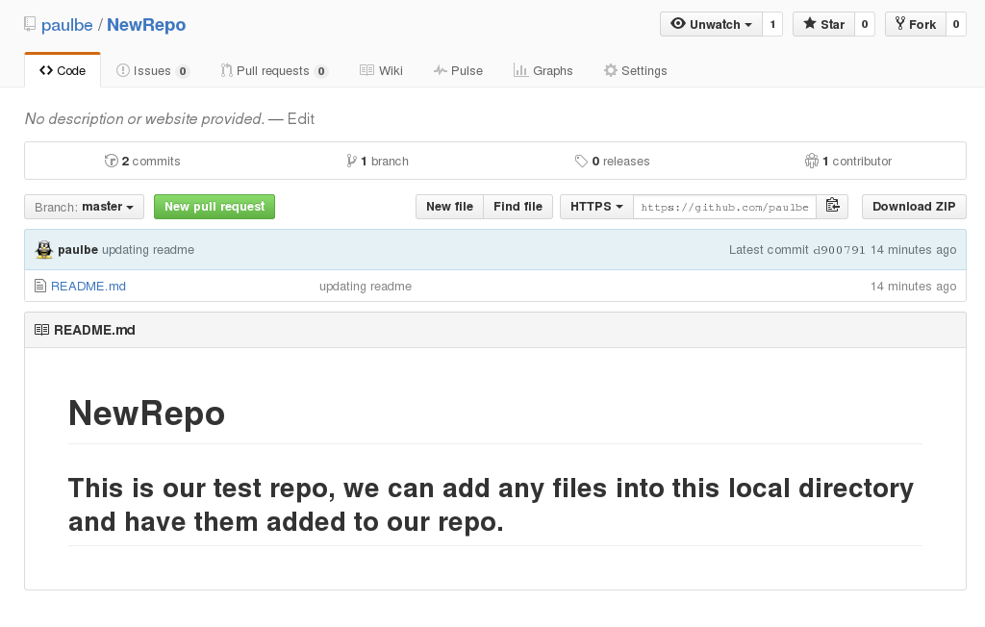

Slide 20
That Is It!
So using git/github is fairly simple, however it can become more complex.
What I have shown you today is the most basic usage that will get you by.
Remember we will have a presentation using this knowledge at our next meeting (at the library).

Slide 21
CLUG Info
Chat almost any time on IRC
  Server: irc.freenode.net
  Channel: #cochiselinux
  If you need help getting an IRC client working / configured, feel free to ask.
Website
  Cochiselinux.com
Mailing List
  Directions to sign up for the mailing list can be found on the website.

Slide 22
Questions / Comments

