Slide 1

INTRODUCTION TO LINUX

Slide 2

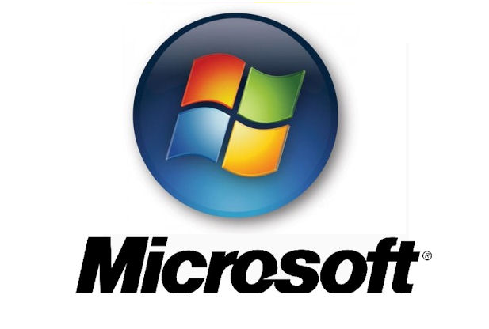

COMPUTER OPERATING SYSTEMS
MICROSOFT WINDOWS
APPLE OS
LINUX

Slide 3
EVERYDAY LINUX
Did you know..
  1.3 million android phones are activated everyday
  100% of the 500 super computers run Linux
  Most of the stock exchanges worldwide run on Linux
  700,000 TV's are sold everyday that run on Linux
  Google, Twitter, Facebook, Amazon use Linux
  IBM uses Linux
  McDonald’s uses Linux

Slide 4
EVERYDAY LINUX II
US Navy Submarines, NASA, Traffic Control Systems run on Linux based system
Self-driving cars
GPS – Garmin and TomTom
USPS and banking industry in most counties
Wikipedia, Pizza Hut, and Japan’s bullet trains
Cisco, the networking giant, completely Linux based

Slide 5
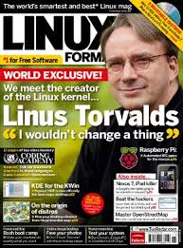
LINUX ORIGINS
Linux started out as a college project for Linus Torvalds in Helsinki, Finland. He was curious about operating systems and frustrated with the licensing of MINIX, which was limited to educational use only.
He began to work on his own operating system kernal, which eventually became the Linux kernal.
He said, “I'm not doing anything big, I'm just having fun!”
That was in 1991, and look at it now!

Slide 6
LINUX FILE SYSTEM
SYSTEM WIDE---> ROOT
FILES SYS CONFIG FILES
LINUX OS----->
H0ME----------------->SYS FILES
PERSONAL FILES

Slide 7
THINGS YOU CAN CHANGE
WEB BROWSER
FILE MANAGER
WINDOW MANAGER
DESKTOP
CONTROLS
APPLICATIONS

Slide 8
WEB BROWSERS
FIREFOX
CHROMIUM
CHROME
OPERA
MIDORI
KONQUEROR

Slide 9
FILE MANAGERS
NAUTILUS
DOLPHIN
THUNAR
PCMAN

Slide 10
WINDOW MANAGERS
METACITY
KDE WINDOW MANAGER
Xfwm4
OPENBOX
COMPIZ

Slide 11
LINUX DESKTOP ENVIRONMENTS
GNOME
UNITY
KDE
XFCE
LXDE
MATE
CINNAMON
ENLIGHTENMENT (MOKSHA)
BUDGIE

Slide 12
APPLICATIONS
ACCESSORIES
GRAPHICS
INTERNET
OFFICE
SOUND AND VIDEO
SYSTEM TOOLS

Slide 13
MAJOR LINUX OS
DEBIAN ( Buster, Bullseye & Sid)
FEDORA (RED HAT)
MANDRIVIA (MAGEIA, PCLINUX)
LINUX MINT
OPEN SUSE
UBUNTU (UBUNTU, KUBUNTU, XUBUNTU, EDUBUNTU, LUBUNTU, MATE UBUNTU, BUDGIE UBUNTU)
ARCH LINUX
GENTOO LINUX
SLACKWARE

Slide 14
ADVANTAGES OF LINUX
SAFER (MORE SECURE)
LESS EXPENSIVE (FREE)
EASY (EASIER)
FASTER
LESS RESOURCE INTENSIVE
INSTABILITY OF MICROSOFT
NO REQUIREMENT TO DEFRAG

Slide 15
ADVANTAGES OF LINUX II
UPDATES DAILY OR WEEKLY VS. MONTHLY
IT IS FREE
MOST DRIVERS INSTALLED BY DEFAULT
UPDATE WITH SINGLE CLICK
NO NEED TO BUY NEW COMPUTERS
BUG REPORTING/PATCHING
TOO MANY OPEN WINDOWS – TRY USING WORK SPACES

Slide 16
DISADVANTAGES OF LINUX
WILL NOT RUN SOME MICROSOFT WINDOWS SOFTWARE
MIGHT NEED AN EXPERT WITH SOME SYSTEMS
FEAR – NEED TO LEARN SOMETHING NEW

Slide 17
WHAT DO YOU USE A COMPUTER FOR?
SURFING THE INTERNET
E-MAILING / INSTANT MESSAGING
WORD PROCESSING
PHOTO EDITING

Slide 18
VIRUSES/MALWARE
FIREWALL
VIRUSES/MALWARE
FIREWALL

Slide 19
CLUG RESOURCES
CLUG IRC CHANNEL:
#cochiselinux on FREENODE.NET
CLUG WEB SITE:
https://cochiselinuxusergroup.org/
CLUG MAILING LIST:
cochiselinux@freelists.org
POC:
majb@azloco.com

