Slide 1

Introduction To The Terminal II

Slide 2
Linux File Permissions and Ownership
By design, Linux is a multi-user operating system. In an enterprise system, there would be multiple users accessing the same system. But if any user could access and modify all files belonging to other users or system files, this would certainly be a security risk.
This is why UNIX and thus Linux (Linux is a Unix-like system) has built-in security measure in place. This ensures that a file or directory can be accessed, modified or executed by only desired user or users.

Slide 3
Linux File Permissions and Ownership
Which file would be accessed by which user is decided by two factors in Linux:
File ownership
File permission
Understanding file ownership and permission is thus crucial for a Linux user.

Slide 4
Linux File Permissions and Ownership
File ownership in Linux
File permissions in Linux
Understanding file permissions and ownership in Linux
Change file permissions in Linux
Change file ownership in Linux

Slide 5
File ownership in Linux
User
User is the owner of the file. When you create a file, you become the owner of the file.

Slide 6
File ownership in Linux
Group
Every user is part of a certain group(s). A group consists of several users and this is one way to manage users in a multi-user environment.
Even if you are the only user of the system, you’ll still be part of many groups.

Slide 7
File ownership in Linux
Other
‘Other’ can be considered as an all inclusive group with all the users on the system. Basically, anyone with access to the system belongs to this group.

Slide 8
File Permissions in Linux
Every file and directory in Linux has the following three permissions for the three kinds of owners:
Permissions for files
Read – Can view or copy file contents
Write – Can modify file content
Execute – Can run the file (if its executable)
Permissions for directories
Read – Can list all files and copy the files from directory
Write – Can add or delete files into directory (needs execute permission as well)
Execute – Can enter the directory

Slide 9
Understanding file permissions and ownership in Linux
You can use the ‘ls command’ to check the file permissions.
If you use the ls command with option -l on a file (or a directory) you will see something like this:

Slide 10
Understanding file permissions and ownership in Linux
rex@rex-M141:~$ ls -l
total 32
drwxrwxr-x 2 rex rex 4096 Apr 9 10:16 Desktop
drwxr-xr-x 30 rex rex 4096 Jun 8 06:59 Documents
drwxr-xr-x 3 rex rex 4096 Jul 5 07:57 Downloads
drwxr-xr-x 6 rex rex 4096 Sep 16 2020 Music
drwxr-xr-x 28 rex rex 4096 Apr 25 13:51 Pictures
drwxr-xr-x 4 rex rex 4096 Feb 18 14:36 snap
drwxr-xr-x 2 rex rex 4096 Apr 25 12:53 Templates
drwxr-xr-x 12 rex rex 4096 Dec 28 2020 Videos

Slide 11
Permissions
r = Enables permission for reading
w = Enables permission for writing
x = Enables permission for execution
If there is a – in place of the r, w, or x, it means that there is no permission to do that particular item.

Slide 12
Permissions
drwxrwxr-x 2 rex rex 4096 Apr 9 10:16 Desktop
What does all this mean
The leftmost or the first character indicates if the permission is for a file or a directory. The first character d indicates a directory. If it were a – it would be a file

Slide 13
Permissions
drwxrwxr-x 2 rex rex 4096 Apr 9 10:16 Desktop
The next three characters are the owners permissions
The following three characters are the group permissions
The last three characters are others permissions

Slide 14
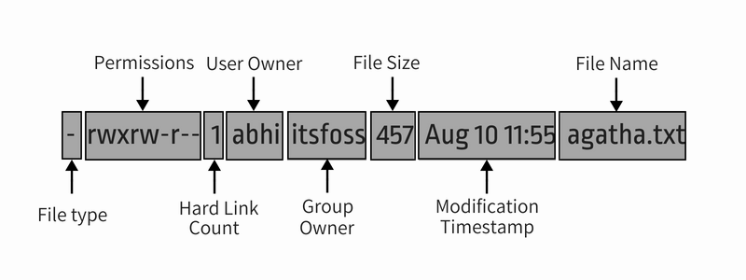
Understanding file permissions and ownership in Linux

Slide 15
Understanding file permissions and ownership in Linux
File type: Denotes the type of file. d means directory, – means regular file, l means a symbolic link.
Permissions: This field shows the permission set on a file.
Hard link count: Shows if the file has hard links. Default count is one.
User: The user who owns the files.
Group: The group that has access to this file. Only one group can be the owner of a file at a time.
File size: Size of the file in bytes.
Modification time: The date and time the file was last modified.
Filename: Obviously, the name of the file or directory.

Slide 16
Changing File Permissions in Linux
There are three ways to change file permissions.
Two involve using the CLI and one using GUI.

Slide 17
Changing File Permissions in Linux
To change file permissions use the chmod command
Example: chmod u=rwx,g=r,o=r [file name]
Where: u = user, g = group, and o = other
There are no spaces, only commas

Slide 18
Changing File Permissions in Linux
There is another way to do this using numeric values. This is the second CLI method. Where:
r = 4
w = 2
x = 1
- = 0

Slide 19
Changing File Permissions in Linux
The previous command was:
chmod u=rwx,g=r,o=r [file name]
It can also be: chmod 744 [file name]
You simply add the three digits
Read, write, and execute = 7
Read and write = 6
Read and execute = 5
Read only = 4
If you want to protect your home directory (or any file or directory) from all others, you could assign permissions as: chmod 700 rex. Then only you can even see the home directory

Slide 20
Changing File Permissions in Linux
If you want to protect your home directory (or any file or directory) from all others, you could assign permissions as: chmod 700 rex. Then only you can even see the home directory
If you want to protect a directory and all the directories and files in that directory you would assign permissions as : chmod -R 700 rex
That will recursively assign the same permission to all of the contents.
See chmod –help in the man pages for more information.

Slide 21
Changing Ownership of a File
In Linux and Unix-like operating systems, all files, directories and processes (which are again files) are owned by users. The group is a set of users that share the same access permissions (i.e read, write and execute) for those objects (files/directories).

Slide 22
Changing Ownership of a File
To change the ownership of a file, type:
chown (new owner) (name of file)
To change the group ownership, type:
chgrp (new group) (name of file)
These commands are mainly used by system administrators and are only provided to you for information.

Slide 23
Gaining root privileges
There are times when you need to run commands as root and we have already discussed some of those.
Because root is so powerful, it's recommended to only request root access when necessary, as opposed to logging in as the root user.
Proceeding your command with sudo and then entering your password will give you root privileges for a short period of time. THIS IS THE RECOMMENDED WAY.

Slide 24
Gaining root privileges
If you open a terminal and type: sudo -i and then press enter, you will be prompted for your password. After you have entered it you will notice that the command line prompt ends in # rather than $
You now have a root shell so be very very careful. Again this is not the recommended way but you will not have to type in sudo for every command.
To leave the root shell type: exit You will return to the normal prompt. (which ends in $)
AGAIN THIS IS NOT RECOMMENDED!!! Using the root terminal can cause irreparable damage to your system if the wrong commands are entered.

Slide 25
Introduction To The Terminal II

