Slide 1

Using LibreOffice Calc

Slide 2
Background
LibreOffice Calc is the spreadsheet component of the LibreOffice software package
After forking from OpenOffice.org in 2010, LibreOffice Calc underwent a massive re-work of external reference handling to fix many defects in formula calculations involving external references, and to boost data caching performance, especially when referencing large data ranges

Slide 3
Free And Open Source
As with the entire LibreOffice suite, Calc is available for a variety of platforms, including Linux, macOS, Microsoft Windows, and FreeBSD

Slide 4
Capabilities
Calc is capable of opening and saving most spreadsheets in Microsoft Excel file format.
Calc is also capable of saving spreadsheets as PDF files

Slide 5
Features
Ability to read/write OpenDocument (ODF), Microsoft Excel (XLSX), CSV, and several other formats
Support for many functions, including those for imaginary numbers, as well as financial and statistical functions
Supports 1,048,576 rows and 16384 columns in a spreadsheet, making LibreOffice spreadsheets more suitable for heavier scientific or financial spreadsheets. Version 7.0 introduced "very large spreadsheets" which can be enabled as an experimental feature. Version 7.4 made very large spreadsheets default

Slide 6
Documentation
If you want to download the latest Calc manual go to https://documentation.libreoffice.org/en/english-documentation/
There you will find all of the manuals for the components of LibreOffice and you can download any that you want.

Slide 7
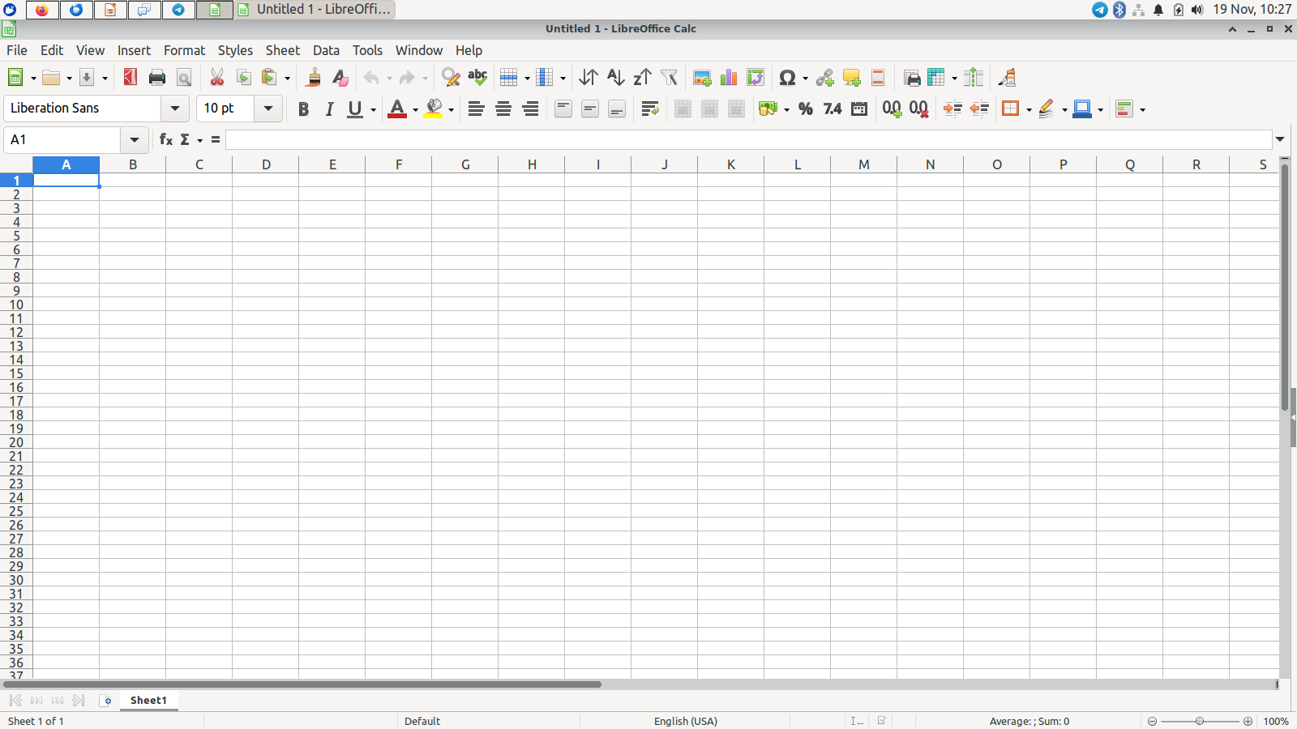
Calc Opening Page

Slide 8
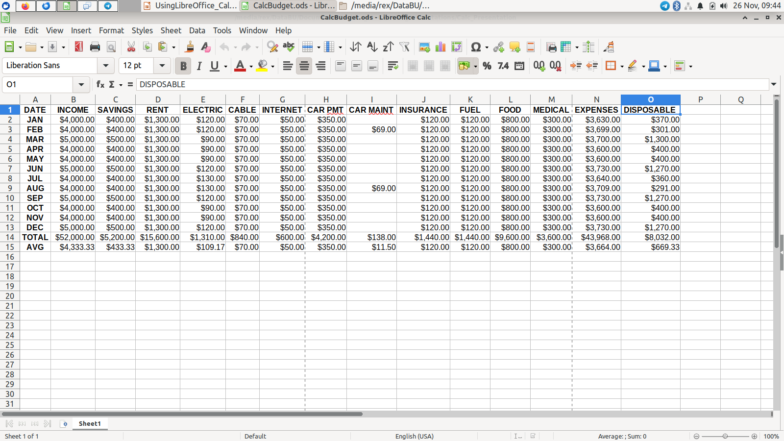
Calc-Budget

Slide 9
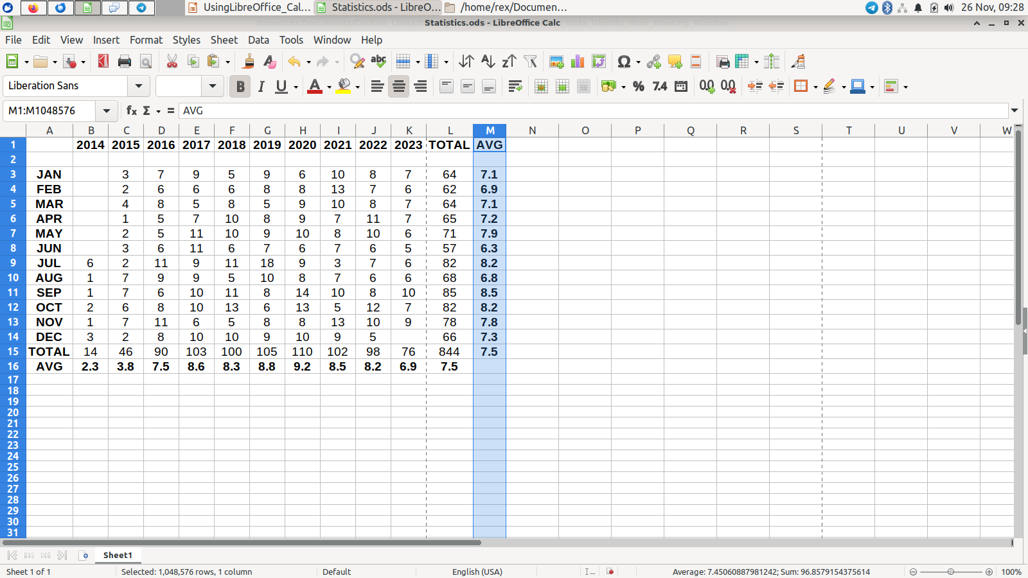
Calc-Attendance

Slide 10
Using LibreOffice Calc

