Slide 1

Cochise Linux User Group

Slide 2
How to Check Out a Distro Before Download
You have succumbed to the disease commonly known as Distro Hopping
You can download the ISO of a new distro and try it out in a live environment or install it to a spare computer
There is a website that will enable you to check out a distro without downloading it

Slide 3
How to Check Out a Distro Before Download
Go to the following site
https://distrotest.net/index.php
Choose the distribution that you want to look at

Slide 4
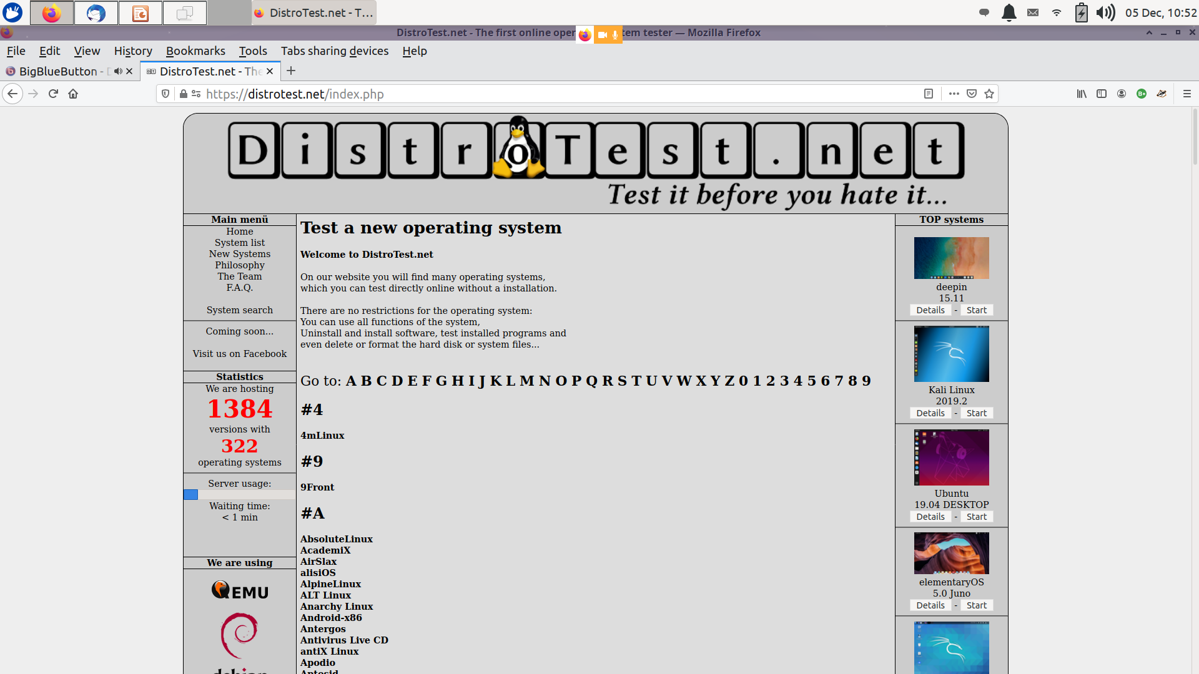
How to Check Out a Distro Before Download

Slide 5
How to Check Out a Distro Before Download
Select the first letter of the distribution
Then the distribution that you want to look at
And finally the version

Slide 6
How to Check Out a Distro Before Download
A live version will be on your desktop and will not change anything on your computer
You will be able to do anything with it as if you had downloaded the ISO, made a bootable flash drive, and booted from that flash drive.

Slide 7
How to Check Out a Distro Before Download
Slow system: The Operating system launched in the server runs very slow
Waiting Queue: Once you tab “system start” you enter a queue in which you are given a number, and no one knows how much time will it take till the other users shut down systems, however, for each user there is a time limit of 30 Minutes.
Server offline: When there is more traffic and heavy usage, the servers can go offline, but the support tries to fix the issue soon.

Slide 8
How to Check Out a Distro Before Download
Give it a try if plan to do some distro hopping

