Slide 1

Email and Thunderbird

Slide 2
Email Providers
Gmail
Outlook (Microsoft)
Yahoo
AOL
iCloud (Apple)

Slide 3
Types of Email
Post Office Protocal (POP)
Internet Message Access Protocol (IMAP)

Slide 4
POP
First released 1984
POP2 released 1985
POP3 released in 1988
No revision since 1998
There is work on POP4 but progressing slowly

Slide 5
IMAP
IMAP released in 1986
IMAP2 released in 1988 Revised in 1990. First widely used version
IMAP3 released 1991. Never caught on in the market place
IMAP2bis 1992
IMAP4 Merely a rename of IMAP2bis
IMAP4rev1 used today

Slide 6
POP vs IMAP
POP downloads email from the server and usually deletes it on server. In some cases you have the option to retain it on server
IMAP downloads the header only and all activity takes place on server. You can download the email to use off line but any permanent action must be done on server

Slide 7
POP vs IMAP
If you check email from only one device there is no reason not to use POP
If you access email from multiple devices then IMAP may be the correct choice

Slide 8
POP vs IMAP
You must be connected to server to read email using IMAP
Using POP the email is downloaded to your computer so connection is not required to read it once it has been downloaded.

Slide 9
Email Clients
An email client is the application that will get the email for you.
Thunderbird
Mailspring
Sylpheed
Mailbird
eM Client
Microsoft & Apple have their own built in email clients

Slide 10
THUNDERBIRD
Installed by default on many Linux operating systems
Can handle most if not all email providers
POP or IMAP
Can handle multiple email accounts

Slide 11
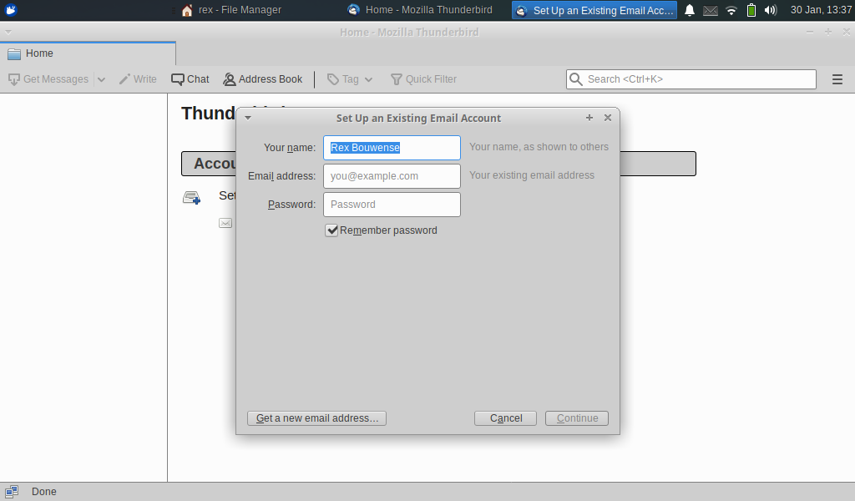
Set Up Existing Email Account-1

Slide 12
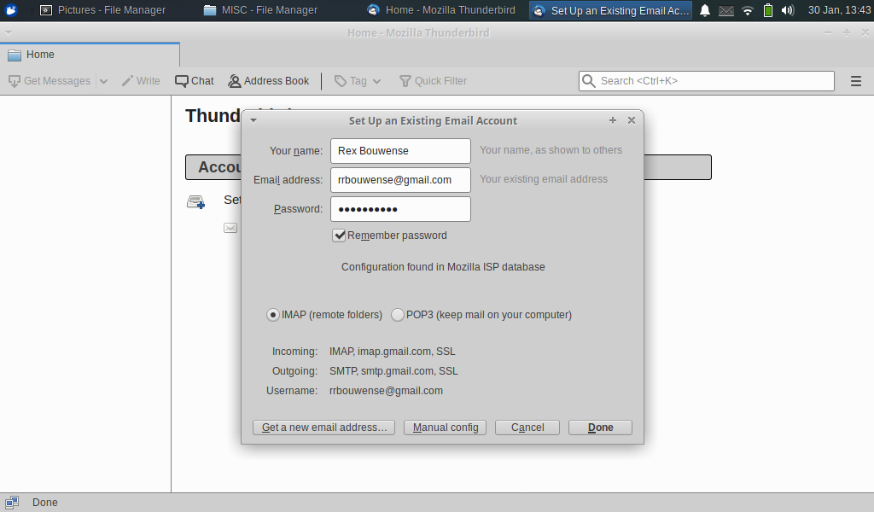
Set Up Existing Email Account-2

Slide 13
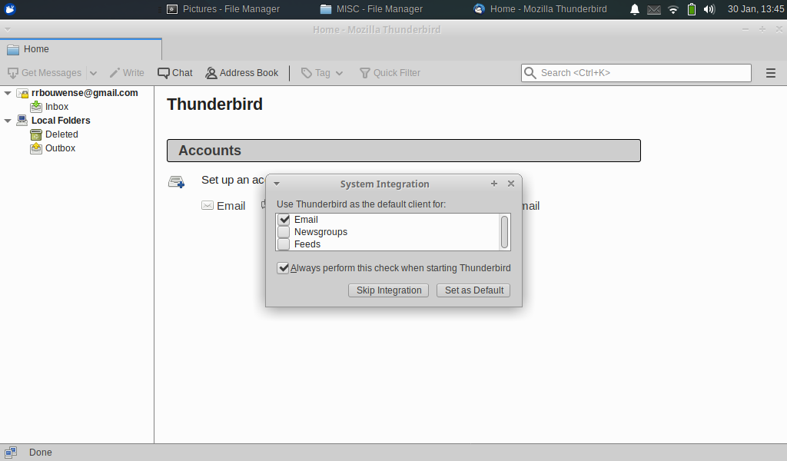
Set Up Existing Email Account-3

Slide 14
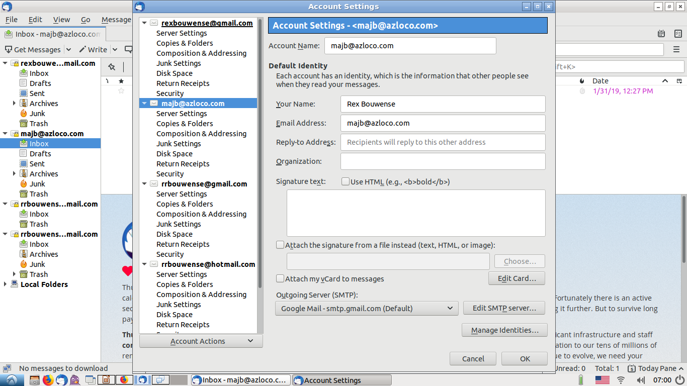
Thunderbird Account Settings

Slide 15
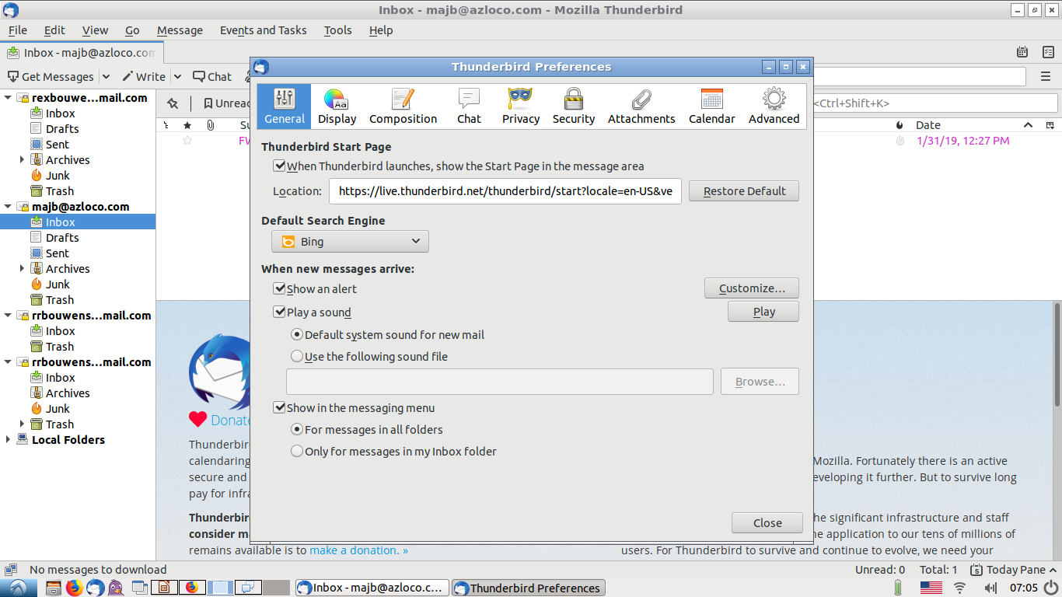
Thunderbird Preferences General

Slide 16
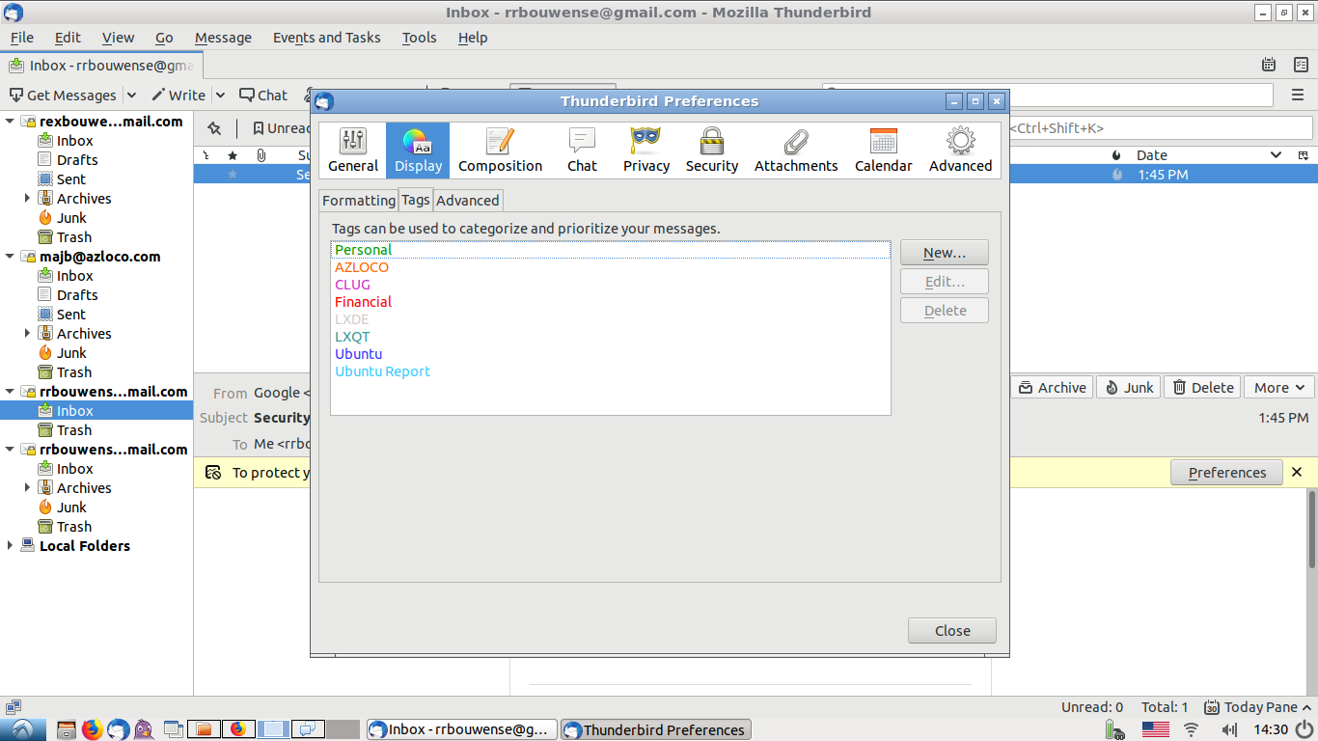
Thunderbird Preferences Display

Slide 17
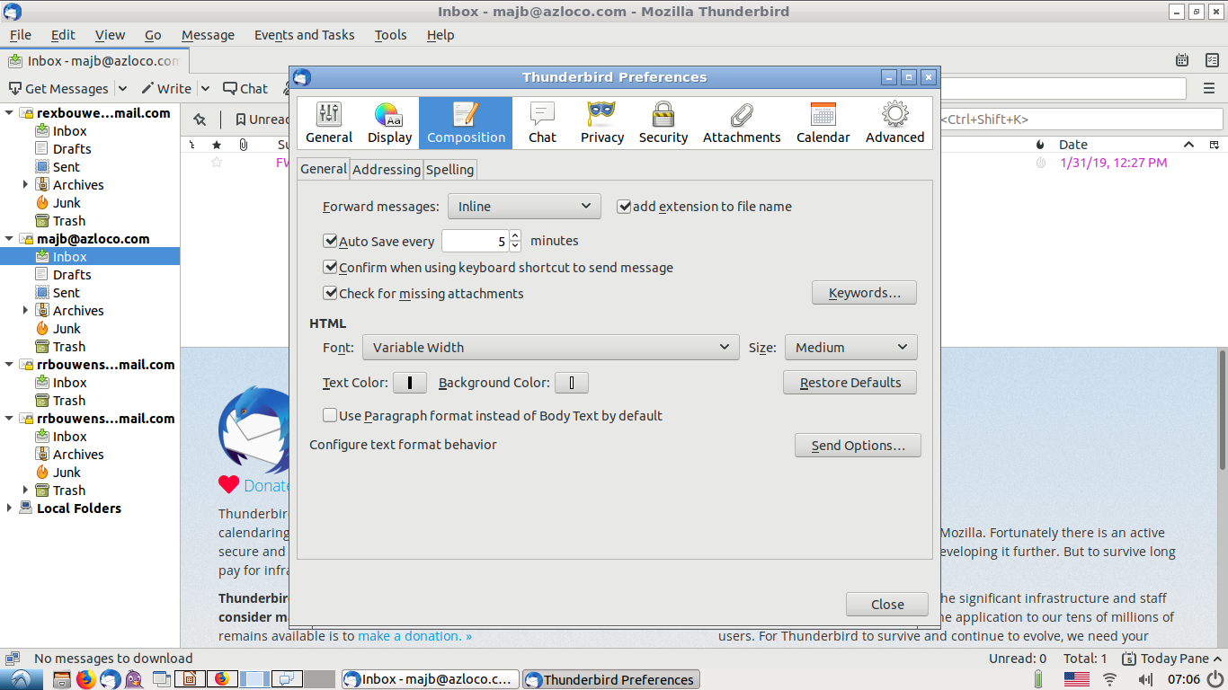
Thunderbird Preferences Composition

Slide 18
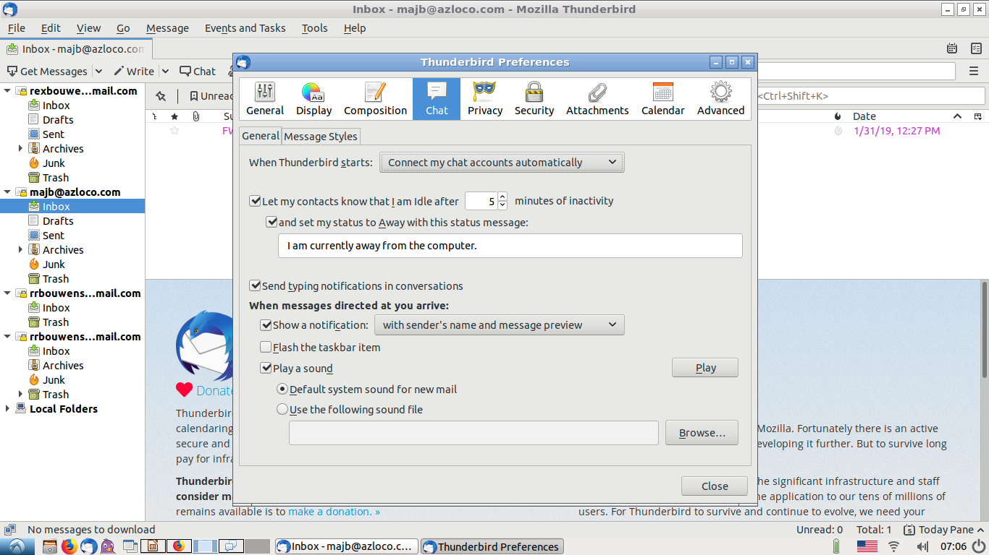
Thunderbird Preferences Chat

Slide 19
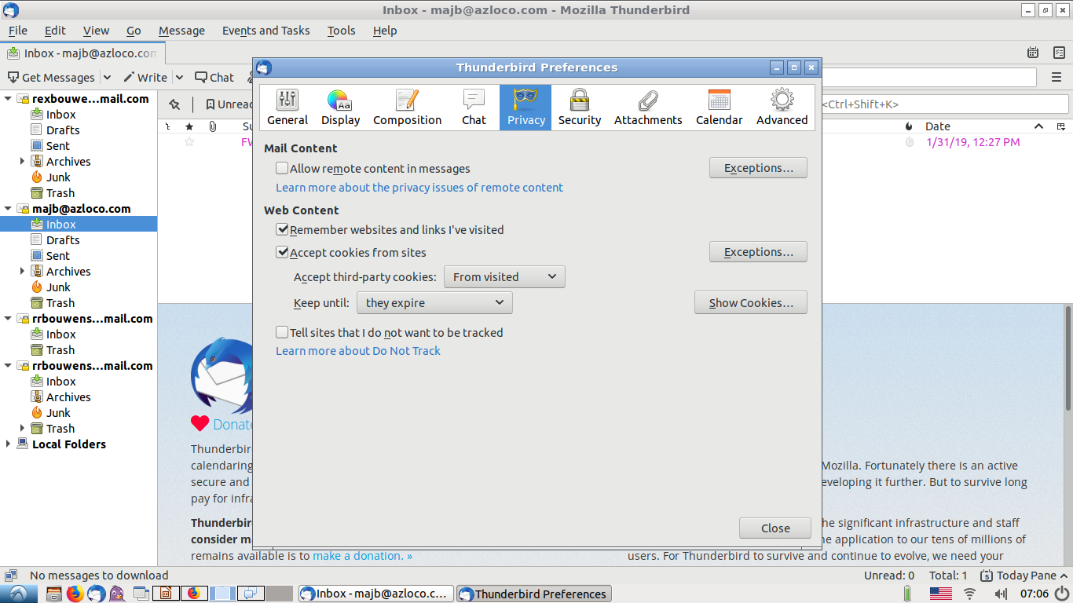
Thunderbird Preferences Privacy

Slide 20
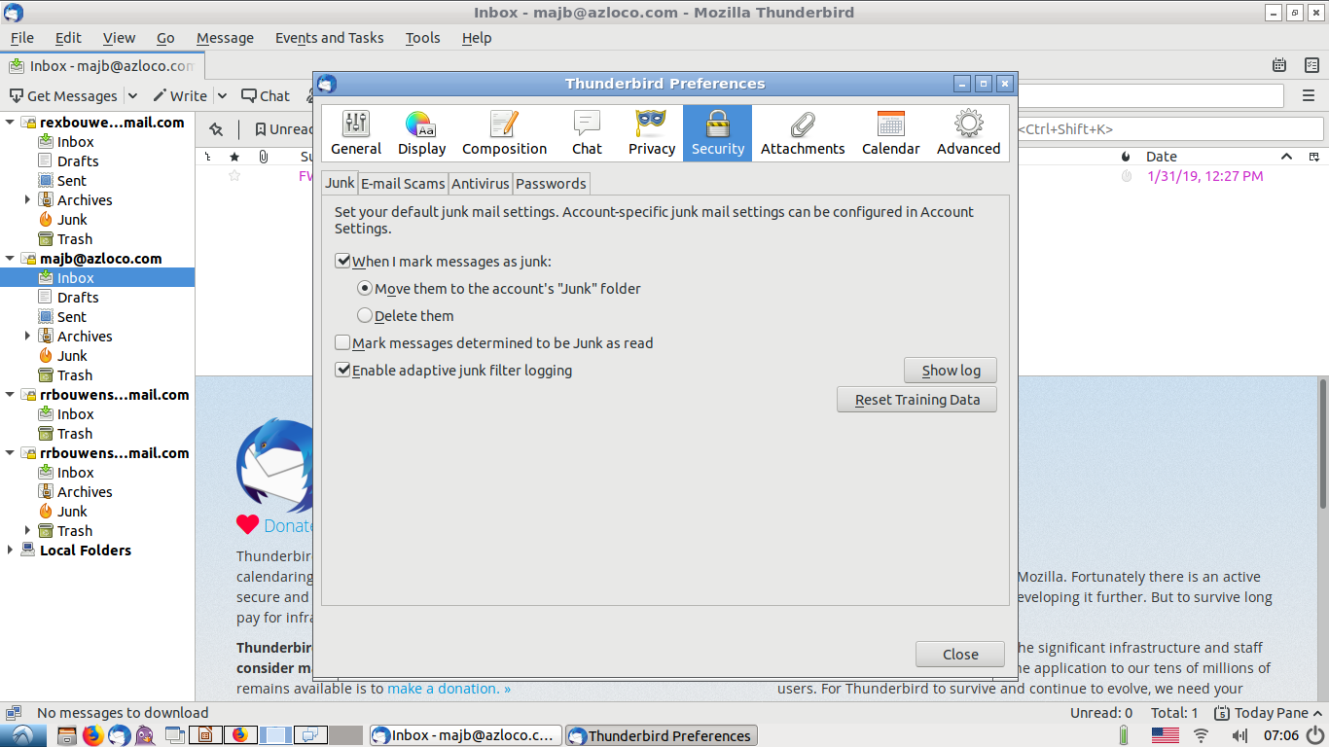
Thunderbird Preferences Security

Slide 21
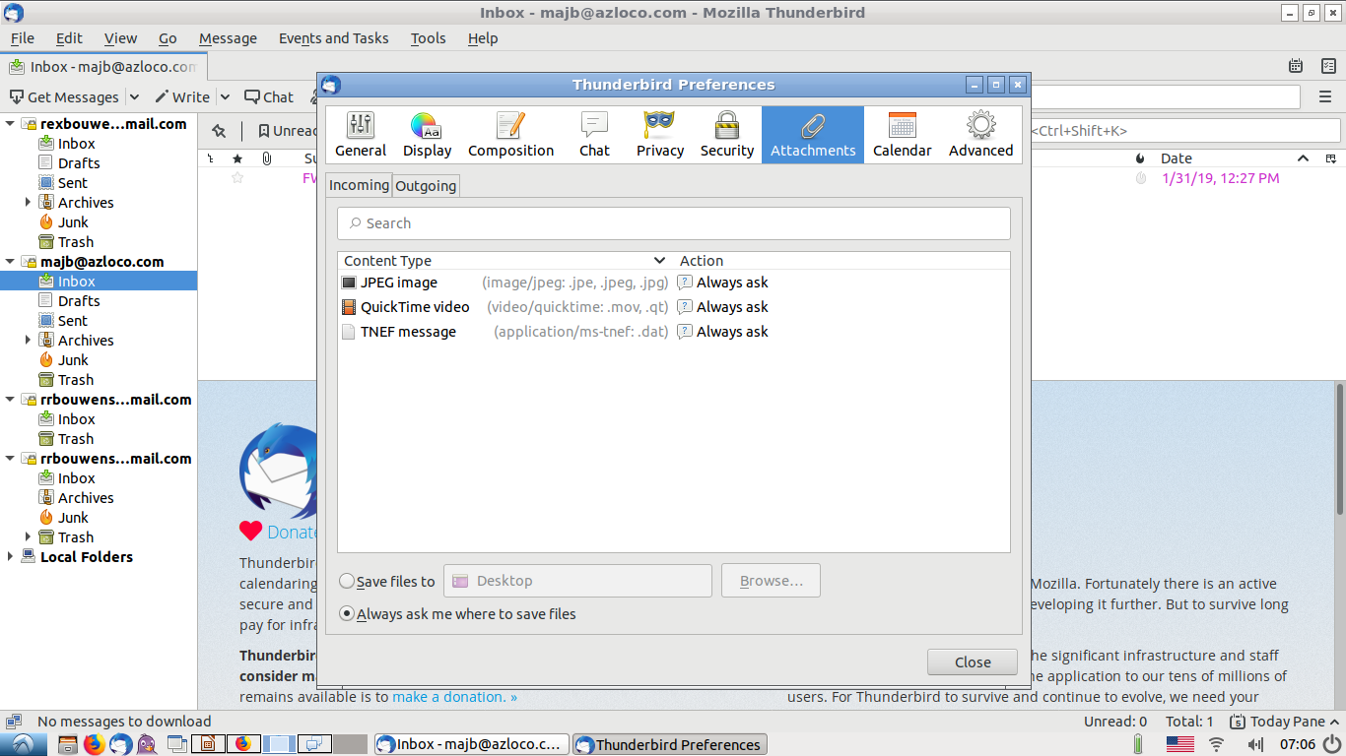
Thunderbird Preferences Attachments

Slide 22
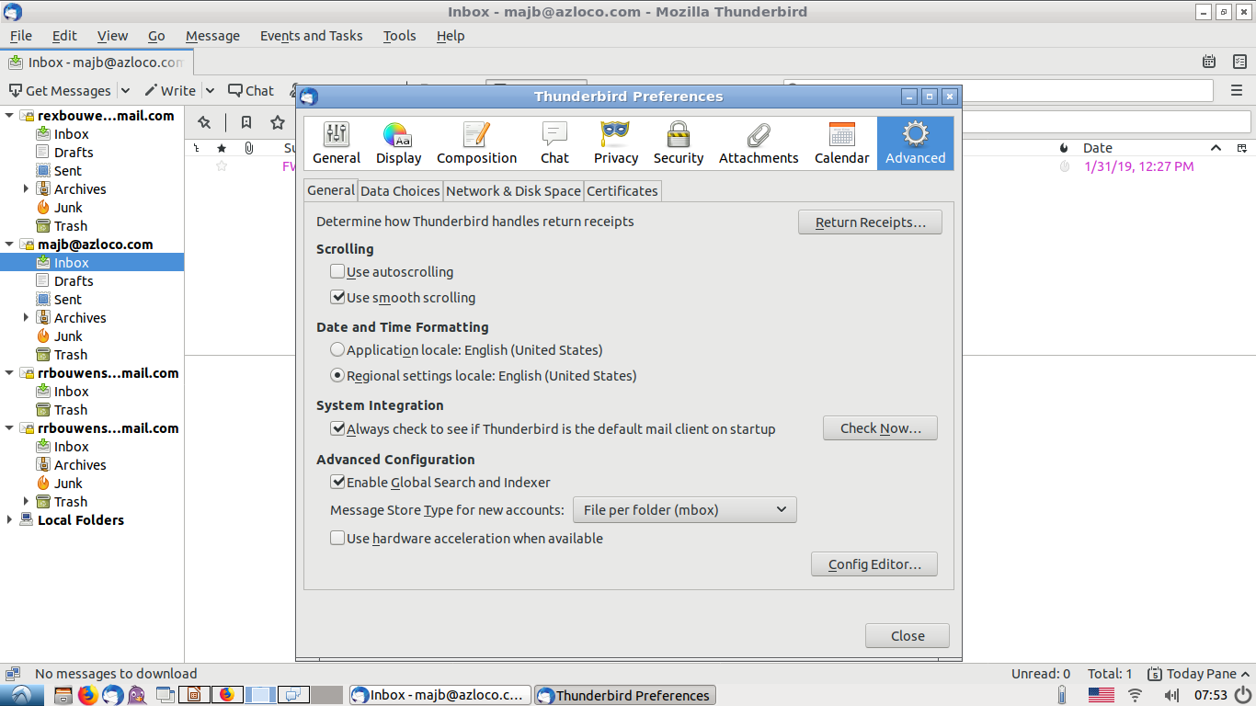
Thunderbird Preferences Advanced

Slide 23
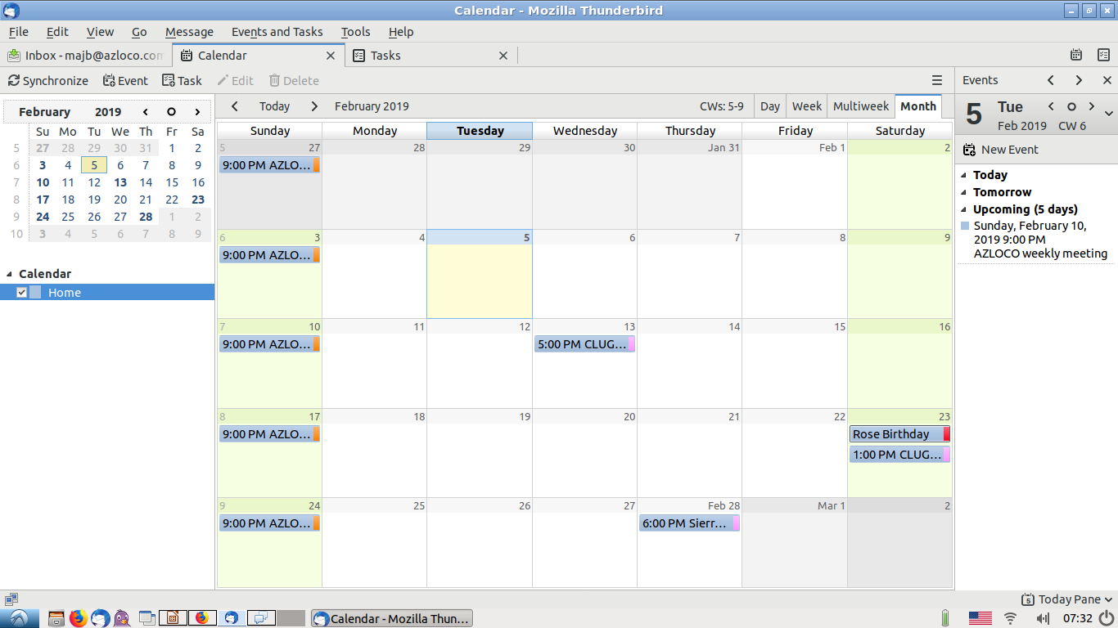
Thunderbird Calendar

Slide 24
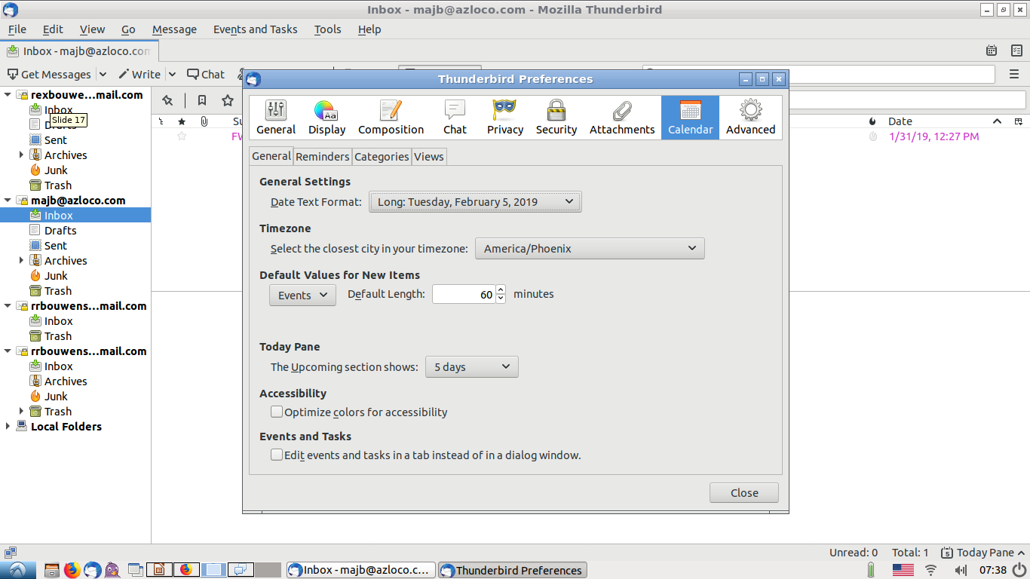
Thunderbird Preferences Calendar General

Slide 25
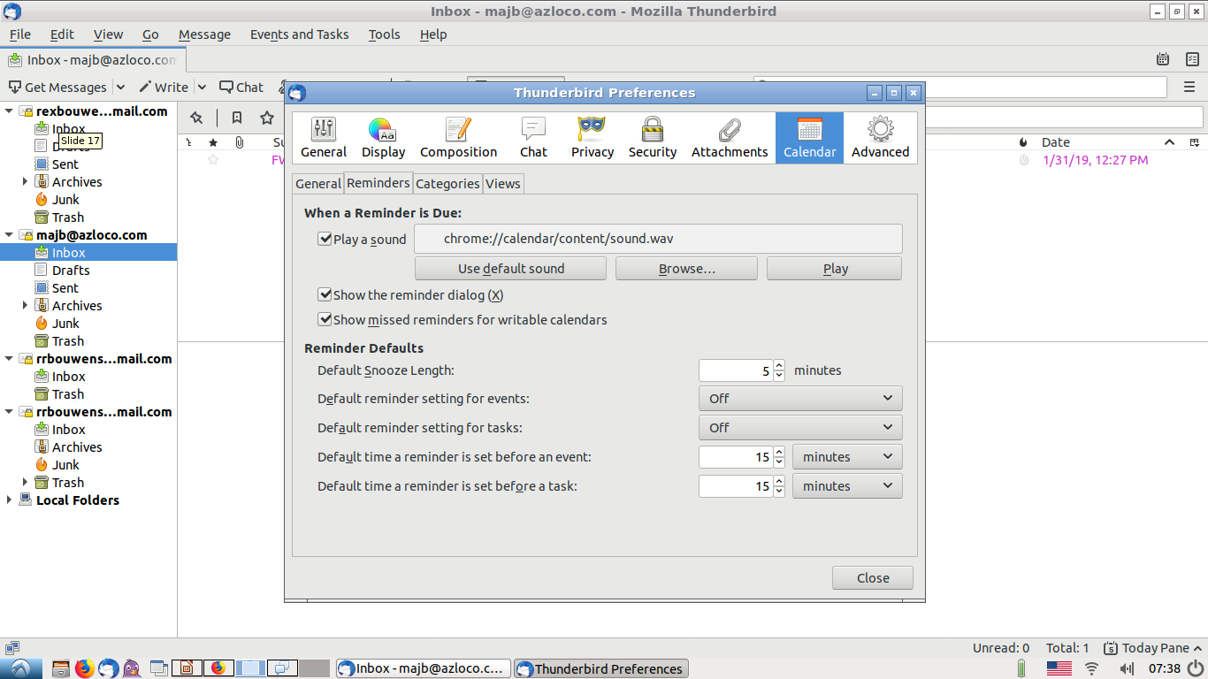
Thunderbird Preferences Calendar Reminders

Slide 26
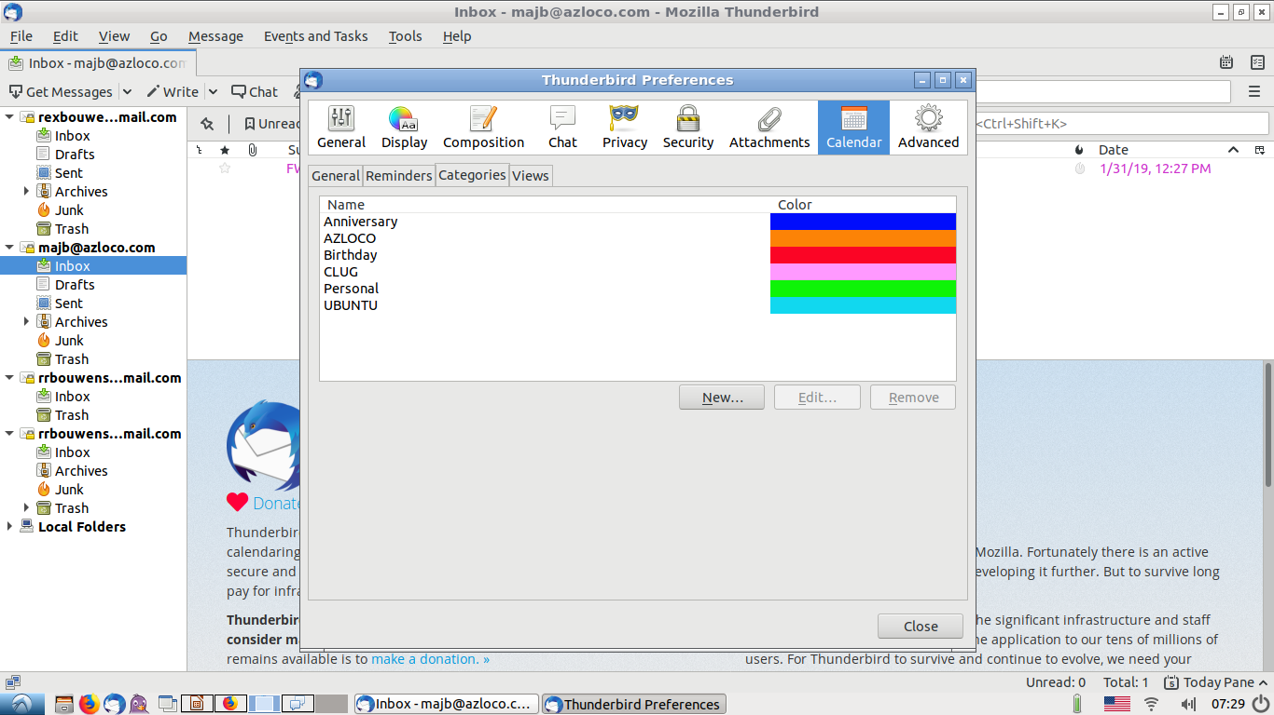
Thunderbird Preferences Calendar Categories

Slide 27
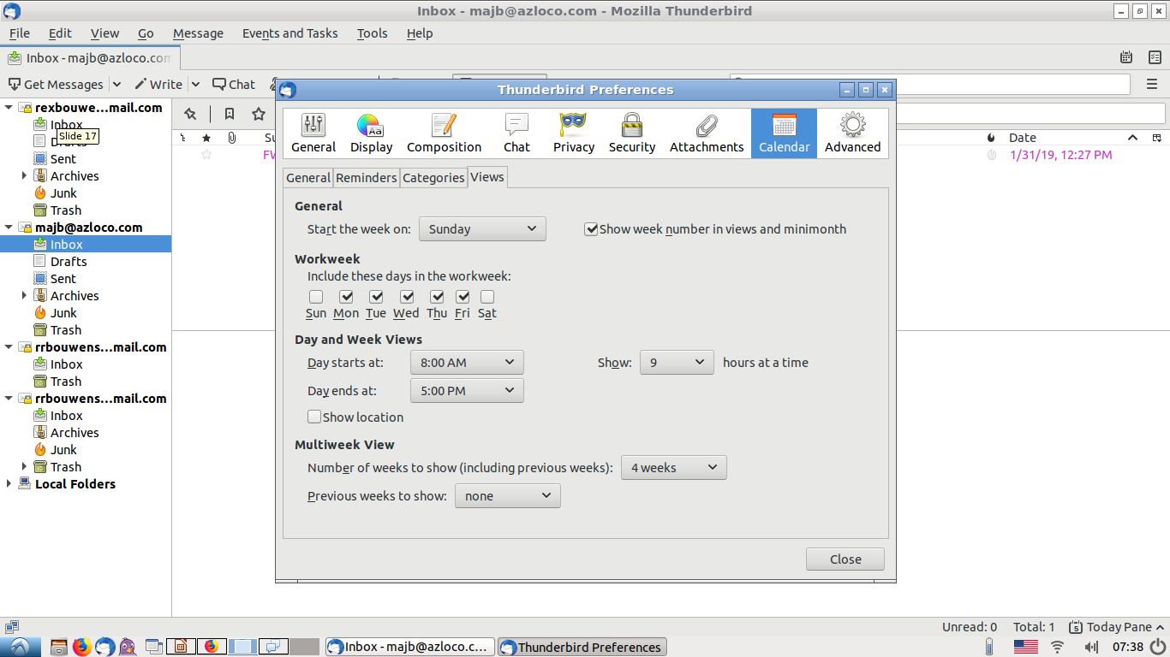
Thunderbird preferences Calendar Views

Slide 28
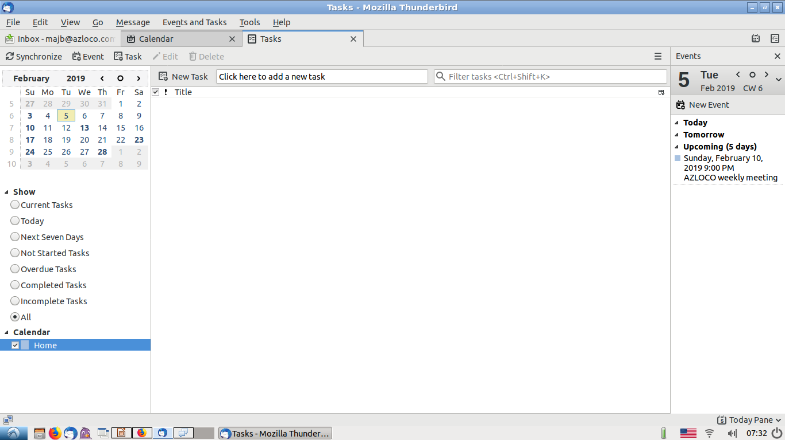
Thunderbird Tasks

Slide 29
Email and Thunderbird
What are your questions?

