Slide 1

Cochise Linux User Group

Slide 2
Upcoming Events
Sierra Vista Ubuntu Hour,
Schlotzsky’s, 3900 E. Fry Blvd.
10 December 1800-1900
Cochise Linux User Group meeting
Location: 143 Street Tacos, 80 S. Carmichael Ave.
19 December 1300-1545

Slide 3
Useful CLUG Links
CLUG Website: https://cochiselinuxusergroup.org/
CLUG FaceBook page: https://www.facebook.com/groups/1059259857477393/
CLUG Mailing List Archives: https://www.freelists.org/archive/cochiselinux

Slide 4
Useful AZLOCO Links
AZLOCO Website: https://www.azloco.org/
AZLOCO wiki page: https://wiki.ubuntu.com/ArizonaTeam
AZLOCO FaceBook page: https://www.facebook.com/UbuntuAZTeam
AZLOCO Mailing List Archives: https://lists.ubuntu.com/archives/ubuntu-us-az/

Slide 5
How to Install Ubuntu to a Flash Drive

Slide 6
How to Install Ubuntu to a Flash Drive
This is based on a 16GB target drive. You will have to adjust for larger drive.
This process seems to be long and involved, but should only take less than ten minutes to do the work.

Slide 7
How to Install Ubuntu to a Flash Drive
Create a Live USB or DVD using SDC, Unetbootin. Mkusb, dd, etc.
If you want the USB to have the ability to boot ISO files using GRUB, create the boot drive using mkusb with the usb-pack-efi option. (This replaces GRUB 2.04 with 2.02).
Alternatively you can put rmmod tpm anywhere above the first menu entry in grub.cfg.

Slide 8
How to Install Ubuntu to a Flash Drive
Turn off and unplug the computer.
Unplug the power cable from the hard drive or unplug the hard drive from the laptop.

Slide 9
How to Install Ubuntu to a Flash Drive
You may omit disabling the hard drive in BIOS boot if after partitioning you choose to install grub to the root of the USB drive you are installing Ubuntu to, (ie sdx not sd1). Be cautious. Many people have overwritten the HDD MBR as default location for boot loader is sda, any items in the internal drive’s grub will be added to the USB’s grub. You may do an update-grub later. If you leave the HDD plugged in with UEFI install, fstab may use the HDD’s UUID for /boot/efi. In this case # or delete the /boot/efi UUID line in fstab.

Slide 10
How to Install Ubuntu to a Flash Drive
Plug the computer back in.
Insert and boot the Live USB or Live DVD.

Slide 11
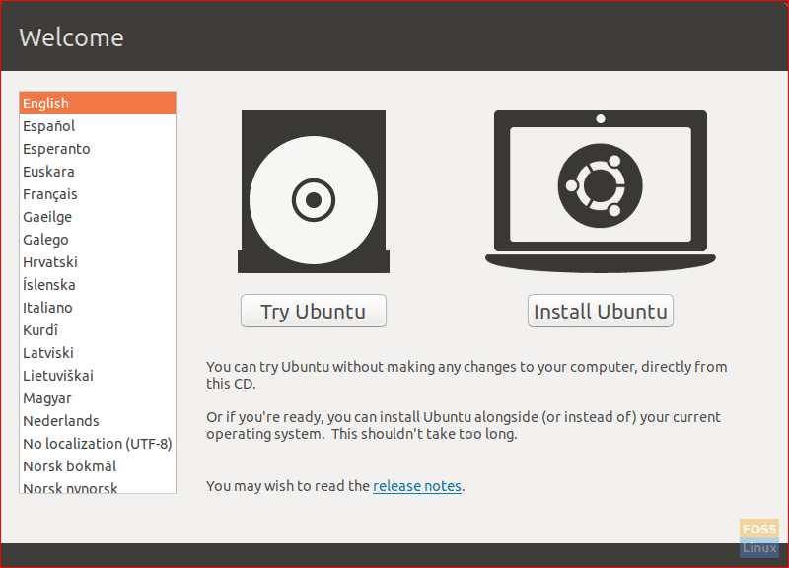
How to Install Ubuntu to a Flash Drive
Select Language and Try Ubuntu.

Slide 12
How to Install Ubuntu to a Flash Drive
Now you are in the Ubuntu Live System.
Insert the target flash drive.
Start Gparted.

Slide 13
How to Install Ubuntu to a Flash Drive
Unmount any mounted partitions.
Select Device tab and create a GPT partition table on the Target drive.

Slide 14
How to Install Ubuntu to a Flash Drive
Create a 3 GB NTFS or FAT32 partition on the right side, (optional Linux/Windows data partition).
Create a 1 MB partition on the left side, format as unformatted.
Create a 300 MB FAT32 partition next to the 1 MB partition.
Create a 7 GB Ext4 partition next to the 300 MB partition.
In the remaining space create an ext4 partition, (optional for /home partition). If no separate /home is desired then this space should be included in the above Ext4 partition.

Slide 15
How to Install Ubuntu to a Flash Drive
Apply All Operations
Flag the 1 MB partition as bios_grub
Flag the 300 MB partition as boot,esp.

Slide 16
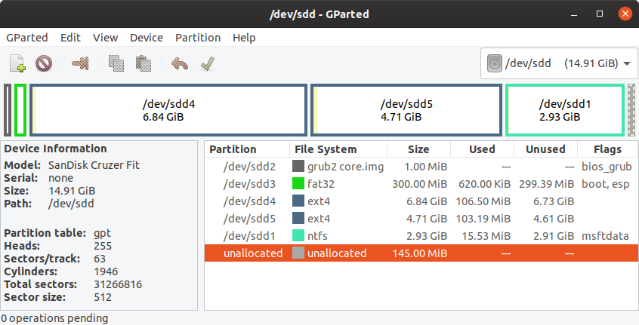
How to Install Ubuntu to a Flash Drive

Slide 17
How to Install Ubuntu to a Flash Drive
Start Install Ubuntu.
Select Language, click “Continue”.
Select Keyboard layout, click “Continue”.
Select Wireless network, click “Continue”. (Optional).

Slide 18
How to Install Ubuntu to a Flash Drive
Select installation preference and select “Download updates while installing Ubuntu” (optional), and select “Install third-party software…” (optional), click “Continue”.
If asked about mounted partitions, select Yes, click “Continue”.

Slide 19
How to Install Ubuntu to a Flash Drive
Do not use Advanced feature disk encryption for this install method.
At “Installation type” select “Something else”, click “Continue”.

Slide 20
How to Install Ubuntu to a Flash Drive
Under Device for boot loader installation select the target drive.
Select partition sdx and click change, select use as Ext4, select format this partition, and Mount point = “/” then OK.
If asked to Write previous changes… click Continue.
*Select partition sdx5 and click change, select use as Ext4, select format this partition, and Mount point = “/home” then OK, (optional).

Slide 21
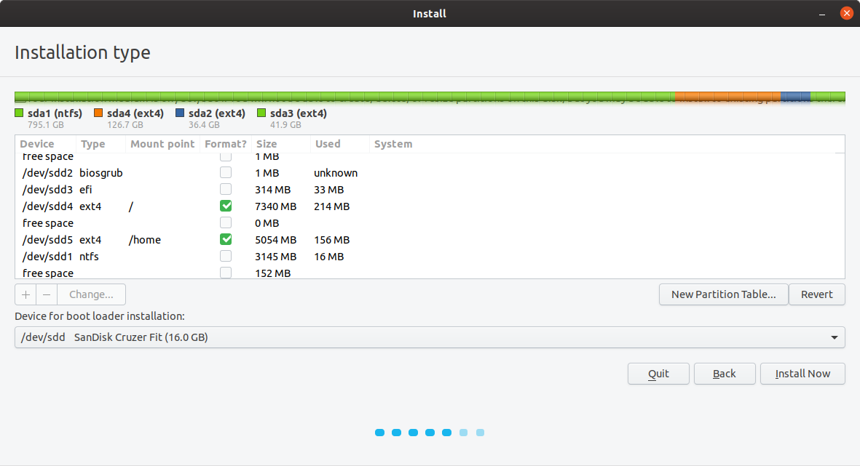
How to Install Ubuntu to a Flash Drive
Click Install now.

Slide 22
How to Install Ubuntu to a Flash Drive
Confirm partitions to be formatted if asked, click continue.
Select your location, click “Continue”.
Insert your name, computer name, user name, password and select if you want to log in automatically or require a password. - Click “continue”.
Wait until install is complete.

Slide 23
How to Install Ubuntu to a Flash Drive
Copy the boot and EFI folders from the Ubuntu ISO file to the boot,esp partition sdx3.
Copy grub.cfg from partition sdx4 boot/grub/ to partition sdx3 boot/grub/ overwriting the grub.cfg file

Slide 24
How to Install Ubuntu to a Flash Drive
Re-Install GRUB:
sudo mount dev/sdx3 /mnt
sudo grub-install –boot-directory=/mnt/boot dev/sdx
Turn off computer and plug in the HDD.
Replace the computer’s cover.

Slide 25
How to Install Ubuntu to a Flash Drive
Congratulations! You have now installed full Ubuntu on the USB Flash Drive.
If you didn’t disconnect your hard drive you MAY have to repair the boot loader on your computer.
https://askubuntu.com/questions/1217832/how-to-create-a-full-install-of-ubuntu-20-04-to-usb-device-step-by-step

Slide 26
Live USB With Persistence Pros
Takes less space
Can be used for installation
With persistence enable you can update *
Can run on almost any computer
The system is read only – Longer life

Slide 27
Live USB With Persistence Cons
Less secure
Not designed to be production vehicle
Slower bootup time
Once created distro becomes outdated
Updated/patched files will stored in persistence portion of the drive. * An installation will only be from the original ISO.

Slide 28
Install USB Pros
Faster boot time
More secure because user name and password are created.
The system can be updated just like an install to a HHD

Slide 29
Install USB Cons
Takes longer to install.
Difficult to move from computer to computer.
Shorter life span (because it is read and write)
Cannot use this USB to install to a computer.

Slide 30
How to Install Ubuntu to a Flash Drive
I have attempted five installations to a flash drive.
The first one took 3 hours and wouldn’t boot.
The second one took only 20 minutes screwed up the boot partition. I had to use boot repair to fix it but it still wouldn’t boot.
The third one took 41 minutes and was successful. I disconnected the hard drive on this one.
The fourth one took about 2 hours and while it booted it was so slow that it was unusable.
The fifth one took 74 minutes and was also successful. This attempt was also done with a disconnected hard drive.

Slide 31
Recommendations
Determine how you want to use the flash drive
Neither method is recommended as a production vehicle. To do that install the ISO to your hard drive or dual boot with your current system.
If you are using the live USB, download and re-create after each point release. Decreases the number of updates required after installation to a computer.

