Slide 1

Linux Desktop Environments

Slide 2
What is a Desktop Environment
A desktop environment is the bundle of components that provide you common graphical user interface (GUI) elements such as icons, toolbars, wallpapers, and desktop widgets.
Thanks to the desktop environment, you can use Linux graphically using your mouse and keyboard like you do in other operating systems like Windows and macOS.
Without a desktop environment, your Linux system would just have a terminal like utility and you would have to interact with it using commands only.

Slide 3
Desktop Environments
Many Linux distributions can be downloaded with the DE that you want by default.
Example: Ubuntu can be downloaded with Gnome, KDE, Xfce, Mate, Budgie, LXQT, Cinnamon, Kaylin, and Unity
Example: Linux Mint can be downloaded with Cinnamon, Xfce, and Mate
Some like Arch or Debian will ask you which one you want
If your distro does not have that capability you can install the DE you want manually

Slide 4
Desktop Environments
GNOME
KDE Plasma
xfce
lxde
Cinnamon
Mate
Budgie
LXQT
Enlightenment/Moksha
Trinity
Pantheon
Deepin

Slide 5

GNOME

Slide 6
GNOME
GNU Object Model Environment
Created in 1997 as an alternative to the K desktop (predecessor to KDE)
Current version GNOME 46
Pure GNOME does not have a dock. (Ubuntu does)
Can extend functions through GNOME Shell Extensions
Click on Activities and it shows all open apps, workspaces, and installed apps. (No real start menu)
Has a small panel on top with no app launchers
Not suitable for older computers with less than 4 Gbs of RAM

Slide 7
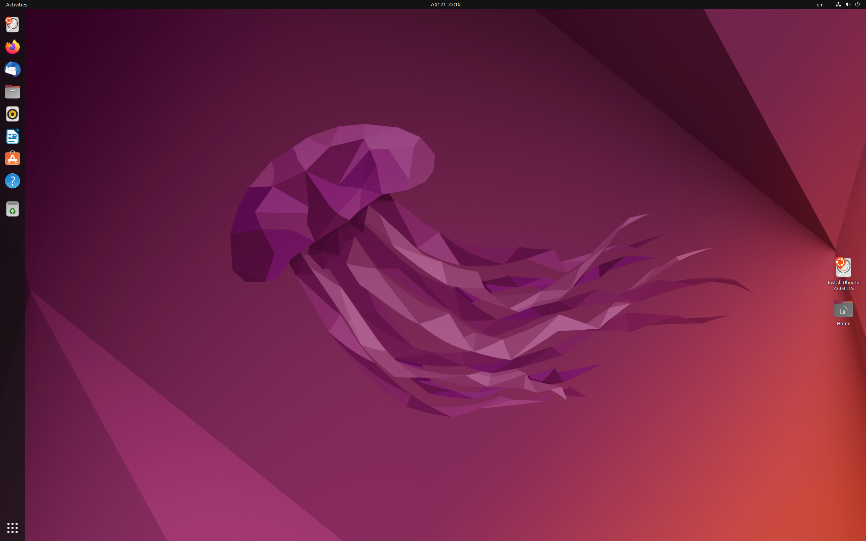
Gnome DE (Ubuntu)

Slide 8

KDE

Slide 9
KDE Plasma
First released in 1998 as Kool Desktop Environment
Completely customizable however the options and tools might be a little overwhelming for newbies, leading to potential confusion
Generally has its own applications that start with a K but has support for GNOME applications
No longer as resource heavy as it used to be. In some tests it has been shown to be lighter than xfce
Has a start menu and app launchers on panel

Slide 10
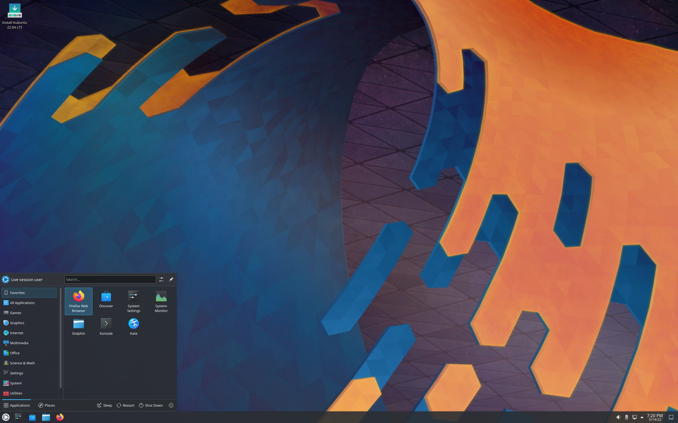
KDE Plasma (Kubuntu)

Slide 11

xfce

Slide 12
xfce
Initially released in 1997 (Xforms Common Environment)
Very low resource requirement
Not as customizable as some of the other DE’s
Uses a panel and app launchers
Included as default DE in many distros

Slide 13
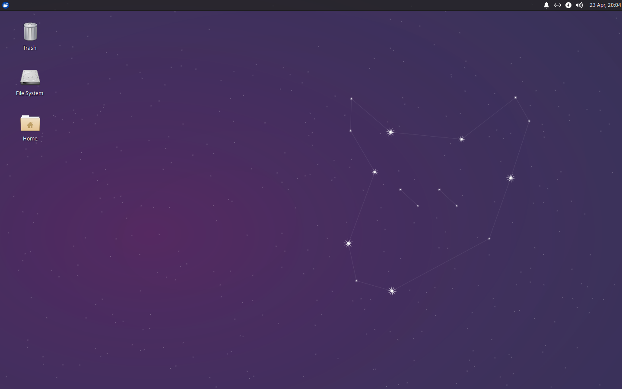
xfce DE (Xubuntu)

Slide 14

lxde

Slide 15
lxde
Initially released in 2006 as Lightweight X11 desktop environment
Very low resource requirements
Most distros have moved away from lxde to LXQT however it is still being updated and can be installed on your OS
Uses a start menu, panel, and app launchers
Each component is independent of all others so if you don’t like the lxPanel you can install another for example

Slide 16
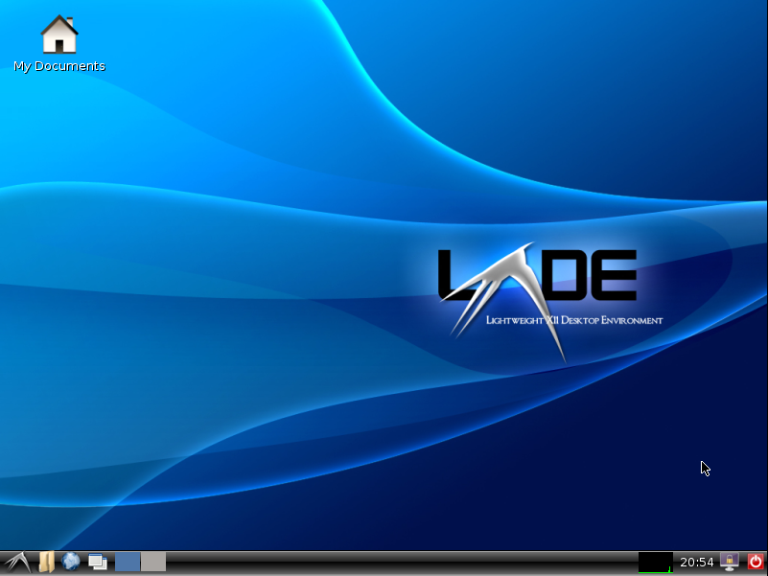
lxde

Slide 17

Cinnamon

Slide 18
Cinnamon
Initially released in 2011 for Linux Mint
Based on fork of GNOME 3
Uses start menu and panel with quick launch icons

Slide 19
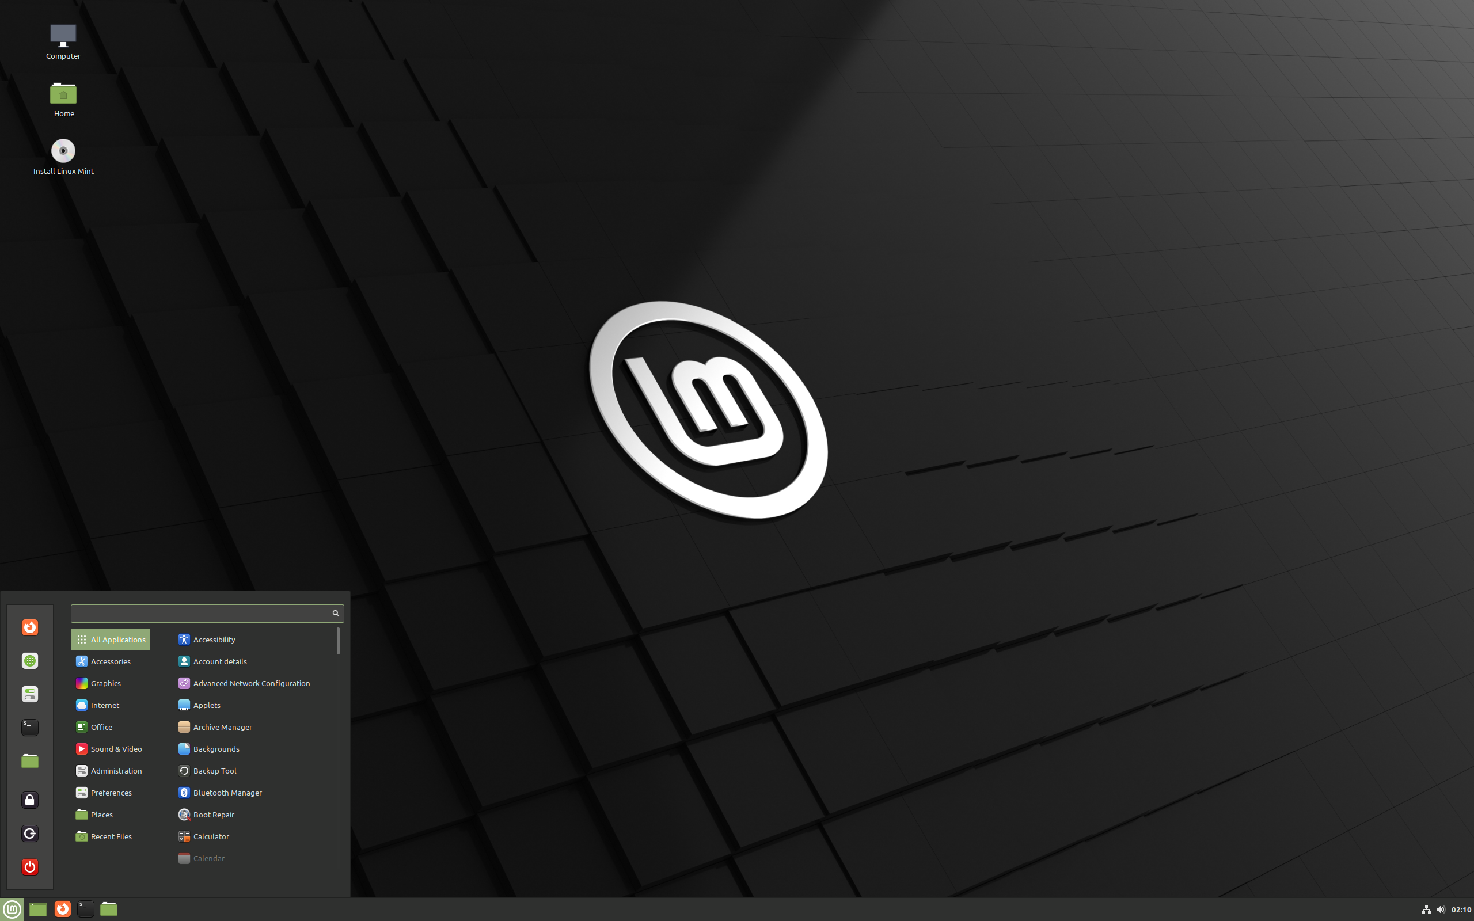
Cinnamon DE (Linux Mint)

Slide 20

Mate

Slide 21
Mate
Initially released 2011
Based on updated GNOME 2
Excellent for lighter resourced computers
Does have a start menu and panel

Slide 22
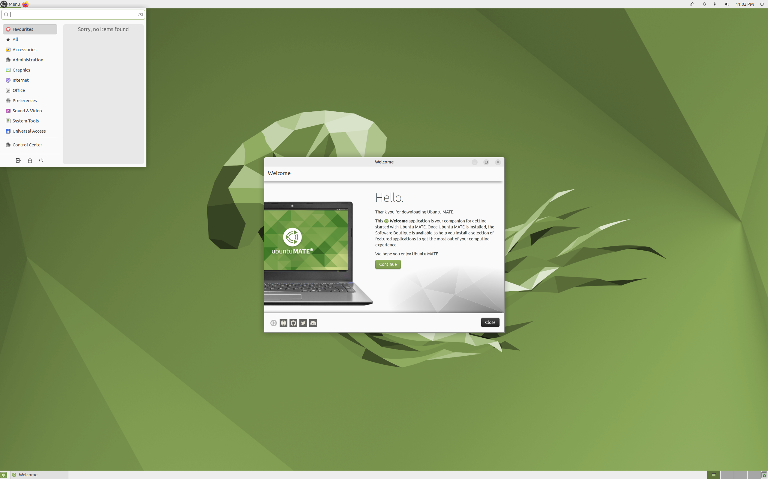
Mate DE (Ubuntu Mate)

Slide 23

Budgie

Slide 24
Budgie
Initially released for Solus 2013
Has a dock, panel, and start menu
Very few distros come with Budgie by default (Solus and Ubuntu)
Sort of a medium resource DE

Slide 25
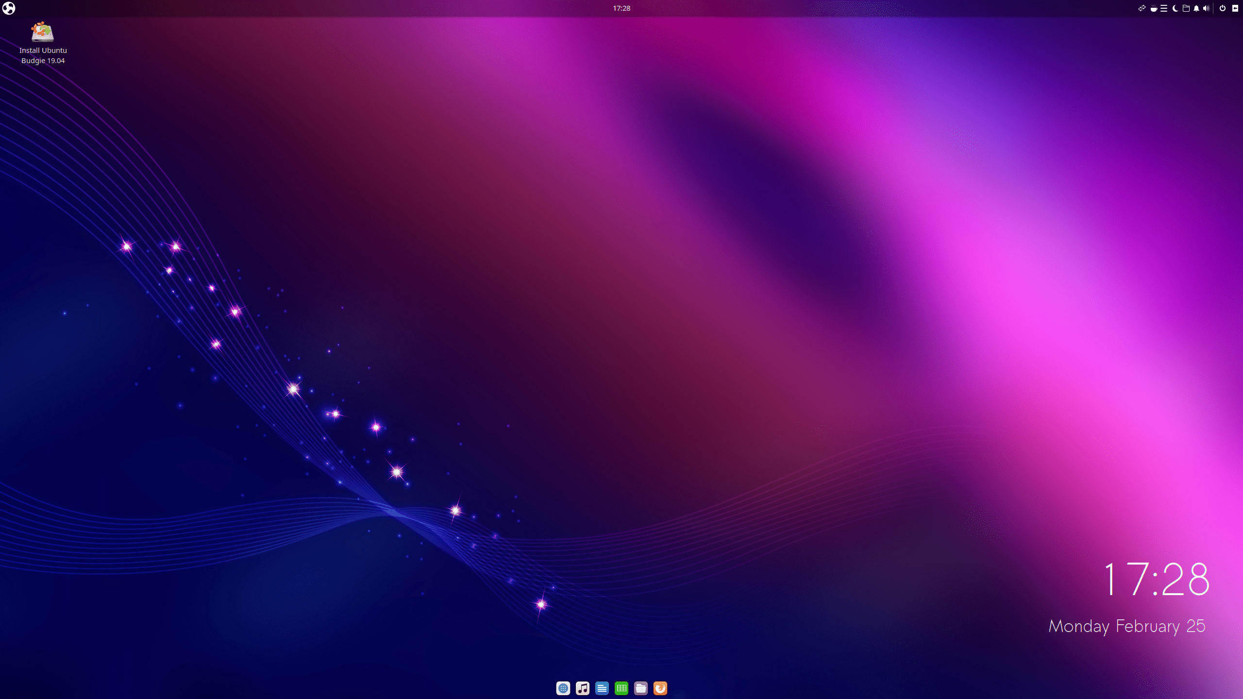
Budgie DE (Ubuntu Budgie)

Slide 26

LXQT

Slide 27
LXQT
First released in 2014
Low resource
Replaced Lxde on many distros
Uses a panel with app launchers

Slide 28
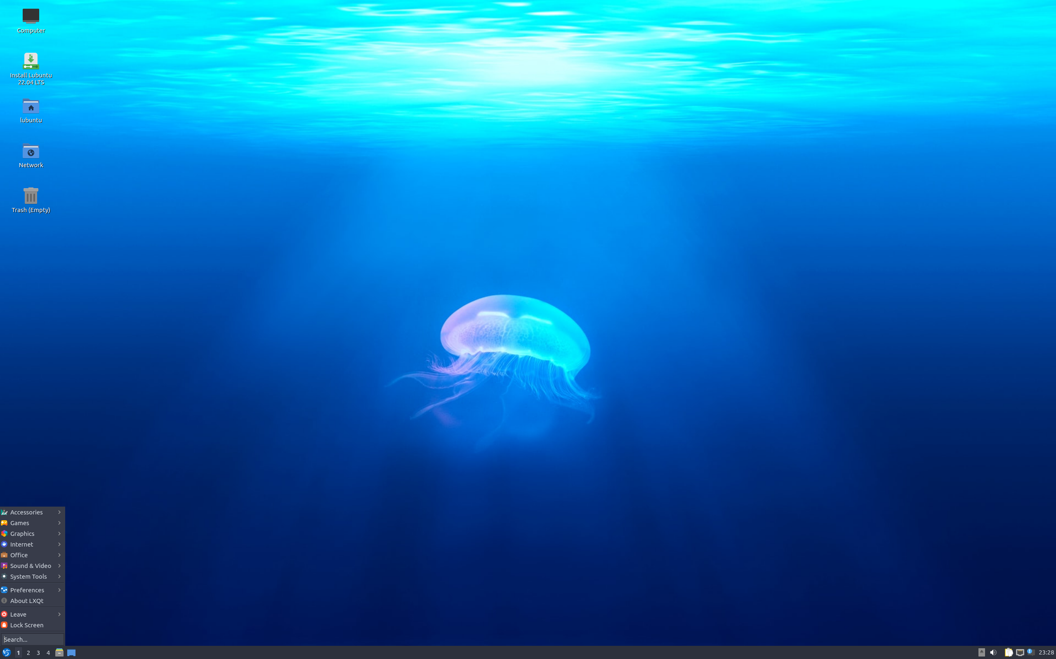
LXQT DE (Lubuntu)

Slide 29

Enlightenment

Slide 30
Enlightenment/Moksha
Primary user is Bodhi Linux but has been installed on other distros
Initially released in 1997 as a Window manager
Moksha forked from it in 2012. Enlightenment is still being maintained as a retro DE
Has start menu and panel

Slide 31
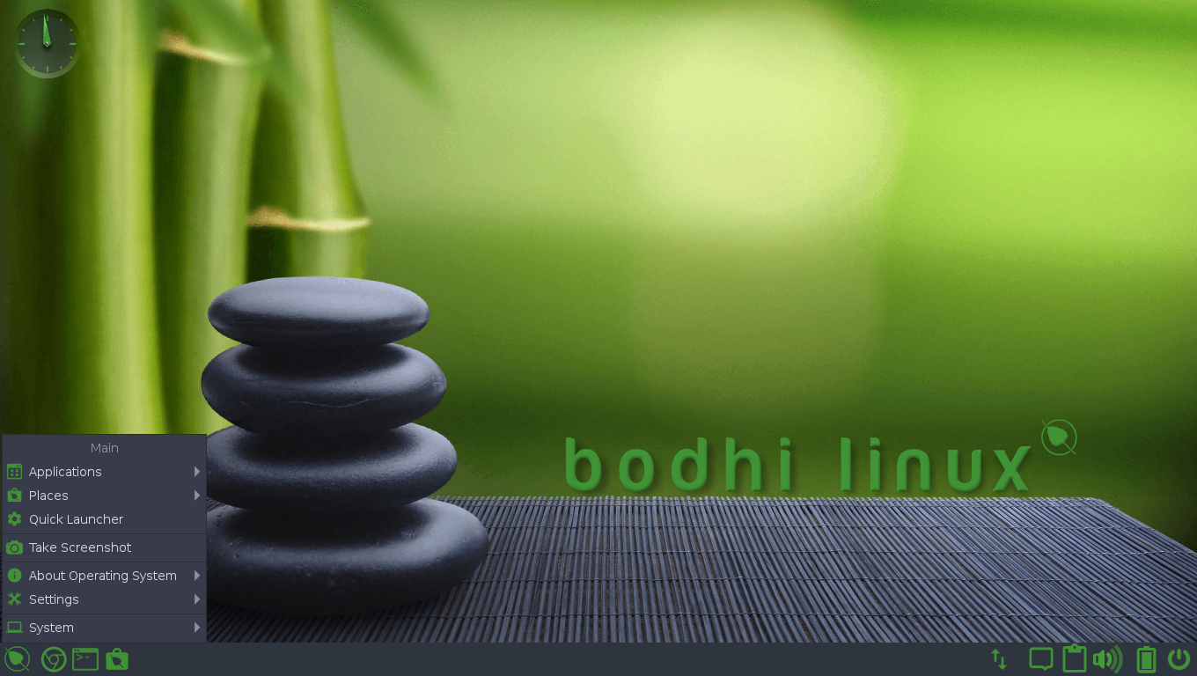
Enlightenment DE (Bodhi)

Slide 32

Trinity

Slide 33
Trinity
Created in 2010 as a fork from KDE
Can be installed on most Linux distros
Uses start menu and panel

Slide 34
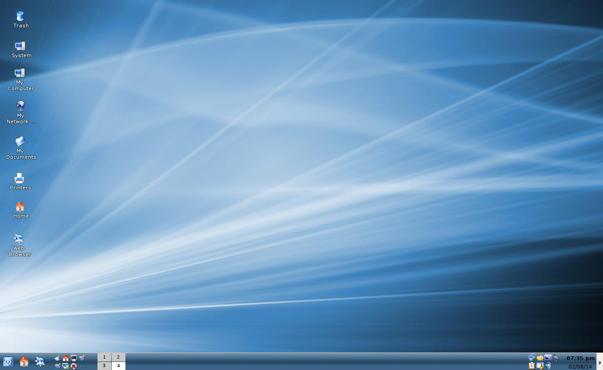
Trinity DE

Slide 35

Pantheon

Slide 36
Pantheon
Developed for Elementary Linux (which is based on Ubuntu) and is generally only seen there
Has the panel on the top of the screen and the dock at the bottom

Slide 37
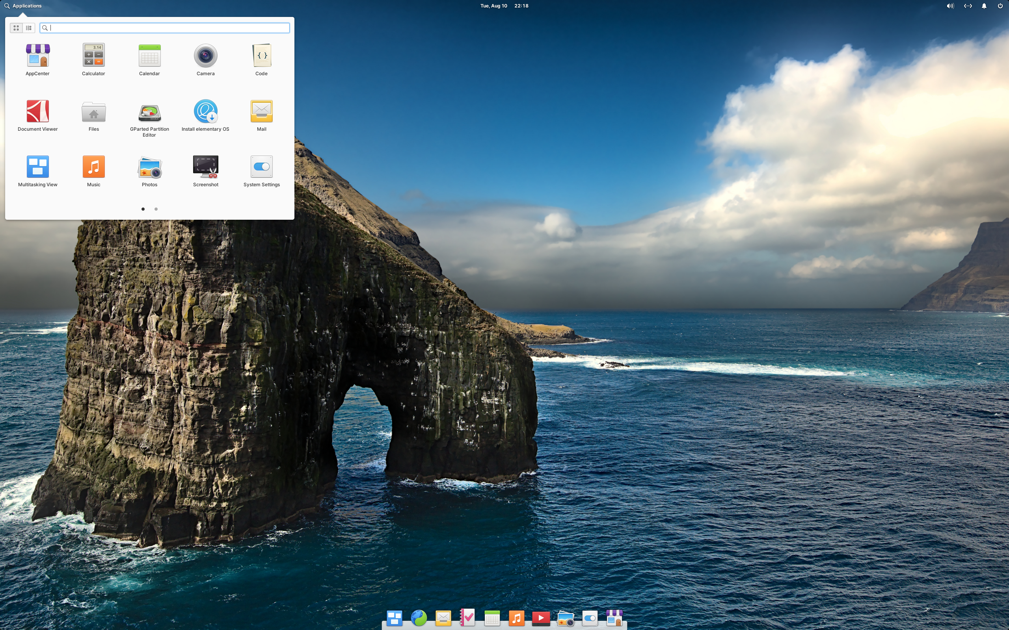
Pantheon DE (Elementary)

Slide 38

Deepin

Slide 39
Deepin
Initially developed for Deepin in 2015
Has a start menu and dock
Very heavy on resources and occasionally sluggish
Chinese based

Slide 40
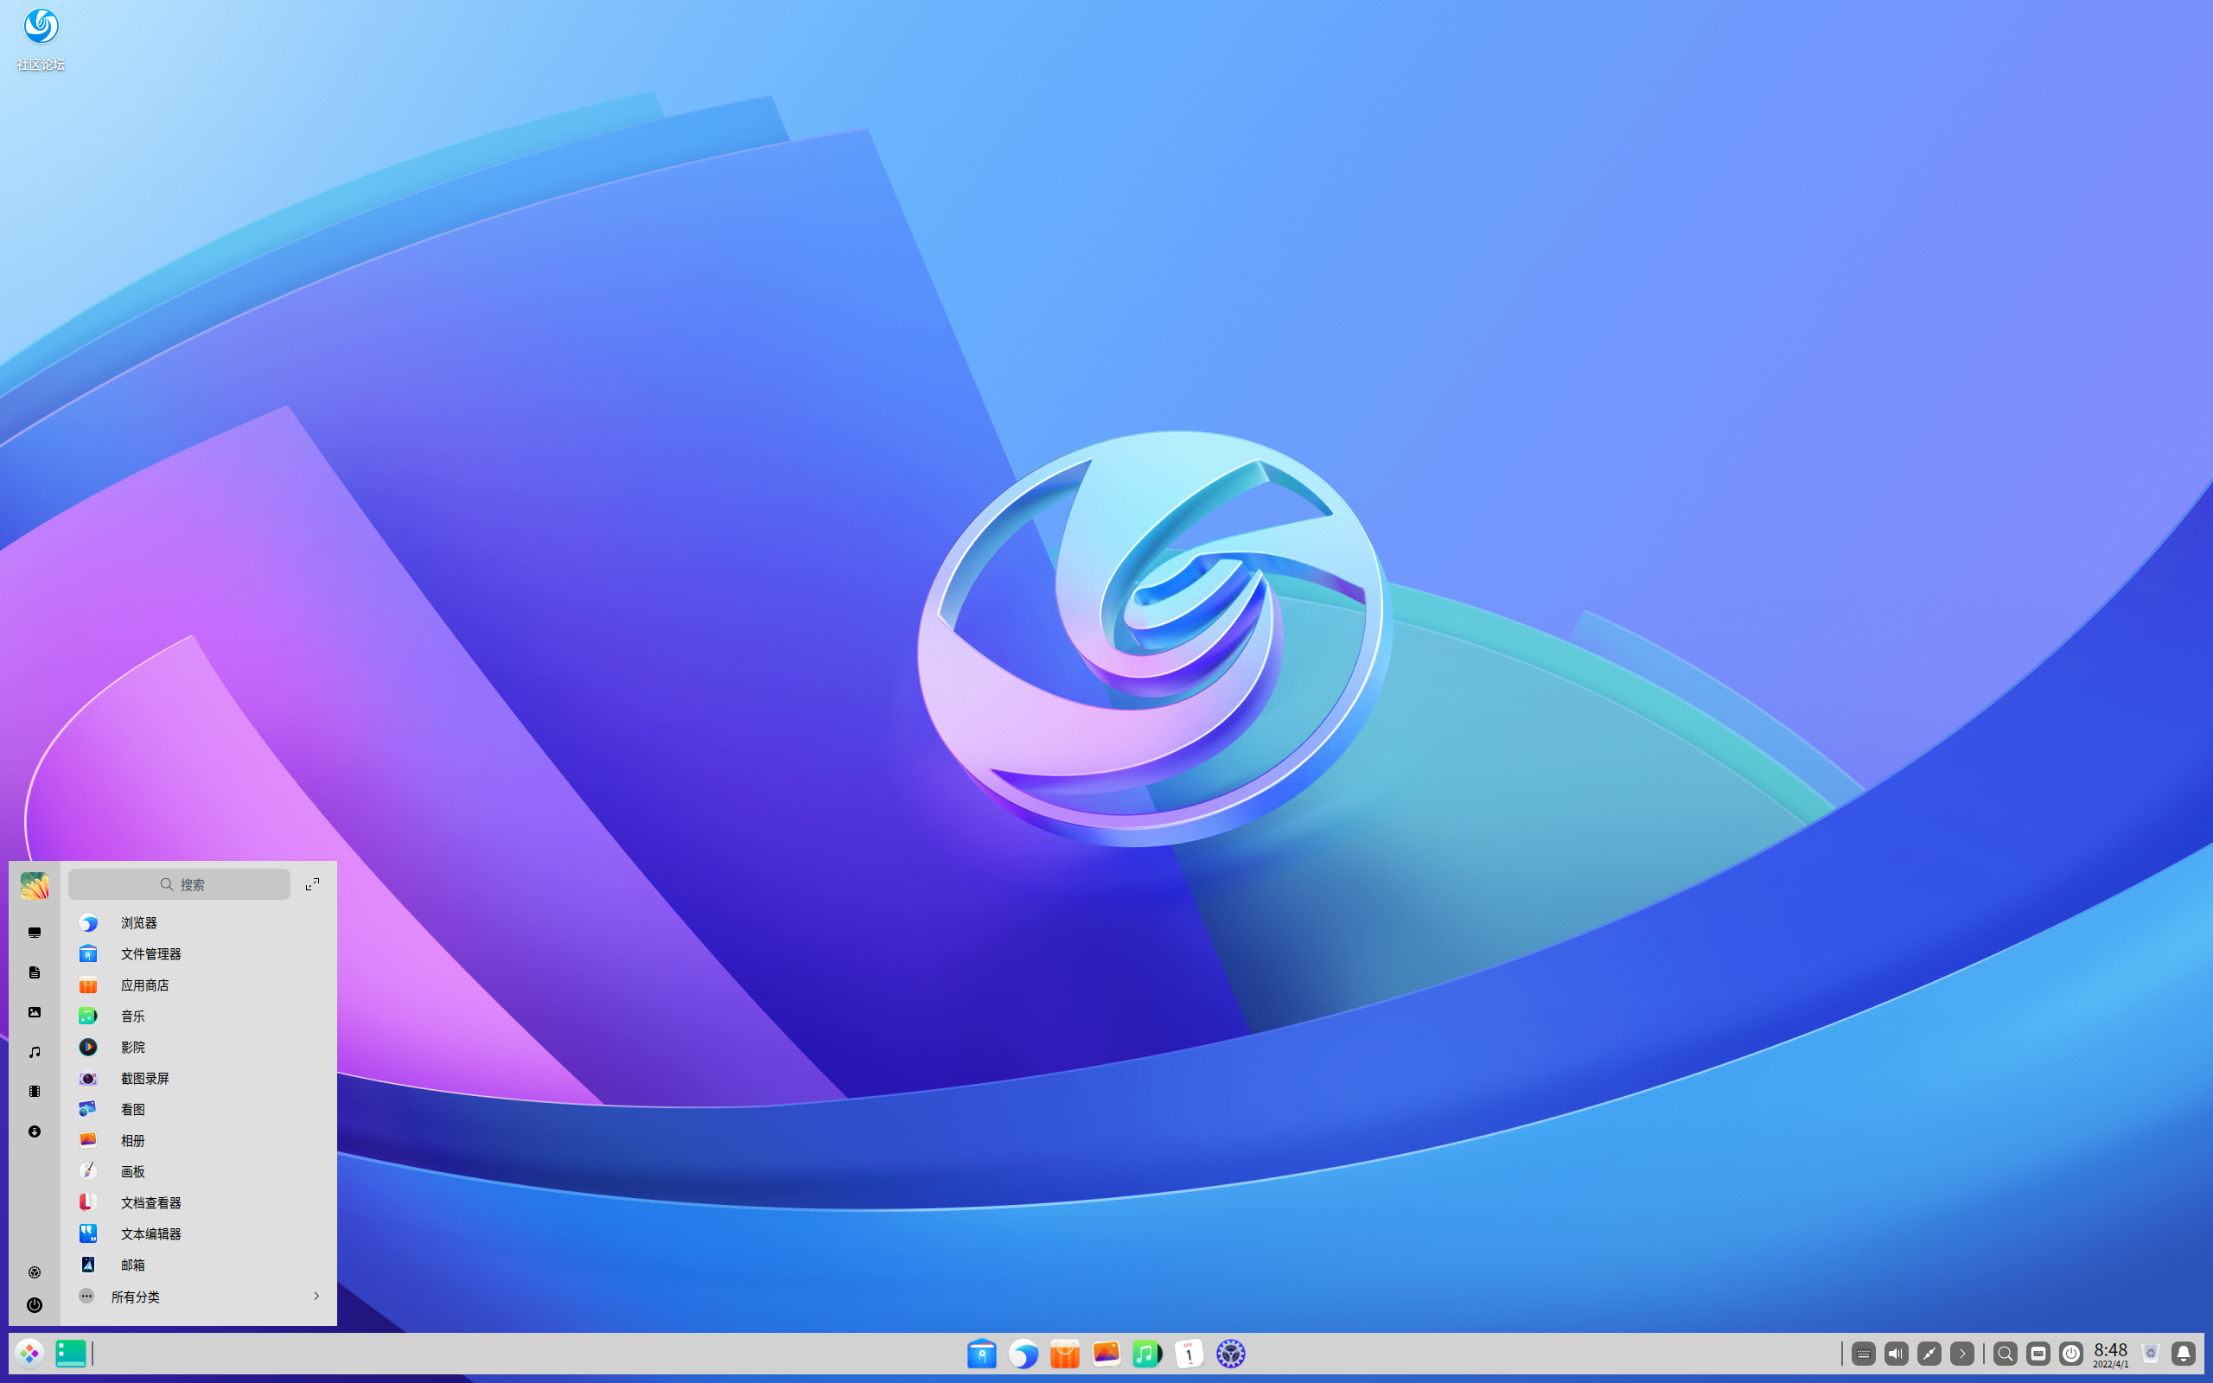
Deepin DE (Deepin)

Slide 41
Desktop Environments
Which should you use?
Depends on what you are looking for.
Ubuntu offers 11 different DE’s by default
Mint offers 3 by default
Debian and Arch ask you which one you want to install
If you are not happy with your current desktop environment, there are others out there.
Some DE’s do not play well with others so do some research before installing multiple desktop environments

Slide 42
Linux Desktop Environments

