Slide 1

COCHISE LINUX USER GROUP

Slide 2

LUBUNTU

Slide 3
LUBUNTU
OFFICIALLY RECOGNIZED BY CANONICAL OCT 2011 (11.10)
FIRST LTS VERSION 14.04
CURRENT SUPPORTED RELEASES
  16.04 LTS
  17.10.1
  18.04 LTS

Slide 4
LUBUNTU
UBUNTU CORE SYSTEM
UBUNTU REPOSITORIES
DEFAULT APPLICATIONS
  Fewer dependencies
  Less resource intensive

Slide 5
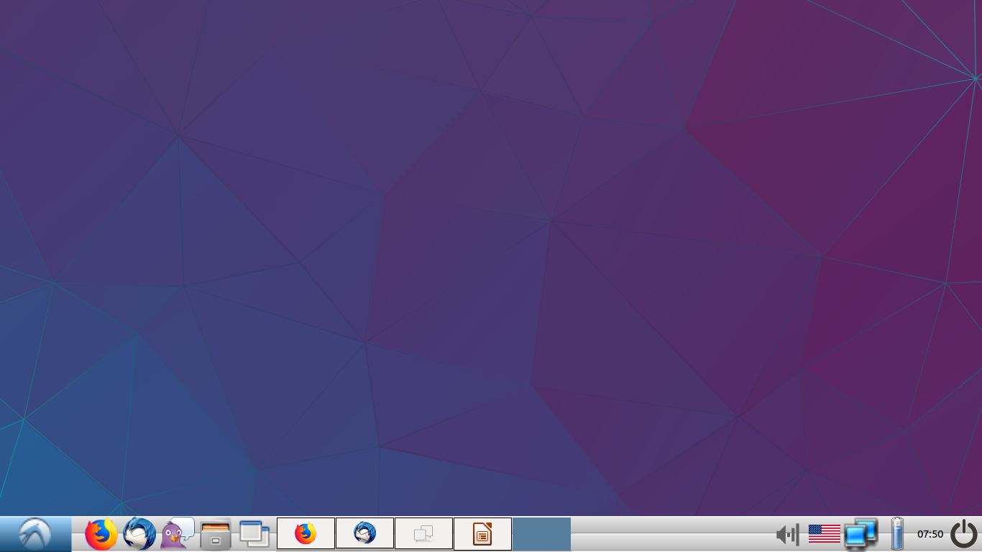
LUBUNTU

Slide 6
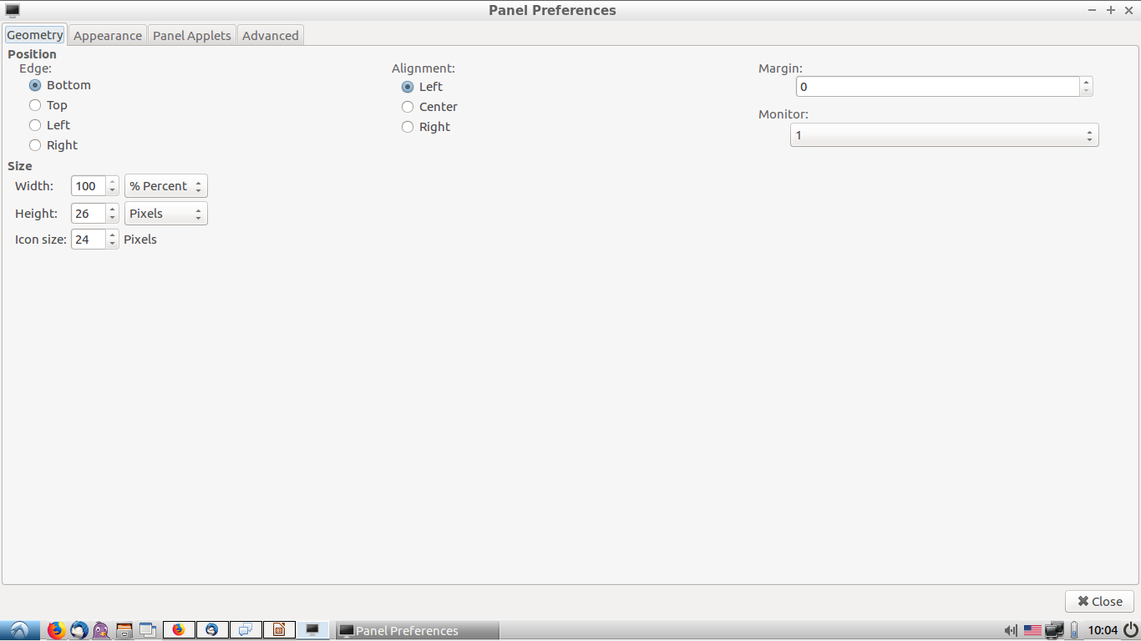
LX PANEL

Slide 7
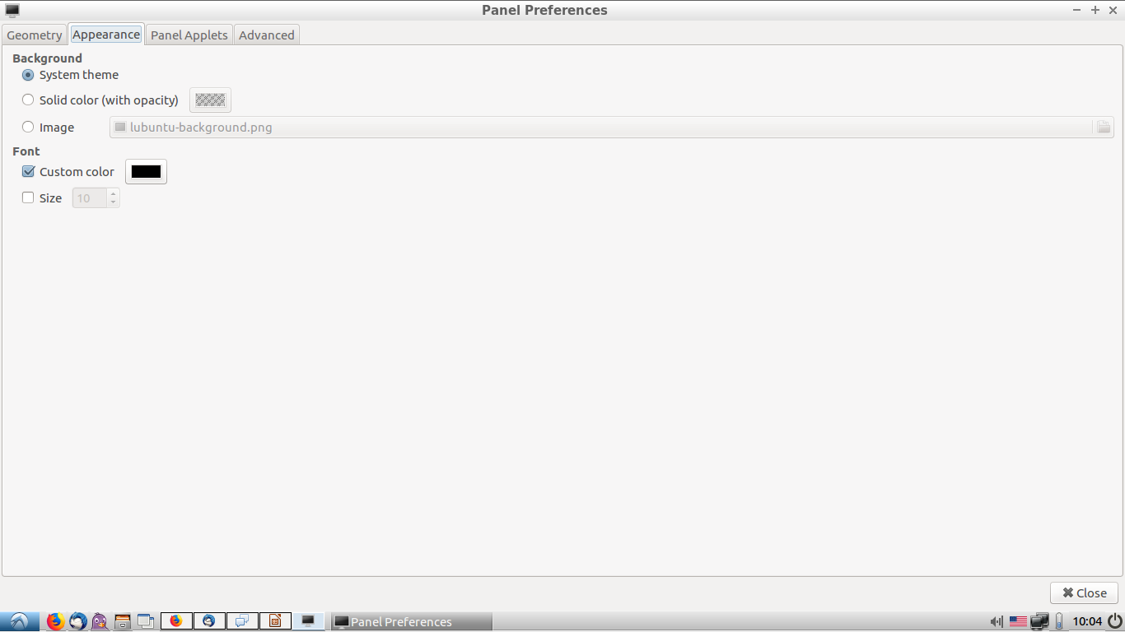

Slide 8
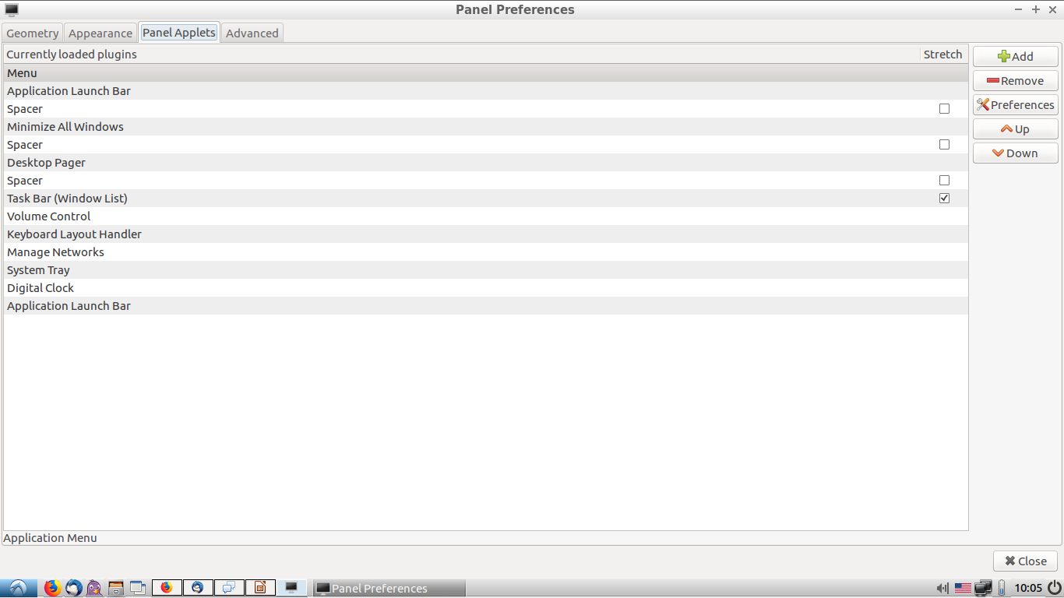
LX PANEL

Slide 9
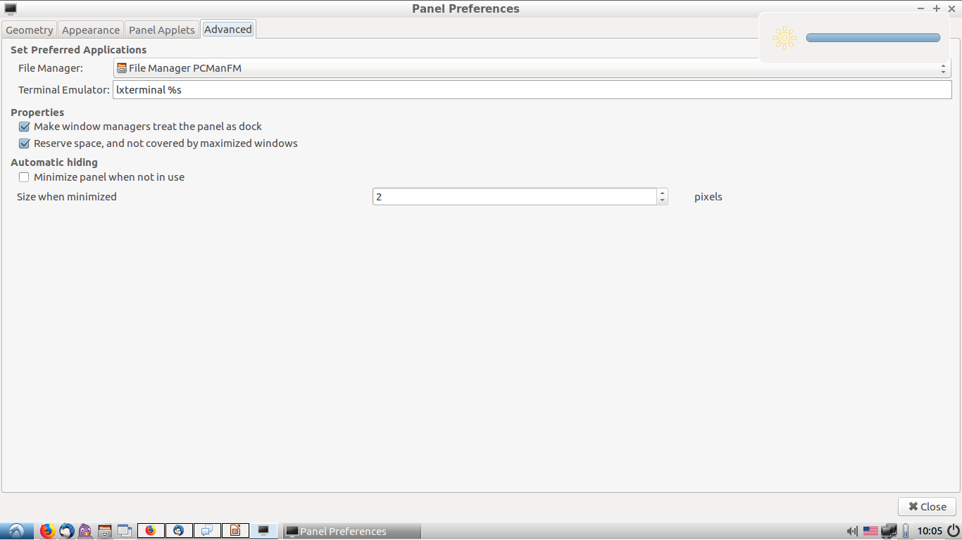
LX PANEL

Slide 10
LUBUNTU CONFIG APPS
LIGHTDM GTK+ GREETER SETTINGS
CUSTOMIZE LOOK AND FEEL
DEFAULT APPLICATIONS FOR LXSESSION
DESKTOP PREFERENCES
OPENBOX CONFIGURATION MANAGER

Slide 11
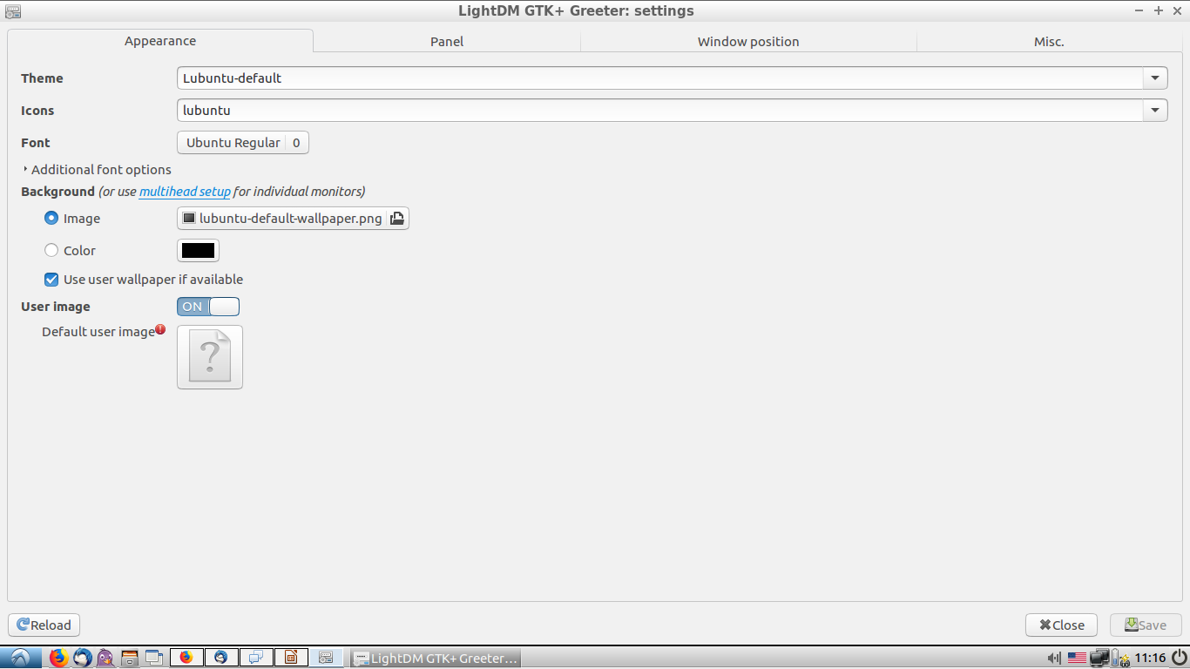
LIGHTDM GTK+ GREETER SETTINGS

Slide 12
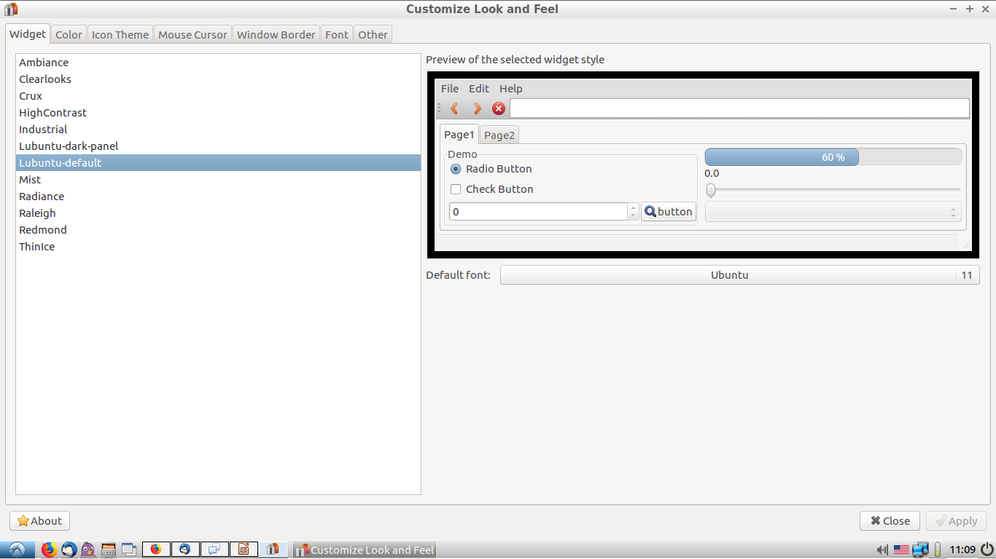
CUSTOMIZE LOOK AND FEEL

Slide 13
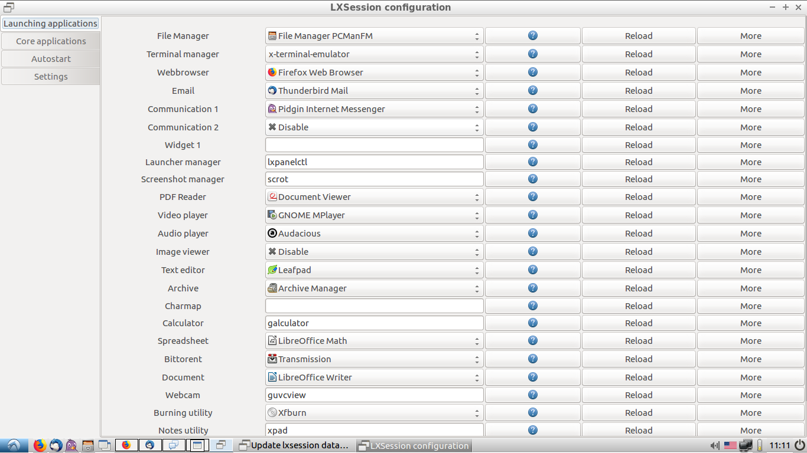
DEFAULT APPLICATIONS FOR LXSESSION

Slide 14
DESKTOP PREFERENCES

Slide 15
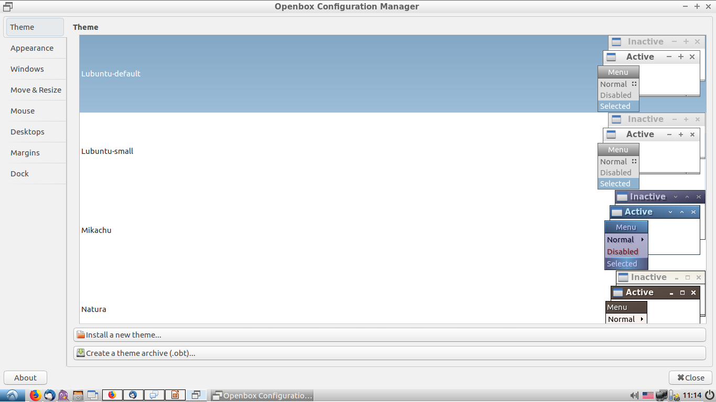
OPENBOX CONFIGURATION MANAGER

Slide 16
LUBUNTU APPLICATIONS 1
Lubuntu App Xpad Evince Gnumeric Abiword Simple-scan Gnome-disk-utility Light-locker Guvcview Gucharmap Scrot Hardinfo Mtpaint | Function Stickies PDF Viewer Spreadsheet Docs Scanner Partition Editor Screensaver Webcam Utility Character Map Screenshot System info Image Editing | Windows App Microsoft One Note Adobe Reader Microsoft Excel Microsoft Word Disk Manager Screensaver Character map System profiler Paint | Included in SP1 (Office suite) (Office suite) (driver) (driver) (3rd party app)

Slide 17
LUBUNTU APPLICATIONS 2
Xfburn Pcmanfm Gcalculator Audacious Gnome-mplayer Transmission Pidgin Sylpheed Mozilla Firefox Leafpad File-roller Lxterminal Gpicview | Cd Burning File Manager Calculator Audio Player Video Player Torrent IM Email Client Web browser Text Editor (De)Compress files Terminal Image Viewer | Explorer Calc Media Player Media Player Microsoft Lync Outlook IE Notepad / Wordpad Explorer cmd Media Center | (3rd party app) (3rd party app) (only ZIP files) (some features)

Slide 18
COCHISE LINUX USER GROUP

