Slide 1

Cochise Linux User Group

Slide 2
GitHub
How to work on GitHub

Slide 3
GIT
Git is a version control system that tracks changes to files in a project over time.
It typically records what the changes were, who made the changes, notes and comments about the changes by the changer, and at what time the changes were made.
Think of Git and version control like a magic undo button

Slide 4
GitHub
GitHub is a web hosting service for the source code of software and web development projects (or other text based projects) that use Git.

Slide 5
GitHub Pages
GitHub Pages are public webpages hosted for free through GitHub. GitHub users can create and host both personal websites (one allowed per user) and websites related to specific GitHub projects.
Pages lets you do the same things as GitHub, but if the repository is named a certain way and files inside it are HTML or Markdown, you can view the file like any other website.

Slide 6
GitHub
Login to GitHub or create an account
https://github.com/

Slide 7
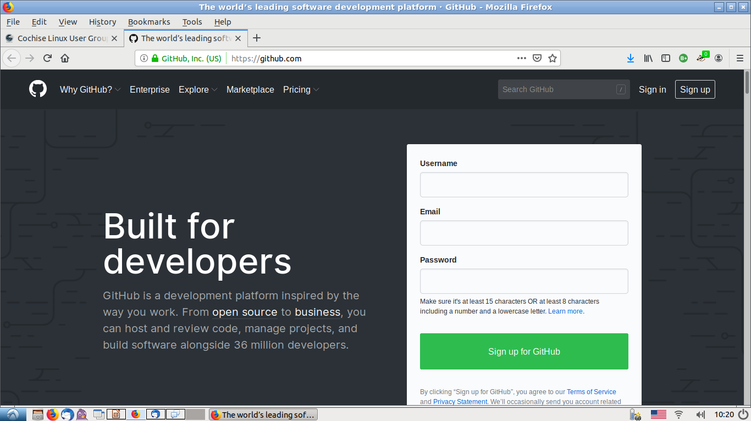
Log in to GitHub

Slide 8
Repositories
A repository is usually used to organize a single project.
Repositories can contain folders and files, images, videos, spreadsheets, and data sets – anything your project needs.
It is recommended that a README, or a file with information about your project, be included.
GitHub makes it easy to add one at the same time you create your new repository.

Slide 9
Create Repository
In the upper right corner, next to your avatar or identicon, click + and then select New repository.
Name your repository “username.github.io” replacing user name with your GitHub user name.
Select public.
Write a short description.
Select Initialize this repository with a README file.

Slide 10
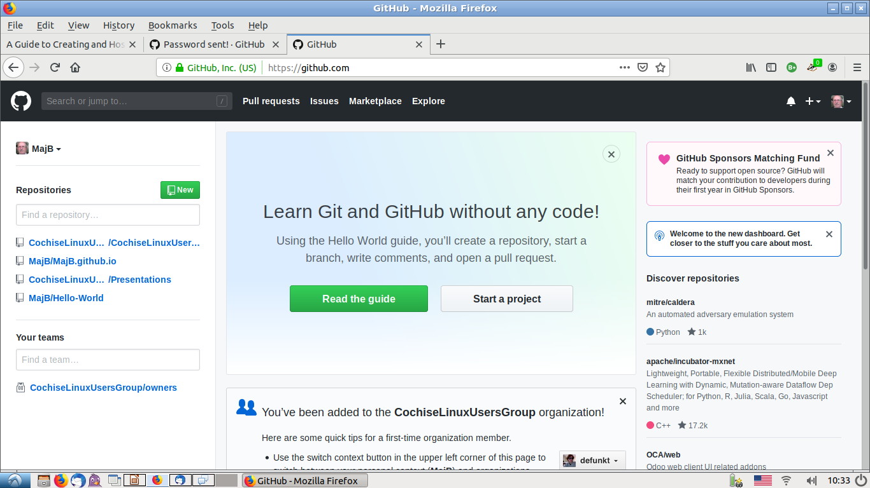
Create a Repository

Slide 11
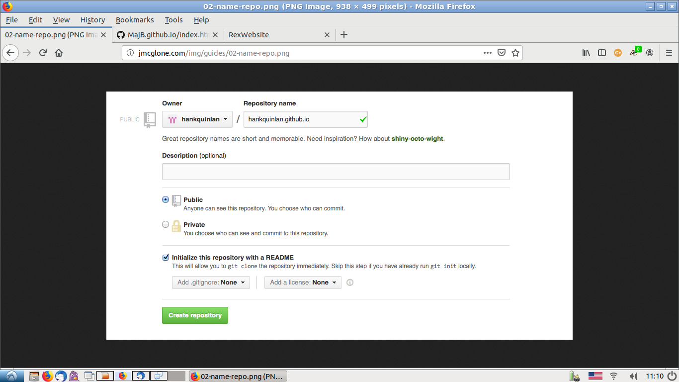
Create a Repository

Slide 12
Create Index File
Create an index.html page by clicking the plus icon next to your repository name and typing the file name directly in the input box that appears.

Slide 13
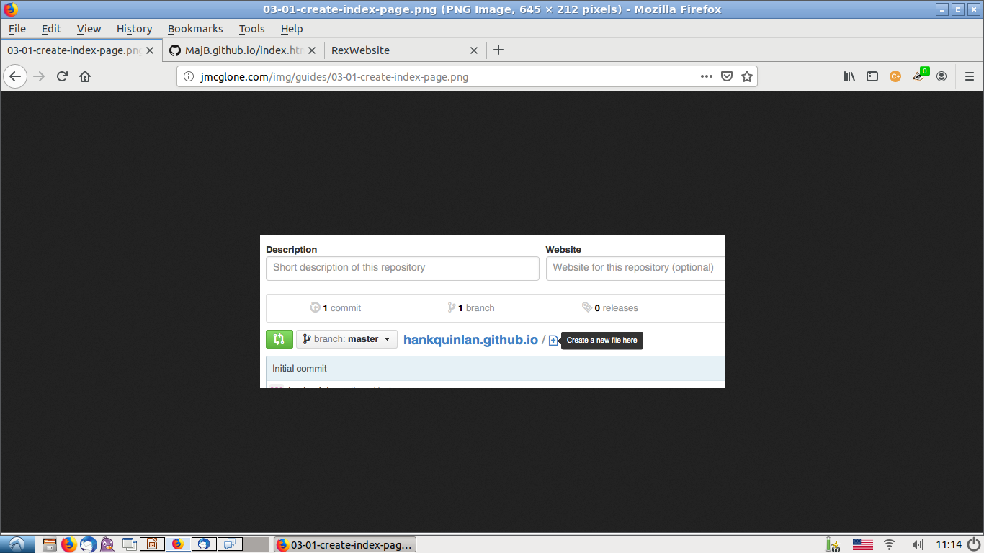
Create an Index File

Slide 14
Create an Index File
<!DOCTYPE html>
<html>
<head>
<title>Rex's Website</title>
</head>
<body>
<nav>
<ul>
<li><a href="/">Home</a></li>
<li><a href="/about">About</a></li>
<li><a href="/cv">CV</a></li>
<li><a href="/blog">Blog</a></li>
</ul>
</nav>
<div class="container">
<div class="blurb">
<h1>Hello I am Rex Bouwense</h1>
<p>I am the unofficial leader of the Cochise Linux User Group. If you are a Linux user or want to know about a free alternative operating system for your personal computer you are invited to attend one of our meetings which take place at the Sierra Vista public library conference room on the 4th Saturday of every month from 1300-1545. Membership is free and all are welcome.</p>
</div><!-- /.blurb -->
</div><!-- /.container -->
<footer>
<ul>
<li><a href="mailto:majb@azloco.com">email</a></li>
<li><a href="https://github.com/MajB">github.com/MajB</a></li>
</ul>
</footer>
</body>
</html>

Slide 15
Create an Index File 1
<!DOCTYPE html>
<html>
<head>
<title>Rex's Website</title>
</head>
<body>
<nav>
<ul>
<li><a href="/">Home</a></li>
<li><a href="/about">About</a></li>
<li><a href="/cv">CV</a></li>
<li><a href="/blog">Blog</a></li>
</ul>
</nav>
<div class="container">
<div class="blurb">
<h1>Hello I am Rex Bouwense</h1>

Slide 16
Create an Index File 2
<p>I am the unofficial leader of the Cochise Linux User Group. If you are a Linux user or want to know about a free alternative operating system for your personal computer you are invited to attend one of our meetings which take place at the Sierra Vista public library conference room on the 4th Saturday of every month from 1300-1545. Membership is free and all are welcome.</p>
</div><!-- /.blurb -->
</div><!-- /.container -->
<footer>
<ul>
<li><a href="mailto:majb@azloco.com">email</a></li>
<li><a href="https://github.com/MajB">github.com/MajB</a></li>
</ul>
</footer>
</body>
</html>

Slide 17
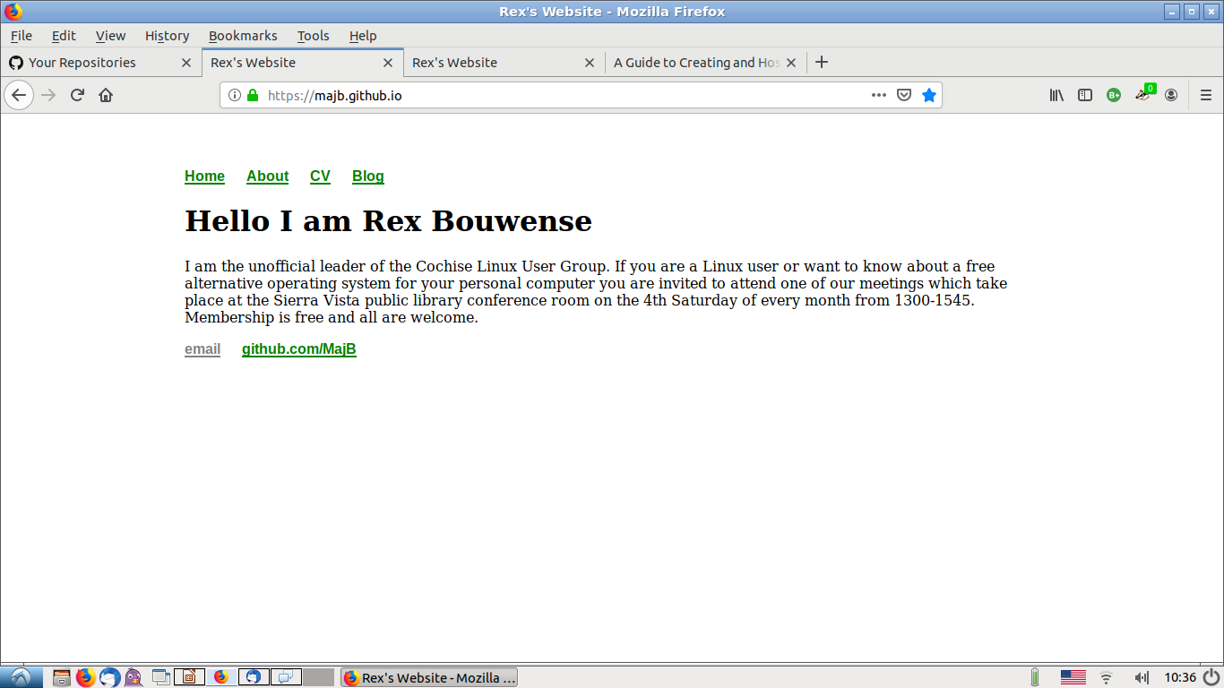
Resulting Web Page

