Slide 1


CLUG
Cochise Linux User Group
Get to know your command line!
By: Paul Bernard
CochiseLinuxUsersGroup.github.io

Slide 2
What is the Command Line?
Simply put, a text-based way to interact with your operating system.
The terms CLI (Command Line Interface) and Shell are often used to describe the command line.
You can have a true text-based command line interface or one that is run through the GUI.

Slide 3
Text Based CLI
More common in server based distributions.
Can be accessed by ctrl + alt + f2 through ctrl + alt + f6.
Each function key gives you a different workspace.
Ctrl + alt + f1 will bring you back to the GUI (if you had one running)

Slide 4
GUI Based Terminals
This will be the most common way to use the command line.
Linux distributions have a graphical based terminal installed by default.
It is generally bundled in the desktop environment and can be accessed through the menu system.

Slide 5
Common GUI Terminals
Konsole – KDE
Gnome-Terminal – Gnome
XFCE terminal – XFCE
Terminology – Enlightenment
Xterm – Xorg
LXTerminal – LXDE
There are many many more to choose from.

Slide 6
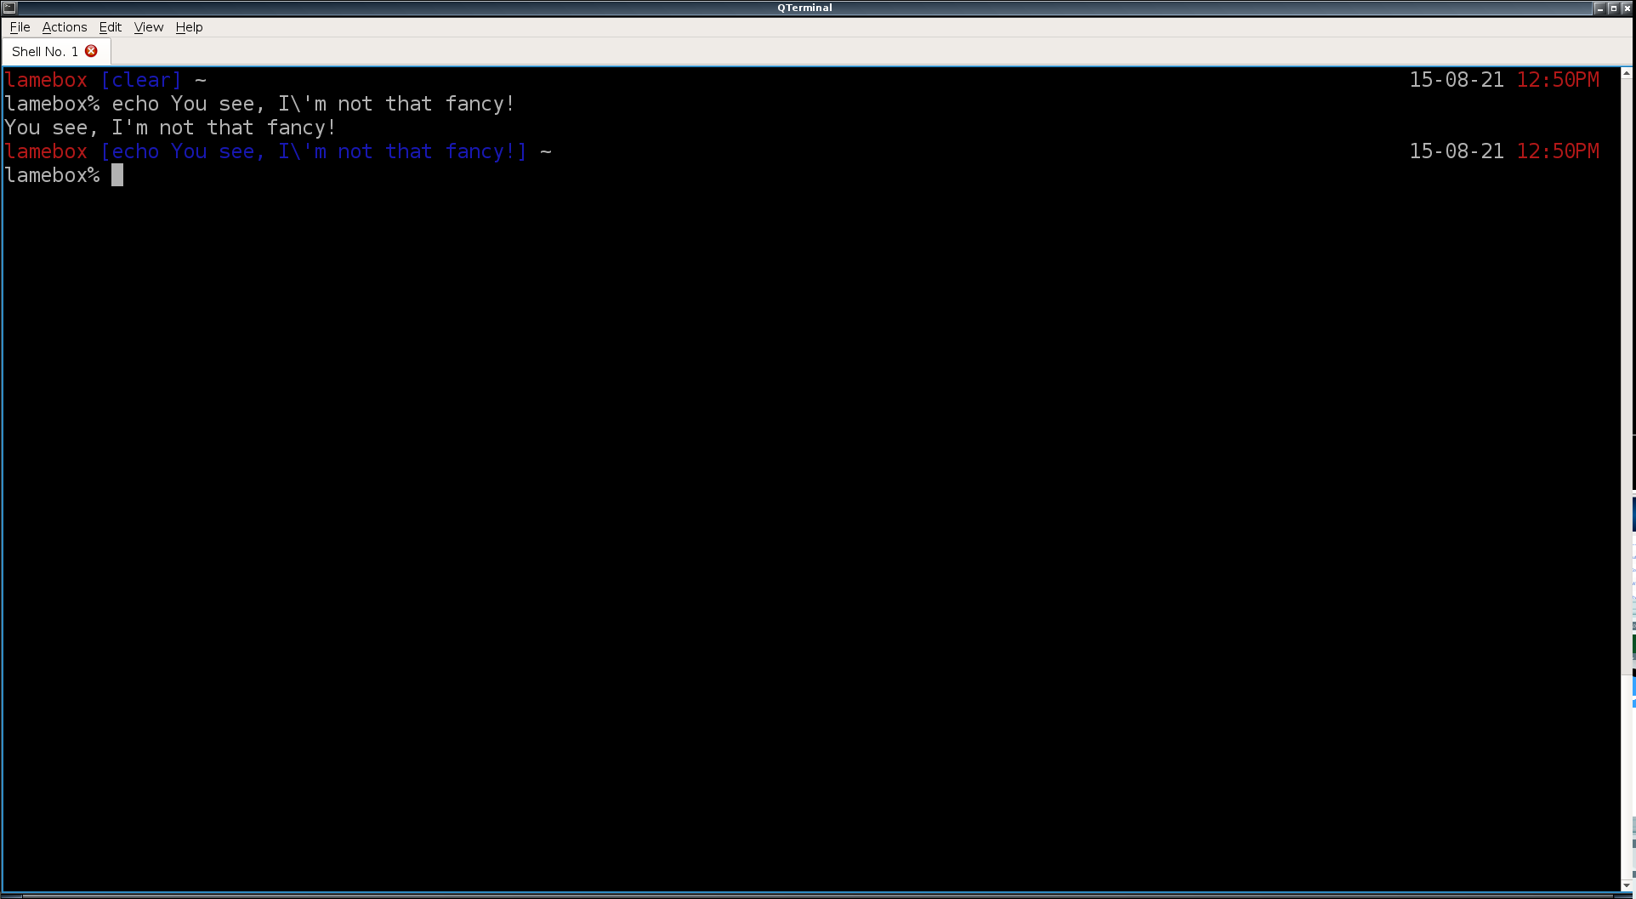
What does this 'Terminal' thing look like?

Slide 7
Basic Commands
ls – list files in a directory
cd – change a directory
cp – copy a file or directory
mv – move a file or directory
rm – remove a file or directory
kill/killall – killing tasks
sudo – run a command with root privilages.

Slide 8
Why Use the Command Line?
Can often be a quicker way to complete a task.
Sometimes you may encounter issues with the GUI that can easily be resolved with the command line.
Scripting and automation. (Makes life easier)

Slide 9
Some Notable Command Line Programs.
Irssi – text based irc client (The client of the future).
vi or vim – text based text editor.
Elinks – text based web browser.
Moc – music over console – a text based music player.
Mutt – text based email client.
There are many, many more...

Slide 10
Helpful links
http://files.fosswire.com/2007/08/fwunixref.pdf
http://vic.gedris.org/Manual-ShellIntro/1.2/ShellIntro.pdf
https://www.loggly.com/wp-content/uploads/2015/05/Linux-Cheat-Sheet-Sponsored-By-Loggly.pdf
http://www.reallylinux.com/docs/basic.shtml
http://www.reallylinux.com/docs/files.shtml

Slide 11
Other Topic Ideas
Grep, Sed, and Awk – Master Regex
Not Just Bash – A Linux shell primer
File System Structure – Where is that one thing?
Bash Scripting – Automate your life.
Wifi Hacking – Secure your network by breaking in.
Steam Life – Why Steam will forever change Linux.
Command Line 2 – Intermediate commands.
Other suggestions?

Slide 12
CLUG Info
Chat almost any time on IRC
  Server: irc.freenode.net
  Channel: #cochiselinux
  If you need help getting an IRC client working / configured, feel free to ask.
Website
  CochiseLinuxUsersGroup.github.io
  We are working on getting a domain that is shorter.
Mailing List
  Directions to sign up for the mailing list can be found on the website.

Slide 13
This slideshow can be found at:
http://tinyurl.com/TermBeginners

Slide 14
Questions / Demo

