Slide 1

Cochise Linux User Group

Slide 2
Synaptic Package Manager

Slide 3
Synaptic Package Manager
Synaptic is a lightweight GUI front end to apt package management system used in Debian, Ubuntu, Linux Mint and many other Debian/Ubuntu based distributions.
Basically, everything that you can do using the apt-get commands in the terminal can be achieved with Synaptic.

Slide 4
Synaptic Package Manager
There was a time when Synaptic was the default graphical software manager on almost all Debian-based Linux distributions. It was considered to be a user-friendly, easy to use way of managing applications.

Slide 5
Synaptic Package Manager
Things changed as modern software manager tools like GNOME Software, KDE Discover, and the AppCenter came up with more modern and intuitive UI. These software managers have better interface, display the package information in a more friendly way with thumbnails, ratings and reviews.

Slide 6
Synaptic Package Manager
Eventually, Synaptic got confined to mostly lightweight Linux distributions.

Slide 7
Synaptic Package Manager
Why would you use an ‘ancient’ software like Synaptic package manager?
You don’t have to. Not most of the time, of course.
But Synaptic is still more versatile than the likes of GNOME Software. Remember, it is basically GUI front end to apt which means it can do (almost) everything you do with apt commands in the terminal.

Slide 8
Here is a summary of what you can do with Synaptic:
Update the package cache
Upgrade the entire system
Manage package repositories
Search for packages by name, description, maintainer, version, dependencies etc
List packages by section, status (installed), origin or more
Sort packages by name, status, size or version
Get information related to a package
Lock package version
Install specific version of a package

Slide 9
How to install Synaptic Package Manager in Ubuntu
Synaptic package manager is available in the Universe repository in Ubuntu. If it is enabled, you may find it in the App Center. Most if not all Debian and Ubuntu based distros have it in their repositories.
You may also install Synaptic via command line.
sudo apt install synaptic

Slide 10
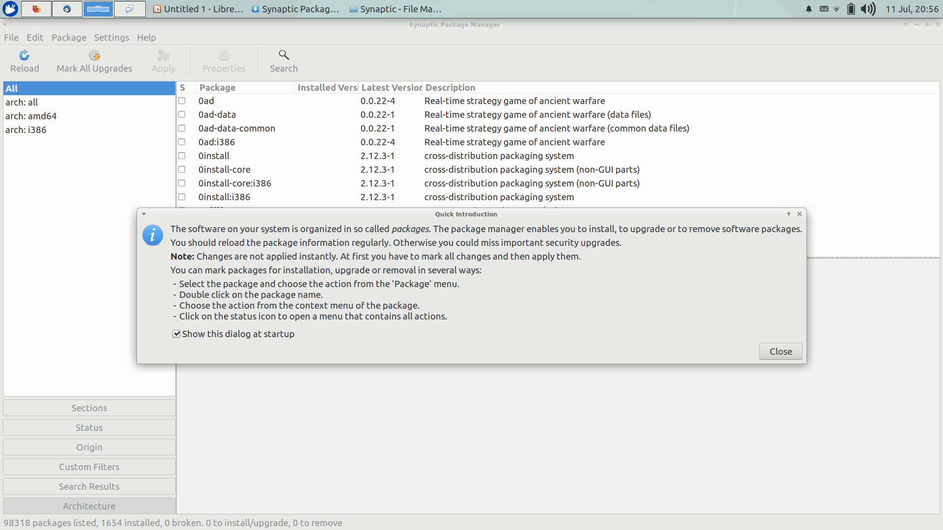
Synaptic Package Manager

Slide 11
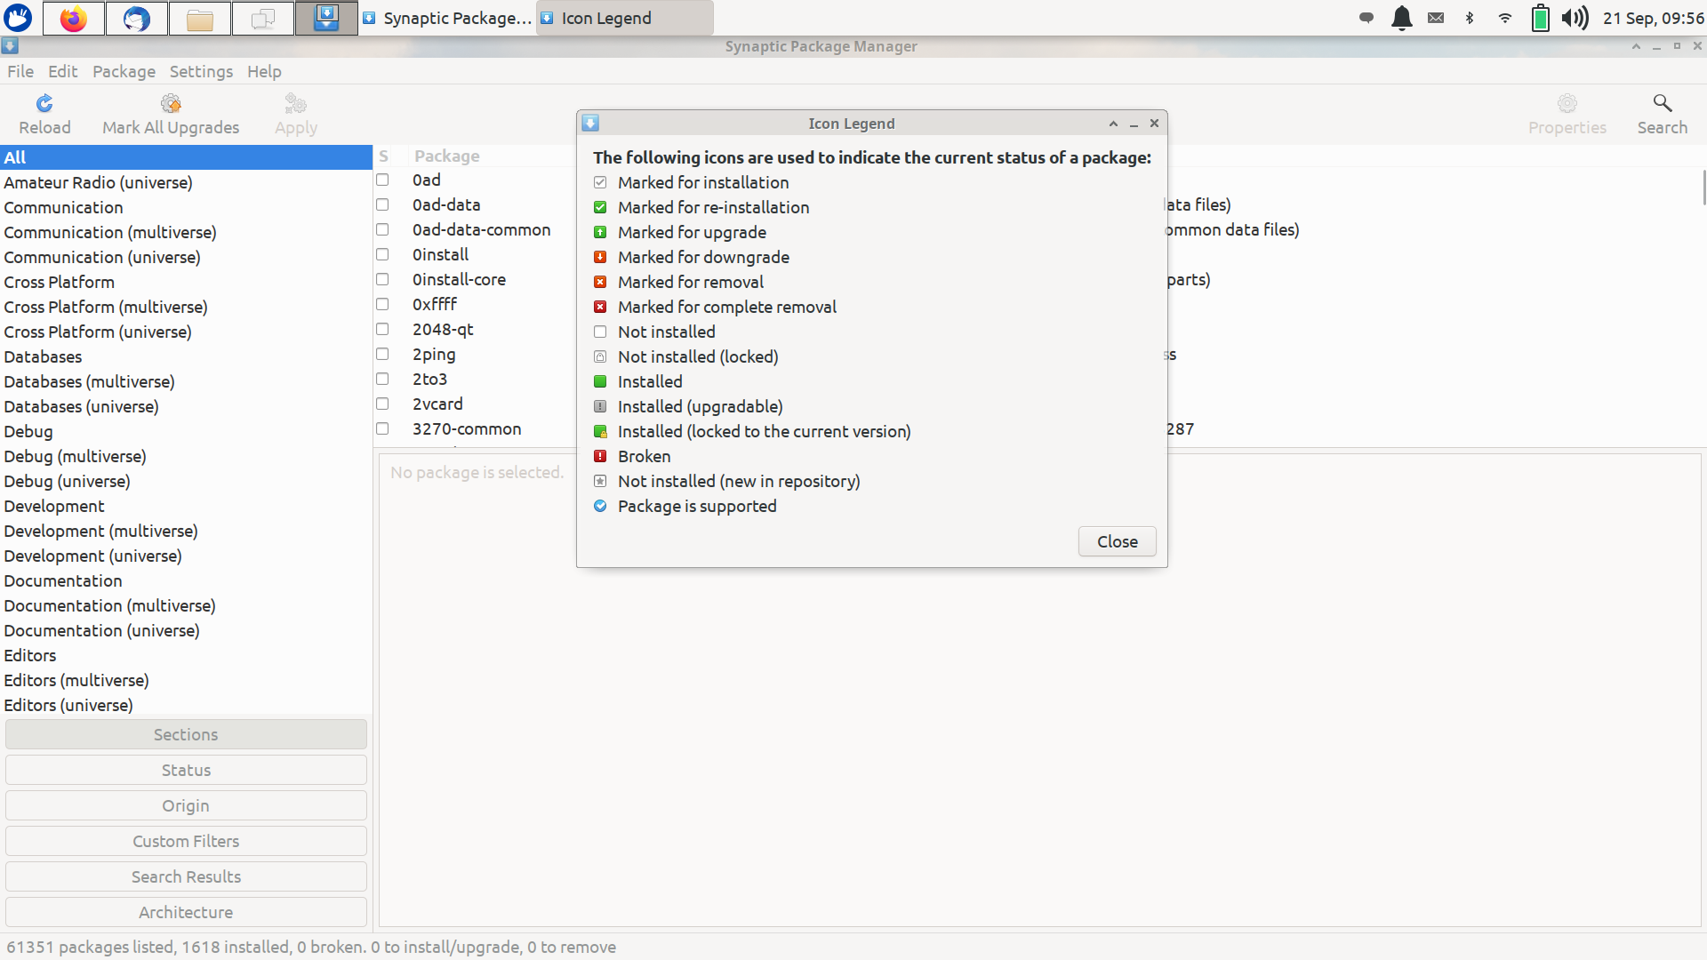
Synaptic Package Manager

Slide 12
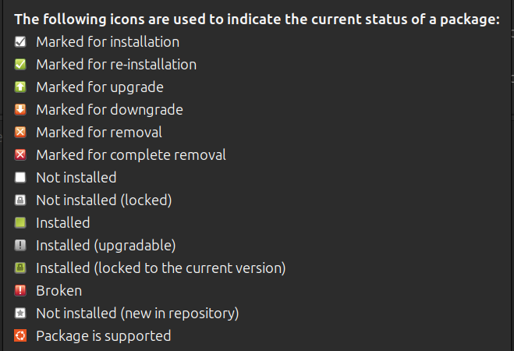
Icon Legend

Slide 13
Synaptic Package Manager
You can see that the interface is not among the best-looking ones here. Note the color of the checkboxes. White means the package is not installed, green means it is installed.

Slide 14
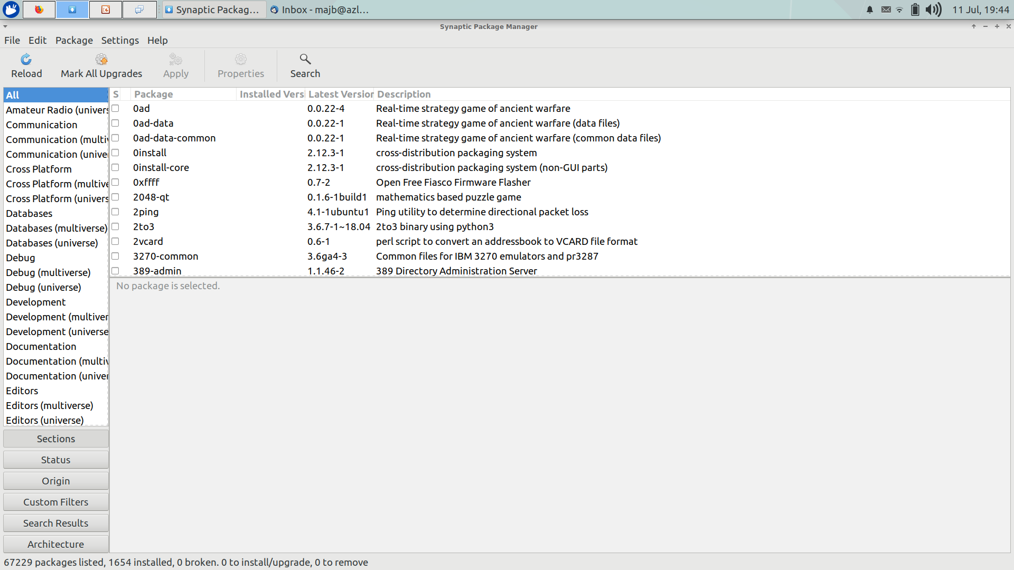
Synaptic Package Manager

Slide 15
Synaptic Package Manager
You can search for an application and click on the checkbox to mark it for installation. It will also highlight packages (in green) that will be installed as dependencies. Hit apply to install the selected packages.

Slide 16
Synaptic Package Manager
You can also search for packages using Synaptic. This is like searching for packages using apt-cache search command.
If you think you made the wrong selection, you can click Undo from the Edit menu.

Slide 17
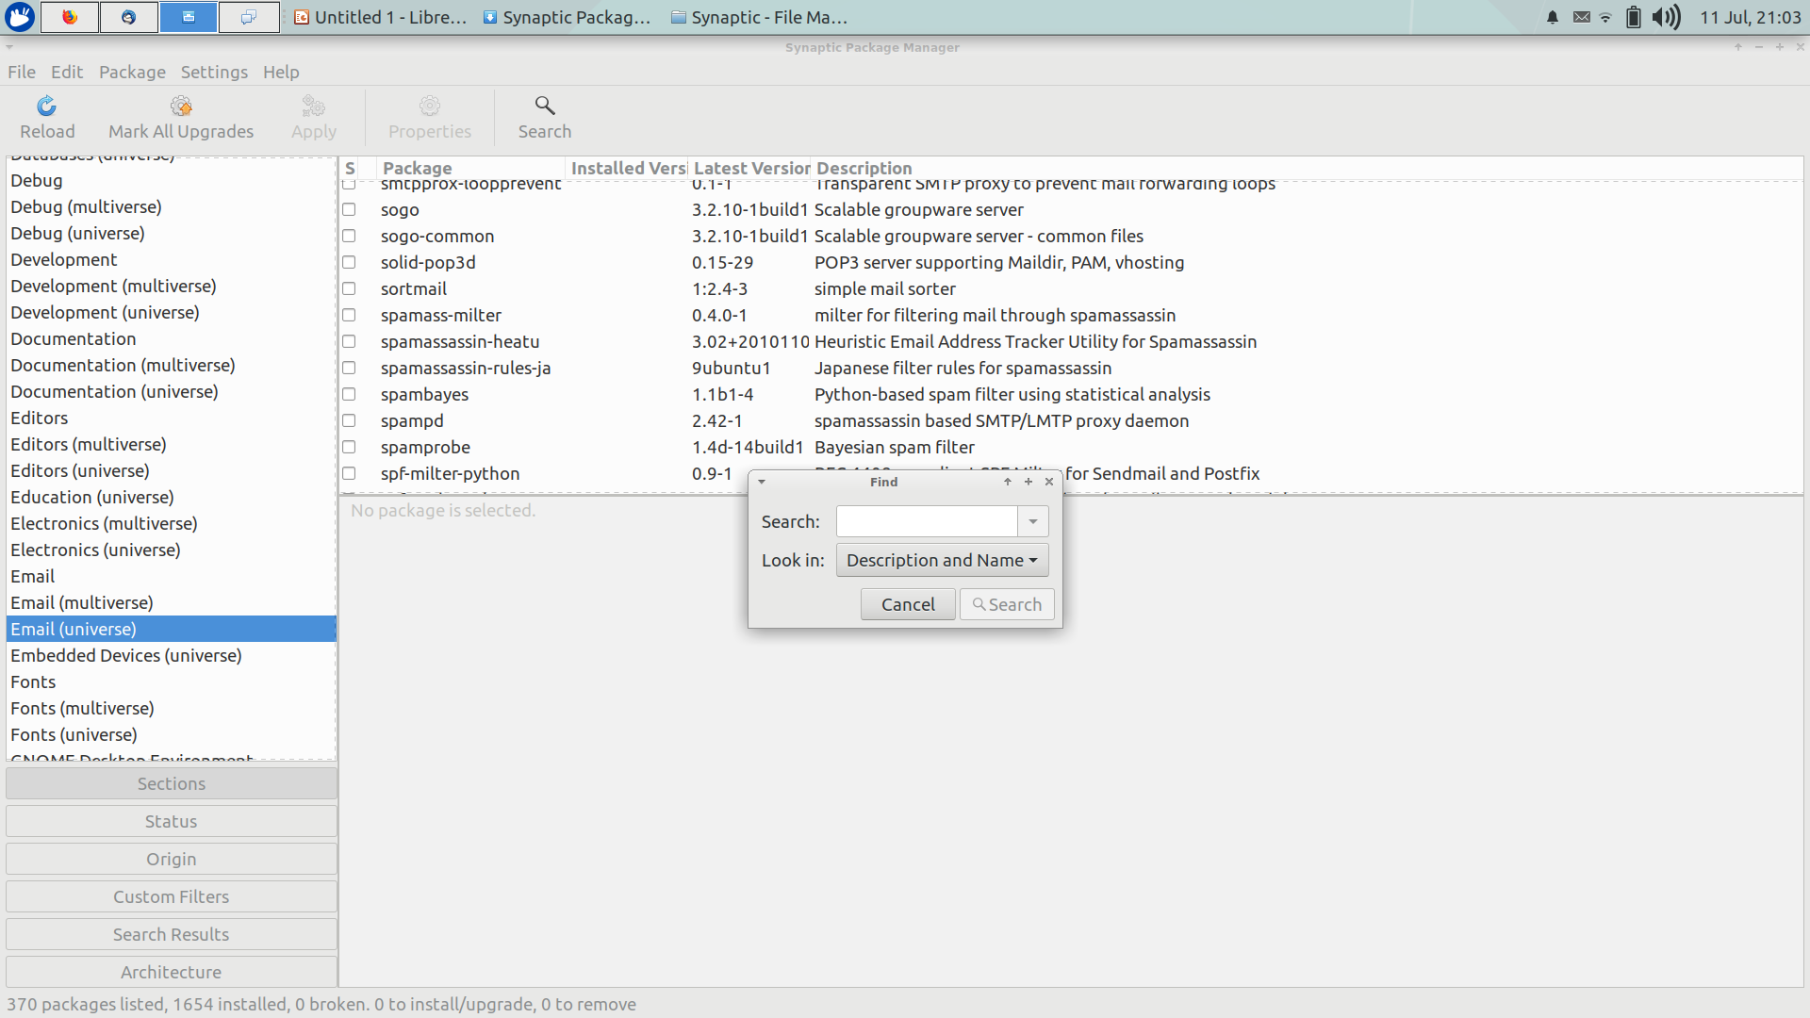
Synaptic Package Manager

Slide 18
Synaptic Package Manager
You can see all the installed packages in Ubuntu using Synaptic.
Select “status” and then select “installed”

Slide 19
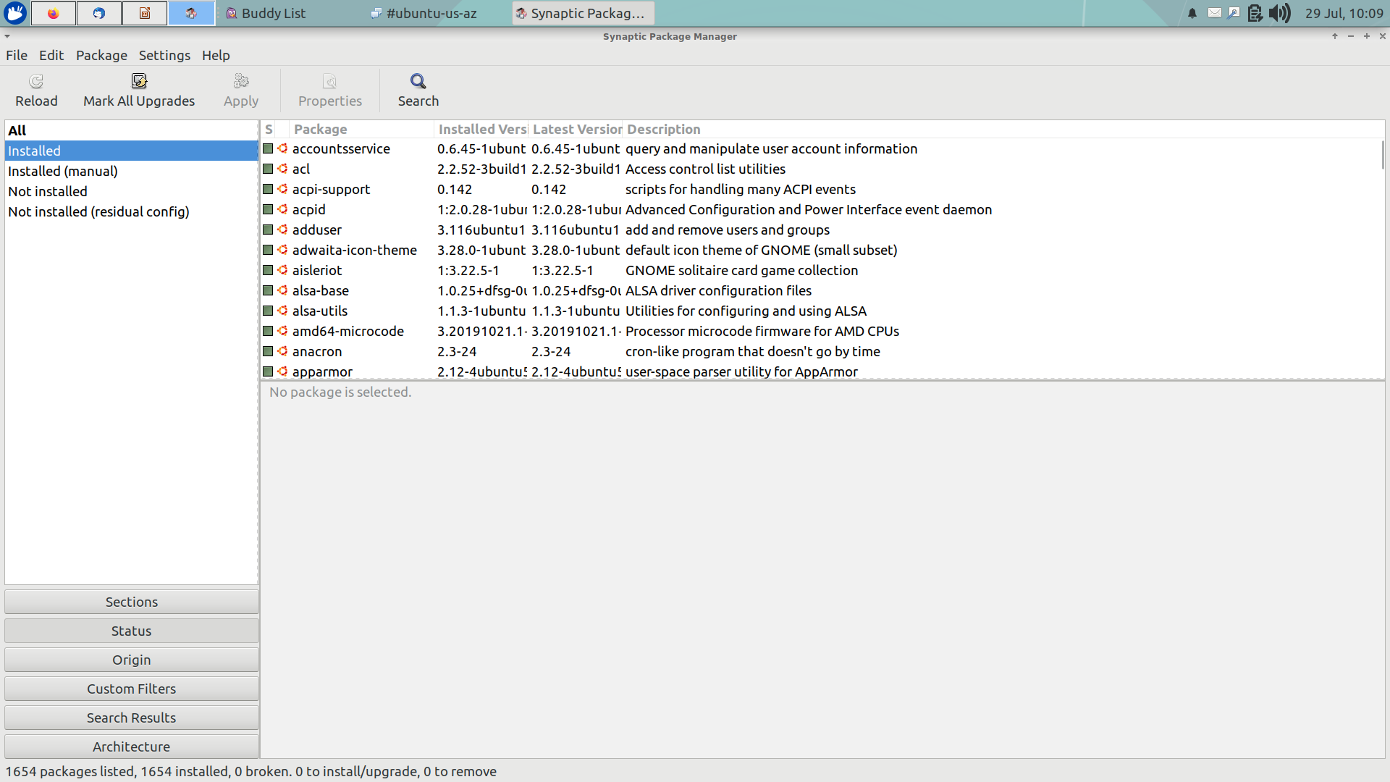
Synaptic Package Manager

Slide 20
Synaptic Package Manager
You can see packages available in individual repositories by displaying them based on Origin. Good way to see which PPA offers what packages. You can install or remove packages as described.

Slide 21
Synaptic Package Manager
Usually, when you update Ubuntu, all the packages are updated at once. With Synaptic, you can easily choose which packages you want to update/upgrade to a newer version.

Slide 22
Synaptic Package Manager
You can also lock the version of packages so that they don’t get updated along with the system updates.
Be careful though. This could possibly break your system.

Slide 23
Synaptic Package Manager
There are plenty more you can do with Synaptic and I cannot cover all the possible usages. I have covered the most common ones here and I leave you to explore it, if you are going to use Synaptic.

Slide 24
Synaptic Package Manager
A copy of these slides can be downloaded from our website:
https://github.com/CochiseLinuxUsersGroup/Presentations

Slide 25
Cochise Linux User Group

