Slide 1


Tips
Most of the slides (not all of them) contain additional info in the “Notes” session.
LibreOffice Impress just click on “VIEW” and select ‘NOTES” now you have the slide with the note below.
To go back to the Slide “only” view just click “VIEW” and “NORMAL”

Slide 2
SUSE Linux
by
Teruel deCampo

Slide 3
openSUSE
1. SUSE history
2. Present SUSE “models” available
3. openSUSE hands on
4. openSUSE Road Map
5. Installation WILL NOT be covered.

Slide 4
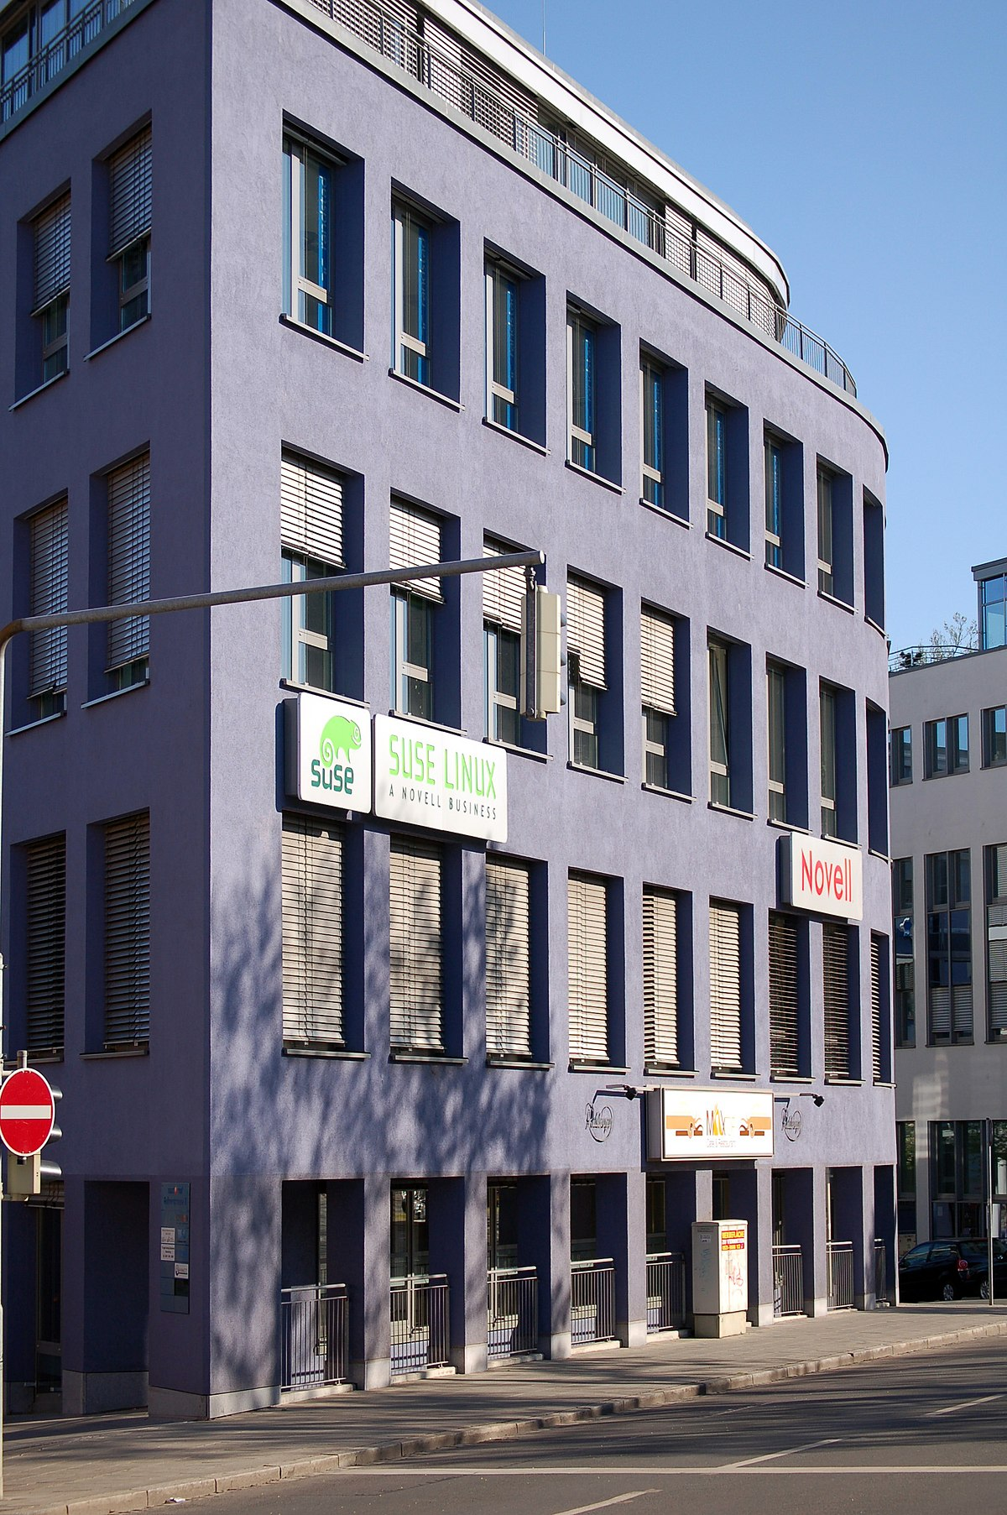
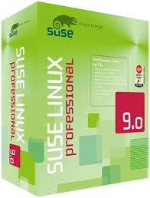
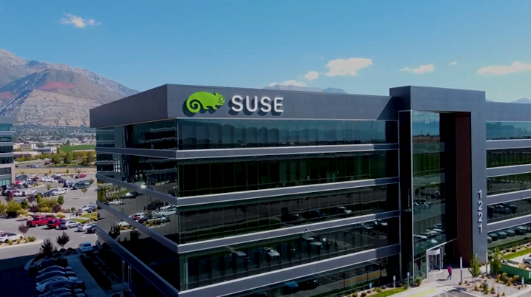
openSUSE
Former HeadQ Nürnberg (Ver 1: 1994)
Software und System-Entwicklung
Notes:
1.1992 SUSE was founded. German acronym for "Software und System-Entwicklung" (software and systems development).
2. 1994 Linux 1.0.0 released supporting single-processor i386
3. 1997 SUSE becomes Europe's leading Linux distribution.
4. 1998 SUSE enters the US market
5. 1999 SUSE develops YaaST
6. 2000 First Enterprise Linux released: SUSE Linux Enterprise Server (for IBM S/390)
7 2000 SUSE help AMD port Linux to x86-64 architecture
8. 2004 SUSE is acquired by Novel
Here is the whole SUSE History
https://www.suse.com/company/history/

Slide 5
openSUSE
1. SUSE history
2. Present SUSE “models” available
3. openSUSE hands on
4. openSUSE Road Map
5. Installation WILL NOT be covered.

Slide 6

openSUSE - Flavors
OpenSUSE Tumbleweed: rolling release:
  updates are continuously rolled out to the system
OpenSUSE Leap: regular release, with guaranteed stability
  Updates are schedule once a year.
  It uses the well-tested base of SLE
SUSE Linux Enterprise (SLE) (includes Service and Support)
  2000 → IBM S/390
  2001 → Intel
Notes:
openSUSE Leap is openSUSE's regular release, which is has the following estimated release cycle:
One minor release is expected approximately every 12 months, aligned with SUSE Linux Enterprise Service Packs
One major release is expected after approximately 36–48 months, aligned with SUSE Linux Enterprise Releases.
SUSE Linux Enterprise Desktop has a 10-year lifecycle: seven years of general support and three years of extended support.
Major releases are made every four years. Service packs are made every 12-14 months.

Slide 7
openSUSE
1. SUSE history
2. Present SUSE “models” available
3. openSUSE hands on
4. openSUSE Road Map
5. Installation WILL NOT be covered.

Slide 8

openSUSE – Features 1
.rpm = pre-compiled archives
YaST = Yet another Setup Tool.
Zypper = command-line package manager
Btrfs default file system = ability to take snapshots
Desktop environments
  Official supported: KDE, Gnome, Xfce
  Supported but not fully tested: LXDE, LXQt, Enlightenment, Cinnamon, MATE, Pantheon
Notes:
Linux has different package management programs:
1 APT (Advance Package Tool) is supported by Debian derivatives (.deb extension) like Ubuntu
2. YUM (Yellow dog Updater Modified) It’s supported by Red Hat and other .rpm based distros.
3. Zypper is supported by SUSE Linux.

Slide 9

openSUSE – Features 2
Red Hat Linux and SUSE Linux were the original major distributions that used the .rpm file format
Both has a community-supported distro:
  Red Hat → Fedora
  SUSE → openSUSE
And a commercially supported distro:
  Red Hat Enterprise Linux
  SUSE Linux Enterprise (SLE)

Slide 10
openSUSE – Features 3
YaST = Yet another Setup Tool
No other distro has any similar
Control Center :
  You can configure your entire system
  Software management, Containers, Services, Kernels, Servers, Hardware

Slide 11
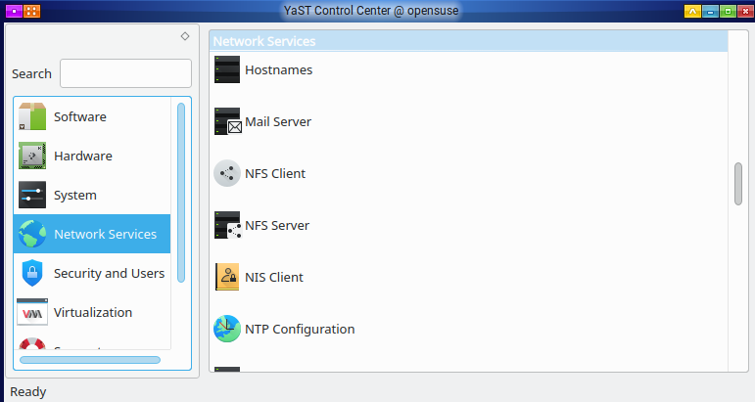
openSUSE – Features 4

Slide 12
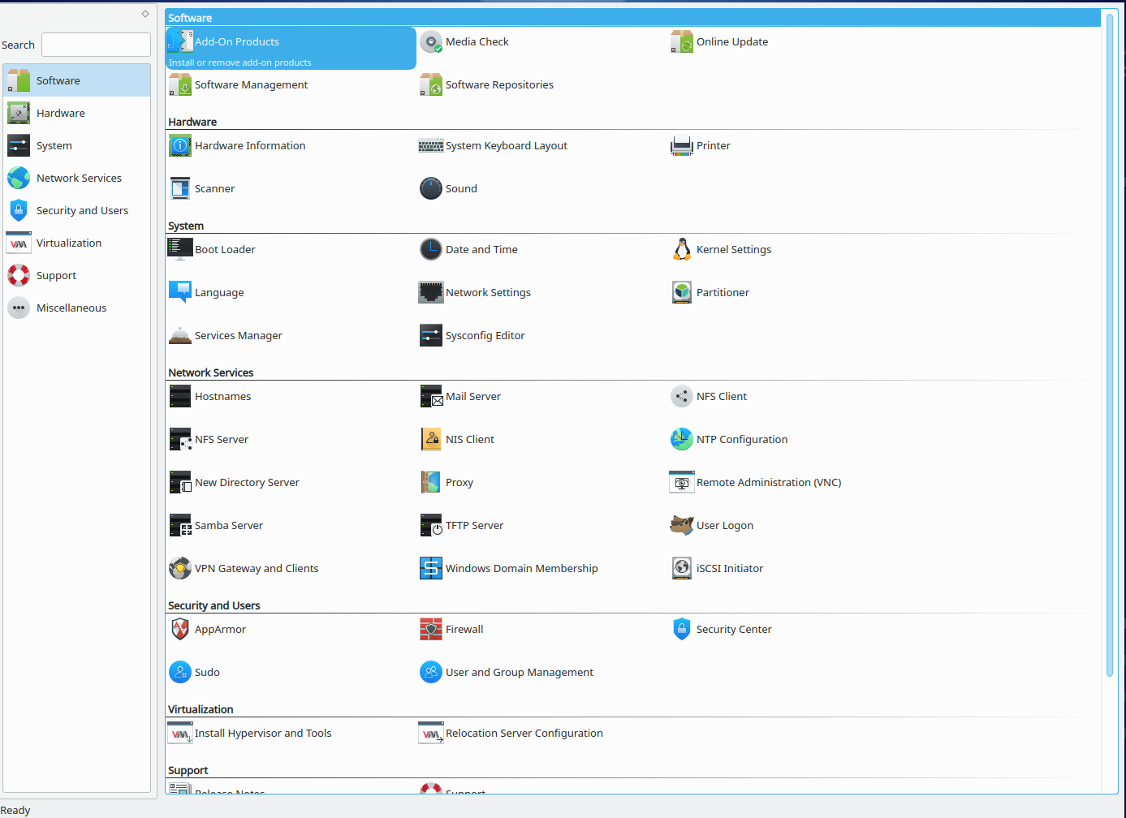
openSUSE – Features 5

Slide 13

openSUSE – Features 6
Btrfs File System = Default
copy-on-write filesystem
Snapshots, allow you to easily roll back your system if needed after applying updates or backup files.
Partitions are optional – While Btrfs can work with partitions, it has the potential to use raw devices (/dev/<device>) directly.
Subvolumes – File systems can share a single space pool instead of being put into their partitions. Subvolumes allow for the partitioning of a Btrfs filesystem into separate sub-filesystems.
Notes:
Almost all system failure can be repaired by a rollback. Even if file system errors happens, you can still repair it without reinstalling operating system. Even a power failure in the middle will not have any effect of the roll back.
https://fedoramagazine.org/working-with-btrfs-general-concepts/
https://fedoramagazine.org/working-with-btrfs-subvolumes/

Slide 14
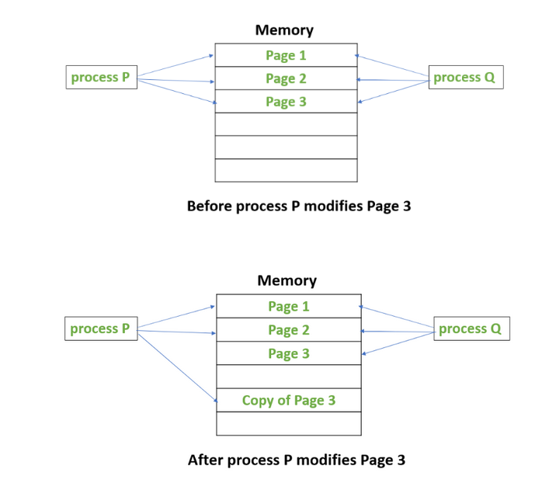
openSUSE - CoW
Notes:
The idea behind a copy-on-write is that when a parent process creates a child process then both of these processes initially will share the same pages in memory and these shared pages will be marked as copy-on-write which means that if any of these processes will try to modify the shared pages then only a copy of these pages will be created and the modifications will be done on the copy of pages by that process and thus not affecting the other process.
Suppose, there is a process P that creates a new process Q and then process P modifies page 3.
The below figures shows what happens before and after process P modifies page 3.

Slide 15
openSUSE – Features 6
Single partition with Btrfs has benefits (default):
Root file system has to be large enough to contain the snapshots
You can even enable snapshots for your home directory
Move of files from system directory to home directory will be faster.
Snapper great tool to manage snapshots
Notes:
Snapper is a Linux filesystem snapshot management tool created by Arvin Schnell, a software developer at SUSE
http://snapper.io/

Slide 16
openSUSE
1. SUSE history
2. Present SUSE “models” available
3. openSUSE hands on
4. openSUSE Road Map
5. Installation WILL NOT be covered.

Slide 17
openSUSE – Road Map
OpenSUSE Tumbleweed – rolling
OpenSUSE Leap 15.6 will come this year and it will have longer cycle because it will be the last of the present platform (Leap 15.6 = SLE)
OpenSUSE Leap 16 is in alpha and it will be based on ALP (Adaptable Linux Platform).

Slide 18
openSUSE – Adaptable Linux Platform
OpenSUSE Tumbleweed – rolling release
SLE same versions of core components like glibc and python for the whole lifespan of a codebase.
OpenSUSE “Leap?” will not depend on SLE anymore. Different ALP products can have different versions of core components, be supported for different lengths of times

Slide 19
openSUSE – Present Platform
TumbleWeed
Rolling Release
Leap 15.X
Stable Release
SLE
SUSE Linux Enterprise

Slide 20
openSUSE - ALP
TumbleWeed
Rolling Release
Hybrid
ALP
Shorter Cycle Releases
SLE
SUSE Linux Enterprise
Leap 16?
ALP
Stable Release

Slide 21


Slide 22
openSUSE
1. SUSE history
2. Present SUSE “models” available
3. openSUSE hands on
4. openSUSE Road Map
5. Installation WILL NOT be covered.
Notes:
1. Some in this group are experts and can run many distros and even many OS’s at the same time. They do not need installation steps!
2. Some in this group are familiar with one distro and sometimes they require help.
3. Many of you are not aware of the value of this group: expertise and FREE support for an OS, you will not find the same in most places.
In summary presenting another distro is more of bar talk but I would have never suggest you to install it because is easier or better. The best distro is the one that had a full time support FREE and that means UBUNTU. This group does not need installation steps!

